Slide 1


Broadly neutralizing antibodies for HIV prevention
Lynn Morris
Deputy Vice-Chancellor, Research and Innovation
University of the Witwatersrand, Johannesburg, South Africa
AIDS 2022, Montreal, Canada. July/August 2022

Slide 2
Outline
Proof-of-concept – the AMP trial
Defining a neutralization titer biomarker
AMP viruses and panels
Predicting bnAb efficacy
bnAb pipeline
Preferred product characteristics of bnAbs for HIV prevention

Slide 3
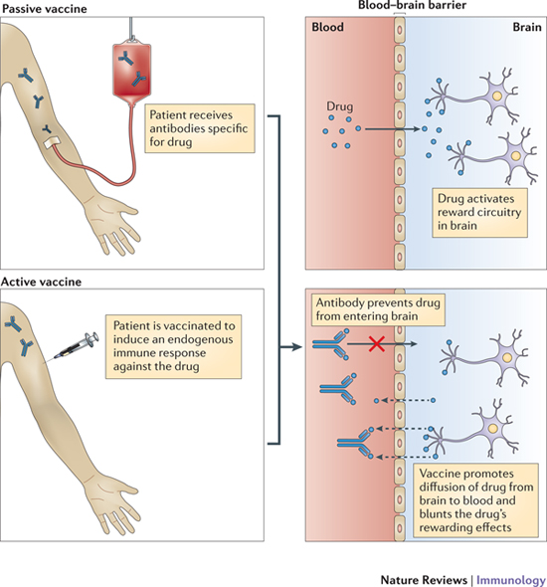



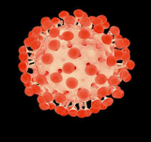





Active Immunization
Passive Immunization
Vaccination to stimulate protective antibody responses. HVTN 702 failed to replicate moderate efficacy seen in RV144
Infusion of pre-formed broadly neutralizing monoclonal antibody. Proof-of-concept for VRC01 provided by AMP trials

Slide 4
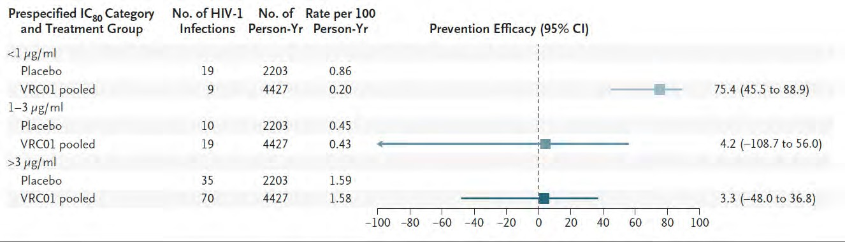
Prevention efficacy in AMP trials limited to the most sensitive viruses
Corey et al., NEJM 2021
Corey et al., NEJM 2021

Slide 5
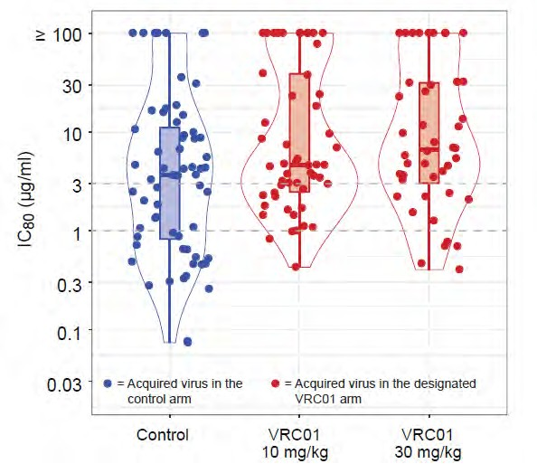
Viruses in VRC01 recipients were more resistant to VRC01 than viruses in placebo recipients
Viruses from VRC01 cases
~2.4-fold greater IC₈₀ than viruses from placebo cases
Corey et al., NEJM 2021
Corey et al., NEJM. 2021

Slide 6
IC80 is Insufficient as a Surrogate Endpoint
IC80 is a property of a virus (bnAb potency against a given virus)
  Contains no information on bnAb concentration
Need to define a biomarker that integrates bnAb concentration level/durability with virus IC80
  → PT80 biomarker (predicted ID80 titer)
Corey et al., NEJM. 2021

Slide 7
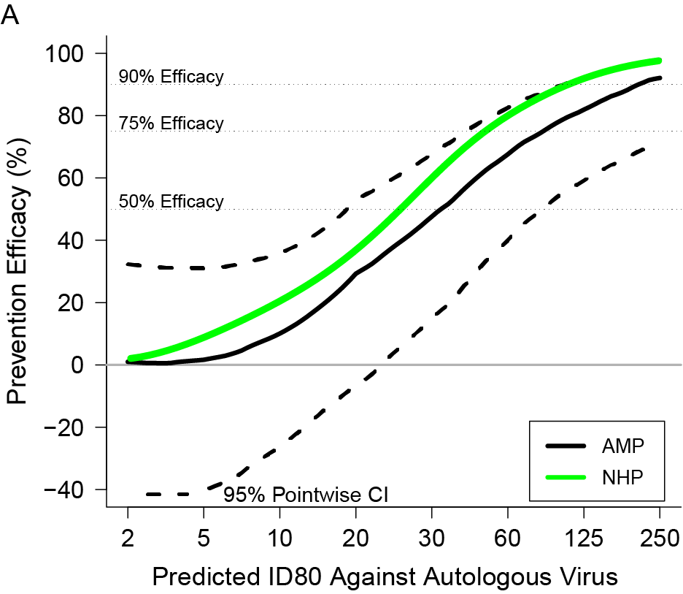
Defined a neutralization titer biomarker of AMP prevention efficacy in humans
Serum titer of 1:200 against circulating viruses required for 90% prevention efficacy.
AMP protection curve is similar to what was seen in NHP (Pegu et al., 2019)
Gilbert et al., in press, Nature Medicine

Slide 8
Lower predicted serum neutralization titers to autologous viruses at HIV-1 acquisition
The PT80 amongst cases was 2-3 times lower than among non-cases in both groups
PT80 titer at the estimated date of HIV-1 acquisition was calculated using the VRC01 IC80 against the autologous virus (red dots).
For 82 sampled non-cases, the PT80 titer was calculated as the estimated VRC01 concentration at every day of follow-up divided by the IC80 of placebo-recipient acquired virus (blue violin).
Gilbert et al., Nat Med in press
Gilbert et al., submitted
Notes:
Fig. 4. . (A) Violin plots for VRC01-recipient cases vs. non-cases, where Approach 2 of Huang et al. (9) was used to calculate predicted serum neutralization ID80 titer against a given virus by dividing the population PK model-predicted VRC01 serum concentration by the IC80 of the VRC01 drug product against the same virus. For each VRC01-recipient case, the serum neutralization ID80 titer at the estimated date of HIV-1 acquisition (red dots) was calculated using the VRC01 drug product IC80 against the autologous virus. For each VRC01 recipient among the 82 sampled non-cases, the serum neutralization ID80 titer at each day of follow-up against each placebo-recipient acquired virus was calculated as the estimated VRC01 concentration divided by the VRC01 drug product IC80 against the virus (blue dots). Boxplots show 25th, 50th, 75th percentiles. (B) By VRC01 dose arm and across dose arms pooled: Geometric mean predicted serum neutralization ID80 titer at HIV-1 acquisition in VRC01-recipient cases against the autologous acquired virus, geometric mean predicted serum neutralization ID80 titer in VRC01-recipient non-cases to placebo-recipient acquired viruses, and their ratio.

Slide 9
What we learned from the AMP trials
Identified antibody correlate of HIV-1 infection risk - provides benchmark for passive and active immunization
High levels of serum antibodies required for protection – a challenge for HIV vaccines?
A combination of more potent bnAbs needed to increase efficacy

Slide 10
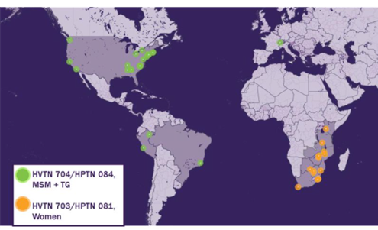
How can we use AMP to progress the bnAb agenda?
703/081 = 92 breakthrough infections (33 placebos)
704/085 = 129 breakthrough infections (43 placebos)
Determine virus sensitivity to other clinically relevant bnAbs
Predict coverage and prevention efficacy
Assess antigenic drift over time
Update virus panels

Slide 11
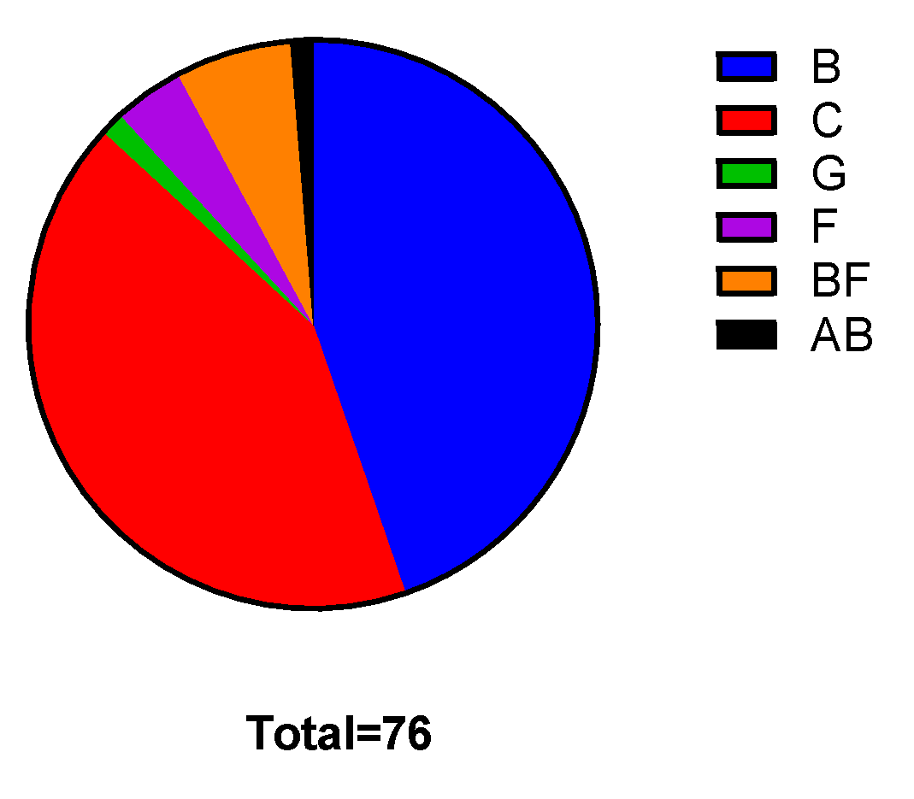
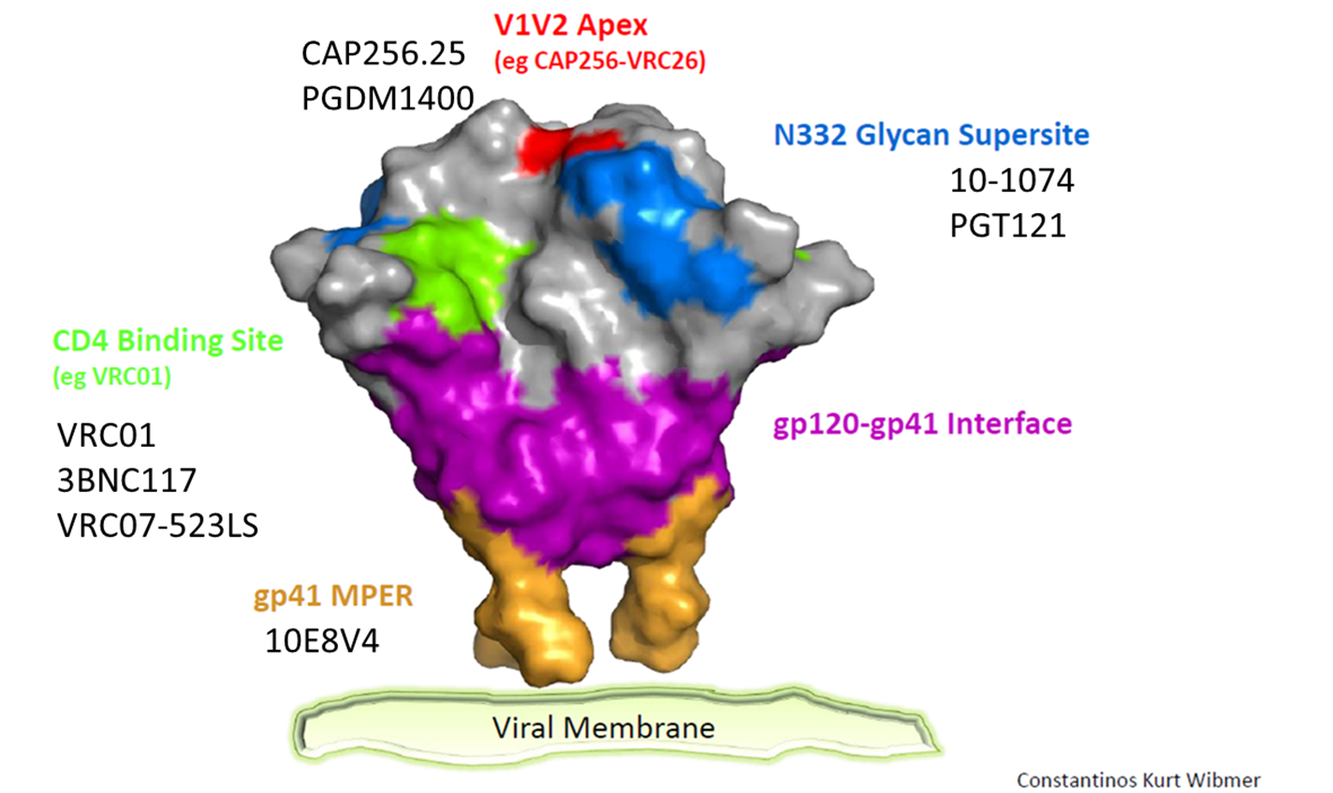
Assess sensitivity of AMP placebo viruses to bnAbs in clinical development

Slide 12
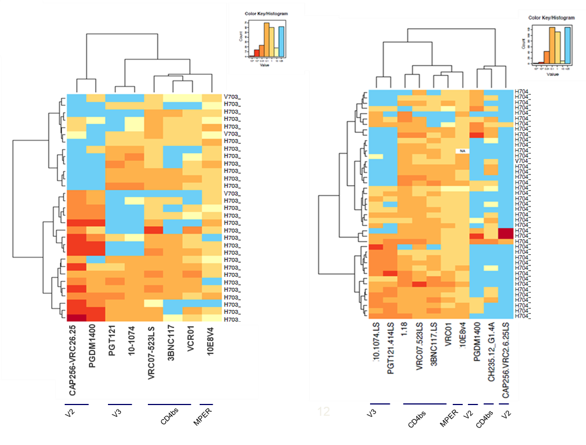
Neutralization profiles of AMP placebo viruses
703 (subtype C) 704 (subtype B, F, BF)
IC80
6 subtype F/BF infections, 3 sensitive to CAP256
Nono Mkhize, NICD
Elena Giorgi, LANL
Notes:
original heat plot……

Slide 13
Predicted prevention efficacy of single infusion of triple bNAb combination over 16 weeks
PGDM1400LS + PGT121LS + VRC07-523LS
Gilbert et al., Nat Med in press

Slide 14
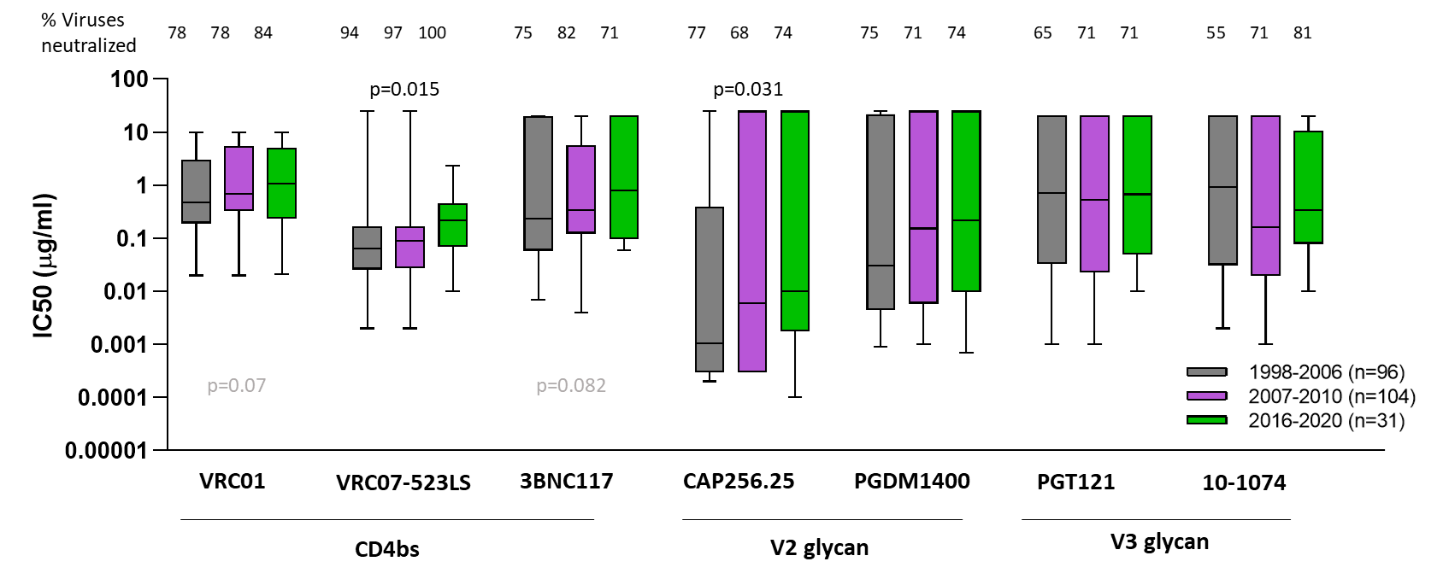
Clade C viruses are becoming more resistant to CD4bs and V2 glycan mAbs
Nono Mkhize

Slide 15
Selecting a panel of highly sensitive viruses (Bette Korber and David Montefiori)
Panel of 12 pseudoviruses for detection of low levels of bnAb lineage activity in vaccine sera i.e. fledgling antibodies that would be on a trajectory to have similar properties to known CD4bs, V2 apex, V3 glycan or fusion peptide bNAbs.
Panel should be optimized as a screening tool, to detect bnAb signal, and the choice for the panel should be made on bnAb profiles, not sequence or sera based.

Slide 16
Approach
75 participants in placebo arm (43 from HVTN 704 and 32 from HVTN 703)
One representative Env selected per person (most representative/most sensitive)
Neutralization data against 13 bNAbs: CD4bs, V2 Apex, V3 glycan, Fusion Peptide, MPER
Devised an algorithm to rank viruses that favored selection of broadly sensitive viruses while including the most sensitive viruses to each antibody tested
Expanded set of 8 highly sensitive Envs for each class antibody (included between 3-6 from the 12 virus panel in each set)
Bette Korber and Elena Giorgi
Kshitij Wagh and James Theiler

Slide 17
12 pseudovirus bnAb detection panel
Panel #
Clade
2 of the 3 most sensitive Envs for each of the 13 antibodies are included in the panel.
  These are indicated by the white letter with the underscore.
Each included Env is sensitive to a spectrum of bNAbs, increasing the opportunity for
  detection of antibody activity against diverse variants
AMP viruses were sampled very early and are extremely well characterized in terms
of being transmitted founder lineage viruses.
above detection
threshold

Slide 18
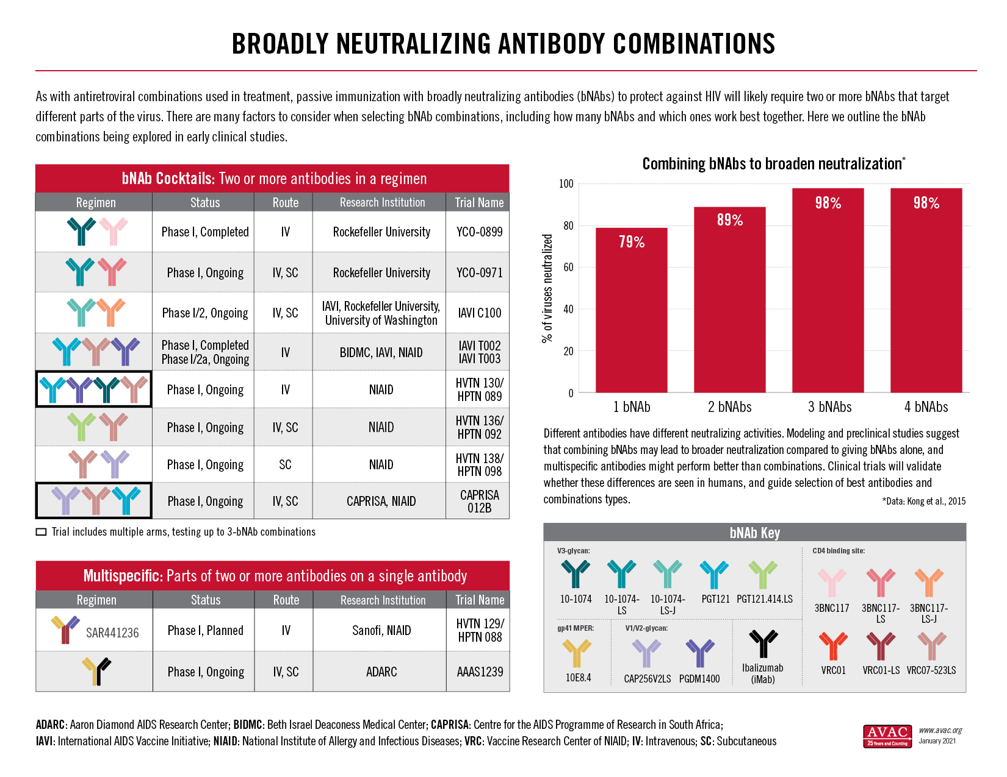

A robust pipeline of broadly neutralizing antibodies for HIV prevention

Slide 19

WHO preferred product characteristics for monoclonal antibodies for HIV prevention (2022)
Target populations
Access and affordability
Efficacy
Safety
Formulation/presentation
Dose regimen
Co-administration
Route of administration
Product stability and storage
Registration, prequalification and programmatic suitability

Slide 20
Conclusions
AMP has provided proof-of-concept for bnAbs in HIV prevention
Modelling suggests that triple bnAb combination will be highly effective over a sustained period
Robust pipeline of bnAbs under development
Evidence of genetic drift among subtype C viruses suggest that virus panels need to continue to be updated

Slide 21



Acknowledgements
NICD
Nono Mkhize
Haajira Kaldine
Rebecca Van Dorsten
Tandile Modise
Prudence Kgagudi
Carol Crowther
Bronwen Lambson
Livhuwani Nxumalo
Valerie Bekker
Rutendo Mapengo
Brent Oosthuysen
Penny Moore
HVTN
Myron Cohen
Larry Corey
John Hural
Julie McElrath
Sri Edupuganti Nyaradzo Mgodi
Study protocol teams
University of Cape Town
Carolyn Williamson
Talita York
Asanda Gwashu-Nyangiwe
Ruwayhida Thebus
Nonkululeko Ndabambi
Colin Anthony
David Matten
Ansie Yssel
Dieter Mielke
Nicolas Beaume
Bruna Galvao
University of Washington
Jim Mullins
Dylan Westfall
Wenjie Deng
Alec Pankow
Kim Wong
Hong Zhao
Lennie Chen
Michaela Anderson
LANL
Bette Korber
Elena Giorgi
Kshitij Wagh
James Theiler
Statisticians
Allan DeCamp
Peter Gilbert
Paul Edlefsen
Yunda Huang
Raabya Rossenkhan
Craig Magaret
Duke University
David Montefiori
Amanda Eaton
Elize Domin
Marcella Sarzotti-Kelsoe
Thank you to the AMP trials participants, sites and study protocol teams

