Slide 1
First-in-human Phase 1 trial with a SOSIP Env trimer based vaccine
Godelieve de Bree
Department of internal Medicine, Infectious Diseases
Amsterdam University Medical Centers, Location AMC, University of Amsterdam, Netherlands
Advances in combatting HIV with broadly neutralizing antibodies

Slide 2
Disclosures
No conflicts of interest

Slide 3
Outline
The rationale behind native like trimer vaccine strategies
Pre-liminary data of the “ACTHIVE-001” study
Amsterdam UMC Clinical Trial with a Native-like HIV-1
Envelope Vaccine
ClinicalTrials.gov NCT03961438

Slide 4
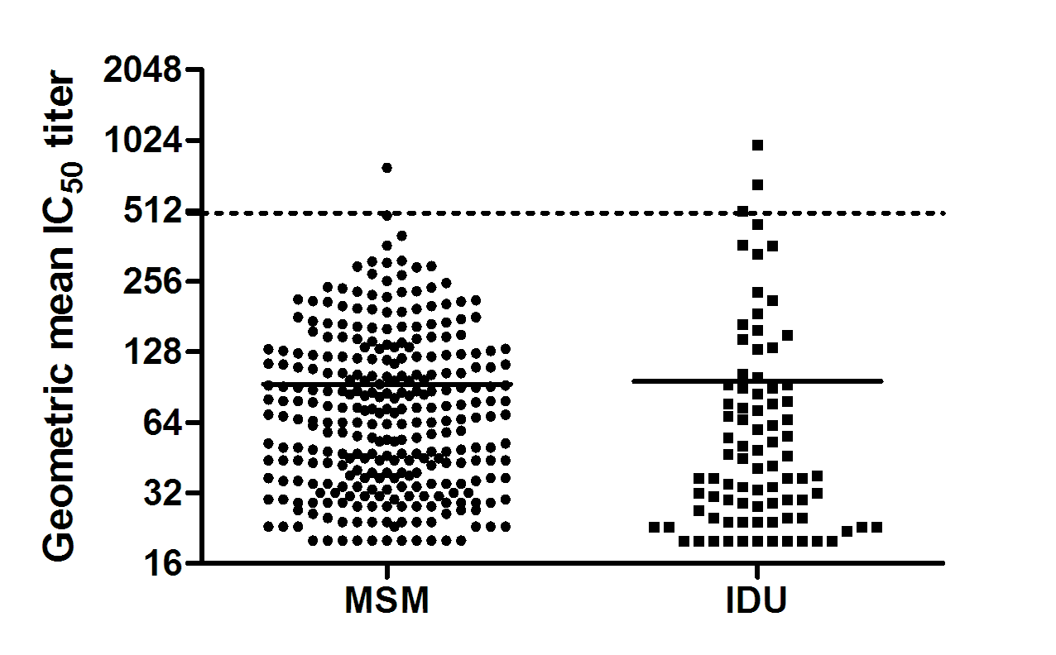
The human immune system can make bN antibodies
bNAb responses in the Amsterdam Cohort Studies
elite neutralization
(~1%)
broad neutralization
(~20%)
Euler Viruses 2019

Slide 5
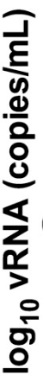


Neutralizing antibodies can protect from infection
Vaginal challenge experiments with SHIV in macaques
neutralizing
non-neutralizing
Burton PNAS 2011
Van Gils, Sanders Trends Microbiol 2014

Slide 6
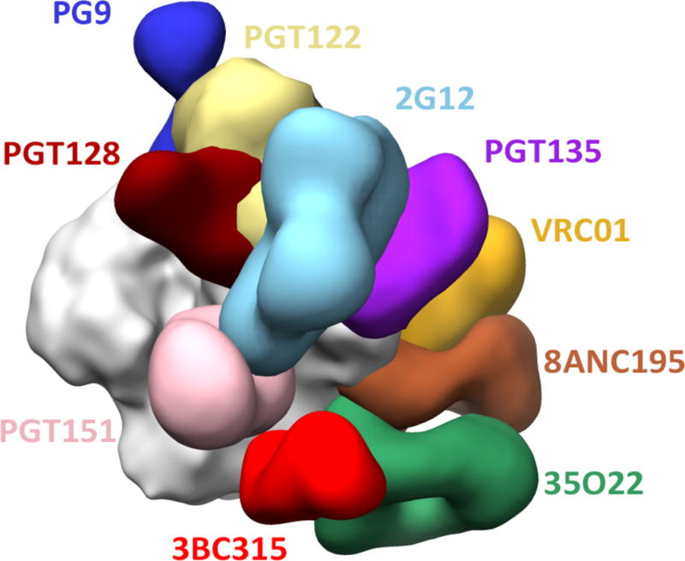
bNAb development in HIV-1 infected individuals
bNAbs
BG505 SOSIP.664 Env trimer
De Taeye Trends Immunol 2016

Slide 7
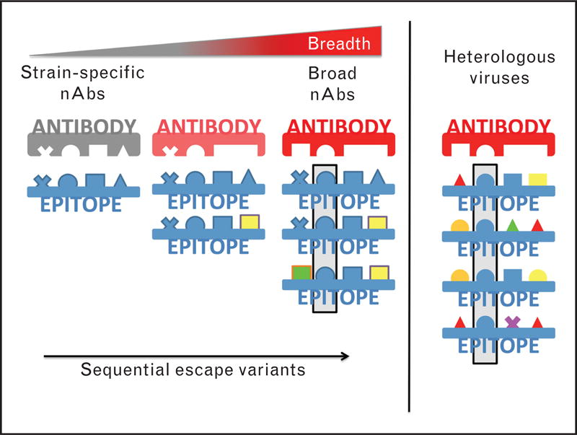
bNAb development in HIV-1 infected individuals
SOSIP ConM
Derdeyn Curr Opin HIV AIDS 2014

Slide 8

ConM SOSIP.v7 induces strong nAb responses in NHP
20 µg ConM SOSIP v7 +
500 µg MPLA liposomes
Intramuscular
500 µg MPLA liposomes
Subcutaneous
500µL Squalene emulstion
Intramuscular
n=6
MPLA-IM
n=6
MPLA-SC
n=6
SQ-IM
W0
W8
W24
BL
D1
W2
D1
W10
W12
D1
W26
W28
W38
Immunization
Serum collection
Blood sampling
Reiss et al. MS submitted

Slide 9
ConM SOSIP.v7 induces strong nAb responses in NHP
Reiss et al. MS submitted

Slide 10
ConM SOSIP.v7 phase 1 study – ACTHIVE001
ACTHIVE−001
ConM SOSIP.v7
MPLA liposomes
Two treatment arms (n = 20)
Dose level reduction
Month 0, 2 and 6
Leukapheresis (baseline, wk10)
Two LN FNA’s
No mucosal sampling
ConM SOSIP: Artificial consensus sequence of the consensus sequences of each clade in HIV-1 group M, responsible for the global pandemic (Sliepen et al., Nature Comm, 2019)
Adjuvanted with MPLA liposomes

Slide 11
Study design
Single centre, randomised, open-label, phase 1 clinical trial with ConM SOSIP.v7 adjuvanted with MPLA liposomes
Amsterdam UMC, location AMC, the Netherlands
Investigator-initiated
20 healthy, HIV-uninfected men and women, 18 − 50 years of age
Low risk of HIV infection

Slide 12
ACTHIVE – study design
 |  | Months
Group | N | 0 | 2 | 6
A | 10 | 100 μg ConM SOSIP.v7 + 500 μg MPLA liposomes | 100 μg ConM SOSIP.v7 + 500 μg MPLA liposomes | 100 μg ConM SOSIP.v7 + 500 μg MPLA liposomes
B | 10 | 100 μg ConM SOSIP.v7 + 500 μg MPLA liposomes | 100 μg ConM SOSIP.v7 + 500 μg MPLA liposomes
TOTAL | 20
20 μg ConM SOSIP.v7
+ 500 μg MPLA liposomes

Slide 13
ACTHIVE – study design
Last vaccination, last volunteer
(May 24 2022)
Last 1.5 year visit, last volunteer
(April 2023)
2022
2023
Q
1
Q
2
Q
3
Q
4
Q
1
Q
2
Q
3
Q
4
Last 1 year visit, last volunteer
(October 2022)
One vaccination | Two vaccinations | Three vaccinations
N = 1 | N = 0 | N = 23

Slide 14
Preliminary data
Primary safety and tolerability (AE, SAE, AR, SUSAR)
Secondary humoral immunogenicity (systemic and lymphoid compartments)
Autologous Ab binding and neutralization; Env-specific B cell repertoire sequence analysis
Precursor frequency naïve B cells (leukapheresis); germinal center B and T cells (LN FNA)
Exploratory e.g. heterologous binding and neutralization, transcriptomics, antibody effector functions, plasmablasts

Slide 15
Interim safety results
70 vaccine administrations
Current median follow-up of 11 months
No Serious Adverse Events
No Suspected Unexpected Serious Adverse Reactions
Majority of Adverse Events were mild to moderate and self-limiting in nature.

Slide 16
Interim neutralization results
Group A |  |  |  | Group B
ConM serum neutralisation (TZM-bl) (IC50)
ID | Sex | Week 10 | Week 26 | ID | Sex | Week 10 | Week 26
005 | F | 183 | 1057 | 006 | F | 102 | 997
010 | F | 40 | 172 | 018 | M | <20 | 1147
013 | M | <20 | 224 | 020 | F | 490 | 1539
017 | F | 80 | 1579 | 022 | F | 4104 | 2008
019 | M | <20 | 43 | 024 | F | 707 | 1290
021 | F | 155 | 372 | 026 | M | 91 | 225
023 | F | 603 | 856 | 027 | F | 1997 | 2634
029 | F | 613 | 1793 | 028 | M | 458 | 559
031 | M | 39 | 651 | 030 | M | 100 | 642
032 | M | <20 | 31 | 034 | F | 1063 | 4125
033 | F | <20 | <20 | 035 | M | <20 | 392
037 | F | 3023 | 5368
IC50
20-40
41-100
101-1000
>1001

Slide 17
Interim neutralization results
Mean IC50 week 10 group A: 401; group B: 835. Δ = 805 (p = 0.3360)
Mean IC50 week 26 group A: 1014; group B: 1414. Δ = 550 (p = 0.4831)

Slide 18
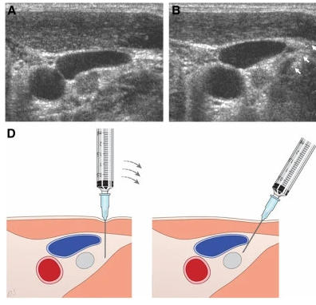
Lymph node FNA characteristics
 | Week 3 | Week 11 | Total
Performed Paired procedures (both W3 and W11): 16 | 19 | 20 | 39
Lymphocytes | 16 (84%) | 9 (45%) | 25 (64%)
Antigen specific - Paired samples: 3 (023, 024, 027) | 7 (44%) | 6 (67%) | 13 (52%)

Slide 19
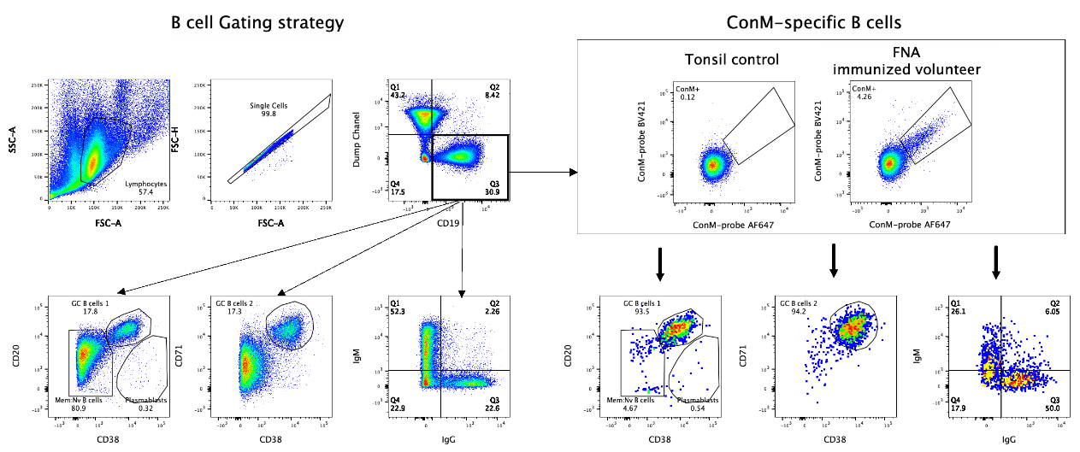
Preliminary FNA LN data
In this example, > 90% of ConM-specific B cells are GC B cells.
Enrichment of ConM-specific B cells towards IgG (50%), compared to total B cells (22%) confirms an isotype switch.
Overall, 64% of LN FNA’s are succesful (i.e. yield lymphocytes)
In 52% of successful LN FNA’s, ConM-specific cells could be detected.
Data Mathieu Claireaux

Slide 20
Conclusion
ACTHIVE-001 fully enrolled: LVLV April 2023
No serious safety concerns (SAE or SUSAR)
Potent autologous neutralization in all (per protocol) analyzed participants (17/23) at week 26, majority at week 10.
64% of LN FNA’s are successful; 52% of successful LN FNA’s yield ConM-specific cells (non-draining LN, size, interpersonal and interoperational differences, time points)
Majority of the analyses to be performed Q3/Q4 2022

Slide 21
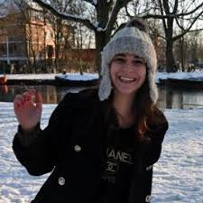
Acknowledgments
Emma Reiss, MD, ConM trial

Slide 22








Acknowledgments ConM
Robin Shattock
Aleisha Miller
Yoann Aldon
Paul McKay
Dietmar Katinger
Richard Vasicek
Markus Simmerstatter
Experimental Virology
Aafke Aartse
Tom Bijl
Ilja Bontjer
Philip Brouwer
Judith Burger
Mathieu Claireaux
Marit van Gils
Marlies van Haaren
Menno de Jong
Iván Del Moral Sanchez
Rogier Sanders
Edith Schermer
Kwinten Sliepen
AMC Pharmacy
Azra Beganovic
Jantine Colen
Marleen Kemper
Internal Medicine
Bram Goorhuis
Jan Prins
Liffert Vogt
Nursing staff
Nathalie Dereuddre-Bosquet
Pauline Maisonnasse
Experimental Clinical Research Unit
Monique Kooijman
Maarten Soeters
Miranda Tran-Poffijn
Gabriella Scarlatti
Monica Tolazzi
Experimental Immunology
Agnes Harskamp-Holwerda
Neeltje Kootstra
BPRC
Petra Mooij
Gerrit Koopman
Willy Bogers

