Slide 1
Resilient and Sustainable Systems for Health AIDS 2022 Prime Session
Rena Janamnuaysook Institute of HIV Research and Innovation Thailand
1 August 2022

Slide 2
Conflict of Interest Disclosure
Gilead Sciences: Research funding
ViiV Healthcare: Speaker fees
MSD: Community Advisory Board
The potential effects of relevant financial relationships with ineligible companies have been mitigated. Any clinical recommendations are based on evidence and are free of commercial bias.

Slide 3
Outlines
Key Population-Led Health Services (KPLHS)
The journey of KPLHS in Thailand
Contribution of KPLHS to the national HIV response in Thailand
Challenges in institutionalizing KPLHS
Conclusions

Slide 4
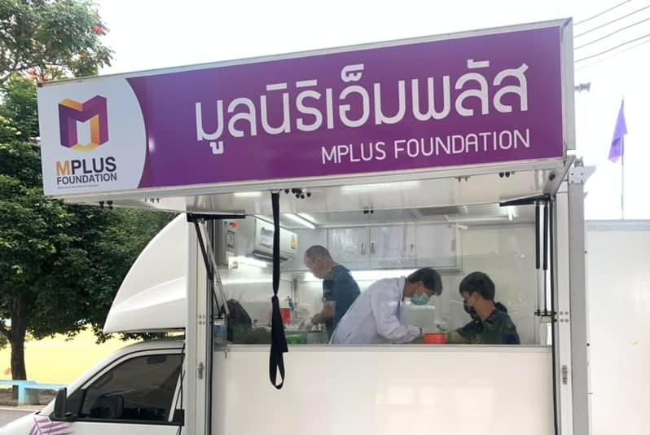
Key Population-Led Health Services (KPLHS)
Health services designed and co-delivered by key populations:
A defined set of HIV-related health services focusing on specific key populations
The services are identified by the key populations themselves and are needs-based, demand-driven, and client-centered
Delivered by trained and certified lay providers who are members of the key population communities
Photo: MPLUS Foundation, Thailand, 2022
Vannakit R, et al, J Int AIDS Soc. 2020; 23(6):e25535.

Slide 5
KPLHS: Filling HIV service gaps for key populations
ACCESSIBILITY
AVAILABILITY
ACCEPTABILITY
QUALITY
Located in hot spots
Flexible service hours suitable for KP’s lifestyles
One-stop services
Needs-based and client-centered services, such as hormone monitoring, STI management, legal consultation, harm reduction
Staff are members of KP communities who understand KP’s lifestyles
Services are gender-sensitive, and free from stigma and discrimination
Staff are trained and qualified according to the national standards
Strong linkages with and high acceptance from public health sectors

Slide 6
The Journey of KPLHS in Thailand
1) Wongkanya R, et al, J Virus Erad. 2018;4(1):12-15. 2) Hiransuthikul A, et al, Int J STD AIDS. 2019; 30(2):140-146.
3) Phanuphak N, et al, Sex Health. 2018;15(6):542-555. 4) Hiransuthikul A, et al, Transgender Health. October 2021.
5) van Griensven F, et al, J Int AIDS Soc. 2021;24(6):e25683. 6) Airawanwat R, et al, APACC 2019, Hong Kong, abstract #92.

Slide 7
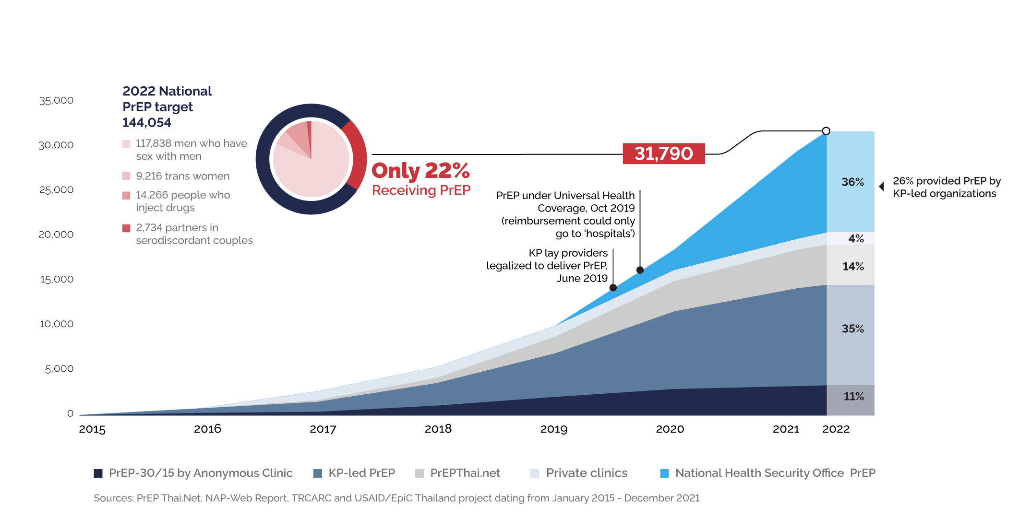
82% current Thai PrEP users from KPLHS
Lertpiriyasuwat C, et al, AIDS2022, Canada, abstract #1228.

Slide 8
The Journey of KPLHS in Thailand

Slide 9
Long-term multi-level implementation strategies to integrate KPLHS into the national healthcare system in Thailand

Slide 10
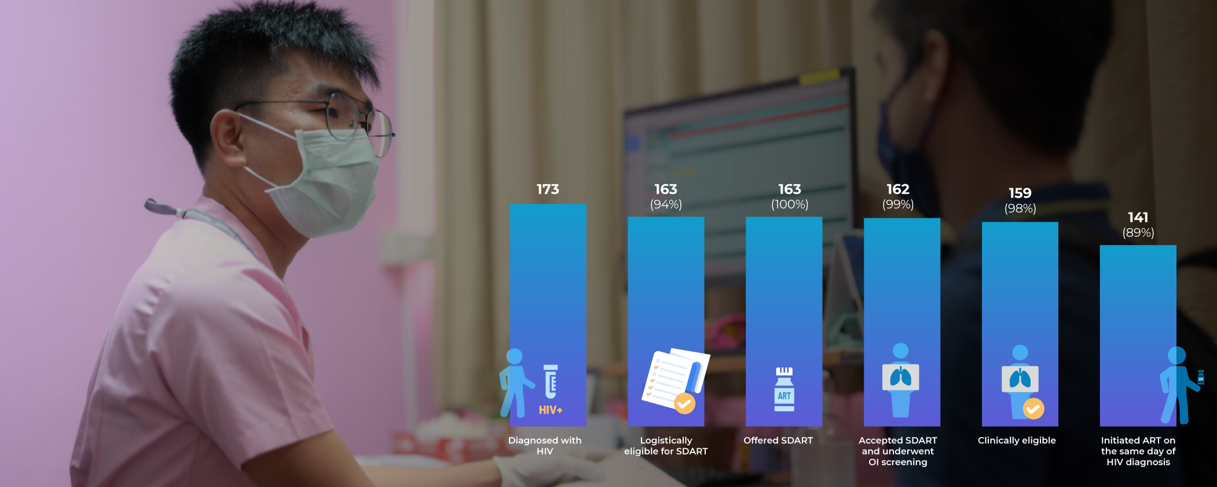
Community-based same-day antiretroviral treatment
“I am so proud I can bring the life-saving treatment to the people who need it most”
Atachai Phunkron
Trained KP lay provider
SWING Foundation
Janamnuaysook R, et al., APACC 2022 Virtual, abstract 12.
Study support: IAPAC and USAID EpiC Thailand
Photo: SWING Foundation, Thailand, 2022

Slide 11
Mental Health Matters: Peer-led depression screening is feasible
Janamnuaysook R, et al, AIDS 2022, Montreal, abstract OAF0204.
Study support: NIH CHIMERA D43, amfAR TREAT Asia-Columbia University

Slide 12
Asia Regional Key Population Investment Funds: Expanding transgender-competent care

Slide 13
The Daisy Clinic in Myanmar HIV service cascade (as of March-April 2022)
Slide: Ni Ni Tun, Medical Action Myanmar, USAID EpiC Myanmar, 2022.

Slide 14
From HIV to COVID-19: Resilient and adaptive
“We cannot provide only HIV services while sex workers are hungry”
Surang Janyam, Executive Director, SWING Foundation, Thailand
Photo: SWING Foundation, 2021
www.unaids.org/en/resources/presscentre/featurestories/2020/june/thailand

Slide 15
Ensuring sustainability of community-led HIV service delivery in Thailand
“This is a key milestone for Thailand regarding sustainable community-led service delivery and sustainable financing for community-based organizations. It is a model for the region and countries globally”
Winnie Byanyima
Executive Director of UNAIDS
24 June 2022
https://www.unaids.org/en/resources/presscentre/featurestories/2022/june/20220624_Thailand_community_led_services

Slide 16
Challenges in scaling-up KPLHS
UNAIDS National Commitments and Policy Instruments, 2018-2021

Slide 17
Conclusions
We need to shift the paradigm from community “engagement” to community “leadership” in the HIV response
Key population-led health services can potentially be adapted to address other health priorities (e.g., CAB-LA delivery, hep C, COVID-19) and in other settings
People-centered and integrated health services can be implemented throughout healthcare systems, especially in primary care
Domestic financing and enabling legal environments must be made available to sustain the community-led and community-owned responses to HIV

Slide 18
Acknowledgements
Praphan Phanuphak
Nittaya Phanuphak
Rattapol Triemvichanon
Cheewanan Lertpiriyasuwat
Patchara Benjaratanaporn
Stephen Mills
Annette Sohn
Chris Duncombe
Supabhorn Pengnonyang
Surang Janyam
Pongpeera Patpeerapong
Thanachai Chaisalee
Ni Ni Tun
Krittaporn Termvanich

Slide 19
rena.j@ihri.org

