Slide 1

Precision Public Health and Infectious Diseases
Jeffrey W Eaton
MRC Centre for Global Infectious Disease Analysis
School of Public Health, Imperial College London
PR07: Strengthening Health Systems
Notes:
Thank you, Saul, for the kind introduction and to the organizing committee for the opportunity to speak today. I would also like to thank the large number of colleagues who have contributed ideas and content for this presentation, who you will see referenced throughout and I will return to at the end.

Slide 2
Conflict of interest disclosure
I have no relevant financial relationships with ineligible companies to disclose.
Notes:
I have no conflicts of interest to disclose.

Slide 3

Precision Public Health
First appearance: Khoury et al. commentary in Am J Preventive Medicine in 2016
  “Could the same technologies that propel precision medicine usher in a parallel era of ’precision public health' beyond treatment of sick individuals?”
Use of detailed data for improved disease prevention
Biomarkers and individual risk data guiding personalised prevention
Genomic data to detect pathogens and outbreaks
Electronic health data systems
for spatial epidemiology and surveillance
Khoury, Iademarco, Riley. Am J Prev Med 2016; 50:396-401
Notes:
When the organisers asked me to speak about Precision Public Health, I realised that it was a phrase that I had heard—and probably even used a few times. But I didn’t know exactly what it referred to.
The term ’Precision Public Health’ first appeared in a commentary by Khoury and colleagues in the American Journal of Preventive Medicine in 2016.
In the same way that detailed individual risk, biomarkers, and genomic data are being used to individualise medical treatments, they envisioned use of new data streams to improve disease prevention.
[CLICK]
Such envisioned data included:
Modernised data systems and data science for detailed spatial epidemiology and health surveillance
Biomarkers and individual risk data to guide personalized prevention options, and
Use of genomic data to detect new pathogens and outbreaks

Slide 4

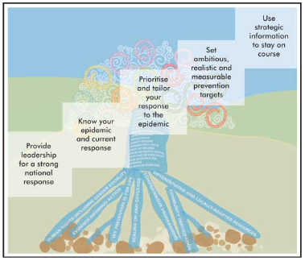
Precision Public Health: A familiar paradigm to the HIV response
“Recognizing that ‘one size does not fit all’, the Strategy prioritizes tailoring of differentiated service packages and service delivery approaches to the unique needs of people, communities and locations, using granular data to focus programmes most effectively”
UNAIDS 2007 “Towards Universal Access”
Notes:
The more I learned about precision public health, it sounded like increasingly familiar language.
The UNAIDS “Know your epidemic, Know your response” initiative in the 2000s guided us to use local data to understand the key modes of HIV transmission, devise locally adapted strategies, and use data to measure progress against ambitious targets.
[CLICK]
Fast forwarding to the present, using data to ensure an effective and equitable HIV response underpins our new Global AIDS strategy adopted last year.
[CLICK]
The strategy implores us: “Recognizing that “one size does not fit all”, the Strategy prioritizes tailoring of differentiated service packages…using granular data to focus programmes most effectively.”

Slide 5
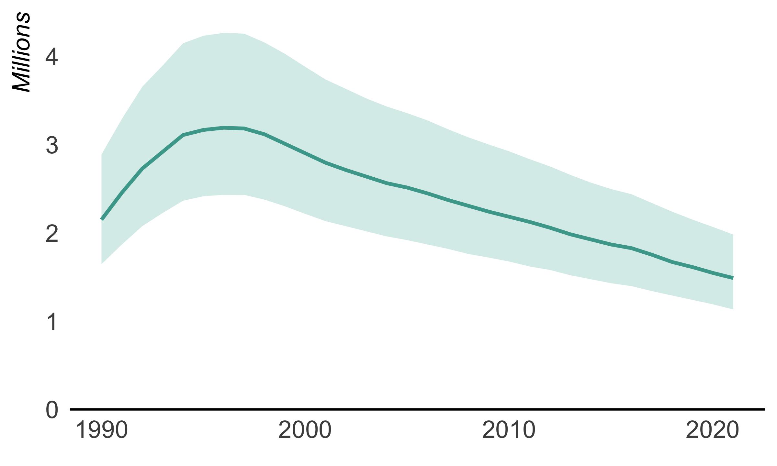

Data at the core of the HIV response
Adults and children newly infected with HIV  1990–2021
2021 Total: 1.5 million
[1.1 million–2.0 million]
Notes:
Precision public health starts with data; and data have been enshrined as a core component of the HIV response.
We’ve seen many references throughout this conference to the recently updated UNAIDS global estimates.

Slide 6
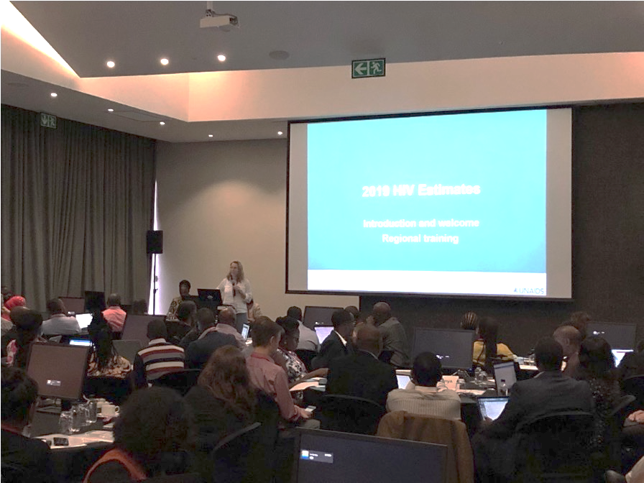
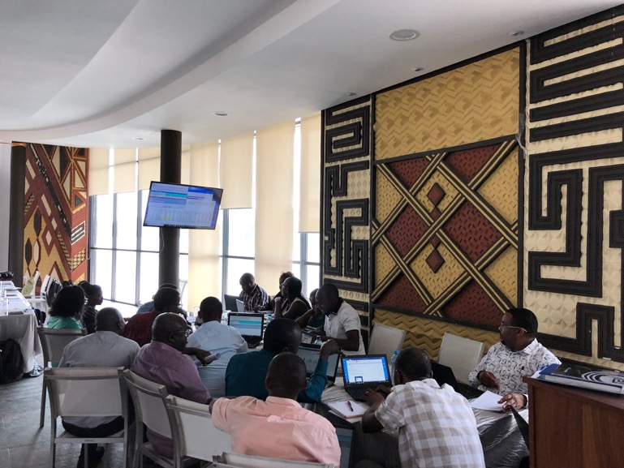
Country-led HIV Estimates Process
Dec-Feb
Workshops to review data and draft results
March
Draft shared with UNAIDS for review
May
Formal approval by health ministry leadership
July
Published via UNAIDS AIDSinfo (aidsinfo.unaids.org)
Notes:
Less discussed is how these estimates are created.
Instead of data being analysed by external researchers or global agencies, countries produce their own estimates, with support from UNAIDS
This has been one key to the effectiveness of HIV data for catalysing action—and a feature that makes HIV data unique compared to other health priorities.

Slide 7
Country-led HIV Estimates Process
2022 Estimates: 172 countries produced estimates
Virtual workshops: >1000 participants
Data ownership
Data quality
Data use
Notes:
In 2022, 172 countries national estimates and shared them with UNAIDS, and over 1000 strategic information partners participated in virtual workshops.
[CLICK]
This process has been the key to entrenching a cycle of data ownership, data use, and expectation of quality data to guide national public health responses to HIV.

Slide 8
Dimensions of Precision Public Health for HIV prevention in sub-Saharan Africa
Geography
Sex and age
Key & vulnerable populations
Risk differentiation
Notes:
Next I would like to turn to considering the opportunities to use granular data to deliver more effective HIV prevention in sub-Saharan Africa, where new infections have been steadily declining, but there is immense attention for how to sustain and accelerate progress.
The Global AIDS strategy describes four main dimensions along which to differentiate HIV risk and services.

Slide 9
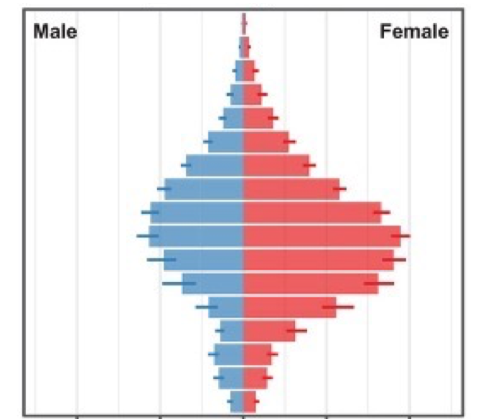
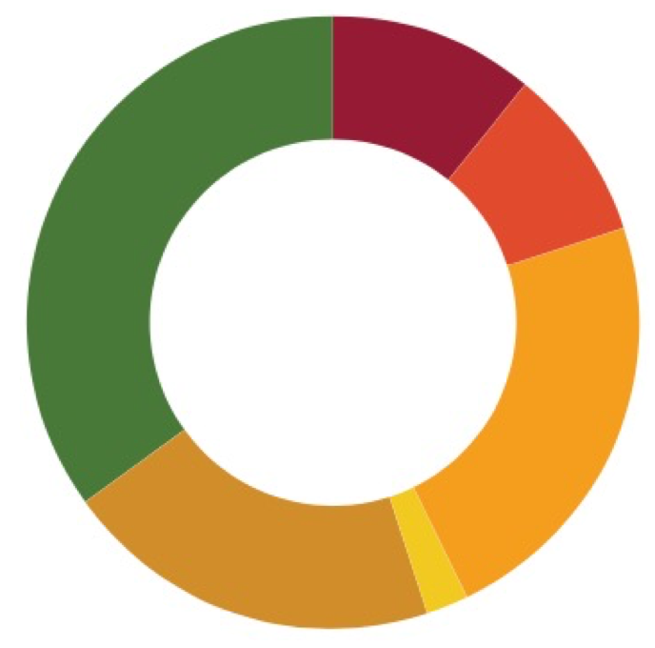

Dimensions of Precision Public Health for HIV prevention
Data to deliver precision response
Efficacy to differentiate prevention
Notes:
I would like to consider each of these along two axes.
[CLICK]
First, what is the evidence that differentiating prevention along each dimension would be effective to efficiently identify those with greatest prevention need?
[CLICK]
And, secondly, whether reliable and granular data exist that allow us to deliver a precision response.

Slide 10
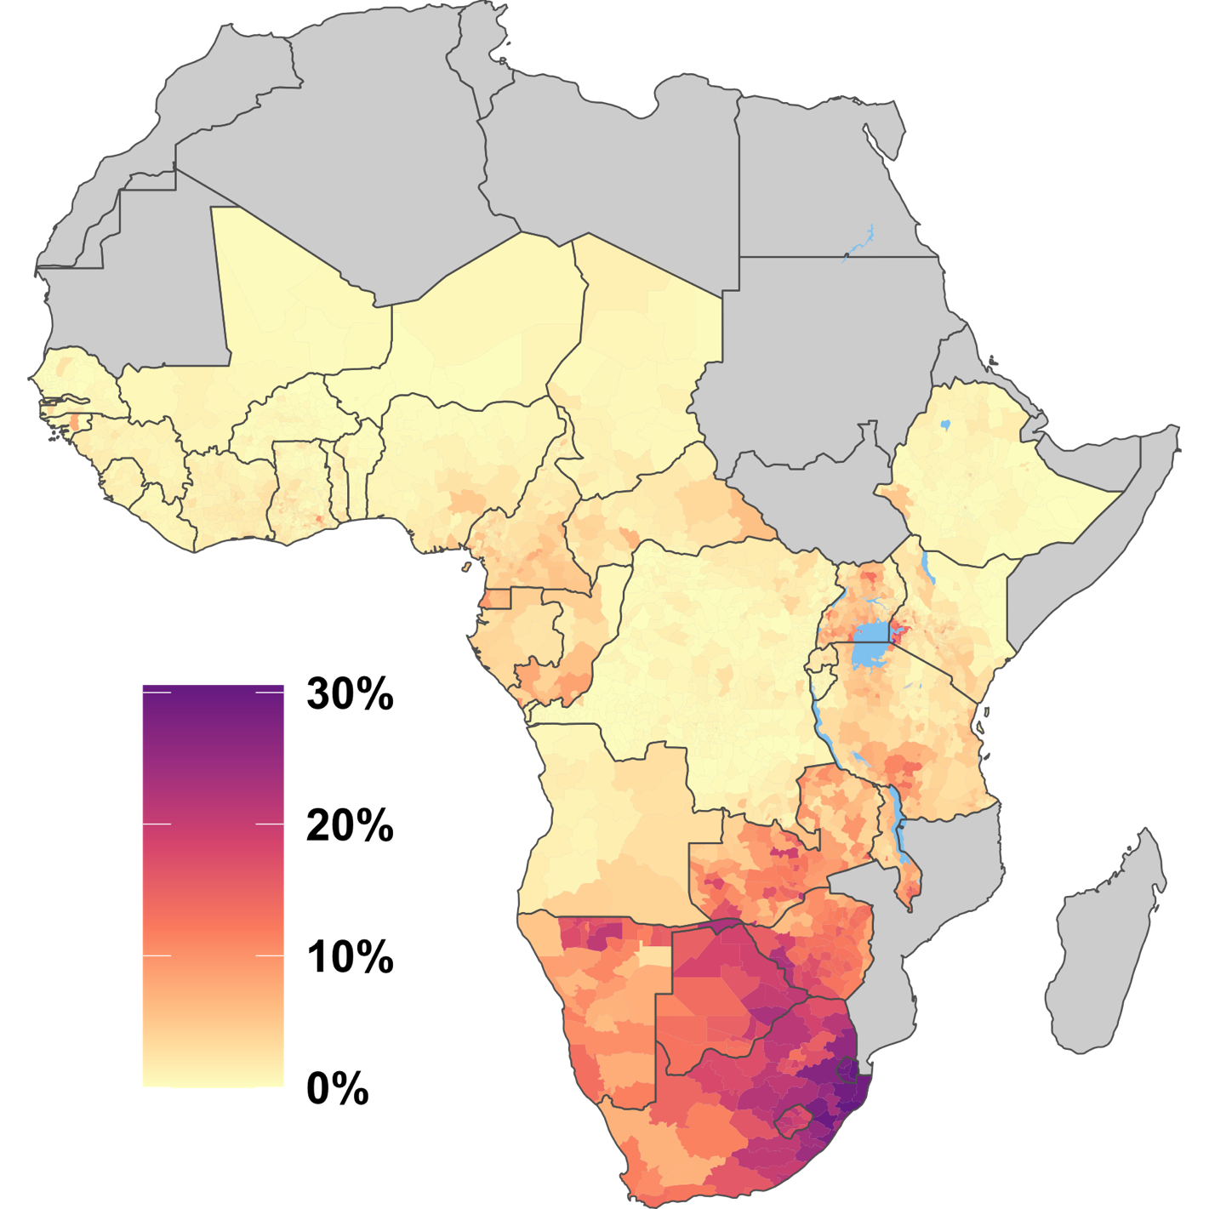
High-resolution HIV data: Combined geographically located survey and health system data
HIV prevalence, age 15-49 years
Granular characterization of:
HIV burden
Treatment coverage and unmet need
New HIV infections
Enabled through facility-level routine health system data
Antenatal clinic HIV testing
Clients receiving ART
Source: UNAIDS 2022 HIV Estimates
Notes:
Subnational geographic variation has been an established factor in HIV spread in Africa since early on.
Early surveillance established large urban / rural differences as a key feature of the ‘know your epidemic’ mantra.
This difference now, compared to 20 years ago, is that spatial variation has transformed from a theoretical epidemiologic determinant to no having precise local-level estimates for key epidemic indicators.
We also have strong evidence that these high burden areas are where the largest number of new infections occur—and therefore are a priority for HIV prevention.
The new availability of routine health system data means that there are real data underpinning the estimates in every district.
The continent-wide results in this figure incorporate data on HIV status for over 30 million pregnant women who were tested for HIV at antenatal care in 2021.

Slide 11
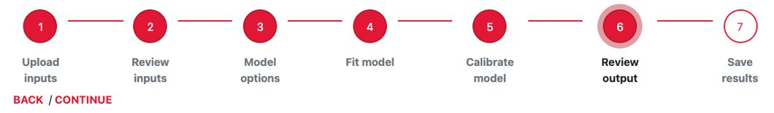
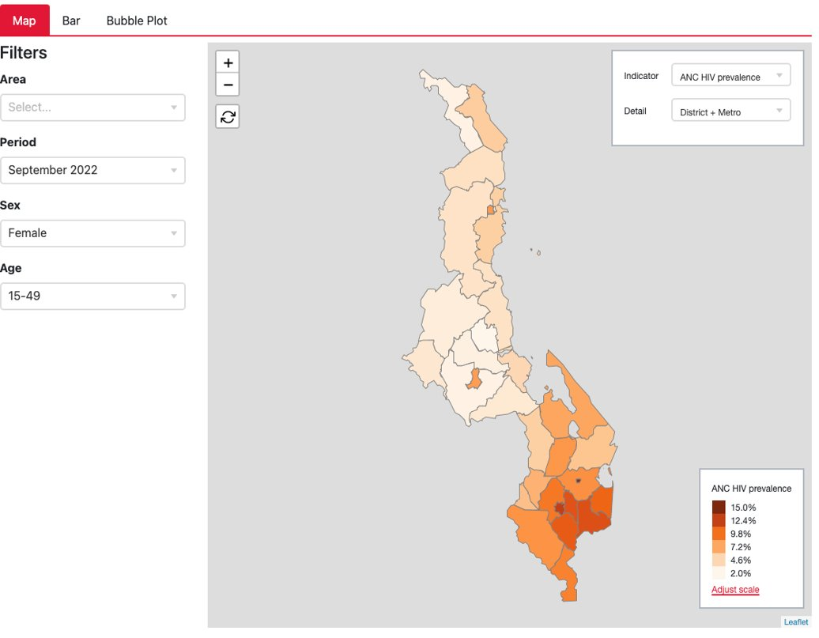
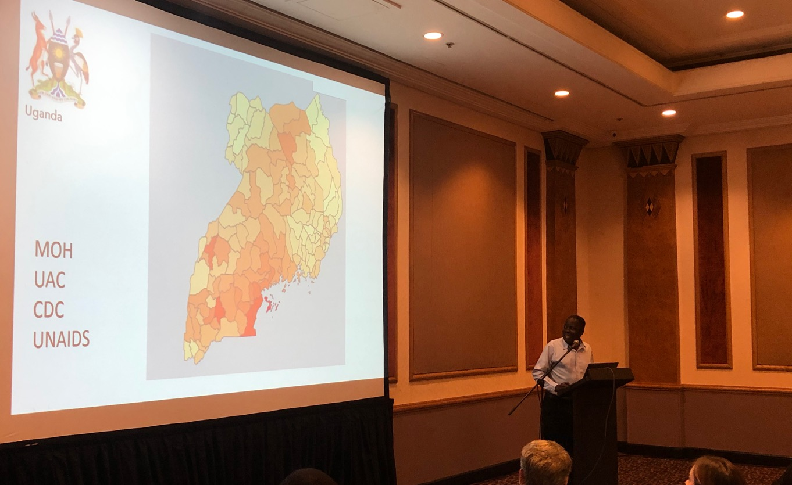

Institutionalising subnational data in HIV strategic information
Naomi: Webtool used annually by 39 SSA country teams
District estimates and targets (NSPs, PEPFAR, Global Fund, etc.)
Results published by UNAIDS
https://naomi.unaids.org
Eaton et al. J Int AIDS Soc 2021; 24:e25788
https://naomi-spectrum.unaids.org (Results)
Notes:
To enable production and use of spatial data for target setting and monitoring, our team of research software engineers at Imperial College created a web-based tool, called ‘Naomi’, that allows users to visualize their spatial HIV data, fit sophisticated geostatistical models, and interrogate results.
Through this, producing subnational HIV data has become institutionalized as a routine component of the country-led HIV estimates process supported by UNAIDS.

Slide 12
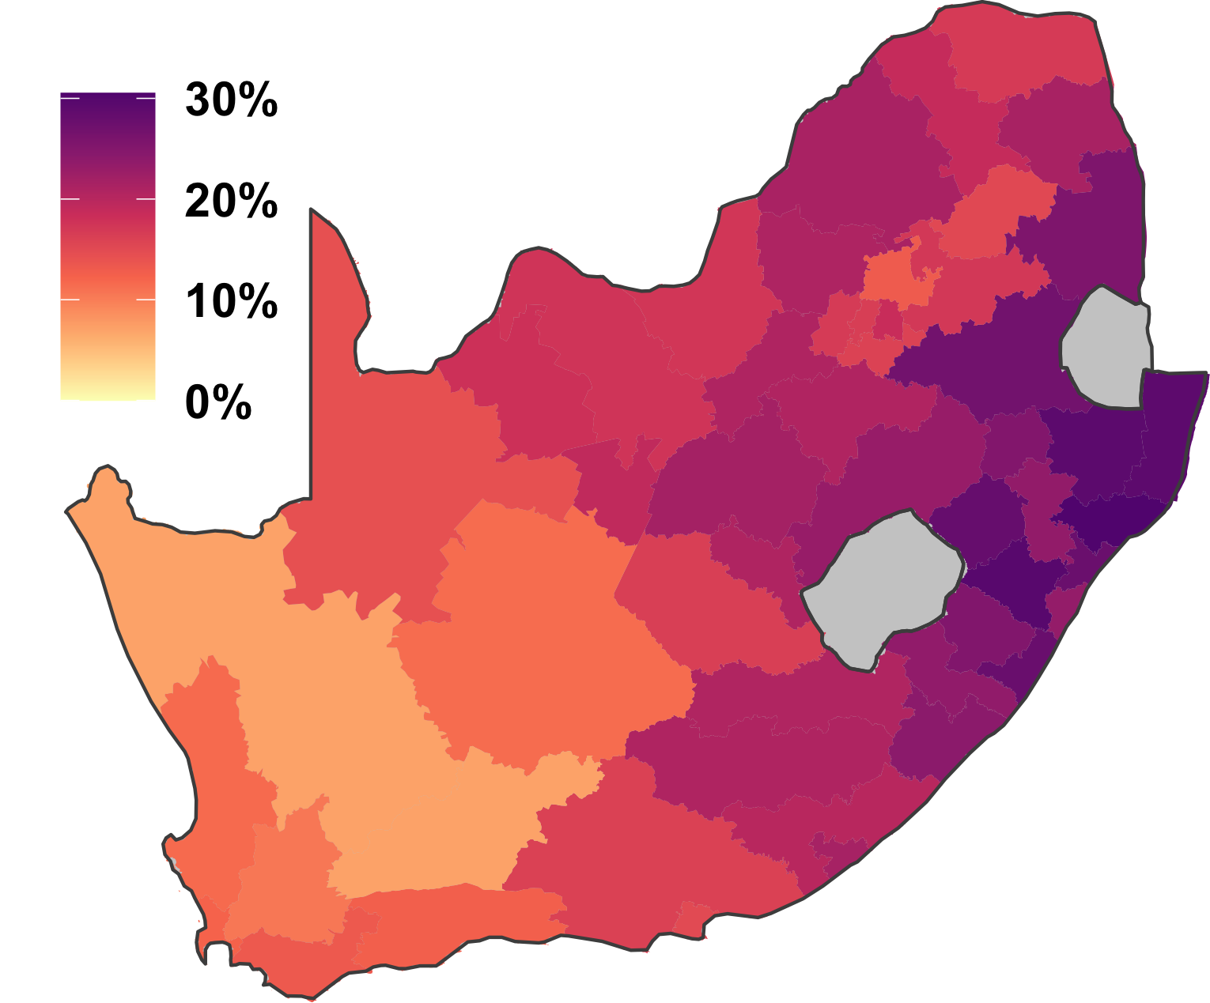
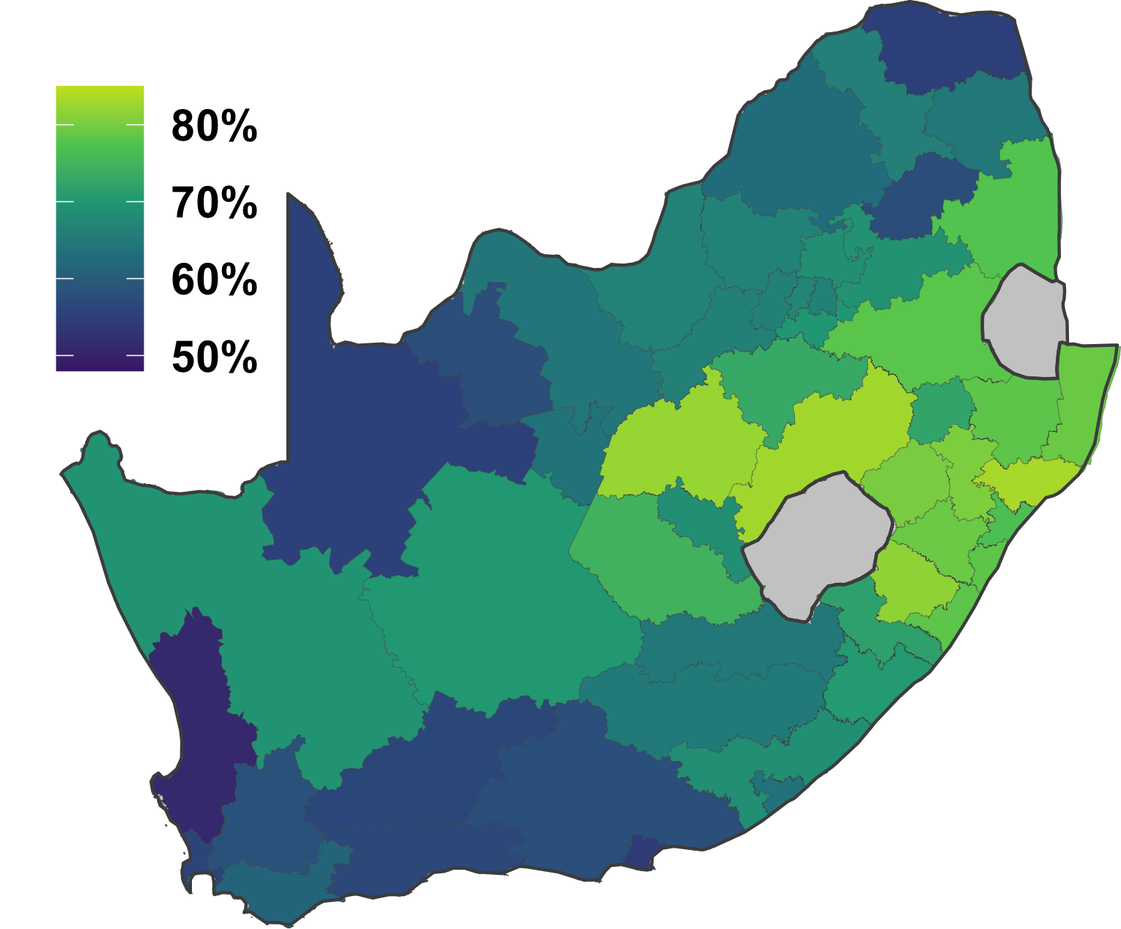
Geographic prioritisation: higher burden stronger programme attainment
HIV prevalence (15-49 years)
ART coverage (15+ years)
https://www.hivdata.org.za
Notes:
New district-level results also show the emerging impacts of geographic prioritization strategies on highest burden locations.
[CLICK]
For example, in the eastern districts of South Africa, where up to 25-30% of adults are living with HIV, treatment coverage is also the highest, nearing attainment of the 90-90-90 targets.
[CLICK]
The inverse is true in western districts, which have much lower prevalence but only around 55-65% of people with HIV are on treatment.
These data underscore the success of intensive programme efforts in high burden geographies, but also that it is essential to monitor equitable access, which these data provide programmes with the ability to do.

Slide 13
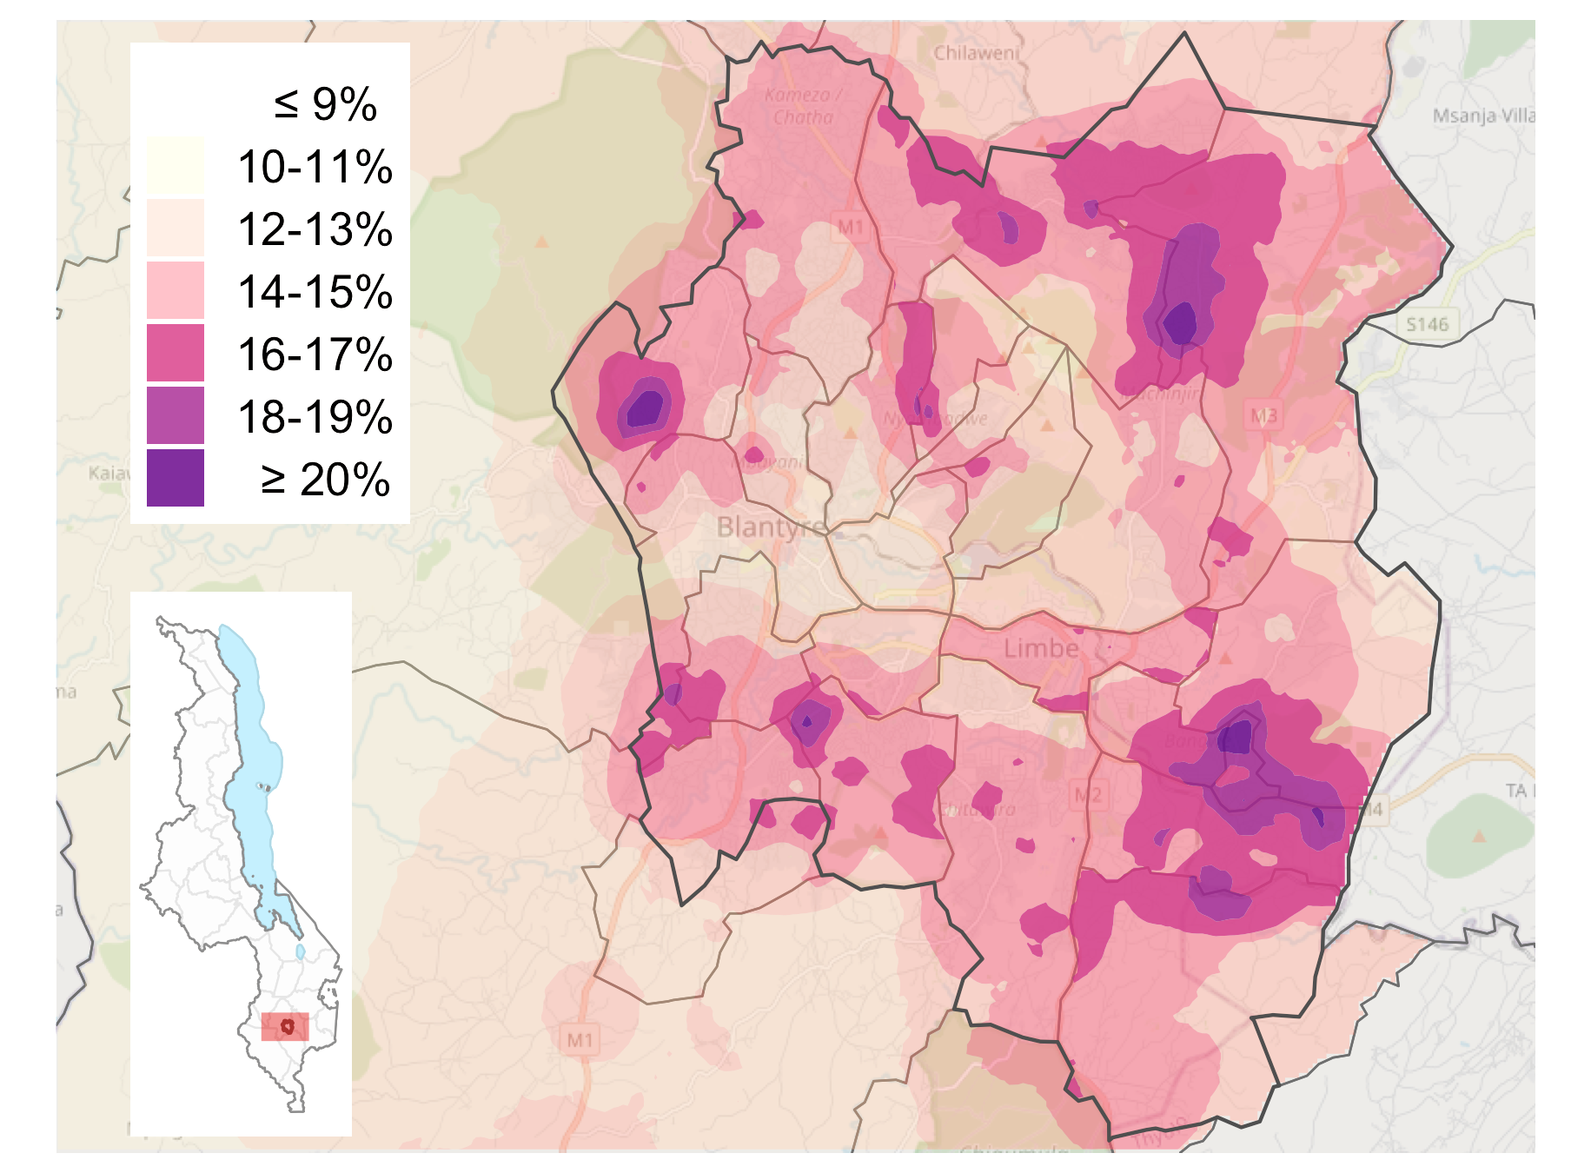




Large HIV variation in urban areas: Blantyre City, Malawi
(Abstract #1666; Rachael Burke)
HIV prevalence (15-49 years)
Across wards on Blantyre City (southern Malawi), HIV prevalence ranged between 13% and 19.5%
SA078: The Blantyre Prevention Strategy
Notes:
In Blantyre City, in southern Malawi, we used household-level HIV testing data to quantify fine scale variation across the city.
Unsurprisingly, the results show remarkable neighbourhood-level variation in HIV prevalence. Across wards, relative burden varied to a similar degree as the amount variation across districts in many countries.
These granular data are being used by the district health office, overlaid with community-level service delivery data, to manage and monitor the local HIV response in the city.

Slide 14
Dimensions of Precision Public Health for HIV prevention
Data to deliver precision response
Geography
Granular routine health system data
Strong evidence burden risk
Efficacy to differentiate prevention
Notes:
Summarising, we now have detailed geographically stratified data and strong evidence that areas with high HIV burden are also areas with largest numbers of new infections.
[CLICK]
Based on that, geographic differentiation has been a clear success of the the Precision Public Health paradigm in HIV.

Slide 15
Dimensions of Precision Public Health for HIV prevention
Data to deliver precision response
Geography
Granular routine health system data
Strong evidence burden risk
Sex and age
Efficacy to differentiate prevention
Notes:
Next, moving on to sex and age stratification. This is another dimension where we have seen large shifts in HIV programming in recent years. In particular an intensive focus on HIV prevention among adolescent girls and young women.

Slide 16
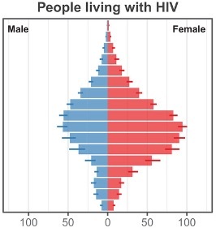
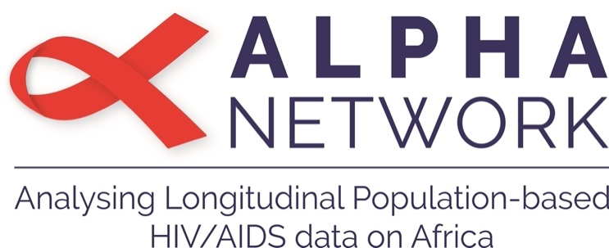
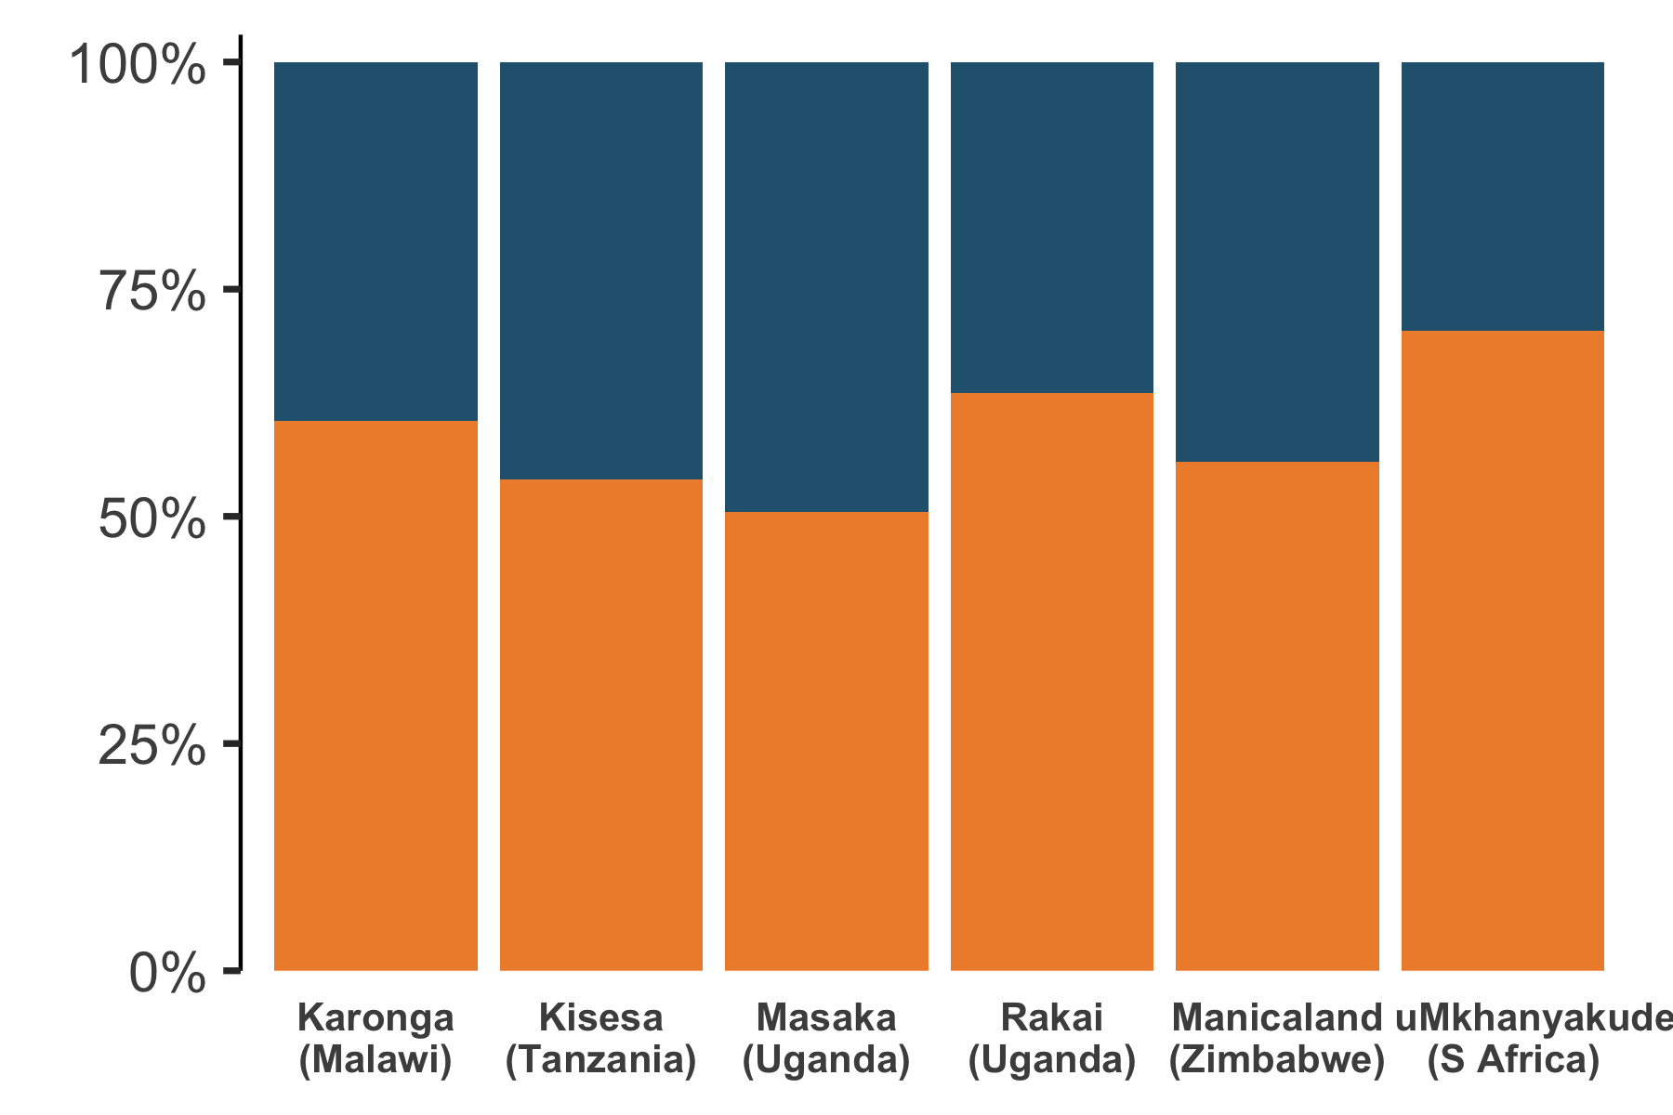
Disproportionate risk among women 15-24y—but infections across all ages
Distribution of new infections by sex
Men
50–70% of adult new infections were among women
Women
Risher et al. Lancet HIV 2021. 8:E429-39
Notes:
To understand the appropriateness of the intense focus in this age group, we analysed data from six long-standing population HIV cohort studies.
[CLICK]
Overall, we found remarkably similar patterns of HIV incidence across studies in Eastern and Southern Africa.
Between 50-70% of adult infections were among women, compared to men.

Slide 17
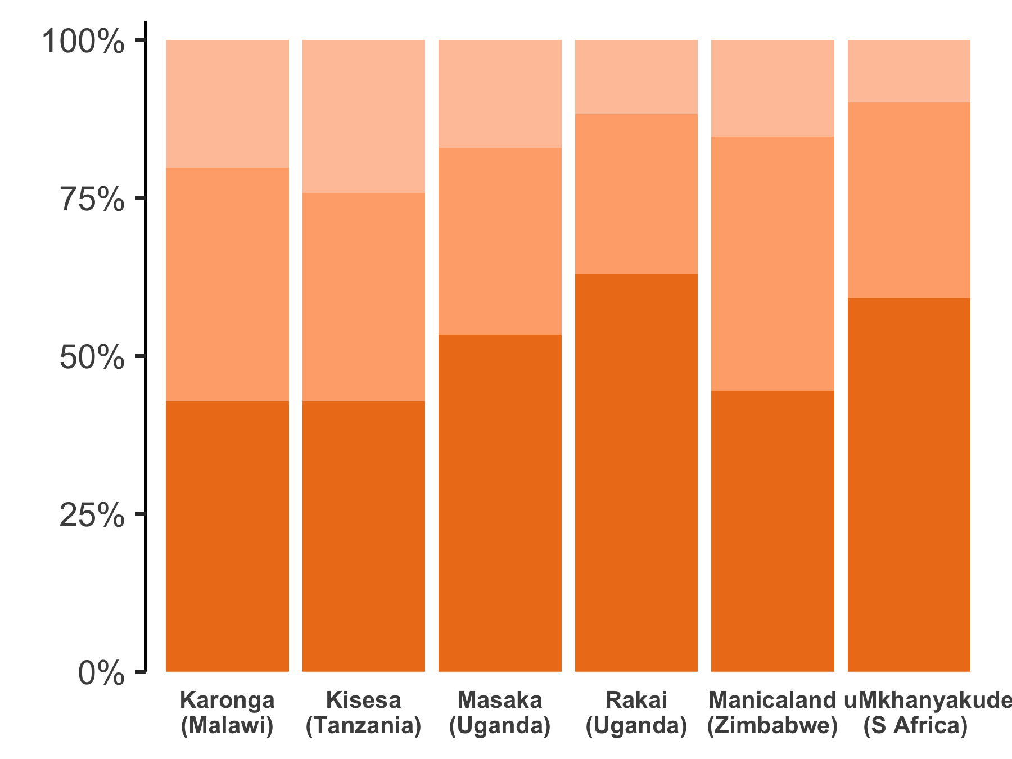
Disproportionate risk among women 15-24y—but infections across all ages
Women: new infections by age
35-54y
40–60% of infections ≥ 25y
25-34y
40–60% of infections in women among age 15-24y
15-24y
Risher et al. Lancet HIV 2021. 8:E429-39
Notes:
Among women, around half of new infections were among aged 15-24 years, highlighting the disproportionate HIV burden among young women.
However, around half of new infections were among women above age 25—underscoring the need for prevention across all ages

Slide 18
Disproportionate risk among women 15-24y—but infections across all ages
Women: new infections by age
Share of new infections among women vs. men increasing
(Joshi et al. J Int AIDS Soc 2021; 24:e25818)
35-54y
25-34y
Share of new infections among older adults vs. younger increasing
(Akullian et al. PNAS 2021; 118:e2013164118)
15-24y
Risher et al. Lancet HIV 2021. 8:E429-39
Notes:
From other studies, we also know that the share of infections among women is increasing over time.
[CLICK]
And we expect that the share of new infections among adults above age 25 will increase as the epidemic matures.

Slide 19
Dimensions of Precision Public Health for HIV prevention
Data to deliver precision response
Geography
Granular routine health system data
Strong evidence burden risk
Sex and age
Granular data and epi characterisation
among AGYW; but across all ages
Efficacy to differentiate prevention
Notes:
Taken together, we have strong data and epidemiologic information about how HIV infection risk varies by sex and age.
But perhaps can’t overly focus prevention on adolescent girls and young women because a large share of infections occur among men and women up to age 45 or 50.

Slide 20
Dimensions of Precision Public Health for HIV prevention
Data to deliver precision response
Geography
Granular routine health system data
Strong evidence burden risk
Sex and age
Granular data and epi characterisation
among AGYW; but across all ages
Efficacy to differentiate prevention
Key populations
Notes:
Next to key populations.
Unlike the district, sex, age stratified data we’ve just discussed, estimates about HIV among key populations are published at the global and regional level, but are not produced, reviewed, or published at country-level as part of the annual estimates process.

Slide 21
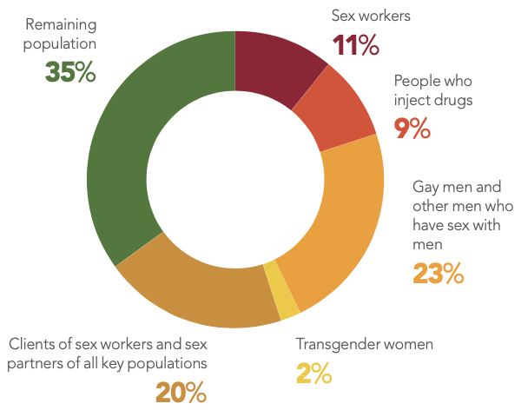
Key populations: disproportionate HIV vulnerability in all sub-Saharan African countries
(Abstract #2887; Oliver Stevens)
 | Population size | Key population living with HIV
Female sex workers | 3.7m (2.6–5.6m) | 790,000 (540,000–1,100,000)
Men who have sex with men | 1.9m (1.3–3.4m) | 300,000 (180,000–520,000)
People who inject drugs | 1.5m (0.8–3.0m) | 120,000 (60,000–250,000
Members of key populations are:
1.6% of adult population in sub-Saharan Africa, but
6.3% of people living with HIV
Stevens et al. medRxiv 2022; doi: 10.1101/2022.07.27.22278071
Notes:
We recently collated all available key population surveys conducted in sub-Saharan Africa since 2010, with colleagues at UNAIDS and others.
This involved over 2500 data points from over 200 studies.
These data made clear the disproportionate vulnerability to HIV experienced by key populations in all countries in sub-Saharan Africa.
Members of key populations were 1.6% of the adult population, but 6.3% of all people living with HIV.

Slide 22
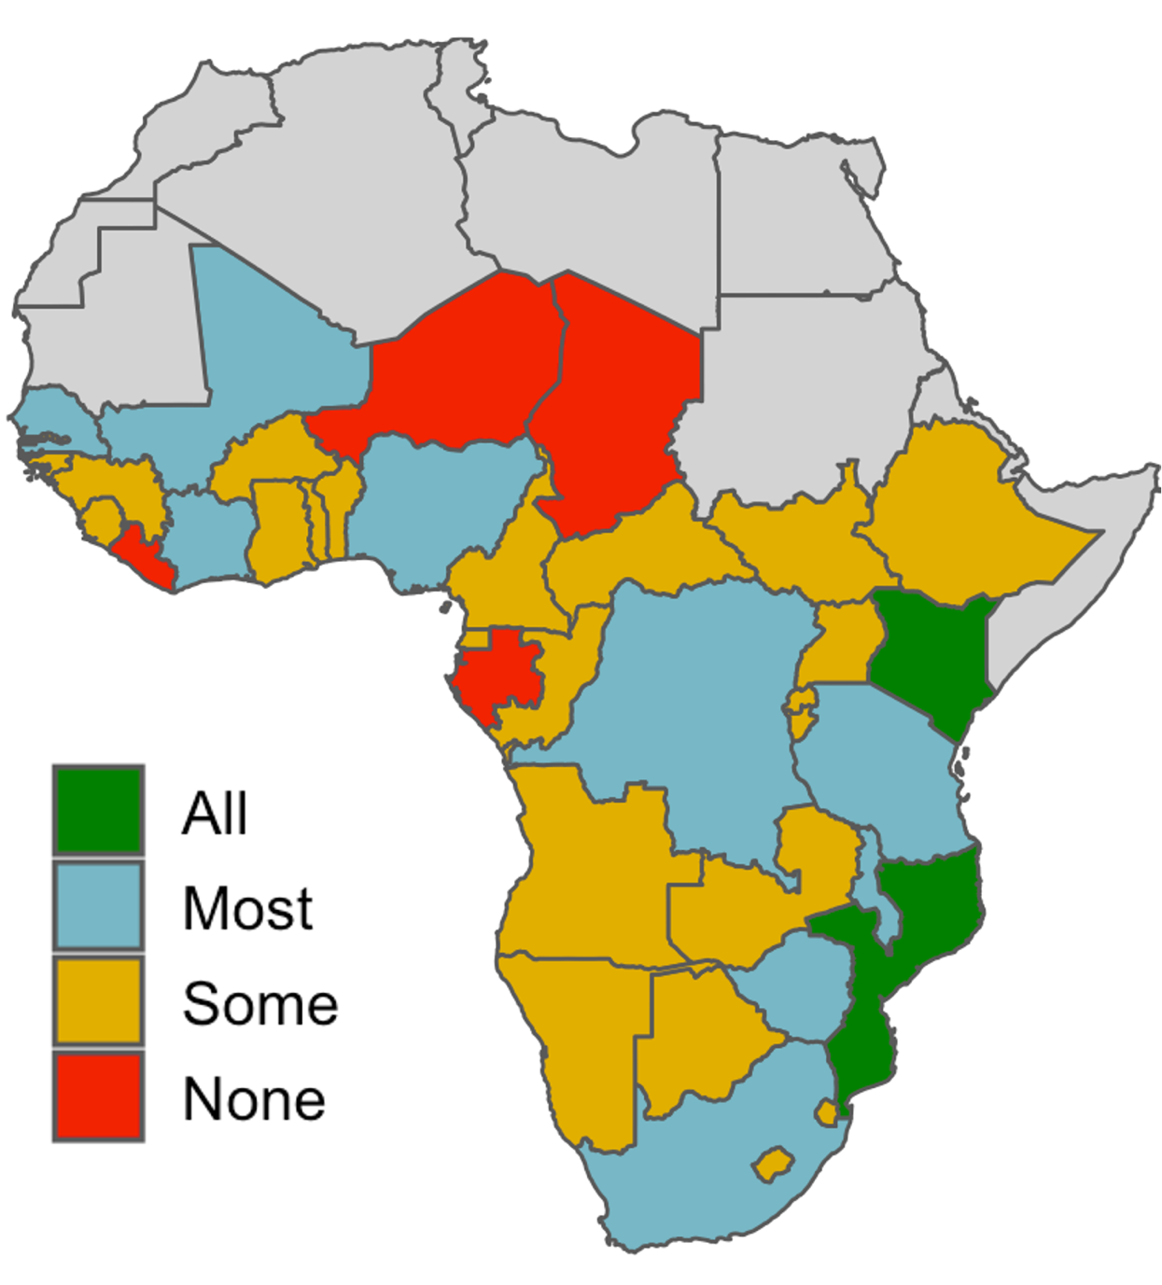
Key Population Surveys: Large data gaps
(Abstract #2887; Oliver Stevens)
Data availability:
key population x outcome
Limitations of existing key population survey data:
Large heterogeneity → very wide uncertainty
Restricted and non-representative geographic coverage
Difficult to relate surveillance to service planning and monitoring
Stevens et al. medRxiv 2022; doi: 10.1101/2022.07.27.22278071
Notes:
However, we also identified major gaps in the availability and usability of key population survey data across the continent.
Across the three outcomes and four key populations, only two countries had some data in the past decade for all of the outcomes
[CLICK]
Use of data for precision programming was also limited by constraints of the existing survey-based approach.
There was very large heterogeneity in survey methods and results, which translated into very wide uncertainty.
Surveys were often restricted to only selected urban locations, and
It was difficult to relate surveillance to service need or programme monitoring outcomes

Slide 23
Dimensions of Precision Public Health for HIV prevention
Data to deliver precision response
Geography
Granular routine health system data
Strong evidence burden risk
Sex and age
Granular data and epi characterisation
among AGYW; but across all ages
Efficacy to differentiate prevention
Key populations
Strong evidence for need (everywhere)
Insufficient data for precision response
Notes:
Taken together, the situation for key population data today is reminiscent to the status of geographic variation 20 years ago.
There is strong evidence for the need for need for key population focused programming in all settings.
But data are severely deficient to guide or monitor programming with the precision envisioned by the Global AIDS Strategy.
There is an urgent need for novel approaches that integrate surveillance with programmes, leverages the expertise in communities, but retains robust sampling strategies to ensure surveillance reaches into the most vulnerable populations that might be missed by programmatically-focused monitoring.

Slide 24
Dimensions of Precision Public Health for HIV prevention
Data to deliver precision response
Geography
Granular routine health system data
Strong evidence burden risk
Sex and age
Granular data and epi characterisation
among AGYW; but across all ages
Efficacy to differentiate prevention
Key populations
Strong evidence for need (everywhere)
Insufficient data for precision response
Risk differentiation
Notes:
Lastly, moving on to risk differentiation among the wider general population at risk

Slide 25

Risk differentiation: What are we seeking?
Distribution of
population
Distribution of
infections
Key populations
75% of infections among remaining 98% population
Remaining
population
UNAIDS 2022 HIV Estimates; Stevens et al.
Notes:
While key populations experience disproportaionate risk, the majority of new infections in sub-Saharan Africa remain among the wider general population and will continue to be for the foreseeable future.

Slide 26
Risk differentiation: What are we seeking?
Distribution of
population
Distribution of
infections
Risk differentiation:
Individual characteristics that identify persons with higher infection risk → individualised prevention?
Higher risk population?
Notes:
To what extent is it possible to use individual sociodemographic and behavioural characteristics to identify those most at risk of infection, and who need more intensive HIV prevention?

Slide 27
HIV Risk Scores: Risk Factors Consistently Predictive of HIV Infection
HIV Risk Score systematic review:
Consistently identified predictors of HIV infection among sexually active adult women
 | Pooled hazard ratio (95% CI)
Non-cohabiting with primary partner | 2.33 (1.73–3.13)
Age <25 years | 1.62 (1.17–2.23)
Curable sexually transmitted infection | 1.45 (1.17–1.79)
HSV-2 infection | 1.67 (1.32–2.09)
Multiple sexual partners | 1.62 (1.27–2.07)
*Education attainment, employment, coital frequency were not predictive of incidence
Jia et al. J Int AIDS Soc 2022; 25:e25861
Notes:
In a systematic review of 14 HIV ‘risk scoring’ algorithms developed for this purpose, indeed there were several factors that were consistently predictive of increased HIV infection risk among women across studies and across settings.

Slide 28
But no ‘silver bullets’ precisely identifying those most likely to acquire HIV
Risk scores: only low-to-moderate ability to differentiate those who subsequently acquired HIV
Required classifying 40-65% of population as ‘high risk’…
…to identify 75% of HIV infections
Individual risk behaviours added minimal predictive ability versus only geographic location and age
(Roberts et al. Clin Infect Dis 2022; online)
Jia et al. J Int AIDS Soc 2022; 25:e25861
Notes:
However, overall, risk scores only had low-to-moderate ability to differentiate those who subsequently acquired HIV.
For example, across the studies, to identify 75% of HIV infections required classifying 40 to 65% of the population in the ‘high risk’ group.
[CLICK]
A recent study by Allen Roberts and colleagues in KwaZulu-Natal, South Africa, concluded that individual-level risk behaviours added only minimal predictive ability compared to residing in a high prevalence area and age.

Slide 29

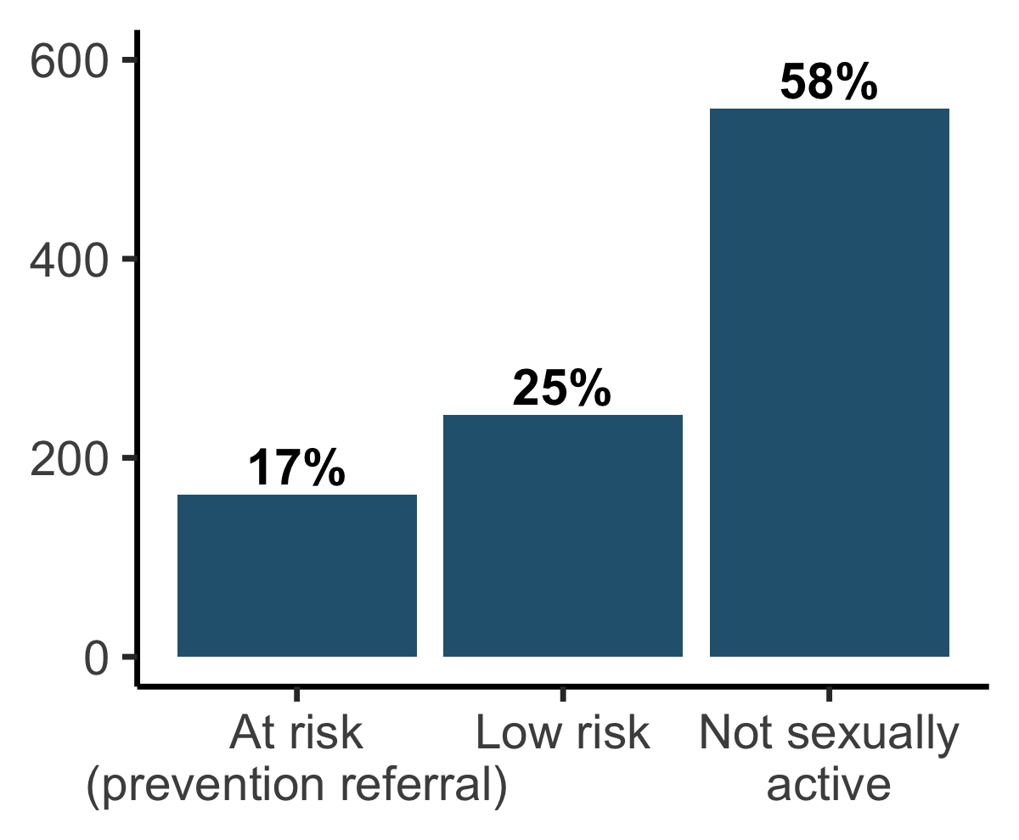
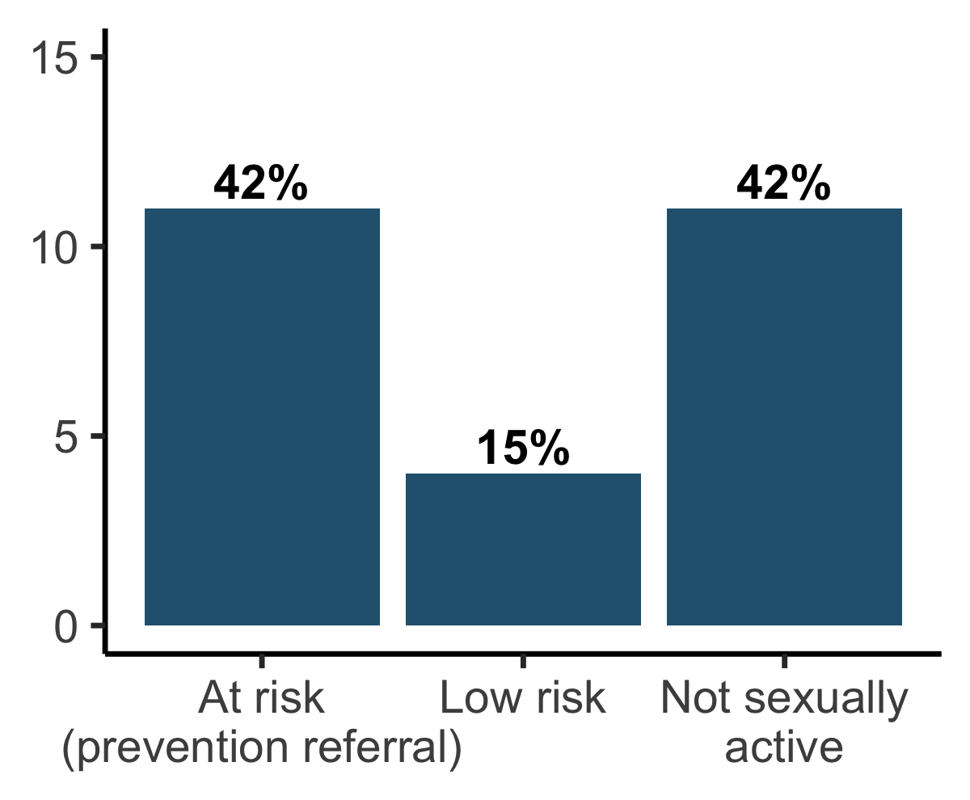
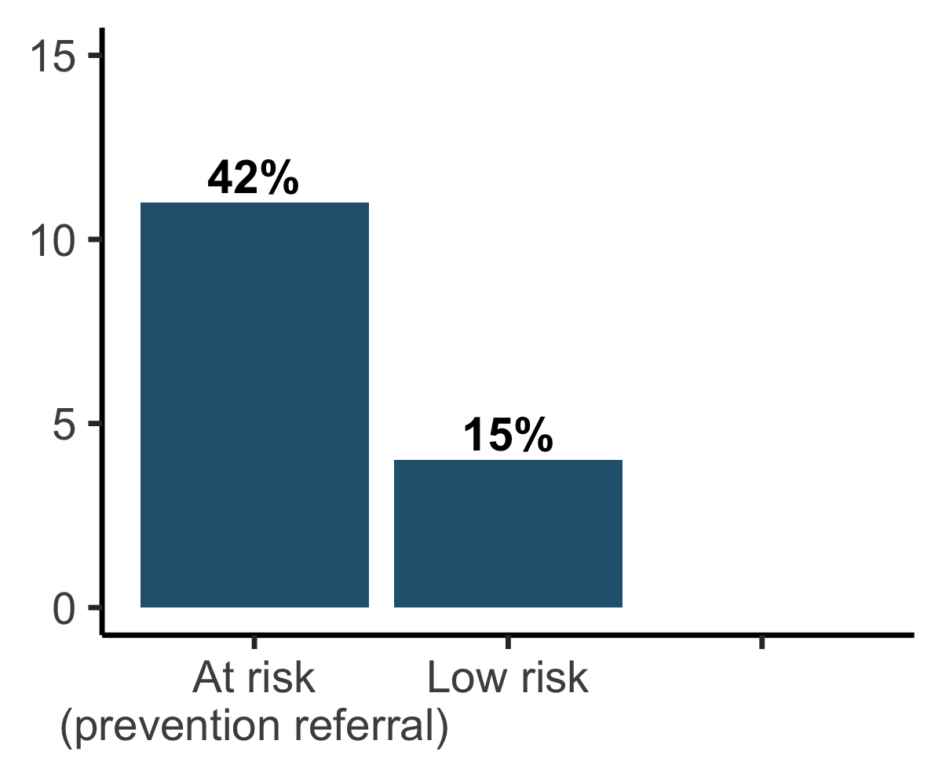
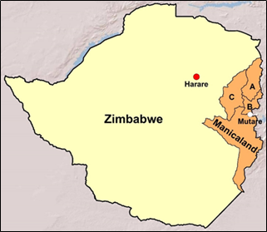
Evaluation of WHO Risk Tool: Manicaland, east Zimbabwe
Prevention group allocation
(n = 960 women 15-24y)
HSV-2/HIV infections
(n=26; 1 year follow-up)
40% of infections among 17% ‘at risk’
But—40% among AGYW ‘not sexually active’ at baseline assessement
Moorhouse et al. in preparation
Notes:
In a recent evaluation of the proposed WHO risk tool in Eastern Zimbabwe, 40% of new HSV-2 or HIV infections were among 17% of the population classified as ‘at risk’ according to the risk tool.
[CLICK]
However, an equal number of infections occurred among girls and young women who reported no sexual activity at all at the baseline assessment.

Slide 30



Evidence from genomic analysis of HIV Transmissions
80% of transmissions within the same community
75% of transmitters infected >1 year
?
Transmission analysis
SA040: HIV cluster sizes in Sub-Saharan Africa
SA105: HPTN071(PopART) (Tuesday 8:00-9:00)
SY38: Ensuring an ethical future for HIV surveillance (Tuesday 11:45-12:45)
Highest transmission age group: men 25-39 years
Typical transmission clusters:
~2-3 individuals
“Transmission is driven by many who infect few, not by few who infect many”
(Prof Christophe Fraser, Principal Investigator, PANGEA-HIV)
Notes:
Why is predicting risk so challenging?
Rapid change of individual-level risk circumstances is part of the story.
But I think an important part of the story is also the diffuse nature of HIV transmission at the current stage in the epidemic in sub-Saharan Africa. Which is characterized by large number of people with relatively average behaviour at a low—but not zero—risk of HIV.
We increasingly have evidence about these transmission dynamics from genomic analysis, which allows us to not only identify who is becoming infected with HIV, but also who is transmitting HIV and the nature of sexual networks across which this is occurring.
Some of the key insights from the PANGEA-HIV consortium, using community trial data in Zambia and Botswana, are:
[CLICK]
Firstly, related to geographic differentiation, 80% of HIV transmissions occur between partners residing in the same community.
[CLICK]
Second, men transmit HIV about four times more than women, with the largest share of transmissions from men age 25-39 years old.
[CLICK]
Third, most HIV transmission comes from persons who have themselves been infected for longer than year, rather than rapid onward transmission of recent infection.
[CLICK]
And, fourth, most transmissions are in small diffuse clusters of 2-3 individuals, not rapid large outbreaks among dense high-risk networks.
[CLICK]
The investigators summarized the predominant patterns of HIV transmission in these communities as: “Transmission is driven by many who infect few, not by few who infect many”

Slide 31

Dimensions of Precision Public Health for HIV prevention
Data to deliver precision response
Geography
Granular routine health system data
Strong evidence burden risk
Sex and age
Granular data and epi characterisation
among AGYW; but across all ages
Efficacy to differentiate prevention
Key populations
Strong evidence for need (everywhere)
Insufficient data for precision response
Risk differentiation
Consistently identified risk factors
No ‘silver bullet’: variable & diffuse risk
Notes:
All in all, I think we need to acknowledge that there are limits to the ability to precisely differentiate HIV risk using individual-level characteristics.

Slide 32
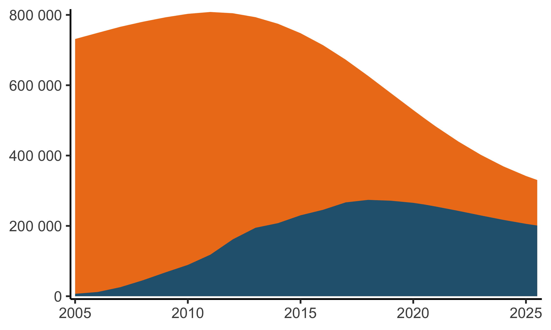
Preventing exposure to HIV infection
South Africa: Men living with HIV, age 25-34 years
Untreated
2015: 518,000 untreated MLHIV 25-34y
2025: 136,000
On ART
Source: Leigh Johnson, personal communication. Thembisa 4.4 (www.thembisa.org)
Notes:
Considering how challenging it is to precisely identify those most at risk, what are we left with to do? Preventing exposure to infection remains one of the most powerful tools in our arsenal.
From genomic data reducing the number of men with viraemia in the age 25-39 will be one of the keys to reducing population new infections going forwards.
This figure shows how the number of untreated men age 25-34 with HIV has change over the past 20 years in South Africa.
[CLICK]
In what I believe one of the best reasons for optimism, in the decade between 2015 and 2025 the number of untreated men with HIV in this priority age group will have decreased four-fold, from over half a million to 140,000.
[CLICK]
Some of this decline is due to increases in the number of men on ART since 2015.
[CLICK]
But the very large majority of the reduction is due to men who never became infected with HIV due to the impacts of combination prevention.
The key message here is that while increasing ART coverage and viral suppression among this population today is the most efficient way to reduce HIV infections tomorrow, a systems-level combination prevention approach to reducing infections is what has had the largest impact on protecting the next generation of South Africans.

Slide 33
What can Precision Public Health learn from the HIV response?
‘Precision public health’ is new, but the paradigm has underpinned the HIV response for decades
Routine health system data have enabled granular space and age stratified estimates
Data ownership and data use are as important as sophisticated data systems and analytics
Limits to ‘Precision Public Health’ paradigm for infectious disease response:
Data revolution under way—not there (yet); quality more important than quantity
Need continued surveillance—adapted to leveraging routine health system data
Actions by communities and populations contain infectious diseases
Notes:
When I started preparing this presentation, I anticipated concluding with a summary of what the HIV response could learn from Precision Public Health
But after reflection, it is also fitting to consider what Precision Public Health can learn from the legacy of effective data use in the HIV response; especially as health systems build to address more diverse infectious disease threats.
[CLICK]
What is new now though is the opportunity for us to leverage new data sources to better focus and deliver services. In particular integrating routine health system data has enabled more granular information to implement this vision.
[CLICK]
One key lesson from the HIV response is that data ownership and data use are equally as important as sophisticated data systems and analytics.
This is important for us to remember as HIV data become more granular. Too frequent a complaint is that data ‘go up’ but the do not come ‘back down’.
[CLICK]
There are also limits to the ‘precision public health’ paradigm.
[CLICK]
We are in the midst of a revolution of health data in settings most affected by HIV, but it is important to be realistic that this remains a work in progress. Certainly the level of individual interconnected health data imagined by Khoury and colleagues is not there—yet.
[CLICK]
There is also clearly a need for continued robust surveillance to ensure that the most marginalized are not being left behind. But we must adapt how we do surveillance to be less monolithic and more focus on integrating and maximizing information from routine health systems.
[CLICK]
Lastly, the precision public health paradigm has largely been focused around more precise characterization of individual risk. But it is important to remember that, ultimately, containing infectious diseases depends on collective actions taken by communities and populations to contain exposure to transmission. This must remain at the core of strategy development, while using the best available data to do so.

Slide 34





Acknowledgements
Mary Mahy, Ian Wanyeki, Keith Sabin (UNAIDS)
Christophe Fraser (Oxford University)
Kate Grabowski (Johns Hopkins University)
Leigh Johnson (University of Cape Town)
Oliver Stevens (Imperial College London)
Louisa Moorhouse, Simon Gregson (Manicaland Project / College London)
Katie Risher (Northwestern University)
National HIV estimates teams
Funding: Bill & Melinda Gates Foundation, UNAIDS, NIH (R01-AI136664, R03-AI125001)
jeffrey.eaton@imperial.ac.uk
@eatonjw
Notes:
In closing, I would like a large number of colleagues who generously contributed their ideas and content to this presentation.
And especially, my wonderful team at Imperial College—pictured here at a local Arsenal FC supporters pub in north London.

Slide 35



Acknowledgements
John Stover
Avenir Health
Notes:
Finally, I would like to make a tribute and personal thanks to John Stover from Avenir Health.
John has not only developed models that have underpinned the public health response to HIV for 3 decades, but also creates and supports software empowering users to understand their own data.
For me personally, John has been a role model, mentor and inspiration.
I hope he is not going anywhere soon, because there is a lot of work left to do, but I would like to take a moment to appreciate and thank him for being a true hero of the global HIV response.

