Slide 1
Caleb Orozco Executive Director UniBAM
Virtual Presentation:
Why is Decriminalisation important to HIV?
30th, July, 2022

Slide 2
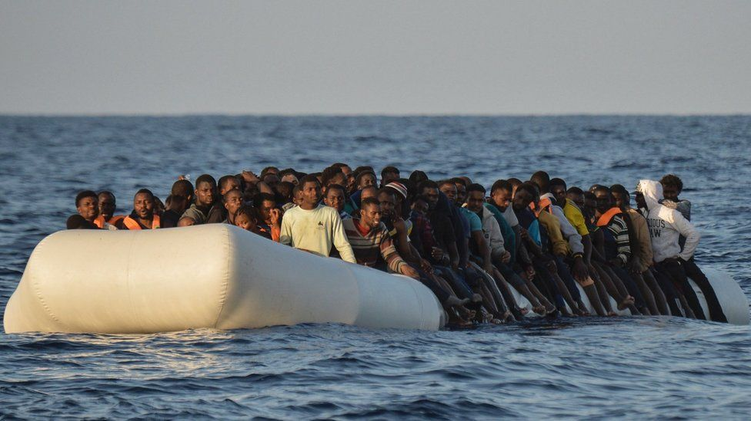
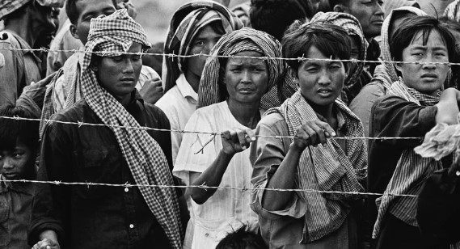
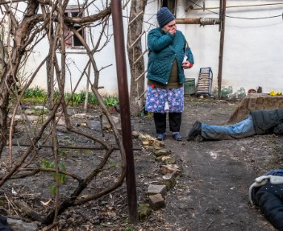
Unpacking: Systems of oppression
How inequality is built into our Global discussion about human rights and medical progress!

Slide 4
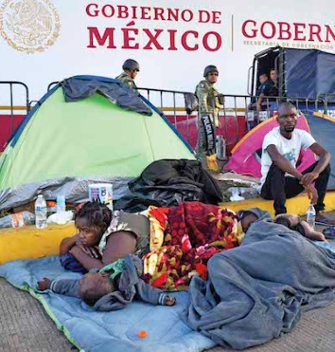
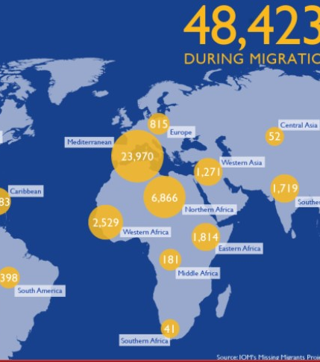
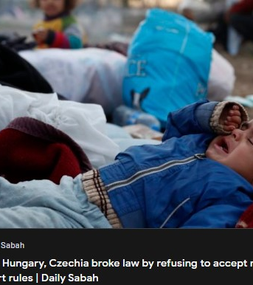
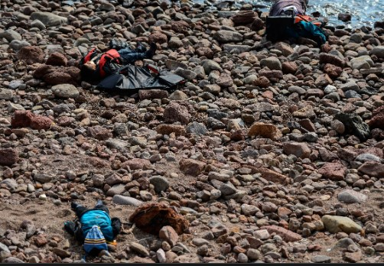
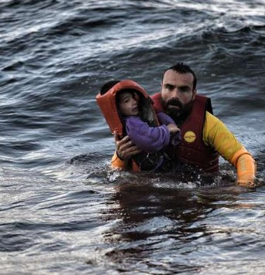
Ordinary People Are Expendable In GEo politics discussions

Slide 5
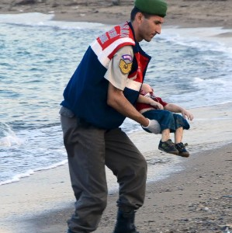
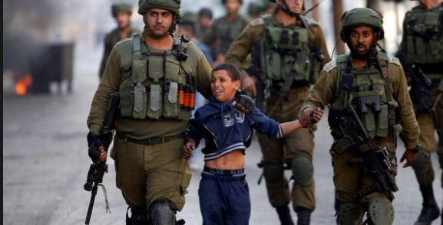
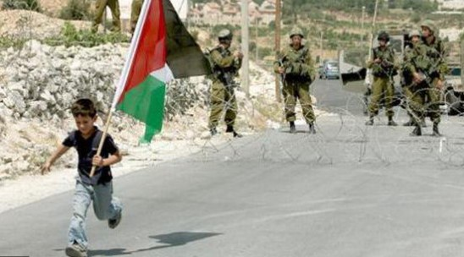
Violence is different around the World

Slide 6
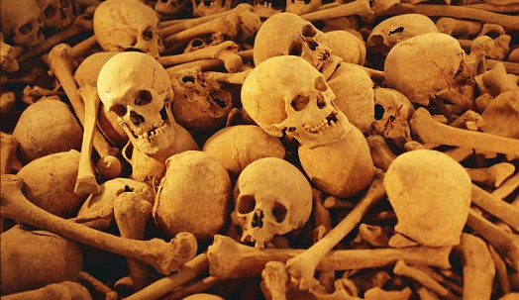
Representation does not always translate into respect for human Rights!
Not all Skinfolk are Kinfolk

Slide 7
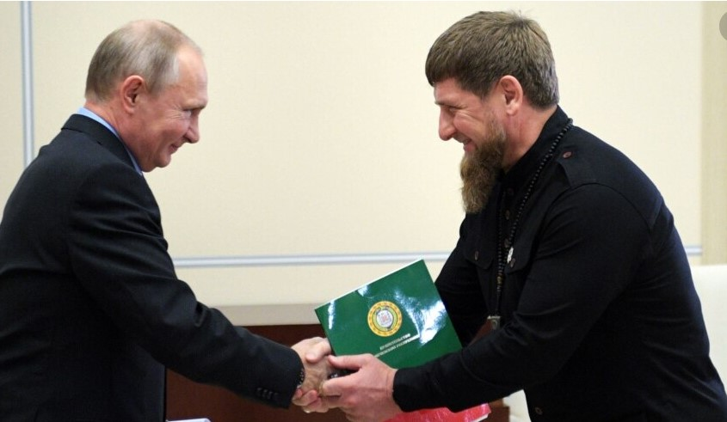
Political and religious pandering
The Hoodies and Sheets have been replaced with suits and ties whether in DC, Moscow, Brussels or London

Slide 8
A BBC Report in 2016

Slide 9
Investments in Human Rights Systems
Through its “breaking down its barrier initiative” it has invested $43m in 20 countries between 2017-2019 with total of 123m in all for the same period for Global Fund.
70 Countries still criminalised same sex acts in 2022
The OHCHR gets just over 4% of the UN regular budget. With $323.2m in 2021 that led to
In a 2021 report for Global Fund:
77,634 test was given to trans populations under Global Fund.
119,119 outreach have been done for key population.
12,194 MSM on PREP in 2021 Global Fund Report.

Slide 10
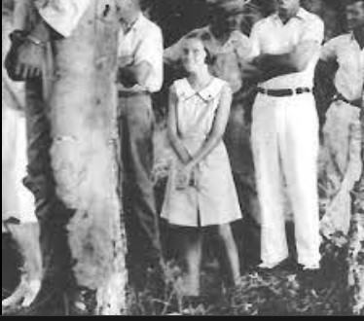
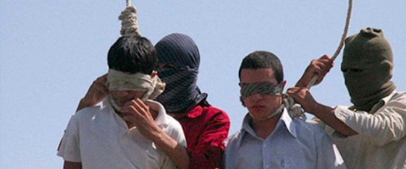
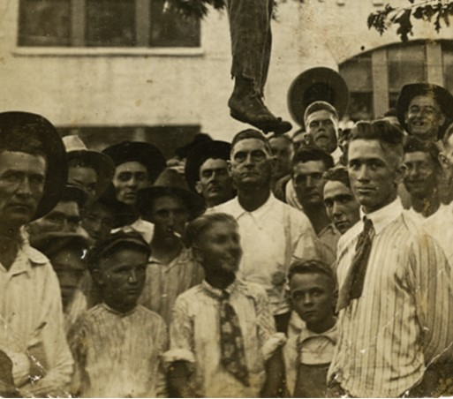
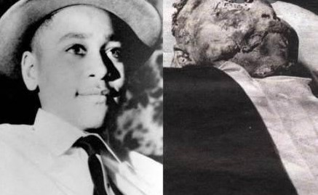
Why challenging LGBT criminalization matters for people living with HIV.
Caleb Orozco
Belize’s Resident Troublemaker
United Belize Advocacy Movement

Slide 11
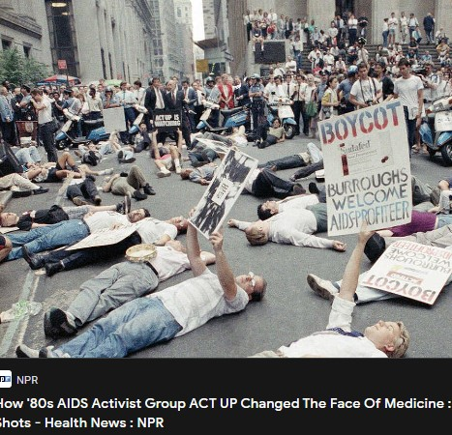
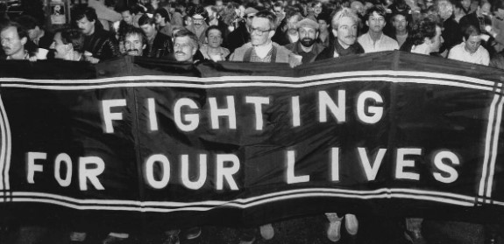
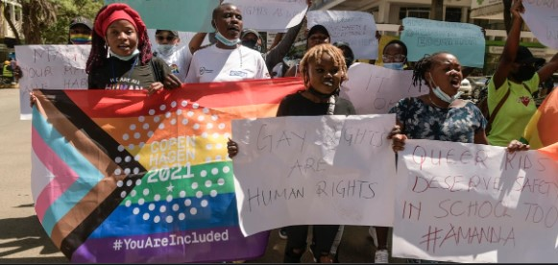
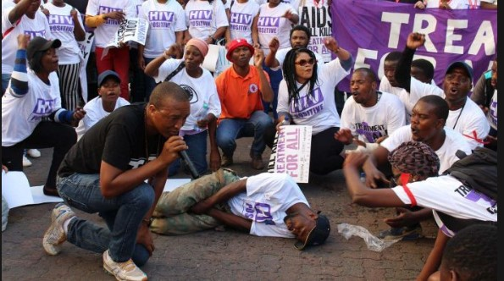
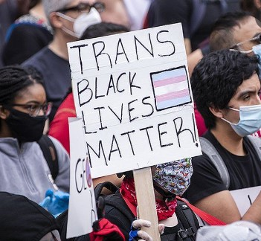
Share tactics of Protest

Slide 12
WE share common tactic to dismantle systems of Oppression

Slide 13
Why is decriminalisation important to HIV?
Reform and strategic litigation are redress tools that legitimize the dignity and fundamental rights of the individual. And so, delegitimize justification for systemic and structural violence.
Citizens do not live single issues or single identity lives .
LGBT activist have been able to use strategic litigation as a tool to dismantle system of oppression to advance other issues like economic rights protection.
Reminds us that our citizenship demands an intersectional framework and forces a conversation about state investments that address the civil and socio-economic needs of its citizens.
The impact of colonisation in promoting systemic marginalisation in policy, budget allocation and law reform can be challenged.

Slide 14
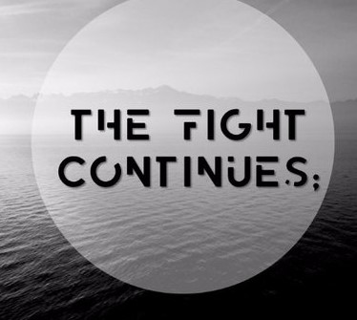

Slide 15
Source
https://www.economist.com/the-economist-explains/2017/09/01/why-transgender-people-are-being-sterilised-in-some-european-countries
https://www.bbc.com/news/world-europe-38420779
https://www.migrationdataportal.org/themes/migrant-deaths-and-disappearances
https://www.theglobalfund.org/en/about-the-global-fund/history-of-the-global-fund/
https://www.theglobalfund.org/en/human-rights/
https://www.theglobalfund.org/media/9020/oig_gf-oig-19-023_report_en.pdf
https://www.humandignitytrust.org/lgbt-the-law/map-of-criminalisation/

Slide 16
Source
https://www.ohchr.org/en/about-us/funding-and-budget
https://data.theglobalfund.org/results

