Slide 1
AIDS 2022
Session title: ART in evidence,OAB03
Saturday, July 30, 10:30 – 11:30
Dual therapy based on DRV/r plus 3TC in HIV-1 naïve patients:
Global 48 week results from ANDES Study
Maria Ines Figueroa on behalf of the ANDES study group
ClinicalTrials.gov Identifier: NCT02770508
Notes:
1
I would like to thank the organizing committee for selecting this work for this session. I am very glad to share with you the global forty eight week results of the ANDES study, based on dual therapy with darunavir -ritonavir plus 3TC compared to standard of care in naive PLWH.

Slide 2
Disclosure Information
Maria Ines Figueroa
I don't have conflicts of interest to disclose.
This study was supported by research grants provided by:
Richmond Pharmaceuticals
Ministerio de Ciencia y Tecnología, Argentina
Notes:
I don’t have conflicts of interest. This was a investigator-initiative study conducted with the support of Richmond Pharmaceutical and the Ministry of Science and Technology from Argentina.

Slide 3
Background/ Objectives
Dual therapy has been explored in different studies
A generic fixed dose combination (FDC) of DRV 800mg/ritonavir 100 mg is available in Argentina.
AIM: to compare efficacy and safety of this FDC plus 3TC to standard of care ARV therapy based on the same drugs plus Tenofovir fumarate.
Primary endpoint
% of patients with HIV-1 RNA <50 copies/mL in an ITT-exposed analysis at 48 weeks (FDA-snapshot algorithm).*
*Alpha 0.05, power 80%, 12% margin
Notes:
As you know, Dual therapy has been explored in different studies, settings and drug combinations. In Argentina, a generic fixed dose combination of DRV800/ritonavir100 mg is available for treatment- naïve subjects. We designed a study to compare the efficacy and safety of this combination plus 3TC to standard-of care ART based on the same drugs plus tenofovir difumarate. The primary endpoint was the percentage of subjects with viral load below 50 copies in an ITT exposed analyses.

Slide 4
Study design
Phase IV, randomized, open-label study that included naïve PLWHIV from 7 sites in Argentina.
Wk 48 primary endpoint
Stratified by screening HIV-1 RNA
(≤ or >100,000 copies/mL)
Triple Therapy:
DRV /r 800/100mg QD, FDC
+
3TC/TDF (300/300mg), QD,FDC
(n=165)
ARV- naïve subjects,
≥18 years
HIV-1 RNA >1,000 copies/mL
No IAS-USA defined NRTI or PI resistance at screening*
HB(s)Ag negative
(N=336 )*
Dual Therapy:
800 DRV/r 100 mg QD, FDC
+
3TC 300 mg QD
(n=171)
The study was carried out in two stage /groups as preplanned protocol study design.
First step/group 48 weeks’ results (n 145) were presented at CROI 2018 (abstract # 1307)
* Resistance to DRV/r is considered to be the presence of any of the following major mutations: I47V, I50V, I54M/L, L76V, I84V or, 3 or more of the minors: V11I, V32I, L33F, T74P, L89V.Resistance to 3TC or FTC is considered to be the presence of the mutationM184V/I and/or K65R and/or Q151M >1 major or >2 minor LPV/r mutations
Notes:
This was a randomized, open label phase 4 study, which included three hundred thirty-six subjects in 2 stages, as per planned protocol . The main inclusion criteria are described in the box. Participants were randomized into two arms, dual therapy, including one hundred seventy one subjects and the triple therapy arm, including one hundred sixty five naïve subjects.
Of note, the results of the first stage were presented in 2018, with one hundred forty five participants included. Here we are presenting the pooled analysis of both stages .

Slide 5
Baseline Characteristics
 | Total | Triple Therapy | Dual Therapy
 | (n=336) | (n=165) | (n=171)
Age, years (median-IQR) | 30 (25-37) | 30 (26-36) | 29 (24-36)
Gender, Male n (%) | 302 (90%) | 146 (88%) | 156 (91%)
Hispanic/Latino | 220 (65%) | 102 (62%) | 118 (69%)
Risk behavior, n (%)
MSM/Bisexual | 248 (74%) | 118 (72%) | 130 (76%)
CDC stage n (%)
CDC Stage A | 315 (94%) | 156 (95%) | 159 (93%)
CDC Stage B | 19 (6%) | 9 (6%) | 10 (6%)
CDC Stage C | 1 (0.3%) | 0 (0%) | 1 (0.6%)
HIV RNA
HIV RNA, log 10,(median-IQR) | 4.5 (4.1-5.0) | 4.5 (4.1-5.0) | 4.6 (4.1-5.1)
HIV RNA, >100,000 c/mL,(n, %) | 76 (23%) | 31 (19%) | 45 (26%)
CD4 count
CD4 count, cells/mm³: (median-IQR) | 415 (300-599) | 417 (300-607) | 414 (300-586)
CD4 count <= 200 cells/mm3, n (%) | 26 (8%) | 11 (7%) | 15 (9%)
Notes:
As you can see, at baseline distributions by gender, age, mode of transmission, viral load, CD4 count, and prior AIDS-defining conditions, were similar between arms. They had a good CD4 status and most of them were asymptomatic at enrollment. In the sample about twenty percent of participants had plasma viral load above than one hundred thousand copies.

Slide 6
ANDES: Virologic Outcomes at Week 48
153/165
155/171
153/155
155/158
28/31
39/45
difference -2.1%
[CI95%: (-7.0;+2.9%)],
p= <0.01*,
difference -0.6 %
[CI95%: (-2.9%; +1.7%)]
p= <0.01*
(difference -3.7%
[CI95%: (-15.7;+ 8.4%)]
p= 0.13)
* p <0.05. Two one-sided 95% confidence intervals are shown for efficacy variables (TOST procedure in R statistical package), which requires p<0.05 for declaring non-inferiority. Non inferiority margin= 12%.
Notes:
The primary endpoint of the study, in an ITT-exposed analysis, using the FDA snapshot algorithm showed non-inferiority between arms. This is also observed in the per protocol analysis. When we analyze the population with more than one hundred thousand copies, we find a similar virological response, but it fails to demonstrate non-inferiority. This could be related to the small subpopulation with a high viral load.

Slide 7
ANDES: Protocol-Defined Virologic Failure through 48 week
Outcomes trougth Wk 48 in ITT-E population | POOLED ANALYSIS
 | DRV/r +3TC (n:171) | DRV/r+TDF/3TC (n:165) | total
Confirmed virological failure , (n) | 4 | 3 | 7
BSL HIV-1 > 500.000 cp/ml | 2 | 1 | 3
BSL CD4 cell /mm < 200 | 3 | 0 | 3
Never supressed | 3 | 2 | 5
HIV-1 VL at VF , cp /ml (median-IQR) | 58 cp/ml (50-250) | 136 cp/ml(68-39914)
Amplified Resistance Test at FV | 2 | 1 | 3
Treatment emergent resistance | 0 | 0 | 0
153/165
155/171
153/155
155/158
28/31
39/45
Virologic failure at weeks 24 and 36 is defined as inability to achieve and maintain a viral load <400 copies/mL.
Virologic failure at week 48 is defined as failure to achieve viral load <50 copies/mL at week 48.
Notes:
Seven patients had Protocol-Defined Virologic Failure through 48 week, similar in both arms. Viral load was at low level at failure. In subjects where the virus could be amplified, we did not find resistance mutations.

Slide 8
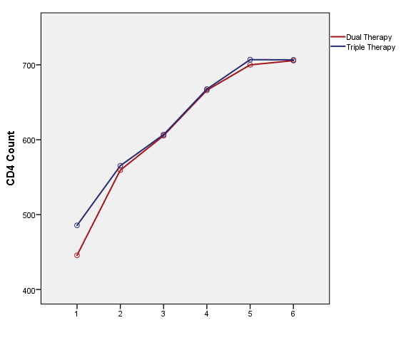
CD4 increase from BSL to W48
+ 238.14 cells/mm³ Triple therapy
+ 275.31 cells/mm³ Dual therapy
p= 0.442
BSL
W4
W12
W24
W36
W48
Notes:
When we compare the immune reconstitution, we can see that the recovery of CD4 cells is greater than two hundred cells, with no differences between study arms .

Slide 9
ANDES: Safety profile
 | Triple Therapy (n=165) | Dual Therapy (n=171) | p-value
Subjects with grade 2-3 Adverse event (possible, probably drug-related), n (%) | 33 (20%) | 20 (12%) | 0.04
SAEs* Possible Drug-related | 2 (2%) | 0 | 0.25
AEs leading to discontinuation (primary reason) | 2 (1%) | 2 (1%) | 1.00
Drug-related (≥1% ppts. in either arm, > or = grade 2 )
Rash | 9 (5%) | 11 (6%) | 0.70
Diarrhea | 8 (5%) | 2 (1%) | 0.06
Abdominal pain/ epigastralgia | 9 (5%) | 2 (1%) | 0.03
Headache | 2 (1%) | 1 (1%) | 0.62
Drowsiness | 1 (1%) | 1 (1%) | 1.00
* lipase increase G4
Notes:
In relation to safety profile, we considerer in the analysis the adverse events of grade two or higher related to study treatment. As you can see, there were twenty percent of subjects with AE in TT and twelve percent in DT.
Only a few AEs grade two or higher were reported in more than 1% , being rash the most frequent in both arms , followed by diarrhea and abdominal pain, both more frequent in the triple therapy arm. AEs leading to discontinuation were unusual and similar between arms. Although twenty serious adverse events occurred during the study, only two had a possible relation with the study treatments.

Slide 10
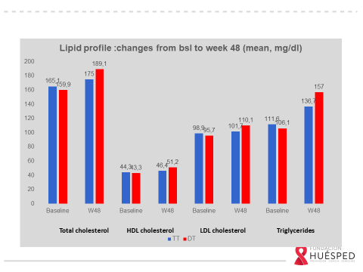
Safety: Laboratory Abnormalities/lipid profile
 |  | Triple Therapy (n=165) |  | Dual Therapy (n=171)
grade 2-4 laboratory abnormalities
AST/ALT | 14 (8%) |  | 5 (3%)
LDL-cholesterol | 17 (10%) |  | 21 (12%)
Total cholesterol | 16 (10%) |  | 28 (16%)
Triglycerides | 18 (11%) |  | 20 (12%)
Creatinine | 2 (1%) |  | 0
Hemoglobin | 1 (1%) |  | 1 (1%)
P-value
0.01*
0.01*
0.01*
0.05**
*p < 0.01 **p<0.05 (T-test).
Notes:
Regarding lab abnormalities, no significant differences were found. Comparing laboratory values changes between baseline and week 48, we only found differences in the lipid profile, with total cholesterol and LDL-cholesterol being higher in the dual therapy arm; however, these changes did not exceed normal values.

Slide 11
ANDES: conclusions
A generic FDC of DRV/r plus 3TC showed non-inferiority to a standard of care TT regimen with ritonavir-boosted Darunavir in FDC plus TDF/3TC at 48 in both ITT and per-protocol populations.
Virologic failure was observed at low levels in both treatment arms.
The DT strategy was safe and well tolerated.
These results support DRV/r+3TC regimen as a potential therapeutic option for ARV naïve subjects, at least for patients with plasma viral load below 100,000 copies/mL.
Notes:
11
In conclusion this fixed dose combination of boosted darunavir plus 3TC compared with a standard of care treatment showed non-inferiority in both ITT and per-protocol analysis. Virologic failure was observed at low levels in both treatment arms. This Dual therapy regimen was safe and well tolerated.
Based on these results we considered that this strategy could be a potential therapeutic option for ARV naïve subjects, at least with plasma viral load below 100,000 copies/mL

Slide 12
Acknowledgments
All study participants and their families
The ANDES clinical investigators and their staff
UEM and Fundación Huésped team (regulatory area, data management, statician and quality team, study coordinator, )
Richmond Pharma
Ministry of Science and Technology
Investigators:
Pedro Cahn, Fundación Huésped
Diego Cecchini, Hospital Cosme Argerich
Daniel Pryluka, Consultorio Infectológico
Marisa Sánchez, Hospital Italiano
Gustavo Lopardo, Centro de Estudios Infectológicos SA (CTD Stamboulian)
Javier Altclas, IPTEI
María José Rolón, Hospital Fernández
Notes:
We would like to thank everyone who has contributed to the success of this study, specially the participants and their families , the clinical investigators and their staff, as well as the great team that supported this study at Fundacion Huesped .

Slide 13
Thank you for your attention!
maria.figueroa@huesped.org.ar

