Slide 1
Survival in advanced AIDS patients treated with efavirenz or dolutegravir in Brazil: a multicenter, observational study
Carlos Brites, MD, PhD – Federal University of Bahia, Salvador, Brazil
OAB-03 - ART in evidence

Slide 2
Conflict of interest disclosure
Research grants: Merck, Janssen, Pfizer, and Glaxo Smith-Kline (GSK)
Advisory board: Merck, Janssen, GSK, and Gilead.
Speaker´s bureau: for Merck, Janssen, GSK, and Gilead.
This work was funded by GSK, through an IIS (Investigator Initiative Study)
The potential effects of relevant financial relationships with ineligible companies have been mitigated. Any clinical recommendations are based on evidence and are free of commercial bias.
https://www.clinicaltrials.gov/ct2/show/NCT01837277?cond=Hiv&cntry=BR&city=Salvador&draw=2&rank=5

Slide 3
Background and rationale
Dolutegravir (DTG) is recommended as a first-line drug for starting cART by most guidelines, regardless disease stage
However, there is scarce information on the effectiveness of INSTI use in patients with advanced AIDS, and its impact on early mortality
Most patients included in clinical trials had a CD4 count > 200 cells/mm³ . In the SINGLE study (DTG vs. EFV) fewer than 10% of patients had CD4<200 cells/m³ [1]
https://www.clinicaltrials.gov/ct2/show/NCT01837277?cond=Hiv&cntry=BR&city=Salvador&draw=2&rank=5
1- Walmsley S, NEJM, 7;369(19):1807-18.

Slide 4
Objectives
To compare the outcomes of patients with advanced AIDS treated with dolutegravir or efavirenz for 48 weeks.
Main outcomes of interest:
Early mortality
Treatment interruption/change
Adverse events
Viral supression rates
Changes in CD4 count

Slide 5
Methods
Study design: prospective cohort, with historical controls (EFV group)
Patients and settings:
184 patients (92 per arm)
5 Brazilian cities (AIDS referral centers)

Slide 6
Methods
Retrospective
Prospective
Drug-naïve patients
CD4 < 50 cells/mm³
Presence of AIDS-defining
condition
3TC+TDF+EFV (2018 - 2021) N=92
3TC+TDF+DTG (2013 - 2016) N=92
Inclusion criteria
Baseline
Week 24
Week 48

Slide 7
Inclusion Criteria and Assessments
Inclusion criteria
Assessments
Confirmed HIV-1 infection
Drug-naïve subjects
CD4<50 cells/mm³
^{Active AIDS-defining condition}
Frequency of treatment interruption/change
Status at 6 and 12 months
Changes in CD4 cells count
Proportion reaching viral suppression (FDA snapshot)
Frequency of adverse events

Slide 8
Characteristics of patients at baseline, by study group
 |  | Group
 |  | DTG |  |  |  | EFV
 |  | n |  |  |  | n
Age (years±SD) |  | 92 | 39.4±4.7 |  | 92 |  | 37.3±35.4
Gender | Male | 63 | 68,5% |  | 59 |  | 64,1%
 | Female | 29 | 31,5% |  | 33 |  | 35,9%
Self reported transmission | Heterosexual | 54 | 58,7% |  | 23 |  | 25,0%
 | MSM | 30 | 32,6% |  | 9 |  | 9,8%
 | Occupational | 0 | 0,0 |  | 1 |  | 1,1%
 | NA | 8 | 8,7% |  | 59 |  | 64,1%
Median CD4(IQR) |  | 92 | 21 (9-34) |  | 92 |  | 20 (12-33)
Median VL (IQR) Log10 copies |  | 92 | 5.5 (5.1-5.9) |  | 92 |  | 5.5 (5.1-5.9)
Ilicit drug use | Yes | 13 | 14,1% |  | 11 |  | 20,0%
 | No | 79 | 85,9% |  | 44 |  | 80,0%
Results

Slide 9
Most frequent AIDS-defining conditions at baseline, by group
 | Group
Clinical condition | DTG N (%) | EFV N (%)
Esophageal candidiasis | 28 (30.8) | 25 (27.5)
Neurotoxoplasmosis | 30 (32.6) | 12 (13.0)
P. jirovecii pneumonia | 21 (22.8) | 14 (15.2)
Bacterial pneumonia | 15 (16.3) | 14 (15.2)
Tuberculosis | 14 (15.2) | 16 (16.7)
Chronic diarrhea | 10 (10.9) | 15 (16.3)
Wasting syndrome | 9 (9.8) | 9 (9.8)
Neurocryptococcosis | 7 (7.6) | 3 (3.3)
Cytomegalovirus infection | 5 (5.4) | 1 (1.1)
Disseminated hystoplasmosis | 5 (5.4) | 3 (3.2)
Malignancies | 4 (4.3) | 2 (2.2)
Disseminated herpes Zoster | 4 (4.3) | 0

Slide 10
Patients oucomes at 48 weeks, according to treatment group
Outcomes | Treatment group |  |  |  |  |  | Total | Total
 | DTG |  |  | EFV | EFV
 | N | % | % | N | N | % | N | N | %
Viral load < 200 copies/mL* | 68 | 73,9 | 73,9 | 44 | 44 | 47,8 | 112 | 112 | 60,9
Viral load <50 copies/mL* | 60 | 65.2 | 65.2 | 42 | 42 | 45.7 | 102 | 102 | 55.4
Deaths | 9 | 9,8 | 9,8 | 12 | 12 | 13,0 | 21 | 21 | 11,4
ART modification* | 1 | 1,1 | 1,1 | 16 | 16 | 17,4 | 17 | 17 | 9,2
Lost to follow-up | 12 | 10,9 | 10,9 | 15 | 15 | 15,2 | 24 | 24 | 13,0
CD4>200 cells/mm³ ** | 41 | 44.6 | 44.6 | 27 | 27 | 29.3 | 68 | 68 | 36.9
 |  | 100,0 |  | 92 |  |  | 184
* p < 0.001, ** p=0.03, Pearson´s Chi-square
Results

Slide 11
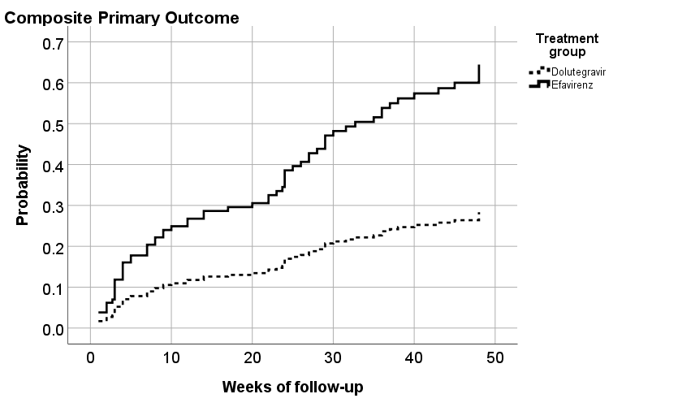
Death and treatment change/interruption
Treatment change/interruption (any cause, p<0.001)
p = 0. 002 in Log-rank (Mantel-Cox) Test
Hazard ratio = 0.44 (95%CI: 0.26 - 0.73)
p = 0.42 in Log-rank (Mantel-Cox) Test
Hazard ratio = 0.70 (95%CI: 0,30 - 1.66)

Slide 12
Early mortality and CD4 changes, by group
25% relative reduction in mortality for
DTG group
In DTG group: 9/92 (9.8%)
In EFV group: 13/92 (13.0%)
Mortality difference: 3.2%
Sensitivity analysis (Mc Nemar change Test) showed a significant change overtime in CD4 count for DTG (p=0.0001), but not for EFV group (92% difference, p=0.64).

Slide 13
Characteristics of patients at baseline by survival status at 48 Wks
 |  | Status of the patient at 48 weeks |  |  | p
 |  | Dead |  | Alive
Gender | Male - n (%) | 27 (22.1) |  | 95 (77.8) | 0.04
 | Female - n (%) | 6 (9.7) |  | 56 (90.3)
Age in years - Median (IQR) |  | 37.1 (31.4-44.6) |  | 36.7 (31.3-43.0) | 0.43
HIV viral load*, - Median (IQR) |  | 5.6 (4.8-5.7) |  | 5.58 (5.1-6.0) | 0.59
CD4* - Median (IQR) |  | 20.0 (11.0-38.0) |  | 21.0 (10.0-32.0) | 0.65
 | Male - Median (IQR) | 20.0 (9.0-39.0) |  | 21.0 (10.0-33.0) | 0.96
 | Female - Median (IQR) | 25.5 (17.0-37.0) |  | 19.5 (9.0-31.5) | 0.33
CD8* - Median (IQR) |  | 316.0 (205.0-560.0) |  | 357.0 (227.0-594.0) | 0.65
Hemoglobin* - Median (IQR) |  | 11.4 (9.3-12.6) |  | 10.2 (8.7-12.0) | 0.09
Hematocrit* - Median (IQR) |  | 34.2 (27.9-37.7) |  | 30.80 (26.3-36.5) | 0.12
* - log10; p - chi-Square for gender and Mann-Whitney U Test for the remaining variables

Slide 14
Causes of death, by group
Causes of death | DTG N (%) | EFV N (%) | Total (%)
Sepsis | 3 (33.3) | 5 (41.7) | 8 (38.1)
Neurotoxoplasmosis | 4 (44.4) | 1 (8.3) | 5 (23.8)
P. jirovecii pneumonia | 1 (11.1) | 0 | 1 (4.8)
Disseminated strongyloidiasis | 1 (11.1) | 0 | 1 (4.8)
Central nervous system lymphoma | 0 | 1 (8.3) | 1 (4.8)
Metastatic anal cancer | 0 | 1 (8.3) | 1 (4.8)
Disseminated hystoplasmosis | 0 | 1 (8.3) | 1 (4.8)
Disseminated Tb | 0 | 1 (8.3) | 1 (4.8)
Neurosyphilis | 0 | 1 (8.3) | 1 (4.8)
Neurotuberculosis | 0 | 1 (8.3) | 1 (4.8)
Anaphylactic shock | 0 | 1 (8.3) | 1 (4.8)
Total | 9 (9.8) | 12 (13.0) | 21 (11.4)

Slide 15
Individual deaths by treatment group and duration of follow up
Mean time from baseline to death: DTG (66.1±62.4 days);
EFV (63.5±55.9 days, p=0.9)

Slide 16
CONCLUSIONS
The use of DTG for treatment of advanced AIDS patients was significantly associated with:
Higher rates of viral suppression at 24 and 48 Wks;
Less treatment interruptions/changes due to AE
Higher proportion of patients reaching a CD4+
count >200 cells/mm³ at 48 Wks
25% Lower mortality
DTG is an effective drug for treatment of patients with advanced AIDS

