Slide 1
Back up slides
-Resistance mutations
-Pregnancy outcomes
-Weight outcomes: BMI
-Quality of life
-Attrition

Slide 2
Resistances, Mutations & Viral Failures
 | Data, n (%)
 | DTG (n=310) | EFV400 (n=303) | Total (n=613)
Primary drug resistance at BL | 37 (12) | 38 (13) | 75 (12)
To EFV | 20 (6) | 17 (6) | 37 (6)
 | Data n
 | Week 48 |  |  |  | Week 96 |  |  |  | Week 192
 | DTG (n=310) | EFV400 (n=303) | Total (n=613) |  | DTG (n=310) | EFV400 (n=303) | Total (n=613) |  | DTG (n=310) | EFV400 (n=303) | Total (n=613)
Resistances and Confirmed Viral Failure | 0 (0) | 15 (5)* | 15 (2) |  | 3 (1)** | 3 (1) | 6 (1) |  | 0 (0) | 0 (0) | 0 (0)
Primary drug resistance from BL to endpoint | 0 | 6 | 7 |  | 3** | 0 | 3 |  | 0 | 0 | 0
To EFV | 0 | 5 | 5 |  | 0 | 0 | 3 |  | 0 | 0 | 0
To 3TC/EFV | 0 | 0 | 0 |  | 3** | 0 | 3 |  | 0 | 0 | 0
To EFV/3TC/TDFn | 0 | 1 | 1 |  | 0 | 0 | 0 |  | 0 | 0 | 0
Acquired drug resistance at endpoint | 0 | 8 | 8 |  | 0 | 3 | 3 |  | 0 | 0 | 0
To EFV | 0 | 2 | 2 |  | 0 | 2 | 3 |  | 0 | 0 | 0
To 3TC/EFV | 0 | 4 | 4 |  | 0 | 0 | 1 |  | 0 | 0 | 0
To EFV/3TC/TDFn | 0 | 2 | 2 |  | 0 | 1 | 1 |  | 0 | 0 | 0
Virological failure: no primary drug resistance and non-acquired drug resistance | 0 | 1 | 1 |  | 2 | 0 | 2 |  | 0 | 0 | 0
Five (DTG: 2; EFV400: 3) new virological failures (WHO-definition) without related resistance mutations (NNRTI+/-NRTI)
BL: baseline, * 1 Resistance **Switch EFV600 : 1 pregnancy, 2 WHO DTG signal 2018
7/14

Slide 3
Pregnancy outcomes
 | Overall, n |  |  |  | Incidence, n
 |  |  |  |  | Week 192
 | DTG (n=310) | EFV400 (n=303) | Total (n=613) |  | DTG (n=310) | EFV400 (n=303) | Total (n=613)
Women at Baseline† | 197 | 207 | 404 |  | 197 | 207 | 404
Pregnancies | 53 | 67 | 120 |  | 18 | 21 | 39
Before exposure† | 0 | 1 | 1 |  | 0 | 0 | 0
Treatment per randomisation | 34 | 34 | 68 |  | 0 | 0 | 0
Treatment per conception* | 4 | NA | 4 |  | 0 | NA | 0
Births¶ | 26 | 35 | 61 |  | 10 | 13 | 23
Abortions | 5 | 8 | 13 |  | 0 | 1 | 1
Miscarriages | 10 | 11 | 21 |  | 3 | 2 | 5
Interruptions | 4 | 0 | 4 |  | 1 | 0 | 1
Stillbirths** | 0 | 2 | 2 |  | 0 | 0 | 0
†404 women were exposed to antiretroviral therapy. *1 Switch to EFV600 due to WHO-DTG alert. **One single case of early stillbirth (26 weeks in utero). ¶No HIV mother-to-child transmission cases. No preterm birth mortality rate

Slide 4
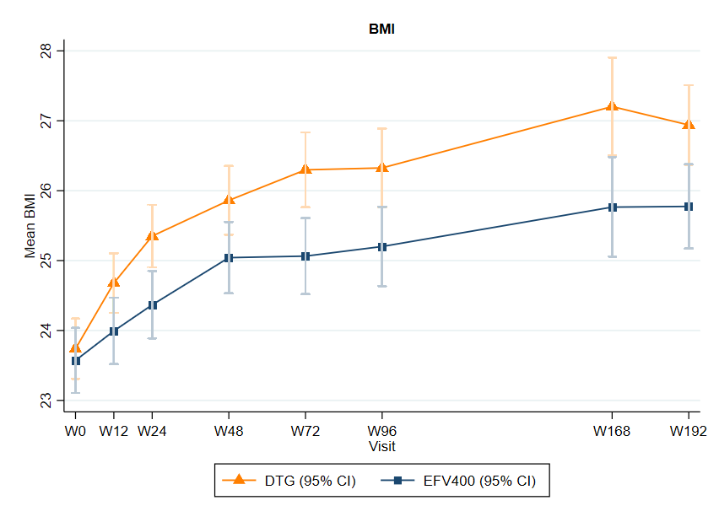
Weight outcomes (1/2)
Overall,
a +2.7 point increase in BMI between baseline mean (SD)
- BMI = 23.7 (4.0)
and Week 192 mean (SD)
BMI = 26.4 (4.6)
But… a significantly larger increase in BMI on DTG group versus EFV400 group, observed from Week 24, which persisted and even increased until Week 192

Slide 5
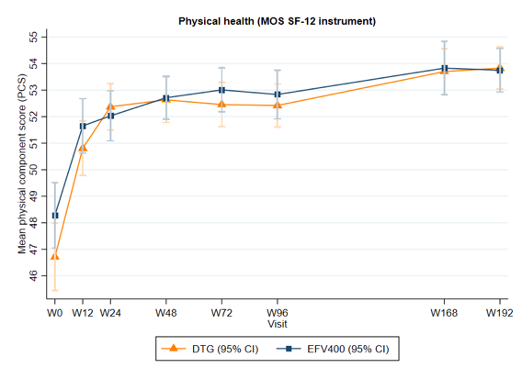
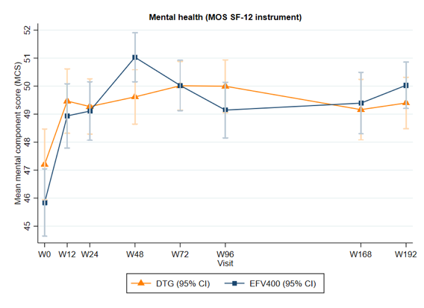
Quality of life
Patients' physical (PCS) and mental (MCS) health-related quality of life improved significantly in both treatment groups
There was no significant difference between arms at Week 192

