Slide 1




Dolutegravir versus efavirenz-400 as first-line ART in Cameroon: week 192 data of NAMSAL trial
Mireille MPOUDI- ETAME – First Region Military Hospital of Yaoundé, Cameroon
ART in evidence (OAB03)

Slide 2
Conflict of interest disclosure
I have no relevant financial relationships with ineligible companies to disclose.

Slide 3
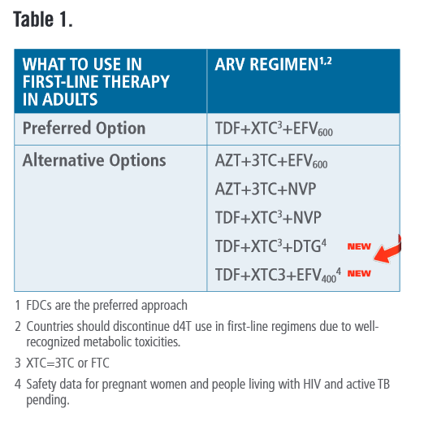
Background
WHO guidelines 2015
Efavirenz (EFV) low dose(400 mg)
  Adaptation of the current preferred regime (EFV 600 > EFV 400)
  Dosage reduction to reduce side effects
Dolutegravir 50 mg (DTG)
  Promising safe, effective and well-tolerated alternative
  Low risk of resistance
« These two options are not recommended as preferred due to their limited use outside of clinical trials [conducted in high-income countries and in men with low viral loads] and the unknown safety and efficacy of DTG and EFV 400mg in pregnancy and for people living with HIV and TB using rifampin »
WHO. Consolidated guidelines on the use of antiretroviral drugs for treating and preventing HIV infection: what’s new.
2015 available from : http://www.who.int/hiv/pub/arv/policy-brief-arv-2015/en/

Slide 4
Main objective and study design
Screening
Primary endpoint
HIV RNA < 50 cp/ml at Wk 48
FDA snapshot analysis in ITT; non-inferiority margin 10%
Superiority test planned if non inferiority demonstrated
n=610
participants
HIV-1
Age ≥ 18 years
ARV naïve
VL> 1000 cp/mL
DTG 50mg + TDF/3TC
W48
W96
W192
Randomisation 1:1
EFV 400mg + TDF/3TC
First inclusion
Stratified by HIV RNA ≤ vs > 100,000 cp/ml
Last inclusion
W48
W96
W192
3 investigation sites
in Yaoundé, Cameroon
June 2016
July 2021
Clinical trial
2 years
Post-trial – Prospective cohort
2 years
Evaluation of the efficacy and safety of DTG and EFV400
First at 48 weeks
Secondly at 96 weeks
Then long-term (week 192), current analysis

Slide 5
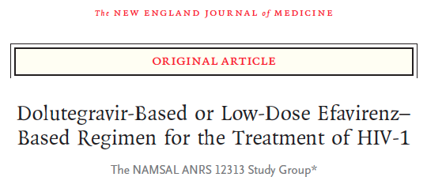
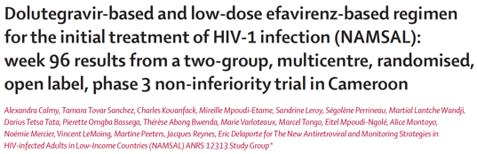
Key results at 48 and 96 weeks of follow up
W96: 48-week efficacy results confirmed
Proportion HIV RNA < 50 cp/ml:
DTG : 74% vs EFV400: 72%
Treatment difference: 1.6% [–5.4 - 8.6]
Virologic suppression among patients with
initial High VL >100 000 copies/mL
DTG arm: 71%; EFV400 arm: 68%
Weight gain +++
Weight gain greater on DTG regimen. Median gain in DTG arm: 5.0Kg vs EFV400 arm: 3.0Kg; p<0·001
Obesity Incidence: DTG:22% vs EFV400:16%; p=0.043
W48: DTG non-inferior to EFV 400
Proportion HIV RNA < 50 cp/ml:
DTG : 74.5% vs EFV400 : 69.0%
Treatment difference: 5.5% [-1.6, – 12.7]
Virologic suppression among patients with
Initial VL >100 000 copies/mL:
DTG arm: 66% vs EFV400 arm: 62%
Kouanfack et al. for the NAMSAL ANRS 12313 Study Group - NEJM 2019
Calmy et al. - The Lancet HIV 2020

Slide 6
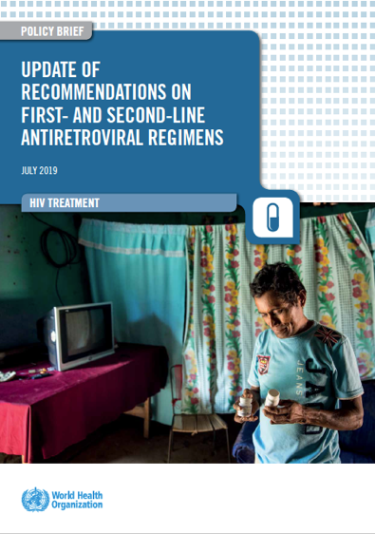

Impact
DTG 1st line and
EFV400 as an alternative
Notes:
c

Slide 7
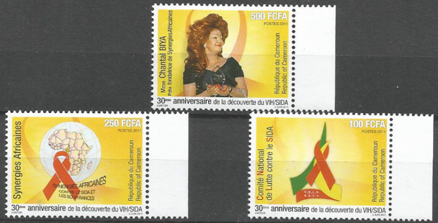
192-week outcomes

Slide 8
Flow diagram of NAMSAL participants at 192 weeks
Screening
n=820
Non-eligible
n=204
Randomisation
n=616
DTG group, n=310
ITT analysis, n=310
EFV400 group, n=306
3 have never received ARV
ITT analysis, n=303
Deaths, n=12
Withdrawals, n=9
Lost to follow-up, n=28
Transfers, n=3
Deaths, n=17
Withdrawals , n=16
Lost to follow-up, n=33
Transfers, n=2
Interruptions, n=25
Treatment errors, n=2
Treatment delay, n= 1
EFV600 switched, n=52
(WHO DTG-signal)
Follow-up at week 192, n=261
On randomised group, n=233
Follow-up at week 192, n= 235
On randomised group, n= 271
Interruptions, n= 23
Treatment delay, n=1
Résistance n=8

Slide 9
Virologic response over time (1/2)
75
74
74
69
Wk 192: Higher proportion of viral suppression on DTG arm :
DTG: 69% vs EFV400: 61.7%
Adjusted treatment difference* :
7.3% [-0.2, 14.8]
DTG non-inferior to EFV400
69
69
72
65
67
62
HIV RNA <50cp/ml n (%) | DTG | EFV | Difference, % (95%CI)
 | 214 (69.0) | 187 (61.7) | 7.3 [-0.2, 14.8]
*Adjusted for baseline HIV RNA

Slide 10
Virologic response over time (2/2)
Participants with initial high viral-load (HVL) (VL>100,000 copies/mL)
Treatment difference was 12.7%
DTG 66.7% vs EFV 54.0%, 95%CI [3.2, 22.1]
had impaired viral suppression
(HVL=64% vs no-HVL=87%)
Those on DTG achieved suppression faster
W48: among participants with HVL: 66% on DTG and 62% on EFV had viral suppression.
Participants with VL<100,000 copies/mL On EFV400, had less durable viral suppression: W48=84% ; W192=77%

Slide 11
Safety outcomes
 | Overall [n (%)] |  |  |  | Week 192 [n (%)] incidence
 | DTG | EFV400 | Total |  | DTG | EFV400 | Total
 | (n=310) | (n=303) | (n=613) |  | (n=310) | (n=303) | (n=613)
WHO clinical stage | 16 (5) | 18(6) | 34 (6) |  | 0 (0) | 1 (0) | 1 (0)
SAE (≥1) | 34(11) | 25(8) | 59 (10)* |  | 13 (4) | 11 (4) | 24 (4)
Tuberculosis | 14 (5) | 17 (6) | 31 (5) |  | 0 (0) | 0 (0) | 0 (0)
Deaths | 12 (4) | 17 (6) | 29 (5) |  | 3 (1) | 5 (2) | 8 (1)
Women at Baseline† | 197 | 207 | 404 |  | 197 | 207 | 404
Pregnancies | 53 (17) | 67 (22) | 120 (20) |  | 18 (6) | 21 (7) | 39 (6)
Births¶ | 26 (8) | 35 (12) | 61 (10) |  | 10 (3) | 13 (4) | 23 (4)
Abortions | 5 (2) | 8 (3) | 13 (2) |  | 0 (0) | 1 (0) | 1 (0)
Miscarriages | 10 (3) | 11 (4) | 21 (3) |  | 3 (1) | 2 (1) | 5 (1)
Interruptions | 4 (1) | 0 (0) | 4 (1) |  | 1 (0) | 0 (0) | 1 (0)
Stillbirths** | 0 (0) | 2 (1) | 2 (0) |  | 0 (0) | 0 (0) | 0 (0)
†404 women were exposed to antiretroviral therapy. *1 Switch to EFV600 due to WHO-DTG alert. **One single case of early stillbirth (26 weeks in utero). ¶No HIV mother-to-child transmission cases. No preterm birth mortality rate
8/14

Slide 12
Weight outcomes (1/2)
Overall, significant median weight gain at Week 192, higher in DTG group
DTG: +7.0 (+3.0; +13.0); EFV400: +5.0 (0.0; +10.0); p<0.001
Weight gain was higher among women
68 (42.8%) of women on DTG had Weight gain >15%, compared to 49 (31.0%) on EFV400; p=0.030
10/14

Slide 13
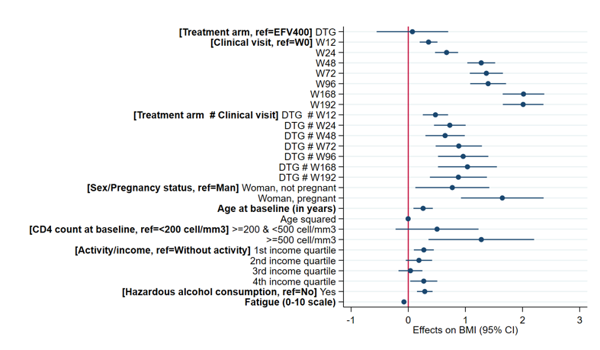
Weight outcomes (2/2)
Overall, a +2.7 point increase in mean BMI between baseline and W192
From 23.7 (4.0) to 26.4 (4.6)]
-Significant positive effect of time from baseline, in both groups:
+2.0 [1.7 – 2.4] BMI points on average between BL and Week 192
-Additional significant effect of DTG on weight gain compared to EFV.
-At Week 192, adjusted difference in BMI gain was +0.9 [0.4 – 1.4] BMI point in favor of DTG versus EFV400
ref=EFV

Slide 14
Conclusion
Overall, both DTG-based and low dose EFV-based regimens have durable safety for use in treatment-naïve patients with HIV-1, with DTG showing higher viral suppression than EFV in the long term, especially among patients with baseline high VL
Participants with VL>100,000 copies/mL on EFV400 had less durable viral suppression.
Weight gain was considerable and steady through years among DTG participants, particularly among women.

Slide 15
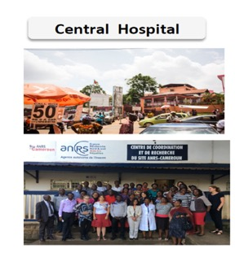
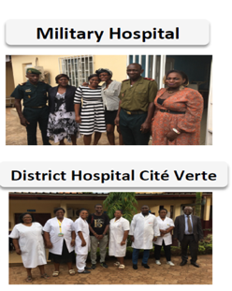














Acknowledgements
The 613 participants
Late (R) Colonel Dr Eitel Mpoudi Ngole

