Slide 1

Session: ART in evidence
Efficacy and safety of dolutegravir plus emtricitabine vs combined antiretroviral therapy for the maintenance of viral suppression:
144-week results of the SIMPL’HIV trial (RCT)
Presented by Annalisa Marinosci¹ on behalf of
Delphine Sculier, Gilles Wandeler, Marcel Stoeckle, Enos Bernasconi, Dominique Braun, Pietro Vernazza, Matthias Cavassini, Marta Buzzi, Karin Metzner, Laurent Decosterd, Huldrych Günthard, Patrick Schmid, Sabine Yerly, Andreas Limacher, Matthias Egger, Alexandra Calmy

Slide 2
Conflict of interest disclosure
I have no relevant financial relationships with ineligible companies to disclose.
The SIMPL’HIV trial was solely funded by academic support.

Slide 3
Background
Dual therapy regimens have become an appropriate alternative to standard combination antiretroviral therapy (cART) to reduce toxicity and costs and improve tolerability, adherence and quality of life.
Both EACS guidelines and the FDA approved dual therapy for both naive and experienced patients based on industry-sponsored registrational trials.^{1,2}
In SIMPL’HIV, switching to dolutegravir (DTG) plus emtricitabine (FTC) was non-inferior to continuing cART, with 91% of participants having HIV-RNA <50 copies/mL (snapshot) in both groups at week 48.
¹ P Cahn et al, Lancet 2019
² J Van Wyk et al, CID 2020

Slide 4
Study objectives
1. To assess the efficacy of DTG-based maintenance therapy in virologically suppressed people living with HIV randomly switched from standard cART to DTG+FTC dual therapy
2. To assess the costs of a simplified, patient-centered monitoring (PCM) compared to standard monitoring (SM)
We present here the long-term (144-week) efficacy and safety results of the SIMPL’HIV trial

Slide 5
Study design
Random allocation
1:1:1:1
Study
interventions
Screening
Participant selection
Post-study
observation
DTG+FTC / SM (N=45)
Therapy and monitoring strategies continued at patient and physician discretion
Adults, virologically suppressed
(HIV-1 RNA < 50cp/ml for ≥ 24 weeks)
On standard cART regimen
DTG+FTC / PCM (N=48)
cART / SM (N=47)
cART / PCM (N=47)
Main exclusion criteria
Known InSTI resistance
Previous ART change due to an unsatisfactory virological response (M184V mutation accepted)
Creatinine clearance <50 ml/min
Transaminase elevation > 2.5 ULN
Pregnant or breastfeeding women
HBV infection
DAY
0
WEEK
6
WEEK
12
WEEK
24
WEEK
36
WEEK
48
WEEK
96
WEEK
144

Slide 6
Study design
Screening
Participant selection
Random allocation
1:1:1:1
Study
interventions
Post-study
observation
DTG+FTC/SM (N=45)
Therapy and monitoring strategies continued at patient and physician discretion
Adults, virologically suppressed
(HIV-1 RNA < 50cp/ml for ≥ 24 weeks)
On standard cART regimen
DTG+FTC/PCM (N=48)
cART/SM (N=47)
cART/PCM (N=47)
DAY
0
WEEK
6
WEEK
12
WEEK
24
WEEK
36
WEEK
48
WEEK
96
WEEK
144
Main methodological aspects
Non-inferiority study
Non-inferiority margin 12%
ITT population
Efficacy and safety endpoints of the post-study:
% of patients maintaining HIV-RNA <100 cp/mL in ITT population
% of patients with HIV-RNA <50 cp/ml at week 144 (snapshot)
Safety outcomes: change from baseline in lipids, renal biomarkers and weight
Change from baseline in quality of life (QoL)

Slide 7
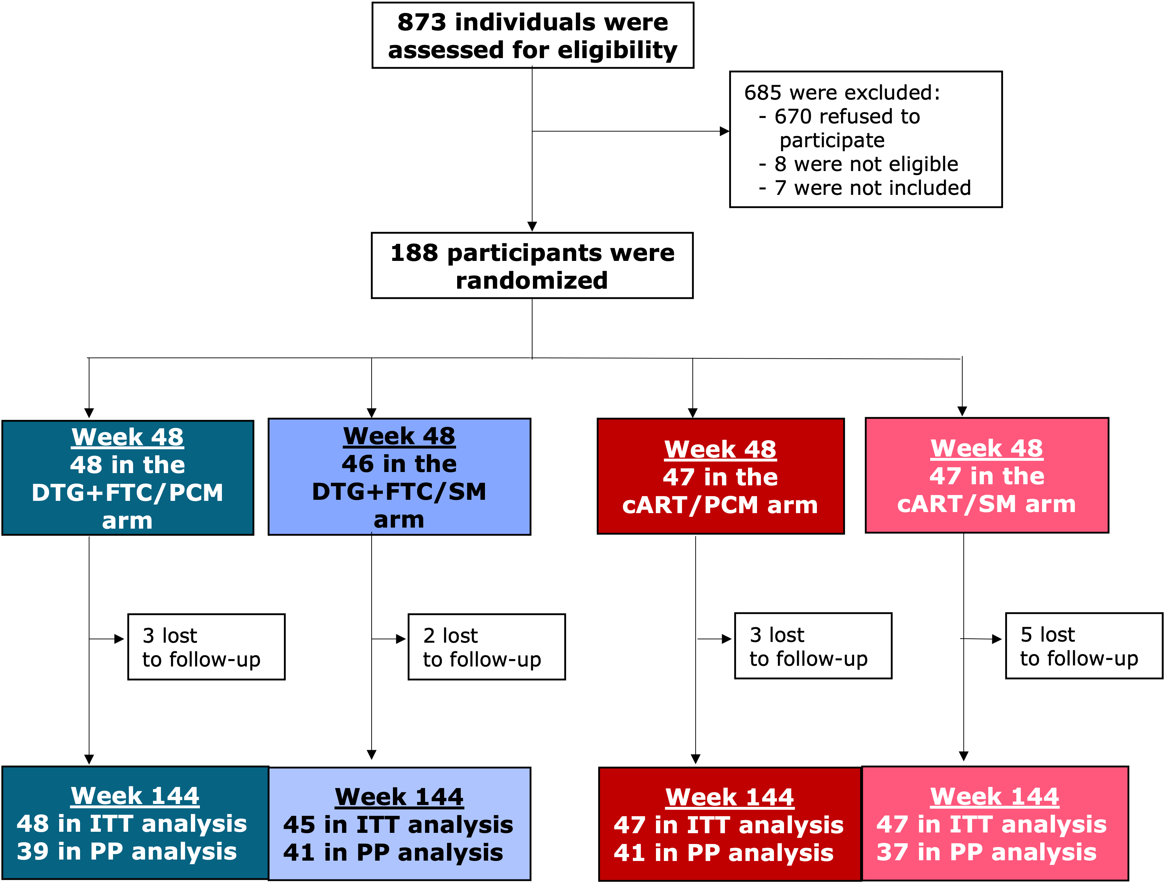
Study flowchart (w48, w144)

Slide 8
Baseline characteristics
 | DTG+FTC (n=93) | cART (n=94)
Age (years), median [IQR] | 48 [40-53] | 47 [42-54]
Female, n (%) | 14 (15) | 18 (19)
Origin
Caucasian, n (%) | 73 (78) | 75 (80)
Asian, n (%) | 2 (2.2) | 3 (3.2)
Black, n (%) | 12 (13) | 12 (13)
Time since ART initiation (years), median [IQR] | 7.9 [4.1-12] | 7.1 [3.8-13]
CD4 baseline (cells/mm³), median [IQR] | 664 [515-898] | 686 [497-847]
Viral load zenith (cp/ml), median [IQR] | 109,757 [41,200-326,000] | 100,000 [31,000-303,000]
Body mass index (kg/m²), median [IQR] | 25 [23-26] | 25 [23-27]
cART at inclusion:
2 NRTI + InSTI, n (%) | 59 (63) | 62 (66)
2 NRTI + 1 NNRTI, n (%) | 27 (29) | 24 (25.5)
2 NRTI + 1 boosted PI, n (%) | 5 (5.4) | 6 (6.4)
Other, n (%) | 2 (2.2) | 2 (2.1)

Slide 9
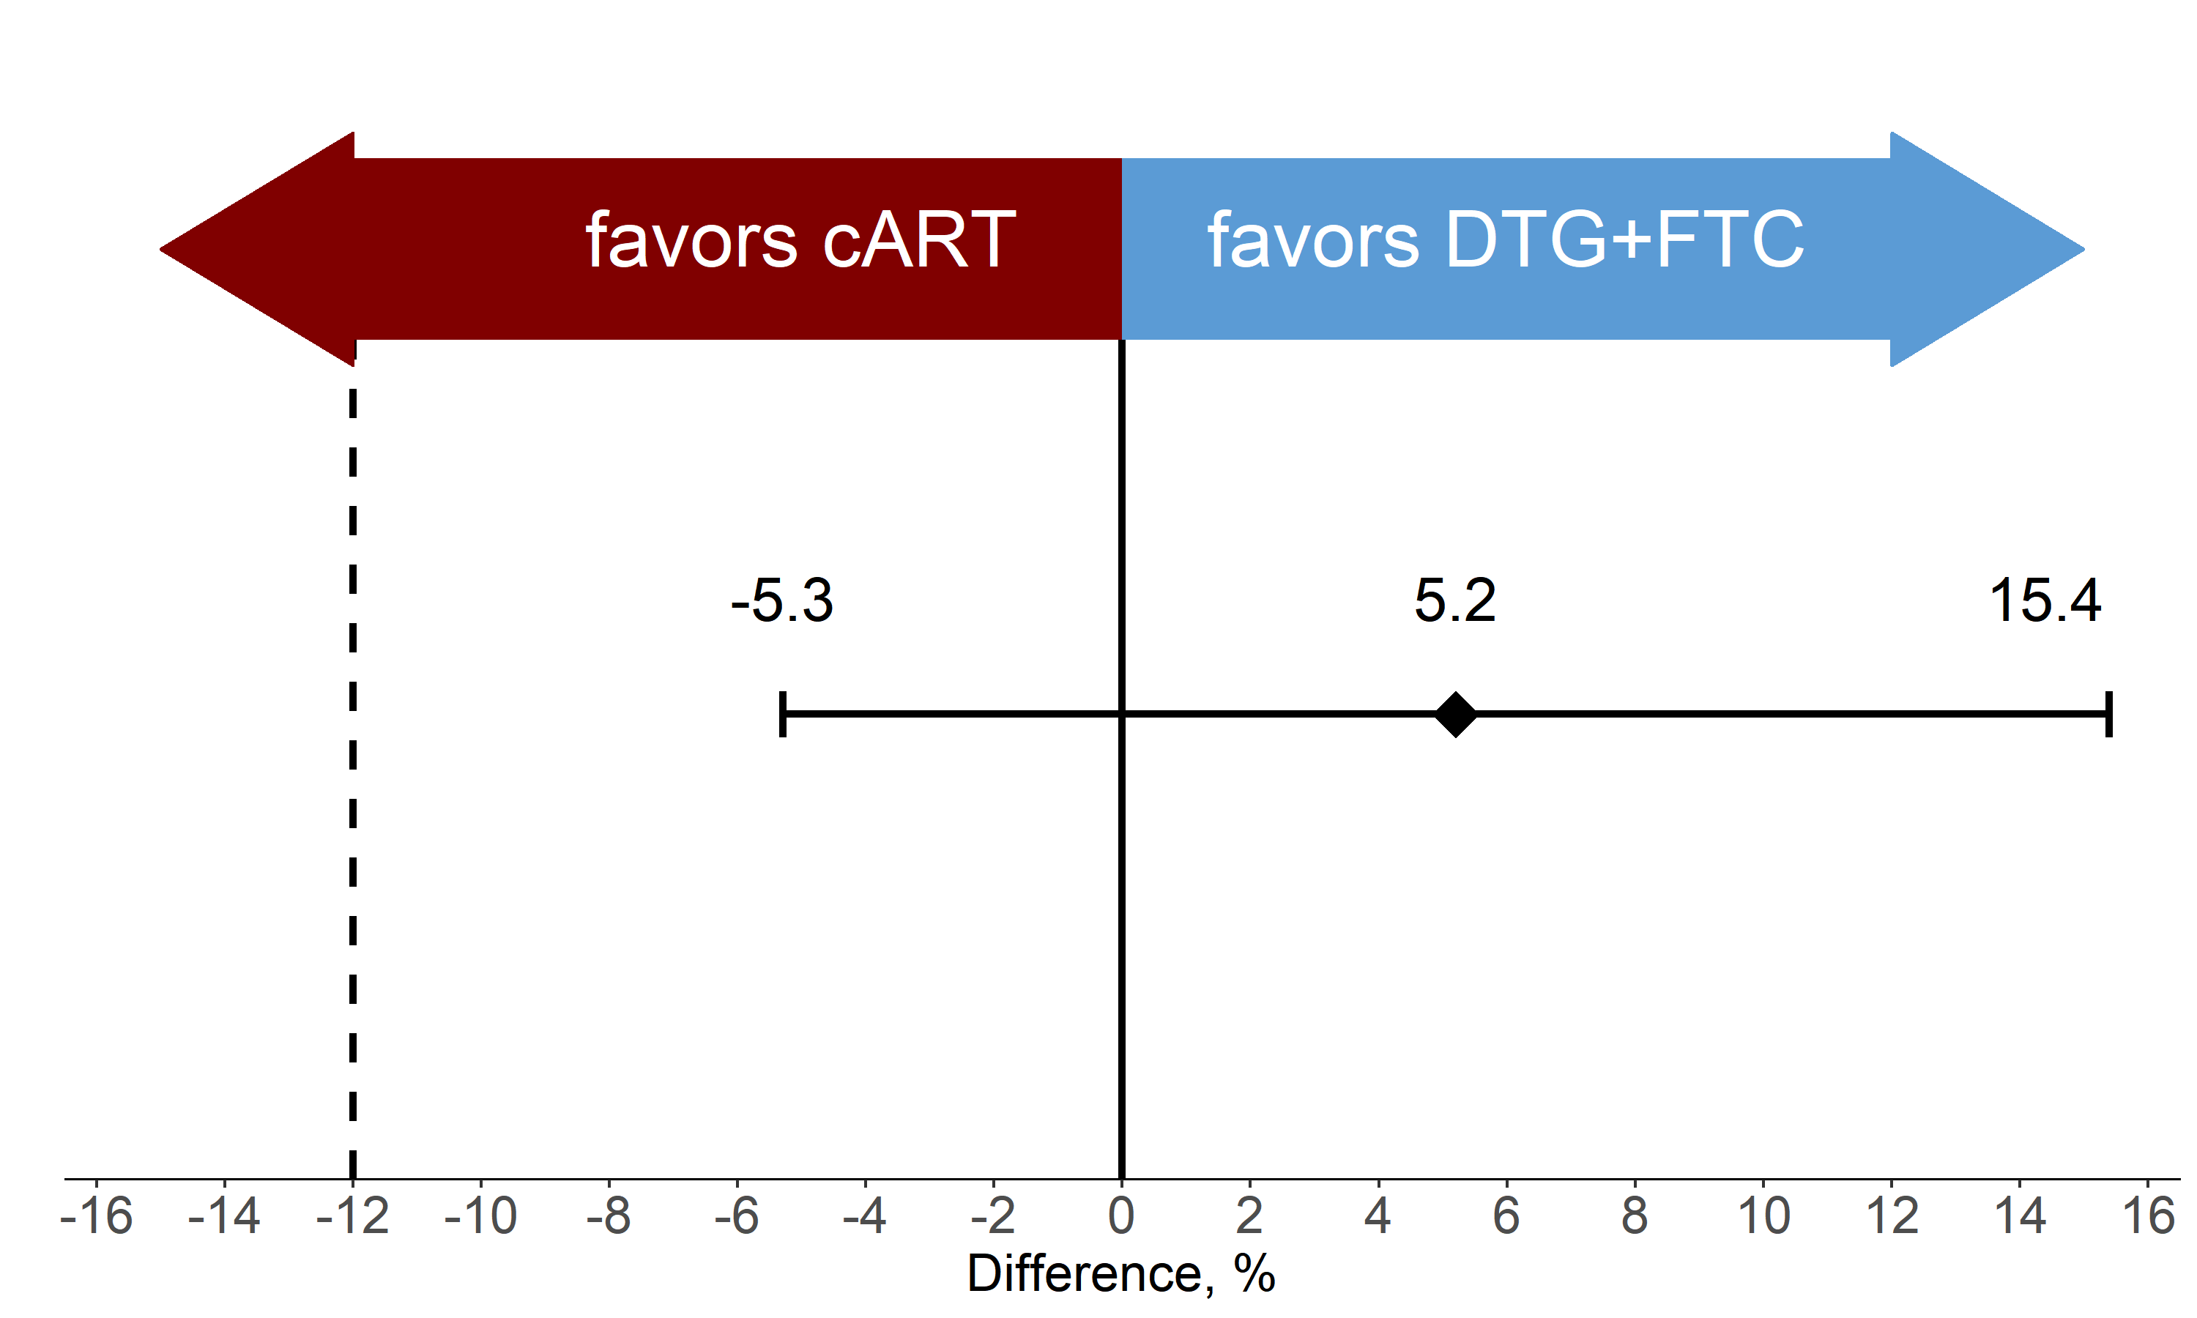
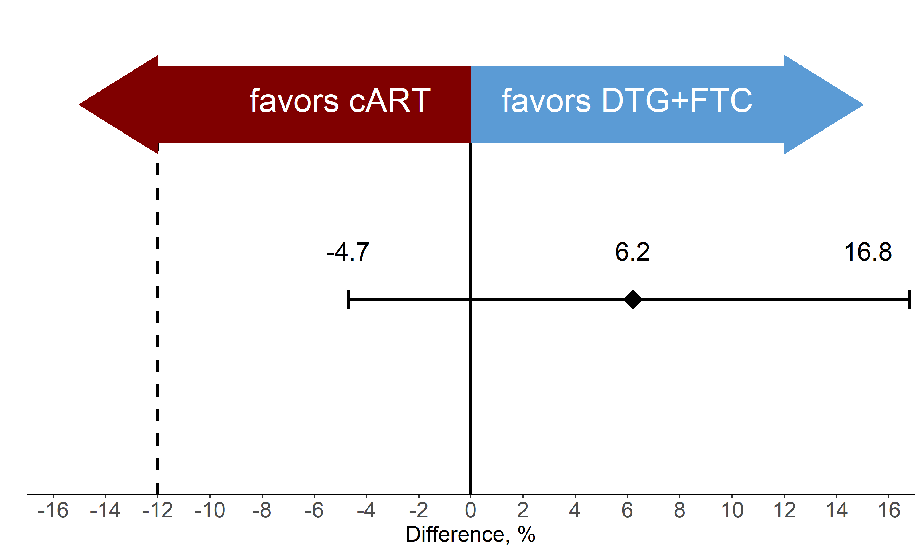
Efficacy outcomes:
HIV-RNA below threshold through 144 weeks
  ITT-population
  HIV-RNA<100 cp/ml throughout 144 weeks
  ITT-population
  HIV-RNA<50 cp/ml at week 144
<50
<100
Mantel-Haenszel risk difference (DTG+FTC – cART) stratified according to the monitoring type with corresponding two-sided 95% CIs

Slide 10
FDA snapshot outcome
HIV-RNA <50 copies at week 144

Slide 11
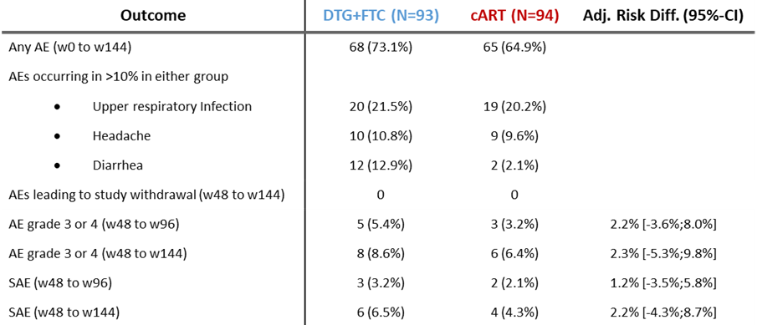
Safety data (1)
AE: adverse event, SAE: serious adverse event

Slide 12
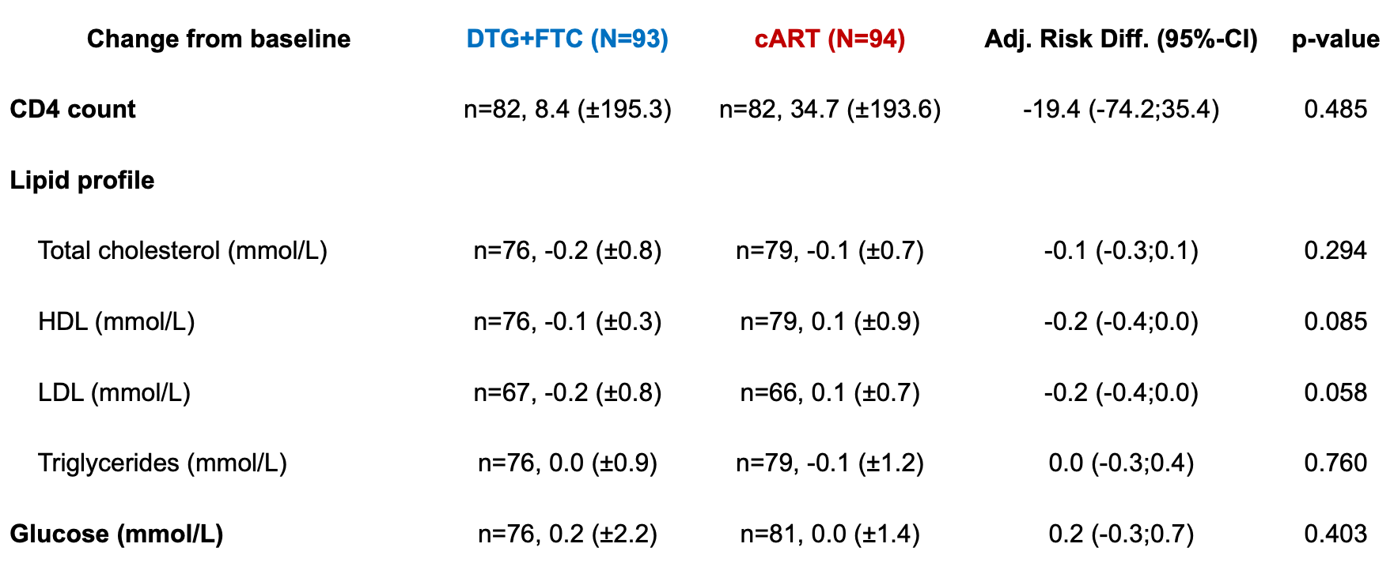
Safety data (2)
LDL: low-density lipoprotein
HDL: high-density lipoprotein

Slide 13
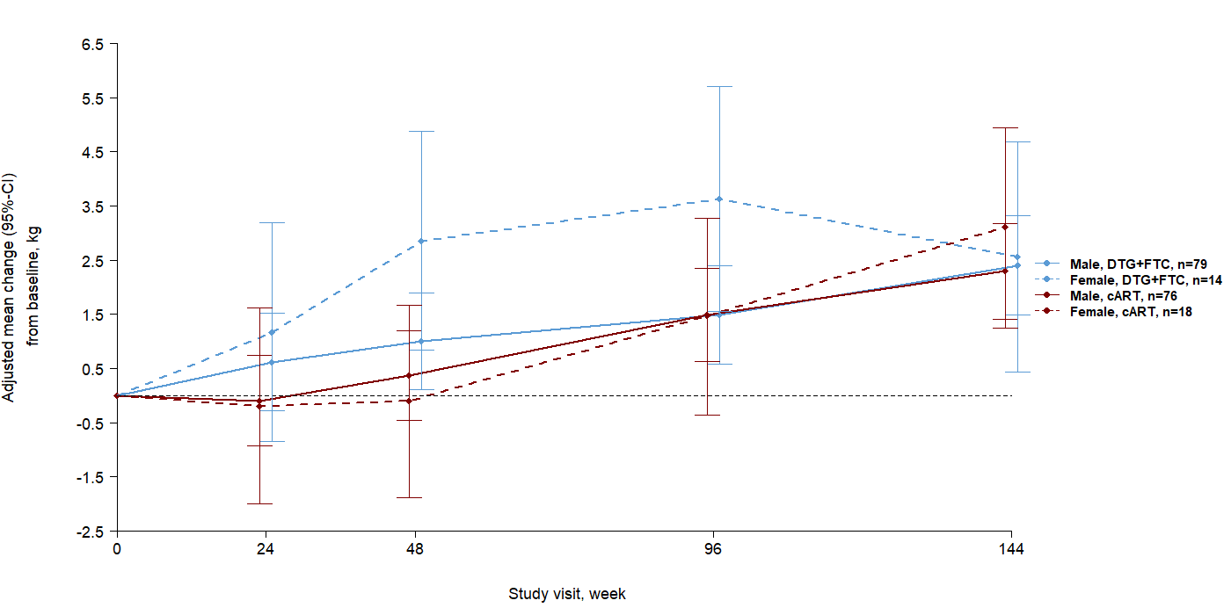
Weight gain over 144 weeks
Adjusted mean change from baseline

Slide 14
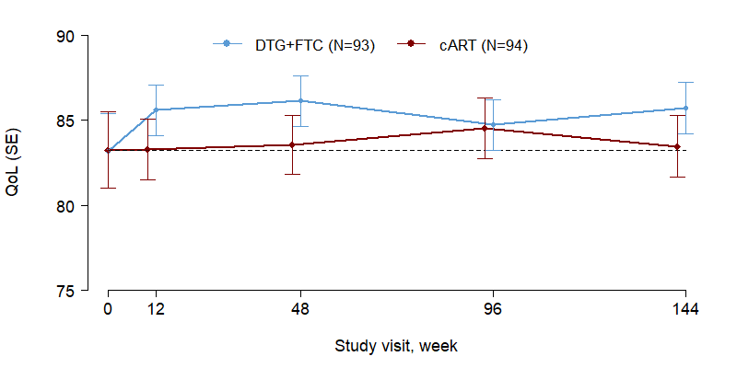
Quality of life (QoL)
85%
83%

Slide 15
Take home message
Switching to DTG+FTC was non-inferior to cART in virologically suppressed adults in a nationwide RCT over 3 years of follow-up. No new safety signals were observed, with similar rates of adverse events between treatment groups.
Quality of life remained excellent in both groups.
No relevant difference in weight change from baseline.
DTG+FTC is safe and effective in the maintenance of
viral suppression in adults living with HIV-1
Notes:
prise de poids continue à mentionner

Slide 16
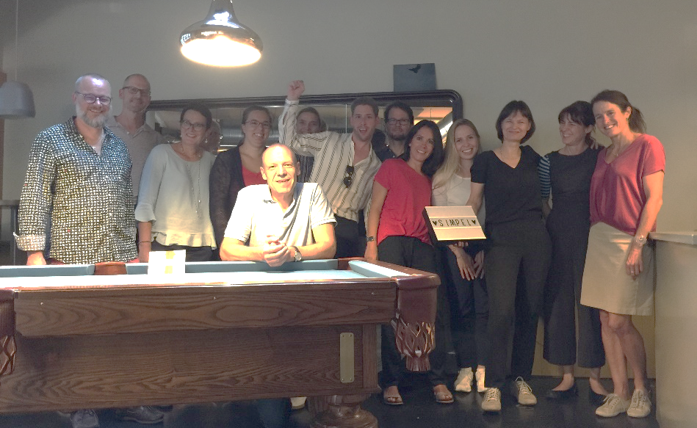


Acknowledgments
Study participants
Swiss HIV Cohort Study
Swiss National Science Foundation (SNSF)
Bern CTU
Study sites
Geneva
Annalisa Marinosci
Marta Buzzi
Tamara Da Silva
Alice Pannerec
Charlotte Barbieux
Christelle Martin
Yvan Gosmain
Sabine Yerly
Rosemary Sudan
Jocelyne Chabert
Zurich
Dominique Braun
Huldrych Gunthard
Jan Fehr
Christine Schneider
Christina Grube
Jürg Boni
Karin Metzner
Bern
Gilles Wandeler
Matthias Egger
Manuela Manz
Daniela Hirter
Christine Bruelisauer
Pia Scherler
CTU Bern
Sven Trelle
Andreas Limacher
Mattia Branca
Matthias Egger
Felix Rintelen
St Gallen
Patrick Schmid
Pietro Vernazza
Simone Kessler
Cornelia Knapp
Lausanne
Matthias Cavassini
Laurent Decosterd
Valérie Narbel
Dominique Niksch
Lugano
Enos Bernasconi
Beatrice Bernasconi
Marina Russotti
Gladys Martinetti
Basel
Marcel Stoeckle
Louise Jayne Seiler
Rebekka Plattner

