Slide 1
Temsavir Treatment of HIV-1-Infected Cells Decreases Envelope Glycoprotein Recognition by Broadly Neutralizing Antibodies
Marianne Boutin, Centre de Recherche de l’Université de Montréal
Shake and bake: Promising strategies for HIV cure

Slide 2
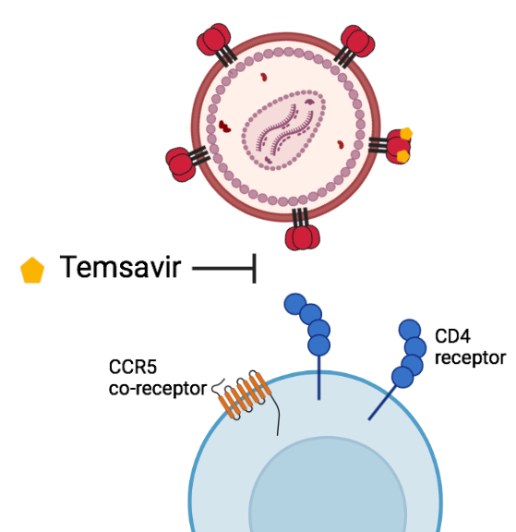
New attachment inhibitor: Fostemsavir (BMS-663068)
Temsavir (BMS-626529) is the active compound of the FDA-approved new attachment inhibitor fostemsavir.

Slide 3
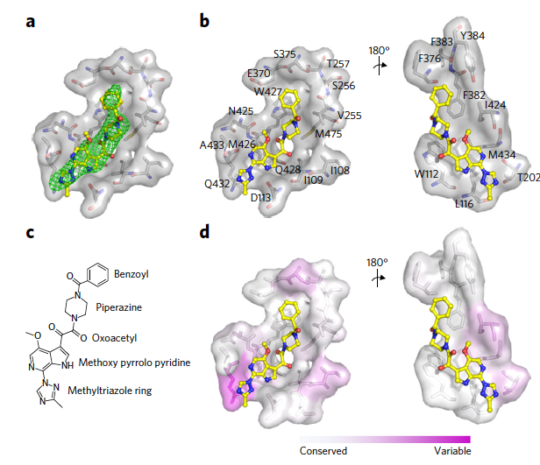
New attachment inhibitor: Fostemsavir (BMS-663068)
Temsavir (BMS-626529) is the active compound of the FDA-approved new attachment inhibitor fostemsavir.
Temsavir binds a conserved pocket under the ß20-ß21 loop of gp120 and prevents the interaction between Env and CD4 receptor (Pancera et al., 2017).
Temsavir treatment stabilizes Env in a prefusion "closed" conformation, State 1, which is preferentially targeted by broadly neutralizing antibodies (bNAbs) (Pancera et al., 2017; Munro et al., 2014; Lu et al., 2019; Si et al., 2004).
Pancera et al., NCM 2017

Slide 4
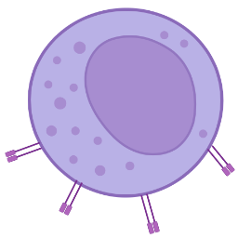
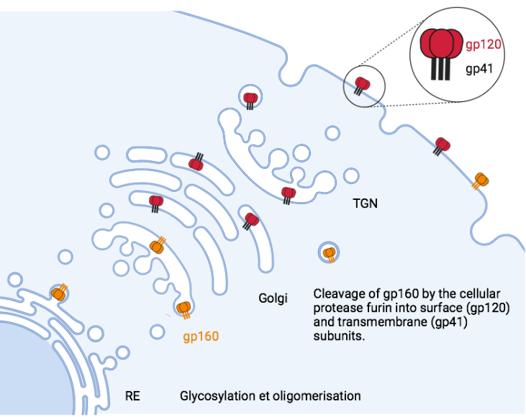

Hypothesis
BMS-377806:
  decreases cleavage
  addition of complex glycans
(Zhang S et al., 2021)

Slide 5
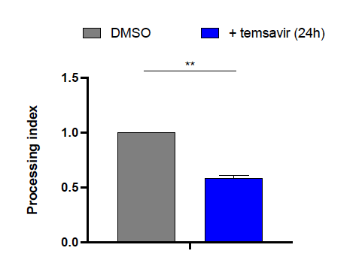
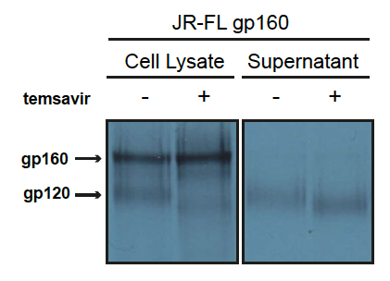
Impact of temsavir on glycosylation and processing
Envelope glycosylation and cleavage are affected by temsavir

Slide 6
Impact of temsavir on envelope conformation

Slide 7
Impact of temsavir on envelope conformation

Slide 8
Impact of temsavir on envelope conformation

Slide 9
Impact of temsavir on envelope conformation

Slide 10
Impact of temsavir on envelope conformation

Slide 11
Impact of temsavir on envelope conformation

Slide 12
Temsavir-resistant Env mutant S375W
Pancera et al., NCM 2017

Slide 13
Temsavir-resistant Env mutant S375W

Slide 14
Temsavir-resistant Env mutant S375W

Slide 15
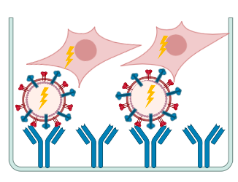
Impact of temsavir on Env conformation at the surface of virales particles
Ding et al., JVI 2019

Slide 16
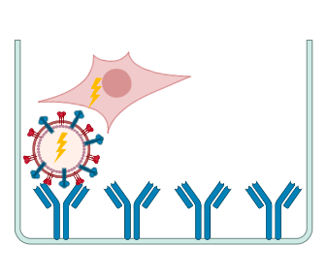
Impact of temsavir on Env conformation at the surface of virales particles

Slide 17
Impact of temsavir on Env conformation at the surface of virales particles

Slide 18
Impact of temsavir on envelope conformation at the surface of infected primary cells
Temsavir impacts Env conformation at the surface of viral particles and infected cells

Slide 19
Antibody-dependent cellular cytotoxicity (ADCC)

Slide 20
Antibody-dependent cellular cytotoxicity (ADCC)
Temsavir reduces the capacity of bNAbs to mediate ADCC

Slide 21
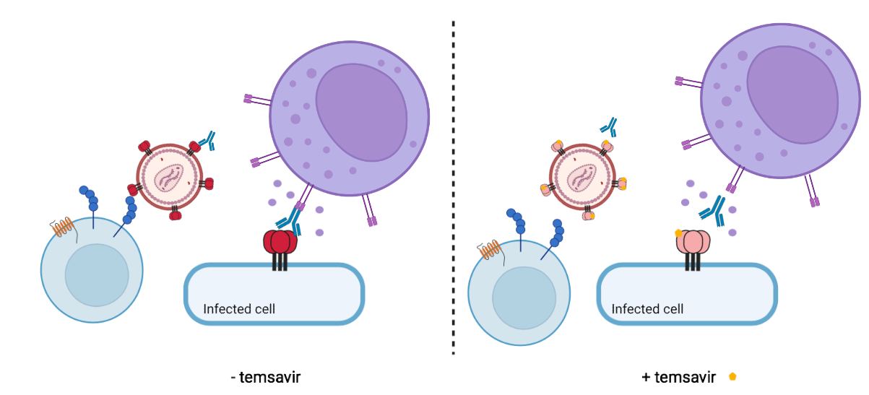
Conclusion
Temsavir impacts Env conformation at the surface of virions and infected cells.
Temsavir-treated cells are more resistant to ADCC mediated by bNAbs.

Slide 22










Laboratory of Dr Finzi
Andrés Finzi
Sai Priya Anand
Catherine Bourassa
Guillaume Beaudoin-Bussières
Debashree Chatterjee
Shilei Ding
Shang Yu Gong
Guillaume Goyette
Annemarie Laumaea
Gabrielle Gendron-Lepage
Lorie Marchitto
Halima Medjahed
Jérémie Prévost
Jonathan Richard
Alexandra Tauzin
Dani Vézina
Collaborators
Andrew Clark
Dennis Burton
THANK YOU!
MERCI!

Slide 23
Annexe

Slide 24
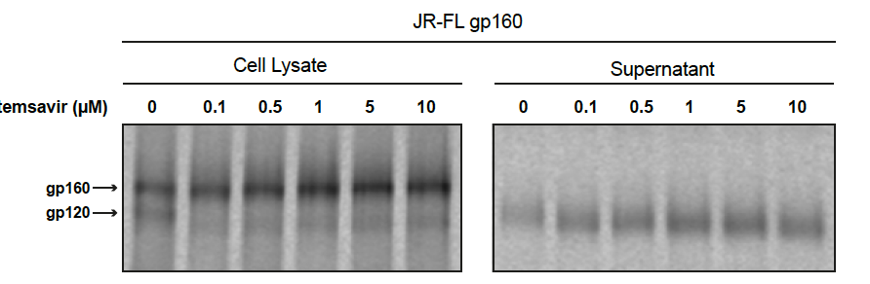
Dose dependent
Annexe

Slide 25
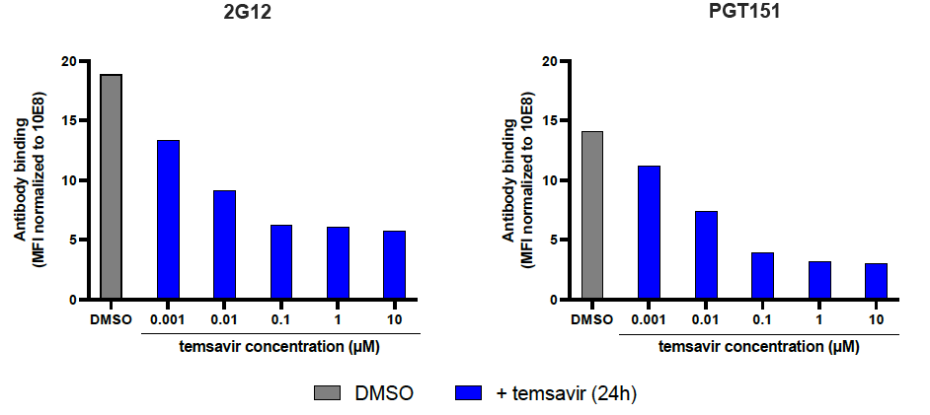
Dose dependent
Annexe

Slide 26
Normalization with 10E8
Annexe

Slide 27
Annexe

Slide 28
Annexe

Slide 29
Annexe

Slide 30
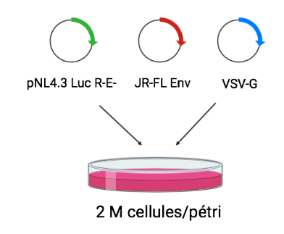
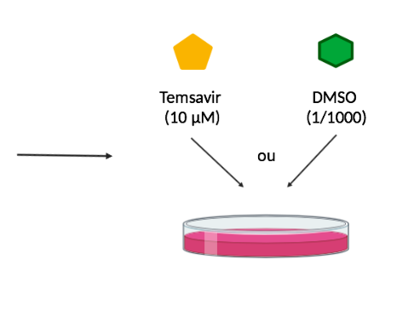
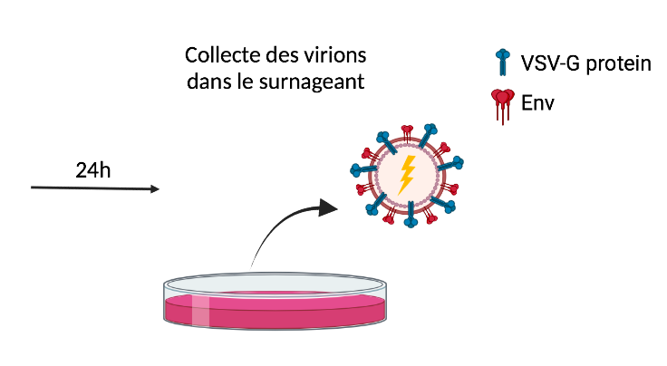
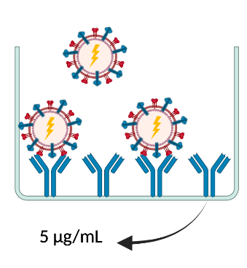
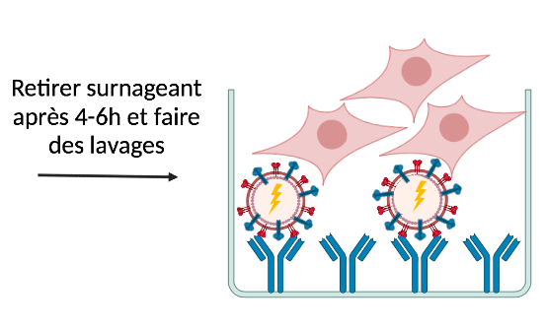
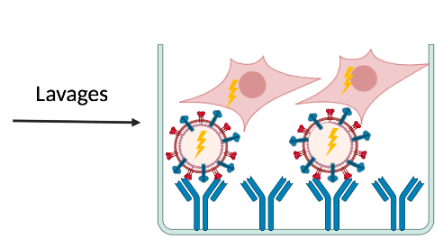
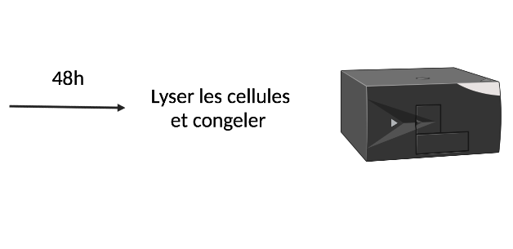
Collect virions in supernatant
or
2M cells / petri dish
Wash and add 293T cells
Washes
Lysis and
froze

Slide 31

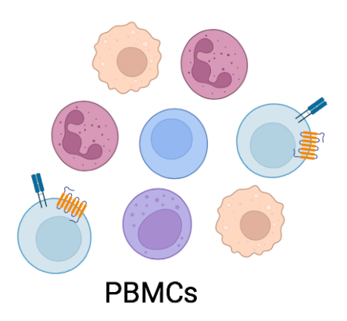
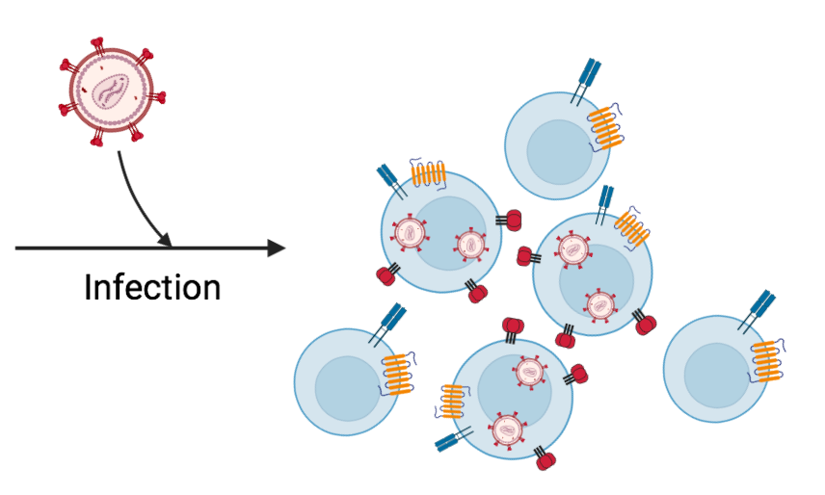
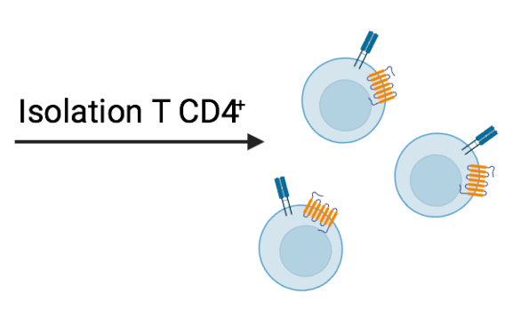
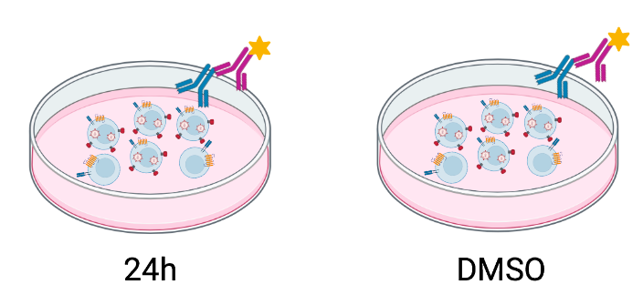
Annexe

Slide 32
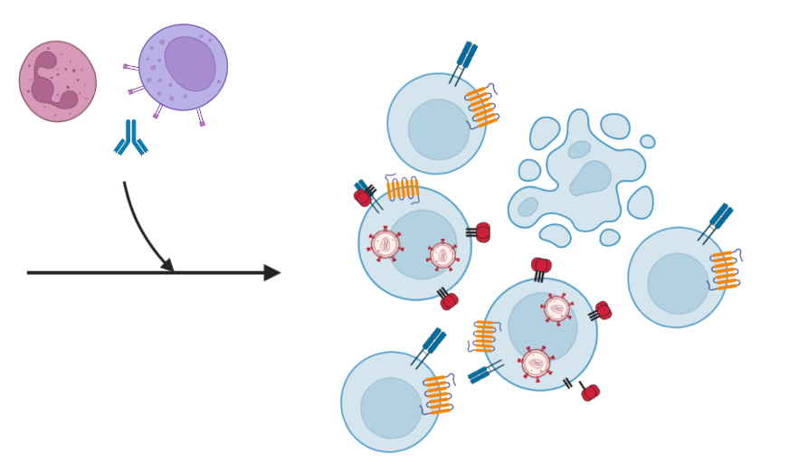

Slide 33
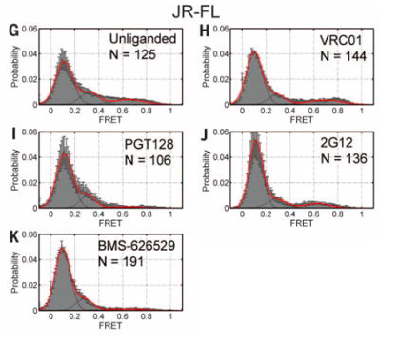
Munro et al., 2014

