Slide 1
INVESTIGATING THE DEVELOPMENT OF T CELL IMMUNITY IN ACUTE HIV-1 INFECTION THROUGH A LONGITUDINAL ANALYSIS OF THE TCR REPERTOIRE
Magalli Magnoumba Africa Health Research Institute
Responding to the virus: Advances in HIV immunology

Slide 2
CONFLICT OF INTEREST
I have no relevant financial relationships with ineligible companies to disclose

Slide 3
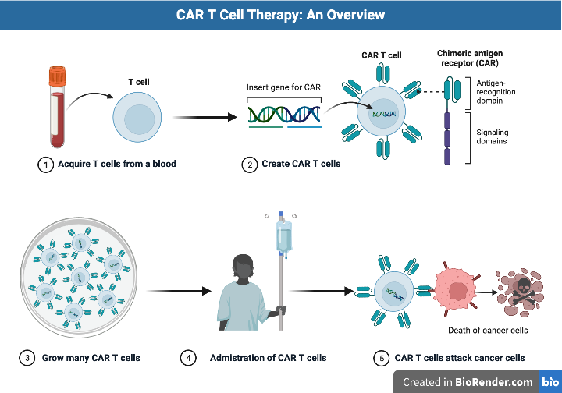



HARNESSING T-CELL RECEPTORS
Could we use the same approach for HIV?
Which TCRs
Source: Biorender

Slide 4


FRESH STUDY
Measuring TCR repertoire in 7 longitudinal samples pre and post HIV infection:
  Global unbiased examination of total TCR response to Acute HIV infection
Source: Dong et al., Lancet HIV. 2017

Slide 5
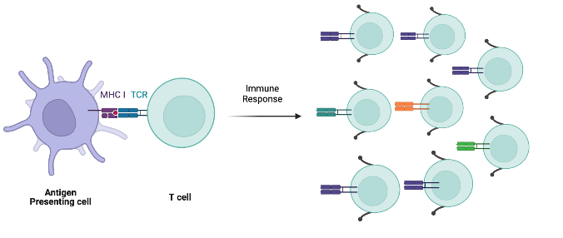



CONCEPT OF THE STUDY
Represented in the TCR repertoire as expanded clones
Proliferation of antigen specific T-cells
Immune response
Expanded TCR
Post-infection
Antigen Presenting cell
T-cell
Source: Biorender
Pre-infection

Slide 6

DIVERSITY AND CLONAL EXPANSION
Clonal expansion
Diversity
Pre-infection
Early infection (2 – 7 weeks)
Mid infection (24 – 36 weeks)
Late infection (after 48 weeks)
Shannon Diversity
Frequency
Naive
Expanded (>3)
Control
Early
Mid
Late

Slide 7
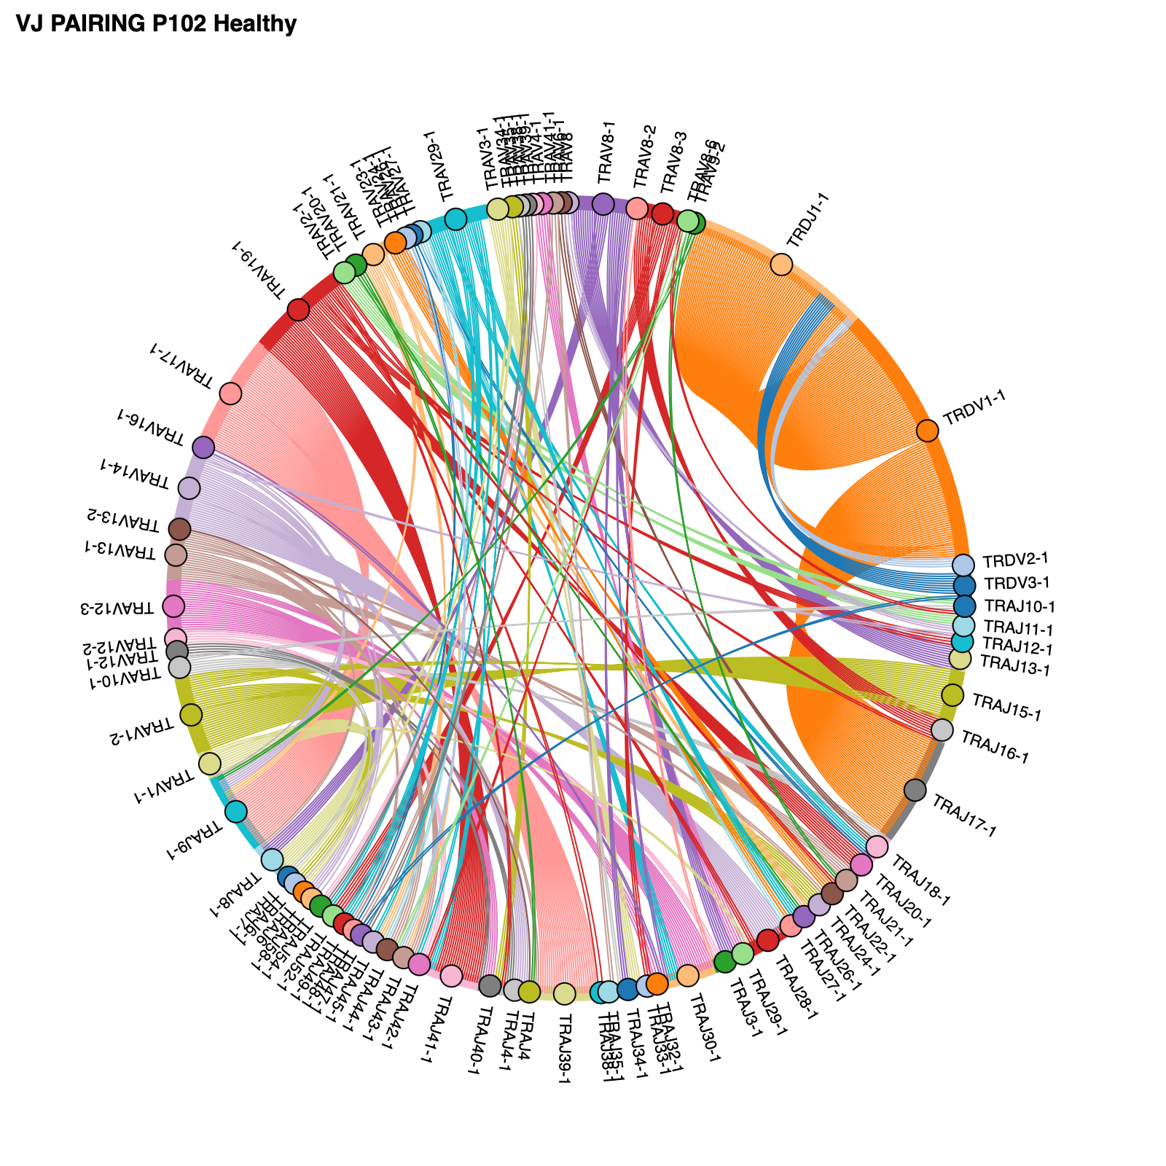
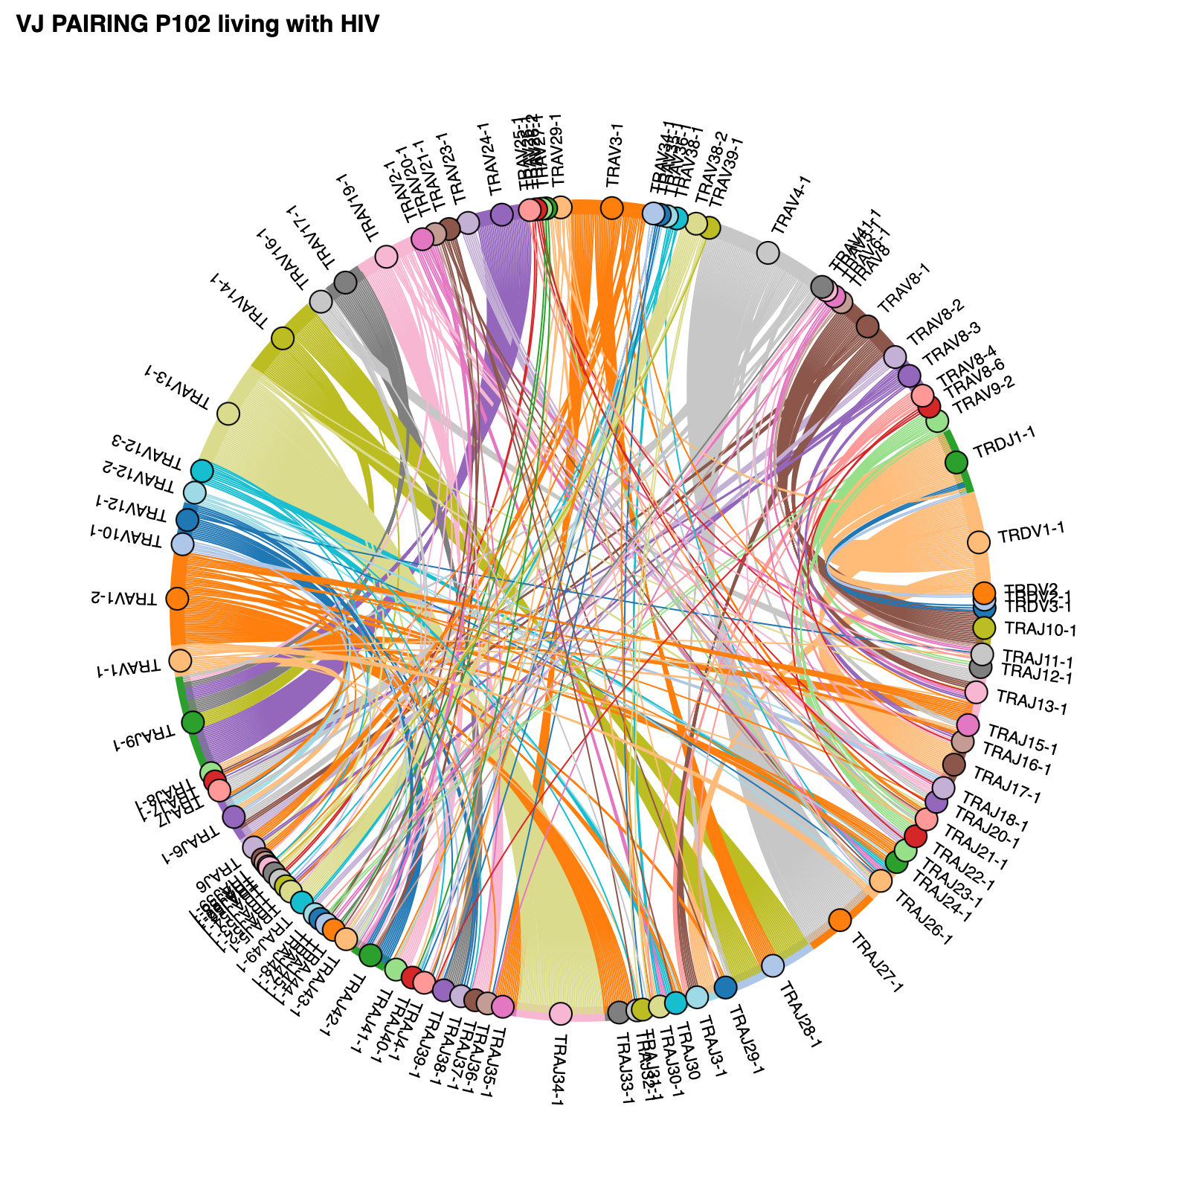
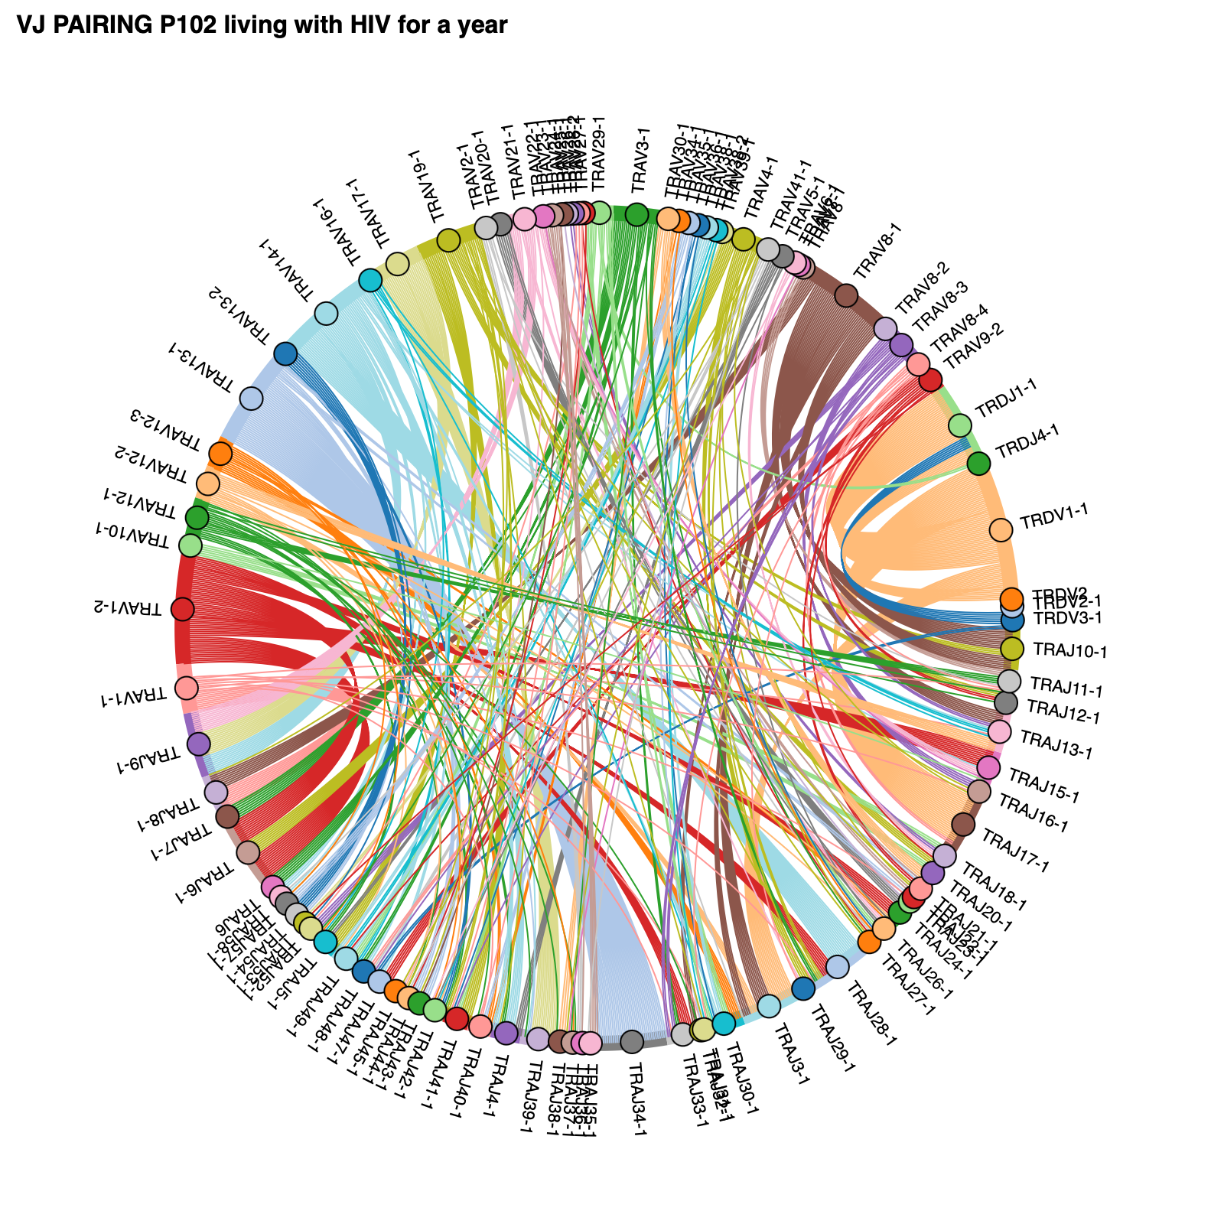
TCR REPERTOIRE OF PARTICIPANT BEFORE AND AFTER HIV INFECTION
VJ Pairing Pre-infection
VJ Pairing Early infection
VJ Pairing Mid infection

Slide 8
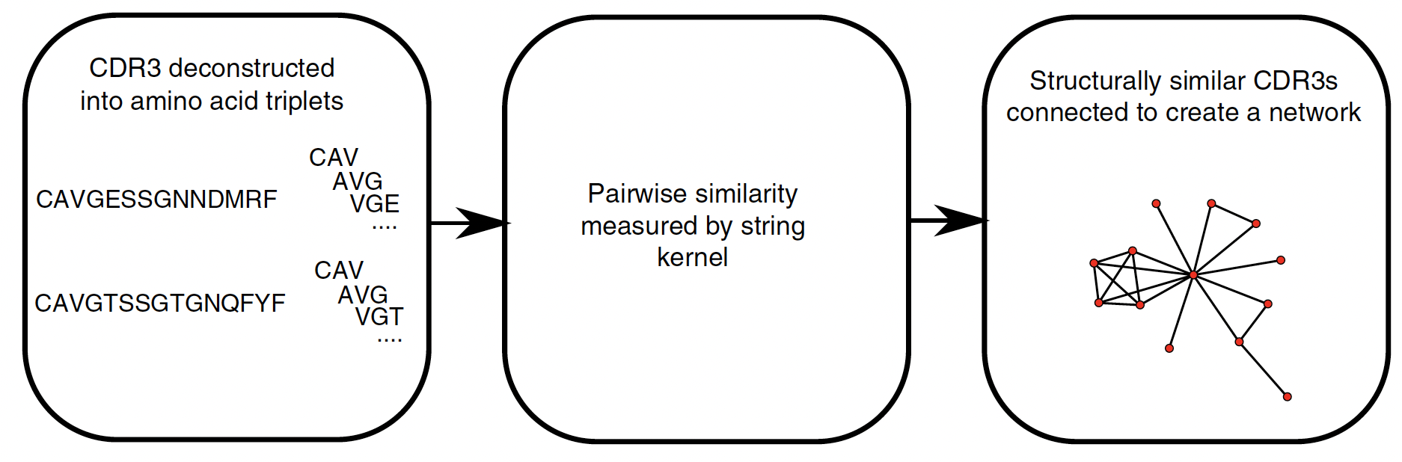
IDENTIFICATION OF RELATED CLUSTERS WITH EXPANDED TCR
Joshi et al., Nat imm. 2019

Slide 9


IDENTIFICATION OF RELATED CLUSTERS
WITH EXPANDED TCR
Pre-infection Clusters
Early infection Clusters
Post-infection clusters

Slide 10
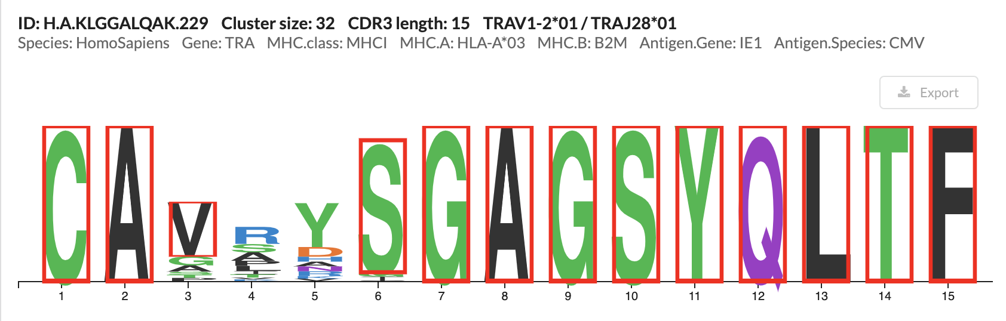

CDR3 MOTIFS FROM CLUSTERS
CMV MOTIF
Novel TCR MOTIF
Post-infection clusters
TCR Database: VDJdb
TCR Logo: ggseqlogo

Slide 11
CONCLUSION
TCR repertoire sequencing reveals clear expansions in early HIV infection and can provide an unbiased view of the total HIV-specific T-cell response
Bioinformatic approaches can identify clusters of expanded TCR likely to target specific antigens
Antigen prediction software can be leveraged to identify important antigenic targets in early HIV that maybe useful in vaccine or TCR engineering strategies
TCR sequencing also provides unbiased view of Donor-Unrestricted T cells (DURTs)

Slide 12
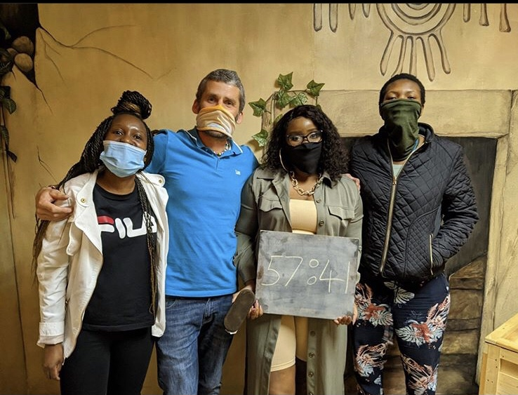




ACKNOWLEDGEMENT
Leslie LAB
Dr Al Leslie
Abigail Tlou Ngoepe
Lerato Ndlovu
Mahlatse Maseeme
Mark Chambers
Robert Klause
Ndung’u Lab
Prof Thumbi Ndung’u
Kavidha Reddy
Nasreen Ismail
FRESH TEAM
Krista Dong
Amber Moodley
Mary Dong
FRESH Study Team
FRESH Study Participants
FACILITIES
Kloverpris Lab
Dr Henrik Kloverpris
Lilian Folarin
Faiaz Abdool
Livo Esemu
Nicholas Herbert
FUNDING
RAGON INSTITUTE
Bruce Walker

