Slide 1




Medical drones to support HIV differentiated service delivery in an island population in Uganda
Rosalind Parkes-Ratanshi, Infectious Diseases Institute, Makerere University
Innovative differentiation: How best to deliver HIV testing, treatment and prevention services

Slide 2
Conflict of interest disclosure
Research Grant for this work and other projects from Janssen, the Pharmaceutical companies of Johnson and Johnson
Donation Grant for work on prevention of congenital syphilis and home based care for COVID-19 – Pfizer Pharmaceuticals

Slide 3

Medical Drones in Africa
Ghana – COVID samples, PPE (UNFPA¹)
Potential
Maybe CHEAPER⁸ or FASTER or SAFER than other forms of transport
Certain medical products/ diagnostics test should be “just in time” (short shelf lives, expensive)
Some populations (e.g. fishermen, refugees) are very mobile and need flexibility
DRC – Vaccinations (Village reach²)
Rwanda – Blood for transfusion (Zipline^{3,4})
Tanzania – Medicines (DHL⁴)
Malawi – infant DBS HIV (UNICEF, Village Reach⁶)
Madagascar – TB
tests (Pasteur Inst⁷⁾
Senegal – medical supplies, vaccines (PATH⁷ )

Slide 4
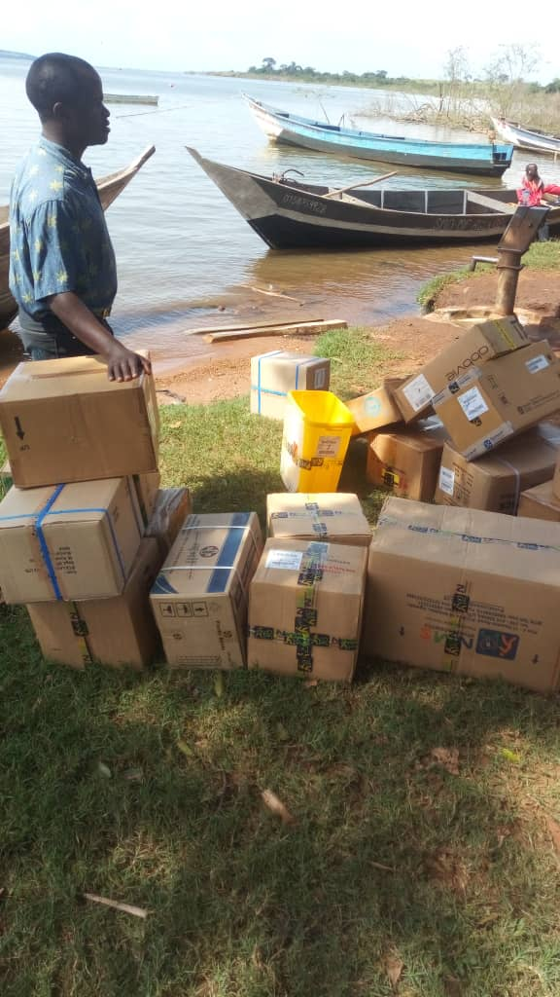
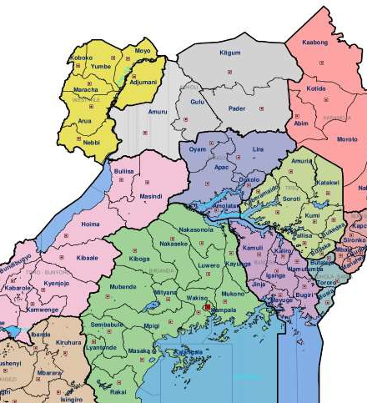
Healthcare in Kalangala islands
Kalangala District in Central Uganda is made up of 84 islands
There are 18 health facilities (16 government and 2 private)
Remote islands are served through boat outreaches which are expensive and risky
HIV prevalence 18.2% due to mobile population (& high loss to follow up)

Slide 5
Baseline Survey in Kalangala District
Data collected at 13/16 government health centres
Retrospective routine MOH data for the previous 6 months collected between July-Sept 2019
Mean number of landing site/out-reaches per health facility (HF) | Mean number of outreaches per HF over 6 months | Mean number of HIV refills at outreaches per month | Other services at outreaches | Proportion of staff time spent on ART refills per outreach | Mean number of staff remaining at health facility during outreach | Mean cost per outreach
5.5 | 5.6 | 168 | -Ante-natal clinic -Childhood immunization -HIV testing -VL & TB screening -Family planning | 64.9% | 2 / 7 | USD$160

Slide 6
Acceptability of medical drones for ART delivery
12 stakeholder in-depth qualitative interviews.
Purposefully sampled for a diverse mix of key leadership roles
The vast majority (n = 11) expressed interest and support in the prospect of a drone delivery program.
Benefits to drones
Challenges foreseen
Transport related obstacles – weather, cost, time, or fuel seem to present the greatest challenges to health care accessibility and could be eased by drones
Most concerns were operational or technical, risks of replacing human workers with drone technology, drone identifying those living with HIV.
”There are those clients who believe in physical contact with specific health workers, they may not feel right that the drone is the one that has delivered his/her medicine. Sometimes they may be having some medical issue requiring medical attention but on that he/she has missed an opportunity of being reviewed or talk to.”
“It will be fasten work because it eases service delivery to the clients so that they get their medicine on time [...] I think using a drone is cheap. A lot of money goes to fuel.”

Slide 7
Establishing a medical drone project
Co-ordination & Stakeholder Engagement
Site feasibility
Resource generation
Partner co-ordination
Community liaison
Approvals &
Governance
High level support MOH, UPDF, CAA, CFA
Compliance to security and CAA requirements
Submission of flight plan
Engineering
Choice of drone
Modifications
Test flights
Hardware horizon scanning
Procurement and shipping support
Capacity building
Flying training for local team
Flight safety training
Peer support worker sensitisation
Research oversight - ethical approvals, data collection, analysis, dissemination, publication

Slide 8
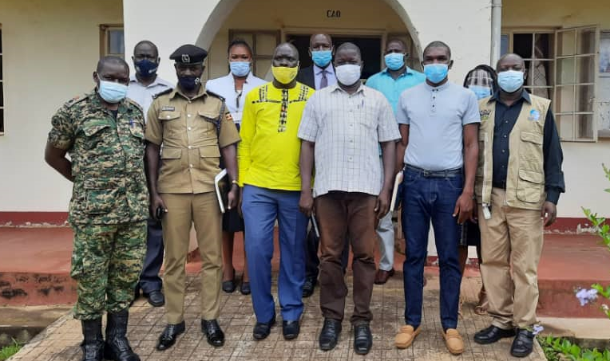
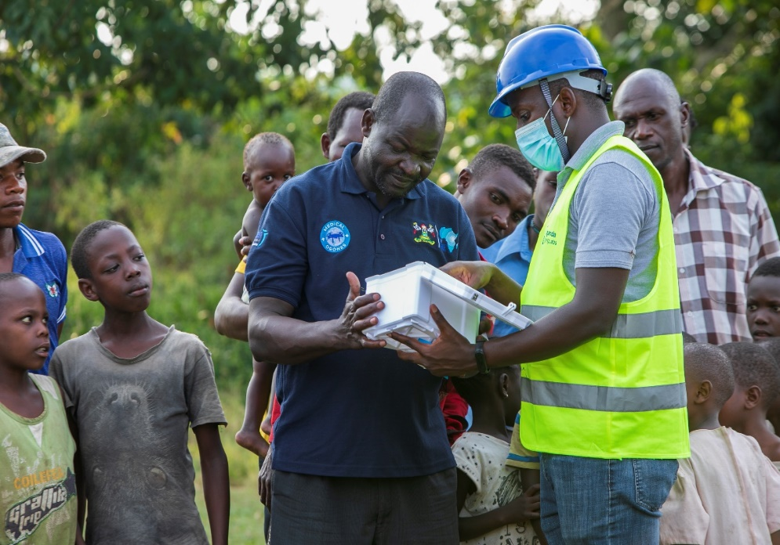
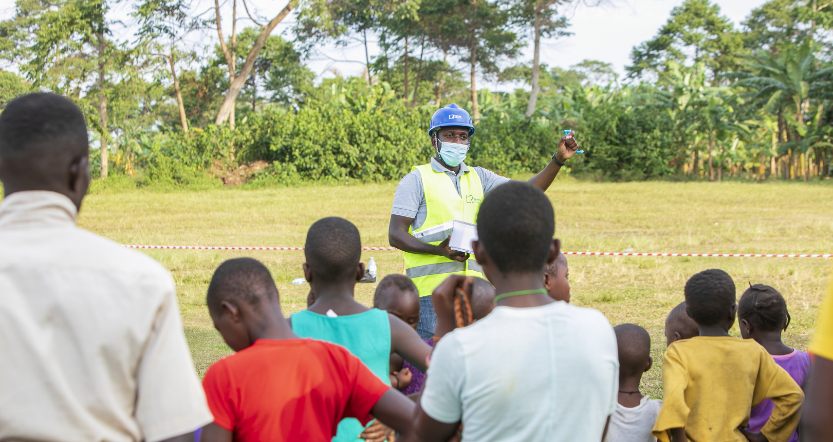
Stakeholder engagement

Slide 9



Research plan
STAGE ONE
Baseline needs assessment
STAGE TWO
Non randomised pilot of medical drones
STAGE THREE
District wide randomised controlled trial
-ART accessibility
-ART challenges
-Perceptions and attitudes towards medical drones
-faesability and acceptability
-process evaluation
- efficacy and cost effectiveness of medical drones for supporting elimination of HIV

Slide 10
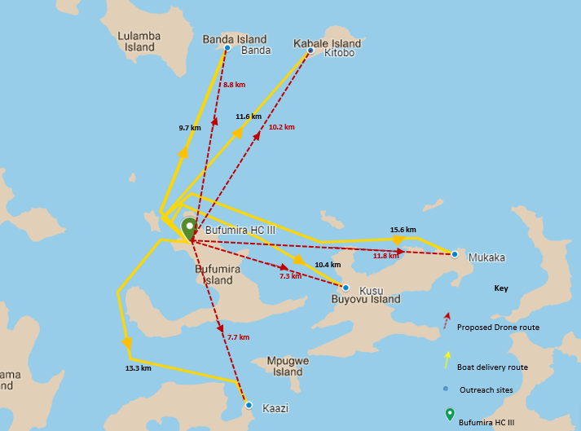
Kalangala flights
DJI Matrice 300
Stable
Cheap
Water resistant
Works on 3G signal
N=103 total enrolled for DAD
3 groups= 21
Buwonge
Dropped sites
Banda – Administrative issues
Mukaka – too far
3 groups= 17
Nabumba
3 groups= 18
2 groups= 12
Nakawa
2 groups= 11
4 groups= 24

Slide 11
Summary of flights so far
 | Sept 2021 | Oct 2021 | Nov 2021 | Dec 2021 | Jan 2022 | Feb 2022 | Mar 2022 | April 2022 | May 2022
Number of flights (test and delivery) | 14 | 0 | 20 | 26 | 24 | 25 |  | 31 | 27
Landing sites | Buwonge Kaazi Kusu |  | Buwonge Nambumba Nakawa Kaazi Kusu Kitobo Mukaka | Buwonge Kaazi Kusu Nambumba Nakawa Kitobo | Buwonge Kusu Nambumba Kitobo Kaazi Nakawa | Kusu Nakawa Buwonge Kaazi Kitobo |  | Kitobo Kusu Kaazi Buwonge | Kitobo Kusu Kaazi Buwonge Nakawa
Number of peer groups | 7 |  | NA | 11 | 0 | 8 |  | 5 | 10
Number of patients | 43 |  | 16 STI samples | 63 | 10 Emergency ART supplies | 41 |  | 31 | 53 Emergency ART supplies

Slide 12
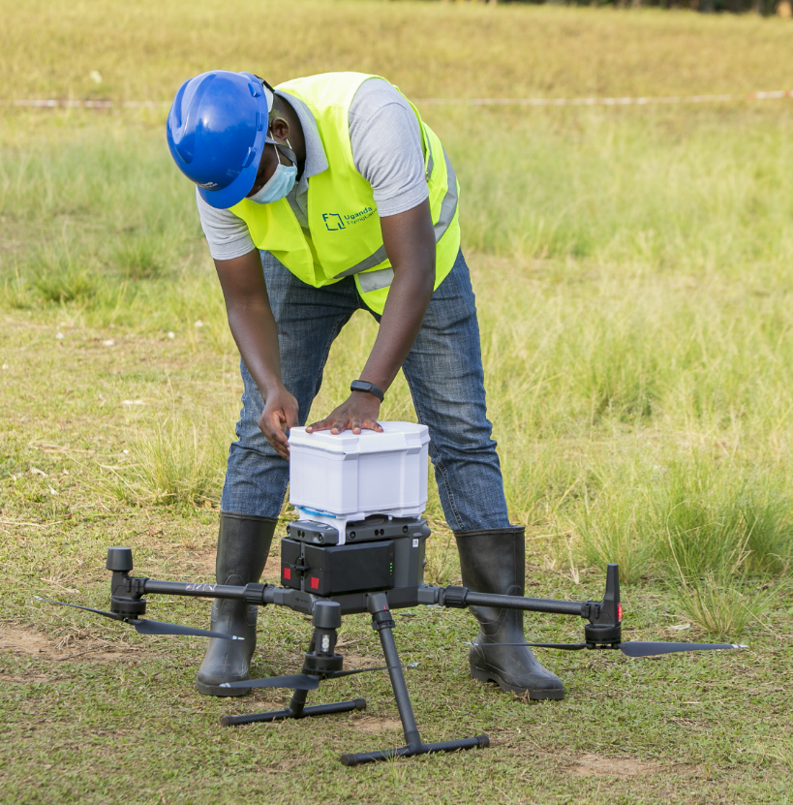
Interim flight analysis
Analysis of flights from September 2021- May 2022 | Total
Number of PLHIV received at least one delivery | 96
Number of PLHIV with 9 months of delivery | 43
Number of emergency ART deliveries | 10
Number of STI samples | 16
Total number of flights | 167
Average flight time drone | 9.3 min
Average boat delivery time | 35 min
Average flight distance | 6.6 km

Slide 13
Other achievements
Five project staff have received UK CAA approved drone training
8 PLHIV peer support workers have been trained in safe approach, unloading and preparing for flight for the drone
Emergency supplies including intermittent ART deliveries undertaken

Slide 14
Conclusions
Next steps for 2022
Lessons learnt so far
Completion of one year follow up of 100 PLHIV receiving medicine by drone
Comparison of ART drug stock outs for Bufumira health centre (with drones) and Mazinga health centre (without drones)
Qualitative interviews post one year of drone delivery
Technology is rapidly evolving but still need modifications
Beyond visual line of site approvals are challenging
Multiple stakeholder engagement at national and local level is vital

Slide 15
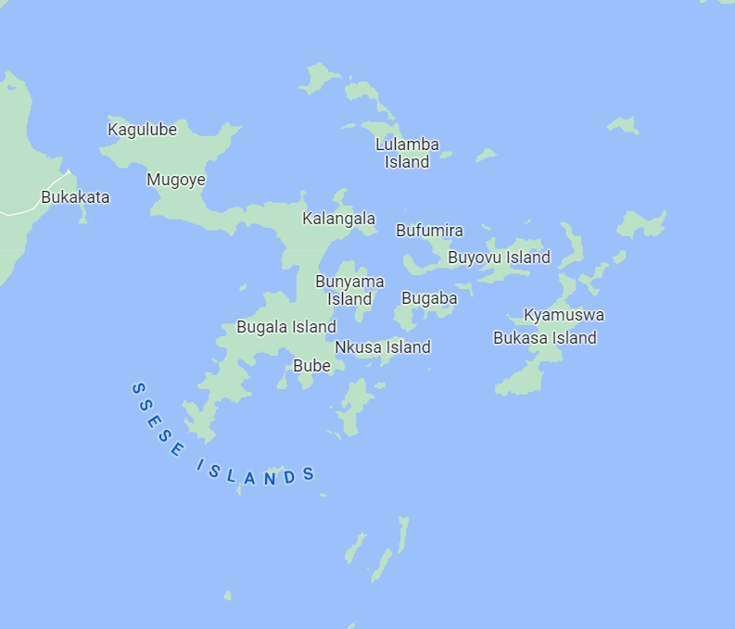
Future possibilities
Expanded coverage
Quarterly ART deliveries for PLHIV in Kalangala
Emergency operations for any top up for patients e.g. malaria treatment and tests
Delivery of stocked out commodities between health facilities
Viral load, STI samples, TB samples, COVID and other samples
Current coverage

Slide 16
Project team
Co-authors
Joan N. Akullo, Jackie Lydia N Ssemata, Patrick Ssesaazi, Dickson Masoni, Agnes Kiragga, Dr Andrew D. Kambugu at Infectious Diseases Institute
Jurg Germann, WeRobotics
Tinah Mutabazi Uganda Flying labs
Theresa Pattery and Robert Kimbui, Janssen, the Pharmaceutical Companies of J&J
Timothy Amukele, John Hopkins Medical Drones
Co-investigators
Dathan Byonanebye Mirembe, Makerere University
Rachel King, UCSF
Joseph Kagaayi, Rakai Health Sciences Program (RHSP)
Hillary Bitakaramire, DHO Kalangala
Drones flying and technical team
Sadat Ntale, IDI
Luke Winjberg, 3D Drone Mapping

Slide 17






Thanks to our partners

Slide 18
… and mostly to our PLHIV peer support group members and leaders
LANDING SITE | DELIVERY OBSERVER
Buwuunge | Nakitende Tina
Nabbumba | Ogwang Bosco Namawejje Stella
Kaazi | Mundu Avora Ovuru Paul
Nakawa | Birimuye Fulugensio
Kusu | Inshemerirwe Innocent
Kitobo | Namatovu Juliet

Slide 19
For further reading….
1. Village Reach https://www.villagereach.org/2022/04/01/a-dream-come-true-delivering-essential-health-products-one-drone-at-a-time/
2. Sibiri H, Zankawah SM, Prah D. Coronavirus diseases 2019 (COVID-19) response: Highlights of Ghana’s scientific and technological innovativeness and breakthroughs. Ethics Med Public Health. 2020 Sep;14:100537.
3. Ezell S. Zipline Enables Real-time Delivery of Essential Medical Supplies in Rwanda [Internet]. Information Technology and Innovation Foundation; 2017 Aug [cited 2021 Jun 15]. Available from: https://itif.org/publications/2017/08/07/zipline-enables-real-time-delivery-essential-medical-supplies-rwanda
4. Ling G, Draghic N. Aerial drones for blood delivery. Transfusion (Paris). 2019;59(S2):1608–11.
5. Eschborn, Bonn, Darmstadt. Rapid Response from the Air: Medicines Successfully Delivered Using a Parcel Drone in East Africa [Internet]. DHL. 2018 [cited 2021 Jun 15]. Available from: https://www.dhl.com/global-en/home/press/press-archive/2018/rapid-response-from-the-air-medicines-successfully-delivered-using-a-parcel-drone-in-east-africa.html
6. UNICEF Malawi. Humanitarian drone corridor launched in Malawi [Internet]. UNICEF. 2017 [cited 2021 Jun 15]. Available from: https://www.unicef.org/stories/humanitarian-drone-corridor-launched-malawi
7. Knoblauch AM, de la Rosa S, Sherman J, et al Bi-directional drones to strengthen healthcare provision: experiences and lessons from Madagascar, Malawi and Senegal BMJ Global Health 2019;4:e001541.
8. Haidari LA, Brown ST, Ferguson M, Bancroft E, Spiker M, Wilcox A, et al. The economic and operational value of using drones to transport vaccines. Vaccine. 2016 Jul 25;34(34):4062–7.
Thanks for listening

