Slide 1




AIDS 2022 Abstract 08042
How soon should patients be eligible for differentiated service delivery models for antiretroviral treatment?
Evidence from Zambia
Lise Jamieson^{1,2}, Sydney Rosen^{1,3}, Bevis Phiri⁴, Anna Grimsrud⁵, Muya Mwansa⁶, Hilda Shakwelele⁴, Prudence Haimbe⁴, Mpande M Mwenechanya⁷, Priscilla Lumano-Mulenga⁶, Innocent Chiboma⁶, Brooke E Nichols^{1,2,3}
¹Health Economics and Epidemiology Research Office (HE²RO), Department of Internal Medicine, Faculty of Health Sciences, University of the Witwatersrand, Johannesburg, South Africa; ²Department of Medical Microbiology, Amsterdam University Medical Centre, Amsterdam, the Netherlands; ³Department of Global Health, Boston University School of Public Health, Boston, MA, USA; ⁴Clinton Health Access Initiative, Lusaka, Zambia; ⁵International AIDS Society, Cape Town, South Africa; ⁶Ministry of Health, Lusaka, Zambia; ⁷The Centre for Infectious Disease Research in Zambia, Lusaka, Zambia
Notes:
AMBIT project: Optimizing the benefits of alternative Models of ART Delivery

Slide 2
Background
Attrition from HIV treatment programs in sub-Saharan Africa is greatest during patients’ first six months after ART initiation.
    In Zambia, 50% have interruptions in months 0-6 (PEPFAR, 2021)
    In South Africa, 26% were lost to follow up by 6 months (Aurum, 2020)
  Likely reasons for high attrition in first six months include:
    Good patient condition (high CD4 counts) at initiation, reducing commitment to lifelong adherence
    Same-day ART initiation, which shifts some losses from before to after starting treatment
    High and increasing proportion of re-initiators, who have already defaulted at least once and may face the same barriers again
    Most differentiated service delivery (DSD) models, which make access easier for patients, systematically exclude patients on ART < 6 months, who are considered “not established.”

Slide 3
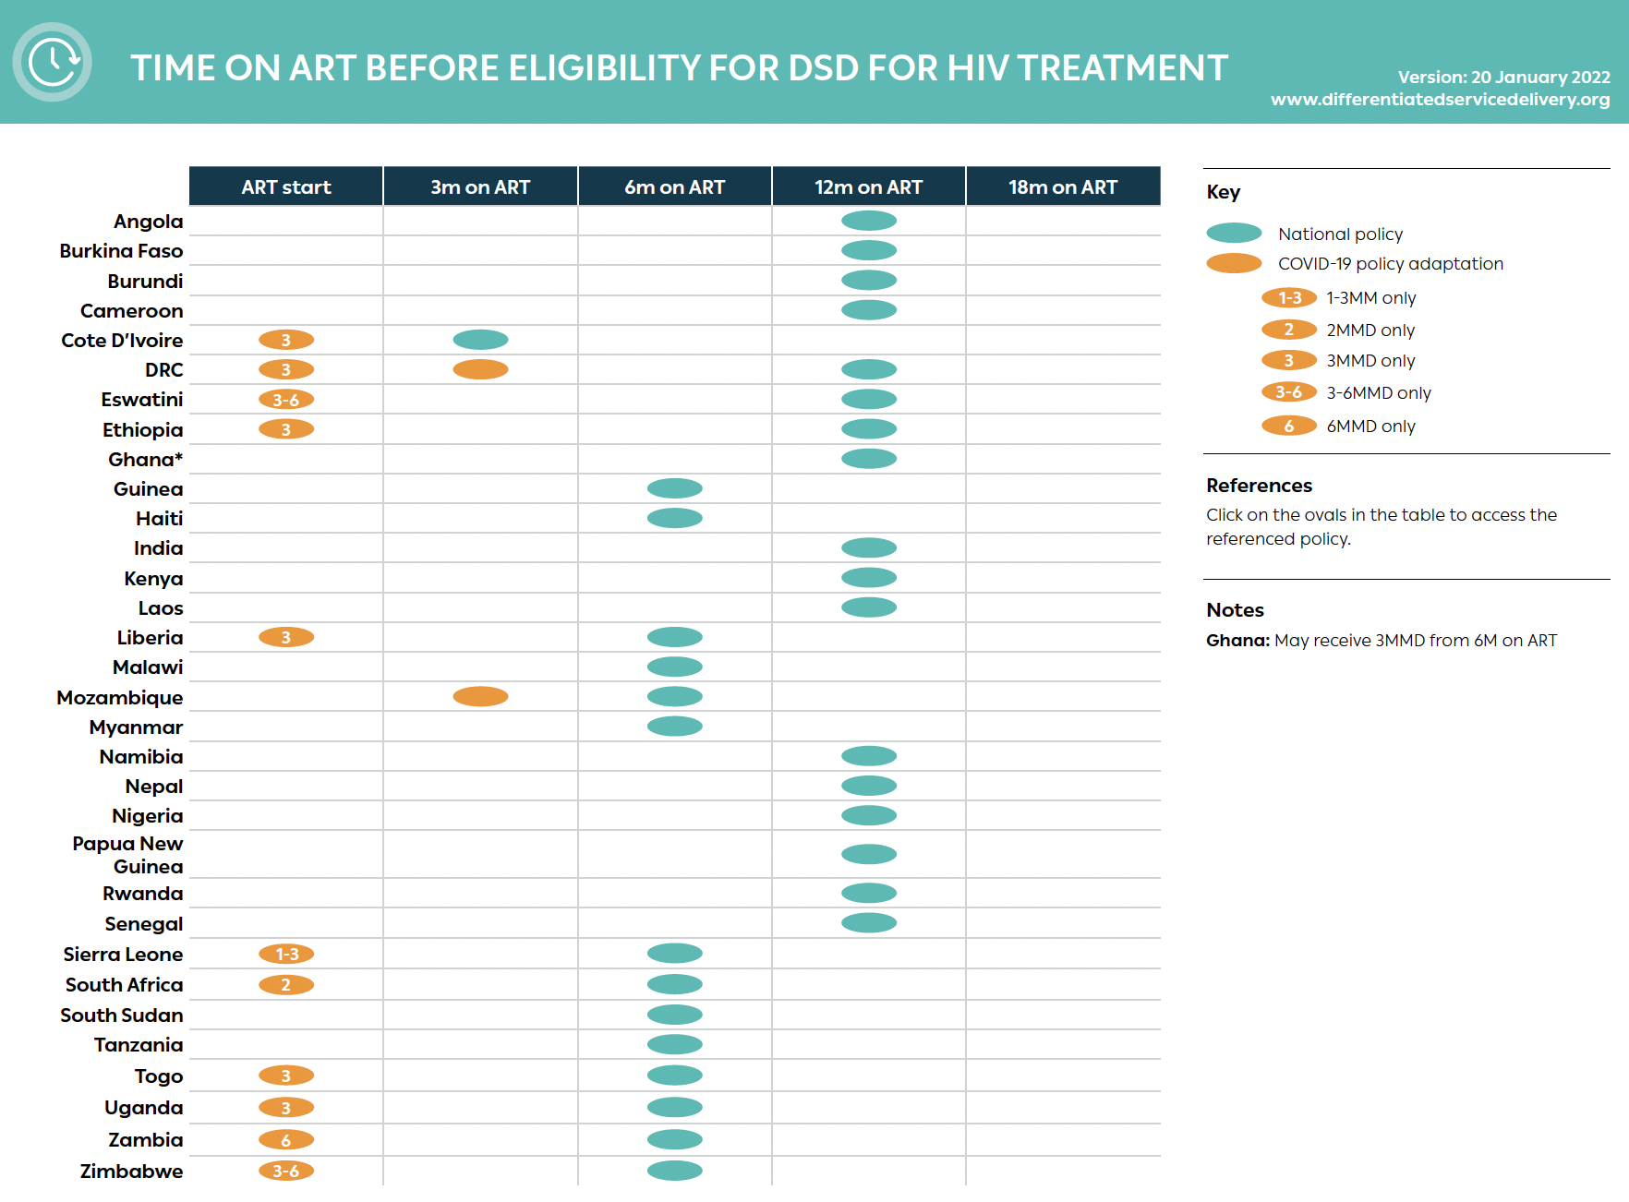
As of January 2022, 6 or 12 months on ART was required by most countries for DSD model eligibility
Our research question:
Should patients with <6 months on ART automatically be excluded from DSD models?
Routine enrollment of some new ART initiators in DSD models in Zambia allowed us to answer this question.

Slide 4
Methods
Retrospective medical record review in Zambia; data from electronic system SmartCare from January 2019 to October 2021
Included adults (≥15 years) who initiated ART in 2019-2020 and subsequently enrolled in any of Zambia’s DSD models
Outcome: loss to follow-up (LTFU) within 18 months of ART initiation, defined as no interaction with healthcare system between 15-21 months after initiation
Compared:
  “Early enrollers” – patients who enrolled in any DSD model with <6 months’ ART experience
  “Established enrollers” – patients who enrolled in a DSD model with >6 months’ ART experience
Estimated risk ratios of LTFU using log-binomial model, adjusting for age, sex, urban/rural, and ART dispensing interval and stratified by DSD model type and ART dispensing interval

Slide 5
Enrollment and patient characteristics
Data from 692 health facilities across all 10 provinces in Zambia
N=32,197 adults who initiated ART in 2019-2020, enrolled in DSD models, and had 18-month outcomes
  6,340 early enrollers
    45% enrolled in month 0-3
    55% enrolled in month 4-6
  25,857 established enrollers
Early and established enrollers were similar with respect to age (median 37), sex (61% female) and setting (64% urban).
Distribution of time on ART at DSD model enrollment (n=6,340)

Slide 6
DSD model enrollment and duration
Variable | Early enrollers in DSD models (N=6,340) | Established enrollers in DSD models (N=25,857)
DSD type
Adherence groups | 149 (2%) | 508 (2%)
Community medication pickup points | 671 (11%) | 1,461 (6%)
Extended clinic hours | 85 (1%) | 97 (<1%)
Fast-track medication pickup at facility | 979 (15%) | 6,266 (24%)
Home ART delivery | 355 (6%) | 973 (4%)
Multi-month dispensing at facility | 4,101 (65%) | 16,552 (64%)
ART months dispensed
<2 months | 636 (10%) | 1,476 (6%)
3 months | 2,197 (35%) | 5,688 (22%)
4-6 months | 3,507 (55%) | 18,679 (72%)
Months on ART at outcome, median (IQR) | 17.9 (16.4-19.5) | 18.4 (16.7-19.8)
In DSD model at outcome
Yes | 6,340 (100%) | 20,856 (81%)
No | 0 (0%) | 5,001 (19%)
Months in DSD model at outcome, median (IQR) | 14.7 (13.0-16.5) | 5.8 (2.9-8.9)

Slide 7
Rates of loss to follow-up at 18 months
Across different DSD models and ART dispensing intervals, early enrollers had similar or lower rates of loss to follow-up 18 months after ART initiation

Slide 8
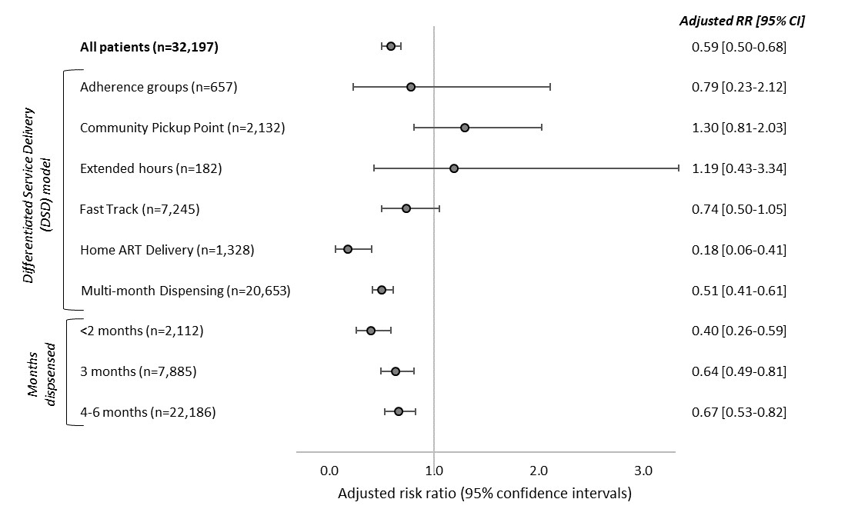
Early vs established enroller risk of LTFU by 18 months after ART initiation
Adjusted for age, sex, urban/rural setting, and dispensing interval (except last three)
Less LTFU
More LTFU
Early enrollers’ risk of LTFU was lower than that of established enrollers for most models of care and all dispensing intervals.
Results held for those enrolled in month 0-3 after ART initiation as well as those enrolled in month 4-6.

Slide 9
Conclusions
Patients who have been on ART for <6 months can successfully be enrolled in DSD models and retained in care
Limitations:
  SmartCare data on DSD model enrolment incomplete; accuracy uncertain
  Roll of COVID-19 illness and restrictions unclear
  Selection bias is very likely—providers or patients’ expectations about future adherence almost certainly influenced early entry into DSD models.
  Behavioural factors that have not been accounted for may make early DSD enrollers fundamentally different from other early ART patients.
Despite the selection bias, DSD models do work for some early ART patients, suggesting that the blanket exclusion of those on ART<6 months should be reconsidered.
Notes:
we assume that patients with < 6 months on ART in our sample were not offered DSD model enrollment at random. If providers made accurate guesses about individual patients’ risks of attrition, patients in our “early enrollment” cohorts could over-represent patients thought to have low attrition risk.

Slide 10
Acknowledgments
Zambian Ministry of Health
Bill & Melinda Gates Foundation
AMBIT project team in Zambia
Notes:
we assume that patients with < 6 months on ART in our sample were not offered DSD model enrollment at random. If providers made accurate guesses about individual patients’ risks of attrition, patients in our “early enrollment” cohorts could over-represent patients thought to have low attrition risk.

Slide 11
Appendix: DSD models in Zambia during the study period (2018-21)
DSD model type | Model(s) | Description
Adherence groups | Community adherence groups | Patient groups (±6 members) meeting every 1-3 months outside clinics. Members take turns to collect ART for other members at clinical appointments .
 | Rural and urban adherence groups/clubs | Patients groups (20-30 members), meeting every 2-3 months; facilitated by health care worker or facility-based volunteer, also providing pre-packaged ART.
Extended clinic hours | Before/after-hours models, weekend models, scholar models | Clinical visit/collect ART outside the conventional operation times at the facility.
Fast-track | Fast-track | Separate, shorter queue to dispense ART at the facility
Home ART delivery | Home ART delivery | Trained community health workers (CHWs) linked to facilities conduct home visits to deliver ART, conduct health screening, monitor adherence and referrals
Multi-month dispensing | Multi-month dispensing | Facility-based, dispensing ART for a longer duration (usually 3 or 6 months).
Community medication pick-up points | Central dispensing units | ART packed at central hub and distributed at multiple approved pick-up points. Clinical visits occur every 6 months at the health facility.
 | Community ART distribution points, Community retail pharmacies, Health posts | ART refills are provided to patients outside of health facilities, eg. schools, churches, community centers, community retail pharmacies and health posts.
 | Mobile ART distribution models | Clinical outreach team does 3-monthly clinical assessments at community distribution points. This model is usually used for hard-to-reach areas.

