Slide 1




The relative cost-effectiveness of long-acting injectable cabotegravir versus oral pre-exposure prophylaxis
A modelled economic evaluation and threshold analysis in South Africa based on the HPTN 083 and 084 trials
Lise Jamieson^{1,2}, Leigh F. Johnson³, Brooke E. Nichols,^{1,2,4}, Sinead Delany-Moretlwe⁵,
Mina C. Hosseinipour^{6,7}, Colin Russell^{2,4}, Gesine Meyer-Rath^{1,4}
1. Health Economics and Epidemiology Research Office, Department of Internal Medicine, School of Clinical Medicine, Faculty of Health Sciences, University of the Witwatersrand, Johannesburg, South Africa; 2. Department of Medical Microbiology, Amsterdam University Medical Centre, Amsterdam, The Netherlands; 3. Centre of Infectious Disease Epidemiology and Research (CIDER), University of Cape Town, Rondebosch, Western Cape, South Africa; 4. Department of Global Health, Boston University School of Public Health, Boston, Massachusetts, USA; 5. Wits RHI, Faculty of Health Sciences, University of the Witwatersrand, Johannesburg, South Africa; 6. University North Carolina, Chapel Hill, NC, USA; 7. UNC Project, Lilongwe, Malawi.

Slide 2
Background
Oral pre-exposure prophylaxis (PrEP), in the combination drug tenofovir (TDF) and emtricitabine (FTC), is 65%-85% effective in preventing HIV infection (Hansom 2016, Fonner 2016, Baeten 2012)
Compared to TDF/FTC, long-acting injectable cabotegravir (CAB-LA) reduced risk of HIV infection by 66% in gay men and other men who have sex with men and transgender women (HPTN 083: Landovitz 2021), and 89% young cisgender women (HPTN 084: Delany-Moretlwe 2022)
CAB-LA removes the need for users to take daily pills, allowing for persistent use and improving adherence in the short term
Acceptability studies have found a higher stated preference for long-acting injectable products compared to daily pills (Tolley 2019, 2020; Cheng 2019; Gill 2020)
Limited studies on the cost and impact of injectable PrEP in sub-Saharan Africa, and no studies comparing injectable PrEP to oral PrEP

Slide 3
Methods
Model the impact and cost-effectiveness of CAB-LA compared to TDF/FTC over a 20-year time horizon (2022-2041) in South Africa
We estimate the threshold cost of CAB-LA, per injection, that makes it similarly or more cost-effective compared to TDF/FTC
Model used: Thembisa, a deterministic compartmental HIV transmission model of the South African HIV epidemic (https://thembisa.org)
We model two coverage scenarios (medium/high) and, for CAB-LA, two duration scenarios (minimum: average duration on PrEP same as oral PrEP, maximum: longer than oral PrEP)
Baseline: current TDF/FTC roll-out programme (low coverage 0.5-3% of target populations)
We target adolescent girls and young women (AGYW), female sex workers (FSW), adolescent boys and young men (ABYM), gay men and other men who have sex with men (MSM)

Slide 4
Methods: Cost analysis
Ingredients-based costing from the provider’s perspective
Resource use data:
  Oral PrEP: guidelines, implementation and demonstration projects
  CAB-LA: trial protocols, adjusted for public sector implementation
Cost includes lowest staff cadre, demand creation and training
Drug prices:
  Oral PrEP: current generic drug prices
  CAB-LA: range between 1-5x that of oral PrEP
CAB-LA costs include staff time for injections, excludes creatinine
Costs in 2021 USD, undiscounted

Slide 5
Methods: Scenarios
 | Oral PrEP (TDF/FTC) |  | CAB-LA
 |  |  | Minimum duration |  | Maximum duration | Maximum duration
 | Medium coverage | High coverage | Medium coverage | High coverage | Medium coverage | Medium coverage | High coverage
Duration | 5 mo (AGYW, FSW, ABYM); 11 mo (MSM) |  | Same as for TDF/FTC |  | 12 mo (AGYW, FSW, ABYM); 24 mo (MSM) | 12 mo (AGYW, FSW, ABYM); 24 mo (MSM)
Coverage | 5% (AGYW, ABYM); 15% (FSW, MSM) | 10% (AGYW, ABYM); 30% (FSW, MSM) | 10% (ABYM); 20% (AGYW); 25% (FSW, MSM) | 20% (ABYM); 40% (AGYW); 50% (FSW, MSM) | 20% (ABYM); 35% (AGYW); 40% (FSW, MSM) | 20% (ABYM); 35% (AGYW); 40% (FSW, MSM) | 35% (ABYM); 60% (AGYW); 67% (FSW, MSM)
Effectiveness | 65% (AGYW, FSW); 85% (ABYM, MSM) |  | 95% (all populations)
Annual cost per person initiated | $76-78 (AGYW, FSW, ABYM); $116 (MSM) |  | $78-81 (AGYW, FSW, ABYM); $122 (MSM) |  |  | $131-137 (AGYW, FSW, ABYM, MSM 1st year); $105 (MSM 2nd year)

Slide 6
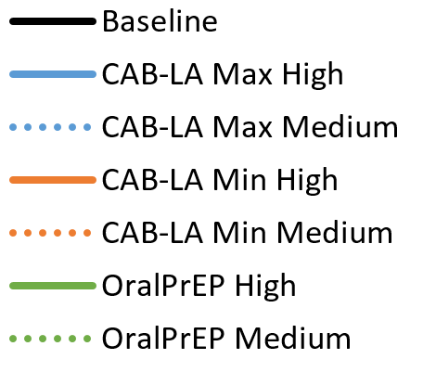
Results: Impact on HIV
At baseline, HIV incidence is declining from 0.39% to 0.17%
By 2041, incidence decreased to:
  0.15%-0.16% (TDF/FTC)
  0.10%-0.13% (CAB-LA)
HIV infections averted:
  max. 8,900-16,300 infections/yr (TDF/FTC)
  max. 26,400-52,000 infections/yr (CAB-LA)

Slide 7
Results: Impact on AIDS deaths
Under CAB-LA, more AIDS deaths are averted annually
Over 20 years, AIDS deaths averted:
  6,500 (0.6%) – 12,400 (1.2%) (TDF/FTC)
  21,500 (2%) – 43,400 (4%) (CAB-LA)

Slide 8
Results: Impact on cost of the HIV programme
By 2041, the number of people on ART, compared to baseline:
  reduced by 1%-2% (TDF/FTC)
  reduced by 4%-8% (CAB-LA)
Total HIV programme cost higher with CAB-LA
  despite less need for ART
  due to assumed higher uptake
  compared to TDF/FTC

Slide 9
Cost effectiveness over 20 years
Medium coverage scale-up for PrEP interventions
Scenario | New HIV infections |  | Life years lost due to AIDS |  | CAB-LA drug cost relative to oral PrEP | Total cost of the HIV programme (billions 2021 USD) |  | Incremental cost effectiveness (2021 USD)
 | Number [millions] | % averted over BL | Number [millions] | % saved over BL |  | Cost | Incremental cost over BL | Cost/ infection averted | Cost/ life year saved
Baseline | 3.02 |  | 37.34 |  |  | 41.29
Oral PrEP | 2.90 | 4% | 37.02 | 1% | - | 42.08 | 2% | 6,053 | 2,309
CAB-LA minimum duration | 2.58 | 15% | 36.19 | 3% | 1x | 43.25 | 5% | 4,471 | 1,705
 |  |  |  |  | 2x | 44.46 | 8% | 7,211 | 2,751
 |  |  |  |  | 3x | 45.66 | 11% | 9,952 | 3,796
 |  |  |  |  | 4x | 46.86 | 13% | 12,692 | 4,842
 |  |  |  |  | 5x | 48.07 | 16% | 15,433 | 5,887
CAB-LA maximum duration | 2.44 | 19% | 35.81 | 4% | 1x | 44.31 | 7% | 5,157 | 1,978
 |  |  |  |  | 2x | 46.24 | 12% | 8,447 | 3,240
 |  |  |  |  | 3x | 48.16 | 17% | 11,737 | 4,501
 |  |  |  |  | 4x | 50.09 | 21% | 15,027 | 5,763
 |  |  |  |  | 5x | 52.02 | 26% | 18,317 | 7,025

Slide 10
Cost effectiveness over 20 years
High coverage scale-up for PrEP interventions
Scenario | New HIV infections |  | Life years lost due to AIDS |  | CAB-LA drug cost relative to oral PrEP | Total cost of the HIV programme (billions 2021 USD) |  | Incremental cost effectiveness (2021 USD)
 | Number [millions] | % averted over BL | Number [millions] | % saved over BL |  | Cost | Incremental cost over BL | Cost/ infection averted | Cost/ life year saved
Baseline | 3.02 |  | 37.34 |  |  | 41.29
Oral PrEP | 2.79 | 8% | 36.72 | 2% | - | 42.92 | 4% | 6,610 | 2,498
CAB-LA minimum duration | 2.31 | 24% | 35.41 | 5% | 1x | 45.42 | 10% | 5,779 | 2,145
 |  |  |  |  | 2x | 47.83 | 16% | 9,147 | 3,394
 |  |  |  |  | 3x | 50.24 | 22% | 12,515 | 4,644
 |  |  |  |  | 4x | 52.64 | 27% | 15,882 | 5,894
 |  |  |  |  | 5x | 55.05 | 33% | 19,250 | 7,144
CAB-LA maximum duration | 2.17 | 28% | 35.03 | 6% | 1x | 47.10 | 14% | 6,785 | 2,510
 |  |  |  |  | 2x | 50.63 | 23% | 10,915 | 4,038
 |  |  |  |  | 3x | 54.16 | 31% | 15,045 | 5,566
 |  |  |  |  | 4x | 57.70 | 40% | 19,175 | 7,094
 |  |  |  |  | 5x | 61.23 | 48% | 23,305 | 8,622

Slide 11
Threshold analysis:
Solving the equation for the exact cost for CAB-LA (per injection) to be as cost-effective as oral PrEP
 | Minimum duration scenario |  | Maximum duration scenario
Cost per CAB-LA injection (2021 USD) | Medium coverage | High coverage | Medium coverage | High coverage
Equal ICERS for cost/HIV infection averted | $14.47 | $11.57 | $11.79 | $9.03
Equal ICERS for cost/life year saved | $14.47 | $11.88 | $11.70 | $9.33
→ Acceptable range of cost per injection $9-$15

Slide 12
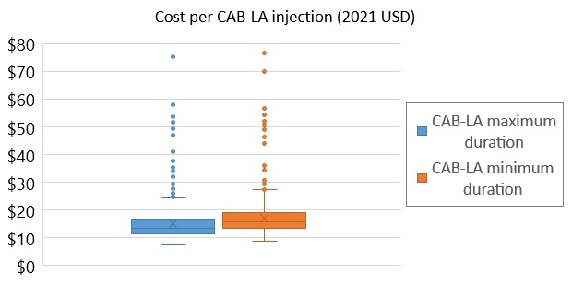
Probabilistic sensitivity analysis
Cost of CAB-LA = 2x cost of oral PrEP
We run 1,000 Monte Carlo simulations, sampling from distributions for key parameters (coverage, effectiveness, reduction in condom use while on PrEP, relative uptake rate in low HIV risk users, cost of PrEP provision)
With uncertainty, acceptable range of cost per injection $11-$19 (interquartile range)
25% of simulations: CAB-LA is more cost-effective than oral PrEP

Slide 13
Conclusion
CAB-LA is a highly effective in preventing HIV transmission
  Estimated 3- to 5-fold increase in averting HIV infections and AIDS deaths over 20 years
Cost of CAB-LA drug needs to be <$9/injection (high coverage) or <$15/injection (medium coverage) for it to be similarly or more cost-effective than TDF/FTC in South Africa
Current US list price = $3,700/injection – unaffordable for low- and middle-income countries
Manufacturer has very recently agreed to discussions on voluntary licensing terms with the Medicines Patent Pool
The last of the 6 current patents on CAB-LA is due to expire in 2031

