Slide 1
Variation in average unit prices of antiretroviral medicines in low- and middle-income countries
Deepak Mattur(UNAIDS), Dr. Vincent Habiyambere
Optimizing investments for health: Cash, cost and prices

Slide 2
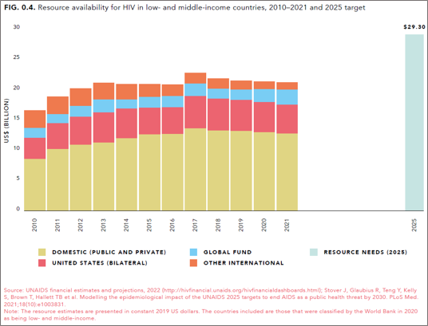
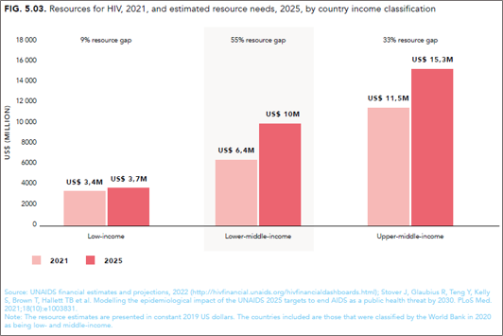
Context of HIV Funding landscape and resource needs(2025)

Slide 3
Market size of antiretrovirals in L&MICs - Why it matters for HIV response?
Estimated market size of ARV commodities in 2020(L&MICs): US$ 4.7 BN, a quarter of all HIV resources.
GAM reporting to UNAIDS from recent 4 years
60 L&MICs reported an expenditure of US$ 1.83 BN on ARV commodities. This was 45% of the total treatment spending reported in these countries amounted to US$ 4BN.
US$ 1831 million
Source: Country reports to UNAIDS through Global AIDS Monitoring, UNAIDS HIV Financial dashboard last accessed Dec 2021

Slide 4
Our study on price monitoring of unit prices of anti retroviral medicines(ARVs)
Data sources
Government reports on procurement volumes and unit costs( price per pack) reported to UNAIDS through Global AIDS Monitoring ( GAM) indicator 8.2
When GAM data was unavailable, data from Government customs of India accessed through SeaAir database.
Scope limited to low-and-middle income countries and high income countries were excluded.
Methods used in the analysis
Average ARV unit prices were extracted from reports to UNAIDS (Global AIDS Monitoring) and government customs to estimate the price trends in 2020 across 1st line and 2 nd line ARV regimens & variations for ARVs in generic accessible low-and-middle-income countries (LMICs)
Treatment line was based on the July 2021 WHO Consolidated guidelines on HIV prevention, testing, treatment service delivery and monitoring.
The treatment price outliers were identified in the whole database before the analysis of ART price per person per year for 1st line, 2nd line and 3rd line.
Notes:
The objective of our modelling work was to estimate the determinants of government spending on HIV in low and middle income countries and also estimate the trends and levels during the last decade.
We employed a panel data random effects regression model for this purpose.
The inputs to create the dependent variable in our model comprised of
Government reports on expenditures by source reported to UNAIDS through Global AIDS Monitoring ( GAM) indicator 8.3
National AIDs spending Assessments (NASAs)
Domestic budgets earmarked to HIV reported to UNAIDs through GAM indicator 8.1
Country reports to PEPFAR Country operational plans( COP)
We had data from South Africa and China which were frequently reported to UNAIDS during the recent years. Together they constituted about US$ 3.3 BN in 2019. Since they were key influencers and had a good trend, we excluded them in our efforts on outlier analysis.
The co-variates we used were …..

Slide 5
How the average prices of ART regimen per person per year were estimated?
Data presented in the databases were procurement data with prices of the ARV formulations - single formulations, dual fixed dose combinations and triple fixed dose combinations (FDC).
Average prices analysed were prices per person per year(PPPY) on ARV treatment
The average price of an ARV treatment regimen was made of a triple FDC’s price PPPY or the addition of a single formulation’s price per person per year (PPPY) on treatment with the average price of a duo FDC PPPY.
No three single ARV formulations’ prices were used. A triple FDC or a duo FDC combined with a single formulation like LPV/r, EFV, DTG, ATV/r was the most used combinations.
Using the data on price per pack, and converting pack size to annual needs of pack per person year, the average price of an annual ARV treatment per person per year (PPPY) for each formulation was estimated.
Notes:
The objective of our modelling work was to estimate the determinants of government spending on HIV in low and middle income countries and also estimate the trends and levels during the last decade.
We employed a panel data random effects regression model for this purpose.
The inputs to create the dependent variable in our model comprised of
Government reports on expenditures by source reported to UNAIDS through Global AIDS Monitoring ( GAM) indicator 8.3
National AIDs spending Assessments (NASAs)
Domestic budgets earmarked to HIV reported to UNAIDs through GAM indicator 8.1
Country reports to PEPFAR Country operational plans( COP)
We had data from South Africa and China which were frequently reported to UNAIDS during the recent years. Together they constituted about US$ 3.3 BN in 2019. Since they were key influencers and had a good trend, we excluded them in our efforts on outlier analysis.
The co-variates we used were …..

Slide 6
Limitations
Due to outliers removed and the countries which had reporting inconsistencies in ARV unit prices, some ART regimens and countries were not included. If the price of these products and outliers are corrected for real prices, it is possible that the average prices presented in this report may be affected.
As data analysed are not consumption data but procurement data, it may be possible that there is lack of uniformity in terms of INCO terms applicable by purchases across various governments and procurement entities. UNAIDS Global AIDS Monitoring establishes standard approaches but the reporting by national governments can vary.
TDF/FTC procured for PrEP may be counted with protease inhibitors for a triple dose regimens in terms of unit costs as it is not easy to distinguish ARVs procured for PrEP from the ARVS for treatment.
The analysis focused on adult ARV regimens as there were pending clarifications concerning the data on bottle packaging from the government customs data.

Slide 7
Results – Number of countries
UNAIDS Region | Number of countries by income level and by region
 | HIC | LIC | LMIC | UMIC | Total
Asia and the Pacific | 1 | 3 | 13 | 8 | 25
Caribbean | 4 | 1 |  | 9 | 14
Eastern and southern Africa | 1 | 8 | 10 | 4 | 23
Eastern Europe and central Asia | 2 | 1 | 4 | 7 | 14
Europe | 3 |  |  |  | 3
Latin America | 3 |  | 4 | 10 | 17
Middle East and North Africa | 2 | 3 | 3 | 5 | 13
Western and central Africa |  | 12 | 9 | 2 | 23
Grand Total | 16* | 28 | 43 | 45 | 132
The analysis focused on adult ARV regimens. 132 countries had data.
They were distributed by UNAIDS region and by income level.
Source: Country reports to UNAIDS through Global AIDS Monitoring, UNAIDS HIV Financial dashboard

Slide 8
Results – ARVs price variation across regions and income groups
Kindly note that the data for Easter Europe and Central Asia/Latin America and Upper middle income countries are reflective of latest available data till 2021 while the data for rest fo the regions are upto 2020.
Source: Country reports to UNAIDS through Global AIDS Monitoring, Indian government customs data accessed through Seaair.co.in

Slide 9
Key messages
Based on the analysis of procurement data, it is encouraging to see that the number of ARV combinations for 1st line treatment is lower than previous years; governments should invest an effort to eliminate from their procurements of d4T and other ARV formulations which are not in line with WHO recommendations.
Second line regimens in Low and lower-middle-income countries are almost thrice as expensive as first line regimens and 8 times more expensive than first line regimens in upper middle-income countries.
It is recommended that countries strengthen the treatment adherence and help patients to stay longer on 1st line treatment and to continue efficient procurement practices using economy of scale through reduced number of ARV combinations.
It is also recommended that the price of 2nd line regimens be brought down in upper middle-income countries, especially in the region of Latin America and Easter Europe and central Asia.
Price reductions for HIV products can free funds to further expand programmes
and upgrade high-impact interventions, such as Long-acting PrEP.

Slide 10
Thank You

