Slide 1
Screening and treatment of common mental disorders at HIV clinics participating in the International epidemiology Databases to Evaluate AIDS (IeDEA) consortium
Angela Parcesepe, Molly Remch, Melissa Stockton, C. William Wester, Charlotte Bernard, Leslie Enane, Andreas Hass, Jeremy Ross, Rogers Ajeh, Keri Althoff, William Pape, Albert Minga, Edith Kwobah, Mpho Tlali, Junko Tanuma, Dominique Nsonde, Aimee Freeman, Denis Nash, Kathryn Lancaster, and the IeDEA Consortium
Client-centred care: Seamless service integration

Slide 2
I have no relevant conflicts of interest to disclose.

Slide 3
Background
Common mental health disorders (CMDs), including depression, anxiety, and post-traumatic stress disorder (PTSD), are highly prevalent among persons with HIV (PWH).
CMDs have been associated with suboptimal HIV treatment outcomes.
Integrating screening and treatment of CMDs into HIV care may improve mental health and HIV treatment outcomes.
Data on integration of CMD screening and treatment into HIV care are scarce.

Slide 4
Study objectives
Describe reported availability of screening and treatment of depression, anxiety, and PTSD at HIV treatment sites participating in the IeDEA consortium in 2020
Examine changes in reported availability of screening and treatment of depression and PTSD from 2016/2017 to 2020 at HIV treatment sites in LMICs

Slide 5
Methods
Site-level surveys of HIV treatment sites were conducted in 2016/17 and 2020
All HIV sites participating in IeDEA were eligible to participate in the 2020 survey
A stratified random sample of IeDEA sites located in LMICs were eligible to participate in the 2016/17 survey
Staff with knowledge of clinic services completed self-administered surveys
Surveys collected information on site characteristics, HIV treatment services, and availability of screening and treatment for depression, anxiety, and PTSD
Changes in availability of depression and PTSD screening and treatment were assessed for clinics that participated in both surveys
Country income group was categorized using the World Bank Income designation (as of July 2021) of the country in which the clinic was located.
Screening was defined as:
Use of a validated tool for screening: when reporting only 2020 data
Any screening (not limited to screening with a validated instrument): when reporting changes from 2016/2017 to 2020

Slide 6
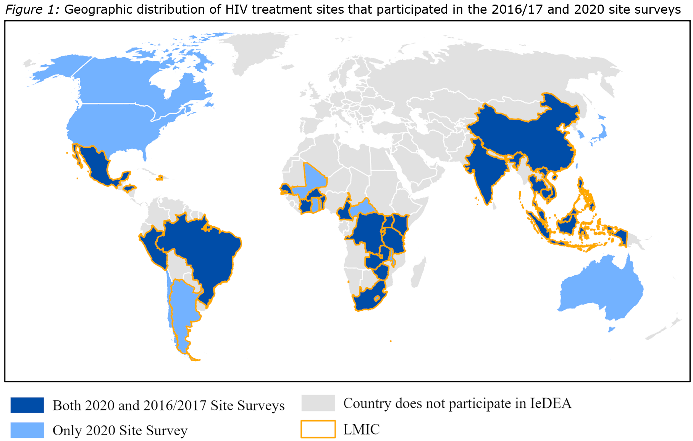
Results
223 sites from 41 countries participated in the 2020 survey
68 sites from 27 LMICs participated in both the 2016/17 and 2020 surveys

Slide 7
Reported availability of mental health screening at IeDEA sites in 2020 (n=223)

Slide 8
Screening availability and site characteristics
 | Screening*
 | Depression N (row %) | Anxiety N (row %) | PTSD N (row %)
Total (N=223) | n=112 | n=32 | n=27
Setting
Urban/mostly urban (n=150) | 80 (53) | 26 (17) | 20 (13)
Mostly rural/Rural (n=70) | 32 (46) | 6 (9) | 7 (10)
Missing (n=3) | 0 | 0 | 0
Population served
Adults or Adults and Children (n=194) | 103 (53) | 26 (13) | 26 (13)
Children only (n=26) | 8 (31) | 6 (23) | 1 (4)
Missing (n=3) | 1 | 0 | 0
IeDEA region
NA-ACCORD (North America) (n=29) | 27 (93) | 7 (24) | 8 (28)
CCASAnet (Latin America) (n=8) | 5 (63) | 1 (13) | 0 (0)
Asia-Pacific (n=51) | 19 (37) | 12 (24) | 3 (6)
East Africa (n=74) | 39 (53) | 5 (7) | 10 (14)
West Africa (n=14) | 1 (7) | 2 (14) | 1 (7)
Central Africa (n=21) | 11 (52) | 2 (10) | 2 (10)
Southern Africa (n=21) | 10 (38) | 3 (12) | 3 (12)
Country income group
Low and Middle Income (n=172) | 75 (44) | 19 (11) | 17 (10)
High Income (n=51) | 37 (73) | 13 (25) | 10 (20)
*Screening with a validated instrument

Slide 9
Mental health screening and treatment in 2020 (n=223)
*Screening with a validated instrument

Slide 10
Changes in screening and treatment from 2016/2017 to 2020 at sites in LMICs (n=68)
*Screening = “Any Screening” (not limited to screening with a validated instrument)

Slide 11
Discussion
Substantial gaps exist in the availability of screening and treatment for CMDs at HIV treatment sites participating in IeDEA.
Particularly in rural, low-income designation, and pediatric HIV treatment settings
Identification and implementation of feasible and sustainable strategies to integrate CMD services into HIV care are needed.
Greater understanding of factors associated with sustainability of integrated services is warranted.
In 2020, almost all sites that reported screening with a validated instrument also reported providing at least one form of treatment.

Slide 12
Limitations
Reported availability of services was not independently verified.
Reported availability of mental health screening and treatment at HIV treatment sites that participate in the IeDEA consortium may not be fully generalizable to sites that do not participate in IeDEA.
Mental health screening instruments used at IeDEA sites may not have been validated in the country, language, or population in which they were used.
Some sub-groups had small sample sizes.

Slide 13
Future Directions
Feasible strategies to assess quality and uptake of integrated care are needed.
The extent to which integration of mental health care into HIV care improves mental health and HIV treatment outcomes requires further study.
The extent to which a lack of mental health screening is motivated by a lack of mental health treatment warrants further investigation.

Slide 14
Thank you
IeDEA site investigators, clinicians, and data managers
IeDEA Site Assessment Working Group
IeDEA Mental Health Working Group
IeDEA Executive Committee

Slide 15
Funding
The International Epidemiology Databases to Evaluate AIDS (IeDEA) consortium is supported by the U.S. National Institutes of Health’s National Institute of Allergy and Infectious Diseases, the Eunice Kennedy Shriver National Institute of Child Health and Human Development, the National Cancer Institute, the National Institute of Mental Health, the National Institute on Drug Abuse, the National Heart, Lung, and Blood Institute, the National Institute on Alcohol Abuse and Alcoholism, the National Institute of Diabetes and Digestive and Kidney Diseases, the Fogarty International Center, and the National Library of Medicine: Asia-Pacific, U01AI069907; CCASAnet, U01AI069923; Central Africa, U01AI096299; East Africa, U01AI069911; NA-ACCORD, U01AI069918; Southern Africa, U01AI069924; West Africa, U01AI069919. Informatics resources are supported by the Harmonist project, R24AI24872. This work is solely the responsibility of the authors and does not necessarily represent the official views of any of the institutions mentioned above. Funding for this work was also provided in part by the National Institute of Mental Health grant K01 MH114721 and the Eunice Kennedy Shriver National Institute of Child Health and Human Development grant P2C HD050924 (Carolina Population Center).

