Slide 1



Successful transition to tenofovir/lamivudine/ dolutegravir (TLD) in PEPFAR-supported countries
Juliana da Silva, MD, Centers for Diseases Control and Prevention
Client-centred care: Seamless service integration
J. da Silva (1), S. Vallabhaneni (1), R. Pati (1), H. Chun (1), C. Malati (2), D. Kiesa (2), J. Rosenfeld (2), M. Belayneh (2), K. Fisher (1), G. Siberry (2), E. Raizes (1),C. Godfrey (3)
Centers for Diseases Control and Prevention, Division of Global HIV and Tuberculosis, Atlanta, United States
United States Agency for International Development, Washington, DC, United States,
Office of Global AIDS Coordination, Washington, DC, United States
Notes:
Good afternoon, I am Juliana da Silva and I will present on the large effort PEPFAR, in partnership with national programs, has undertaken to transition millions of patients to tenofovir/lamivudine and dolutegravir, TLD.

Slide 2
Conflict of Interest Disclosure
I have no relevant financial relationships with ineligible companies to disclose
Notes:
I have no conflict of interest to declare

Slide 3
5 years to the best therapy to all PLHIV
TSEPAMO RAISES POSSIBLE ASSOCIATION BETWEEN DTG AND NTDs IN THE OFFSPRING
MOST COUNTRIES OPT TO HALT OR DELAY TLD TRANSITION
87% OF ARVs DISPENSED TO ADULTS IN PEPFAR-SUPPORTED COUNTRIES ARE TLD.
FDA APPROVES pDTG
2017
2019
2021
2018
2020
2022
TLD RECEIVES FDA APPROVAL
WHO RECOMMENDS DTG AS AN ALTERNATIVE 1st LINE REGIMEN
PEPFAR ISSUES CABLE TO INITIATE TLD ROLL OUT
TRANSITION TO DTG FOR CHILDREN <20kgs BEGINS.
ADDITIONAL DATA HELP MITIGATE CONCERNS AROUND NTDs
WHO RECOMMENDS TLD FOR ALL
Notes:
The history of transitioning patients to TLD starts in 2017, when generic TLD was first approved, leading to its inclusion as an alternative regimen in the WHO guidelines and to PEPFAR first issuing a cable to initiate its roll out.
(CLICK) In 2018, the Tsepamo study in Botswana raised the alert for the possible association between DTG use and the risk of neural tube defects.
As a consequence, most countries opted to stop or delay the transition.
(CLICK) In 2019, additional data helped mitigate these concerns and TLD was recommended by WHO to all populations. (CLICK) In 2020, FDA approved pediatric DTG and in (CLICK) 2021 the transition to pDTG in children less than 20Kg has begun. (CLICK) In 2022, 87% or ARVs dispensed to adults in PEPFAR-supported countries are TLD.

Slide 4
How did PEPFAR monitor TLD uptake?
Primary data source are drug-dispensation indicators.
  ARV dispensation indicators reports number of bottles dispensed, not as number of patients who received the drugs.
Correlation between drug dispensation and viral suppression is inferred temporally but does not reflect data on individual patients ascertained as having taken TLD.
ARV dispensation not reported by sex
Notes:
PEPFAR monitored TLD uptake by using drug-dispensation indicators that report on number of bottles distributed, converted to 30-pill bottle count, but not on the number of patients receiving these drugs.
This could lead to some distortions, for example a single 90-day bottle is dispensed to one patient, as opposed to three 30-day bottles being dispensed to three patients.
Therefore, the correlation between drug dispensation and viral suppression can only be inferred by how these two measures evolved
These indicators are also not disaggregated by gender

Slide 5
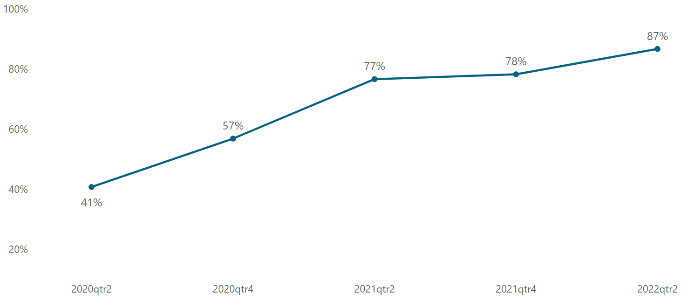
TLD dispensation more than doubled in two years
Percentage of TLD bottles among all antiretrovirals dispensed to adults in PEPFAR-supported countries, March 2020—March 2022
*35 countries

Slide 6
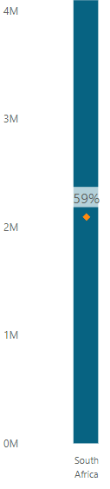
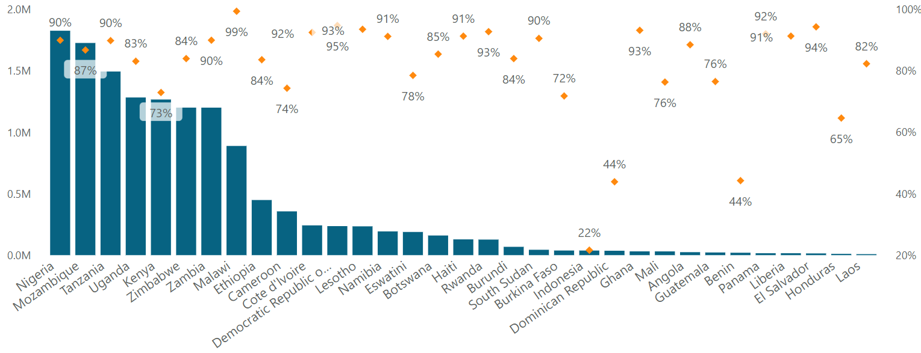

Most large national programs have >80% of TLD dispensation
Number of PLHIV on ART by country versus % dispensed bottles that were TLD
PLHIV on ART
% of dispensed bottles that were TLD
Data source: PEPFAR MER indicators
Notes:
This increase was mostly driven by large programs with over one million PLHIV, to the left of the red dashed line.
All but two national programs with more than one million PLHIV, had over 80% TLD dispensation.

Slide 7
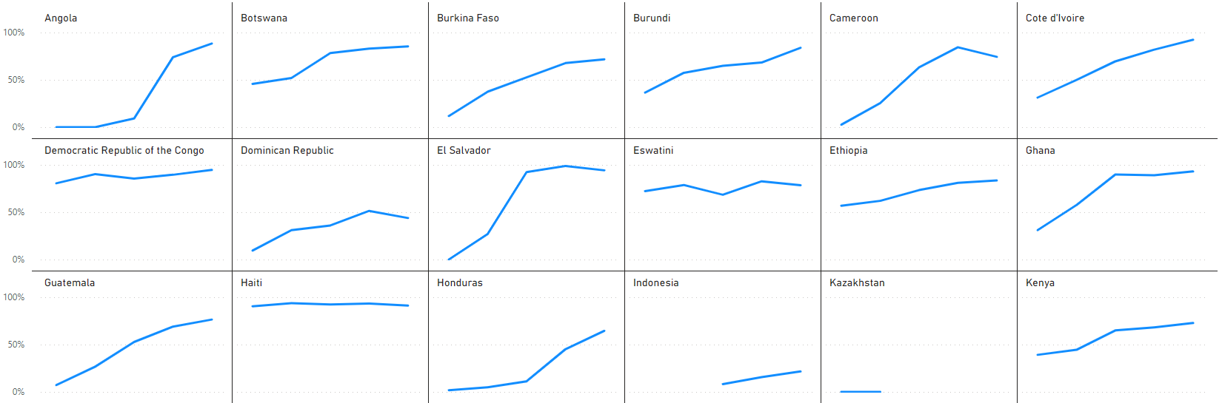

Timing of TLD adoption varied among countries
% of dispensed bottles that were TLD, March 2020—March 2022
Data source: PEPFAR MER indicators
Notes:
But the uptake of TLD differed by both timing and rate at the country level. Here we see countries ordered alphabetically, and each individual graph shows % of dispensed bottles that were TLD.

Slide 8
Timing of TLD adoption varied among countries
% of dispensed bottles that were TLD, March 2020—March 2022
Data source: PEPFAR MER indicators
Notes:
Note some of the countries, such as Botswana, DRC and Haiti, were early adopters

Slide 9
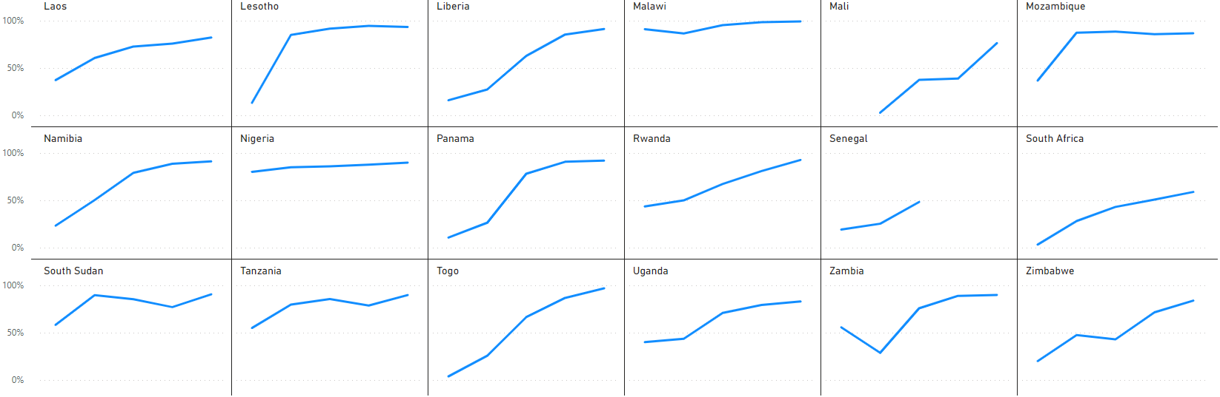
Rate of TLD adoption varied among countries
% of dispensed bottles that were TLD, March 2020—March 2022
Data source: PEPFAR MER indicators
Notes:
While other countries, such as Lesotho and Mozambique were rapid adopters, thanks to broad policies that allowed simultaneous uptake in multiple sub-populations in these countries

Slide 10
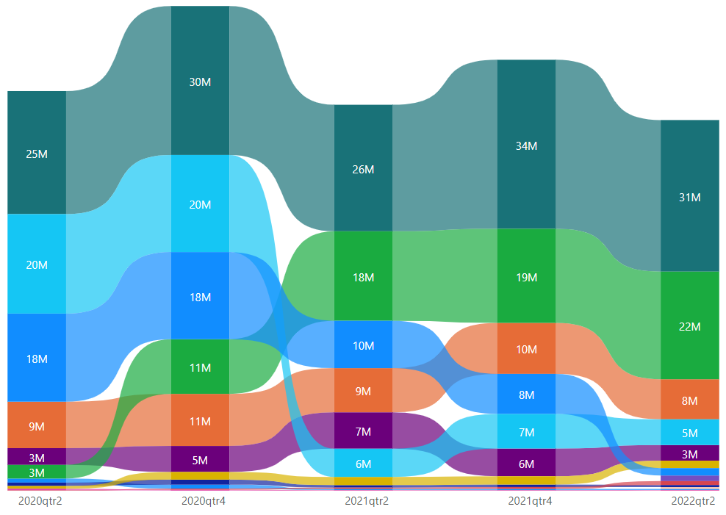
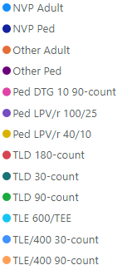
TLD use drove overall ARV optimization
Number of bottles dispensed across PEPFAR-supported countries March 2020—March 2022
Data source: PEPFAR MER indicators
Notes:
This figure shows volume of ARV bottles dispensed overtime, by different regimens, bottle counts and in adults and pediatric formulations.
Lets take a closer look at what has happened

Slide 11
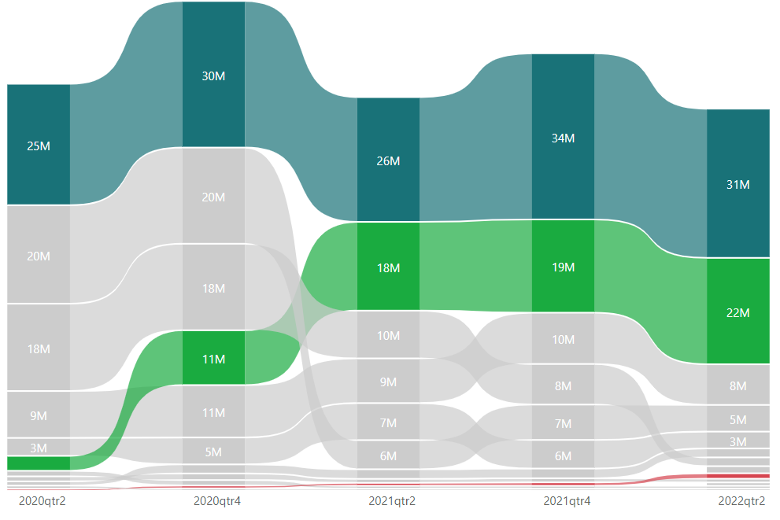
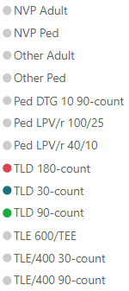
Multi-month TLD bottles on the rise
Number of TLD bottles dispensed across PEPFAR-supported countries March 2020—March 2022
Data source: PEPFAR MER indicators
Notes:
The number of TLD bottles continued to increase, and 90-day pill bottles, supporting multi-month dispensation polices, are on the rise

Slide 12
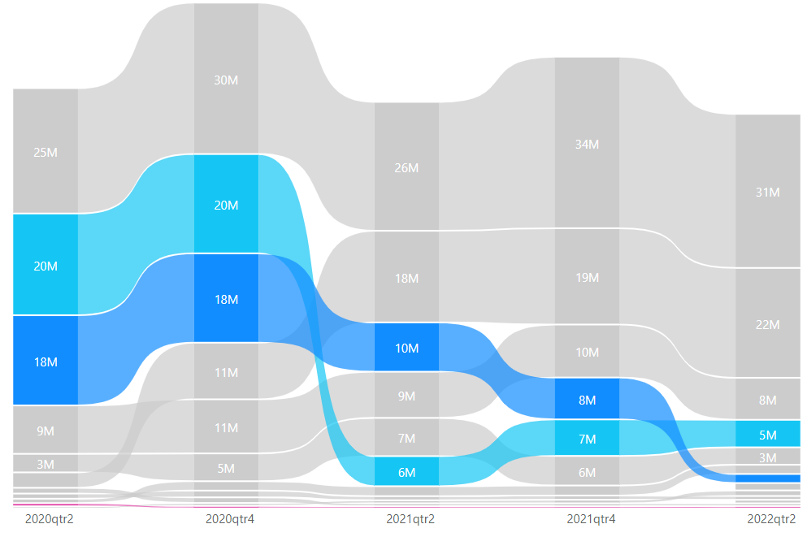
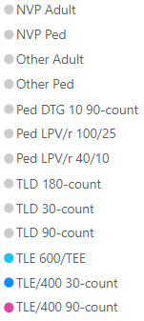
TLE dispensation has decreased
Number of TLE bottles dispensed across PEPFAR- supported countries March 2020—March 2022
Data source: PEPFAR MER indicators
Notes:
TLE, both 600 and 400 had a striking decrease

Slide 13
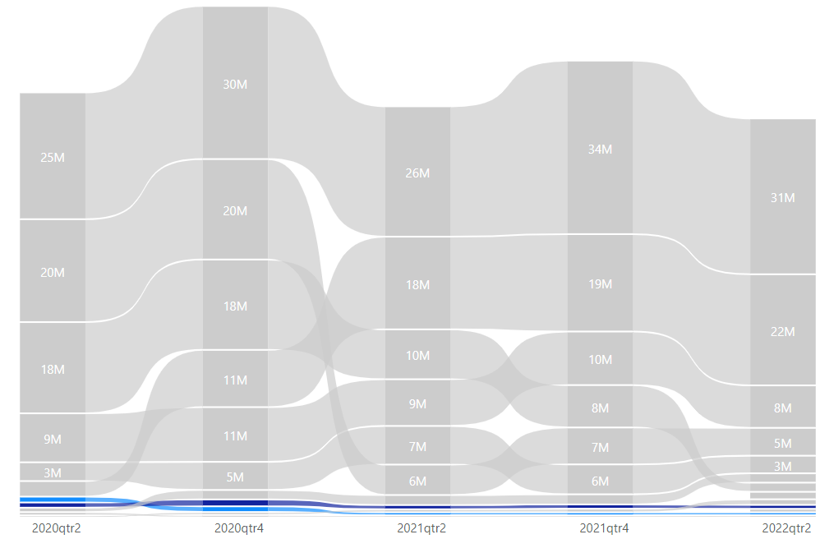
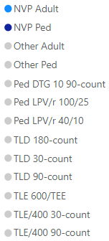
NVP use has been nearly
eliminated
Number of NVP bottles dispensed across PEPFAR- supported countries March 2020—March 2022
Data source: PEPFAR MER indicators
Notes:
And NVP use for both adult and children has been nearly eliminated

Slide 14
What program and policy strategies enabled a rapid transition to TLD?
Notes:
So how was this achieved, and what program and policy strategies enabled a successful transition?

Slide 15
Programmatic simplicity and removal of policy barriers
Promotion of streamlined clinical guidance
Removal of viral load testing requirement
Optimized supply chain practices
Notes:
We identified 6 key strategies that allowed for these results (CLICK)
First, was the promotion of streamlined clinical guidance
PEPFAR worked with national programs to advocate for the adoption of TLD as preferred regimen for naïve, suppressed, non-suppressed and individuals with unknown VL status,
As well as for both male and female adults, adolescents and eligible children, thus simplifying supply chain and implementation at the site level
(CLICK)
Second, it advocated for the removal of viral load testing requirement prior to transition, since most patients were not expected to have multi-class drug resistance and a single pill for second line had the potential to improve adherence.
(CLICK)
Third it adopted optimized supply chain practices:
A low price point for TLD, at 75USD per patient/year, was lower than TLE and drove demand and production. This led to a competitive marketplace that further reduced the price to approximately 50 USD per patient-year.
PEPFAR also discouraged the procurement of NVP and created a review process for orders of TLE.

Slide 16
Partnership with civil society and national governments
Adoption of a risk-benefit approach
Civil society advocacy
Country and multilateral partnership
Notes:
In addition, once more data provided reassurance regarding the safety of DTG, PEPFAR adopted a risk benefit approach, encouraging shared decision-making with women of childbearing-age and recommending against additional barriers to care such as written consent and mandatory contraception.
(CLICK) None of the previous strategies would have been successful without the pivotal role civil society played in demand creation and in advocating against gender dipartites in drug access.
(CLICK) And finally, partnership with national programs, implementing partners and multilateral organizations allowed for synergies in lessons learned and in addressing policy barriers as they emerged

Slide 17
What was the impact of increased TLD uptake on viral suppression?
Notes:
So what was the impact of increased TLD uptake on viral suppression?

Slide 18
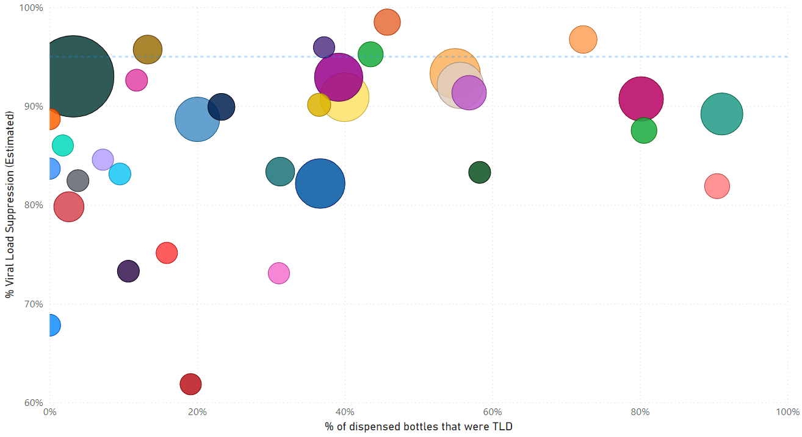
Impact of TLD dispensation on viral suppression by country- 2020
%Viral load suppression
% of dispensed bottles that were TLD
Proxy viral load suppression: % of VL <1000 cps/ml among those tested
Data source: PEPFAR MER indicators
Notes:
Here we display proxy VLS per % of dispensed TLD. Each bubble represents a country, and its size is proportional to the number of PLHIV on ART in that country. Note how countries progress from march 2020

Slide 19
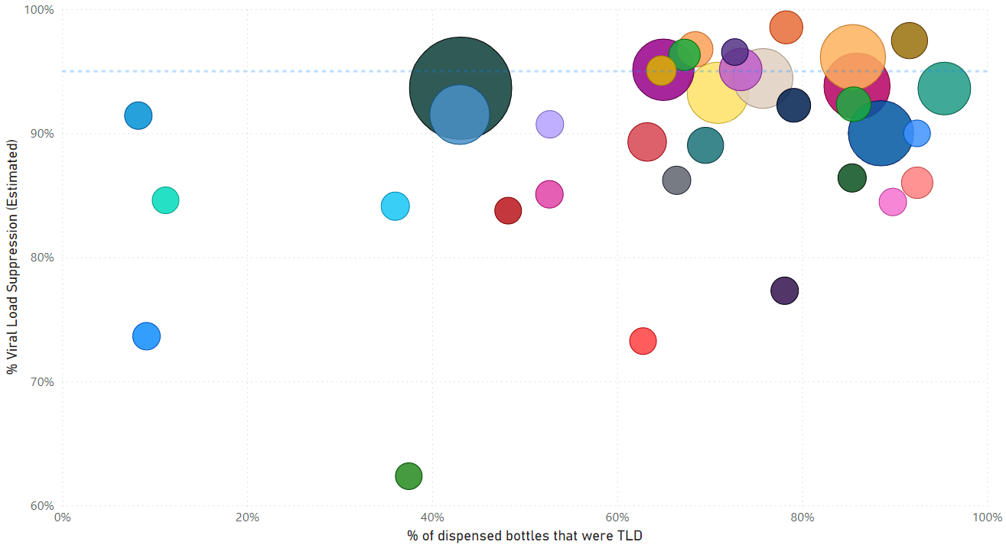
Impact of TLD dispensation on viral suppression by country- 2021
%Viral load suppression
% of dispensed bottles that were TLD
Proxy viral load suppression: % of VL <1000 cps/ml among those tested
Data source: PEPFAR MER indicators
Notes:
To march 2021

Slide 20
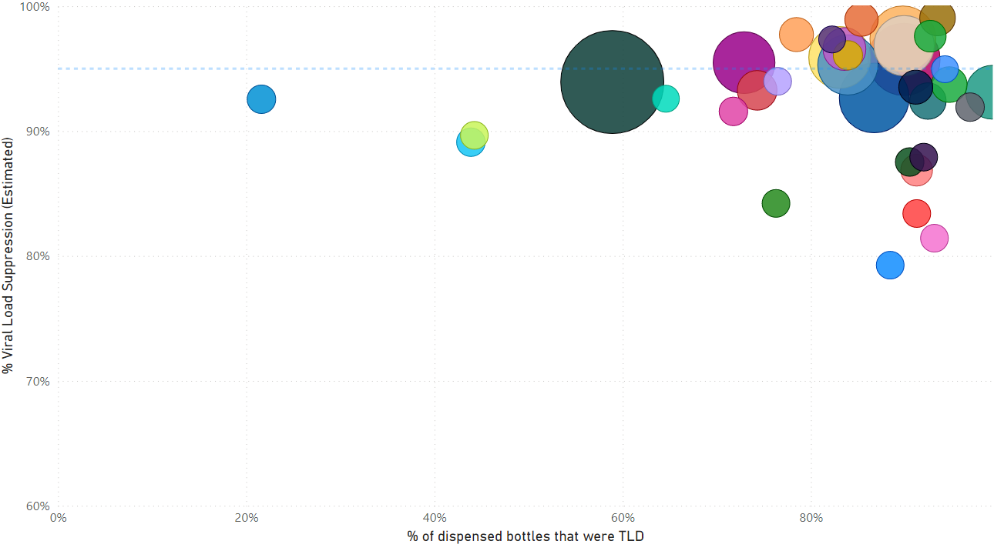
Impact of TLD dispensation on viral suppression by country- 2022
%Viral load suppression
% of dispensed bottles that were TLD
Proxy viral load suppression: % of VL <1000 cps/ml among those tested
Data source: PEPFAR MER indicators
Notes:
And tend to cluster in the right upper corners in march 2022

Slide 21
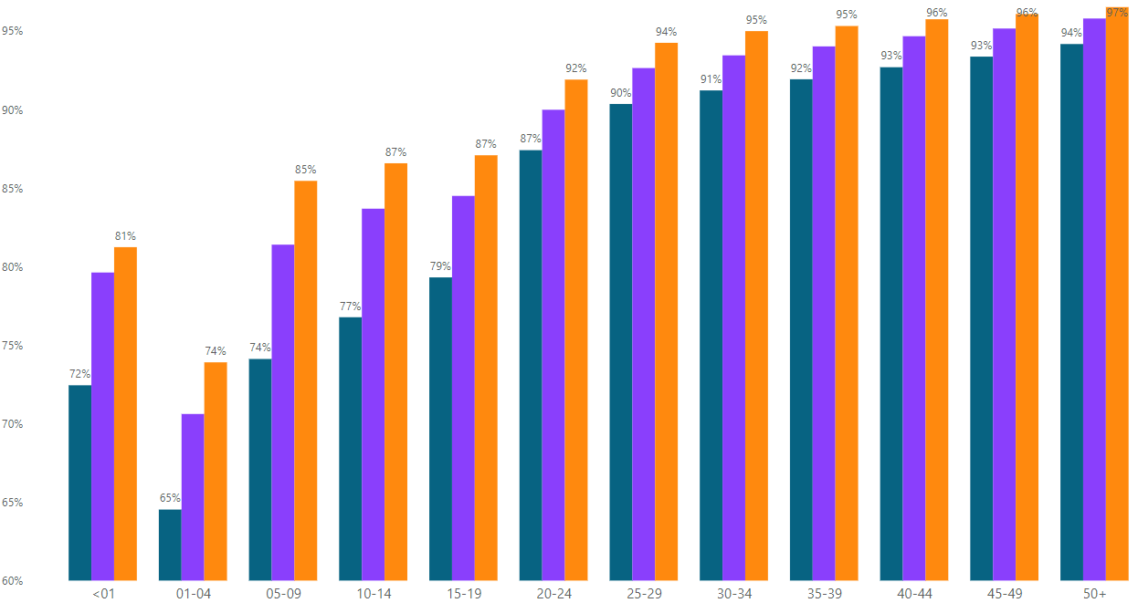

Viral suppression has improved in all age bands, but less in children
Viral load suppression among PEPFAR-supported countries by age, March 2020—March 2022
%Viral load suppression
Data source: PEPFAR MER indicators
Notes:
Virologic suppression has improved over time across all age bands, however, children under 19 years, and specially children under 5, still lag behind.

Slide 22
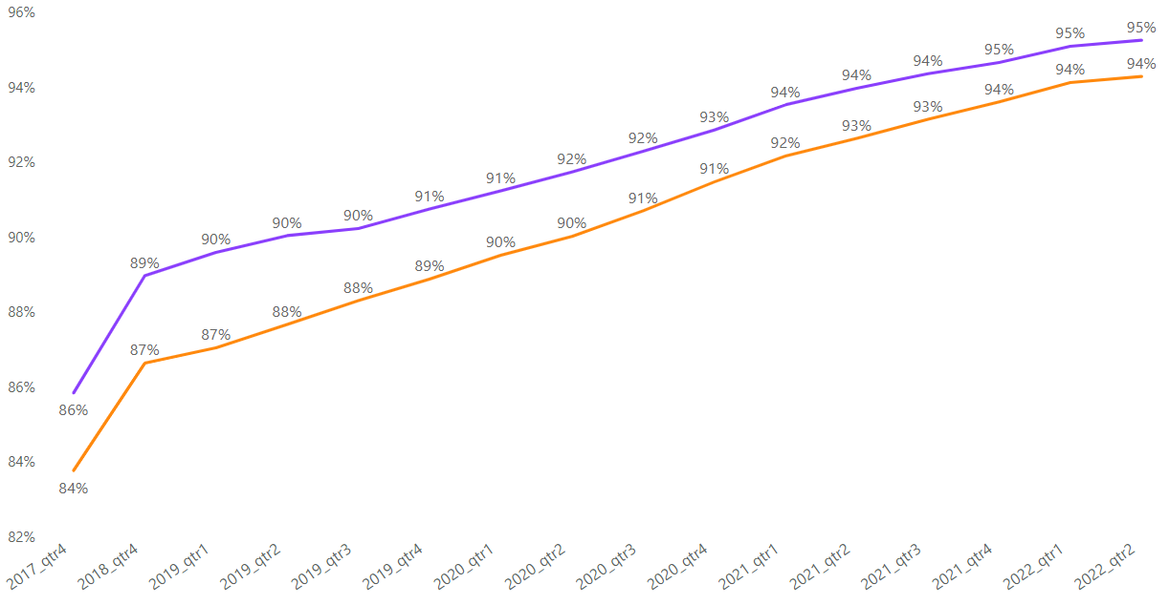
Men and women have similar gains in viral suppression
%Viral load suppression
Viral suppression by sex from 2017—2022 across all PEPFAR-supported countries
Female
Male
Data source: PEPFAR MER indicators
Notes:
Although there were concerns over TLD access for women, both women, in light blue, and men, in dark blue, had similar gains in viral suppression. Note that because both viral load coverage and the number of patients on ART have sizably increased in this period, this represent millions of additional patients achieving viral suppression

Slide 23
Policy and programmatic simplicity enabled successful TLD transition
TLD adoption had measurable impact on viral suppression, but not all age groups were equally benefited.
  Unable to verify drug dispensation vs patients receiving drugs
Rapid uptake of pediatric DTG is a high priority to address age disparities in viral suppression.
Drug resistance surveillance is crucial to preserve DTG effectiveness, but adherence support is the key intervention for patients failing TLD.
Notes:
In summary, the lesson here is to keep it simple: streamlined guidance, supply chain management, removal of policy barriers and partnership with civil and governmental organizations allowed for the vast majority of the 18.5 million patients served by PEPFAR to receive the same high-quality drugs dispensed in high-income countries.
These strategies serve as a roadmap for the scale up of other biomedical interventions in order to increase care equity in HIV and other diseases.
TLD contributed to improved viral suppression in adults, although we acknowledge the limitations of supply chain indicators, since we are unable to verify individual country data.
PEPFAR will continue to work with country partners to ensure that the same excellent results are achieved for children through the uptake of pediatric. But 95% viral suppression is not enough, and the gains resulting from TLD transition will need to be preserved by drug resistance surveillance and by improved adherence support.
.

Slide 24


Thank you
Neha Mehta- CDC
Co-authors
National programs that rolled-out TLD

Slide 25
Additional slides

Slide 26
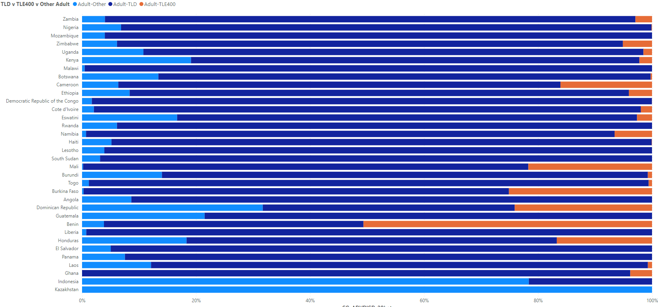
ARV dispensation landscape across PEPFAR- March 2022
.
Proportion of 30-day bottle dispense that were TLD
Data source: PEPFAR MER indicators
Notes:
Healthcare worker reticence of TLD use in women.
Protease inhibitors continue to be used in second line
BIG message is that programs are not routinely shifting adults from PIs to TLD, in large part due to lack of WHO leadership on this.

