Slide 1
Quality of Life for Young Women and Girls: Is it achievable?

Slide 2
Partners

Slide 3
Access to quality health care services
Cost effective
Non judgemental accessible
Youth friendly
Environment
Conducive for participation and growth
Career,
Psychosocial Support
Physical, emotional, spiritual, financial

Slide 4
What Is Working
Inclusion
Programming
Design, implementation, monitoring and evaluation
Peer Led programmes/ interventions
(safe spaces, young mothers, treatment clubs)
Livelihoods
Comprehensive training and seed capital
Mentorship
Policy level, community, soft skills, business

Slide 5
GAPS
Gender in equality
Top down approach in implementation
Resources
Mentorship

Slide 6
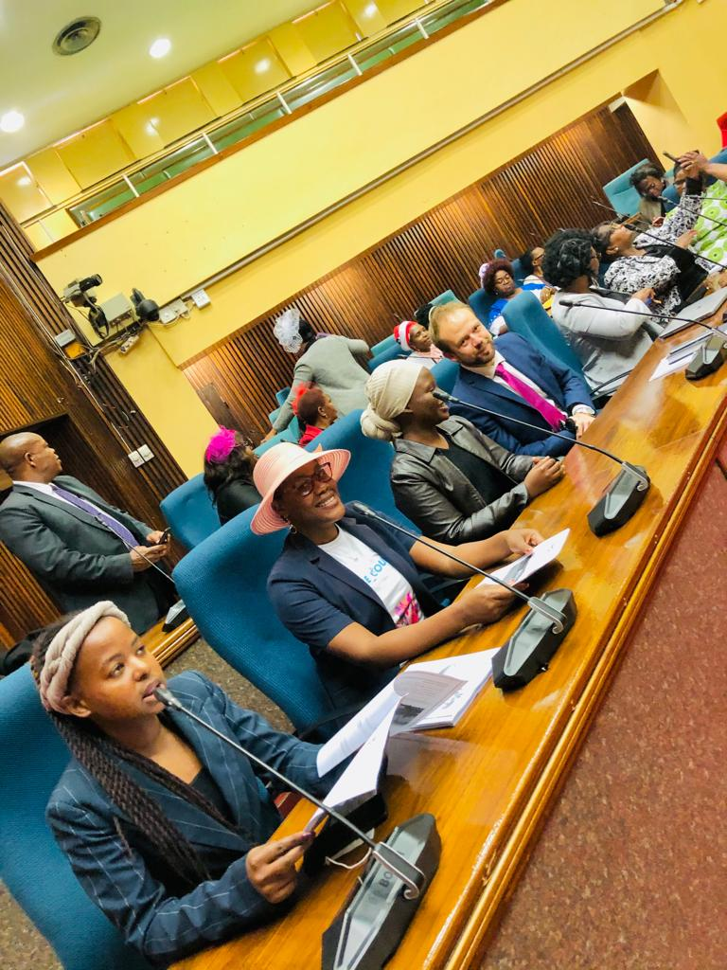
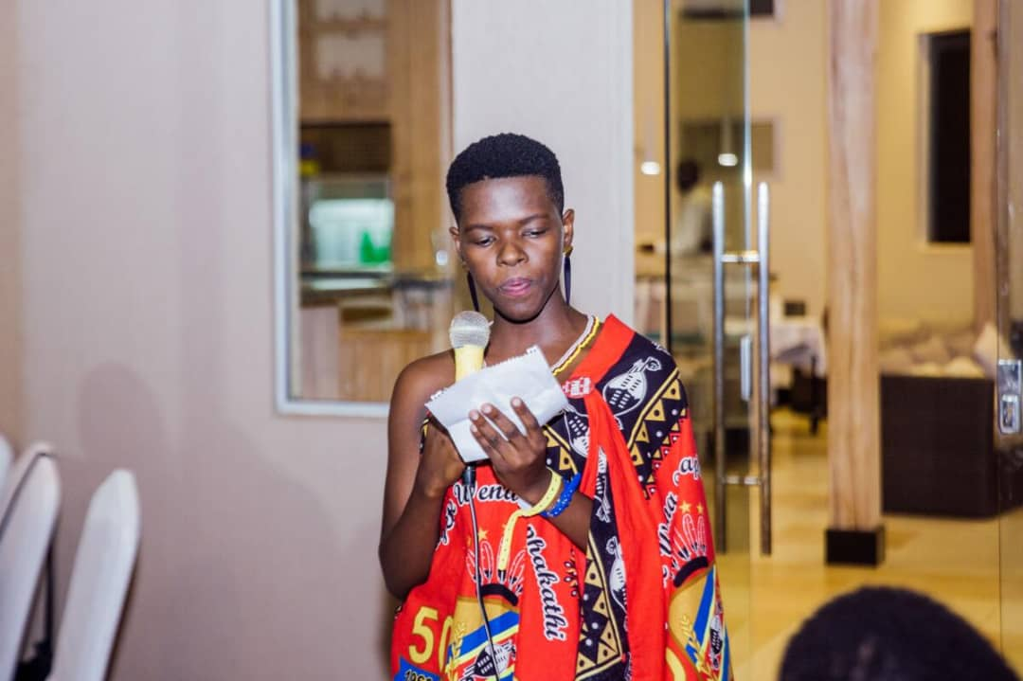
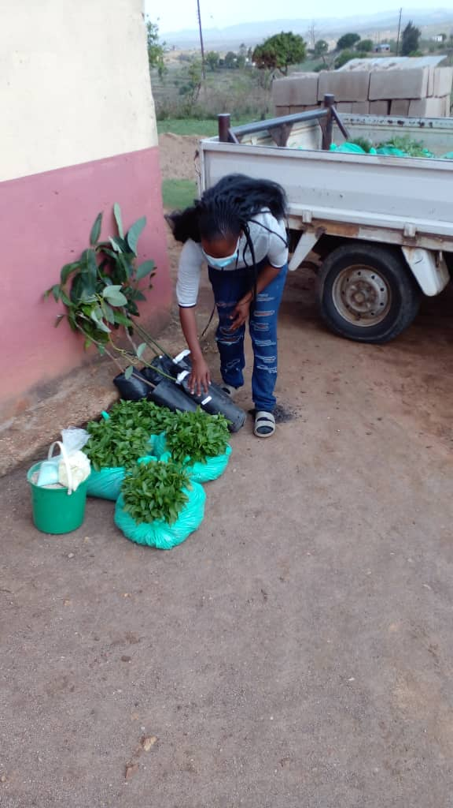
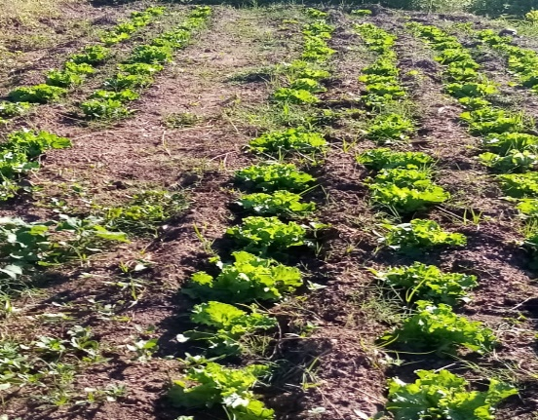
Young Women and Girls Can!

