Slide 1
Conflict of interest disclosure
I have no relevant financial relationships with ineligible companies to disclose.

Slide 2
Human rights violations faced by women from key populations in Ukraine: evidence collected through the community-based monitoring approach
Nadiia Semchuk,
ICF "Alliance for Public Health", Ukraine
Nothing about us without us:
Community-led responses and research
Notes:
Good afternoon, dear participants!
My name is Nadiia Semchuk. I am representing Alliance for Public Health, Ukraine.
It is a great honor to me that you are having me today here. Thank you so much for such an opportunity.
Today I will be presenting the evidence collected on human rights violations faced by women from key populations in Ukraine.

Slide 3
Background
Gender inequality
Increase women vulnerability to HIV
Prevent from adequate access to HIV, harm reduction and other health and legal services
Influence actual use of these services
Have an overall impact on HIV-related national outcomes
Multi-layered stigma
Denial of services
Violence
Discrimination
Notes:
Women remain vulnerable to HIV. Such factors as gender inequality, violence and discrimination, multi-layered stigma towards women, as well as denial of services, prevent women from accessing and actual use of HIV, harm reduction and other health and legal services. Those factors stand as significant barriers and public health issues and have a negative impact on HIV-related national outcomes.

Slide 4
Methods: REAct System Overview
REAct (Rights – Evidence – ACTions) is a system that was developed by Frontline AIDS (UK).
The system is implemented by
ICF “Alliance for Public Health” (Ukraine) with the financial support of the Global Fund.
Data is collected by REAct online system that is used for monitoring and response to human rights violations of key populations at community level.
System allows to:
DOCUMENT barriers and rights violations of key populations in their access to HIV and other health care services, dealing with police
RESPOND to identified barriers
ANALYZE data using built-in features of the software platform DHIS2
USE data for informing programs and changing policies
Notes:
The data presented today is collected using the REAct (which stands for Rights – Evidence – ACTion) online system that is used for monitoring and response to human rights violations of key populations at community level.
System allows to document barriers when accessing services, dealing with polce, respond to those barriers, analyze data and use it for informing programs and changing policies.
The system was developed by our partner Frontline AIDS (United Kingdom) and they are implementing the system now. However, Alliance for Public Health is managing now its own REAct project with a financial support of the Global Fund.

Slide 5
Notes:
REAct is designed for civil society organisations to document data about human rights violations experienced by individuals within the communities they serve. They also provide and refer them to health, legal and other public services; and use the data collected to inform quality human rights-based HIV programming, as well as policy and advocacy at national, regional and global levels.
This illustrates the REAct programme in a nutshell, from REActor to how the evidence can be used to inform better programming and for advocacy
How REAct works?
Trained staff in NGOs at local level register a case of human rights violations into the database (online\offline\mobile).
Provide an individual response directly or by referral to other services.

Slide 6
REAct Coverage
Start Year: 2019
NGOs: 174
REActors (registration and response): 363
Implementing countries: 12
Cases of human rights violations registered: 11, 768
Notes:
Here you can see deliverables of REAct System implementation under the Alliance for Public Health management.
Since the start of the system in 2019, there were registered more then 11 000 of cases of human rights violations among key groups in 12 implementing countries.
More then 300 of REActors in more then 170 NGOs are engaged in cases registration and provision of individual response in these countries.

Slide 7
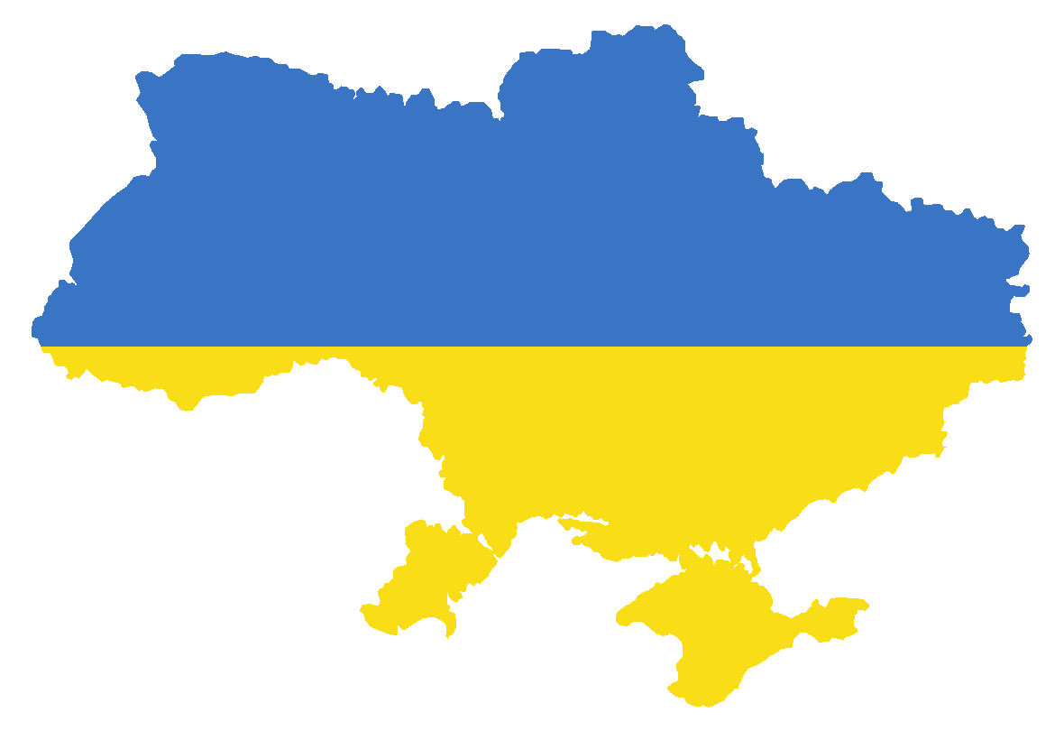
REAct in Ukraine
4,361
Cases registered
Regions:
17 out of 24
NGOs: 77
REActors (registration and response): 103
4,217
Clients applied
88%
Resolved
1,737
Women
35
Transgender women
Data as of 01.06.2022,
REAct database
Notes:
As of 1st June 2022, the system is implemented in 17 out of 24 regions in Ukraine by 103 REActors from 77 NGOs.
In total since the start there were registered more then 4000 of cases, among them more then 1000 of cases were registered among women and transgender women. About 90% of all cases are fully or partially positively resolved.

Slide 8
Women Profile in REAct System
Data as of 01.06.2022,
REAct database
One client can belong
to several KP groups
Notes:
The majority of women, the REAct clients, belong to such key groups as women living with HIV, injecting drugs, receiving OST, and sex workers.
It should be mentioned that this data only reflect who the data is coming from and not necessarily mean that human rights violations occurred mostly within these groups in such proportions.

Slide 9
Key perpetrators
Data as of 01.06.2022,
REAct database
One case can contain several types of perpetrators
Notes:
The main perpetrator of women rights is state, it accounts for 70% of cases. In particular the state is represented by health workers, police, social services provider, local authority and other.
Inner circle of women like sexual partner, family, neighbor account for 15% of registered cases.
Private individuals like private health care workers, employer, provider of private services account for 9%
(like stores, recreation and shopping malls, eateries, sports facilities, beauty care, hair and massage salons, swimming pools and saunas, etc.)
And other perpetrator for 5%. It should be mentioned that One case can contain several types of perpetrators.

Slide 10
Key human rights violations and most common types of incidents
One case can contain several types of incidents
71% Health care services
Inpatient/outpatient medical care (not related to HIV/TB)
OST provision/dosage reduction
56% Verbal abuse
32% Domestic violence
39% Deprivation/destruction
of personal property
30% HIV status disclosure
Data as of 01.06.2022,
REAct database
Notes:
The majority of cases connected with a denial to provide services or assistance because of key population status of women and mostly it is about health services such as Inpatient/outpatient medical care (not related to HIV/TB), OST provision/dosage reduction.
Other most common types of incident that women are facing are verbal abuse, domestic violence, deprivation/destruction of personal property, HIV status disclosure.
As with the perpetrator once case also can contain several types of incidents.

Slide 11
“A woman who was drugged by her husband in her youth, for many years is being abused by her husband who also forced her to engage in sex work, so that he could have money for drugs. She sought out to the police several times, where they told her that she could be arrested for drug use and sex work, and that they could not help her because she knew what she was doing”
REAct Case Story
Notes:
Here is a REAct Case Story from a women who belong to several key groups illustrating multiple vulnerability that women may and actually are facing. This is an example of influence on the ability of women to adopt protective behaviours, to seek services and use them.

Slide 12
russia invasion to Ukraine
War crimes
Forced migration within Ukraine and abroad
Increased risks of sexual, physical violence
Barriers in ensuring access to proper health and legal services
Today is a
158 day of russian aggression in Ukraine
Notes:
Today is a 158 day of russian aggression in Ukraine
Russian aggression, in addition to war crimes against representatives of key communities, forced migration within Ukraine and abroad, Russia invasion has had a negative impact on ensuring the proper health, social, legal and other services, as well as and the ability to defend the rights of women in cases of human rights violations.

Slide 13
Conclusions
Understanding of human rights violations among women from key populations enable to:
identify their actual needs in health and legal services,
ensure access to HIV-related and other health and legal services and their actual use,
facilitate women empowerment and gender equality in the context of HIV,
produce evidence-informed recommendations to promote effective HIV response.
Notes:
Having picture of the scale and types of human rights violations among women from KP groups it is important to gain a broader perspective on their needs and plan more effective responses, to ensure access to HIV and other health and legal services, facilitate women empowerment and gender equality in the context of HIV, produce evidence-informed recommendations to promote effective HIV response.

Slide 14
Thank you for attention!

