Slide 1
Characteristics associated with viral suppression among transgender women with HIV in 7 U.S. cities
Johanna Chapin-Bardales U.S. Centers for Disease Control and Prevention
Optimizing the HIV care continuum
Notes:
Hello, I’m Johanna Chapin-Bardales and I will be presenting on behalf my co-authors our abstract: Characteristics associated with viral suppression among transgender women with HIV in 7 U.S. cities

Slide 2
Disclosures & Disclaimers
I have no relevant financial relationships with ineligible companies to disclose.
The findings and conclusions of this presentation are those of the authors and do not necessarily represent the official position of the Centers for Disease Control and Prevention. Use of trade names is for identification only and does not imply endorsement by the U.S. Department of Health and Human Services, the Public Health Service, or the Centers for Disease Control and Prevention.
Notes:
Here are my disclosures and disclaimers.

Slide 3
Studies of transgender women and their experiences with HIV are limited
Improve quality of life
Treat people with HIV rapidly and effectively to reach sustained viral suppression
Reduce transmission to sexual partners
Notes:
Transgender women are disproportionately affected by HIV in the U.S. Yet, studies of transgender women and their experiences with HIV are limited.
*Click* The Treat pillar of the ending the HIV epidemic in the U.S. seeks to treat people with HIV rapidly and effectively to reach sustained viral suppression. *Click* Viral suppression, meaning having a low amount of HIV virus in one’s body, can *Click improve one’s quality of life and being virally suppressed to the point where virus is undetectable *Click* can greatly reduce the risk of transmission to sexual partners. In our analysis, we sought to understand which transgender women with HIV may need additional support towards becoming virally suppressed in order to inform interventions for ending the HIV epidemic in the U.S.
In addition, because many behavioral studies rely on *Click* self-reported measures of viral suppression which are subject to recall and other biases, we sought to look at this question using biological markers of viral suppression in our analysis.

Slide 4
NHBS-Trans
Seattle
Formative work with community & hiring local staff prior to data collection
June 2019 to February 2020 data collection
New York City
San Francisco
Respondent driven sampling
Philadelphia
Los Angeles
Eligibility:
18 years old or older
Assigned male at birth or intersex
Reported a gender identity of woman or transgender woman
Resided in a participating city
Atlanta
New Orleans
Participants completed a survey, HIV testing, and dried blood spots (DBS)
Notes:
The National HIV Behavioral Surveillance, or NHBS, Trans study took place in the 7 U.S. cities shown on the map to the left. NHBS-Trans began with a year of formative work with the trans communities in each of these cities and focused on hiring local staff with work or lived experience in the trans community. *Click* NHBS-Trans data collection then took place between June 2019 to February 2020. *Click* Transgender women were recruited via respondent driven sampling. This project primarily sought to assess the needs of transgender women of color, therefore recruitment began with initial seed participants who identified as Black or Hispanic/Latina. *Click* Recruited persons were considered eligible if they were at least 18 years old, were assigned male at birth or intersex, reported a gender identity of woman or transgender woman, and resided in a participating city. *Click* Participants completed a survey, HIV testing, and dried blood spot, or DBS, card.

Slide 5
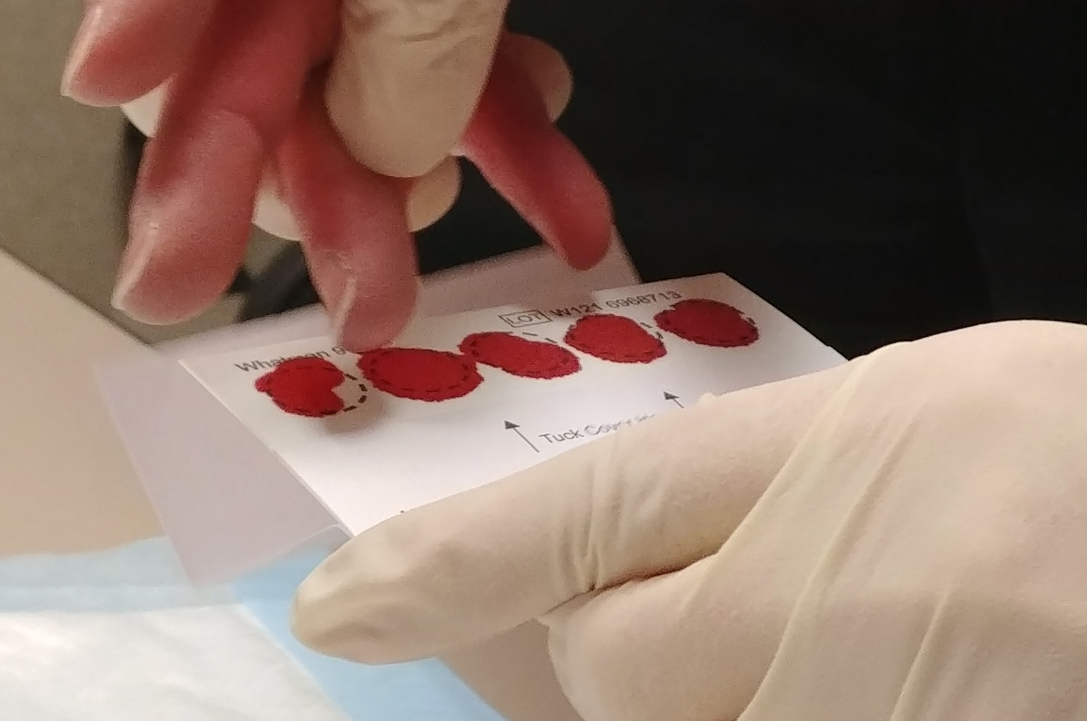
HIV testing & DBS collection
Rapid-rapid HIV testing algorithm
An initial reactive rapid HIV test result was confirmed with a second orthogonal rapid test or self-reported previous positive test
DBS collection
DBS were collected from HIV-positive participants
5 spots collected on filter paper
Notes:
Project areas conducted a rapid-rapid HIV testing algorithm in which all consenting participants received a rapid HIV test. And an initial reactive rapid test was confirmed with a second orthogonal rapid test or a self-reported previous positive test in the interview.
DBS were collected from HIV-positive participants and this consisted of 5 blood spots collected on filter paper. The DBS were then packaged and sent to the CDC HIV lab.

Slide 6
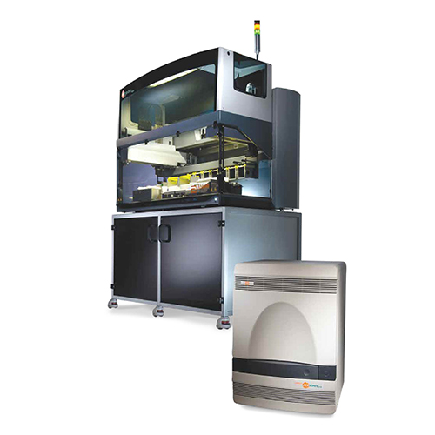
HIV viral load testing
HIV-1 viral load kits for use on the Abbott RealTime m2000 system
Modified, laboratory-validated protocol for testing on DBS¹
Limit of detection at 832 copies/mL
Photo: https://www.molecular.abbott/us/en/products/instrumentation/m2000-realtime-system
¹Luo W, Sullivan V, Chavez PR, et.al. The feasibility of modified HIV and antiretroviral drug testing using self-collected dried blood spots from men who have sex with men. BMC Infect Dis. 2021 May 5;21(1):423.
Notes:
At CDC, we tested for HIV viral load using HIV-1 viral load kits for the Abbott RealTime m2000 system. A modified, laboratory-validated protocol for this testing on DBS was conducted to obtain viral load results for analysis.

Slide 7
Analysis
Viral suppression
Viral load result <1000 copies/mL in DBS
Statistical approach
Frequencies of viral suppression overall and by key characteristics
Adjusted prevalence ratios (aPR) and 95% confidence intervals (CI)
Poisson regression models with robust standard errors accounting for clustering by RDS recruitment chain and adjusting for city and network size
Notes:
Our main outcome for this analysis was viral suppression. This was defined as having a viral load result less than 1000 copies/mL in DBS.
We analyzed frequencies of viral suppression both overall and by key characteristics. We also obtained adjusted prevalence ratios and their 95% confidence intervals from Poisson regression models with robust standard errors accounting for RDS recruitment chain and adjusting for city and network size.

Slide 8
Results
1,561
eligible, consented, and had a valid final HIV test result
659
had a final HIV test result that was HIV positive
496
consented to blood specimen storage, provided DBS, and had valid HIV viral load test result
42% living with HIV
Notes:
And here are our results.
A total of 1,561 recruited persons were considered eligible to participate in NHBS-Trans, consented to the survey and HIV testing, and had a valid final HIV test result. *Click* Of these, 659 had a final HIV test result that was positive. *Click* This meant that about 42% of transgender women in our study were living with HIV.
*Click* Among these persons, 496 consented to storage of blood specimens, provided DBS with sufficient spots, and had a valid viral load test result. This was our analytic sample moving forward. *Click*

Slide 9
Results
81% virally suppressed
Notes:
*Click* When we looked at viral suppression overall among these participants, we found that 81% were virally suppressed based on our testing.

Slide 10
Percentage of participants with HIV that were virally suppressed
Percentage (%)
Other
30-39
Black
White
18-29
≥40
≤High school
≥College
Hispanic
Some college
Age (years)
Race/ethnicity
Education
Notes:
We then assessed viral suppression by key characteristics. By age, we found a higher percentage of participants ages 40 and older to be virally suppressed, at 86%.
By race/ethnicity, a higher percentage of Hispanic/Latina participants, at 88%, were virally suppressed.
By education, a much higher percentage of transgender women who had a college degree or higher were virally suppressed at 93%.

Slide 11
Percentage of participants with HIV that were virally suppressed
Percentage (%)
≤$10k
No
None
Other
≥$40k
Yes
Private
$10k-20k
$20k-$40k
Public
Homeless (past 12 months)
Health insurance
Annual income
Notes:
By income, we did not see a particular pattern across income groups.
We did however see that those who had been homeless in the past 12 months had a lower percentage that were virally suppressed at 76%.
By health insurance, most notably those without health insurance had a much lower percentage that were virally suppressed at 71%.

Slide 12
Percentage of participants with HIV that were virally suppressed
Percentage (%)
Yes
No
Yes
No
Yes
No
Yes
No
Comfort with healthcare provider
Unmet need for healthcare due to cost (past 12 months)
Usual source of healthcare
HIV care visit (past 6 months)
Notes:
We also looked important health care-related variables.
We asked whether participants had a usual source of healthcare when they were sick and those that did had a slightly higher percentage that were virally suppressed than those who did not.
A much higher percentage of transgender women who had an HIV care visit in the past 6 months were virally suppressed, at 83%, compared with 68% for those who did not have a regular visit.
We asked whether participants had a healthcare provider with whom they felt comfortable discussing gender-related issues, yet we didn’t see much of a difference in viral suppression between those who did and those who did not.
And to the far right you can see that we asked participants about whether there was a time in the past 12 months when they needed medical care but didn't get it because they couldn't afford it. Those who reported having an unmet need for healthcare had a much lower percentage who were virally suppressed at 66% compared with 83% among those who did not have an unmet need.

Slide 13
Characteristics significantly associated with being virally suppressed
Less likely to be virally suppressed
More likely to be virally suppressed
aPR¹ | 95% CI | P-value
0.95 | (0.83, 1.08) | 0.43
0.87 | (0.79, 0.95) | <0.01
1.12 | (1.02, 1.23) | 0.02
0.99 | (0.83, 1.20) | 0.95
1.03 | (0.88, 1.19) | 0.74
0.94 | (0.83, 1.07) | 0.34
1.13 | (1.03, 1.24) | 0.01
0.89 | (0.83, 0.96) | <0.01
0.81 | (0.72, 0.91) | <0.01
0.77 | (0.67, 0.89) | <0.01
Natural log of adjusted prevalence ratio¹
¹Adjusted for network size and city & clustering on RDS recruitment chain
Notes:
Next, we looked how these variables I just presented were associated with our outcome of viral suppression. And we found a few variables that had significant associations which are listed here.
Let me take a moment to walk you through this figure. On the left you can see the variable categories and the comparison referent groups. On the X axis is the natural log of the adjusted prevalence ratio. *Click* On this scale, the 0 represents no association. *Click* To the left means that index group was less likely to be virally suppressed than the reference group. *Click* To the right means that the index group was more likely to be virally suppressed than the reference group. For each of these associations, the orange dot represents the point estimate and the whiskers represent the lower and upper 95% confidence intervals.
*Click* I am also going to display to the right a table with the corresponding adjusted prevalence ratios, their confidence intervals and p-values, just in case some of you may be more comfortable with seeing this information in that format.
Here are the associations we observed. We found that *Click* those who were younger ages 30-39 compared to 40 or older were less likely to be virally suppressed. *Click* In addition, those who had been homeless within the past 12 months, those who did not have a recent HIV care visit, and *Click* those who had an unmet need for healthcare due to cost were less likely to be virally suppressed.
*Click* We also observed that those who identified as Hispanic/Latina were more likely to be virally suppressed compared with Black participants. *Click* Also, those who had a college degree or higher were more likely to be virally suppressed compared with those who had a high school education or less.

Slide 14
Social determinants of health & continuity of care matter
not virally suppressed
Regular HIV care visits
Stable housing
Access to welcoming educational opportunities
Assistance with healthcare costs
Notes:
Based on our findings in this study, our general conclusions are that social determinants of health and continuity of care matter when it comes to supporting transgender women in becoming virally suppressed.
*Click* About 1 in 5 transgender women with HIV in our study were not virally suppressed.
Our findings suggest that programs that can *Click* provide stable housing and that can improve access to welcoming educational opportunities for transgender women may be important to increasing viral suppression. In addition, investment in programs that can assist transgender women in obtaining and attending regular HIV care visits and that can provide assistance with healthcare costs could be critical to supporting transgender women with HIV in becoming virally suppressed.

Slide 15
Acknowledgements
Co-authors
NHBS-Trans Workgroup
NHBS-Trans Staff
NHBS-Trans Participants
Minority HIV/AIDS Fund
Savannah Harris^{1,2} Shamaya Whitby³
Silvina Masciotra³
Amanda Smith³
Jeff Johnson³
Kathryn Lee¹
Evelyn Olansky⁴
Teresa Finlayson¹
Lyssa Faucher¹
Cyprian Wejnert¹
THANK YOU!
¹ Behavioral and Clinical Surveillance Branch, Division of HIV Prevention, U.S. Centers for Disease Control and Prevention, Atlanta, GA
² Oak Ridge Institute for Science and Education, Oak Ridge, TN, assigned to the Division of HIV Prevention, U.S. Centers for Disease Control and Prevention, Atlanta, GA
³HIV Lab Branch, Division of HIV Prevention, U.S. Centers for Disease Control and Prevention, Atlanta, GA
⁴Social and Scientific Systems, Inc., a DLH Holdings Company, Silver Spring, MD
Notes:
I’d like to acknowledge my co-authors, the NHBS-Trans Workgroup, and the NHBS-Trans staff in each of the participating cities for their invaluable contributions to this study. I also want extend our deep appreciation to NHBS-Trans participants who offered their time, knowledge, and experiences to bring the needs of transgender women to the forefront of efforts to end the HIV epidemic. Lastly, we thank the Minority HIV/AIDS Fund for contributing funds towards this project.

Slide 16
Johanna Chapin-Bardales (she/her)
wif3@cdc.gov
More information on NHBS-Trans can be found here:
https://www.cdc.gov/hiv/statistics/systems/nhbs/populations-projects/trans.html
Notes:
Thank you for your time and please contact me with any questions.

