Slide 1
Introduction of gain-framed pre-exposure prophylaxis counseling increased uptake among transgender women at the Tangerine Clinic, Bangkok, Thailand
Peevara Srimanus
Institute of HIV Research and Innovation (IHRI)
Notes:
Not sure if you want to mention the abstract number as the reference.

Slide 2
I have no relevant financial relationships with ineligible companies to disclose.

Slide 3
Background
Transgender women continue to be disproportionally affected by HIV in Thailand.
Tangerine Clinic, as the first transgender-led clinic in Asia, experienced a low PrEP uptake among transgender women clients in the past 5 years on implementation.
Despite its efficacy and availability, PrEP remains underutilized by transgender women due to several barriers, including stigma related to sexual behaviors and to taking PrEP.
Loss-framed counseling, in which risk behavior is emphasized, further exacerbates PrEP stigma and can impede PrEP uptake.

Slide 4
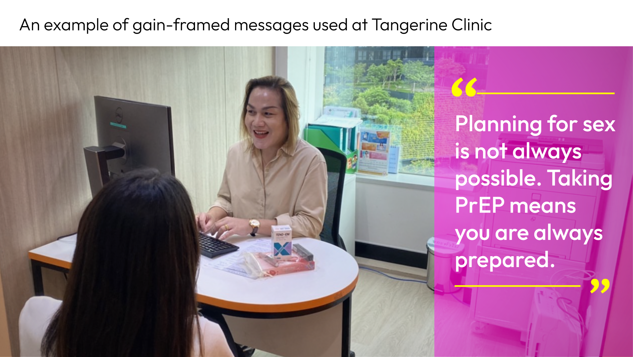
Background
In June 2020, Tangerine Clinic developed a practical guide and introduced gain-framed PrEP counseling to encourage clients to focus on protection and healthy behavior, and ultimately increase PrEP uptake.
Here, we assessed PrEP uptake before and after implementation of gain-framed PrEP counseling.

Slide 5
Methods
We analyzed data from transgender women visiting Tangerine Clinic from June 2020 through July 2021, including demographic and sexual behavioral characteristics from self-administered questionnaire.
Data related to HIV and sexually transmitted infections, including syphilis, gonorrhea and chlamydia were retrieved from clinic database.
Although not the focus of counseling messages, HIV risk was determined by asking about self-perceived HIV risk and through self-reported behavioral risk factors.
PrEP uptake during this period was also compared to the uptake before the implementation of gain-framed PrEP counseling (Period: June 2019–May 2020).

Slide 6
Results
1,149 transgender women not on PrEP visited Tangerine, median age was 26 years
398 (35%) accepted PrEP after gain-framed counseling (80% were new initiations, and 20% restarted PrEP after previous discontinuation)
106 (27%) did not perceive themselves to be at risk for HIV
41 (39% reported risk behaviors and 26 (25%) were diagnosed with an STI

Slide 7
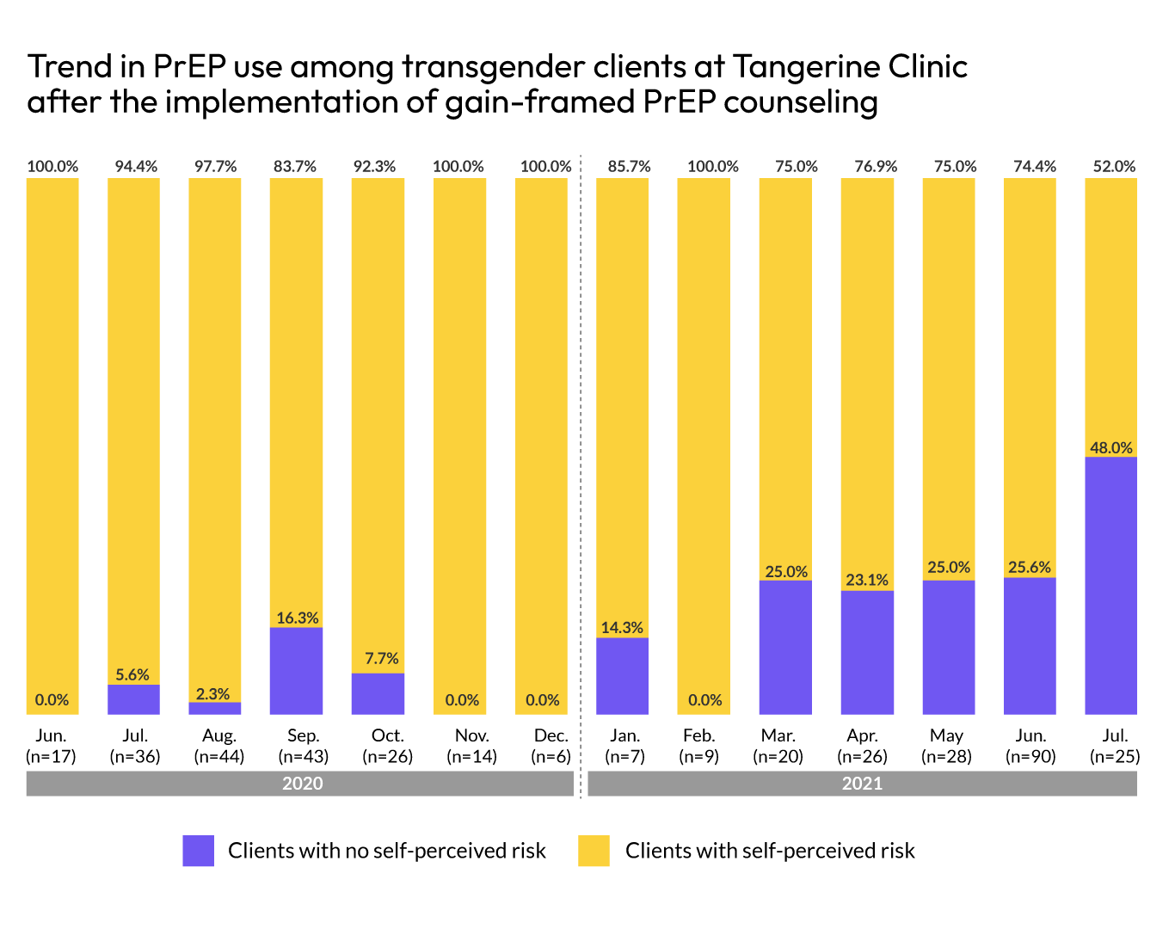
Results
Before the implementation, PrEP uptake was 13.5%, with transgender women having no self-perceived risk accounting for 8.1% of initiations.
After the implementation, the overall PrEP uptake increased to 147% and a 715% increase among transgender women without self-perceived HIV risk.

Slide 8
Conclusion
Gain-framed messages were developed based on the lessons learned at the Tangerine Clinic and other key population-led health clinics in Thailand.
Replacing traditional risk-based counseling with empowering messages emphasizing on health improved overall PrEP, notably among transgender women without self-perceived risk.
To maximize PrEP use and its impact on the HIV epidemic, gain-framed messages could be one of the message intervention use in combination with PrEP counseling.
Notes:
Another conclusion is that the gain-framed counseling messages were developed in consultation with transgender staff and nurses based on their direct experience in providing PrEP to transgender clients.

Slide 9
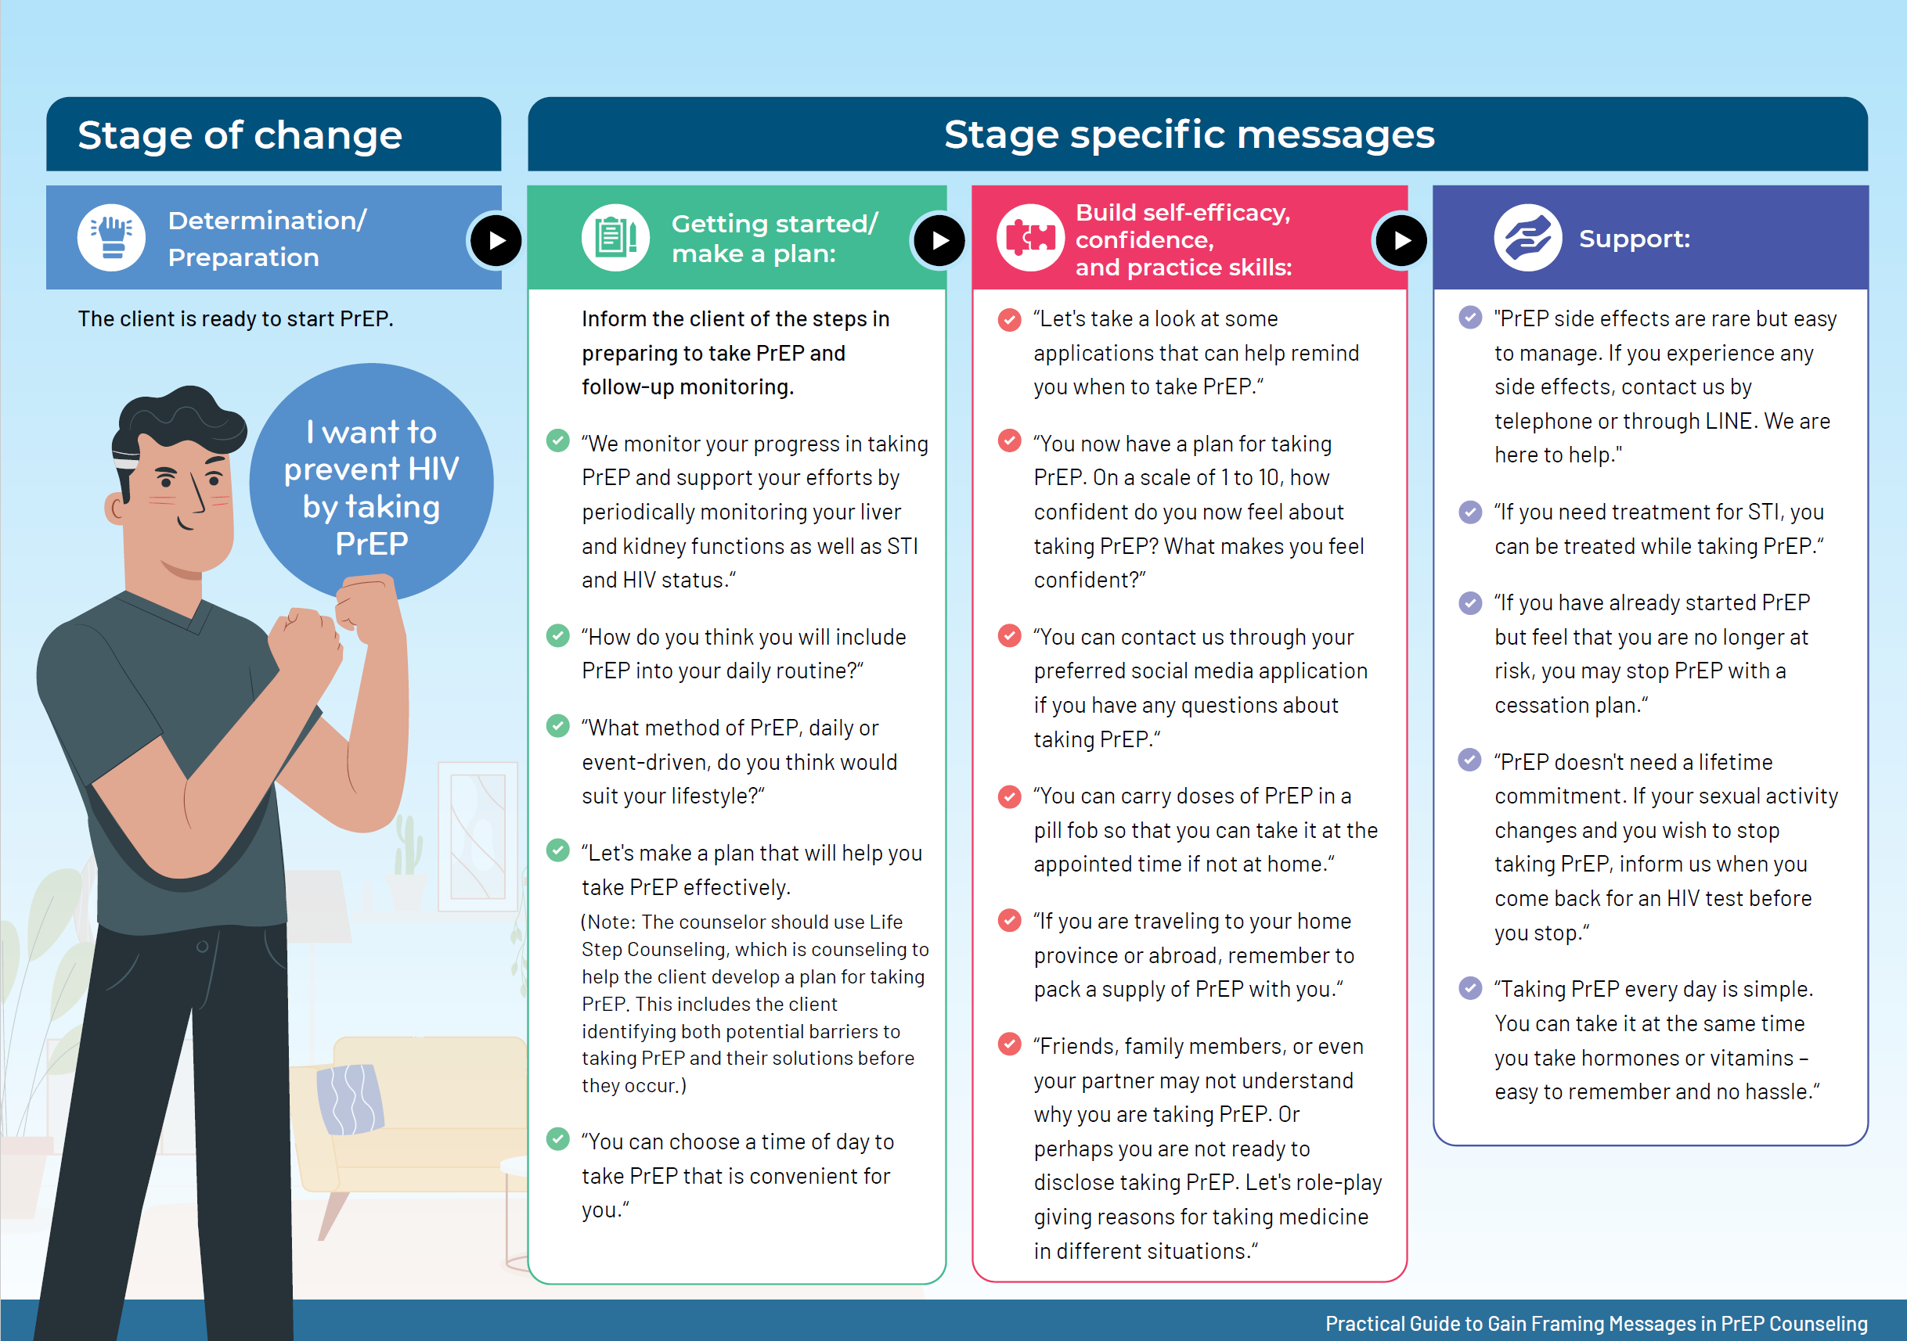
Practical Guide
Practical Guide to Gain Framing Messages in PrEP Counseling for Men Who Have Sex with Men and Transgender Women
Provide examples of gain-framed messages that correspond to the client’s readiness to adopt PrEP as a prevention strategy.

Slide 10
Acknowledgement
Phat Parkpien, Rena Janamnuaysook, Kritima Samitpol, Artsanee Chancham, Jiratchaya Kongkapan, Tidarat Amatsombat, Jeeranuch Rueannak, Pintusorn Getwongsa, Waranya Tasomboon, Mawin Bucha, Matthew Avery, Stephen Mills, Praphan Phanuphak, Nittaya Phanuphak, Reshmie Ramautarsing
Tangerine Clinic clients
Institute of HIV Research and Innovation (IHRI), Bangkok, Thailand
FHI 360, Bangkok, Thailand
USAID Regional Development Mission Asia, Bangkok, Thailand

Slide 11
Notes:
For more information, please put your e-mail address ka.

