Slide 1
High HIV incidence and mortality in a multi-site cohort of transgender women in the eastern and southern United States
Enlightenment through estimation: New insights in HIV epidemiology
Andrea L. Wirtz, Johns Hopkins University
On behalf of the LITE Study Team: Elizabeth Humes, Keri N Althoff, Tonia Poteat, Asa Radix, Kenneth Mayer, Jason S Schneider, J Sonya Haw, Andrew J Wawrzyniak, Allan E Rodriguez, Chris Beyrer, Dee Adams, Meg Stevenson, Erin Cooney, James Case, Oliver Laeyendecker, Sari L Reisner

Slide 2
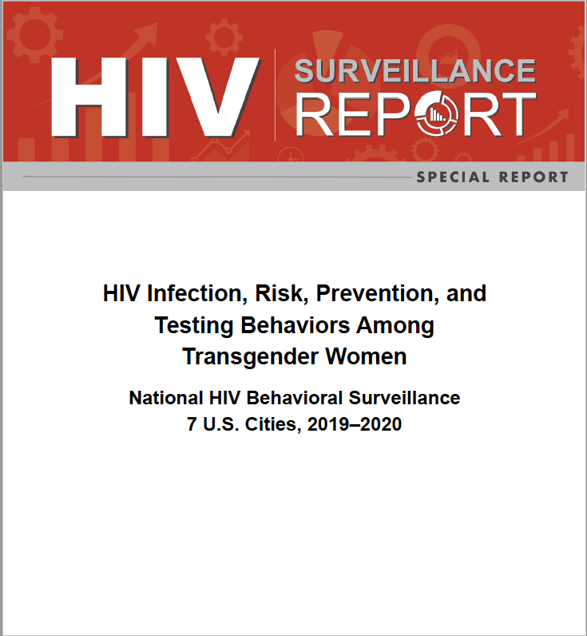
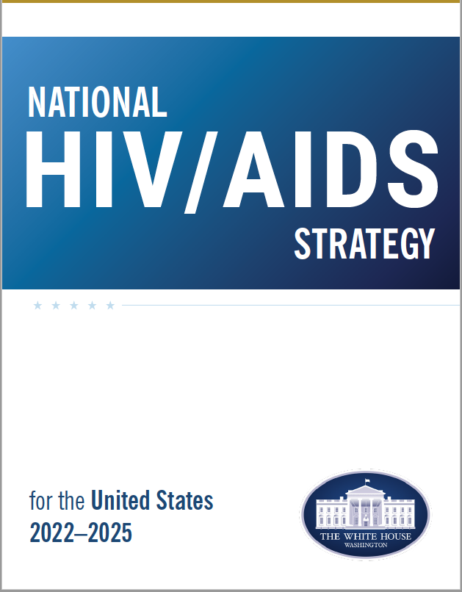
Background
High burden of HIV in the U.S., particularly among Black and Latinx transgender women
Historical contribution in HIV research and trials
Little prospective research designed for transgender women in the US
Emerging digital methods in HIV research
Objective: Develop a multi-site, digitally enhanced cohort focused exclusively on understanding HIV risks among transgender women in the U.S.
Notes:
This study was designed in response to the disproportionate burden of HIV among transgender women in the US, particularly among people of color.
Transgender women are recognized as a priority population in the National HIV strategy and have historically contributed extensively to HIV research and trials, yet there has been little prospective resarch designed to assess the unique HIV risks and inform prevention strategies for transgender women. National HIV surveillance reports only recently reported HIV estimates for transgender women.
Methodologically, prospective cohorts provide important opportunities to understand risks for HIV infection, as well as monitor effects of public health policy and interventions over time. Increasingly digital methods are used in HIV research, including cohorts, in an effort to mitigate challenges, costs and biases associated with facility-based cohorts. As these methods are emerging there is less known about the trade-offs of digitally-enhanced research.
CLICK
Given this, we aimed to develop a multi-site, digitally enhanced cohort focused exclusively on understanding HIV risks and informing prevention strategies for transgender women in the U.S.

Slide 3
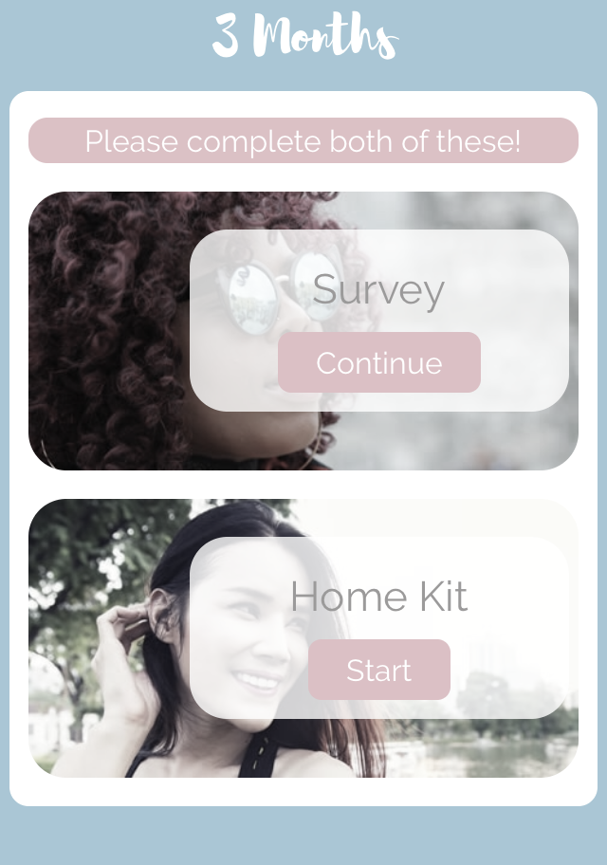
Methods
Enrollment:
Aimed to enroll 1,100 transgender women not living with HIV
Mixed mode cohort:
Technology-enhanced site-based mode: 6 cities in eastern and southern U.S.
Digital mode: 72 eastern and southern US cities
Study assessments:
Survey + oral fluid HIV testing every 3 or 6 months
STI testing every 12 months (site-based only)
Referrals for confirmatory testing and other services
24 months of follow-up with option to extend participation
Extensive retention activities
Analyses:
Planned: HIV incidence and risks
Analysis of mortality rates conducted after observing deaths
Participant app displaying 3mo assessment activities
Wirtz et al. JMIR 2019; Reisner et al. BMJ Open 2020; Wirtz et al. JMIR Res Prot 2020; Akinola et al. AIDS Care 2021
Notes:
Informed by extensive formative research, we established a mixed-mode, multi-site cohort of transgender women in eastern and southern US.
The two modes included first, a technology-enhanced site-based mode that enrolled participants in six cities. In this mode, participants enrolled and completed in-person assessments annually with all other visits optional as in-person or remote. The second mode was exclusively digital. Participants could enroll in 72 cities and complete all assessments remotely.
Adults identifying along the trans feminine spectrum, who were not living with HIV, spoke in English or Spanish languages and provided consent were enrolled and followed for >=24 months.
Participants completed surveys, oral fluid HIV testing with referrals for confirmatory testing and medical record reviews.
We initially aimed to assess HIV incidence, but after the passing of several participants over the course of follow-up, we felt that we could not evaluate HIV risks without equally considering trauma and premature death experienced within the community.

Slide 4
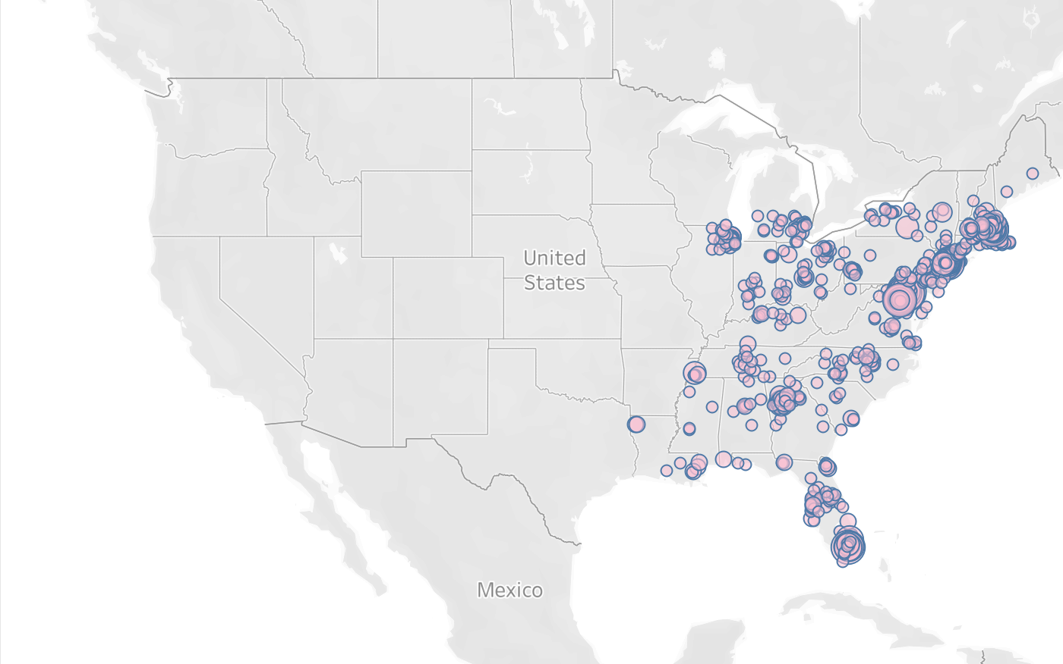
Enrollment and Retention
Enrollment opened:
March 2018 in the site-based mode
January 2019 in the digital mode
Closed August 2020
N=1,312 enrolled
Site-based: n=734
Digital mode: n=578
16 participants transferred sites or modes
83% retention
2,730 person-years accumulated
Map displays number of participants enrolled across eastern and southern US; node size represents number of participants by zip code; cities included in the site-based mode are Boston, New York, Baltimore, Washington DC, Atlanta, and Miami
Notes:
Enrollment in the site-based mode launched in March 2018 and January 2019 for the digital mode and continued to August 2020.
At the 24-month visit, 59% of eligible participants consented to extend participation (at the time of this analysis, 14 had not yet entered their 24-month visit window).
As of May 2022, the cohort participants contributed an accumulated total of 2,730 person-years (py) in the analytic dataset with 83% retention.

Slide 5
Participant characteristics
Characteristic | Site-based mode N = 734 | Digital mode N = 578 | Overall cohort N = 1,312 | p-value
Median age, years [IQR] | 29 (24, 37) | 27 (22, 34) | 28 (23, 35) | <0.001
Race and ethnic identity |  |  |  | <0.001
Non-Hispanic White | 266 (36%) | 431 (75%) | 697 (53%)
Non-Hispanic Black | 147 (20%) | 26 (4%) | 173 (13%)
Hispanic White | 67 (9%) | 19 (3%) | 86 (7%)
Hispanic Black | 23 (3%) | 0 (0%) | 23 (2%)
Non-Hispanic multi-racial or other race | 110 (15%) | 73 (13%) | 183 (14%)
Hispanic multi-racial or other race | 111 (15%) | 22 (4%) | 133 (10%)
Born in the U.S. (ref: no) | 596 (82%) | 553 (96%) | 1,149 (88%) | <0.001
Education |  |  |  | <0.001
High school diploma/GED or less | 259 (36%) | 103 (18%) | 362 (28%)
Some college or higher | 468 (64%) | 470 (82%) | 938 (72%)
Current employment status |  |  |  | <0.001
Unemployed | 330 (46%) | 193 (35%) | 523 (41%)
Employed full-time | 223 (31%) | 246 (44%) | 469 (37%)
Employed part-time | 164 (23%) | 117 (21%) | 281 (22%)
Income above the federal poverty level (ref: below FPL) | 332 (45%) | 366 (63%) | 698 (53%) | <0.001
Health insurance |  |  |  | <0.001
Uninsured | 71 (10%) | 54 (10%) | 125 (10%)
Public insurance | 353 (52%) | 147 (27%) | 500 (41%)
Private insurance | 258 (38%) | 348 (63%) | 606 (49%)
Notes:
This table displays baseline characteristics of cohort participants and stratified by mode.
The study population was relatively racially and ethnically diverse and well-distributed across eastern and southern US but different across mode.
CLICK
Site-based participants were slightly older and more likely to be Black, Hispanic, or other people of color.
CLICK
Despite high levels of education – 72% had some college or higher- unemployment was also high at about 41% and only half had incomes above the federal poverty level. These were different across modes, in which online participants had less financial and educational vulnerabilities.
CLICK
Across the board, 10% reported no health insurance, while site-based participants were more likely to have public insurance and digital participants more frequently had private insurance.

Slide 6
HIV Incidence Rates
Group | Incident HIV
 | Rate per 1,000 py (95%CI)
All | 5.5 (2.7-8.3)
Cohort mode
Digital | 1.6 (0.2-5.8)
Site-based | 8.7 (4.0-13.5)
Race & Ethnicity*
White | 1.6 (0.3-4.7)
Black | 19.3 (8.4-30.2)
Hispanic/Latinx ethnicity | 9.9 (3.2-23.1)
Geographic region
North | 3.0 (0.8-7.7)
Mid-Atlantic | 4.8 (1.0-14.1)
South | 10.3 (4.5-20.3)
Age category
18-24 | 8.5 (3.4-17.5)
>=25 | 4.2 (1.8-8.3)
PrEP indicated at baseline
No | 0.7 (0.0-3.8)
Yes | 11.2 (5.3-17.0)
Cumulative incidence densities of HIV seroconversion
2,730 py accrued; *Race and ethnicity may overlap for participants with multi-racial and ethnic identities
Notes:
This table displays HIV incidence rates overall and by subgroup and the figure displays cumulative incidence densities by race and ethnicity.
Across 2,730 py accrued, 15 seroconversions were confirmed giving an overall HIV incidence of 5.5 per 1,000 py.
CLICK
HIV incidence was significantly higher among Black participants compared to white participants.
CLICK
HIV incidence was also higher among participants who were PrEP indicated at baseline. Notably, Of the 15 participants who seroconverted over follow-up, 7 were PrEP-naïve at time of seroconversion, 7 were former PrEP users, and 1 participant declined to answer questions on PrEP use.
CLICK
We observed qualitative differences across other categories, with elevated rates among site-based participants, Latinx participants, people residing in the mid-Atlantic or South, and youth, though the confidence intervals overlapped.

Slide 7
Mortality
Group | Rate per 1,000 py (95%CI)
All | 3.3 (1.5-6.3)
Cohort mode
Digital | 0.8 (0.0-4.5)
Site-based | 5.4 (2.3-10.6)
Race & Ethnicity
White | 3.2 (1.2-7.0)
Black | 4.8 (1.0-14.1)
Hispanic/Latinx ethnicity | 9.9 (3.2-23.1)
Geographic region
North | 0.0 (0.0-2.8)
Mid-Atlantic | 4.8 (1.0-14.1)
South | 7.7 (2.8-16.8)
Age category
18-24 | 3.6 (0.8-10.6)
>=25 | 3.2 (1.2-6.9)
Cumulative incidence densities of participant death
2,730 py accrued; *Race and ethnicity may overlap for participants with multi-racial and ethnic identities
Notes:
Nine participants were confirmed to have passed away during the course of the study. Deaths were ascertained by community report, clinical reports, and obituaries during follow-up.
Causes of death were attributed to homicide (n=1), suicide (n=1), overdose (n=2), cardiac arrest (n=1), other health concern (n=1) and unknown causes (n=3).
The mortality rate overall was 3.3/1000py
Rates were qualitatively higher among site-based participants, people of color, and those residing in the mid-Atlantic or South

Slide 8
Baseline Predictors
Incident HIV
Premature Death
Characteristic | No HIV N = 1,297 | Incident HIV N = 15 | RR (95%CI)
Black or African American race | 273 (21%) | 12 (80%) | 14.8 (4.7-65.4)
Phone disconnected (n=983) | 133 (14%) | 4 (50%) | 6.3 (1.5-27.1)
Internet connection at home (n=983) | 919 (94%) | 5 (62%) | 0.1 (0.0-0.5)
Self-reported STI | 258 (20%) | 6 (43%) | 3.0 (1.0-8.6)
Indicated for PrEP* | 605 (47%) | 14 (93%) | 16.0 (3.2-291.0)
Partner PrEP use | 188 (15%) | 5 (36%) | 3.1 (1.0-9.2)
Has a personal doctor/provider | 912 (71%) | 7 (47%) | 0.4 (0.1-1.0)
Characteristic | Alive N = 1,303 | Deceased N = 9 | RR (95%CI)
Hispanic / Latinx | 237 (18%) | 5 (62%) | 7.4 (1.8, 36.4)
Currently employed full or part-time (ref: unemployed) | 749 (59%) | 1 (11%) | 0.1 (0.0, 0.5)
Homeless last 6 mo | 134 (10%) | 3 (33%) | 4.3 (0.9-16.4)
Arrested last 12 mo | 60 (5%) | 3 (33%) | 10.1 (2.1-39.3)
Lifetime sex work | 486 (38%) | 6 (67%) | 3.3 (0.9-15.7)
Uninsured or public insurance (ref: private) | 616 (50%) | 9 (100%) | All
Stigma-related barriers to care | 731 (56%) | 2 (22%) | 0.2 (0.0-0.9)
* Unadjusted RRs calculated for variables significant at p<0.10; Phone and internet connection added later; PrEP indication based on CDC criteria that have been adapted for transgender women –Malone et al. JAIDS 2021
Notes:
These tables display baseline predictors and associated risk ratios of incident HIV or premature death.
CLICK
On the left, consistent with the last slide and other reports, Black participants experienced a higher odds of HIV seroconversion.
CLICK
Also consistent with other reports are associations between STI infection and PrEP indication with incident HIV.
Notably, participants who reported that their partner was using PrEP at baseline had a greater risk of incident HIV. This could suggest that the partner discontinued PrEP, they were different partners, or may reflect findings from other studies that have shown discrepancies in partner sexual agreements.
CLICK
Participants who had a personal healthcare provider had 60% lower risk of seroconversion.
CLICK
Finally, there is a clear association between phone and internet access and HIV seroconversion.

Slide 9
Baseline Predictors
Incident HIV
Premature Death
Characteristic | No HIV N = 1,297 | Incident HIV N = 15 | RR (95%CI)
Black or African American race | 273 (21%) | 12 (80%) | 14.8 (4.7-65.4)
Phone disconnected (n=983) | 133 (14%) | 4 (50%) | 6.3 (1.5-27.1)
Internet connection at home (n=983) | 919 (94%) | 5 (62%) | 0.1 (0.0-0.5)
Self-reported STI | 258 (20%) | 6 (43%) | 3.0 (1.0-8.6)
Indicated for PrEP* | 605 (47%) | 14 (93%) | 16.0 (3.2-291.0)
Partner PrEP use | 188 (15%) | 5 (36%) | 3.1 (1.0-9.2)
Has a personal doctor/provider | 912 (71%) | 7 (47%) | 0.4 (0.1-1.0)
Characteristic | Alive N = 1,303 | Deceased N = 9 | RR (95%CI)
Hispanic / Latinx | 237 (18%) | 5 (62%) | 7.4 (1.8, 36.4)
Currently employed full or part-time (ref: unemployed) | 749 (59%) | 1 (11%) | 0.1 (0.0, 0.5)
Homeless last 6 mo | 134 (10%) | 3 (33%) | 4.3 (0.9-16.4)
Arrested last 12 mo | 60 (5%) | 3 (33%) | 10.1 (2.1-39.3)
Lifetime sex work | 486 (38%) | 6 (67%) | 3.3 (0.9-15.7)
Uninsured or public insurance (ref: private) | 616 (50%) | 9 (100%) | All
Stigma-related barriers to care | 731 (56%) | 2 (22%) | 0.2 (0.0-0.9)
*Unadjusted RRs calculated for variables significant at p<0.10; Phone and internet connection added later; PrEP indication based on CDC criteria that have been adapted for transgender women – see Malone et al. JAIDS 2021.
Notes:
The table on the right displays baseline predictors of death over the course of follow-up.
CLICK
Latinx participants had a 7-fold increased risk of death during follow-up.
CLICK
There are multiple associations between structural vulnerabilities and risk environments with premature death, including recent homelessness, arrest, and lifetime engagement in sex work. Whereas, being employed at baseline, whether full-time or part-time, appears to be protective.
All deaths occurred among participants who were uninsured or had public insurance.
CLICK
Finally, stigma-associated barriers to care appeared to be inversely associated with premature death. This may reflect increased engagement in healthcare.

Slide 10
Shared Predictors
 |  | HIV incidence |  |  |  | Mortality
Characteristic | Overall N = 1,312 | No HIV N = 1,297 | Incident HIV N = 15 | p-value | RR (95%CI) | Alive N = 1,303 | Deceased N = 9 | p-value | RR (95%CI)
Digital mode (ref: site-based) | 578 (44%) | 576 (44%) | 2 (13%) | 0.016 | 0.2 (0.0-0.7) | 577 (44%) | 1 (11%) | 0.086 | 0.2 (0.0-0.9 )
Region |  |  |  | 0.075 |  |  |  | 0.002
North | 655 (50%) | 651 (50%) | 4 (27%) |  | Ref | 655 (50%) | 0 (0%) |  | Not calculated; all occurred in mid-Atlantic & South
Mid-Atlantic | 301 (23%) | 298 (23%) | 3 (20%) |  | 1.6 (0.3-7.5) | 298 (23%) | 3 (33%)
South | 356 (27%) | 348 (27%) | 8 (53%) |  | 3.7 (1.2-14.1) | 350 (27%) | 6 (67%)
Cocaine use (ref: no) | 136 (11%) | 132 (10%) | 4 (29%) | 0.051 | 3.5 (0.9-10.6) | 134 (10%) | 2 (22%) | 0.200
Methamphetamine use (ref: no) | 73 (6%) | 70 (5%) | 3 (21%) | 0.040 | 4.7 (1.1-15.5) | 72 (6%) | 1 (11%) | 0.400
Any stimulant use (ref: none) | 211 (16%) | 207 (16%) | 4 (29%) | 0.300 |  | 207 (16%) | 4 (44%) | 0.044 | 4.2 (1.0-15.9)
Laboratory confirmed STI (site-based only) | 80 (11%) | 75 (11%) | 5 (38%) | 0.009 | 5.3 (1.6-16.3) | 76 (11%) | 4 (50%) | 0.007 | 8.4 (2.0-36.2)
Gender(s) of casual &/or regular partners (past 3 mo) |  |  |  | 0.027 |  |  |  | 0.037
Cis man only | 364 (42%) | 356 (42%) | 8 (73%) |  | Not calculated; all occurred among participants with partners that included cis men | 359 (42%) | 5 (100%) |  | Not calculated; all occurred among participants with partners that included cis men
Cis woman or trans people only | 259 (30%) | 259 (30%) | 0 (0%) |  |  | 259 (30%) | 0 (0%)
Multiple genders | 244 (28%) | 241 (28%) | 3 (27%) |  |  | 244 (28%) | 0 (0%)
Sought gender-transition related care (past 12 mo) | 1,082 (83%) | 1,072 (84%) | 10 (67%) | 0.087 | 0.4 (0.1, 1.3) | 1,078 (84%) | 4 (50%) | 0.030 | 0.2 (0.1-0.8)
Notes:
Several indicators were associated with both HIV and death.

Slide 11
Shared Predictors
 |  | HIV incidence |  |  |  | Mortality
Characteristic | Overall N = 1,312 | No HIV N = 1,297 | Incident HIV N = 15 | p-value | RR (95%CI) | Alive N = 1,303 | Deceased N = 9 | p-value | RR (95%CI)
Digital mode (ref: site-based) | 578 (44%) | 576 (44%) | 2 (13%) | 0.016 | 0.2 (0.0-0.7) | 577 (44%) | 1 (11%) | 0.086 | 0.2 (0.0-0.9 )
Region |  |  |  | 0.075 |  |  |  | 0.002
North | 655 (50%) | 651 (50%) | 4 (27%) |  | Ref | 655 (50%) | 0 (0%) |  | Not calculated; all occurred in mid-Atlantic & South
Mid-Atlantic | 301 (23%) | 298 (23%) | 3 (20%) |  | 1.6 (0.3-7.5) | 298 (23%) | 3 (33%)
South | 356 (27%) | 348 (27%) | 8 (53%) |  | 3.7 (1.2-14.1) | 350 (27%) | 6 (67%)
Cocaine use (ref: no) | 136 (11%) | 132 (10%) | 4 (29%) | 0.051 | 3.5 (0.9-10.6) | 134 (10%) | 2 (22%) | 0.200
Methamphetamine use (ref: no) | 73 (6%) | 70 (5%) | 3 (21%) | 0.040 | 4.7 (1.1-15.5) | 72 (6%) | 1 (11%) | 0.400
Any stimulant use (ref: none) | 211 (16%) | 207 (16%) | 4 (29%) | 0.300 |  | 207 (16%) | 4 (44%) | 0.044 | 4.2 (1.0-15.9)
Laboratory confirmed STI (site-based only) | 80 (11%) | 75 (11%) | 5 (38%) | 0.009 | 5.3 (1.6-16.3) | 76 (11%) | 4 (50%) | 0.007 | 8.4 (2.0-36.2)
Gender(s) of casual &/or regular partners (past 3 mo) |  |  |  | 0.027 |  |  |  | 0.037
Cis man only | 364 (42%) | 356 (42%) | 8 (73%) |  | Not calculated; all occurred among participants with partners that included cis men | 359 (42%) | 5 (100%) |  | Not calculated; all occurred among participants with partners that included cis men
Cis woman or trans people only | 259 (30%) | 259 (30%) | 0 (0%) |  |  | 259 (30%) | 0 (0%)
Multiple genders | 244 (28%) | 241 (28%) | 3 (27%) |  |  | 244 (28%) | 0 (0%)
Sought gender-transition related care (past 12 mo) | 1,082 (83%) | 1,072 (84%) | 10 (67%) | 0.087 | 0.4 (0.1, 1.3) | 1,078 (84%) | 4 (50%) | 0.030 | 0.2 (0.1-0.8)
Notes:
Participants in the digital mode were less likely to experience both while people in the mid-Atlantic and Southern were more likely to experience both incident HIV and death.

Slide 12
Shared Predictors
 |  | HIV incidence |  |  |  | Mortality
Characteristic | Overall N = 1,312 | No HIV N = 1,297 | Incident HIV N = 15 | p-value | RR (95%CI) | Alive N = 1,303 | Deceased N = 9 | p-value | RR (95%CI)
Digital mode (ref: site-based) | 578 (44%) | 576 (44%) | 2 (13%) | 0.016 | 0.2 (0.0-0.7) | 577 (44%) | 1 (11%) | 0.086 | 0.2 (0.0-0.9 )
Region |  |  |  | 0.075 |  |  |  | 0.002
North | 655 (50%) | 651 (50%) | 4 (27%) |  | Ref | 655 (50%) | 0 (0%) |  | Not calculated; all occurred in mid-Atlantic & South
Mid-Atlantic | 301 (23%) | 298 (23%) | 3 (20%) |  | 1.6 (0.3-7.5) | 298 (23%) | 3 (33%)
South | 356 (27%) | 348 (27%) | 8 (53%) |  | 3.7 (1.2-14.1) | 350 (27%) | 6 (67%)
Cocaine use (ref: no) | 136 (11%) | 132 (10%) | 4 (29%) | 0.051 | 3.5 (0.9-10.6) | 134 (10%) | 2 (22%) | 0.200
Methamphetamine use (ref: no) | 73 (6%) | 70 (5%) | 3 (21%) | 0.040 | 4.7 (1.1-15.5) | 72 (6%) | 1 (11%) | 0.400
Any stimulant use (ref: none) | 211 (16%) | 207 (16%) | 4 (29%) | 0.300 |  | 207 (16%) | 4 (44%) | 0.044 | 4.2 (1.0-15.9)
Laboratory confirmed STI (site-based only) | 80 (11%) | 75 (11%) | 5 (38%) | 0.009 | 5.3 (1.6-16.3) | 76 (11%) | 4 (50%) | 0.007 | 8.4 (2.0-36.2)
Gender(s) of casual &/or regular partners (past 3 mo) |  |  |  | 0.027 |  |  |  | 0.037
Cis man only | 364 (42%) | 356 (42%) | 8 (73%) |  | Not calculated; all occurred among participants with partners that included cis men | 359 (42%) | 5 (100%) |  | Not calculated; all occurred among participants with partners that included cis men
Cis woman or trans people only | 259 (30%) | 259 (30%) | 0 (0%) |  |  | 259 (30%) | 0 (0%)
Multiple genders | 244 (28%) | 241 (28%) | 3 (27%) |  |  | 244 (28%) | 0 (0%)
Sought gender-transition related care (past 12 mo) | 1,082 (83%) | 1,072 (84%) | 10 (67%) | 0.087 | 0.4 (0.1, 1.3) | 1,078 (84%) | 4 (50%) | 0.030 | 0.2 (0.1-0.8)
Notes:
Baseline cocaine and methamphetamine use predicted incident HIV while any stimulant use was associated with increased risk of premature death.
And laboratory-confirmed STI was associated with both outcomes among site-based participants.

Slide 13
Shared Predictors
 |  | HIV incidence |  |  |  | Mortality
Characteristic | Overall N = 1,312 | No HIV N = 1,297 | Incident HIV N = 15 | p-value | RR (95%CI) | Alive N = 1,303 | Deceased N = 9 | p-value | RR (95%CI)
Digital mode (ref: site-based) | 578 (44%) | 576 (44%) | 2 (13%) | 0.016 | 0.2 (0.0-0.7) | 577 (44%) | 1 (11%) | 0.086 | 0.2 (0.0-0.9 )
Region |  |  |  | 0.075 |  |  |  | 0.002
North | 655 (50%) | 651 (50%) | 4 (27%) |  | Ref | 655 (50%) | 0 (0%) |  | Not calculated; all occurred in mid-Atlantic & South
Mid-Atlantic | 301 (23%) | 298 (23%) | 3 (20%) |  | 1.6 (0.3-7.5) | 298 (23%) | 3 (33%)
South | 356 (27%) | 348 (27%) | 8 (53%) |  | 3.7 (1.2-14.1) | 350 (27%) | 6 (67%)
Cocaine use (ref: no) | 136 (11%) | 132 (10%) | 4 (29%) | 0.051 | 3.5 (0.9-10.6) | 134 (10%) | 2 (22%) | 0.200
Methamphetamine use (ref: no) | 73 (6%) | 70 (5%) | 3 (21%) | 0.040 | 4.7 (1.1-15.5) | 72 (6%) | 1 (11%) | 0.400
Any stimulant use (ref: none) | 211 (16%) | 207 (16%) | 4 (29%) | 0.300 |  | 207 (16%) | 4 (44%) | 0.044 | 4.2 (1.0-15.9)
Laboratory confirmed STI (site-based only) | 80 (11%) | 75 (11%) | 5 (38%) | 0.009 | 5.3 (1.6-16.3) | 76 (11%) | 4 (50%) | 0.007 | 8.4 (2.0-36.2)
Gender(s) of casual &/or regular partners (past 3 mo) |  |  |  | 0.027 |  |  |  | 0.037
Cis man only | 364 (42%) | 356 (42%) | 8 (73%) |  | Not calculated; all occurred among participants with partners that included cis men | 359 (42%) | 5 (100%) |  | Not calculated; all occurred among participants with partners that included cis men
Cis woman or trans people only | 259 (30%) | 259 (30%) | 0 (0%) |  |  | 259 (30%) | 0 (0%)
Multiple genders | 244 (28%) | 241 (28%) | 3 (27%) |  |  | 244 (28%) | 0 (0%)
Sought gender-transition related care (past 12 mo) | 1,082 (83%) | 1,072 (84%) | 10 (67%) | 0.087 | 0.4 (0.1, 1.3) | 1,078 (84%) | 4 (50%) | 0.030 | 0.2 (0.1-0.8)
Notes:
Reported genders of sexual partners were diverse; however, all incident infections and deaths occurred among participants who reported casual or regular partnerships that included cisgender men.

Slide 14
Shared Predictors
 |  | HIV incidence |  |  |  | Mortality
Characteristic | Overall N = 1,312 | No HIV N = 1,297 | Incident HIV N = 15 | p-value | RR (95%CI) | Alive N = 1,303 | Deceased N = 9 | p-value | RR (95%CI)
Digital mode (ref: site-based) | 578 (44%) | 576 (44%) | 2 (13%) | 0.016 | 0.2 (0.0-0.7) | 577 (44%) | 1 (11%) | 0.086 | 0.2 (0.0-0.9 )
Region |  |  |  | 0.075 |  |  |  | 0.002
North | 655 (50%) | 651 (50%) | 4 (27%) |  | Ref | 655 (50%) | 0 (0%) |  | Not calculated; all occurred in mid-Atlantic & South
Mid-Atlantic | 301 (23%) | 298 (23%) | 3 (20%) |  | 1.6 (0.3-7.5) | 298 (23%) | 3 (33%)
South | 356 (27%) | 348 (27%) | 8 (53%) |  | 3.7 (1.2-14.1) | 350 (27%) | 6 (67%)
Cocaine use (ref: no) | 136 (11%) | 132 (10%) | 4 (29%) | 0.051 | 3.5 (0.9-10.6) | 134 (10%) | 2 (22%) | 0.200
Methamphetamine use (ref: no) | 73 (6%) | 70 (5%) | 3 (21%) | 0.040 | 4.7 (1.1-15.5) | 72 (6%) | 1 (11%) | 0.400
Any stimulant use (ref: none) | 211 (16%) | 207 (16%) | 4 (29%) | 0.300 |  | 207 (16%) | 4 (44%) | 0.044 | 4.2 (1.0-15.9)
Laboratory confirmed STI (site-based only) | 80 (11%) | 75 (11%) | 5 (38%) | 0.009 | 5.3 (1.6-16.3) | 76 (11%) | 4 (50%) | 0.007 | 8.4 (2.0-36.2)
Gender(s) of casual &/or regular partners (past 3 mo) |  |  |  | 0.027 |  |  |  | 0.037
Cis man only | 364 (42%) | 356 (42%) | 8 (73%) |  | Not calculated; all occurred among participants with partners that included cis men | 359 (42%) | 5 (100%) |  | Not calculated; all occurred among participants with partners that included cis men
Cis woman or trans people only | 259 (30%) | 259 (30%) | 0 (0%) |  |  | 259 (30%) | 0 (0%)
Multiple genders | 244 (28%) | 241 (28%) | 3 (27%) |  |  | 244 (28%) | 0 (0%)
Sought gender-transition related care (past 12 mo) | 1,082 (83%) | 1,072 (84%) | 10 (67%) | 0.087 | 0.4 (0.1, 1.3) | 1,078 (84%) | 4 (50%) | 0.030 | 0.2 (0.1-0.8)
Notes:
Finally, participants who sought gender transition related care in the past 12 months appeared to have a lower risk of incident HIV and death.

Slide 15
Conclusions
Partner-based interventions
HIV and STI testing with linkage to Care
Support to reduce structural vulnerabilities
Co-located services
Multilevel interventions that address social and structural contexts, other health concerns, alongside HIV prevention
Community and location-based efforts should be maintained as HIV research and interventions are increasingly digitally-delivered
Notes:
Study findings, in particular shared predictors of incident HIV and death, highlight opportunities for multilevel interventions that address social and structural contexts and other health concerns alongside HIV prevention.
Finally, as HIV research and interventions are increasingly delivered online it is critical to continue community engagement, outreach and provide in-person support. This is important for both mitigating bias in research, but also ensuring equity in research as well as the interventions and programs that follow.

Slide 16
Acknowledgements:
Photo Credit: LITE Atlanta Community Photo Shoot
We express gratitude to the many participants of this research without whom this research would not be possible. We also want to thank all study staff who contributed to actualize this study and connect with study participants in meaningful ways.
Brigham Women’s Hospital
Sari Reisner (joint PI)
Johns Hopkins University:
Dee Adams
Keri Althoff
Chris Beyrer
James Case
Erin Cooney
Charlotte Gaydos
Oliver Laeyendecker
Meg Stevenson
Callen-Lorde Community Health Center
Asa Radix
Fenway Health
Ken Mayer
Emory Univ. /Grady Hospital
Jason Schneider
Sonya Haw
University of North Carolina
Tonia Poteat
Whitman Walker Institute
Christopher Cannon
University of Miami
Allan Rodriguez
Andrew Wawrzyniak
LITE Community Advisory Board
Centers for AIDS Research at Johns Hopkins, Harvard, DC CFAR, Univ. of Miami, and Emory
National Institutes of Health: Joint support by NIAID, NICHD, NIMH award #UG3/UH3AI133669
Lori Zimand, Gerald Sharp
Sonia Lee, Michael Stirratt
Notes:
With that, I will close by acknowledging all of the people who make this study possible, particularly the participants and study staff across the region.

