Slide 1
I have no relevant financial relationships with ineligible companies to disclose.
Presenter: Xinsheng Wu
School of Public Health (Shenzhen), Sun Yat-sen University, Shenzhen, China

Slide 2
Colliding epidemics: AIDS, NCDs, TB, STIs, COVID-19 and others
The impact of COVID-19 non-pharmaceutical interventions on cases and deaths of AIDS, gonorrhea, syphilis, hepatitis B, and hepatitis C in China: an interrupted time series analysis
Xinsheng Wu^{1#}, Xinyi Zhou ^{1#}, Yuanyi Chen ^{1#}, Ke Zhai ¹, Ruoyao Sun¹, Ganfeng Luo¹, Yi-Fan Lin¹, Yuwei Li¹, Chongguang Yang^{1*} and Huachun Zou^{1,2*}
¹ School of Public Health (Shenzhen), Sun Yat-sen University, Shenzhen, PR China
² Kirby Institute, University of New South Wales, Sydney, Australia

Slide 3
Background
Contents
Methods
Results
Conclusions

Slide 4
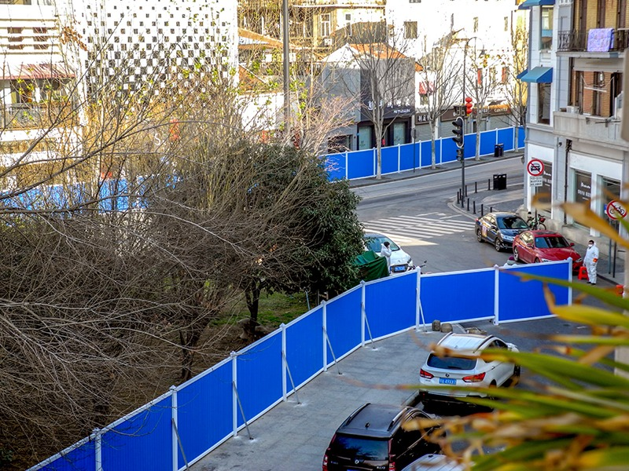
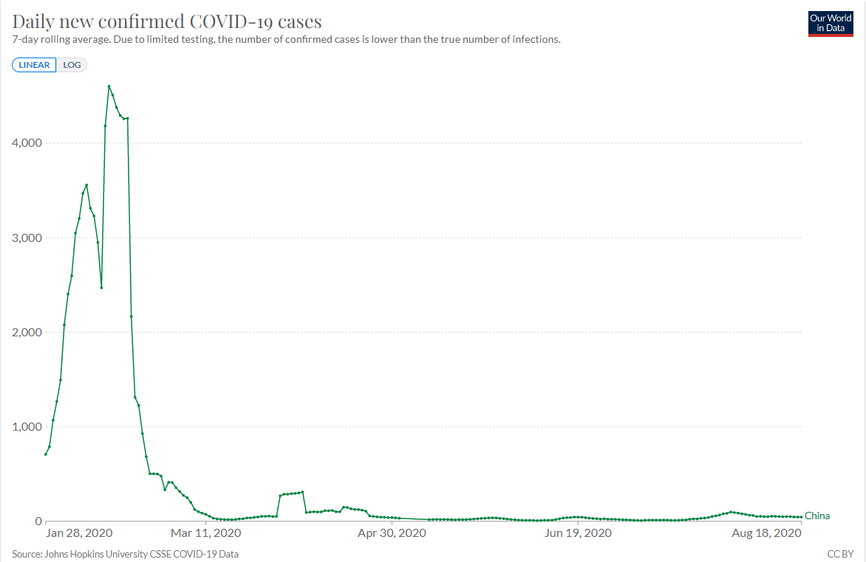
Background
China implemented nationwide non-pharmaceutical interventions (NPIs) to contain COVID-19 at the early stage.
We aimed to elucidate the impact of COVID-19 NPIs on the cases, deaths, and case-fatality ratios of sexually transmitted diseases (STDs) and diseases caused by blood-borne viruses (BBVs) in China.
Figure 1 Wuhan lockdown
City lockdowns
Traffic restrictions
Social distancing
School closures…

Slide 5
Methods
Study design
National Health Commission of China
Notifiable disease reporting database
Monthly cases and deaths data from January 2015 to December 2021
AIDS
Gonorrhea
Syphilis
Hepatitis B
Hepatitis C

Slide 6
Methods
Statistical analysis
Case
Death
Descriptive statistics
Incidence
$\frac{Cases}{Population size}$ $×100,000$
Case-fatality ratios
$\frac{Deaths}{Cases}$ $×1,000$
STDs and BBVs
Immediate impact of NPIs
(January 2020)
Poisson segmented regression models
Long-term impacts of NPIs
(December 2021)

Slide 7
Results
Table 1 Cases and incidence rates for AIDS, gonorrhea, syphilis, hepatitis B, and hepatitis C in China from January 2015 to December 2021
 | Cases (n) | Incidence before NPIs (per 100 000) | Incidence after NPIs (per 100 000)
Overall | 14800330 | 149.11 | 151.41
AIDS | 428715 | 4.31 | 4.40
Gonorrhea | 846935 | 8.65 | 8.38
Syphilis | 3612684 | 36.15 | 37.56
Hepatitis B | 8219292 | 82.72 | 84.29
Hepatitis C | 1692704 | 17.27 | 16.78
Table 2 Deaths and case-fatality ratios for AIDS, gonorrhea, syphilis, hepatitis B, and hepatitis C in China from January 2015 to December 2021
 | Deaths (n) | Case-fatality ratios before NPIs (per 1000) | Case-fatality ratios after NPIs (per 1000)
Overall | 127030 | 8.21 | 9.50
AIDS | 122508 | 273.44 | 315.96
Gonorrhea | 15 | 0.01 | 0.04
Syphilis | 516 | 0.14 | 0.15
Hepatitis B | 3168 | 0.38 | 0.40
Hepatitis C | 823 | 0.49 | 0.48

Slide 8
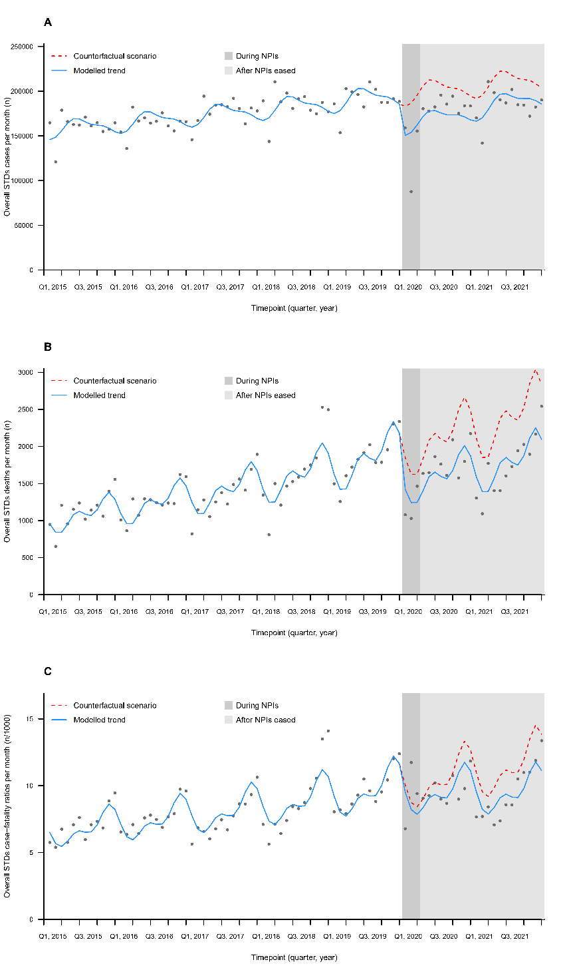
Overall STDs
Results
Figure 2 Monthly numbers, trends and fitted Poisson segmented regression models for overall STDs and BBVs in China from January 2015 to December 2021
Table 3 Poisson segmented regression models of the impact of COVID-19 NPIs on overall STDs and BBVs in China from January 2015 to December 2021
 | IRR at NPIs | IRR at study end | Trend before NPIs | Trend after NPIs
Overall
Cases | 0.822(0.729-0.926) | 0.913(0.854-0.976) | 1.004(1.003-1.004) | 1.008(1.001-1.016)
Deaths | 0.767(0.658-0.894) | 0.739(0.638-0.856) | 1.011(1.009-1.013) | 1.009(1.000-1.019)
Case-fatality ratios | 0.946(0.822-1.089) | 0.804(0.686-0.943) | 1.007(1.006-1.009) | 1.000(0.991-1.010)
In the Poisson model, there was a 17.8% (IRR 0.822, 95% CI 0.729-0.926) decline in overall cases and a 23.3% (0.767, 0.658-0.894) decline in overall deaths in January 2020.

Slide 9
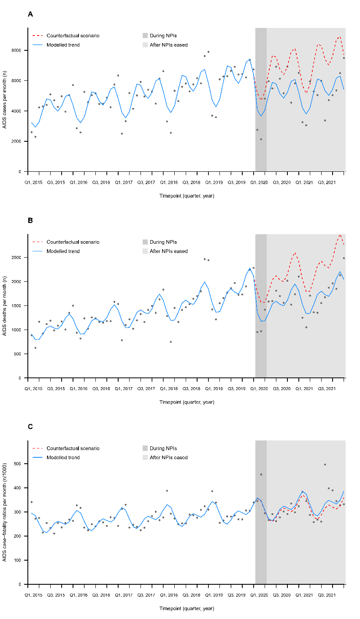
Results
AIDS
Figure 3 Monthly numbers, trends and fitted Poisson segmented regression models for AIDS in China from January 2015 to December 2021
Table 4 Poisson segmented regression models of the impact of COVID-19 NPIs on AIDS in China from January 2015 to December 2021
 | IRR at NPIs | IRR at study end | Trend before NPIs | Trend after NPIs
AIDS
Cases | 0.784(0.646-0.951) | 0.702(0.582-0.847) | 1.008(1.007-1.009) | 1.003(0.989-1.017)
Deaths | 0.755(0.639-0.893) | 0.738(0.634-0.859) | 1.011(1.009-1.013) | 1.010(1.000-1.021)
Case-fatality ratios | 1.004(0.899-1.123) | 1.074(0.924-1.248) | 1.003(1.002-1.004) | 1.006(0.996-1.016)
In the Poisson model, there was a 21.6% (0.784, 0.646-0.951) decline in AIDS cases and a 24.5% (0.755, 0.639-0.893) decline in AIDS deaths in January 2020.

Slide 10
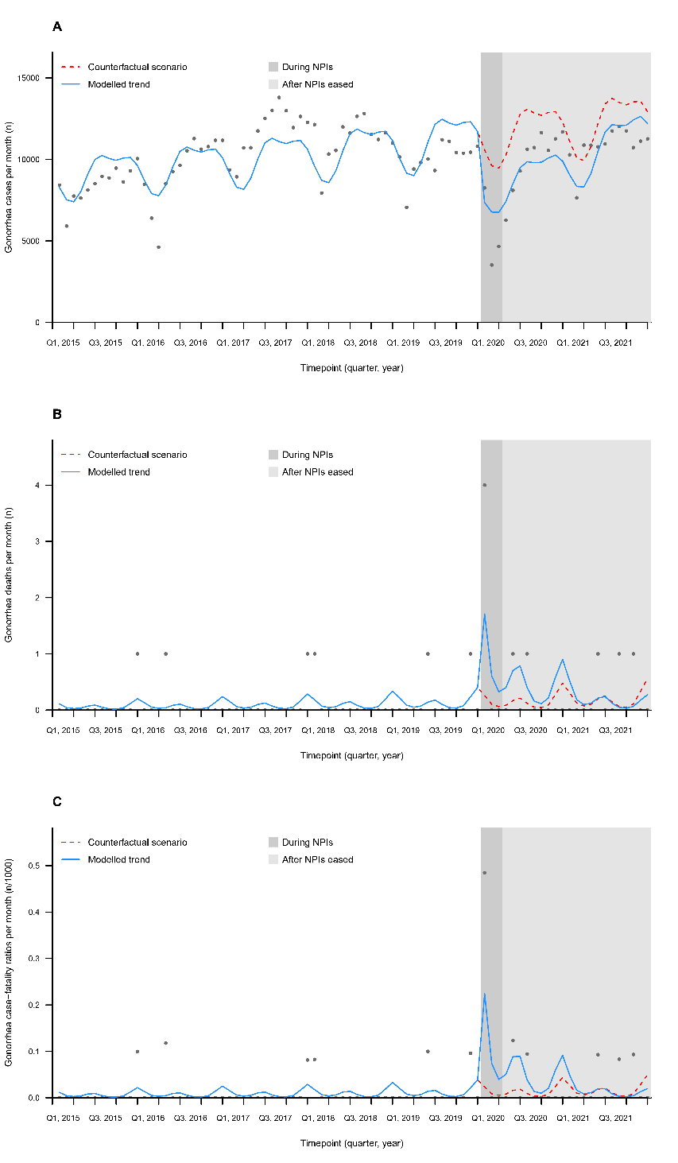
Gonorrhea
Results
Figure 4 Monthly numbers, trends and fitted Poisson segmented regression models for gonorrhea in China from January 2015 to December 2021
Table 5 Poisson segmented regression models of the impact of COVID-19 NPIs on gonorrhea in China from January 2015 to December 2021
 | IRR at NPIs | IRR at study end | Trend before NPIs | Trend after NPIs
Gonorrhea
Cases | 0.695(0.558-0.866) | 0.943(0.729-1.220) | 1.004(1.001-1.008) | 1.018(1.005-1.030)
Deaths | 6.574(1.280-33.779) | 0.480(0.029-7.991) | 1.015(0.982-1.049) | 0.905(0.793-1.033)
Case-fatality ratios | 9.677(1.764-53.088) | 0.398(0.018-8.891) | 1.012(0.977-1.048) | 0.880(0.766-1.012)
In the Poisson model, there was a 30.5% (0.695, 0.558-0.866) decline in gonorrhea cases, a 557.4% (6.574, 1.280-33.779) increase in gonorrhea deaths and an 867.7% (9.677, 1.764-53.088) increase in gonorrhea case-fatality ratios in January 2020.

Slide 11
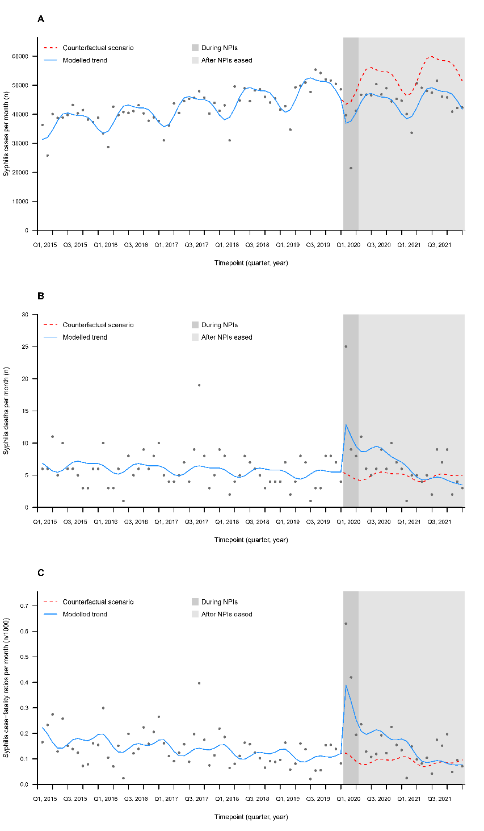
Syphilis
Results
Figure 5 Monthly numbers, trends and fitted Poisson segmented regression models for syphilis in China from January 2015 to December 2021
Table 6 Poisson segmented regression models of the impact of COVID-19 NPIs on syphilis in China from January 2015 to December 2021
 | IRR at NPIs | IRR at study end | Trend before NPIs | Trend after NPIs
Syphilis
Cases | 0.850(0.770-0.938) | 0.811(0.749-0.879) | 1.005(1.005-1.006) | 1.003(0.997-1.010)
Deaths | 2.444(1.432-4.171) | 0.708(0.383-1.310) | 0.996(0.989-1.002) | 0.943(0.909-0.979)
Case-fatality ratios | 3.173(1.877-5.365) | 0.810(0.442-1.484) | 0.990(0.984-0.996) | 0.933(0.897-0.971)
In the Poisson model, there was a 15.0% (0.850, 0.770-0.938) decline in syphilis cases, a 144.4% (2.444, 1.432-4.171) increase in syphilis deaths and a 217.3% (3.173, 1.877-5.365) increase in syphilis case-fatality ratios in January 2020.

Slide 12
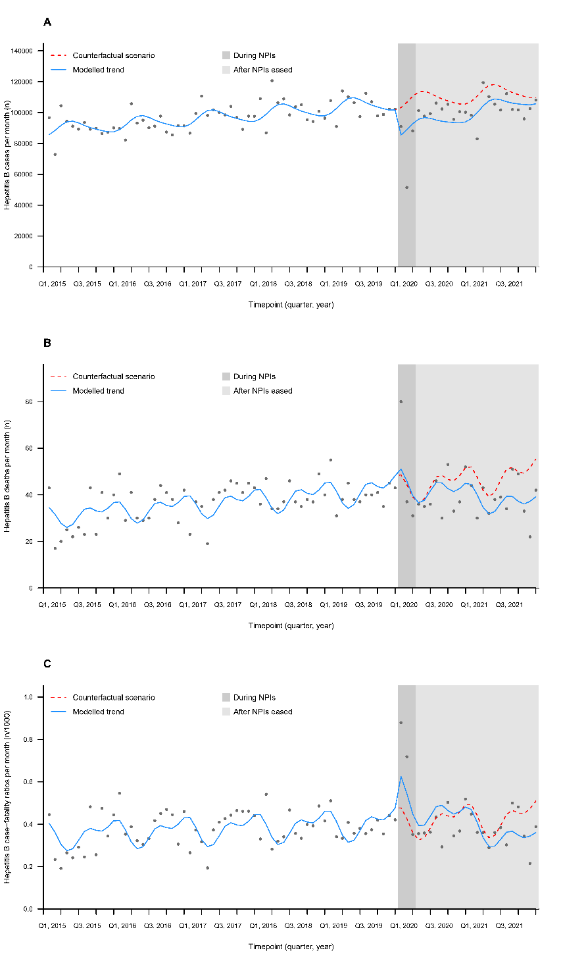
Hepatitis B
Results
Figure 6 Monthly numbers, trends and fitted Poisson segmented regression models for hepatitis B
in China from January 2015 to December 2021
Table 7 Poisson segmented regression models of the impact of COVID-19 NPIs on hepatitis B in China from January 2015 to December 2021
 | IRR at NPIs | IRR at study end | Trend before NPIs | Trend after NPIs
Hepatitis B
Cases | 0.828(0.733-0.935) | 0.965(0.906-1.027) | 1.003(1.003-1.004) | 1.010(1.002-1.017)
Deaths | 1.051(0.860-1.284) | 0.708(0.595-0.843) | 1.006(1.003-1.009) | 0.989(0.978-0.999)
Case-fatality ratios | 1.312(0.997-1.726) | 0.709(0.556-0.902) | 1.003(1.000-1.006) | 0.976(0.958-0.995)
In the Poisson model, there was a 17.2% (0.828, 0.733-0.935) decline in hepatitis B cases in January 2020.

Slide 13
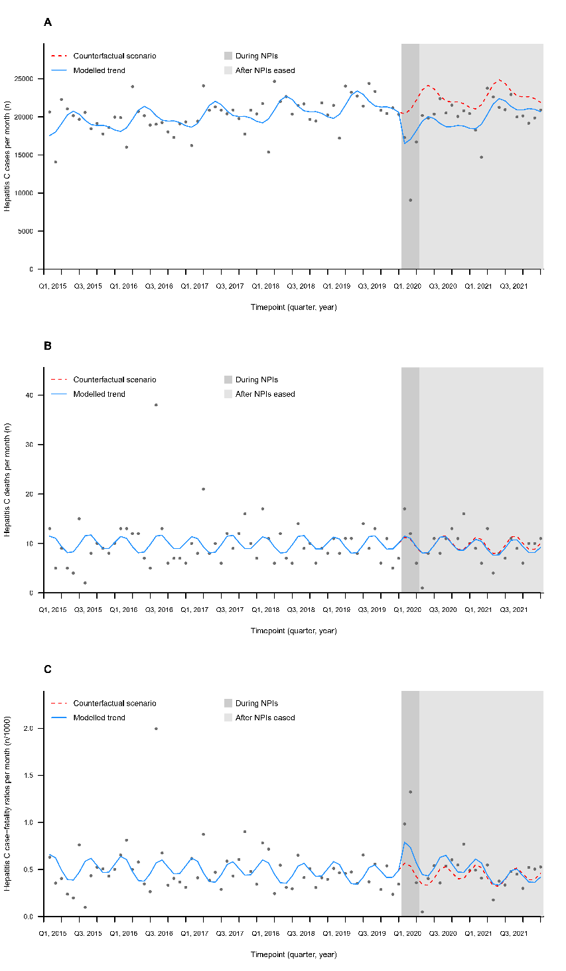
Hepatitis C
Results
Figure 7 Monthly numbers, trends and fitted Poisson segmented regression models for hepatitis C
in China from January 2015 to December 2021
Table 8 Poisson segmented regression models of the impact of COVID-19 NPIs on hepatitis C in China from January 2015 to December 2021
 | IRR at NPIs | IRR at study end | Trend before NPIs | Trend after NPIs
Hepatitis C
Cases | 0.808(0.700-0.934) | 0.944(0.868-1.025) | 1.003(1.002-1.003) | 1.009(1.001-1.018)
Deaths | 1.020(0.796-1.307) | 0.921(0.669-1.266) | 1.000(0.994-1.006) | 0.995(0.981-1.009)
Case-fatality ratios | 1.394(1.080-1.800) | 0.906(0.653-1.258) | 0.997(0.991-1.004) | 0.979(0.966-0.992)
In the Poisson model, there was a 19.2% (0.808, 0.700-0.934) decline in hepatitis C cases and a 39.4% (1.394, 1.080-1.800) increase in hepatitis C deaths in January 2020.

Slide 14
Conclusions
NPIs may have contributed to fewer reported cases of AIDS, gonorrhea, syphilis, hepatitis B, and hepatitis C, and
more reported deaths or case-fatality ratios of gonorrhea, syphilis and hepatitis C in China.
More long-term observations are needed to investigate the trend of STDs and BBVs over time.

Slide 15
Acknowledgement
Correspondence to:
Prof. Huachun Zou
Email: zouhuachun@mail.sysu.edu.cn
Prof. Chongguang Yang
Email: yangchg9@mail.sysu.edu.cn

