Slide 1
Digital services for key populations
Workshop

Slide 2
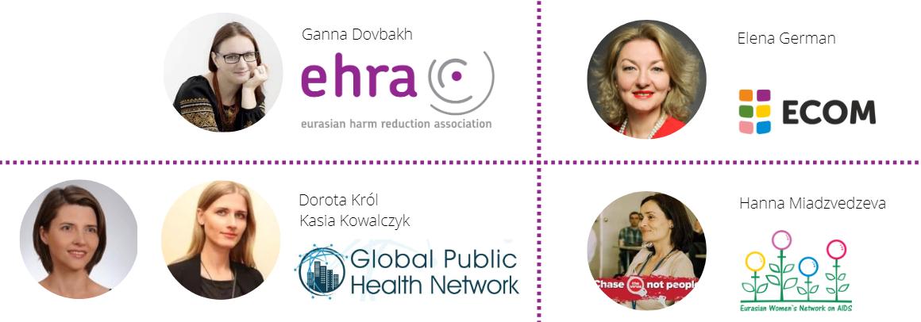
About us

Slide 3
Plan for the workshop
Course presentation (plus self assessment task)
Reflections on the course from the trainer’s perspective
Benefits of participation
Q & A

Slide 4
Rationale
“The lack of a unified definition and understanding of digital/remote services, as well as standards for their provision and a transparent and reliable accounting system for digital services, makes it impossible to carry out full quality control and to assess the effectiveness of digital services”
Pandemic
Mapping digital and remote medical and social services for key populations in relation to HIV in the region of Central and Eastern Europe and Central Asia (October-December 2020; 30 countries of the CEECA)

Slide 5
Before we start…
Digital security test

Slide 6
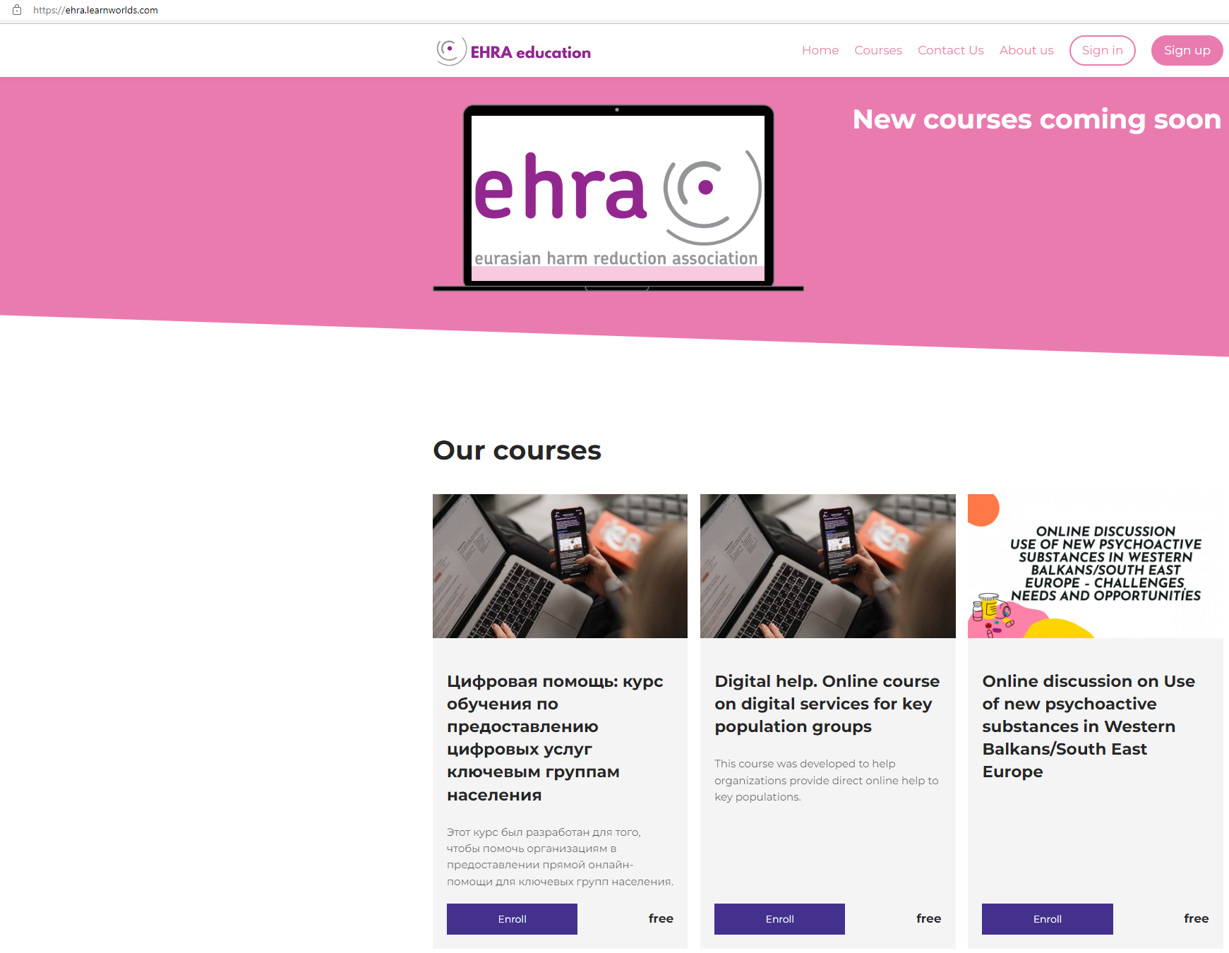
https://ehra.learnworlds.com/home

Slide 7
Key assumptions
Basic knowledge on the core elements of providing digital services for key populations;
No one tool fits all needs - main objective of this course is to show how to properly select digital tools and evaluate their usefulness;
For those who already run digital services and those who plan to.

Slide 8
Course overview
Dedicated platform
Russian and English versions
4-5 weeks
4 modules
Trainer’s supervision
Homework and self assessment
Certificate

Slide 9
Course overview
Module 1
Module 2
Introduction to digital services (terminology, goals, strategies, benefits and limits of digital services);
Online communication (specifics of computer mediated communication, rules of netiquette, language in digital services);
Persona tool (why and how to use persona to understand and target your audience);
Selecting digital tools.
Online counselling and therapy (framework for practice, structure of effective client session, practicalities of developing online relationship);
Monitoring and evaluation of services.

Slide 10
Course overview
Module 3
Module 4
Secure digital services;
Privacy & confidentiality;
Security guidelines, secure software and hardware, encrypting sensitive data, tips to protect your online privacy and security.
Ethics and dilemmas of running on-line services;
Online services - impact on staff (work-life balance)

Slide 11
Self check summary
Interpret your score
Over 80%
Between 40% and 80%
Under 40%

Slide 12
Persona task
Understanding the needs of the client
Enabling project managers and service planners to see their project or service through the eyes of users and beneficiaries

Slide 13
Reflections on the course from the trainer’s perspective
Participant’s and trainer’s perspective;
Solid basis for understanding on-line technologies;
Starting point for building and transforming on-line services for key populations.

Slide 14
Benefits of digital services
Covid as an impetus for change in delivering support for key populations;
Supporting key and vulnerable communities;
Digitalisation of services – best practices examples from the CEECA region.

Slide 16
Thank you
Contact:
anna@harmreductioneurasia.org
kasia@gphnetwork.org
dorkrol@ gphnetwork.org
elena@ecom.ngo
ravnaya1976@gmail.com
Register for the Digital Services for Key Populations course:
https://ehra.learnworlds.com/course/digital-services

