Slide 1
How to Start a Low Cost Texting Line:
In Under an Hour!
Sam Davin, MSW, AIDS Community Care Montreal, Staff
Kimberly Wong, M.A., AIDS Community Care Montreal, Staff
Saina Beitari, PhD, AIDS Community Care Montreal, Board of Directors

Slide 2
Overview
What is SextEd?
Why do we need SextEd?
Setting up a texting helpline
Demo
Questions/Comments?

Slide 3
What is SextEd?
Notes:
Updated video is embedded - need to choose if we want to show whole video or just clip

Slide 4
STBBIs on the rise in Canada
Despite the advancement of HIV care, high rates of STBBIs have been reported across Canada
Syphilis increased from 5.1 per 100,000 in 2011 to 24.1 per 100,000 in 2020.
Notes:
https://www.ncbi.nlm.nih.gov/pmc/articles/PMC8889924/pdf/CCDR-48-52.pdf

Slide 5
Need for SextEd
There is a need for innovative programs to:
Provide rapid and accurate information
Ensure equitable access to sexual eduction
Empower individuals through knowledge transmission

Slide 6
SextEd
Well-researched answers are written by youth volunteers and ACCM staff
All responses include links to relevant local organizations, credible online resources, or both
Answers focus on harm reduction and inclusivity

Slide 7
1. What’s the set up?
We use three online programs:

Slide 8
Twilio
An online phone number that accepts texts, calls, and MMS
Let’s you send and receive texts through integrations like Sunshine Conversations
Reliable, hasn’t been down since starting the program
Lets you export the history of texts that go in and out through Excel (helpful for reporting)

Slide 9
Sunshine Conversations (by Zendesk)
Redirects texts from Twilio, Facebook Messenger, website messaging, and other places to apps like Slack.
Lets you answer messages from any of these through email or programs like Slack
Sign up for an account, then connect to Twilio and Slack

Slide 10
Slack
Messaging system
Built-in co-worker messaging, which we use to share and edit drafts
Easy to customize with JavaScript integrations
Lets you save and search past answers

Slide 11
Messaging Costs
$1 per month for a number
$0.0075 for each text
That’s it! Up to 500 users a month!
$4.75 buys you about 100 exchanges per month.

Slide 12
Messaging Costs
Twillio gives a $500 credit and 25% discount for registered charities
That can be over 100 months free!
*Sunshine Conversations costs $60 if you reach 5,000 users a month

Slide 13
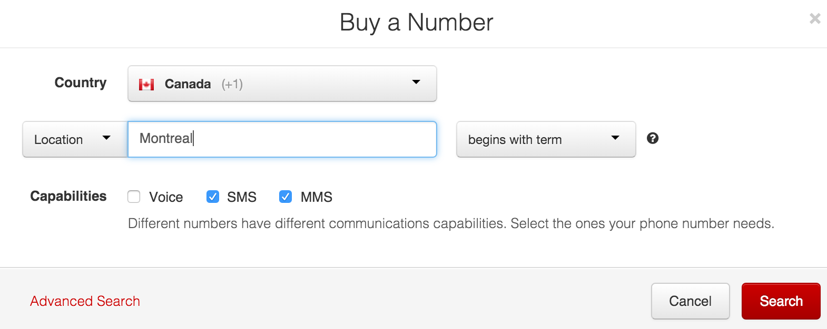
Step 1: Sign up for Twilio and get a phone number

Slide 14
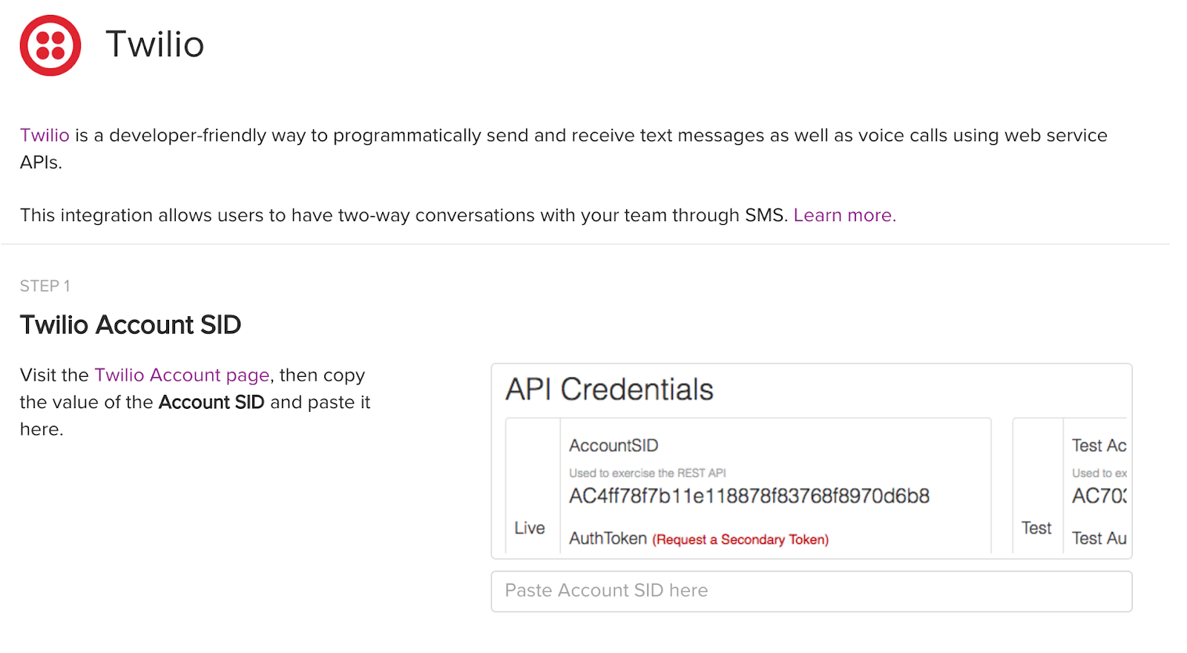
Step 2: Sign up for Sunshine Conversations and enable Twilio SMS integration

Slide 15
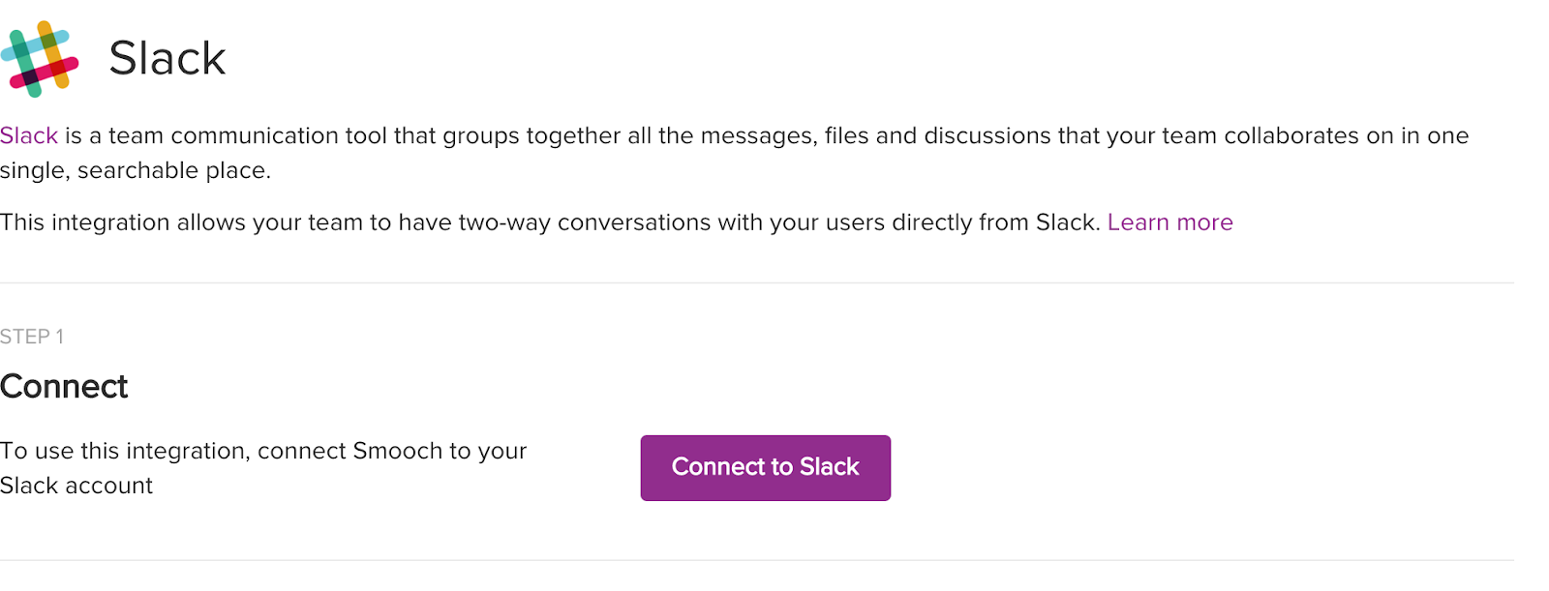
Step 3: Connect Sunshine Conversations to Slack

Slide 16
Step 4: You’re Done! Start Texting!
Really, that’s it!
Promote the number that you registered
Any texts that come in will be sent through Slack and you can reply back right away

Slide 17
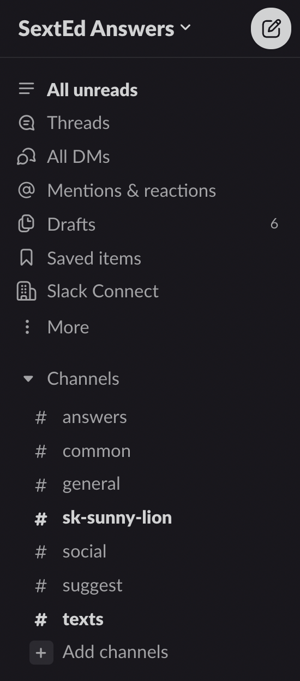

Slide 18
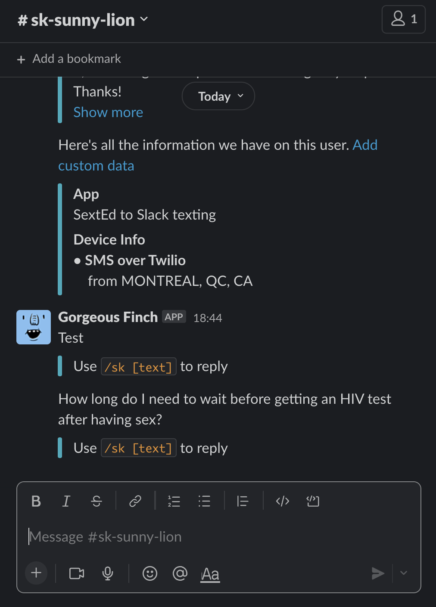

Slide 19
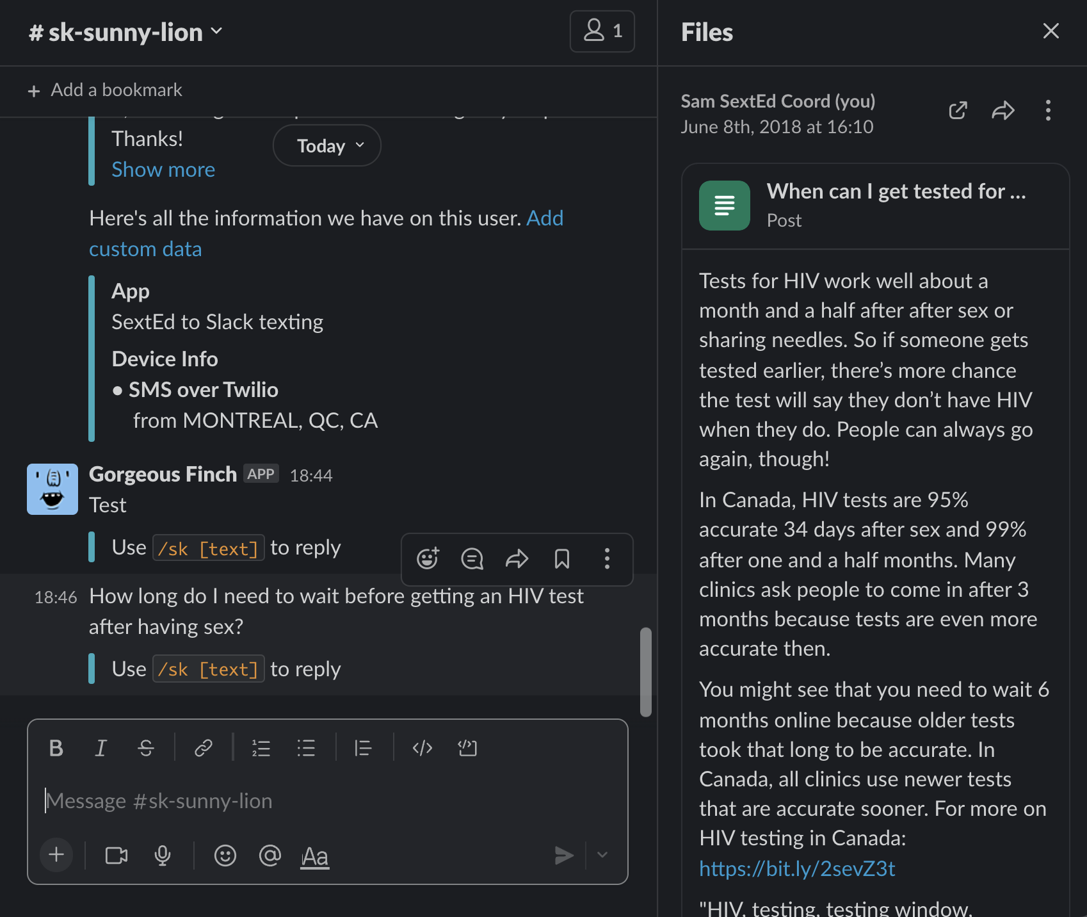

Slide 20
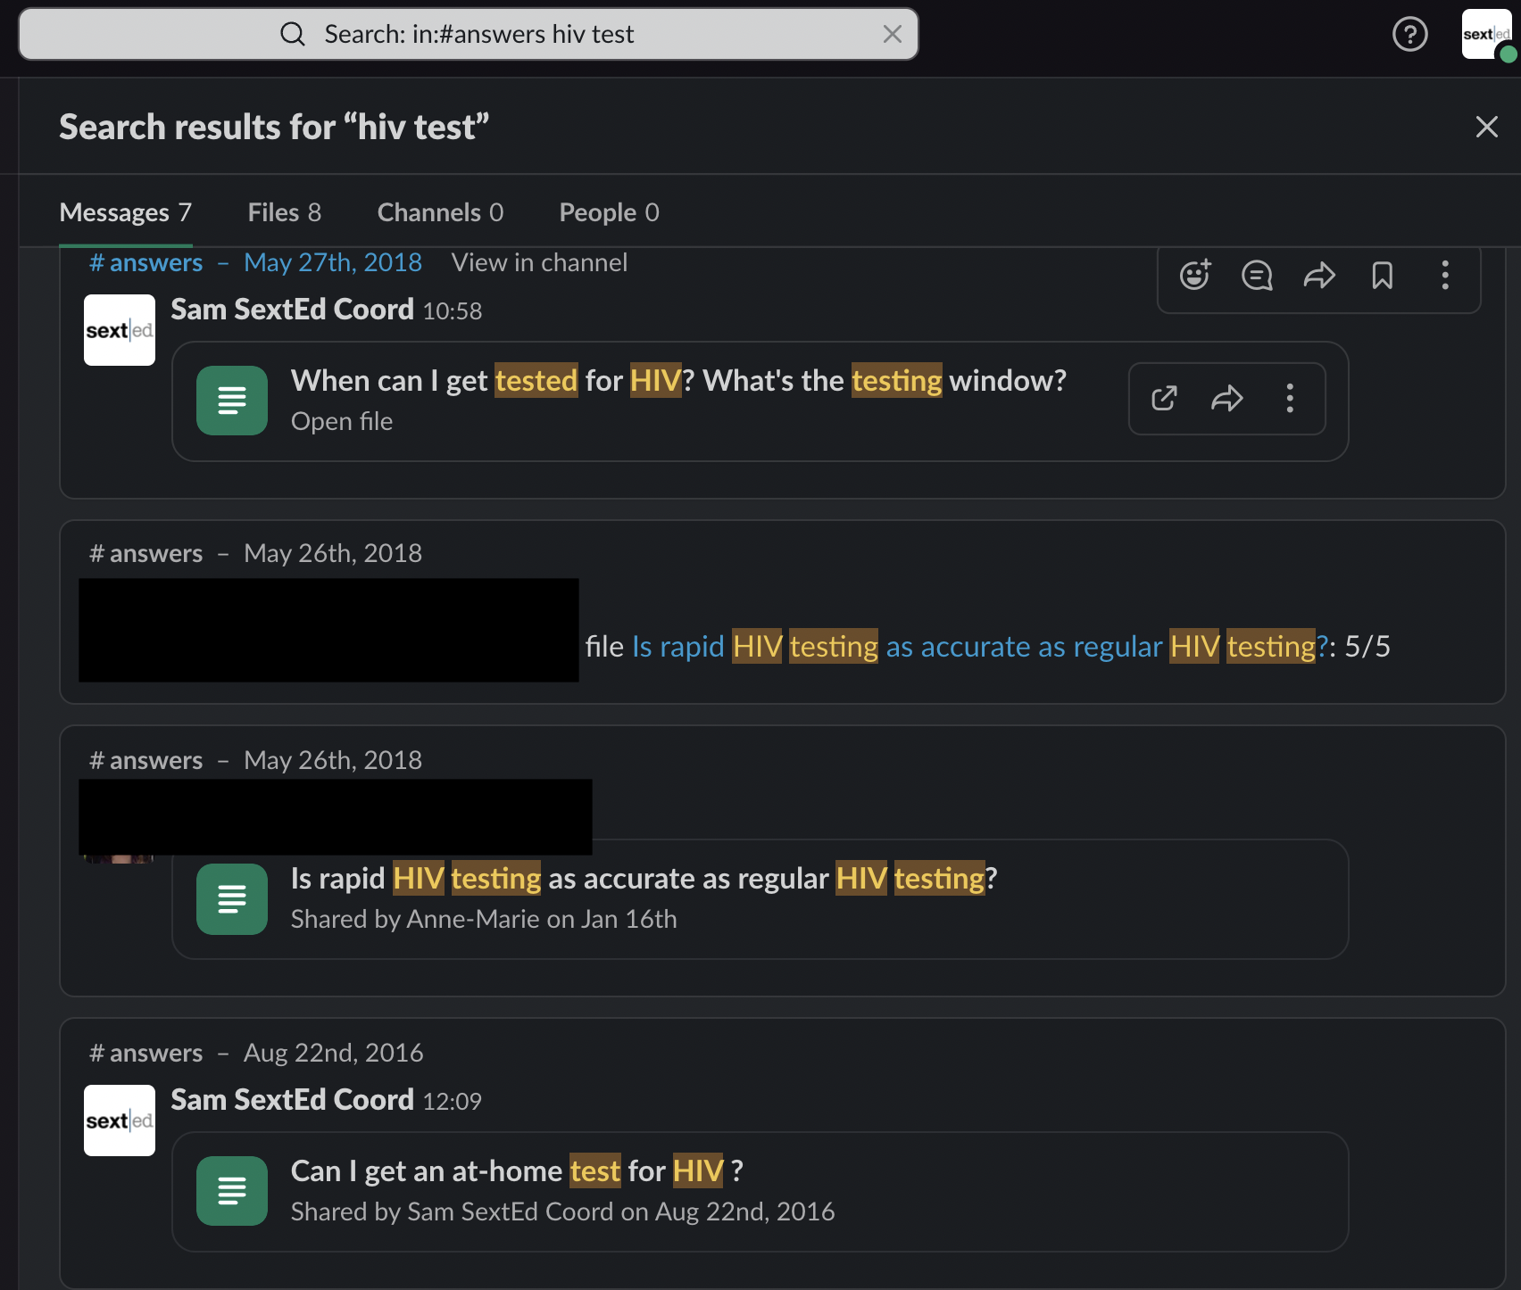

Slide 21
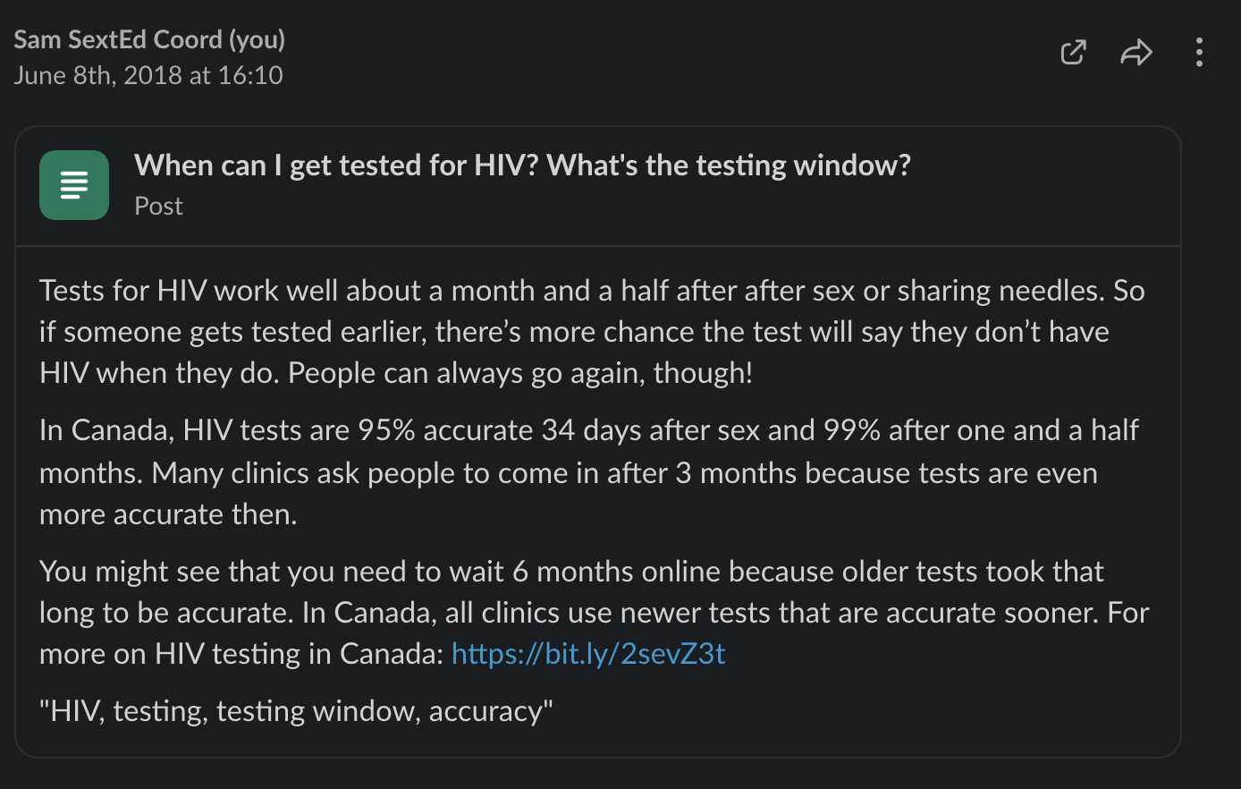
Notes:
Lets you save and search past answers
Using saved answers, our volunteers can create personalized responses for each texter while already having research on the topic in an easily accessible place

Slide 22
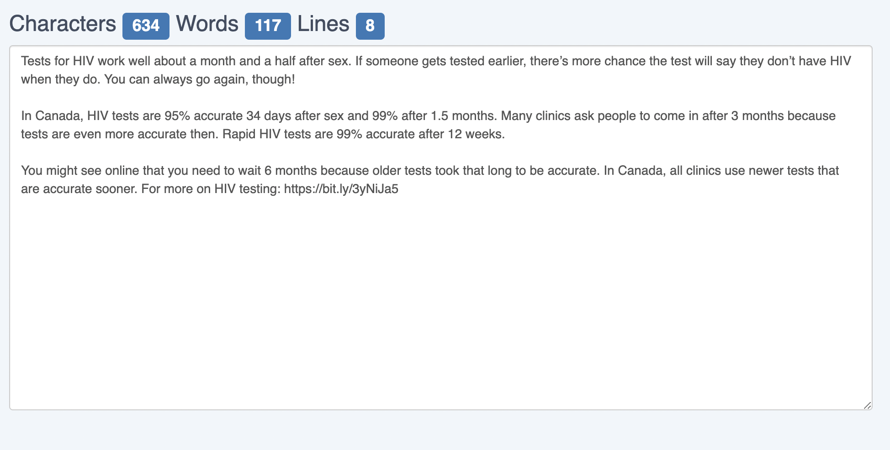
Notes:
Character limit - sometimes if long texts will not go through - better to break up into two texts with under 500 characters each (limit used to be 640 on Twilio)
Twilio recommends sending messages that are no more than 320 characters to ensure the best deliverability and user experience

Slide 23
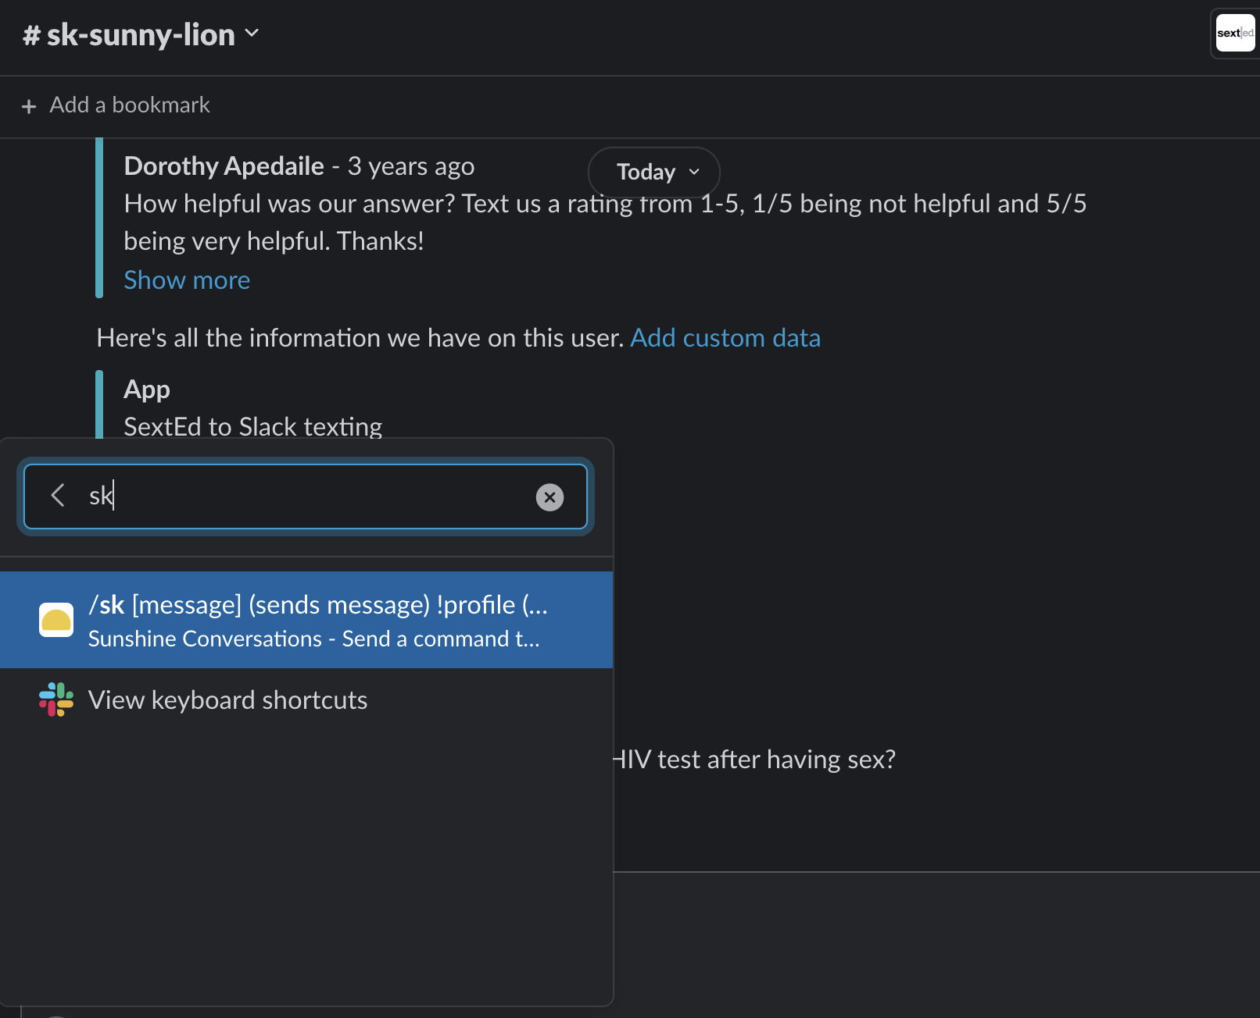
Notes:
/ lets you put in code commands - (/sk) before any response and then enter to text it back to texter or else will just be sent with Slack to other volunteers/colleagues
/archive allows you to easily archive messages (can still be found through search function in Slack)

Slide 24
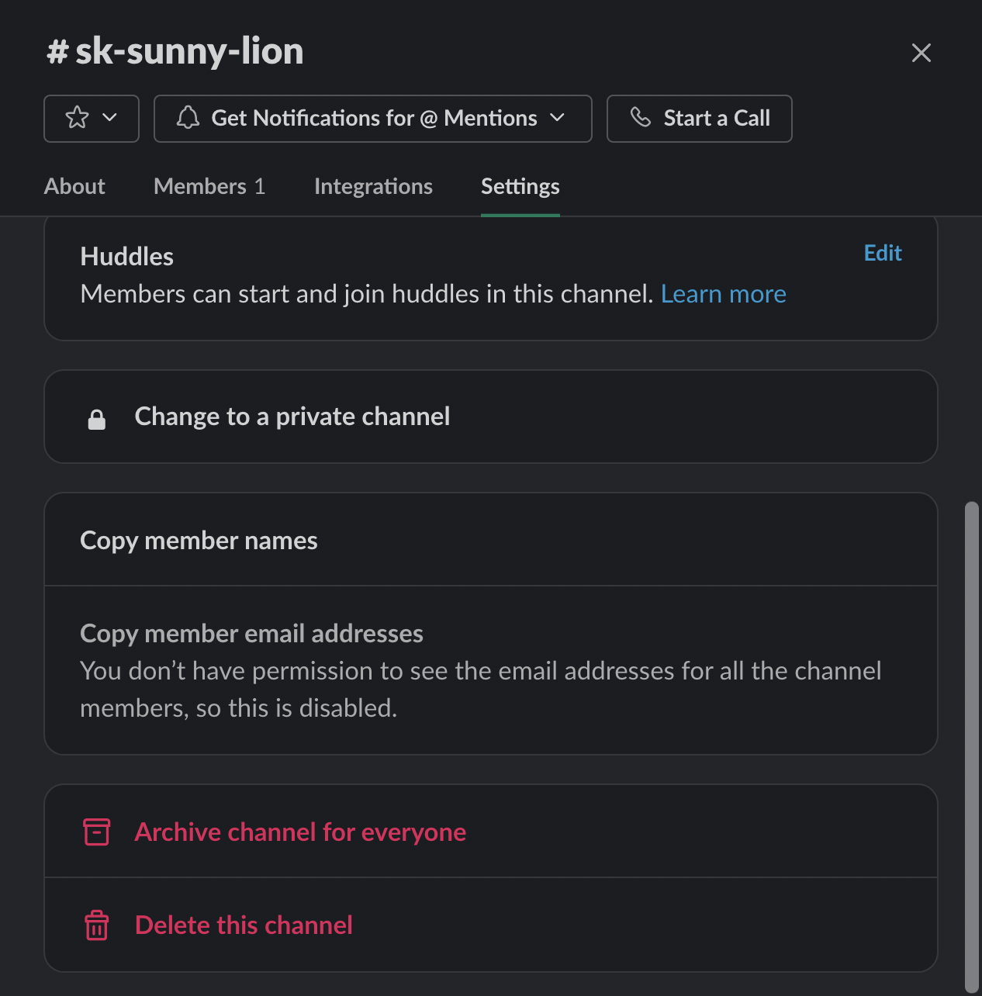
Notes:
How to archive a channel -

Slide 25
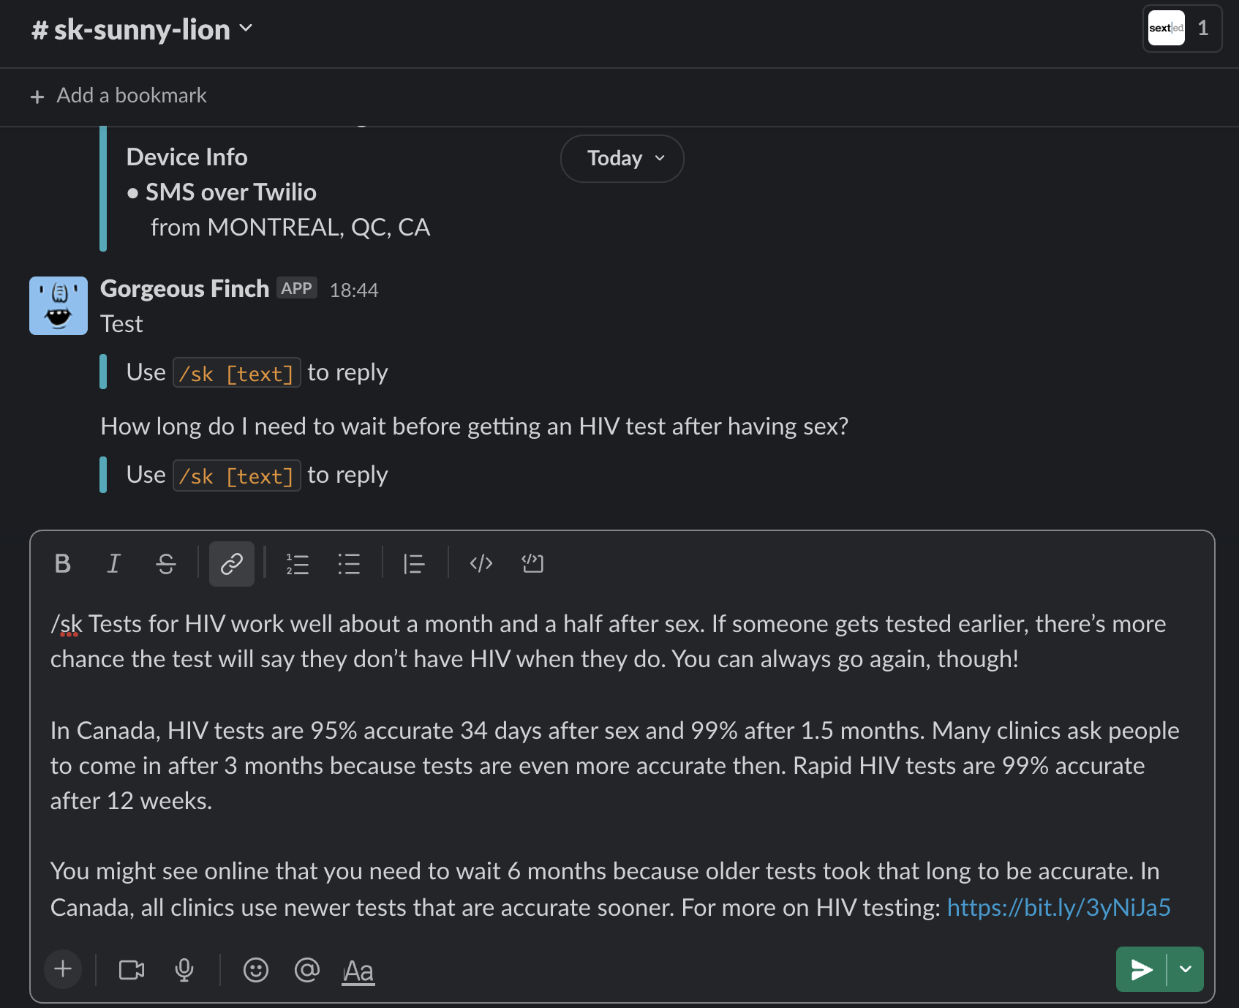

Slide 26
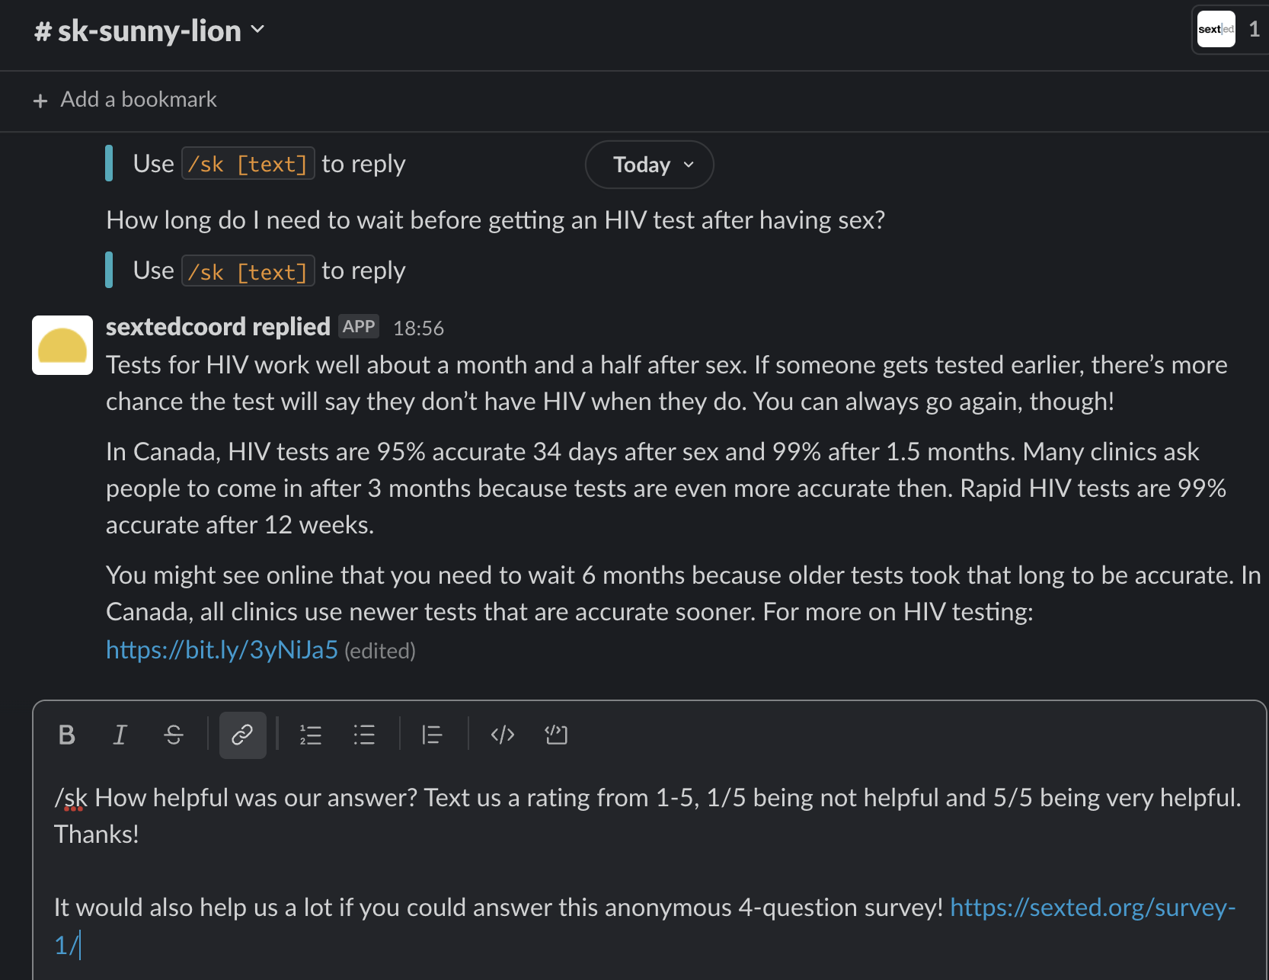

Slide 27
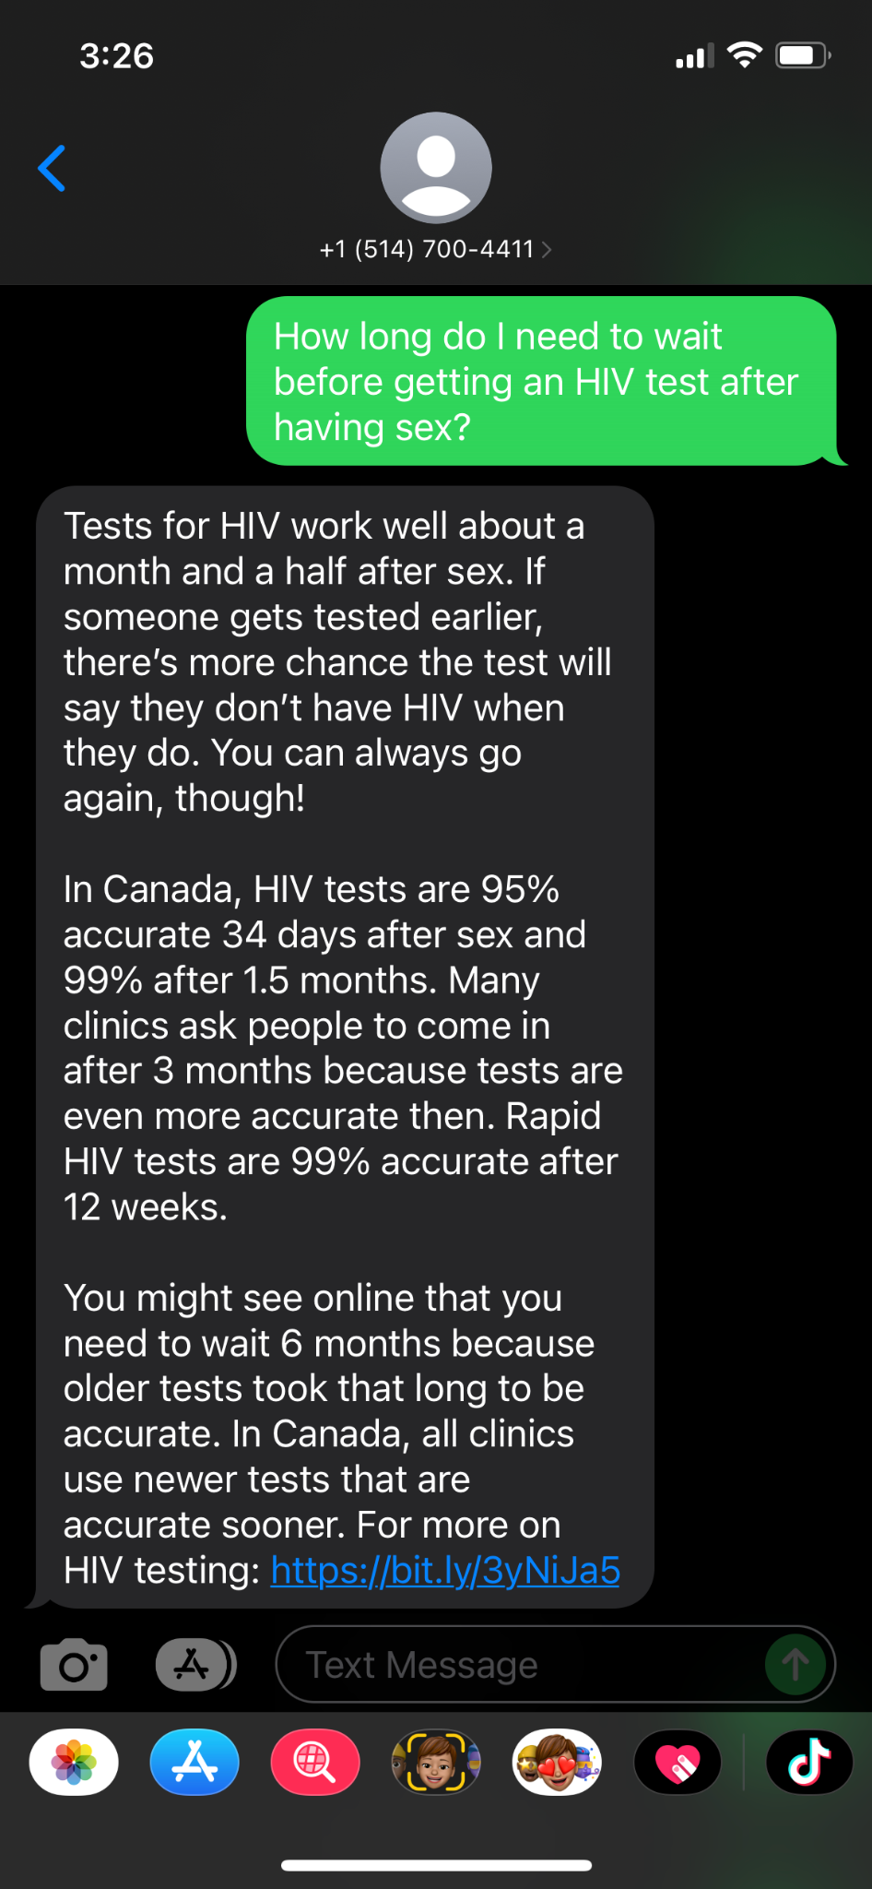
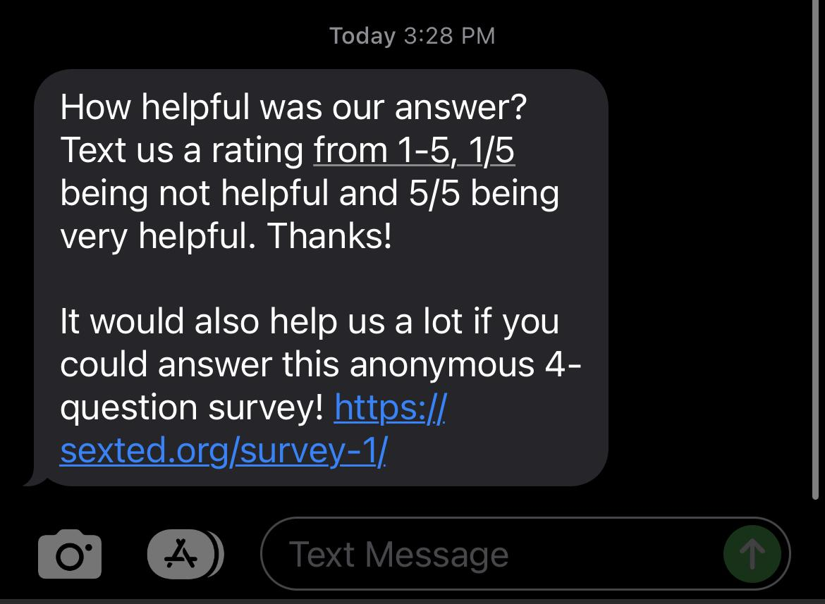
Notes:
Texter’s perspective of responses and feedback request
Texters can click directly on links

Slide 28
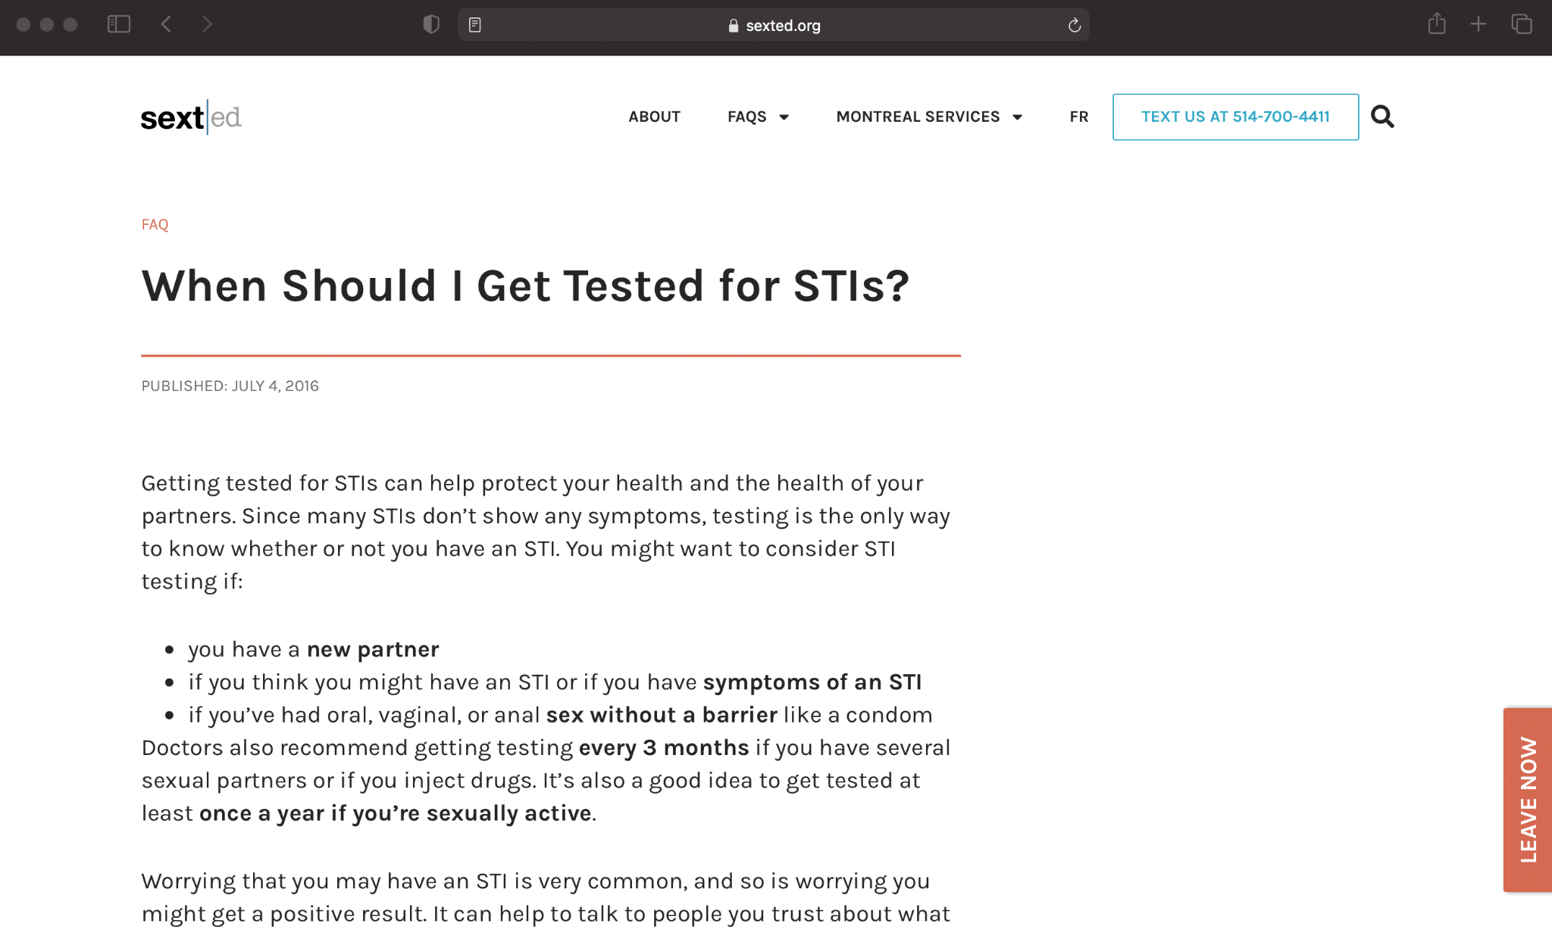
Links?
We try to include a link in every text response - either from our own SextEd website or a reliable resource!
You can use bit.ly to shorten long URLs!
Notes:
Texters can click directly on links through phone or computer

Slide 30
Key Considerations
When answering a text:
What is the person asking for? What topics might help?
Am I making assumptions about: gender, orientation, age, experience, etc.?
Am I answering the question?
Readability and youth-friendly language
Referrals, online and local
Check out our Resource Kit!

Slide 31
Take Home Messages
Setting up a text-based program is…
Inexpensive
Fast
Easy to add to other organization programs

Slide 32
Take Home Messages
Texting-based programming is great because it…
Increases accessibility
Makes it easy to connect people to resources
Automatically collects data

Slide 33
Thank You!
Leave us your contact info for digital copies of our resource materials!
You can also find them on our website: sexted.org/start-a-texting-helpline/
Notes:
Need to edit resource sheet - and upload to SextEd website!

Slide 34
Contact Info
Sam Davin | sexted@accmontreal.org
Kimberly Wong | pdm@accmontreal.org
Saina | saina.beitari@gmail.com
AIDS Community Care Montreal
514 527-0928
sexted.org
Notes:
Kim email update

Slide 35
Questions?
Text them into 514-418-0563 !
We’ll answer them live! You can see firsthand how easy a texting line can be!
We’ll answer as many as possible - any we don’t get to we’ll text back an answer in the next 24 hours (after which the line will close)!
And we’ll add any frequently answered questions to our Resource Sheet!

