Slide 1
Empowerment Art Therapy Workshop
for People Living with HIV
Speakers:
Shirlene Cooper, Project Director of the
Women’s Empowerment Art Therapy Group
Blake Paskal, Artist Engagement and
Community Programs Manager, Visual AIDS

Slide 2
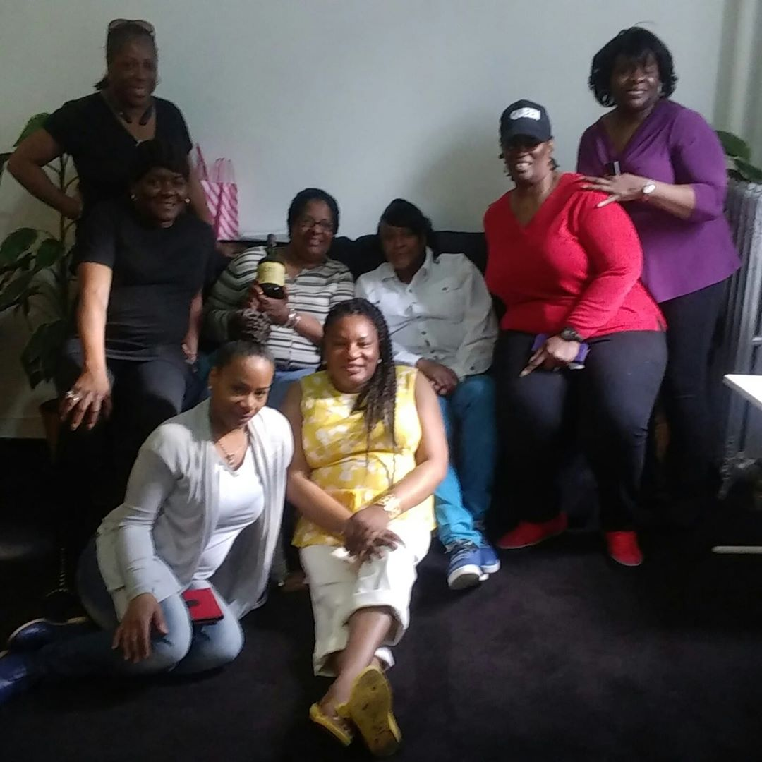
Women’s Empowerment Art Therapy Group

Slide 3
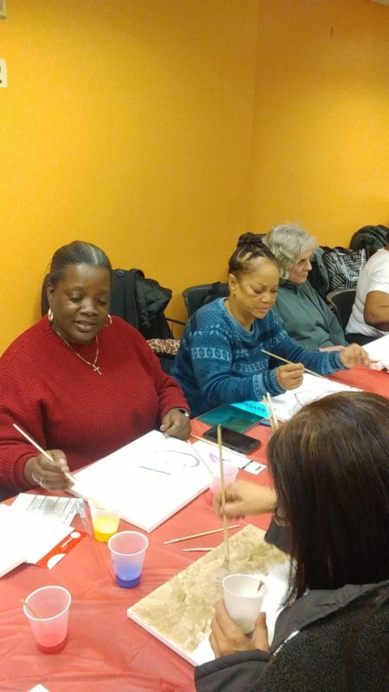
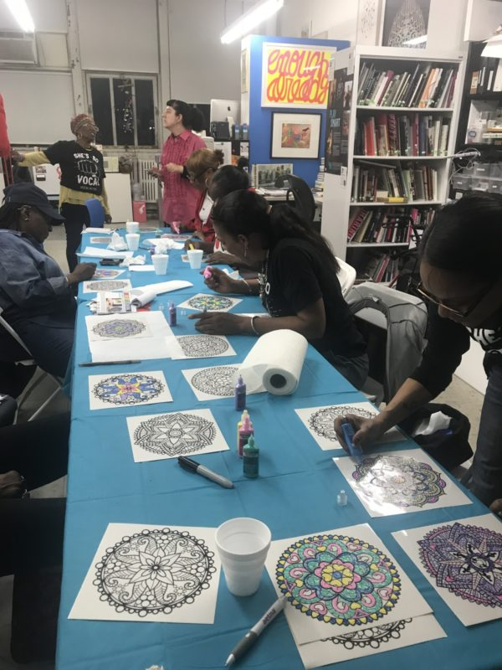

Slide 4
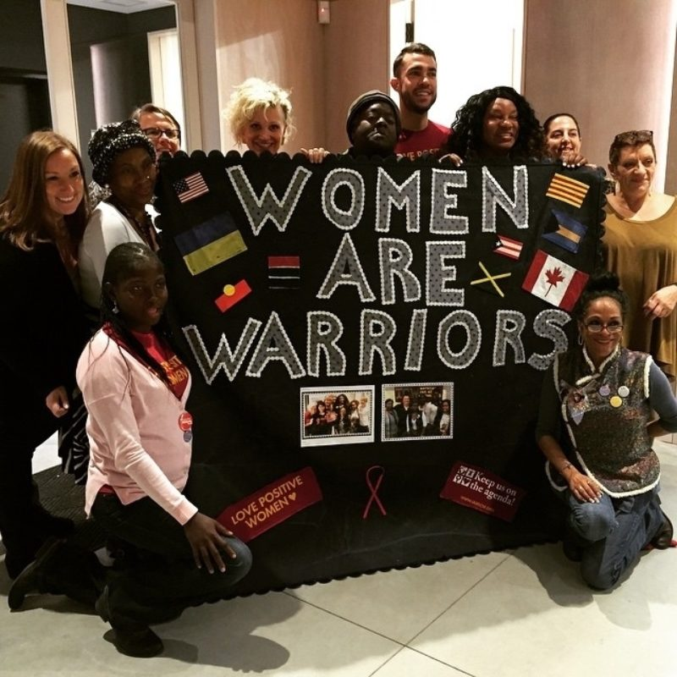

Slide 5
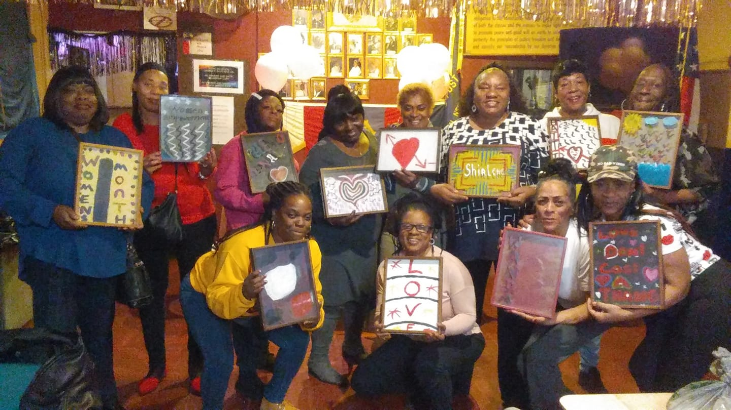
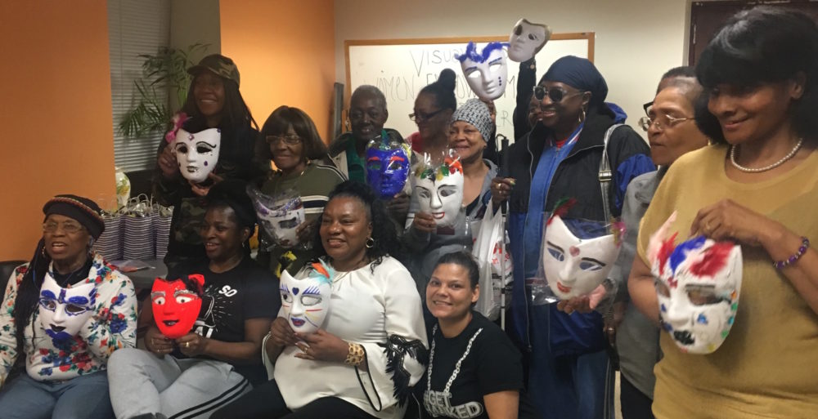

Slide 6
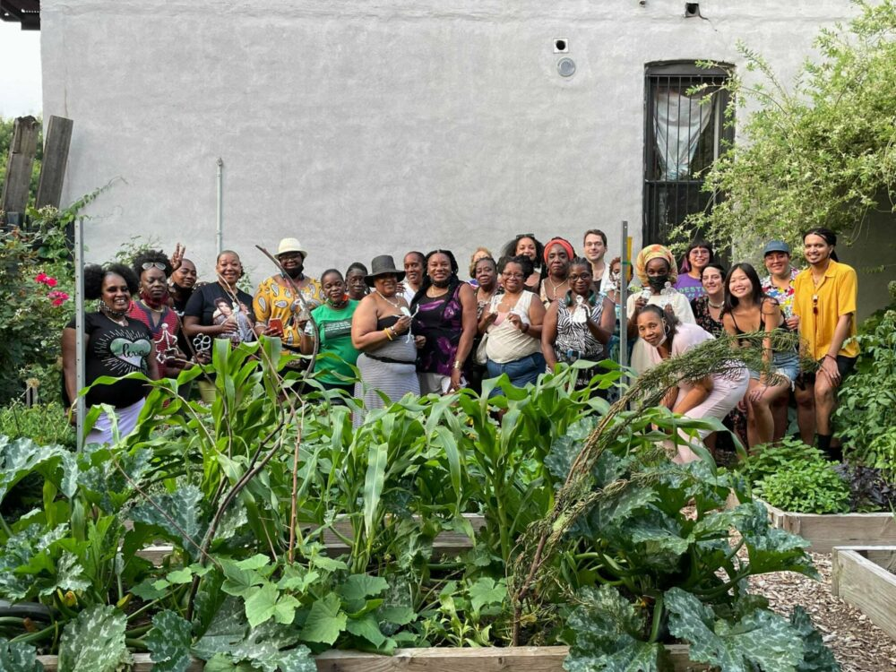

Slide 7
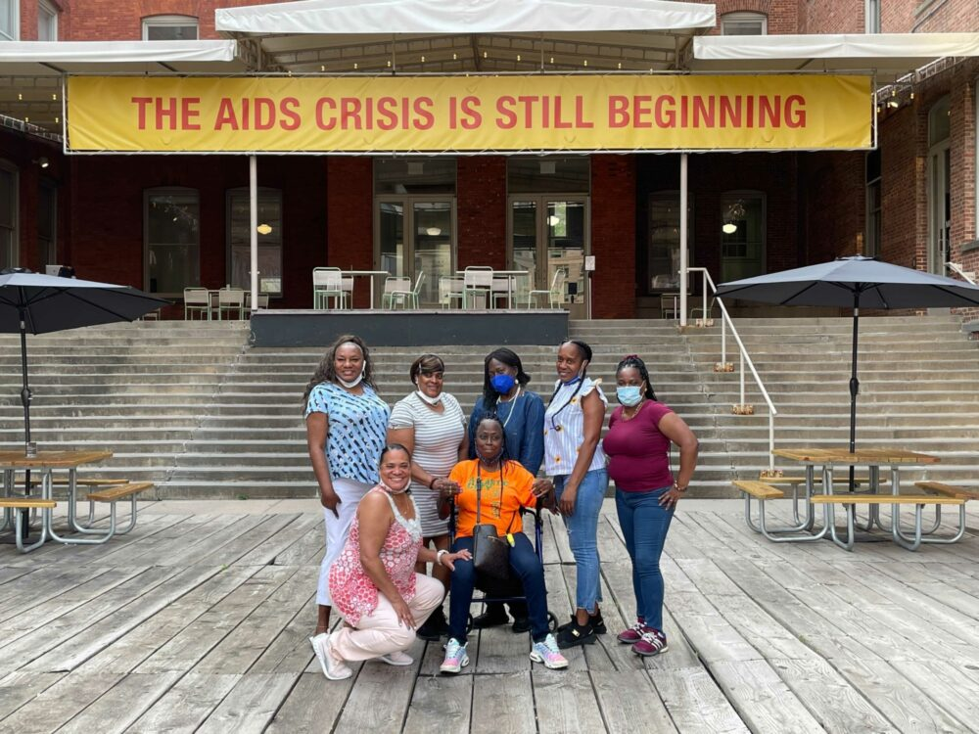

Slide 8
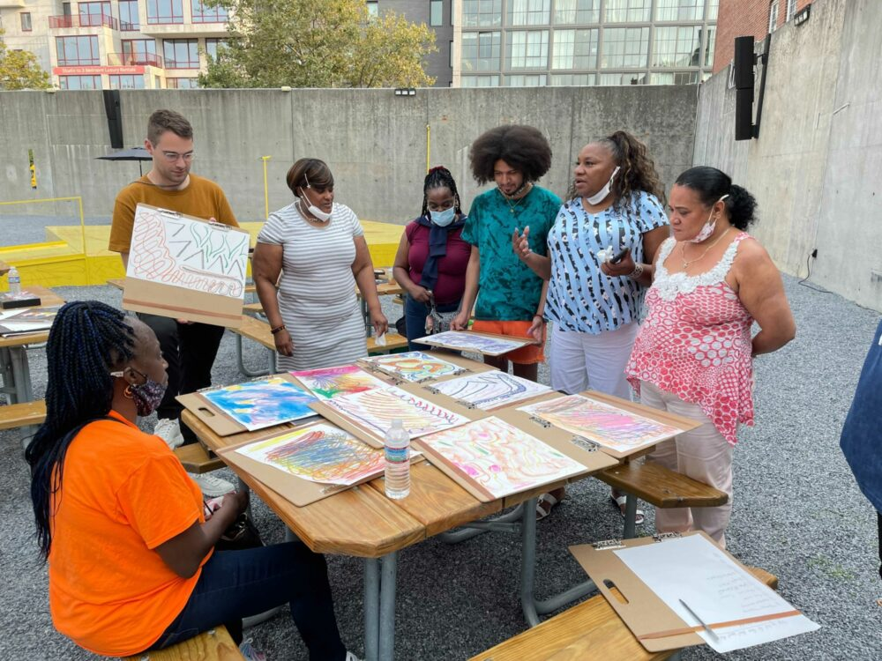

Slide 9
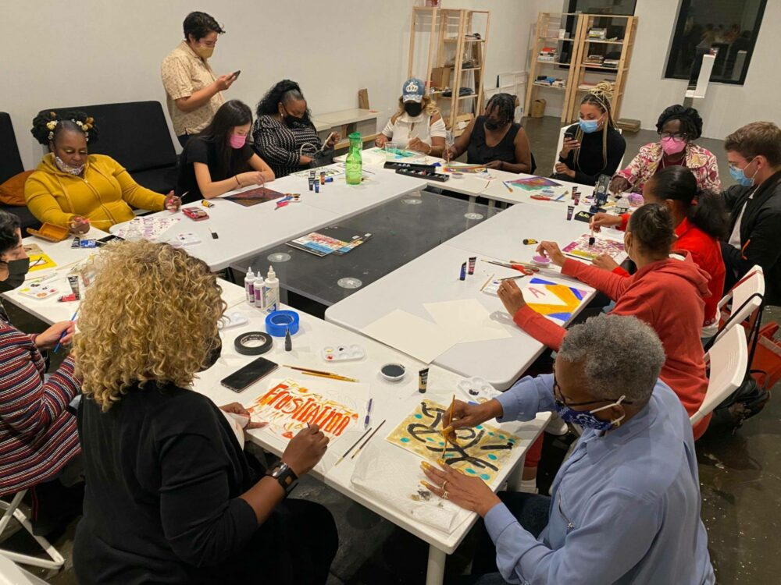

Slide 10
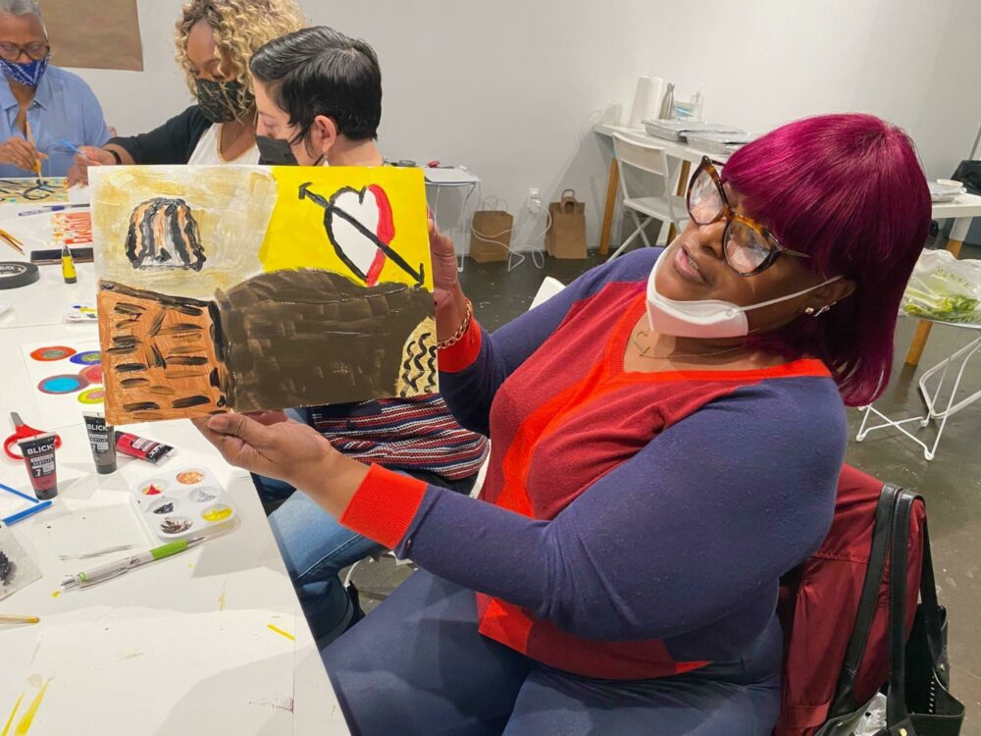

Slide 11
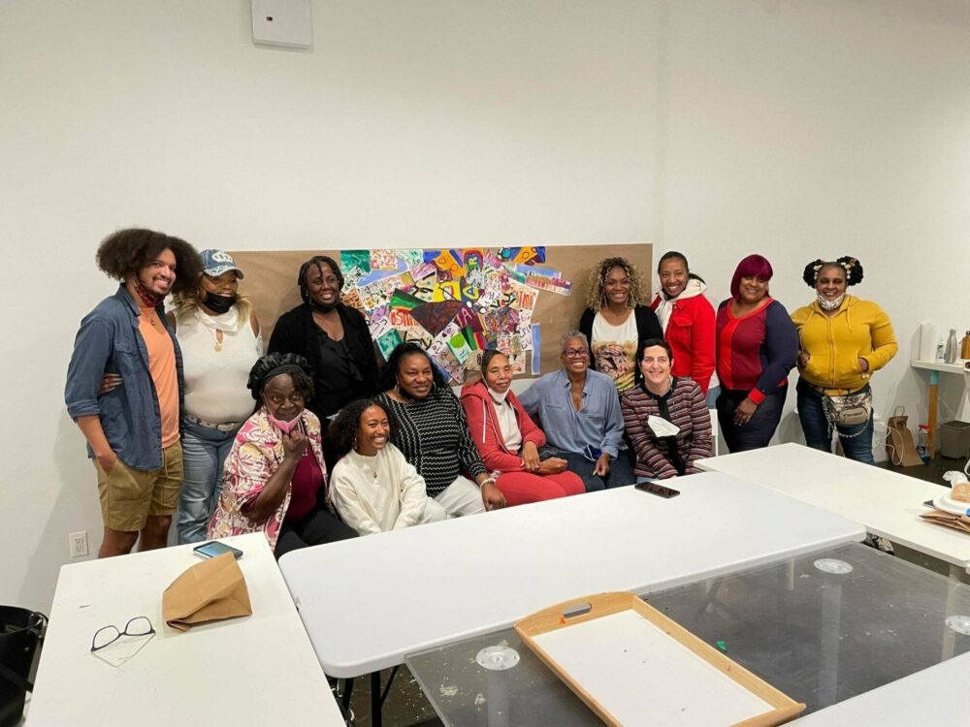

Slide 12
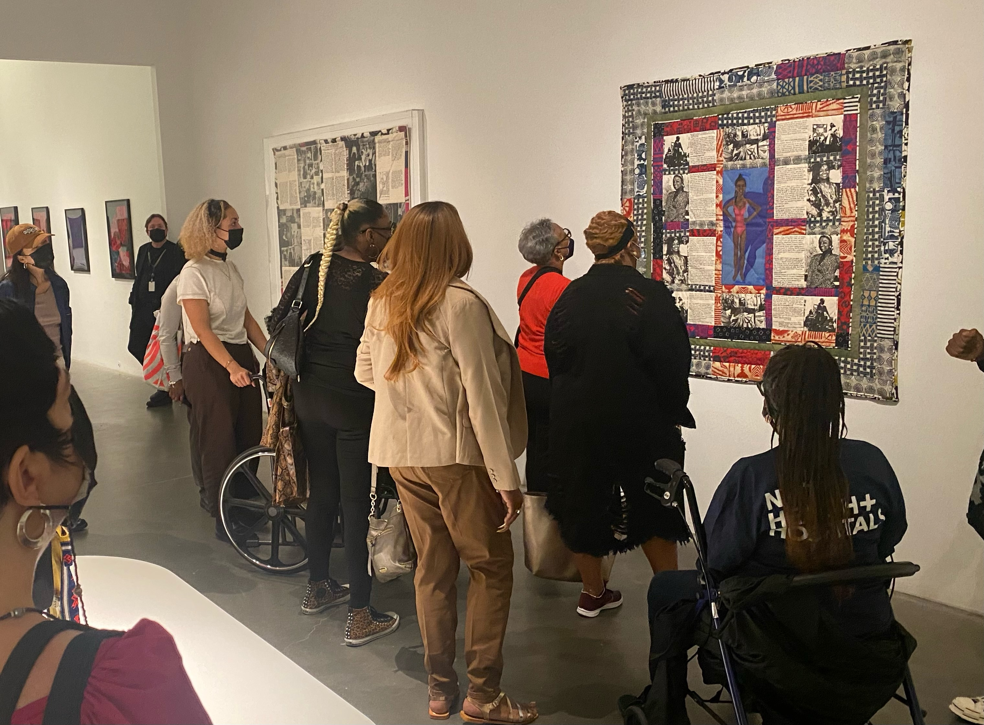

Slide 13
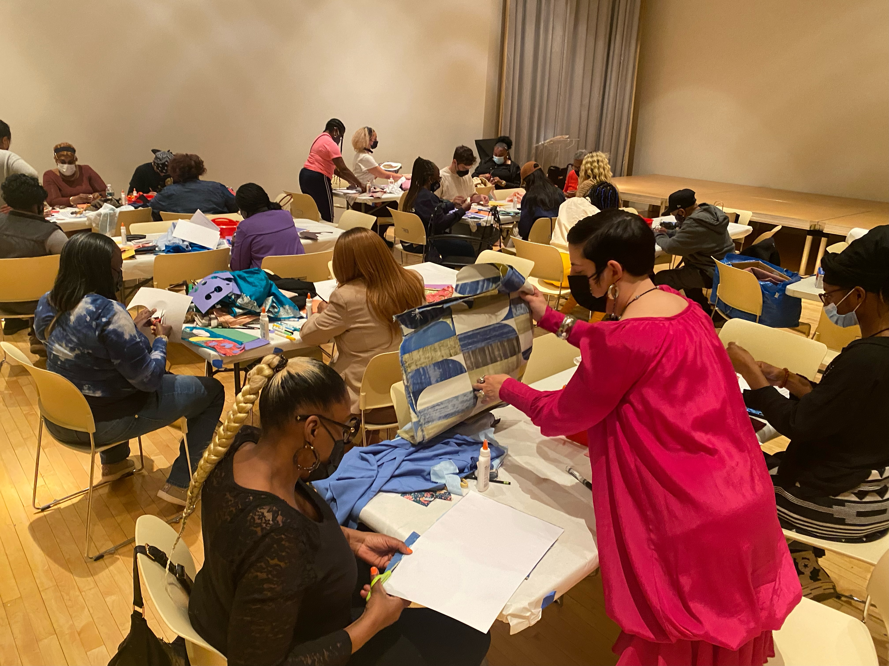

Slide 14
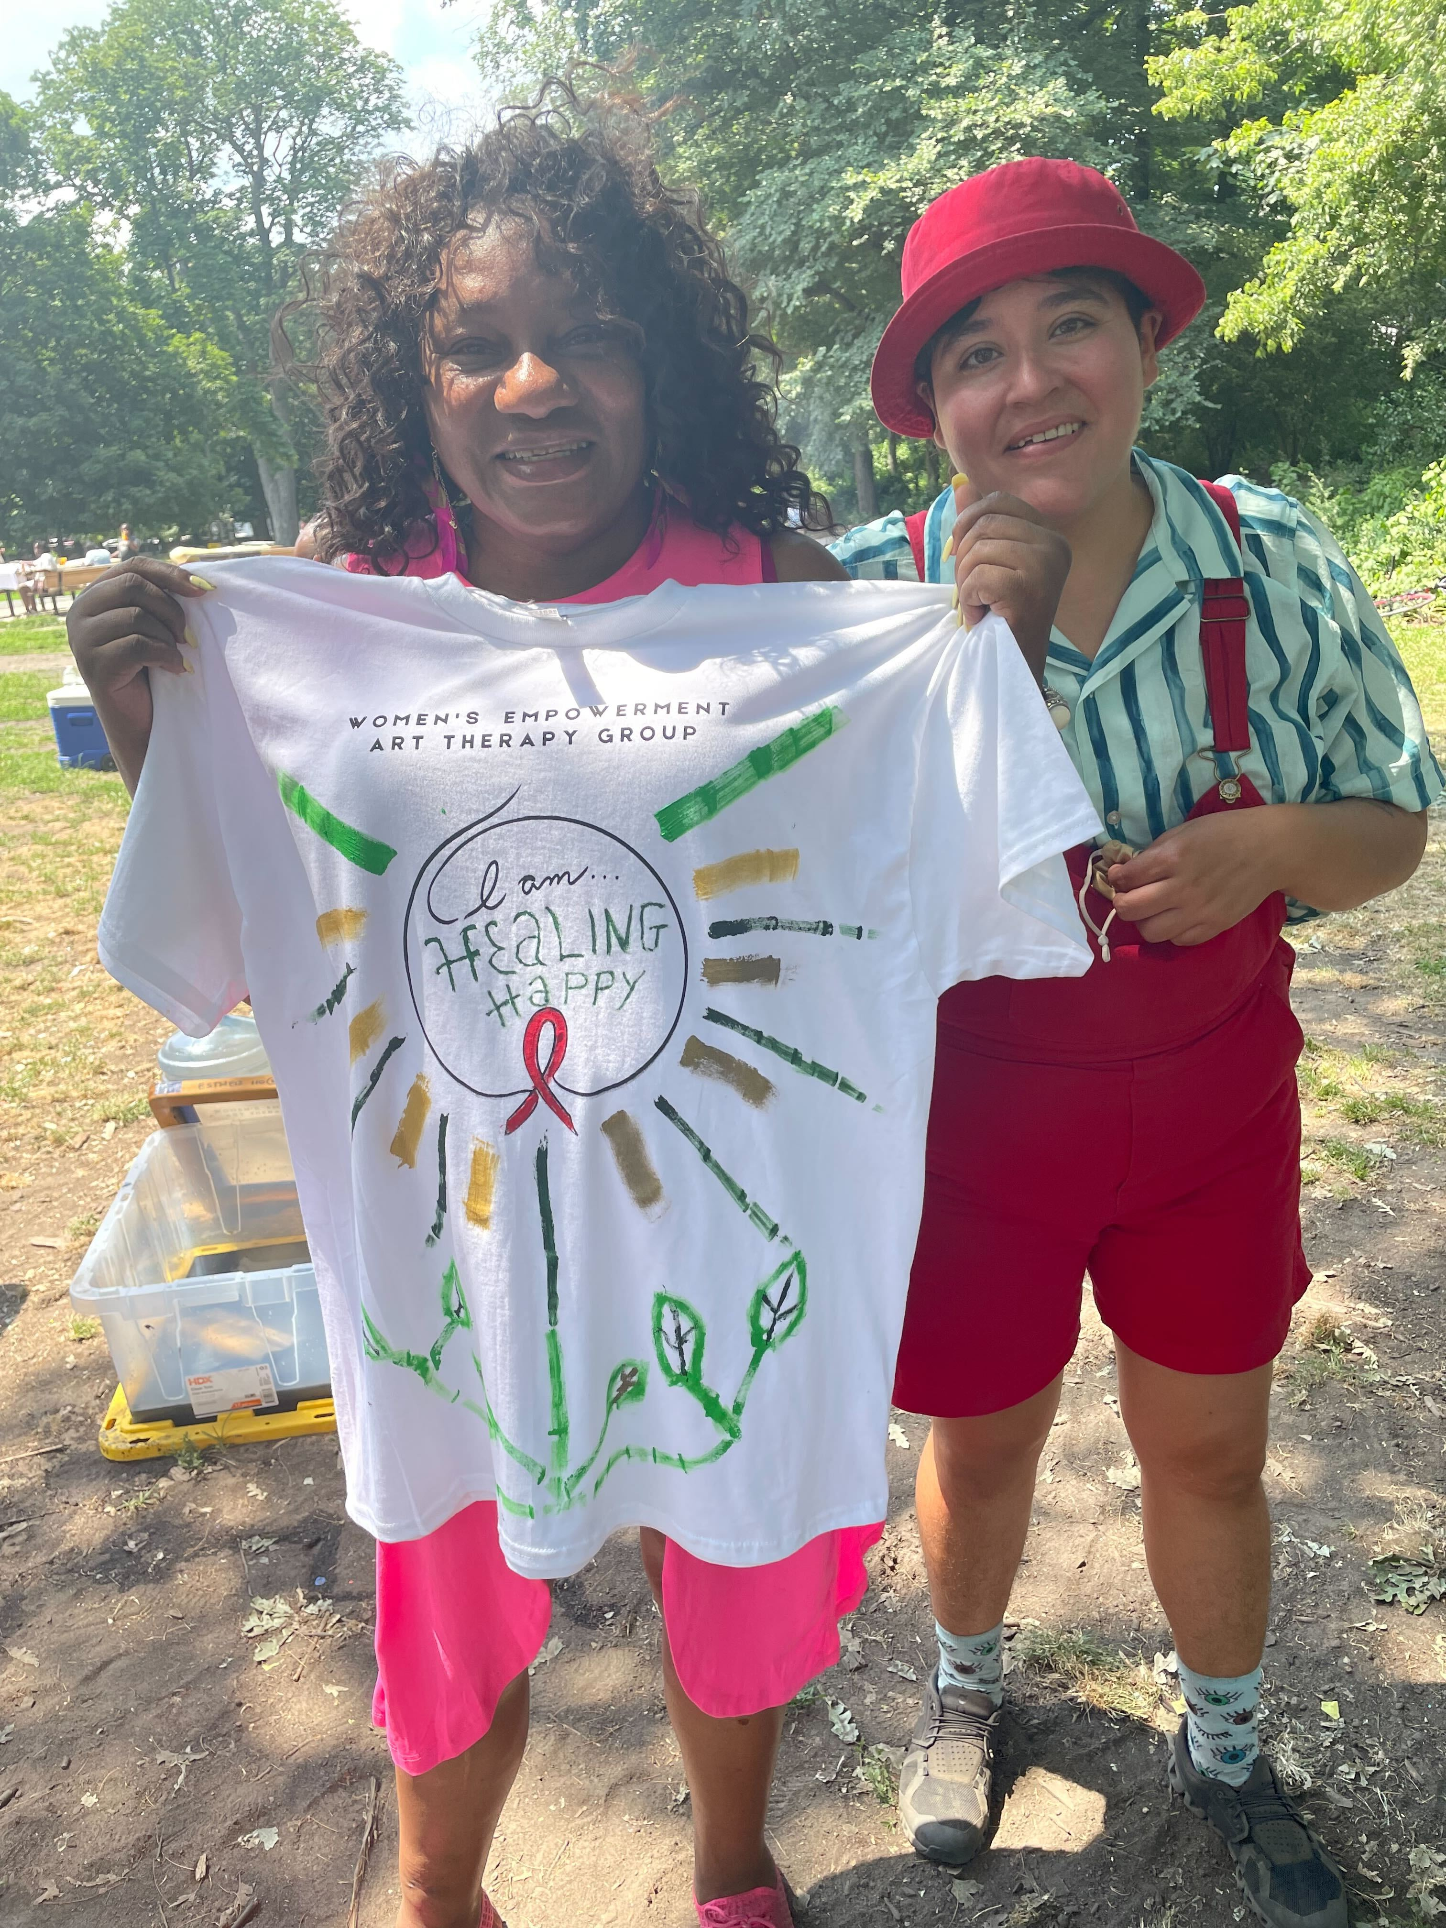
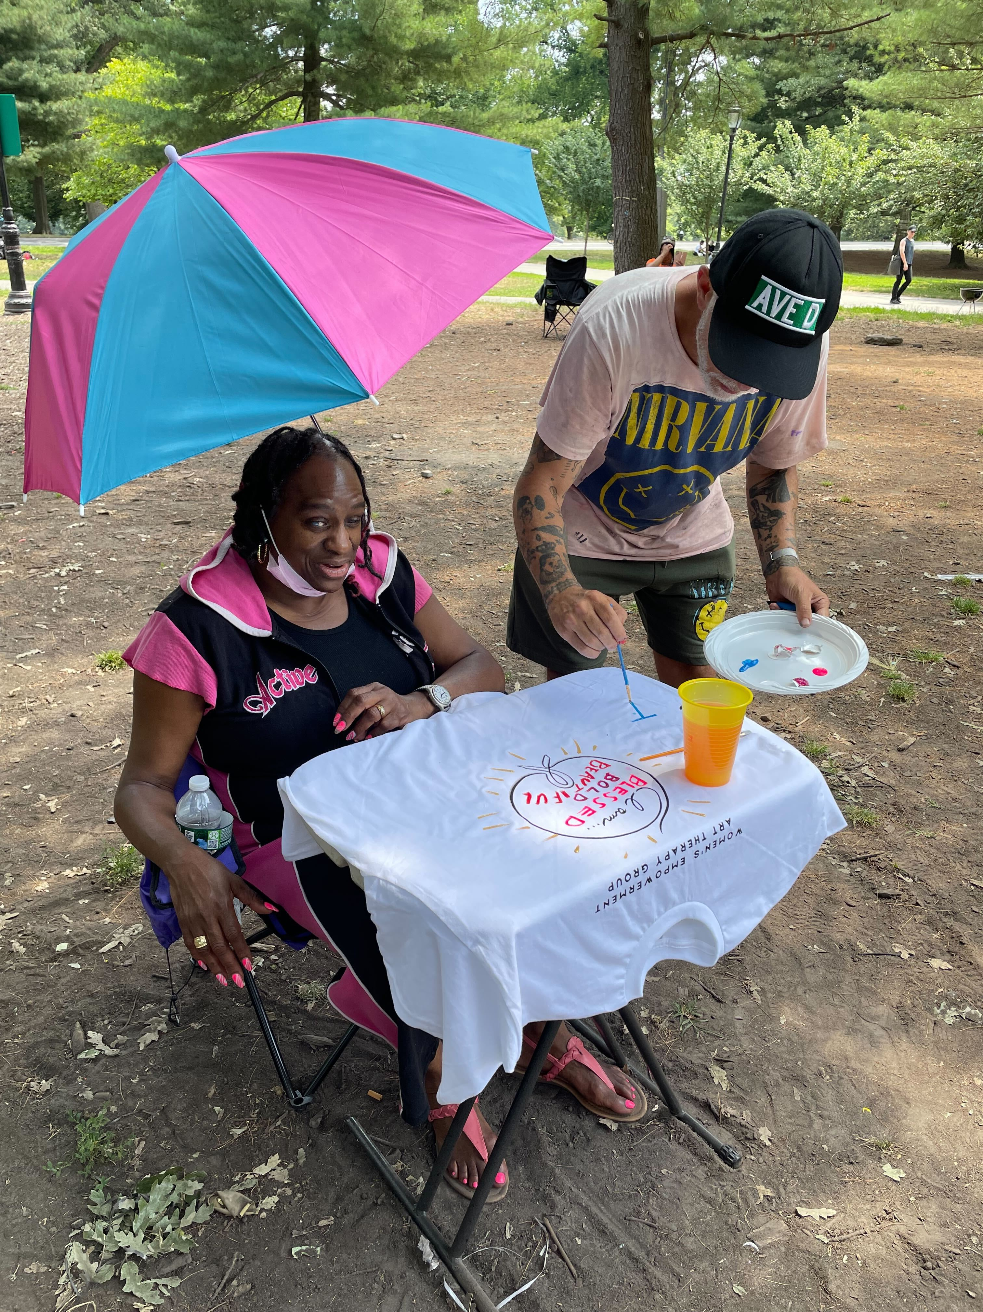

Slide 15
Kia Labeija
Eleven, October 2015, Digital Photograph

Slide 16
Kia and Mommy, February 2014, Digital Photograph

Slide 17
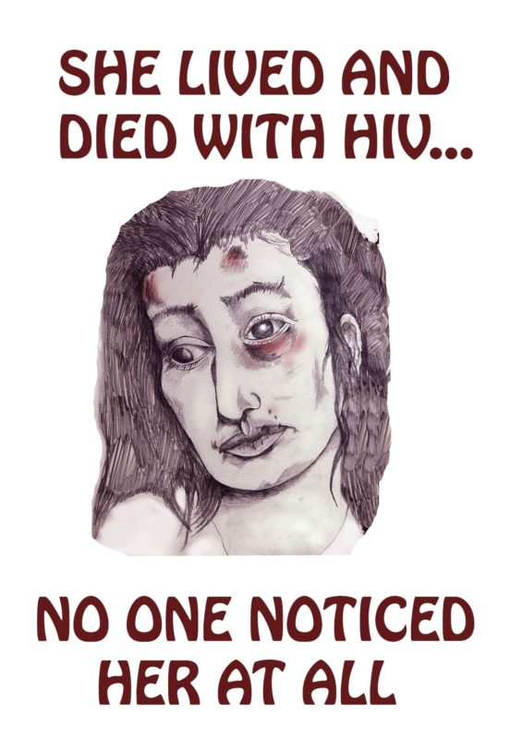
Nancer Lemoins
Lanni, 2016, digital print, 18"x24"
64 years, 2013, silkscreen, 18"x24"

Slide 18
L'Orangelis Thomas Negrón

Slide 19
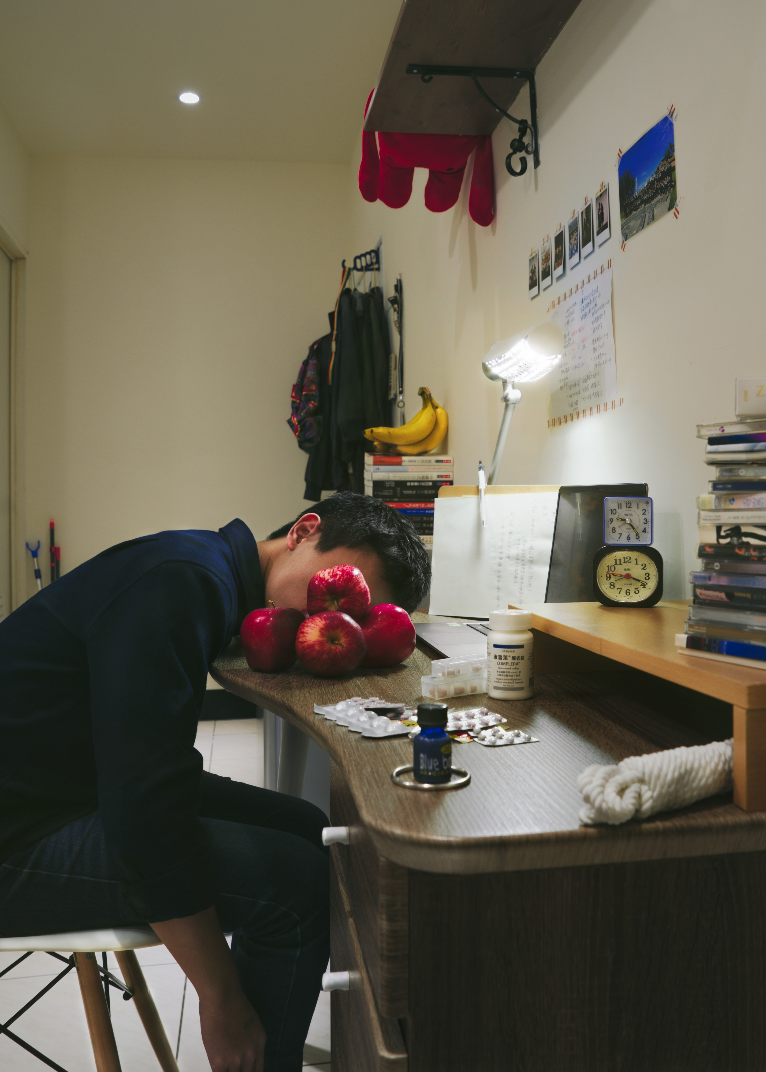
Kairon Liu
Humans As Hosts: 008, 2018
self portrait, photography

Slide 20
Forgiveness and Fallible Beings, 2015, photography

Slide 21
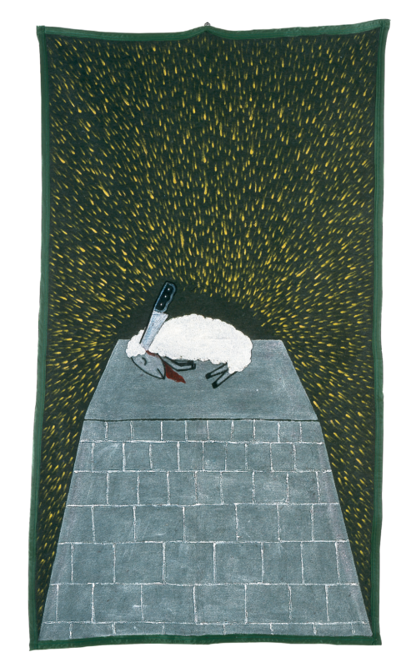
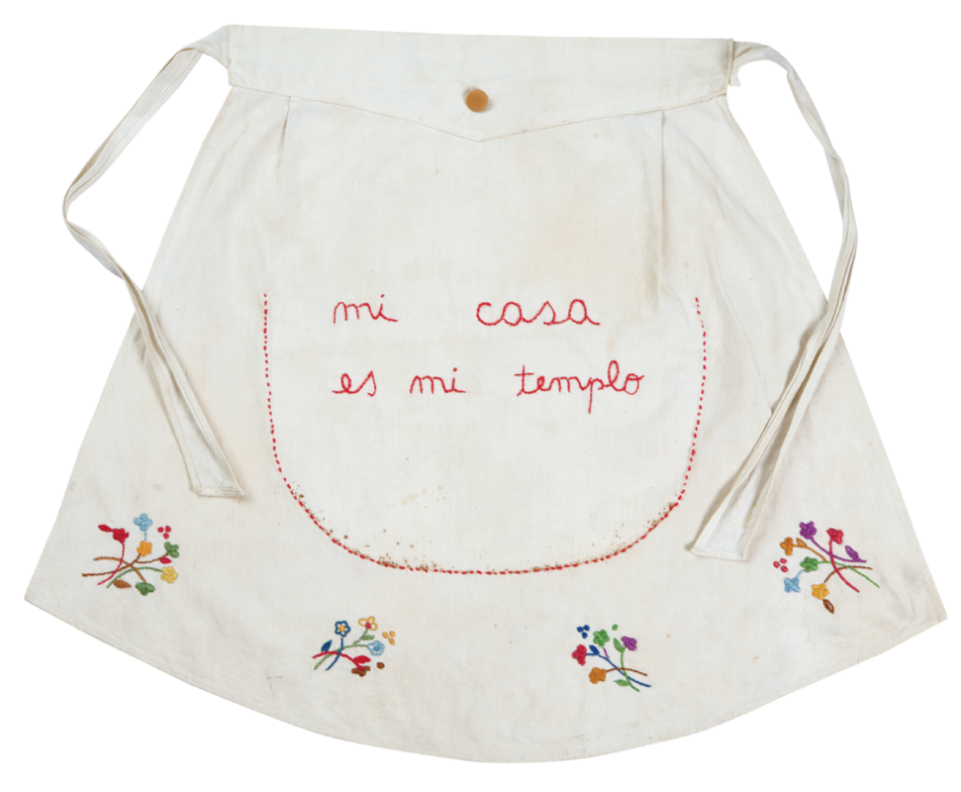
Feliciano Centurión
Cordero sacrificado (Sacrificed lamb), 1996
Acrylic on polyester blanket, 93" x 51.5”
Mi casa es mi templo (My house is my temple), c.1996, Embroidery on fabric, 13" x 26"

Slide 22
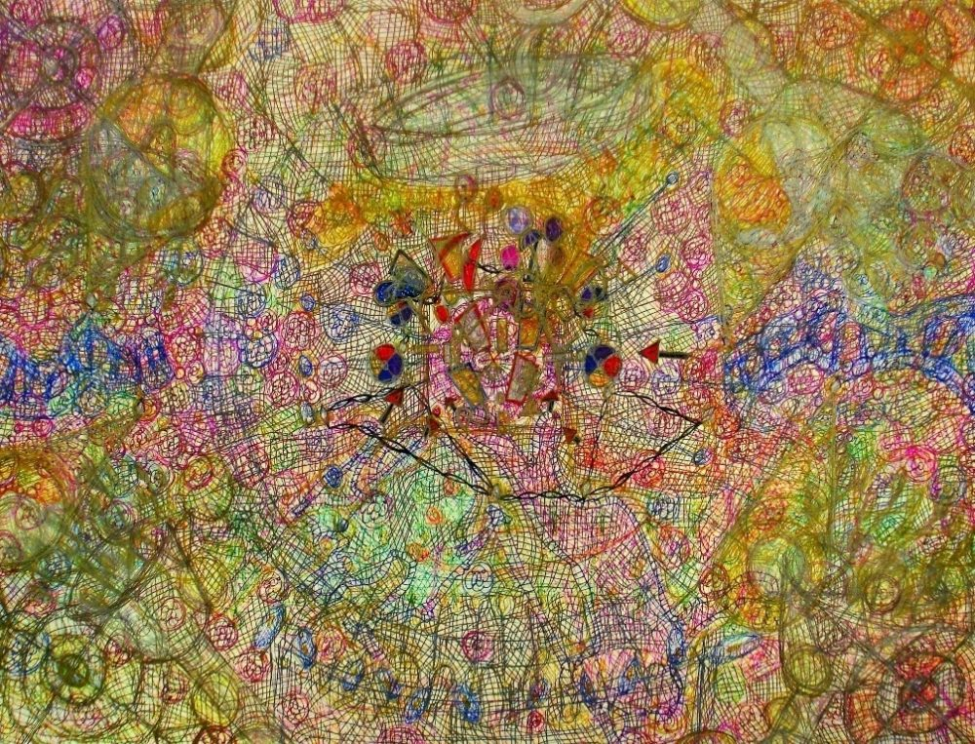
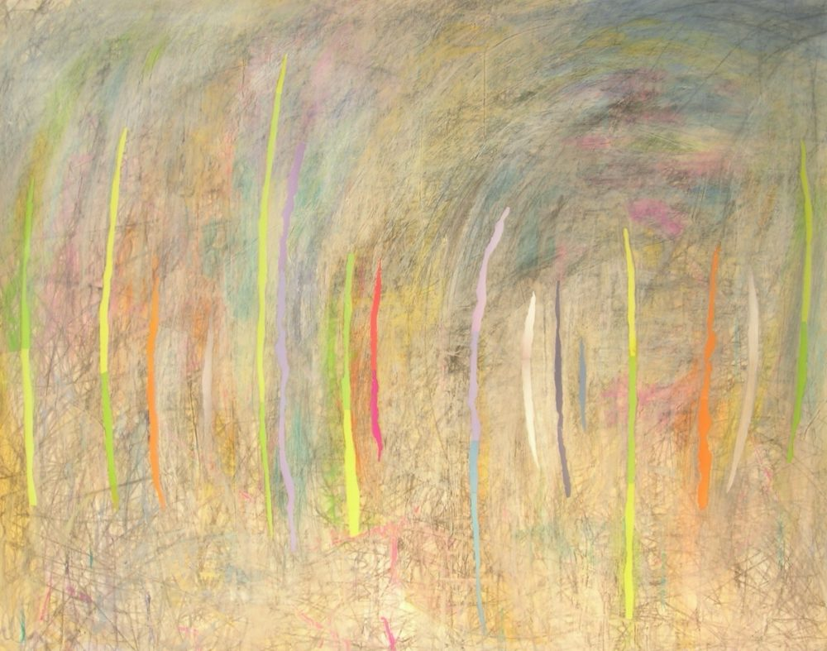
Art Making Prompt
How can you represent your current emotions or depict a specific feeling via abstract imagery?
Anthony Smith,
The Magnificent Concert 13, 2013
sharpie marker, 24 x 30 in.
David Arnold, Sonic,
mixed-media on paper

Slide 23
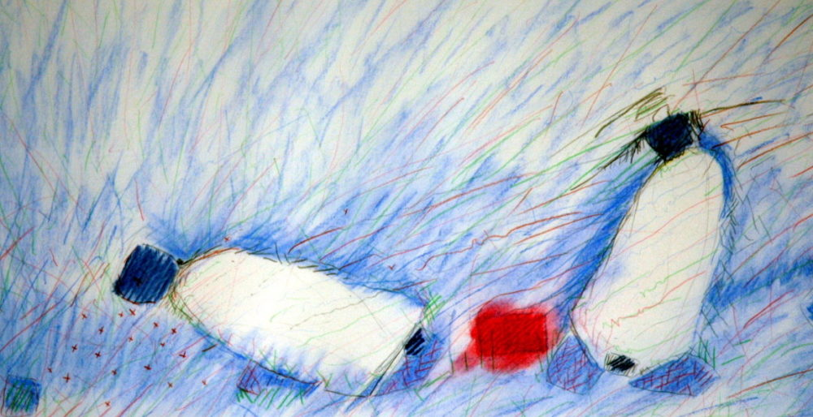
Art Making Prompt pt. 2
How can you add to the original drawing in a way that complements and responds to the imagery but doesn’t overtake the drawing?
Michael Shanoski, The Blood, 1980s, pastel

Slide 24
Stay Connected
If you are interested in learning more about the
Women’s Empowerment Art Therapy Group please contact:
Shirlene Cooper at scooper1123@gmail.com or
Blake Paskal at bpaskal@visualaids.org
To stay up to date with Visual AIDS many programs and projects, subscribe to our newsletter at visualaids.org
or follow us on Instagram: @visual_aids

