Slide 1
Probability of AIDS and non-AIDS-related mortality of early-treated children living with HIV-1
C. Bréhin , A. Tagarro , S. Domínguez-Rodríguez , L. Kuhn , T. Nhampossa , K. Otwombe , A. Janse van Rensburg , N. Klein , M.G. Lain , A.I. Maiga , C. Giaquinto , P. Rossi , P. Rojo , EPIICAL Consortium

Slide 2
Conflict of interest disclosure
I have no relevant financial relationship with ineligible companies to disclose

Slide 3
Background
Low HIV reservoir
Early antiretroviral therapy (ART) initiation in children
Payne et al, AIDS Res Ther 2021
Ajibola et al, CID, 2021
Good immunological outcomes
Consortium
Aim: to select promising HIV therapeutic strategies candidates
Early-treated perinatally HIV-positive children
Early treated Perinatally HIV Infected individuals: Improving Children’s Actual Life

Slide 4
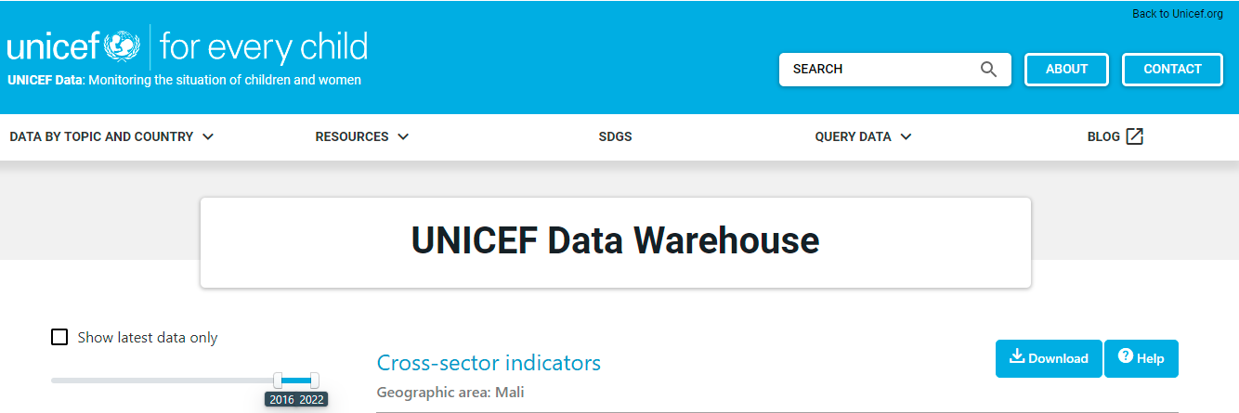
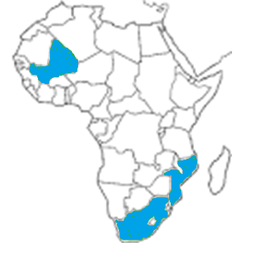
Background
Baseline mortality rate < 2 years
(UNICEF 2019):
Mali: 6/100 live births
Mozambique: 5,5/100 LB
South Africa: 2,7/100 LB
Total proportional baseline: 3,8/100 LB
Data Warehouse - UNICEF DATA

Slide 5
Background
Are the CD4% a powerful mortality predictor in children living with HIV?
CD4% monitoring is the best for predicting HIV/AIDS mortality
CD4% monitoring is not the best for predicting HIV/AIDS mortality
Chekole, SAGE Open Med, 2022
Arage, SAGE Open Med, 2019
Steiniche, Trop Med Int Health, 2018
Gebremedhin et al. BMC Public Health 2013
Mutanga et al. BMC Public Health, 2019
Njom Nlend et al, Med Mal infect, 2017
Shanbangu et al, Afr J AIDS Res, 2017

Slide 6
Aim 1
To describe the proportion of AIDS-related mortality in a cohort of early treated children born with HIV
Aim 2
To assess factors related to AIDS and non-AIDS related mortality

Slide 7
Methods
EARTH-EPIICAL Cohort: 2 rural and 4 urban sites in Mozambique, Mali, and South Africa (SA)
Infants with HIV who started ART in the first 3 months of life
Follow-up to 4 years

Slide 8
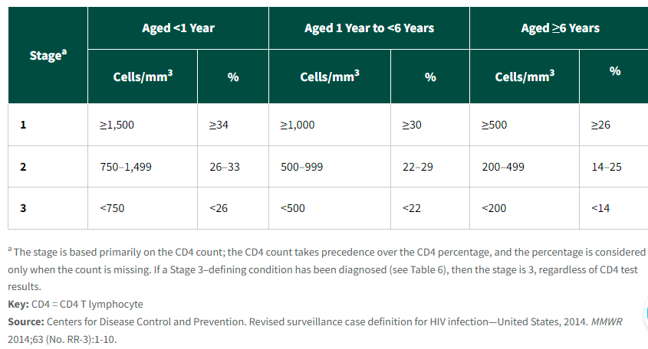
Methods
AIDS related death: Death in a child with prior or current diagnosis of a disease defining WHO clinical stage III or IV or with severe immunosuppression according to CDC thresholds

Slide 9
Methods
Statistical approch
In studies with multiple endpoints, such as AIDS-specific mortality, conventional statistical approaches evaluate mortality as a global analysis (all-cause mortality) or using a separate analysis without considering whether these endpoints are competing events for each other
Survivor
AIDS-related death
Survivor/right-censored
Survivor/right-censored???
Competing risk events
Other-cause death
Start
of the follow-up
End
of the follow-up

Slide 10
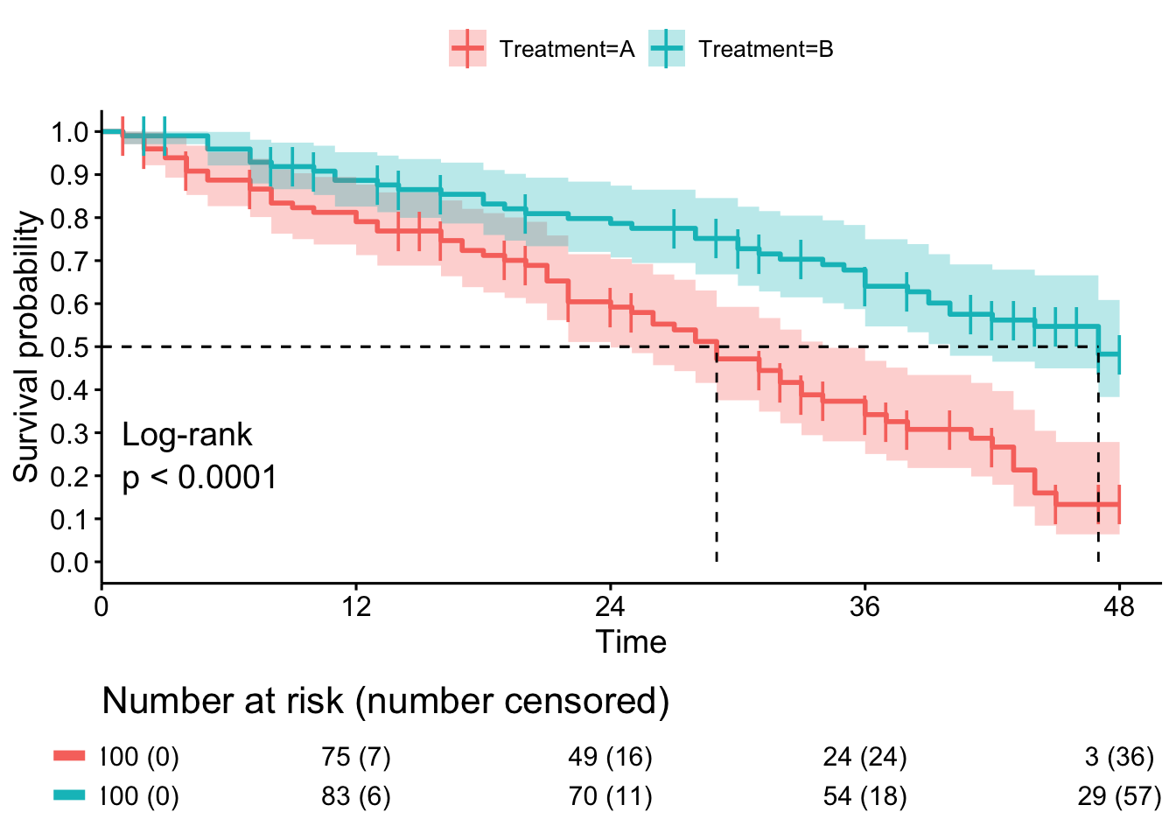
Methods
Statistical approch
Most of the studies analyse the association between CD4% and mortality using baseline measurements (at ART initiation) or arbitrary setpoints such as slope in the first years within ART. However, biomarkers are often not statics but follow specific trajectories
Cox proportional hazard regression with time-dependent/time-varying variables
Joint-modelling
Longitudinal CD4
Survival Probability
Mixed-models
Notes:
Most of the studies in the literature analyse the association between %CD4 and mortality using baseline measurements (at ART initiation) or arbitrary setpoints such as slope in the first years within ART. However, biomarkers are often not statics but follow specific trajectories.
To deal with this issue, several analytic approaches have been used to quantify the relationship between longitudinal CD4 count data
and time to event data. One approach has been to employ Cox proportional hazards regression models with time-dependent or time varying covariates. However, these standard models do not consider the dependencies between the two data types.
Alternative approaches have been suggested in the biostatistics literature, such as twostage modeling and joint modeling (JM) analyses, which enable both longitudinal repeated biomarker measurements and survival processes to be modeled together while accounting for the association between them, which leads to enhanced efficiency and correction of biases

Slide 11
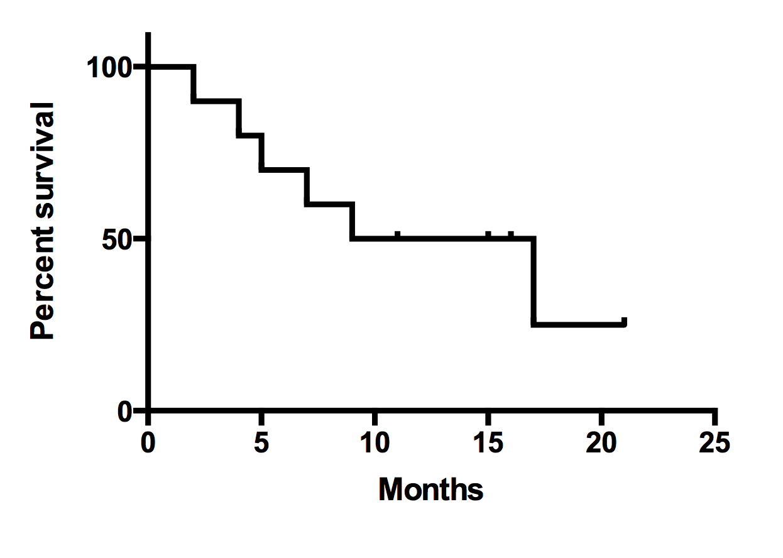
Methods
Two-stage modelling joint models
MODEL THE %CD4 DURING THE TIME OF FOLLOW-UP
MODEL THE SURVIVAL PROBABILITY IN THE PRESENCE OF COMPETING RISK
%CD4
Time on ART
The association between CD4 and time on ART adjusted by confounders
The survival probability adjusted by confounders AND the longitudinal CD4 trajectories in time

Slide 12
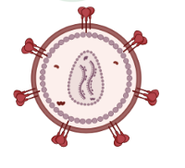
Results
212 enrolled in EARTH
Median VL = 5.21 logs (3.8 to 6)
Median time of follow-up
17 [6.8;27.5] months
Median ART = 34 [26;74] days
< 3 months
1 year
2 years
3TC+ABC+LPV/r
or
3TC+AZT+ LPV/r
83%
Suboptimal adherence (<90%): 56%
212
173
84

Slide 13
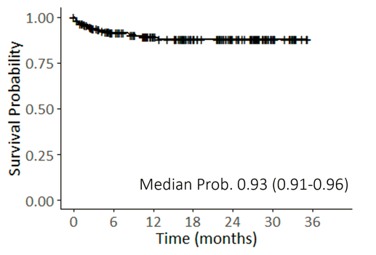
Results
212 enrolled in EARTH
23 patients (10.8%) died
At a median of 2.5 [0.6;6.8] months
74% in the first 6 months
Probability of death:
at 1 year = 11% (CI95%,6 to 15)
at 2 years = 12% (CI95%,7 to 17)

Slide 14
Results
Excess of mortality compared to baseline mortality = 7%
Due to AIDS-related causes = 5.7%
Due to non-AIDS related causes = 1.4%
 | South Africa |  |  | Mozambique |  |  | Mali |  |  | All
 | n=123 Baseline 2,7/100 LB |  |  | n=79 5,5/100 LB |  |  | n=10 6/100 LB |  |  | n=212 3,8/100 LB
 | Deaths | % | Excess | Deaths | % | Excess | Deaths | % | Excess | Deaths | % | Excess
All | 7 | 5,7 | 3% | 14 | 17,7 | 12.2% | 2 | 20 | 14% | 23 | 10,8 | 7%
No AIDS | 3 | 2,4 | -0.3% | 8 | 10,1 | 4.6% | 0 | 0,0 | 0% | 11 | 5,2 | 1,4%
AIDS | 4 | 3.3 | 3.3% | 6 | 7,6 | 7.6% | 2 | 20,0 | 14% | 12 | 5,7 | 5.7%

Slide 15
Results
 | Estimate (95% CI) | p-value
Longitudinal model
Time on ART | -0.008 (-0.01-(-0.004)) | 2.1·10⁻⁴
ART regimen
3TC+ABC/AZT+NVP | 5.29 (0.36-8.24) | 0.007
3TC+AZT+LPVr | -3.84 (-8.0-0.70) | 0.063
Survival model
Baseline Viral load | AIDS-related cause, 1.47 (0.87-3.74) Other cause, 4.34 (1.84-20.7) | 0.290 0.026
Baseline Weight-for-age | AIDS-related cause, 1.22 (0.78-1.71) Other cause, 1.07 (0.70-2.12) | 0.353 0.792
Age at diagnosis | AIDS-related cause, 1.01 (0.99-1.01) Other cause, 0.99 (0.95-1.00) | 0.411 0.276
Association CD4 | AIDS-related cause, 0.9 (0.86-0.98) Other cause, 1.09 (1.02-1.15) | 0.046 0.003

Slide 16
Conclusion
- Despite early treatment, excess of AIDS- and non-AIDS-related mortality remains high in children living with HIV-1 in Sub-Saharan Africa
- Differentiating AIDS and non-AIDS related mortality in children with HIV may allow us to understand better the risk factors associated with mortality
- CD4 percentage changes over time, and it impacts the probability of death
- Infants with high baseline VL and low CD4% require specific attention.

Slide 17
Aknowledgements
Patients and families EPIICAL Consortium EARTH Cohort

