Slide 1
DIFFERENTIATED SERVICE DELIVERY FOR SEX WORKERS- Success stories during Covid-19 Monday 1st, August, 2022 Montreal,Canada Co facilitator: Doreen Moraa
Presenter: Josephine Achieng
Bar Hostess Empowerment and Support Programme (info@bhesp.org)

Slide 2
Who we are
Bar Hostess Empowerment and Support Programme (BHESP) is a registered Non-Governmental Organization in Kenya.
Mission: To influence policy and facilitate access to quality health services, human rights awareness, legal services and economic empowerment for bar hostesses, female sex workers, women who use drugs and vulnerable young women in Kenya.
Established in 1998.
BHESP has over 15 years’ experience in implementing HIV prevention, care and treatment programs, gender-based violence/human rights violation monitoring and response for female sex workers and young women in informal settlements of Nairobi, Kenya.
Established Cohort:18,968 Female Sex Workers

Slide 3
Key areas:
Strategic Areas of Focus
01
HIV/AIDS Prevention
02
Care and Treatment.
03
Gender/human rights/Advocacy

Slide 4
Background of BHESP Differentiated Service Delivery Models
Impacts of COVID 19 created significant interruptions in access to HIV services for Key Population. This has led to economic uncertainty, increased risk-taking behavior, further experience of stigma and personal violence. Community outreach and traditional peer outreach approaches which have been the norm in service delivery have since been disrupted.
BHESP prioritized differentiated service delivery model towards achieving the 95 95 95 UNAIDS global goal amidst COVID 19 pandemic guided by the key principles as involvement of the client, providing alternative, stigma free and needs oriented service delivery model.

Slide 5
COVID-19: REASON FOR ADAPTATION • For sex workers, the effects of the COVID-19 pandemic go beyond the virus: growing financial insecurity has led to a new desperation, potentially increasing the risk of sexualized violence and poor health outcomes. • Government direction to give 3 months ART refills, our sites struggled with potential stock outs and gaps in adherence support. • The cessation of movement, dusk to dawn curfew, stay-at-home, closure of bars and clubs (hotspots), lock down of high COVID 19 areas and a ban on all forms of gatherings drastically made it difficult for the sex workers to access their healthcare needs especially HIV care and treatment. • Increased rates in missed appointments due to fear of contracting COVID in the sites. • Healthcare facilities limiting the number of clients they are serving at a time to observe social distancing rules

Slide 6
Workshop Objectives
1. To increase understanding on how organizations from Kenya are delivering care to Sex Workers in the advent of Covid-19
2. To collaboratively identify what strategies affect the effectiveness and efficiency of Differentiated Service Delivery for key populations
3. To improve global consensus on means of supporting scale up of DSD for key populations.

Slide 7
Differentiated Care
Various definitions from various Programmes.
According to consensus definition (WHO,UNAIDS, CDC, GR, USAID,…)
Differentiated care is a client centered approach that simplifies and adapts HIV services across the cascade to reflect the preferences and expectations of groups of people living with reducing unnecessary burdens on the health system

Slide 8
DSD in Practice: Definition
DSD - Redefinition of Stability - Established on ART.
Patients established on ART (must have achieved ALL the following)
On their current ART regimen for ≥ 6 months
No active Illness (including TB) in the previous 6 months (patients with well controlled chronic conditions should not be excluded)
Adherent to scheduled clinic visits for the previous 6 months
VL < 50 copies/ml (LDL) within the last 6 months
Patients established on ART should be transitioned to less intense DSD models, reduced frequency of visits (1 clinical visit per 6 months) and receive longer dispensation of ART 3-6 months dispensing

Slide 9
DSD IN PRACTICE EXPLAINED IN ART DISPENSING

Slide 10
DSD: What BHESP is doing
Models in practice:
1.Facility Based Model (Drop in Centre)
2. Community Based DSD (Sex Workers hotspots and convenience points)
3. Personalized Client Centred Care Approach

Slide 11
DSD MODELS UNPACKED
Facility Based DSD Models
Community Based DSD Models
More Intense care
Less Intense
Community ART groups
Community ART distribution points
Community client led ART delivery
Individual ART Distribution
Adolescent and Young Sex Workers(18-24)
Pregnant and Breastfeeding FSW
Viremic clients.
Fast Tract
DICE ART Distribution Group

Slide 13
Our Success stories
“ Our group has grown. We no longer only meet monthly to pick medication….we also talk about other issues affecting us and we are able to advice each other and support each other. ”
1. Integrated services were taken to the community. 2. Home ART delivery through project motorcycle targeted BHESP clients not able to afford transport to the DICE. 3. Test and start in the hotspots for newly diagnosed clients. 4. Initial monthly ART refills expanded to Multi Month Dispensing (MMD): 3-6 months

Slide 14
Our Success stories
5. Psychosocial services and support provided through virtual spaces i.e. WhatsApp groups coordinated by a case manager. Groups with specific membership categories of either stable, unstable or viremia clients.
6. Opportunities for tele-counselling explored via hotline and reverse calls. 7. Decongesting the DICE as a measure/government directive of Covid 19 pandemic.

Slide 15
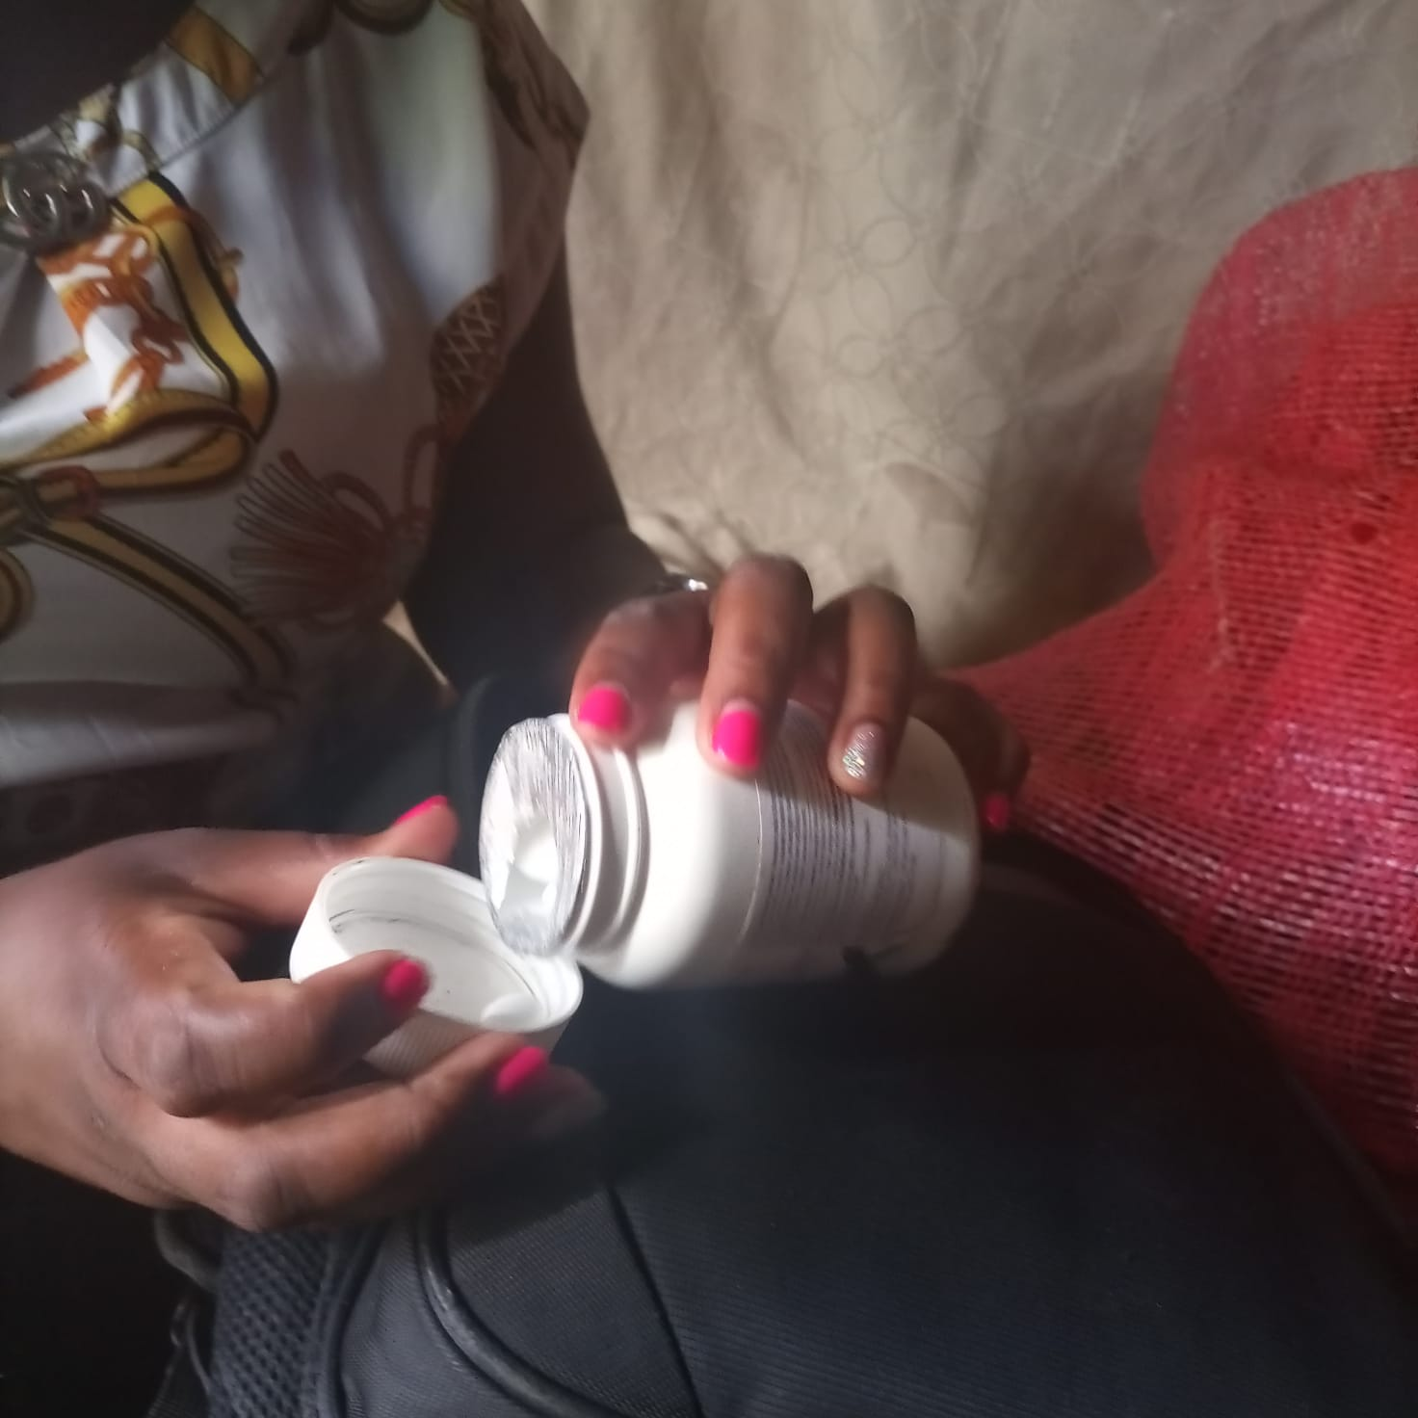
Programme Reflections Panel Discussion
Where is the DSD data for key population?

Slide 16
Conclusion
Through adaptations to DSD models, BHESP has been able to deliver Patient Centered Care
BHESP has prioritized DSD as one of its strategies towards achieving the 95
95 95 UNAIDS global goal amidst COVID 19 pandemic.
Through documentation of BHESP DSD best practices adaptations, BHESP
advocates for recognition of this models as strategies towards global goal of
achieving zero HIV infections by 2030

Slide 17
….In pictures

Slide 18
Follow BHESP on Twitter: https://twitter.com/bhesp Like BHESP on Facebook: https://www.facebook.com/bar.hostess Email us info@bhesp.org Visit our Site https://www.bhesp.org
Stay Connected with BHESP

