Slide 1
Lessons Learned From Meaningful Adolescent and Youth Engagement (MAYE) to Scale Up High-quality Models and Strengthen HIV Prevention, Care and Treatment Efforts
Rayo Soyemi, MPH- Youth Engagement Intern
Elizabeth Berard, MPH- Youth Branch Chief
USAID/Office of HIV/AIDS/Youth Branch
August 1, 2022
PEPFAR, United States Agency for International Development (USAID), Washington D.C International Aids Society (IAS), Geneva
Notes:
Title
Recognizing IAS and USAID

Slide 2
Agenda
Presentation: | Presenter:
Prioritizing Meaningful Adolescent Youth Engagement (MAYE): Why is MAYE important to USAID? | Amy Cunningham Associate Director for Strategic Operations USAID
Meaningful Adolescent Youth Engagement - What is it and what difference does it make? | Dr. Lesley Gittings Post-doc Researcher The Accelerating Achievement for Africa’s Adolescents (Accelerate) Hub
Meaningful Engagement of Young People in the Red Carpet Program (Malawi) | Cosima Lenz Adolescent and Youth Technical Officer Elizabeth Glaser Pediatric AIDS Foundation (EGPAF)
Layering PrEP onto the DREAMS Program: Using a Peer-Led Model (Zambia) Determined, Resilient, Empowered, AIDS-free, Mentored and Safe (DREAMS) | Mwansa Njelesani-Kaira Director of Behavioural Interventions DISCOVER Health
Breakout Groups Four Small Group Sessions | Annaliese Limb Elizabeth Berard Marissa Vicari Amy Cunningham

Slide 3
Workshop Objectives
Participants are able to identify at least one reason meaningful adolescent youth engagement (MAYE) is critical to HIV programs.
Participants identify up to two new approaches to youth engagement for integration in their current programming.
Participants provide programmatic gaps/barriers to and recommendations to inform development of an advocacy paper on meaningful youth engagement in HIV programs.

Slide 4
Prioritizing Meaningful Adolescent Youth Engagement (MAYE)
Amy E. Cunningham, MPH, MBA & PgDIP
Associate Director for Strategic Operations
USAID/Office of HIV/AIDS

Slide 5
Why is Meaningful Adolescent Youth Engagement (MAYE) important to USAID ?
“Meaningful youth engagement is an inclusive, intentional, mutually-respectful partnership between youth and adults whereby power is shared, respective contributions are valued, and young people's ideas, perspectives, skills and strengths are integrated into the design and delivery of programs, strategies, policies, funding mechanisms and organizations that affect their lives and their communities, countries and globally.”
USAID’s YouthPower Project

Slide 6
USAID’s Approach to HIV and Optimized Programming (AHOP) Pathway 2: Adolescent and Youth Health and Resilience
INTERMEDIATE RESULTS
Increased uptake of health services that directly reduce the impact of HIV on adolescents and youth
Adolescents and youth receive education and employment assistance that increases the probability of remaining HIV-free or virally suppressed through adulthood.
Photo courtesy of: Elizabeth Glaser Pediatric AIDS Foundation, Arusha, Tanzania, March 10, 2020
Goal: Durable, positive health outcomes for HIV-affected adolescents and youth achieved through employment of USAID’s multi-sectoral assets.

Slide 7
Meaningful Adolescent Youth Engagement - What is it and what difference does it make?
Lesley Gittings, PhD
Accelerate Achievement for Africa’s Adolescents (Accelerate) Hub
Factor-Inwentash Faculty of Social Work, University of Toronto, Canada
with
Accelerate Achievement for Africa’s Adolescents Research Hub teams at the Universities of Cape Town and Oxford
(PI: Professor Lucie Cluver)
Notes:
1) Value of youth engagement in research and programme design - high level overview of evidence (1 slide, 1-2 minutes)
(2) Present one model or two models that help us think about youth engagement systematically (e.g. Cahill P7 framework and/or Swartz and Nyamjoh continuum of participation). Both are visual models and relatively accessible frameworks that have been applied in LMIC and upper income countries to guide youth engagement in research and practice. (3-4 minutes)
(3) Present a few key considerations/questions based on the above and with regard to your questions of reach, scale and engagement. I think the question of 'doing' youth engagement without additional resources is a tricky one - but I think finding the right balance between scale and involvement is possible and certain approaches (like advisory groups, youth as part of leadership structures, peer service delivery, youth feedback mechanisms) can help based on the programme size, structure and resources. This would lead nicely into the examples and group work. (2-3min)

Slide 8
Conflict of interest disclosure
I have no relevant financial relationships with ineligible companies to disclose.

Slide 9
Notes:
Acknowledge Nkosi Xolani Johnson, young man 22 years ago at this same conference who advocated for the South African government to roll out HIV medicines to people who needed it. At 11, he was the oldest known child born with HIV at the time and was able to powerfully advocate.

Slide 10
Background: Why ‘do’ meaningful adolescent engagement?
'Wicked’, ‘intractable’ issues continue to exist in adolescent HIV & health, unmet needs;
Need to find tools that facilitate and boost young people’s participation;
Adolescents are capable, creative & experts in their own situations!
Engaging youth in multiple ways can help understanding of their needs (Padian et al., 2010), save money and improve acceptability;
Interventions are more likely to be successful if the young people they target find them acceptable. (Casale, 2021);
Meaningful adolescent engagement is a spectrum with benefits and limitations!

Slide 11
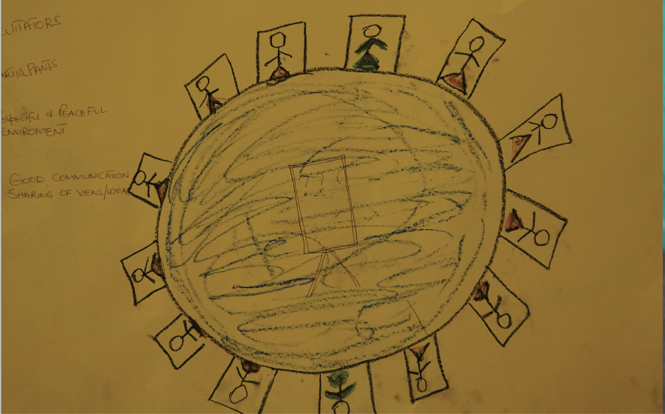
What is MAYE? Building blocks
Support leadership
Shifting power
Sustained engagement
Build skills & knowledge
Support & resources
Enabling environments
Source: GLOBAL CONSENSUS STATEMENT MEANINGFUL ADOLESCENT & YOUTH ENGAGEMENT, http://meaningfulyouthengagement.org/
Notes:
Some of the central building blocks

Slide 12
What is Meaningful Adolescent & Youth Engagement?
Models to consider

Slide 13
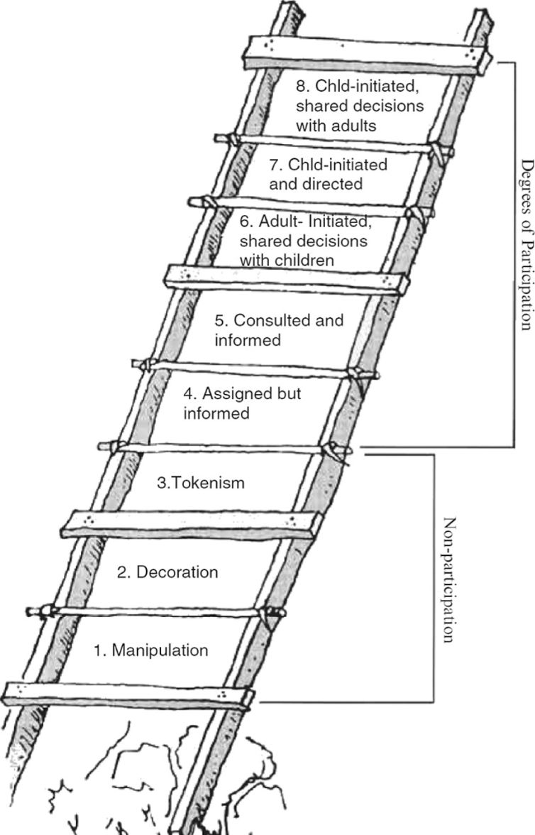
Ladder of Participation (Hart, 1992)
What is Meaningful Adolescent & Youth Engagement?
Models to consider

Slide 14
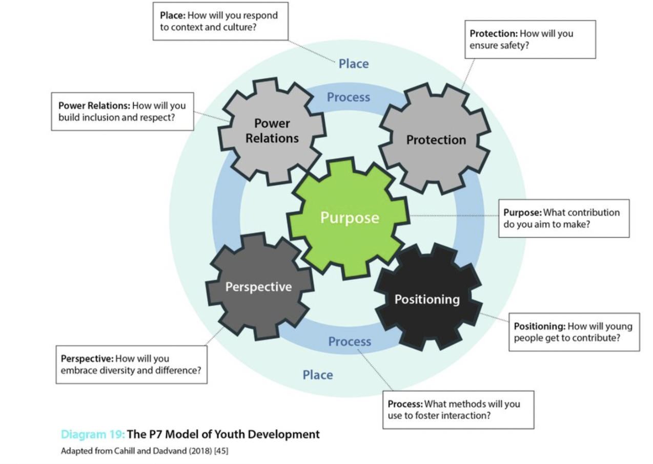
P7 Model of Youth Development (Cahill & Dadvand, 2018)
What is Meaningful Adolescent & Youth Engagement?
Models to consider

Slide 15
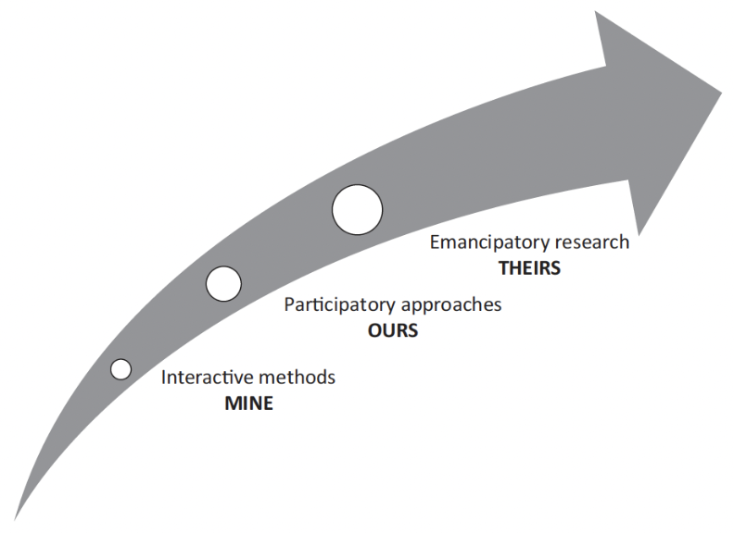
What is Meaningful Adolescent & Youth Engagement?
Models to consider
A continuum for addressing youth marginality (Swartz & Nyamnjoh, 2018)

Slide 16
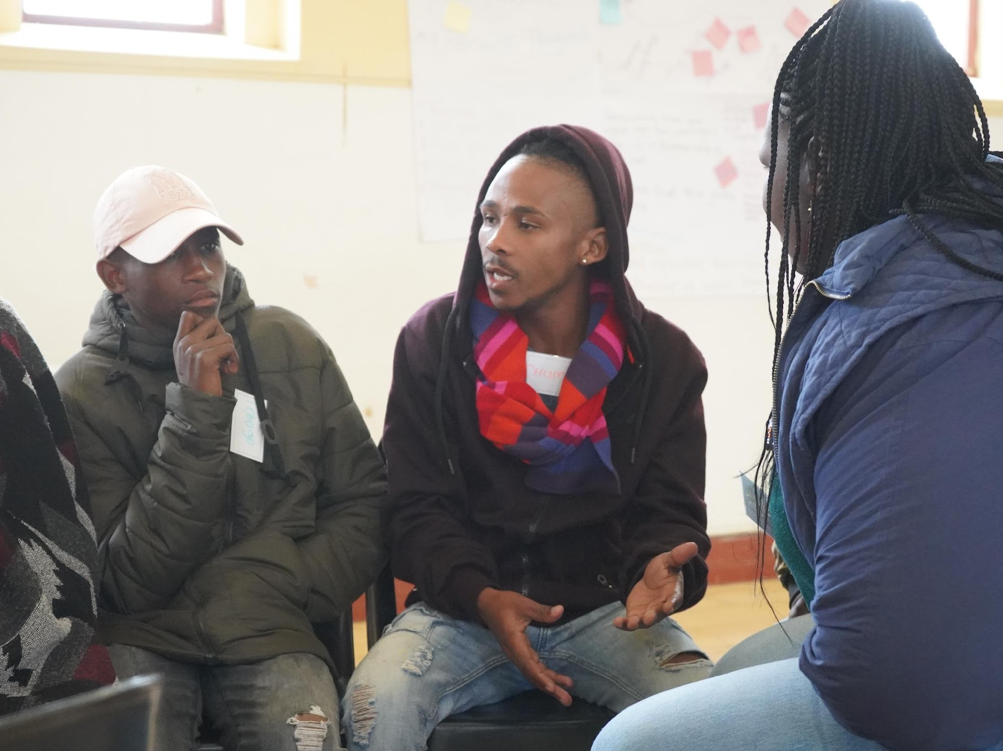
Meaningful Adolescent Engagement: Things to think about
How meaningful, and to whom?
From acceptability to uptake? (Casale, 2019)
Intervention lifecycle: when? (Casale, 2019)
Notes:
(3) Present a few key considerations/questions based on the above and with regard to your questions of reach, scale and engagement. I think the question of 'doing' youth engagement without additional resources is a tricky one - but I think finding the right balance between scale and involvement is possible and certain approaches (like advisory groups, youth as part of leadership structures, peer service delivery, youth feedback mechanisms) can help based on the programme size, structure and resources. This would lead nicely into the examples and group work. (2-3min)

Slide 17
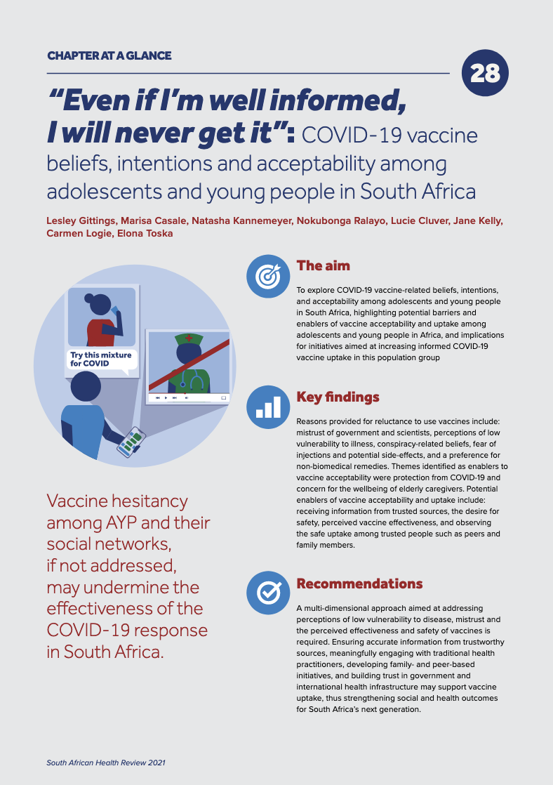
Notes:
e.g. of intervention acceptability work with MAYE of youth living with HIV/closely affected by HIV - Biomedical intervention acceptability COVD-19 vaccine – Ref Casele 2021, Vaccine paper – what learnt from HIV – acceptability framework

Slide 18
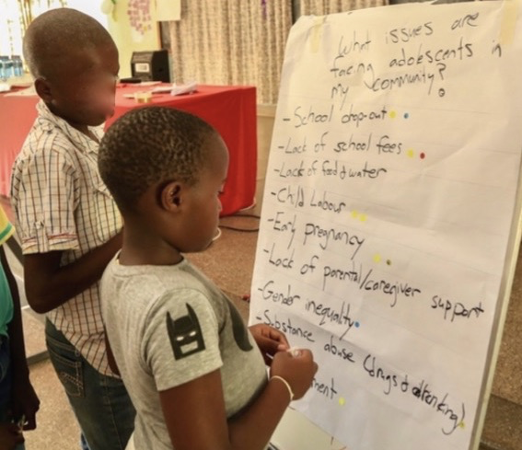
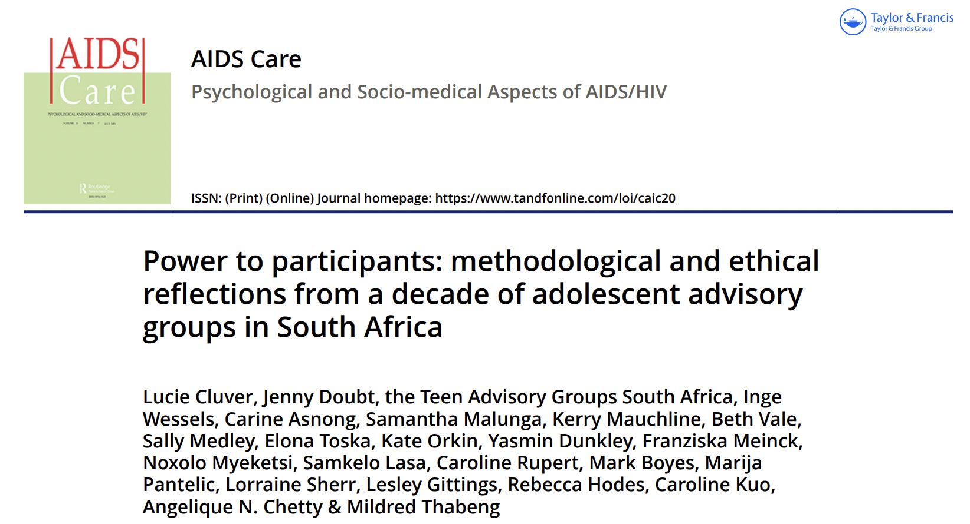
Meaningful Adolescent Engagement:
Considerations
Scale & size
Structure
Resources
Level of involvement
Representation
Notes:
Some of the central building blocks – and say it is a tradeoff – invite othere to share reflections on effective ways to balance…. Here are some options (next page)

Slide 19
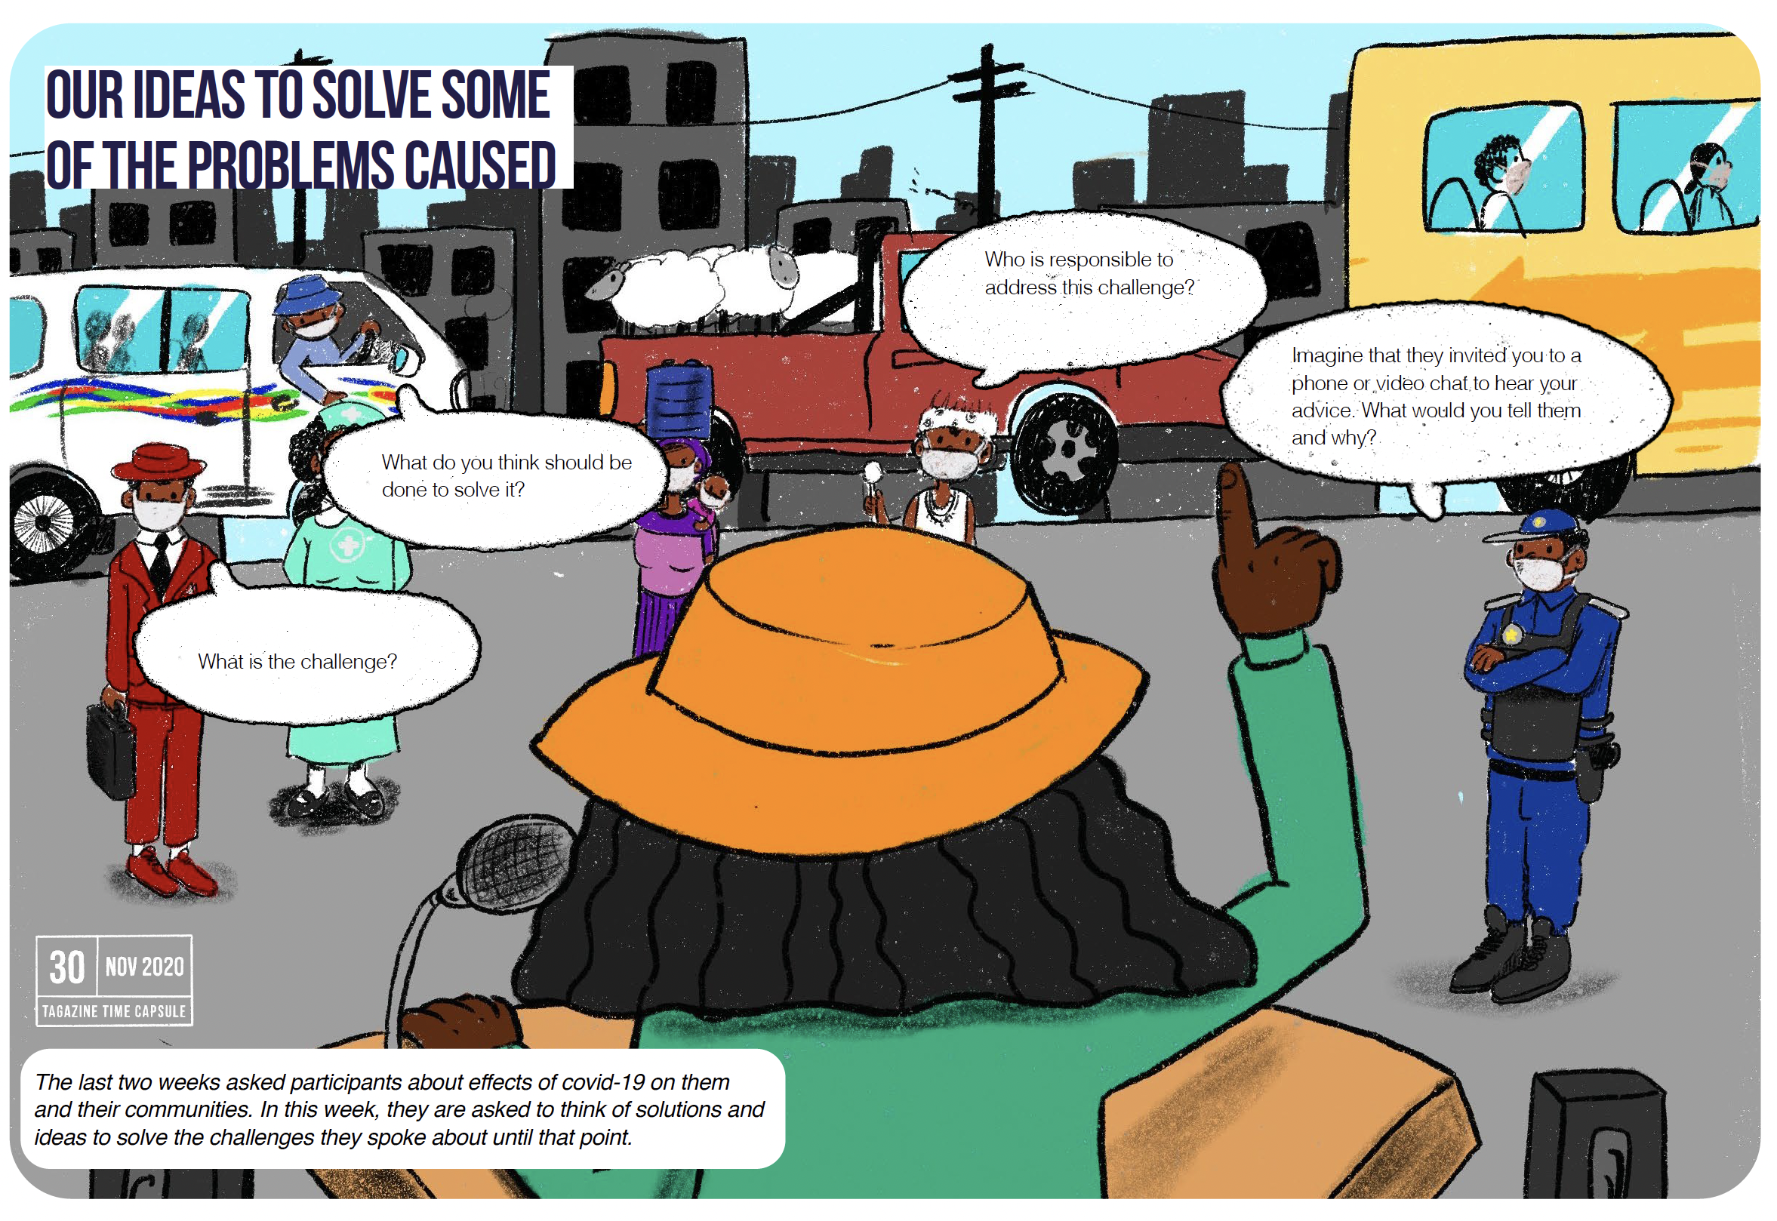
Meaningful Adolescent Engagement:
Options
Participatory approaches
Peer models
Advisory group
Leadership structures
Feedback mechanisms
Other?
Notes:
Some examples of models – will hear more from participant & you!

Slide 20
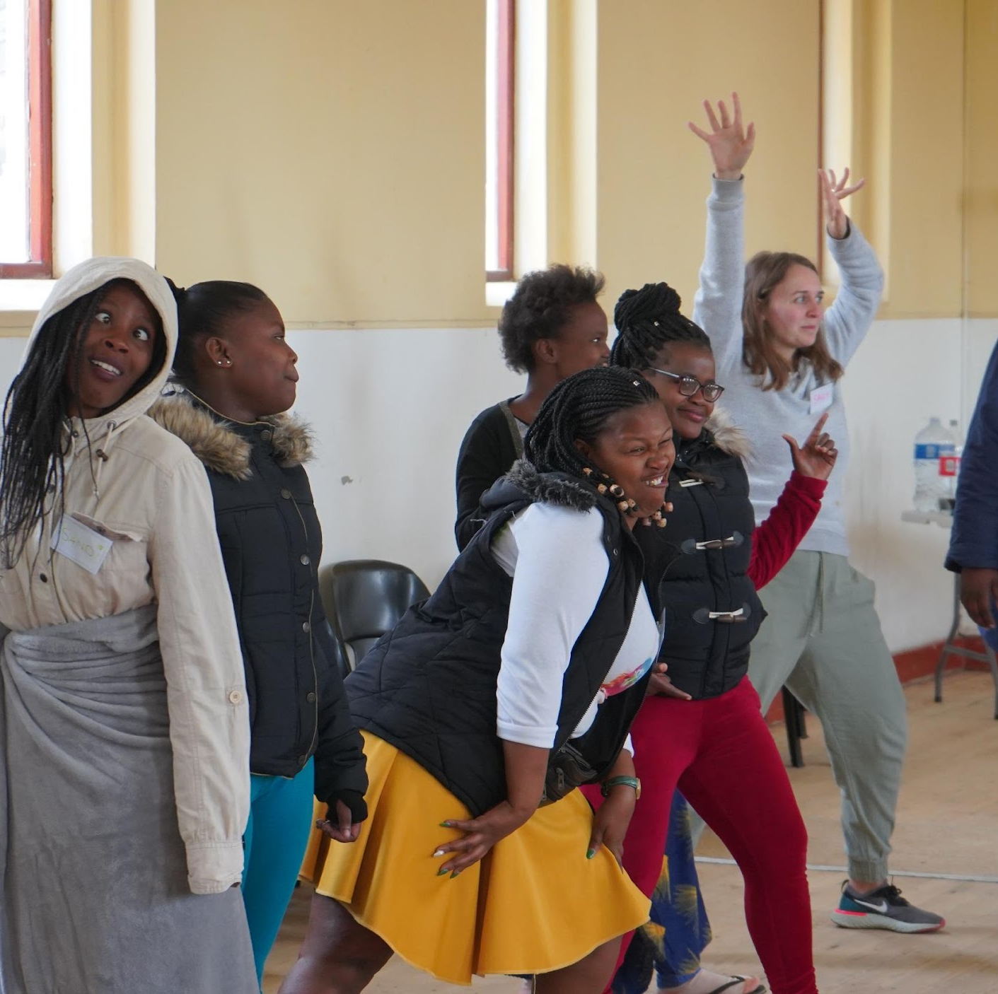
Things to remember…
Get uncomfortable! (Discomfort isn’t always a sign that something is wrong)
Everyone is a participant! This work should (and will!) affect you
Participation is an investment, that pays off in many ways
Empowered youth, better acceptability, improved outcomes
Trundle through and trust the magic – it will be worth it!
Notes:
A few thing to cloe with

Slide 21
Thank you to our partners & funders, and a big team of researchers at the Universities of Oxford, Cape Town & Toronto
For questions: Lesley.gittings@gmail.com

Slide 22
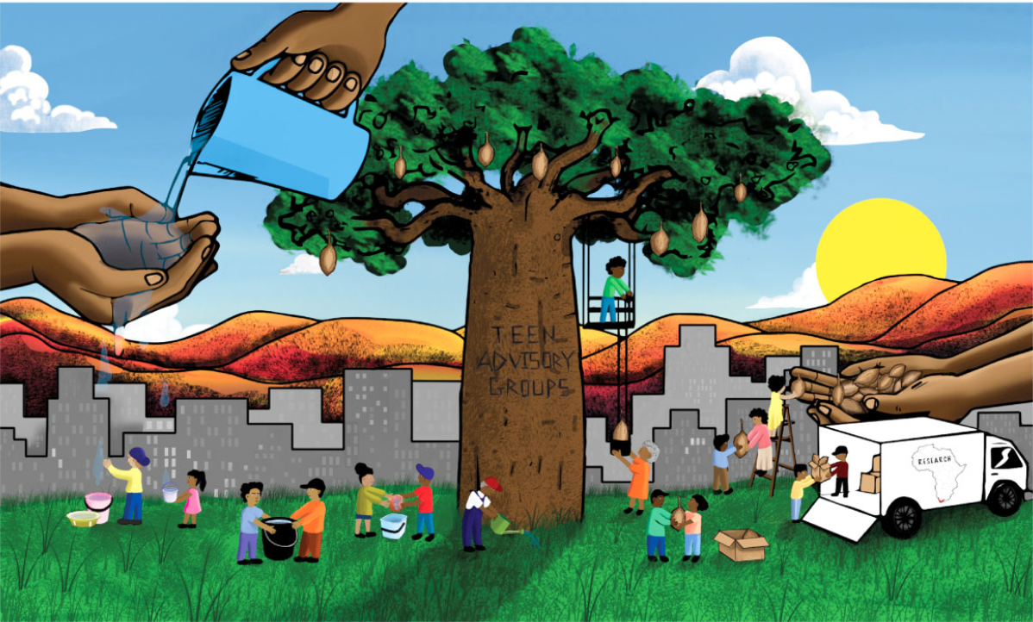

Slide 23
Meaningful Engagement of Young People in the Red Carpet Program
EGPAF

Slide 24
Conflict of interest disclosure
I have no relevant financial relationships with ineligible companies to disclose.

Slide 25
Youth Engagement More Broadly at EGPAF
“CAYA helped our members find encouragement because it shows them people care about their status. It is a changing forum”
-Vincent Nyapigoti, Malawi CAYA focal point
MAYE = Create a dynamic partnership with youth across EGPAF countries to better align global investments toward EGPAF’s mission: ending pediatric AIDS
Committee of African Youth Advisors (CAYA)
Engagement in the design of programs, tool development and validation, responding to gaps in AY HIV response (U=U), research engagement, advocacy initiatives, and formal technical assistance (TA)
Trained, mentored, and ongoing capacity building for youth cadres at EGPAF-supported sites

Slide 26
Red Carpet: What it Addresses and Why it is Important
Young people aged 10-14 years, 15-19 years, and 20-24 years have unique and specific needs across the continuum of care
Sub-optimal linkage and retention in care among adolescents and youth living with HIV (AYLHIV) 🡪 worse clinical outcomes (morbidity, mortality, viral suppression)
The Red Carpet Program (RCP) is a package of services to increase early linkage and retention on HIV Treatment for AYLHIV (10-24 years) and evolved to supporting all AYLHIV in care at the community and facility levels
Youth-driven model

Slide 27
Youth Engagement Across the Red Carpet Program
Initial discussions with young people in the design of programs and tools
Focus group discussions held in EGPAF-Kenya’s RCP informed programming and adaption in Kenya and Malawi
Introduction of trained youth cadre/youth champions—five per facility (provided stipends, phones, airtime)
Youth champions participate in facility meetings including QI meetings to ensure their perspectives and expertise are included
School and facility-based engagements: supporting teachers and school matrons
Sensitizations for school staff
School anti-stigma messaging
Health clubs
Engaging young people through meetings to develop awareness-building activities
Previous exiting IEC materials were not youth-specific 🡪 integrated youth-created tools from CAYA (cartoon-based treatment literacy, disclosure, etc.)
Redesign of the logo with members of the Committee of African Youth Advisors

Slide 28
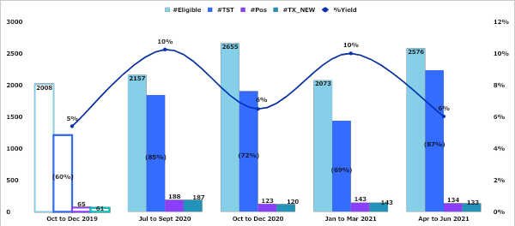
Trends of adolescents and youth reached at RCP sites and testing yield
Baseline – pre-RCP

Slide 29
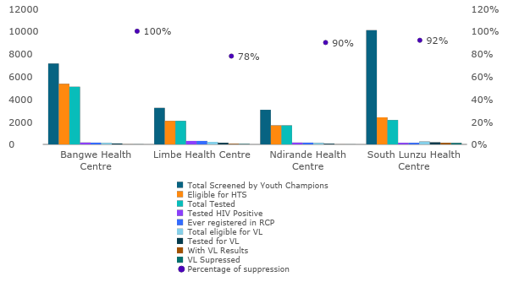
Improved Retention
Significantly improved retention among AYLHIV
73% retained at RCP sites at three months compared to 62% in control sites (p=0.08) and 81% at six months compared to 69%, respectively (p=0.004) after ART initiation
“I highly appreciate our doctors, together with our adolescent peers, for the care and concern they've been showing us. They have been treating us well as per our expectations…We request our health workers to continue loving, advising, and sharing ideas more so the adolescents sharing problems they have been going through and finding out best solutions to sought the problems out.”
– 17-year-old female RCP client

Slide 30
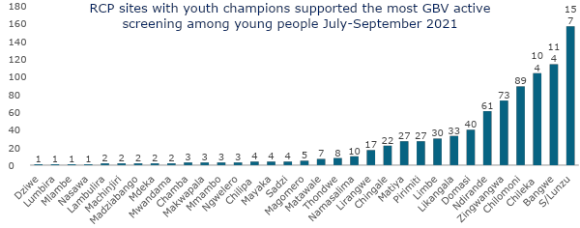
Impacts – GBV Screening
Overall RCP sites with support from youth champions identified 61% (524/862) of all GBV cases identified in reported facilities in the time frame (July-September 2021).

Slide 31
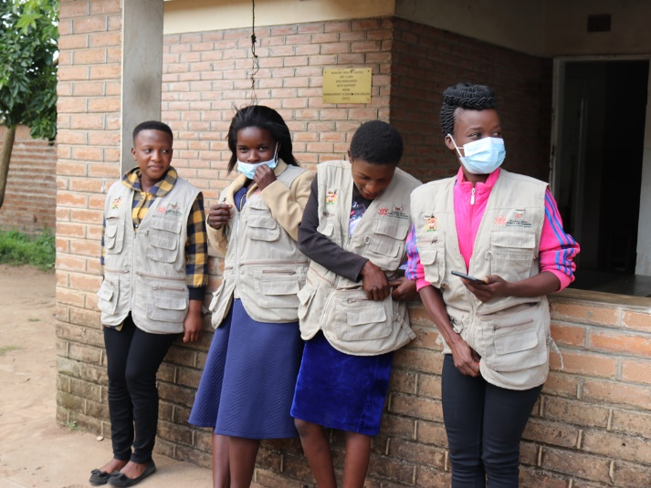
Recommendations
Intentional engagement with young people throughout the life of a project—from inception, design, implementation, and evaluation
Provide ample support for young people to grow with the program
Mentorship, ongoing capacity building, stipends, leadership roles, support structures (supervision, mental health)
Include youth in the data capture and ongoing monitoring to react to real-time trends
Ensure availability of feedback mechanisms—satisfaction surveys, focus group discussion, and interviews with young people (cadres, patients, etc.)
Youth Champions in Malawi

Slide 32
Thank you!
Contact:
Cosima Lenz
clenz@pedaids.org

Slide 33
Layering PrEP onto the DREAMS Program: Using a Peer-Led Model
Ms. Mwansa Charity Njelesani,
JSI- USAID DISCOVER-Health Project

Slide 34
Conflict of interest disclosure
I have no relevant financial relationships with ineligible companies to disclose.

Slide 35
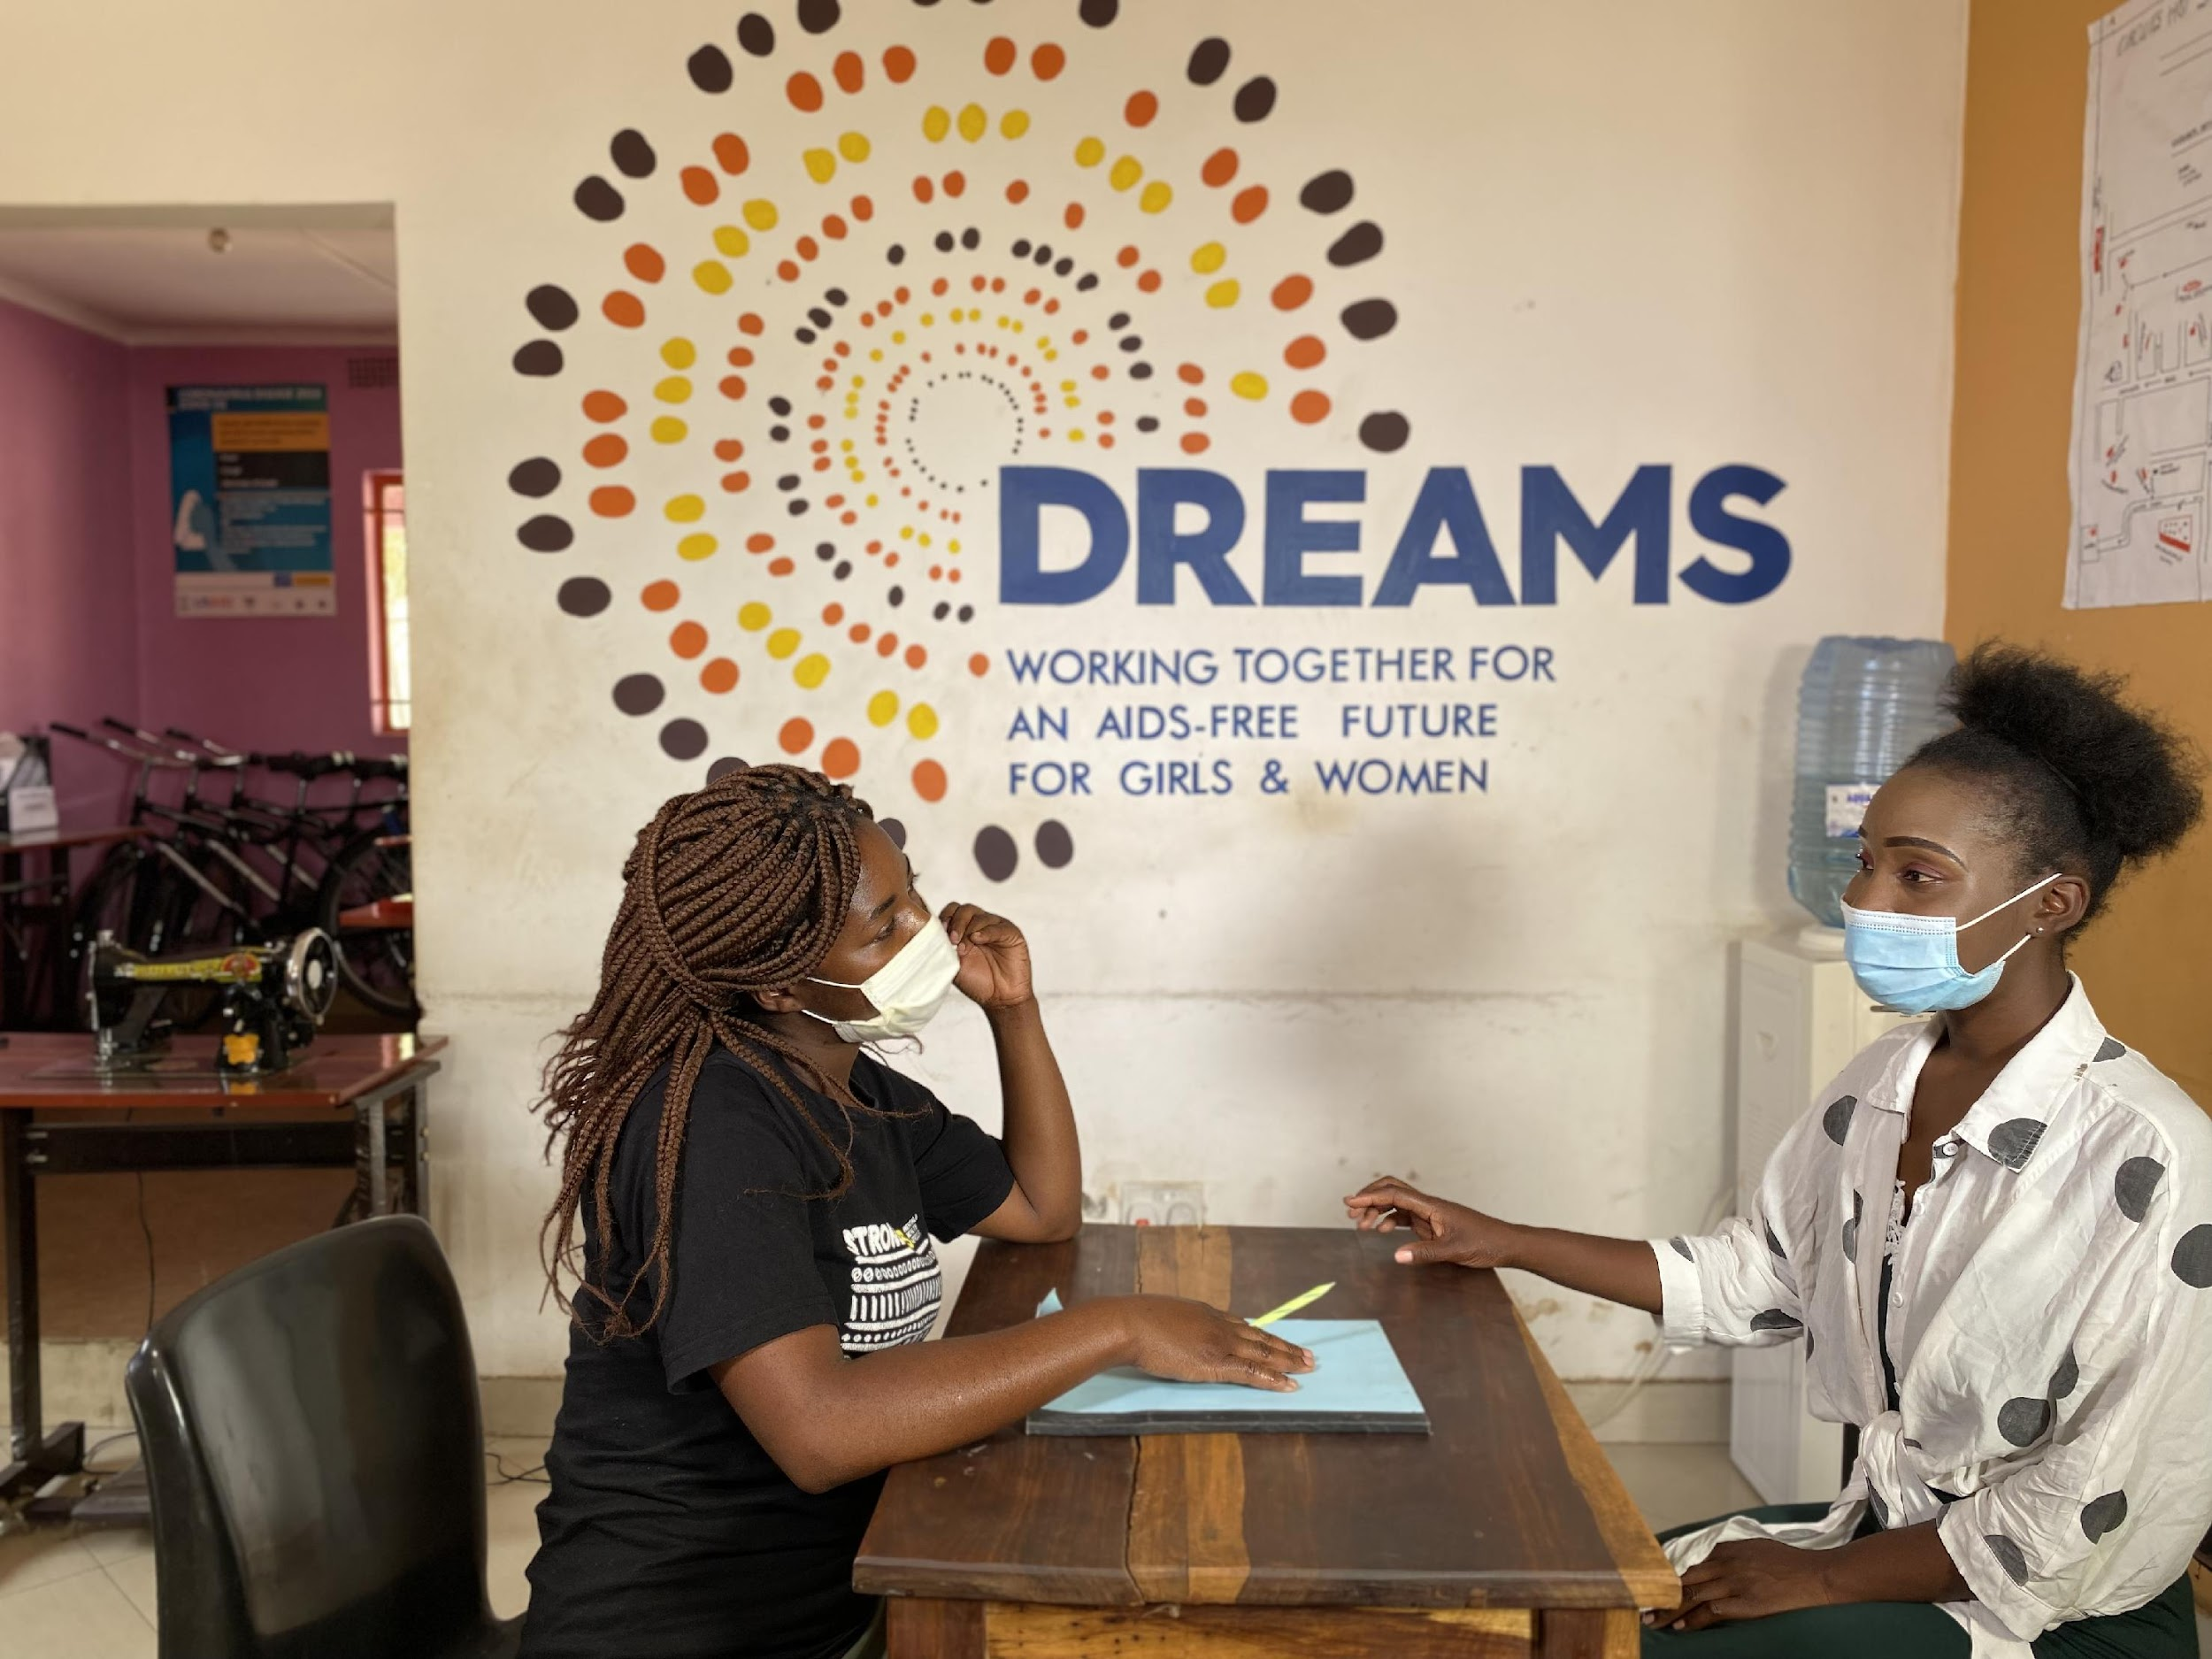
Background
2018: The Government of the Republic of Zambia received a PrEP donation from Gilead Sciences for AGYW (Adolescent Girls & Young Women aged15-24 years old) in DREAMS districts.
2018: USAID DISCOVER-Health mandated as the sole partner to roll-out PrEP in DREAMS centres.
2022: USAID DISCOVER-Health is operational in 40 centres in 9 DREAMS districts.
PrEP services have been extended to at-risk AGYW in non-DREAMS districts, using a similar peer-led model.
A PrEP mentor meets with her PrEP Client
Notes:
DISCOVER-Health was among the first implementers to support PrEP scale-up in Zambia.
In order to prepare for Roll-out, in 2018, the Project undertook extensive training and sensitization of providers, CHWs; and DREAMS partners.
Thereafter began roll-out of PrEP tailored to AGYW at substantial risk of HIV by layering the service onto the DREAMS platform. In FY20, we provided the service in 28 DREAMS centres in 6 districts and in FY 22, we were operational in 40 DREAMS centres and PrEP services have also been extended to AGYW in non-DREAMS districts using a similar peer-led model that will be discussed on the following slide.

Slide 36
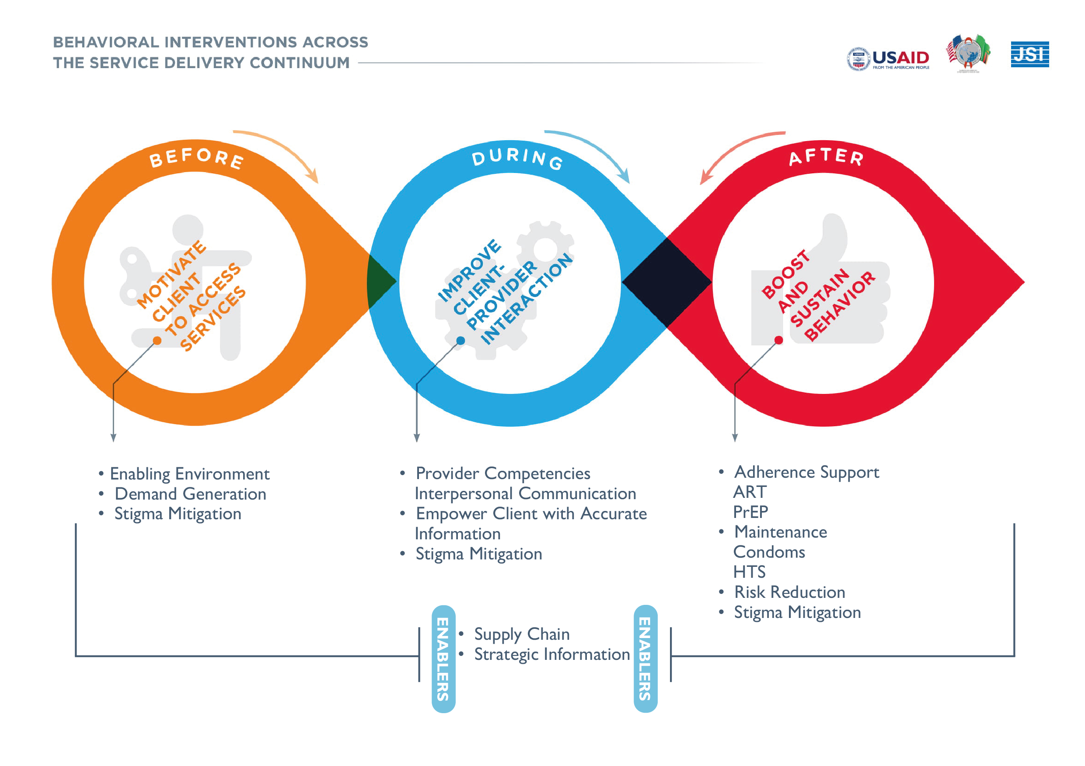
The Prevention & Behavioural Interventions Peer-led Model
Notes:
Used the results from a human centred design study to guide our programming. Study focused on primarily on HIV Prevention amongst adolescents and young people. As a result, developed a peer-led mobilisation model.
Peer-led model that guides our roll-out of various HIV Prevention interventions including layering of PrEP onto the DREAMS programme
We identify peers (in this case AGYW) that are then trained and mobilise and provide adherence support to their fellow peers that may be eligible for PrEP. In out partnership with DREAMS, potential PrEP clients are drawn from DREAMS network (primary target audience).
I have show this model, as one key lessons from our work with adolescent and youth; and service delivery, is that you have to ensure that all components of the service delivery cascade flow as seamlessly as possible.
Therefore, beyond the peer led model that supports mobilisation, it’s important to have providers that are youth friendly and that there are systems in place to sustain the client on PrEP, while they remain at risk.
youths are taking control of their own lives at each stage of the model.

Slide 37
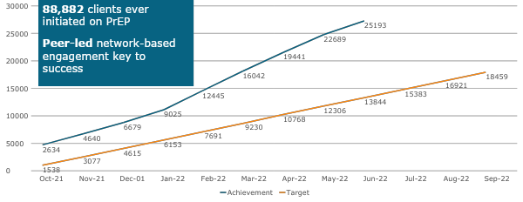
FY22 PrEP Target and Monthly Achievement
Notes:
How have HIV prevention outcomes been strengthened as a result of youth engagement in your specific activity?
We have seen a continuous uptake of PrEP, despite COVID-19. We have even surpassed our annual target, due to the investment in the sub-campaigns. Early data from a recent ZAMPHIA study, has show a significant drop in HIV incidence amongst Adolescent and young people, though we are yet to carry-out further analysis for correlation.

Slide 38
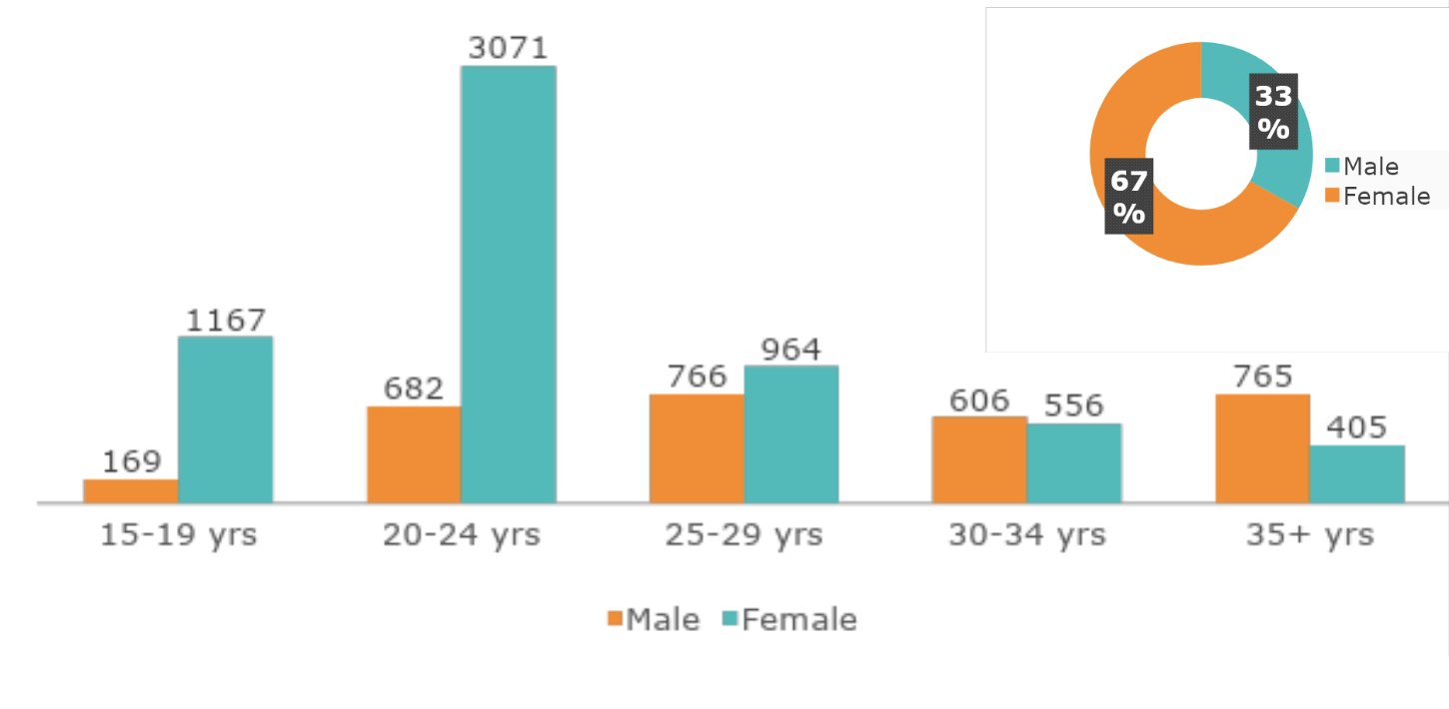
FY22: Q3 PrEP Uptake by age and sex
DREAMS AGYW accessing PrEP contributed 72% (3,048) of all PrEP initiations among females aged 15-24 years old.
Notes:
Overall, AGYW Accessing PrEP through DREAMS Centres contributed 72% (3,048) of all PrEP Initiations among females 15-24
FY22 Q3: PrEP Uptake by Age and Sex

Slide 39
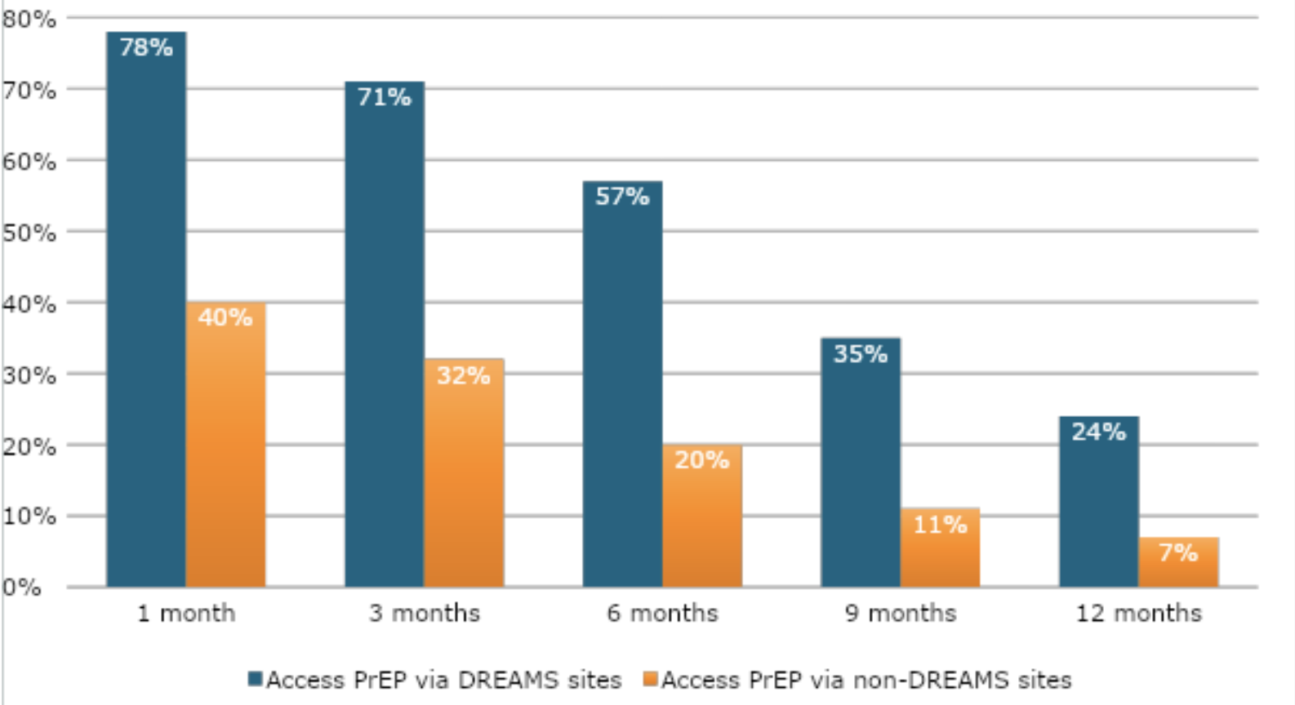
AGYW Persistence on PrEP via DREAMS & non-DREAMS sites
AGYW accessing PrEP via DREAMS sites persisted longer on PrEP than AGYW accessing PrEP via non-DREAMS sites.
Notes:
As earlier noted: DISCOVER engages peer supporters, sometimes former DREAMS graduates, to provide one-on-one support to AGYW. The PrEP continuation rates for AGYW increased significantly when we put in place the peer-led strategy to provide additional support to AGYW on PrEP.
A quick background, DISCOVER runs a system called PIPAT where we enter all PrEP clients ever-initiated (currently totaling more than 80,000) and assign each client a unique identifier. This allows us to track how long each client stays on PrEP and provide support to clients.
After we began implementing their peer-led approach, the continuation rates improved to what is indicated in the graph above. We believe that the additional benefits of layering PrEP onto the DREAMS programme has also assisted, as on one hand, we have since more girls at risk of HIV (18-24 years), enrolling onto the DREAMS programme – many of whom are interested in the economic strengthening component of the programme. Girls these age, also tend to better understand their own situation and risk, and are more likely to adhere prepare, despite any challenges that they may face.
DREAMS centres are often strategically located in the heart of communities, thus providing additional convenience for AGYW
We further developed DSD models that also took PrEP into safe spaces for AGYW on PrEP; and collaborated closely with DREAMS staff, to enable us speak about PrEP to parents and guardians; during sessions with parents. This is in addition, to them, helping us identify girls that may be at risk of HIV through their DHIS system. As can be seen, this collaboration, has seen many girls persist on PrEP for

Slide 40
Recommendations
A PrEP mentor meets with her PrEP Clients
Ongoing mentorship of peer mobilisers i.e. monthly surges to reinforce messaging ahead of demand creation and adherence support.
Linkage of peer mentors to DREAMS programme, for their own benefit/economic empowerment.
Significant investment in community engagement and sensitization to build ownership and facilitate service uptake.
Buy-in from key gatekeepers i.e. parents, partners, and community leaders, to create an enabling environment for PrEP uptake.
Put young people at the heart of programming, let them inform and guide, following a human-centered design approach from the outset.

Slide 41
Thank you For more information: Mwansa_Njelesani@zm.jsi.com

Slide 42
Breakout Room Session
Participants will self-select into one of the groups below:
Program Design/Implementation
Research
Monitoring & Evaluation
Support for Youth-led Organizations
Each small group will respond to the following questions:
What are the most critical gaps for MAYE?
What are the top three recommendations/approaches from the small group for overcoming the identified gaps?
Notes:
This portion of the meeting is designed to identify gaps in current programs and develop recommendations that can be adopted by program managers, developers, and donors to improve and enhance MAYE across the 4 areas noted
-Time in Session 40 minutes
-

