Slide 1
Conflict of interest disclosure
I have no relevant financial relationships with ineligible companies to disclose.

Slide 2
Sensitization workshop for healthcare providers and audience ‘’to sensitize and enhance their knowledge and awareness of trans health needs and rights’’
Mahnoor Aka Moon –Khawaja Sira Society
Session title

Slide 3
Overview
- To know more about the background of the TG community - To familiarize with various terminologies under the transgender umbrella - To familiarize with common behaviors and practices of The TG community - To understand their needs, vulnerabilities and requirements pertaining to health and rights based services - To gain an understanding of the communication and language pointers while addressing the Khawaja Sira & TG community

Slide 4
What is a Transgender person ?
Transgender" is an umbrella term that describes people whose gender identity or expression does not match the sex they were assigned at birth. For example, a transgender person may identify as a woman despite having been born with male genitalia

Slide 5
Transgender person Protection Act 2018 Define?
Intersex“ Mixture of male and female genital
Eunuch's“ Undergoes genital excision or Castration
Transgender Women/Men“ Gender expression is differs from sex assigned at birth

Slide 6
Right to Health?
To review medical curriculum and improve research for doctors and nursing staff to address specific health issues of transgender persons in cooperation with medial board.
To facilitate access by providing an enabling and safe environment for transgender persons in hospitals and other healthcare institution and centers.
To ensure transgender persons access to all necessary medical and Psychological gender corrective treatment.

Slide 7
BARRIERS TO ACCESS HEALTH CARE SERVICES

Slide 8
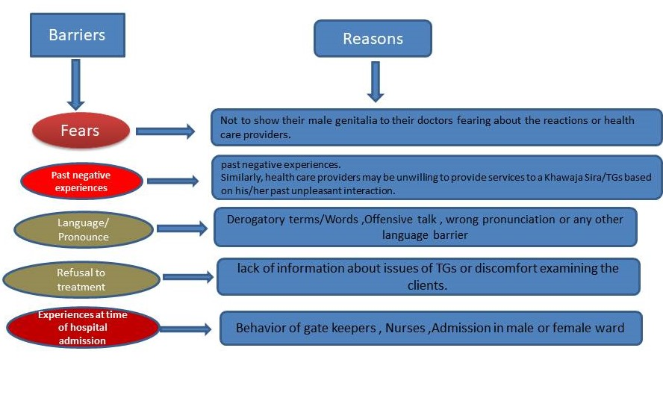
What Are the Barriers and Its Reasons?

Slide 9
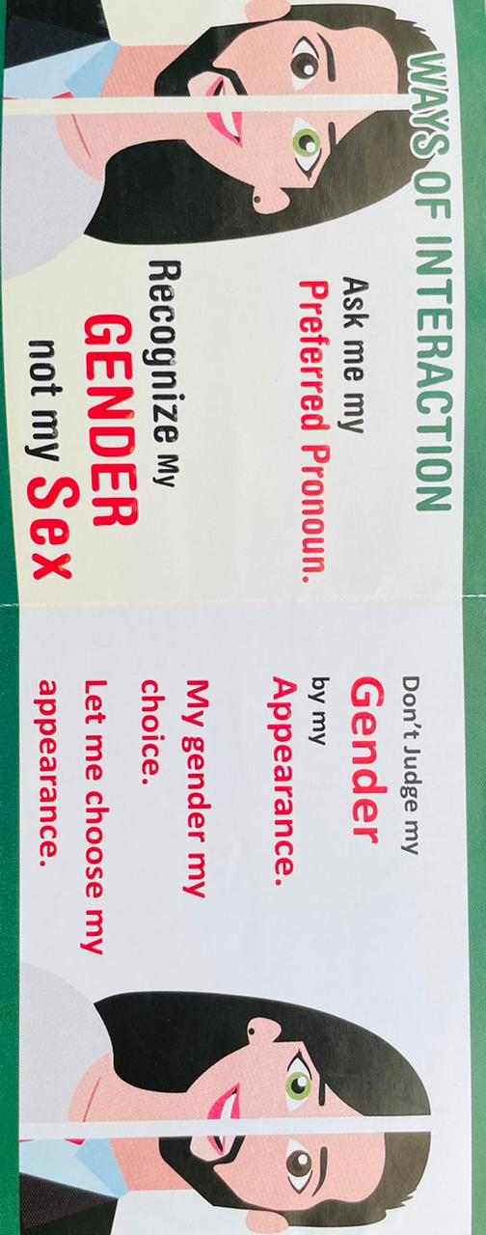
How to interact with transgender Community?
Way of Interaction

Slide 10
What are the basic health issues of transgender community?
Practices and behavior | Implications | Health Risks
Hazardous working and living conditions | General impact of mental, physical and emotional wellbeing | Malnutrition, lifestyle diseases, and general illnesses
Non-gender conformity on account of Gender identity dysphoria | Stigma and discrimination, lower self-esteem, social and familial un-acceptance | Depression, anxiety, suicidal tendency, alcoholism, substance use, inter-partner violence
Limited access to health care | Self-medication (High dosage of antibiotic , hormone pills and injections, contraceptive pills) Approaching quacks | Case-basis Seeking health care at very late stage
Higher number of sexual partners /Unsafe sex practices /sex work | Increased vulnerability to STI and HIV | Contracting HIV and STI
Castration | Increased vulnerability to UTIs Increased vulnerability to renal infections | Contracting UTIs; difficulty in micturition, urethral stricture Kidney issues such as infections and stone formations
Breast Implants | Post-surgical complications | Implant rejection; inadequate post-operative care
Hormones | Side effects of long-term or prolonged hormone intake | Obesity, liver and heart diseases, mood swings, depression, fatigues, acne, blood pressure, etc
Sex-reassignment surgery | Post-surgical complications | Graft rejection, difficulty in micturition, vaginal stricture, numbing of external genitalia; other side-effects as stated in castration

Slide 11
How to Provide Health care to transgender community?
DO’s
1- Ask Prefer Pronoun
2- Accept his/her on Self perceived identification
3-Treat Khawaja Siras/TG as any other patient with dignity and respect wihout using offensive and derogatory terms,
4-Prefer using terms like Khawaja Sira/ or transgender while addressing the community.
5-Goal of the treatment is to treat the problem that is presented and is medically diagnosed.
6- Prefer to use CBO models Guidelines for health service delivery or for STI management if any.
7-It is advisable to check with Khawaja Sira/Transgender person which ward (male or female) they would to be admitted to.
8-Detailed sexual-history taking with Khawaja Sira/Transgender person clients is helpful in diagnosis, or what tests to be conducted or advised.
Don'ts
Do not insist on knowing their male names or whether they are castrated or not.
Certain terms have derogatory connotations and are best avoided like chakka, 50-50, hermaphrodite,Shemale

Slide 12
How can health care providers take sexual history sensitively from the TG Community?
Addressing myths about the Transgender community
All Trans-genders are not inter-sex/ hermaphrodite
Trans-genders are not people with mental or physical disability
Trans-genders could have male, female sexual partners
Trans-genders may or may not be castrated
Khawaja Siras is a social category specific to South-Asia /Differs with the term transgender
Transgender don’t like to be included within the category of men who have sex with men.

Slide 13
How can health care providers take sexual history sensitively from the TG Community?
Is there any special care to be taken during physical examination?
1-Be sensitive while performing a physical examination of the Transgender.
2- Imperative to discuss with Transgender about the importance of genital examination.
3- Some of the Transgender who have not been operated would not be willing to show their male genitalia due to shame or hesitation.
4- May discuss the operative status of the client and also encourage the clients to get their male genitalia examined for any penile STIs.
5-Follow Universal Safety precautions with all clients irrespective of their gender, HIV status, sexuality, appearance and risks.

Slide 14
Case Study
Doc: Hi, I am Dr ---- ---, may I know your name?
Transgender Person: My name is Simi. [Doctor may refer to the client with feminine pronoun]
Doc: Saira, can you tell me what health problems are you facing?
Transgender Person: I have been experiencing severe burning sensation while peeing.
Doc: Ok, any other symptom.
Transgender Person: Yes, and also greenish yellow discharge that gives off a bad smell.
Doc: Since how long have you been experiencing this?
Transgender Person: Since a week.
Doc: I would like to ask you a few questions that we generally ask our clients. So, when was the last time you had sex?
Transgender Person: Last night. I am a sex worker, so I have sex every day.
Doc: How often do you use condom during sex?
Transgender Person: It depends on my customer.
Doc: Ok. I will prescribe you some medicines that you would need to take; in the meanwhile I recommend that you for a physical examination and some blood tests. Please ensure that you use condom every time you have sex.
Transgender Person: Thank you doctor.

Slide 15
Thanks
We strive for healthy and better life

