Slide 1
A community-based participatory approach to understanding preferences, needs, and barriers to uptake of longer-acting formulations of PrEP in transgender and gender diverse Texans.
Phillip W. Schnarrs, Ph.D., The University of Texas at Austin
Late Breaker Track D

Slide 2
Acknowledgements
Research Partners
Community Partners
Community Advisory Board
Julie Zuniga, PhD, RN (Co-PI)
UT School of Nursing
Aliza Norwood, MD (Co-I)
UT Dell Medical School
Liz Arnold, PhD, LSCW (Consultant)
UT Southwestern
Gaby Benitez (GRA)
UT Dell Medical School
Paul Fliedner (GRA)
UT Dell Medical School
Sheridan Aguilar (GRA)
UT School of Social Work
Jacey Buchorn (UGRA)
UT Dept. of Sociology
Liany Serrano Oviedo (UGRA)
UT College of Natural Sciences
Alexander Andersen (Consultant)
KB Brookins (Consultant)
Allie Cole (Consultant)
Madeleine Croll (Consultant)
Hexa Dulce (Consultant)
Kewal Hausmann (Consultant)
Kelly Marshall (Consultant)
John Oeffinger (Co-I)
Texas Health Institute
TransFORWARD
Rocky Lane (Consultant)
TransFORWARD
Transgender Education Network of Texas
Gin Pham (Co-I)
Transgender Education Network of Texas
Emmett Schelling (Co-I)
Transgender Education Network of Texas
TransFORWARD

Slide 3
Acknowledgements
Merck : Research grant
The potential effects of relevant financial relationships with ineligible companies have been mitigated. Any clinical recommendations are based on evidence and are free of commercial bias.

Slide 4
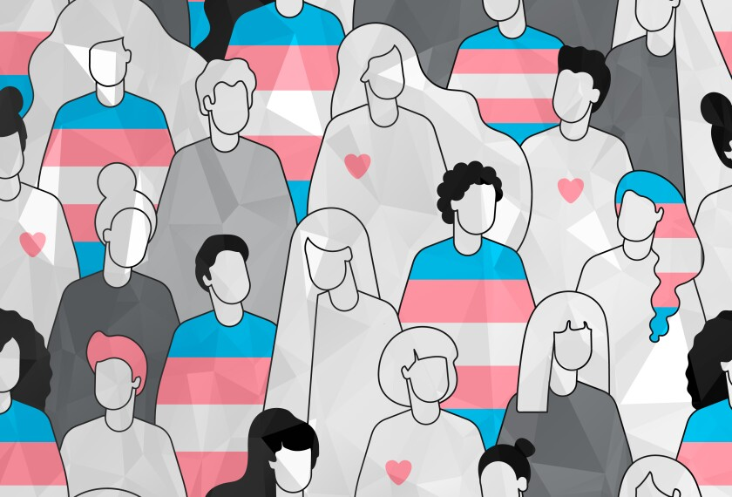
Background
1.6 million people in the United States identify as transgender.
Transgender individuals are disproportionately burdened by HIV.
Disparities in burden exist for Black/African-American and Hispanic/Latine’ transgender women.
HIV prevalence is greatest in the southern United States

Slide 5
Background

Slide 6
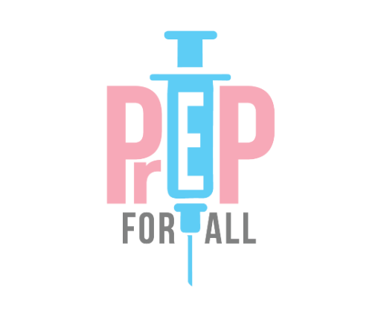
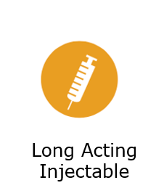
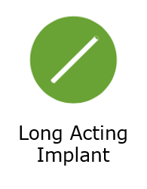
Purpose

Slide 7
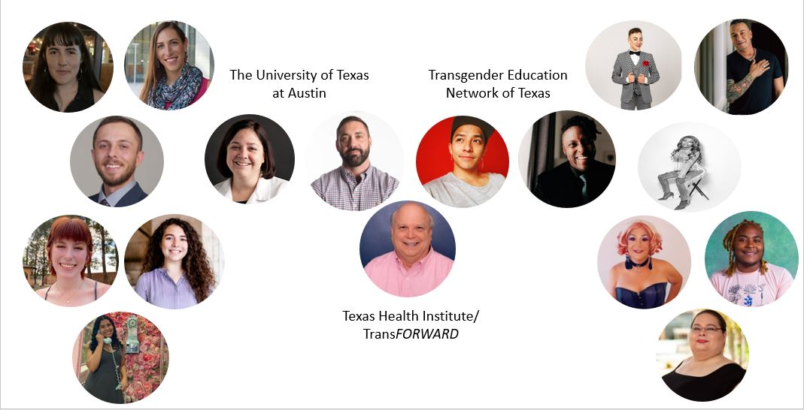
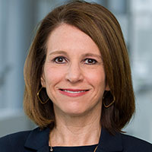
Methods
Community Based Participatory Research
Research Partners
Community Partners
Project Leadership

Slide 8
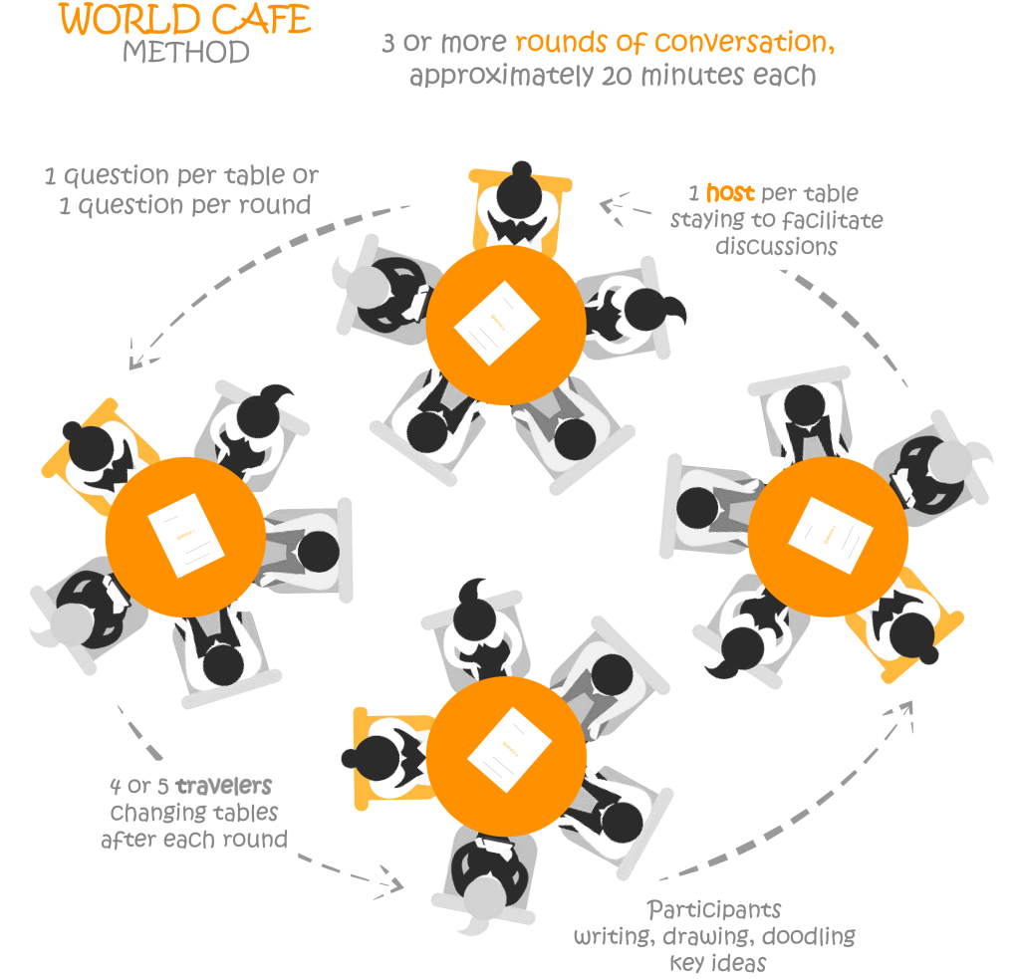
Methods
World Café Conversations
In-depth Interviews

Slide 9
Methods
Data Analysis
Structural Coding
Transcript Review
Codebook Creation
Theme 1
Theme 2
Theme 3

Slide 10
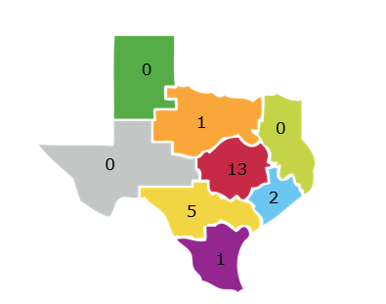
Results
Gender Identity (n = 22)
Transgender Woman | Transgender Man | Gender Expansive
7 | 5 | 10
Geographic Disruption
Dallas
Lubbock
Tyler
Austin
Age in Years (n = 22)
18 - 24 | 25 - 29 | 30 - 39 | 40 - 49 | 50 - 59
5 | 7 | 7 | 1 | 2
Structural Coding
El Paso
Houston
San Antonio
McAllen
Race and Ethnicity (n = 22)
American Indian or Native American | Asian or Pacific Islander | Biracial or Multiracial | Black or African-American | Hispanic or Latinx | White | Something Else or Not Listed
1 | 1 | 2 | 2 | 2 | 13 | 1

Slide 11
Results
Individual Barriers
Interpersonal Barriers
Structural Coding
Clinic or Health System Barriers
Social and Structural Barriers

Slide 12
Results
Mental Health or Psychological Distress
Individual Barriers
Structural Coding
Physical Health or Effect on the Body
Lack of Knowledge or Awareness

Slide 13
Results
Mental Health or Psychological Distress
Individual Barriers
Structural Coding
“…Also, because you have to get the injection in your hip you have take your pants off too or pull your pants down to get it done which, like with dysphoria some people might not like really like to do.”

Slide 14
Results
Physical Health or Effects on The Body
Individual Barriers
“That would be something I would like as well because I am a melanated woman, and being melanated, a lot of us keloid. Now, I don't think I would keloid, but a lot of people have family who do, so a long-acting implant could leave a mark, and it could be a raised area.”
Structural Coding

Slide 15
Results
Lack Knowledge or Awareness
Individual Barriers
“I guess, there's still a stigma surrounding HIV, AIDS and PrEP. I’ve come across people who have just like, “Oh, you know you're part of this group you're going to get AIDS.” I’m like ‘well no that's not how it works.’ I’ve educated them and they're like, ‘Oh I didn't know.’ So, education will destigmatize it.”
Structural Coding

Slide 16
Results
Interpersonal Barriers
Experiences of Discrimination/Stigma
Structural Coding
Medical Distrust
Medical Trauma

Slide 17
Results
Experiences of Discrimination or Stigma
Interpersonal Barriers
“And there's also problems with medical discrimination against us where if you're not fortunate enough to live in an area with easy access to a gender affirming clinic, it can be very difficult to access sexual health care as a trans individual.”
Structural Coding

Slide 18
Results
Experiences of Discrimination or Stigma
Interpersonal Barriers
“And so there's just like very little information or consideration at all for disabled people [and] for intersex people…I just don't think that people are always, I guess like intersectionality is not a thing that is centered in medical spaces. And that's a problem for a lot of reasons.”
Structural Coding

Slide 19
Results
Medical Distrust
“For the long acting injectable and the long acting implants, one thing I could think of is the distrust of health professionals, especially living in Texas. I mean so many are fairly conservative, so if you live in one of those areas you may be kind of reluctant to go to a hospital and have to have some sort of injection done, just because of the distrust for health professionals, but I’m not sure like what can be done to overcome that.”
Interpersonal Barriers
Structural Coding

Slide 20
Results
Medical Trauma
Interpersonal Barriers
Structural Coding
“As a trans, intersex and disabled person, I have a lot of medical trauma. So, while in my mind, the [long acting] implant is being practical, because I have so much medical trauma, it might be hard for me to do something that was more of an invasive procedure.”

Slide 21
Results
Clinic or Health System Barriers
Structural Coding
Requires clinic or pharmacy
administration
More frequent follow-ups

Slide 22
Results
Requires Clinic of Pharmacy Administration
Clinic or Health System Barriers
Structural Coding
“And that includes the number of refills with the oral seeming like the most accessible because of the autonomy involved and being able to administer my own medication monthly or even daily.“

Slide 23
Results
More Frequent Clinic Visits
Clinic or Health System Barriers
“Yeah, I live in San Marcos I have to drive to Cedar Park to get treatment for my HRT and the less I have to go into a clinic and risk encountering someone who is not prepared to work with me in a way that is meaningful or helpful, the better. The less contact I have to make the better.”
Structural Coding

Slide 24
Results
Clinic or General Accessibility
Clinic or Health System Barriers
“I’m well employed, well insured, but some of my friends are underemployed and don't have transportation, so there's lots of barriers for them. And that's why I keep harping about let me get this to them at their locations. If I can get mobile clinics, with this stuff in there it’s a quick in and out, and you have your medication. Versus them having to get to the doctor or a clinic and take time off work which they won’t do because they can't afford it. They live paycheck to paycheck.”
Structural Coding

Slide 25
Discussion
Discrimination and stigma undergird barriers to longer-acting formulations of PrEP.
Multi-level interventions are needed to address barriers at various levels.
We need to rethink how longer-acting formulations are administered to reduce burden on transgender and gender diverse people.
More research is needed to identify where transgender and gender diverse people are lost in HIV prevention cascade.
Structural Coding

Slide 26
Next Steps
Co-developing best practices for engaging transgender and gender diverse people in HIV prevention research.
Co-develop policies and provider training to decrease medical trauma.
Launching a statewide survey supported by grassroots organizations across Texas.
Structural Coding

Slide 27
References
Herman JL, Flores AR, O'Neil KK. How Many Adults and Youth Identify as Transgender in The United States. https://williamsinstitute.law.ucla.edu/subpopulations/transgender-people/. Published 2022. Accessed July 14, 2022.
CDC. Transgender People and HIV. https://www.cdc.gov/hiv/group/gender/transgender/index.html. Published June 28, 2022. Accessed July 14, 2022.
Rael CT, Martinez M, Giguere R, et al. Transgender women's concerns and preferences on potential future long-acting biomedical HIV prevention strategies: The case of injections and implanted medication delivery devices (IMDDs). AIDS Behav. 2020;24(5):1452-1462. doi:10.1007/s10461-019-02703-5.
Löhr K, Weinhardt M, Sieber S. The “World Café” as a participatory method for collecting qualitative data. International Journal of Qualitative Methods. 2020 doi:10.1177/1609406920916976.
Clarke V, Braun V. Thematic analysis. The Journal of Positive Psychology, 12:3, 297-298, DOI: 10.1080/17439760.2016.1262613.
Ogunbajo, A., Storholm, E.D., Ober, A.J. et al. Multilevel Barriers to HIV PrEP Uptake and Adherence Among Black and Hispanic/Latinx Transgender Women in Southern California. AIDS Behav 25, 2301–2315 (2021). https://doi.org/10.1007/s10461-021-03159-2
Pagkas-Bather J, Young LE, Chen YT, Schneider JA. Social Network Interventions for HIV Transmission Elimination. Curr HIV/AIDS Rep. 2020 Oct;17(5):450-457. doi: 10.1007/s11904-020-00524-z. PMID: 32720253; PMCID: PMC7497372.
Structural Coding

