Slide 1
Conflict of interest disclosure: I have no relevant financial relationships with ineligible companies to disclose.
Dr. Nagesh N. Borse
Deputy Chief Health Officer,
Project HOPE, Washington DC
Abstract ID: OALBE0104
What Women Want –
Results from Discrete Choice Experiment about Preferred PrEP Method from Khomas Region of Namibia
Notes:
Thank you and Good morning!

Slide 2
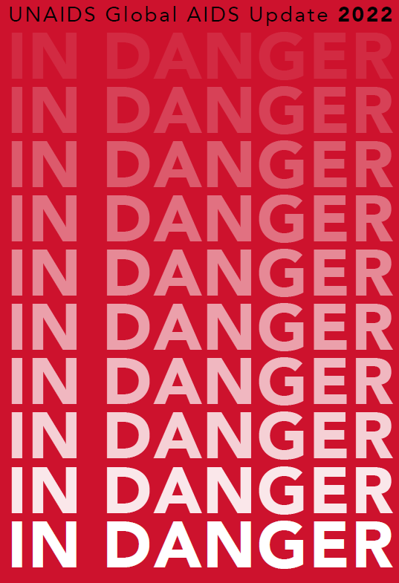
Every two minutes in 2021, an adolescent girl or young woman was newly infected with HIV.

Slide 3
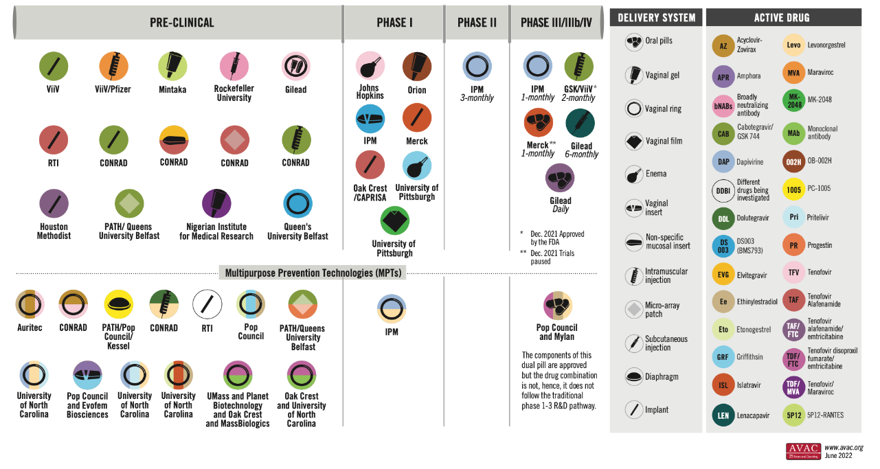
ARV-Based Prevention Pipeline
Notes:
For HIV Prevention work and new ARV-based technologies, AVAC maintains this pipeline and tracks new technologies on the horizon.
A user-centric approach to different users on which products will be of interest can help prioritize these efforts and streamline future introduction and scale-up planning. The study I am presenting today looked at three products – currently available daily PrEP pills, IPM Dapivirine vaginal ring, and Cabotegravir Long-acting Injectable.

Slide 4
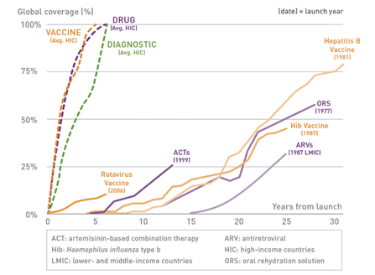
Years to Scale Up New Technologies:
High-Income
Less than 5 Years >>
<< Low- and Middle-Income
20+ Years
Ref: Gates Foundation
Notes:
The graph borrowed from Gates Foundation shows the number of years it takes us to scale up new technologies.
In HIC, it takes less than five years. For the COVID-19 Vaccine it was less than a year.
For LIC, the lines drag for two to three decades. For COVID-19 vaccine, although not perfect, did see improvements in improving access.

Slide 5
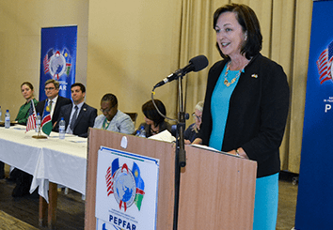
Background
Since June 2018, the Project HOPE Namibia-led consortium has been implementing the PEPFAR/USAID-funded DREAMS project in three regions of Namibia to reduce new HIV infection among AGYW (10-24y).
HIV Oral Pre-exposure Prophylaxis (PrEP) is offered as part of the package for Adolescent Girls and Young Women (15-24y).
From January 2019 to March 2022, the project initiated 13,195 AGYW on oral PrEP. However, the PrEP discontinuation rate at one month remains consistently high at 46%.
U.S. Ambassador to Namibia, Lisa Johnson, speaks at the launch of the DREAMS project, 2018

Slide 6
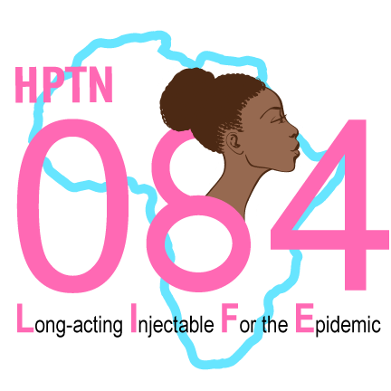
Study Results from HPTN 084
LIFE Study – Lancet, APRIL 2022
Although both products for HIV prevention were generally safe, well tolerated, and effective, cabotegravir was superior to TDF-FTC in preventing HIV infection in women.

Slide 7
WHO recommendation – Dapivirine Vaginal Ring, Jan 2021

Slide 8
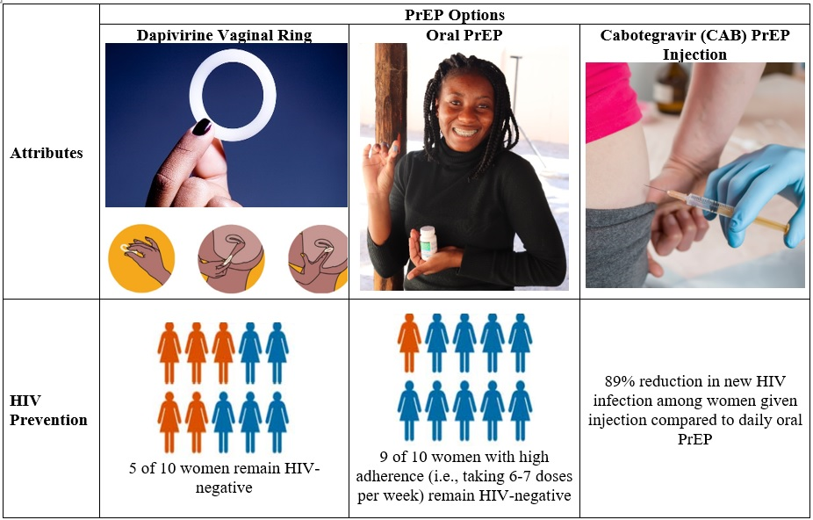
Objectives
To understand Knowledge, attitudes, and practice (KAP) toward Oral PrEP and
To offer PrEP Choices and identify the preferred method of choice

Slide 9
Methodology
The survey questionnaire had three sections: Basic demographics, PrEP KAP, and Preferred PrEP options.
Convenient sampling method was used to conduct an anonymous survey among 1,675 active DREAMS participants.
Visual and narrative descriptions used to educate AGYW on the attributes of PrEP options.
In April 2022, DREAMS staff utilized the REDCap mobile application to collect data.
Data was analyzed in STATA v15.
Notes:
The survey questionnaire had three major components Basic demographics, PrEP KAP and Preferred PrEP option
A convenient sample of 1,675 dreams participants was surveyed
For clarity for the respondents, visual aids and narrative descriptions were used to inform them about the attributes of the PrEP options.

Slide 10
Results: Sociodemographic Characteristics
Characteristics | Age Group
 | 15 - 19 Years (n= 1081, 67%) | 20 – 24 Years (n= 575, 33%) | Overall (n=1656)
Single | 1058 (98%) | 560 (97%) | 1618 (98%)
Education
Less than secondary | 893 (83%) | 224 (39%) | 1117 (68%)
Secondary | 165 (15%) | 261 (45%) | 426 (26%)
Diploma or University Degree | 17 (2%) | 88 (15%) | 105 (6%)
Own source of income | 25 (2%) | 58 (10%) | 83 (5%)
Response Rate: 99% (Only 19 AGYW declined to respond to the survey questions)
Notes:
67% of the respondent were aged 15-19 years old.
98% of the respondents were single

Slide 11
Results: Knowledge of Oral PrEP
 | Age Group
 | 15 - 19 | 20 - 24 | Overall
Heard about oral PrEP for HIV prevention | 960 (89%) | 560 (97%) | 1520 (92%)
Current/previous users of oral PrEP | 216 (23%) | 260 (46%) | 476 (31%)
DREAMS staff as primary source of information | 795 (83%) | 502 (90%) | 1297 (85%)
Knew where to get oral PrEP | 924 (96%) | 559 (100%) | 1483 (98%)
Knew oral PrEP could reduce new HIV infection | 725 (76%) | 480 (86%) | 1205 (79%)
Knew oral PrEP could not prevent other STIs | 601 (63%) | 435 (78%) | 1036 (68%)
Notes:
Knowledgeable about oral PrEP for HIV prevention
One in three have been current or past users of oral PrEP
DREAMS Staff plays essential role in providing information
98% knew where and how to access it

Slide 12
Results: Knowledge, Practice and Attitude towards PrEP
 | Age Group
 | 15 - 19 | 20 - 24 | Overall
Agreed/strongly agreed that oral PrEP has serious side effects | 374 (39%) | 243 (43%) | 617 (41%)
Knows Oral PrEP | 775 (81%) | 516 (92%) | 1291 (85%)
Knows Dapivirine Vaginal Ring | 38 (4%) | 8 (1%) | 46 (3%)
Knows CAB-LA Injection | 102 (11%) | 26 (5%) | 128 (8%)
Notes:
We know side effects have been reported as one of the key reasons for oral prep discontinuation
Awareness was high among respondents on Oral prep (81-92%) however anticipatedly it was low for a vaginal ring or injectable PrEP.

Slide 13
Results: Preferred Method of PrEP
83% (n=1262) of AGYW were willing to use any PrEP option

Slide 14
Results: Key Attributes in PrEP

Slide 15
Key Findings
Oral PrEP Knowledge and Awareness among AGYWs are high
83% of AGYWs are willing to use any PrEP Option
61% prefer CAB-LA due to its effectiveness, dosage frequency, and discreteness
Oral PrEP (27%) and Vaginal Ring (12%) are other preferred methods

Slide 16
Conclusions
The results provide vital information for the successful introduction, scale-up, and continued use of PrEP in the high-risk population.
User-centric introduction and scale-up approaches can help improve adherence and prioritize resource utilization to minimize new HIV infections.

Slide 17
Thank you!
Survey Respondents
Namibian Ministry of Health
PEPFAR USAID/Namibia
DREAMS/Namibia Consortium Partners
E. Melese 1, E. Negumbo 2, M. Nur 1, C. Uakuramenua 2, B. Haufiku 3, M. Rubeni 2, S. David 2, M. Kakende 2, P. Kamanga 2, C. Makuyana 2, M. Shilomboleni 3, B. Harases 2, R. Indongo 2, S. Neri 1, M. Manyando 4, N. N Borse 5
1 Project HOPE, Windhoek, Namibia,
2 Project HOPE Namibia, Windhoek, Namibia,
3 IntraHealth, Windhoek, Namibia,
4 US Agency for International Development (USAID\Namibia), Windhoek, Namibia,
5 Project HOPE, Global Health Technical Unit, Washington, United States

