Slide 1


Long-term risk of hospitalization and chronic diseases among children HIV exposed but who were uninfected compared to population control in Montreal, Canada
Jeanne Brochon, Thierry Ducruet, Suzanne Taillefer, Marie-Elaine Metras, Silvie Valois, Valérie Lamarre, Isabelle Boucoiran, Hugo Soudeyns, Joseph Puyat, Joel Singer, Fatima Kakkar
Jeanne Brochon, MD
Division of Pediatric Infectious Diseases
Centre Hospitalier Universitaire Sainte-Justine
Université de Montréal
Notes:
Thank you Tonia for the introduction and to AIDS for the organisation. I am Dr Jeanne Brochon, and I am happy to present on behalf of the team our work about outcomes of children HIV exposed who are not infected

Slide 2

Financial disclosure
Nothing to declare

Slide 3
Land acknowledgement
We acknowledge that this work takes place in Tiohtià:ke (Montréal), from where I speak, on the unceded lands of the Kanien’kehá:ka (Mohawk Nation)
Notes:
Tchiotchiaugué, Goniangéhagua

Slide 4

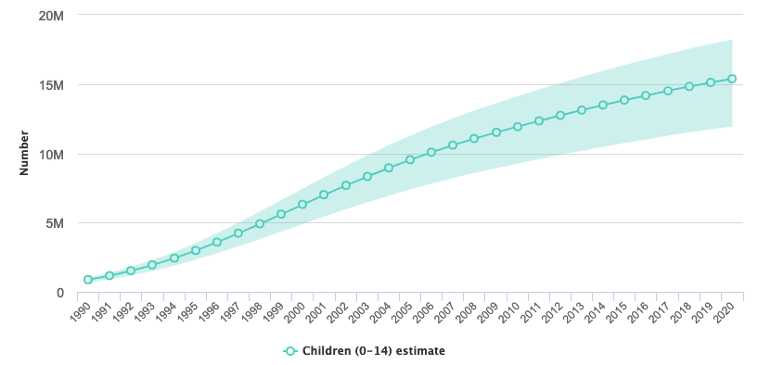

Uninfected, but not unaffected
There are an estimated 15.4 million of children HIV-exposed but who are uninfected (CHEU) globally. ¹
Despite averting HIV infection, there are concerns about the health of CHEU.
CHEU²
¹ Wedderburn, Lancet, 2022
² UNAIDS epidemiological estimates, 2021

Slide 5






Data from predominantly resource-limited settings
Mortality¹
Hospitalisation (all cause and ID)²
Bacterial infections³
¹ Brennan, AIDS, 2016
² Anderson, AIDS, 2021
³ Taron-Brocard, CID, 2014
Poor growth and stunting ⁴
Neurological outcomes⁵
Psychiatric disorders⁶
⁴ Evans, Clin Infect Dis, 2021
⁵ Wedderburn, Lancet, 2022
⁶ Gadow, J Dev Behav Pediatr, 2010

Slide 6
Causes likely multifactorial
Maternal
immune
suppression
Increased
mortality
Immunological
abnormalities
HIV viremia
Increased
hospitalization
ART Drug
exposure
Mitochondrial
dysfunction
Infectious diseases
Access to health
care ?
Neurodevelopmental
disorders?
Preterm delivery
Socio-economic factors ?
Chronic diseases?

Slide 7

In a resource-rich setting, with universal access to care, will we see these same outcomes?

Slide 8
Objectives
To determine the incidence rate of hospitalization among CHEU (cases) compared to population controls who were HIV-unexposed uninfected (CHUU)
To determine the risk of chronic diseases (heart disease, malformation, malignancy, neurologic and psychiatric disorders, endocrinological, and immunological diseases) among cases vs. controls

Slide 9


Methods
CMIS cohort
  Prospective cohort established in 1988 in Montreal to follow pregnant women living with HIV and their children from birth until early childhood
Quebec public medical services database
  The Régie assurance maladie du Québec (RAMQ) is a universal health care system that covers all residents of the province regardless of age or income
  Individuals are assigned a unique lifetime single patient identifier
  RAMQ database includes all medical services and procedures billed, across all health care settings
Notes:
Oldest HIV children in the world

Slide 10
Methods
CHEU from the CMIS were matched (1:3) to a CHUU control from the RAMQ database, identified at random after matching for age, gender, and postal code (neighborhood)
1988 – 2016
Outcomes
Hospitalization: Any hospitalization in the province of Quebec registered in the RAMQ database
Chronic conditions:
Defined by system à priori
Determined by ICD-9 codes
Analysis
Survival analysis to compare incidence rate of all-cause hospitalization compared between CHEU and CHUU using Kaplan-Meier curves and Cox Proportional Hazards models
For the outcome of any chronic condition, we will present risk-ratios (RR) and 95% confidence intervals (CI) for the first occurrence of each outcome within the two groups

Slide 11
CHEU
Birth years
NRTI Exposure
NNRTI, PI, INSTI

Slide 12
CHEU vs. CHUU controls
 | CHEU N(%) | CHUU N(%) | p-value
Total | 726 (100) | 2178 (100) | NA
Female sex assigned at birth | 357 (49.2) | 1071 (49.2) | NA
Gestational age <37 weeks | 99 (13.7) | 164 (8.5) | <0.001
Follow-up time, median Q1-Q3 (years) | 11.1 [6.6-15.9] | 11.1 [6.7-15.8] | NA

Slide 13
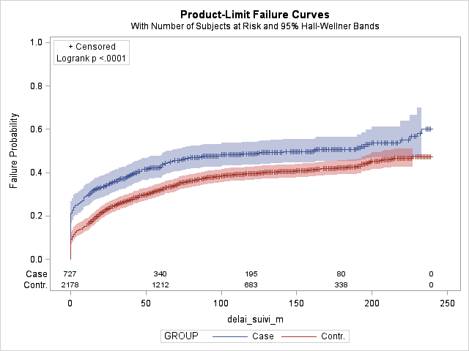
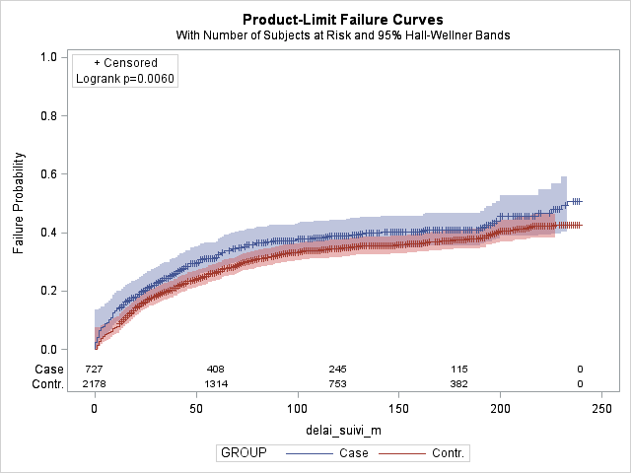
Risk of hospitalization over time
CHEU
CHEU
CHUU
CHUU
All hospitalization CHEU vs. CHUU
Excluding prolonged birth hospitalization
HR= 1.42 [1.26-1.61], p<0.001
aHR for gestational age: 1.23 [1.08-1.40], p=0.001
HR= 1.21 [1.06-1.40], p=0.006
aHR for gestational age: 1.14 [0.99-1.31], p=0.078
Notes:
Signifcantly increased risk of hospitalisation over time with an HR of 1.42 which remains significant after adjustinf for gestationnal age. The ris persisted as wele after excluding prolonged birth hospitalisation defined as an hospitalization that lasted more than 5 days

Slide 14
Chronic conditions defined by ICD-9 codes

Slide 15
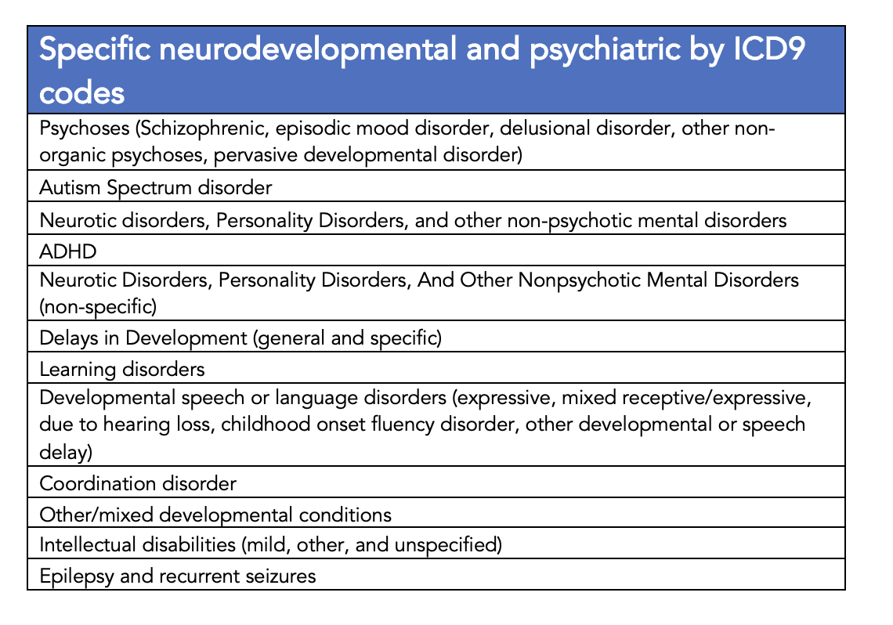
Neuropsychiatric conditions
RR= 1.28 [1.13-1.45], p<0.001
Notes:
In all neuropsychiatric conditins

Slide 16
Specific neuropsychiatric conditions
RR= 1.39
[1.10-1.76]
p=0.007
RR= 1.71
[1.20-2.44]
p=0.003
RR= 2.13
[1.37-3.33]
p<0.001
RR= 1.92
[1.14-3.21]
p=0.012
RR= 2.29
[1.12-4.70]
p=0.020
RR= 4.50
[1.27-15.90]
p=0.010
Notes:
Cases had a relative risk of 4.5 for ID, followed a risk of 2.29 for coordination disorder and 2.13 for psychoses and then autism spectrum disorder, delays in development and other and muxed developmental conditions
Bonferroni correction

Slide 17
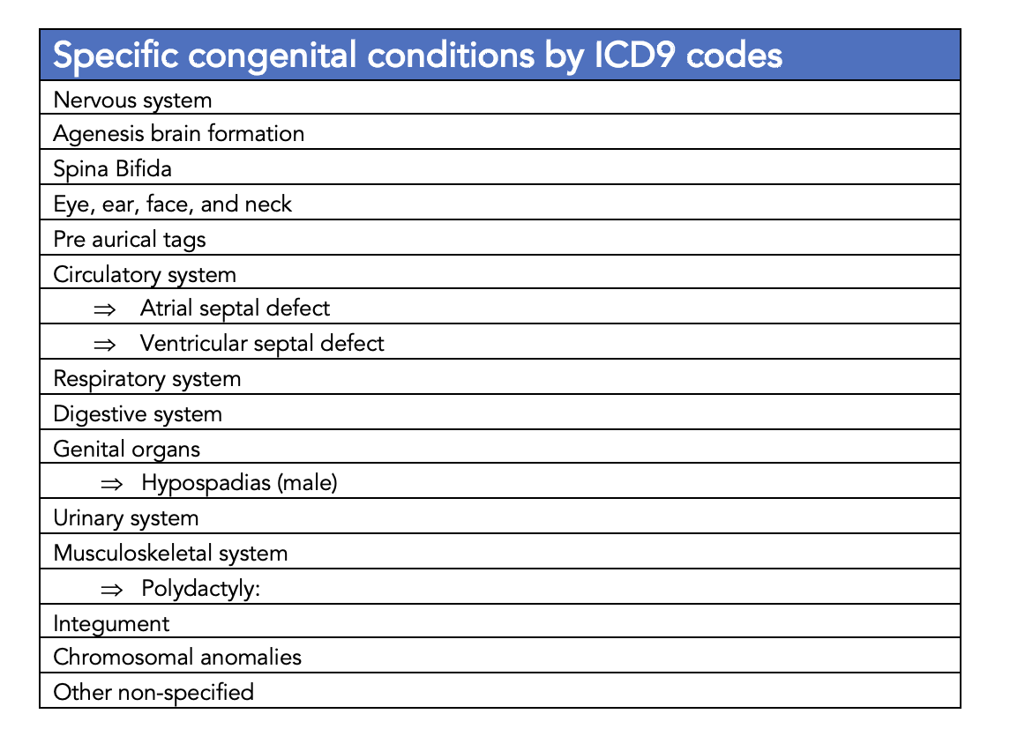
Congenital anomalies
RR= 1.58 [1.09-2.30], p=0.016

Slide 18
Specific congenital anomalies
RR= 3.00 [2.13-4.24], p<0.001
RR= 1.37 [1.10-1.69], p=0.004
Notes:
Polydactily

Slide 19
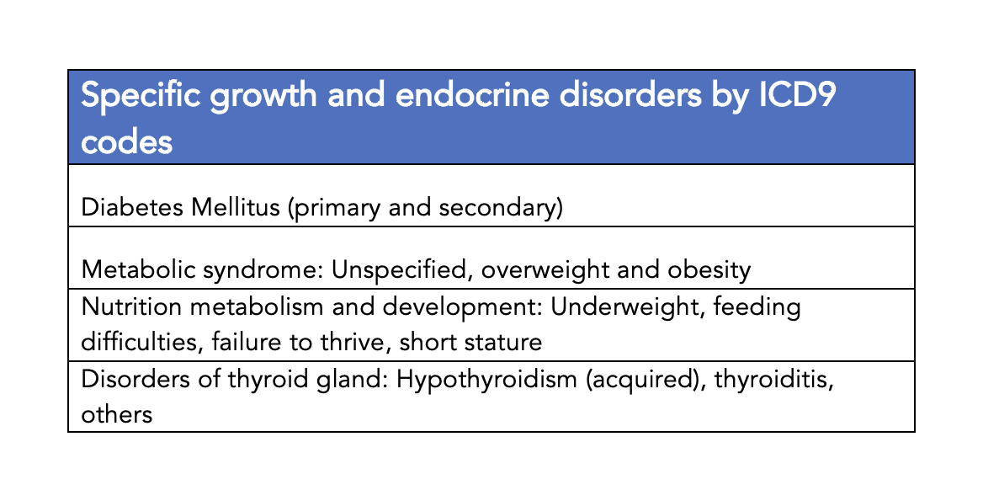
Endocrine system
RR= 0.70 [0.55-0.88], p=0.002

Slide 20
Specific endocrine conditions
RR= 0.52 [0.41-0.66], p<0.001
RR= 2.43 [1.14-1.80], p=0.002

Slide 21
Summary of chronic conditions
Incidence rate ratios | CHEU (n=726) N(%) | CHUU (n=2178) N(%) | RR 95%CI | p-value
Congenital anomalies | 40 (5.5) | 76 (3.5) | 1.58 [1.09 - 2.3] | 0.016
Neuro-psychiatric disorders | 241 (33.3) | 566 (26.1) | 1.28 [1.13 - 1.45] | <0.001
Endocrine nutritional, metabolic and immunity disorders | 79 (10.9) | 340 (15.7) | 0.70 [0.55 - 0.88] | 0.002
Respiratory diseases | 161 (22.3) | 559 (25.8) | 0.86 [0.74 - 1.01] | 0.06
Cardiovascular system diseases | 21 (2.9) | 75 (3.5) | 0.84 [0.52 - 1.35] | 0.47
Neoplasms | 12 (1.7) | 45 (2.1) | 0.8 [0.43 - 1.5] | 0.89

Slide 22
Summary
Increased risk of hospitalization in CHEU vs. CHUU controls
  Despite controls matched for socio-economical status (neighborhood), age and gender, and adjustment for gestational age
Increased risk of neuro-psychiatric diagnoses in CHEU vs. CHUU controls
  Significant concern given the millions of CHEU globally
  Confirms findings from previous cohorts^{1,2}, and clinical reality
¹ Piske, AIDS, 2018
² Wedderburn, Lancet, 2022

Slide 23
Discussion
Study limitations
  Administrative data: ICD9 codes are non-exhaustive, reflect billing not necessarily clinical reality
  Imperfect matching within neighborhoods, and multiple unadjusted confounders
  Different ART exposure over time, including older regimens no longer used in pregnancy
Strengths
  Linkage of clinical to administrative data allows for long-term outcomes assessment of CHEU as they move into adulthood
  Provides insight into potential signals that could be assessed in larger cohorts (for example: risk of diabetes)

Slide 24
CHEU: Beyond surviving to thriving?
While work into understanding the causes of differences in health outcomes among CHEU and CHUU is ongoing, these data suggest that CHEU could benefit from:
  Enhanced access to primary care regardless of setting
  Early neurodevelopmental assessments and screening
  Ongoing care beyond time of HIV negative diagnosis

Slide 25






Acknowledgements
The CMIS clinical cohort team
Dr Normand Lapointe
Dr Marc Boucher
Dr Valerie Lamarre
Dr Chris Karatzios
Dr Christian Renaud
Dr Isabelle Boucoiran
Dr Fatima Kakkar
Dr Soren Gantt
Nathalie Pichette
Marie Elaine Metras
Pascal Bedard
Silvie Valois
Dr Suzanne Taillefer
Dr Hugo Soudeyns
Martine Caty
Joanne Samson
Thierry Ducruet
Patricia Connolly
Chantal Lapointe
Diane Noel
Anne Marie Vermette

