Slide 1
Predictors of high viral load among adult HIV recipients of care in Zambia, 2021: A cross-sectional analysis of HIV case-based surveillance data
Sulani Nyimbili, Centre for Infectious Disease Research in Zambia (CIDRZ)
Track C: Epidemiology and prevention science
Notes:
I am Sulani Nyimbili, Surveillance Epidemiologist with CIDRZ, Zambia.
The title of my presentation is “ Predictors of high viral load among adult HIV recipients of care in Zambia, 2021: A cross-sectional analysis of HIV case-based surveillance data

Slide 2
Conflict of Interest Disclosure
I have no relevant financial relationships with ineligible companies to disclose.
Notes:
I have no conflict of interest to disclose

Slide 3
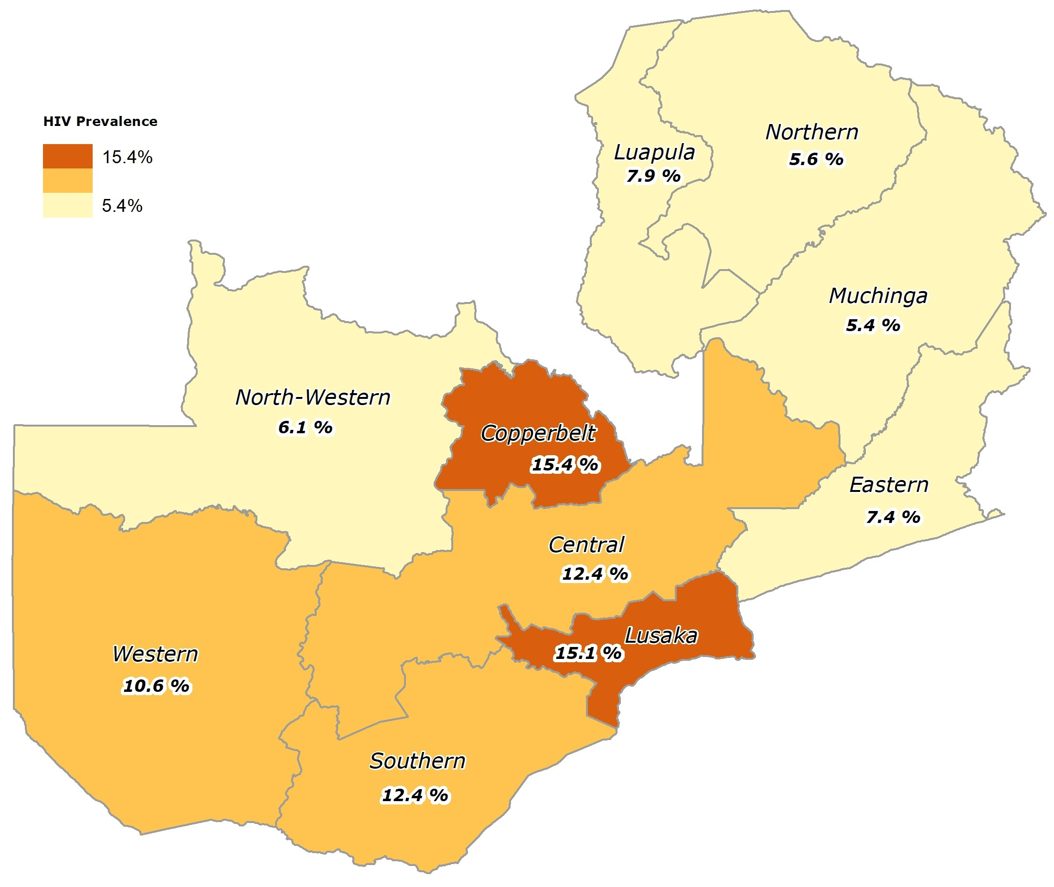
Background
Zambia has a generalized HIV epidemic with a national prevalence of ~ 11% among adults (15-49 years)
Zambia has made progress in attaining the UNAIDS 95-95-95 targets for epidemic control
HIV Prevalence among adults 15-49 years, by province, ZDHS, 2018
Notes:
Zambia has a generalized HIV epidemic, with a national prevalence of approximately 11% among adults between the age of 15 and 49 years (this is according to the Zambia Demographic Health Survey, 2018).
Since then, the country has made progress in attaining the UNAIDS 90-90-90 targets and is on track to reach the 95-95-95 targets for epidemic control.

Slide 4
Background (contd)
Sustaining epidemic control and achieving the UNAIDS 95-95-95 targets by 2030 will require maintaining high viral suppression among people living with HIV (PLHIV)
Identifying and characterizing predictors of high viral load (VL) among recipients of care (RoC) could guide development of interventions critical to improving HIV treatment outcomes and help achieve epidemic control
Notes:
Sustaining epidemic control and achieving the 95-95-95 targets by 2030 will require maintaining high viral suppression among people living with HIV.
This implies that there is need for better understanding and closer monitoring of viral load suppression at the individual and population level.
In this regard, identifying and characterizing predictors of high viral load among PLHIV could guide development and design of interventions critical to improving treatment outcomes and help achieve epidemic control.

Slide 5
Methodology
We used data from HIV case-based surveillance (CBS), a system that collects individual-level data from each person diagnosed with HIV across the course of the disease, in a longitudinal manner
CBS leverages Zambia’s electronic health record system (SmartCare) operating in 1,542 health facilities, and covering 85% of PLHIV
Information on PLHIV is continuously collected in the health facilities, and transmitted monthly to the National Data Warehouse
Notes:
To determine predictors of high viral load, we use HIV case-based surveillance (CBS), a system that collects individual-level data from each PLHIV across the course of the disease in a longitudinal manner.
In Zambia, CBS leverages on the national electronic health record system (SmartCare), which is operational in over 1500 health facilities across the country and covering about 85% of PLHIV.
Typically, information about each recipient of care who accesses services at the facility is entered directly into SmartCare. The data are transmitted to the national data warehouse, where they are de-duplicated (and this is one of the unique attributes of CBS)

Slide 6
Methodology (contd)
We conducted a cross-sectional analysis of HIV CBS data (January-December 2021)
Inclusion criteria:
Adult (≥15 years)
On Antiretroviral Treatment (ART) ≥ 6 months
Latest valid VL measurement on record
Regression analyses were conducted to estimate associations between covariates and high VL.
Notes:
We conducted a cross-sectional analyse of CBS data for the period January to December 2021. For the inclusion criteria, we considered adults (15+ yrs), being on ART for at least 6 months and having the latest valid VL measurement on record
We conducted logistic regression analysis to estimate association between covariates and high viral load

Slide 7
Results
531,864 HIV RoC met the inclusion criteria
Median age:35 years [Interquartile range (IQR)] 29-42)
Median duration on ART: 52 months (IQR: 29-99)
(12 %)
(69 %)
(19 %)
Notes:
A total of 531,864 PLHIV met inclusion criteria, that is, those who had a VL measurement on record, with 35 years median age and 52 months (~4 yrs) median duration on ART.
The general profile of RoC is consistent with what is known about the epidemiology of HIV in Zambia, where females are disproportionately affected (65%) and age group 25-44 accounting for close to 70% of PLHIV

Slide 8
Characteristics of RoC with high VL (N= 18,540)
Gender | n (%) | Geolocation | n (%)
Female | 11,083 (59.78) | Rural | 7,857 (42.51)
Male | 7,457 (40.22) | Urban | 10,626 (57.49)
Age group |  | ART duration (months)
15-19 | 1,064 (05.74) | <12 | 2,658 (14.34)
20-24 | 2,544 (13.72) | 12 | 390 (02.10)
25-29 | 3,562 (19.21) | 13-24 | 3,208 (17.30)
30-34 | 3,582(19.32) | 25-36 | 2,991 (16.13)
35-39 | 3,150 (16.99) | 37-48 | 2,313 (12.48)
40-44 | 2,054 (11.08) | 49-60 | 1,612 (08.69)
45-49 | 1,263 (06.81) | 61-72 | 906 (04.89)
50-54 | 704 (03.80) | 73-96 | 1,433 (07.73)
55-59 | 335 (01.81) | 97+ | 3,029 (16.34)
60-64 | 177 (0.95)
65+ | 105 (0.57)
We defined high VL as ≥ 1,000 copies HIV RNA/mL
High VL occurred in 18,540 (3.49%) RoC
Notes:
Characteristics of RoCs with high VL among those with a VL record are shown in this table.
~60% were females,
~ 67% between the age of 25 and 44, ~20% were adolescents and young people
~ 60% were from urban settings
~34% on ART within 24 months, ~ 66% on ART for > 24 months)

Slide 9
Characteristics associated with high VL among RoC
Characteristics | N (% of total) | Suppressed (Low) (%) | Unsuppressed (High) VL (%) | Multivariable analysis
 | 531,864 | 513,324 (96.51) | 18,540 (03.49) | AOR | AOR (95% CI)
Gender
Female | 344,458 (64.76) | 333,375 (96.78) | 11,083 (03.22) | 1.00 | ref
Male | 187,406 (35.24) | 179,949 (96.02) | 7,457 (03.98) | 1.43 | 1.37-1.46
Age group
35-39 | 99,549 (18.72) | 96,399 (96.84) | 3,150 (03.16) | 1.00 | ref
15-19 | 14,208 (02.67) | 13,144 (92.51) | 1,064 (07.49) | 2.48 | 2.31-2.67
20-24 | 50,267 (09.45) | 47,723 (94.94) | 2,544 (05.06) | 1.67 | 1.57-1.75
25-29 | 87,094 (16.38) | 83,532 (95.91) | 3,562 (04.09) | 1.32 | 1.26-1.39
30-34 | 105,607 (19.86) | 102,025 (96.61) | 3,582 (03.39) | 1.10 | 1.05-1.16
40-44 | 74,209 (13.95) | 72,155 (97.23) | 2,054 (02.77) | 0.85 | 0.80-0.90
45-49 | 47,618 (08.95) | 46,355 (97.35) | 1,263 (02.65) | 0.79 | 0.74-0.84
50-54 | 26,813 (05.04) | 26,109 (97.37) | 704 (02.63) | 0.79 | 0.72-0.85
55-59 | 14,563 (02.74) | 14,228 (97.70) | 335 (02.30) | 0.68 | 0.60-0.76
60-64 | 6,939 (01.30) | 6,762 (97.45) | 177 (02.55) | 0.74 | 0.63-0.86
65+ | 4,997 (0.94) | 4,892 (97.90) | 105 (02.10) | 0.58 | 0.48-0.71
N/B: AOR = Adjusted Odds Ratio ; CI = Confidence Interval ; We adjusted the model for gender, age group, ART duration, geolocation and province
Notes:
This Table shows characteristics associated with high VL after adjusting the multivariate logistic regression model for gender, age group, duration on ART, geolocation and province; and calculating adjusted odds ratios at 95% confidence interval
Males were 1.43 times more likely to have high VL than females
Younger age groups 15-19 , 20-24 and 25-29 were 2.5 , 1.7 and 1.3 times more likely, respectively, to have high VL than those between 35 and 39 years. We note decreasing odds of high VL with increasing age

Slide 10
Characteristics associated with high VL among RoC
Characteristics | N (% of total) | N (% of total) | Suppressed (Low) (%) | Unsuppressed (High) VL (%) | Multivariable analysis
 | 531,864 | 531,864 | 513,324 (96.51) | 18,540 (03.49) | AOR | AOR (95% CI)
Duration on ART (months)
37-48 | 66,170 (12.44) |  | 63,857 (12.44) | 2,313 (03.50) | 1.00 | ref
<12 | 28,596 (05.38) |  | 25,938 (90.70) | 2,658 (09.30) | 2.76 | 2.60-2.92
12 | 6,341 (01.19) |  | 5,951 (93.85) | 390 (06.15) | 1.73 | 1.55-1.94
13-24 | 72,031 (13.54) |  | 68,823 (95.55) | 3,208 (04.45) | 1.25 | 1.18-1.32
25-36 | 77,658 (14.60) |  | 74,667 (95.55) | 2,991 (03.85) | 1.11 | 1.05-1.17
49-60 | 51,576 (09.70) |  | 49,964 (95.55) | 1,612 (03.13) | 0.89 | 0.83-0.94
61-72 | 32,221 (06.06) |  | 31,315 (95.55) | 906 (02.81) | 0.81 | 0.75-0.87
73-96 | 58,881 (11.07) |  | 57,448 (95.55) | 1,433 (02.43) | 0.71 | 0.65-0.75
97+ | 138,390 (16.02) |  | 135,361 (95.55) | 3,029 (02.19) | 0.66 | 0.63-0.63
N/B: AOR = Adjusted Odds Ratio ; CI = Confidence Interval ; We adjusted the model for gender, age group, ART duration, geolocation and province
Notes:
Here, we show association between duration on ART and high VL
Those newer on ART (<12, 12 and between 13 and 24) were 2.8, 1.7 and 1.3 times more likely, respectively, to have high VL compared to RoC between 37 and 48 months on treatment

Slide 11
Characteristics associated with high VL among RoC (contd.)
Characteristics | N (% of total) | Suppressed (Low) (%) | Unsuppressed (High) VL (%) | Multivariable analysis
 | 531,864 | 513,324 (96.51) | 18,540 (3.49) | AOR | AOR (95% CI)
Geolocation
Urban | 326,298 (61.56) | 315,672 (96.74) | 10,626 (3.26) | 1.00 | ref
Rural | 203,747 (38.44) | 195,890 (96.14) | 7,857 (3.86) | 1.15 | 1.12-1.20
Province
Lusaka | 126,014 (23.77) | 121,262 (96.23) | 4,752 (3.77) | 1.00 | ref
Central | 55,709 (10.51) | 53,903 (96.76) | 1,806 (3.24) | 0.82 | 0.77-0.87
Copperbelt | 103,827 (19.58) | 100,659 (96.95) | 3,168 (3.05) | 0.82 | 0.78-0.86
Eastern | 44,921 (8.47) | 43,569 (96.99) | 1,352 (3.01) | 0.80 | 0.75-0.86
Luapula | 24,889 (4.69) | 23,461 (94.26) | 1,428 (5.74) | 1.42 | 1.33-1.51
Muchinga | 16,170 (3.19) | 15,725 (97.25) | 445 (2.75) | 0.63 | 0.57-0.69
North Western | 16,917 (3.19) | 16,417 (97.04) | 500 (2.96) | 0.69 | 0.63-0.76
Northern | 25,662 (4.84) | 24,606 (95.88) | 1,056 (4.12) | 1.00 | 0.93-1.08
Southern | 74,534 (14.06) | 72,391 (97.12) | 2,143 (2.88) | 0.77 | 0.72-0.81
Western | 41,495 (7.83) | 39,658 (95.57) | 1,837 (4.43) | 1.10 | 1.04-1.17
N/B: AOR = Adjusted Odds Ratio ; CI = Confidence Interval ; We adjusted the model for gender, age group, ART duration, geolocation and province
Notes:
For geolocation, we considered rural Vs urban settings. In this context, we considered rural settings for health facilities located in areas with a population less than 2,000, with households’ economic activities largely characterized by subsistence-based agriculture (and typically have limited social economic activities/ facilities, limited key infrastructure such as roads, piped water etc.)
RoC in rural settings were 1.2 times more likely to have high VL than those in urban settings.
This association is marginally notable in the provinces highlighted

Slide 12
Limitations of the Study
We only considered RoC who had a latest valid VL on record in the electronic health record system
Cross-sectional analysis of VL without factoring in two repeat VL measurement for each RoC
We did not factor in the potential effect of regimen switches and treatment interruption when assessing duration on treatment
Notes:
Some limitations in this analysis are that we considered only RoC who had a valid VL document in SmartCare
This analysis was cross-sectional and did not include repeat VL measurements to rule out viral blips among RoC
Also, we did not consider the potential effect of regimen switches or treatment interruption when assessing ART duration

Slide 13
Conclusions
We identified being new on ART, male and young adult as predictors of high VL
CBS analysis has provided longitudinal individual-level data, which can be used to guide program implementation. Targeted interventions centered on service delivery models for these risk groups will help Zambia in its efforts to reach the UNAIDS 95-95-95 goals
Future analyses of sentinel events in a longitudinal manner i.e., adherence and treatment interruption, ART regimen changes, and individual VL monitoring will promote CBS data use for program improvement
Notes:
In conclusion, were identified being new on ART, male and young adult as predictors of high VL. This is in contrast with findings by Waju et al (2021) noted reduced risk of high VL among those new on ART (< 24 months) in Ethiopia.
Also, analysis of longitudinal individual level data can be used to guide program implementation. Designing & targeting interventions centred on service delivery models for the risk groups will help Zambia in its efforts to reach epidemic control.
Lastly, future analyses of sentinel events in a longitudinal manner ie adherence and treatment interruption, ART regimen switched will promote CBS data use for program improvement and will be cascading these type of longitudinal analysis to the subnational level

Slide 14
Acknowledgment
Author Contributions:
Zambia Ministry of Health: Prof L. Mulenga, Dr S. Sivile, Dr C. Phiri, Dr M. Kalubula, Mr P. Funsani, Mr M. Mwansa, Mr C. Sianyinda
Centre for Infectious Disease Research in Zambia (CIDRZ): Dr I. Sikazwe, Dr C. Bolton, Dr T. Savory, Dr M. Wa Mwanza, Dr S. Bosomprah, Dr JM. Pry, Dr D. Mwamba, Mr M. Lumpa, Mr J. Mutale, Mr P. Somwe, Mr T. Sinkala
CDC Zambia: Dr PA Minchella, Ms L. Tally, Mr B. Hanunka, Dr K. Mweebo, Dr M. Mudenda
Funding: This work was supported by the U.S. President’s Emergency Plan for AIDS Relief (PEPFAR) through the Centers for Disease Control and Prevention (CDC) under the terms of cooperative agreements NU2GGH002234
CDC Authorship Disclaimer: The findings and conclusions in this report are those of the author(s) and do not necessarily represent the official position of the funding agencies

