Slide 1
High prevalence of asymptomatic Omicron carriage and correlation with CD4⁺ T-cell count among adults with HIV enrolling in CoVPN 3008 Ubuntu clinical trial in sub-Saharan Africa
Jessica Andriesen, PhD, Fred Hutchinson Cancer Center, Seattle, WA, USA
Late breaker Track C
Abstract reference code: OALBC0102

Slide 2
Outline
Introduction to Ubuntu
Key findings of population at baseline:
Asymptomatic Omicron carriage
Association with CD4 count
Summary and future work
Conflict of interest disclosure:
I have no relevant financial relationships with ineligible companies to disclose.

Slide 3
Ubuntu: Multicenter, randomized, efficacy study of mRNA COVID-19 Vaccine in Sub-Saharan regions with SARS-CoV-2 virus variants
Participating Countries:
Botswana, Eswatini, Kenya, Malawi, South Africa, Uganda, Zambia
No prior COVID-19 vaccination
Predominantly enrolling people living with HIV
Those enrolled without HIV have another known risk factor for severe COVID
Enrolling all genders
Screening began 15 July 2021; First enrollment 29 Nov 2021
Presentation includes baseline data collected through 01 July 2022

Slide 4
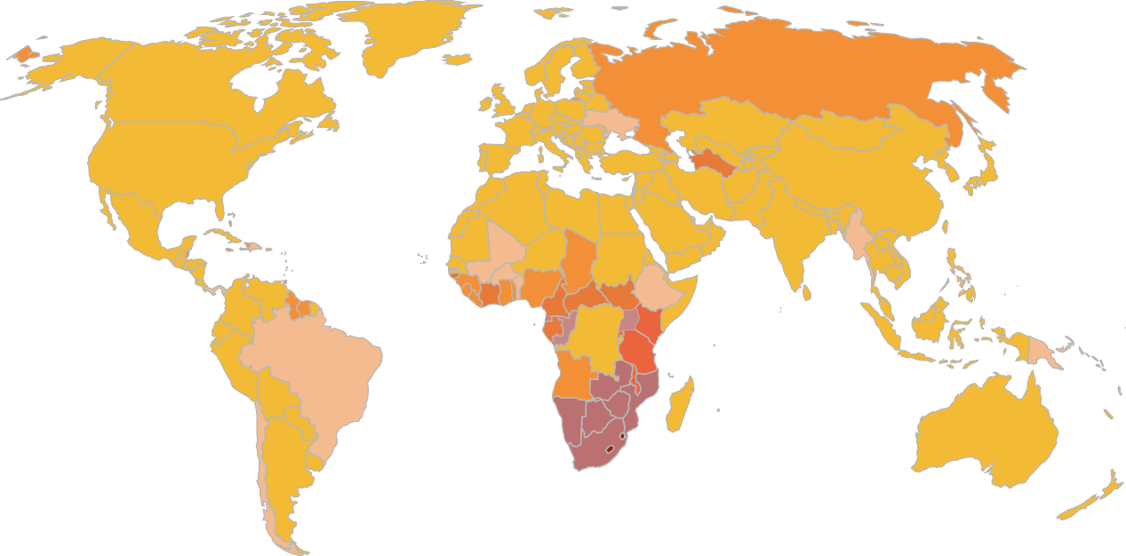
HIV prevalence among adults (aged 15–49 years), global, 2020
Motivation for
Ubuntu
Regions with the least access to COVID-19 vaccines are those with the highest prevalence of HIV.
Ubuntu will provide information on:
Effectiveness of mRNA vaccines against COVID-19 caused by variants of concern in people living with HIV
Vaccine-induced immunity and hybrid immunity in people living with HIV
Correlates of risk & protection in people living with HIV
Safety and efficacy data to regulators to facilitate access to mRNA vaccine technology across Africa
< 0.5
0.5–1
1–2
2–3
3–5
5–10
10–20
>20
Source: UNAIDS special analysis, 2021.
Note: Data includes 244 countries
and territories.
Share of people who received at least one dose of COVID-19 vaccine (as of 7 July 2022)

Slide 5
Ubuntu study groups
Point of Care Testing at
Screening / Enrollment
Total enrollment =11,324
as of 01 July 2022
People living with HIV |  | People living without HIV
Without prior SARS-CoV-2 | With prior SARS-CoV-2 | Without prior SARS-CoV-2 | With prior SARS-CoV-2
Group 1 n=2,956 | Group 2 n=6,301 | Group 3 n=599 | Group 4 n=1,468
=blood collection
Enrollment visit:
(all groups)
=nasal swab
=vaccine

Slide 6
Baseline participant information as of 01 July 2022
 |  | Group 1 n= 2,956 People living with HIV; without prior SARS-CoV-2 | Group 2 n= 6,301 People living with HIV; with prior SARS-CoV-2 | Group 3 n= 599 People living without HIV; without prior SARS-CoV-2 | Group 4 n= 1,468 People living without HIV; with prior SARS-CoV-2
Age, n (%) | < 40 years | 1,508 (51%) | 3,296 (52%) | 351 (59%) | 911 (62%)
Sex assigned at birth, n (%) | Female | 2,078 (70%) | 5,132 (81%) | 198 (33%) | 830 (57%)
CD4 count* (cells/ml³), n (%) *of those with available data | >= 500 | 1,472 (58%) | 3,958 (71%)
 | 200 – 500 | 793 (31%) | 1,344 (24%)
 | < 200 | 284 (11%) | 297 (5%)

Slide 7
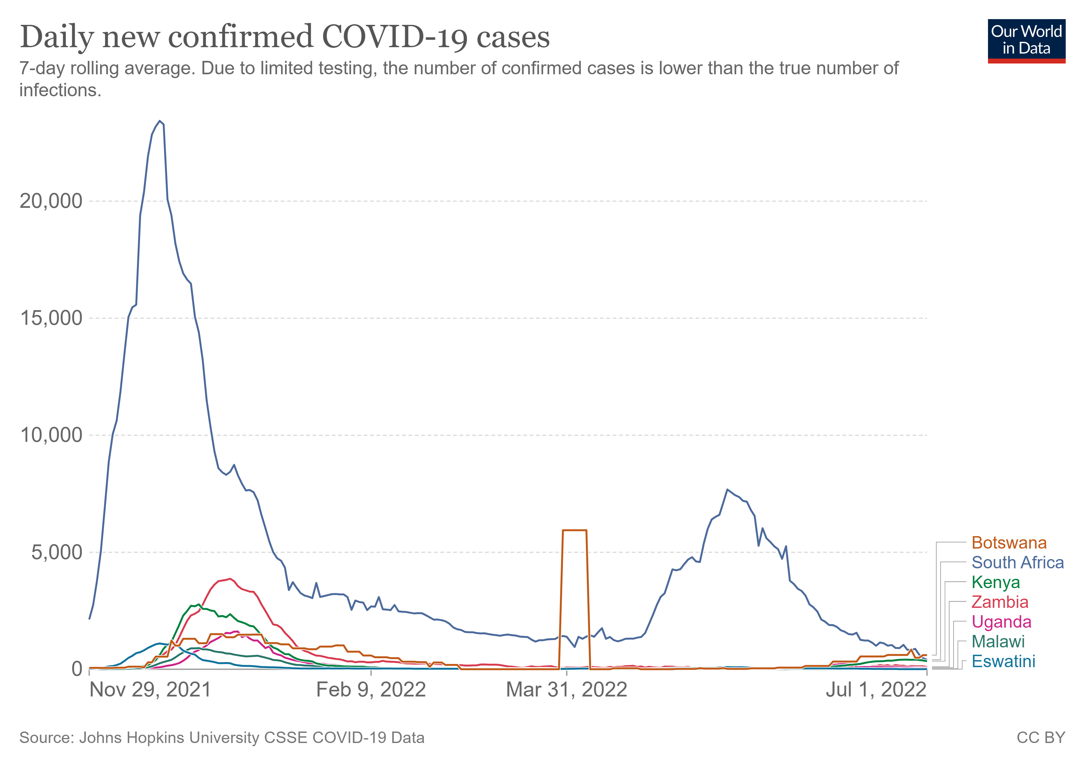
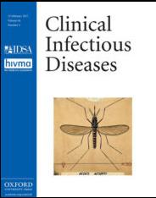
High prevalence of asymptomatic SARS-CoV-2 detection at baseline
Key finding #1
Cumulative percentage of tested individuals with positive PCR results at enrollment | Dec 2021 31% | Jan 2022 23% |  | July 2022 6%
Percentage is higher than seen in other vaccine trials at enrollment prior to Omicron
https://doi.org/10.1093/cid/ciac237

Slide 8
Asymptomatic SARS-CoV-2 detection at baseline differs between groups
Key finding #2
 |  | Group 1 n= 2,956 People living with HIV; without prior SARS-CoV-2 | Group 2 n= 6,301 People living with HIV; with prior SARS-CoV-2 | Group 3 n= 599 People living without HIV; without prior SARS-CoV-2 | Group 4 n= 1,468 People living without HIV; with prior SARS-CoV-2
SARS-CoV-2 PCR, n (%) [95% CI] | positivity | 235 (8.0%) [7.0% - 9.0%] | 288 (4.6%) [4.0% - 5.1%] | 40 (6.7%) [4.9% - 9.0%] | 71 (4.8%) [3.9% - 6.1%]
CD4 count* (cells/ml³), n (%) [95% CI] *of those with available data | >= 500 | 96 (6.6%) [5.4%-8.0%] | 160 (4.1%) [3.5%-4.7%]
 | 200 – 500 | 73 (9.3%) [7.5%-11.5%] | 58 (4.3%) [3.4%-5.6%]
 | < 200 | 26 (9.2%) [6.3%-13.1%] | 20 (6.7%) [4.4%-10.2%]

Slide 9
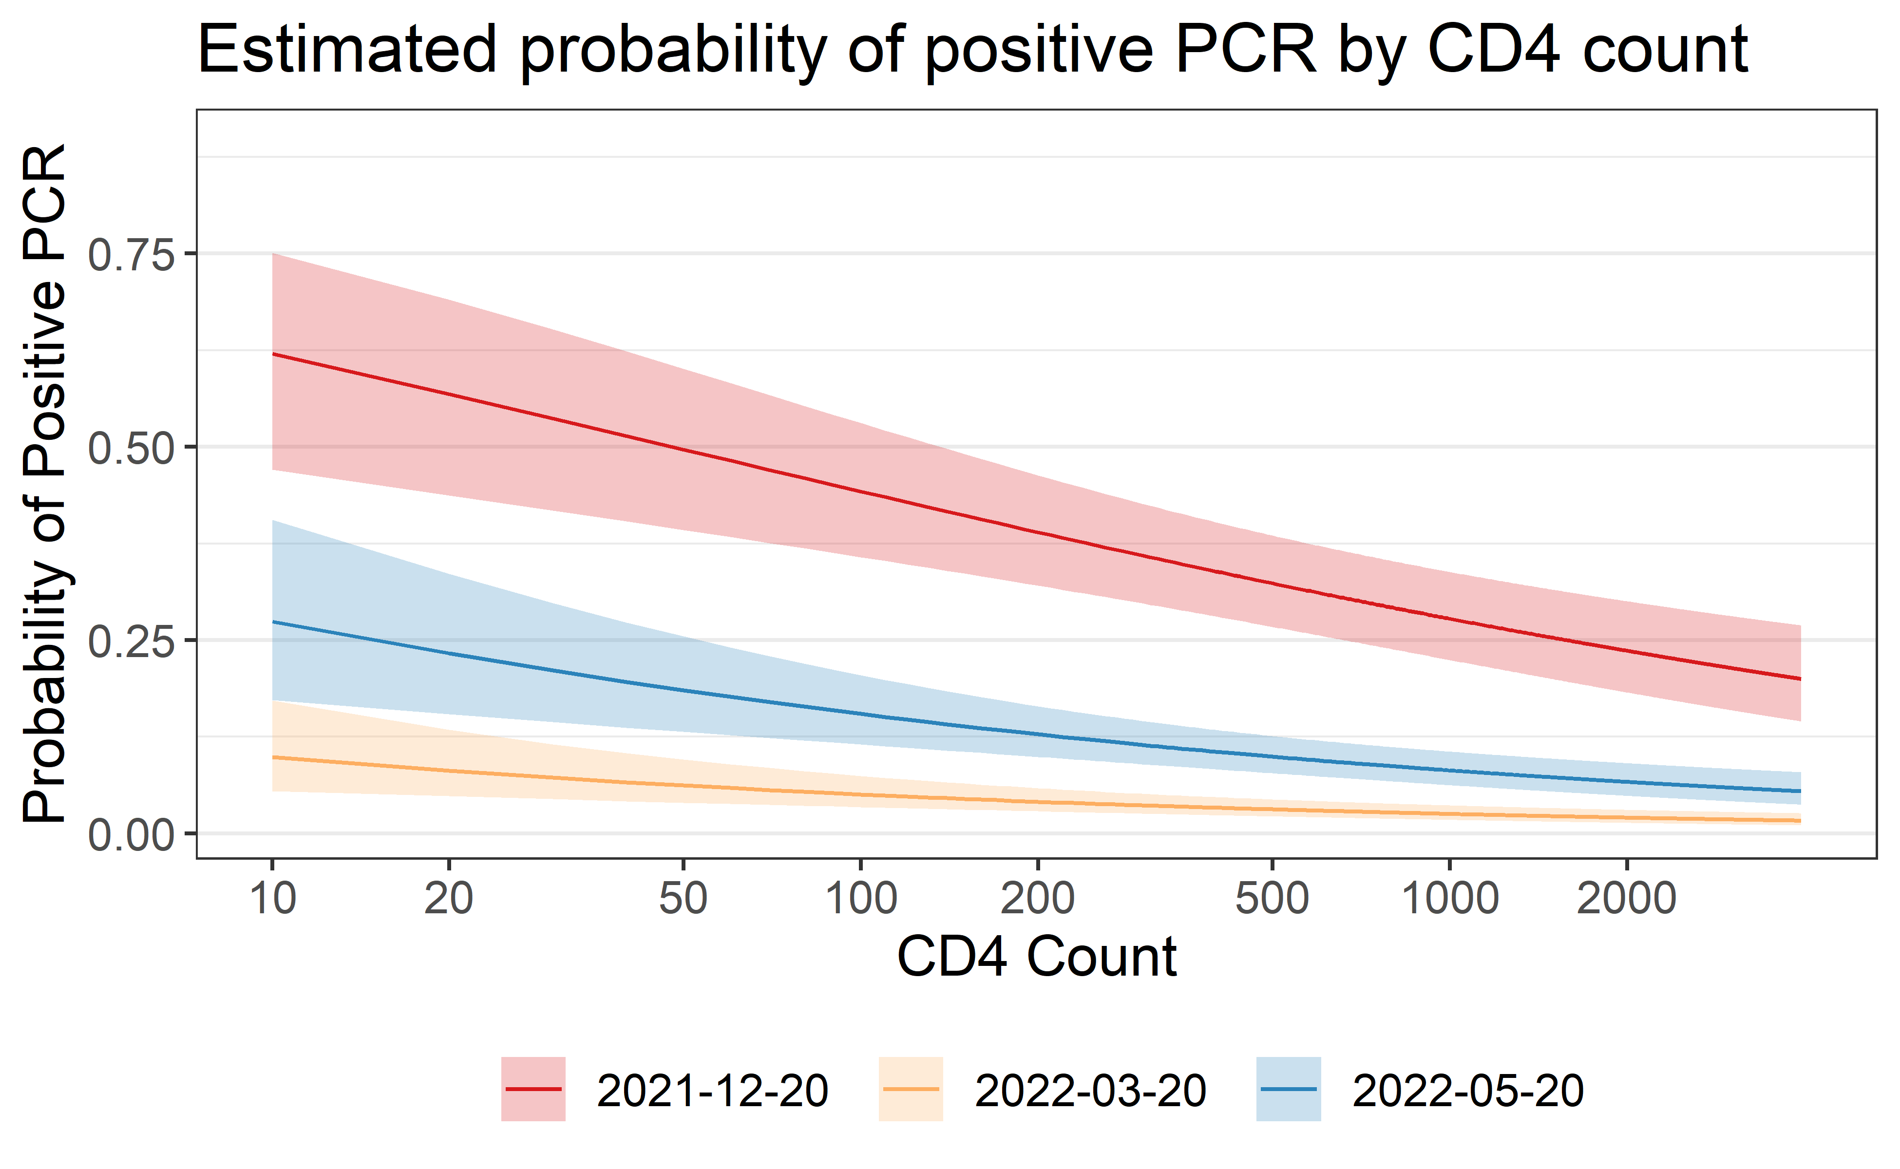
Lower CD4 count is associated with greater probability of SARS-CoV-2 detection at baseline
Key finding #2
10-fold decrease in CD4 count corresponds to a 2.06-fold higher odds of a positive PCR test (95% CI: 1.50-2.83)
Model adjusts for sex assigned at birth, antibody status, and temporal trend

Slide 10
Summary
Ubuntu is designed to further our understanding of the efficacy, safety, and immunogenicity of COVID-19 vaccines in people living with HIV
We found a rate of asymptomatic SARS-CoV-2 detection at baseline far higher than in COVID-19 vaccine trials prior to Omicron (key finding #1)
Baseline data also showed an association between CD4⁺ T-cell count and probability of having a positive PCR test result for SARS-CoV-2 (key finding #2)

Slide 11
Ongoing and future work
Assess efficacy of mRNA vaccines against symptomatic and severe COVID-19 from variants of concern among people living with HIV
Compare efficacy of vaccine-induced immunity versus hybrid immunity (induced from vaccination and prior infection)
Evaluate antibody and T-cell immune responses to identify correlates of risk/protection
Assess safety data to help inform regulators and facilitate access to mRNA vaccines in Africa
Further characterize SARS-CoV-2 viral persistence and evolution among people living with HIV

Slide 12
Thank you to the Ubuntu participants
Thank you to the study staff, CAB and community members

Slide 13
Ubuntu Study Team
Co-Chairs Nigel Garrett Philiip Kotze Sufia Dadabhai Nyaradzo Mgodi Lead Statisticians Yunda Huang Peter Gilbert | Protocol Lead Advisors Larry Corey Glenda Gray Linda-Gail Bekker Julie McElrath Myron Cohen James Kublin | Clinical Research Physician Aida Asmelash Regional Medical Liaisons Azwidhwi Takalani Veronique Bailey | SDMC Associate Director of Operations Jessica Andriesen Community Engagement Unit Representative Kagisho Baepanye | SDMC Associate Director of Lab Science April Kuar Randhawa Community Advisory Board representative Nosipho Cynthia Zungu | Project Coordinator Haven Wilvich Protocol Development Manager Smitha Sripathy
Protocol Team Leaders Nzeera Ketter Manuel Villaran Asa Tapley | Laboratory Leads John Hural Erica Andersen-Nissen Guido Ferrari | Clinical Safety Specialists Maija Anderson Megan Jones | Faculty Statistician Leigh H Fisher | Community Educator/Recruiter Sam Sandile Mthiya | Emmes Statisticians Jill El-Khorazaty Jeanine May Alicia Toledano
In-Country Lead Investigators Joe Makhema (Botswana) Harriet Nuwagaba-Biribonwoha (Eswatini) Taraz Samandari (Kenya) Sufia Dadabhai (Malawi) Nigel Garrett (South Africa) Philip Kotze (South Africa) Peter James Elyanu (Uganda) Roma Chilengi (Zambia) Zvavahera Chirenje (Zimbabwe) Nyaradzo Mgodi (Zimbabwe) | DAIDS Medical Officers Margaret Yacovone Laura Polakowski Core Medical Monitors Nzeera Ketter Manuel Villaran Asa Tapley | Clinical Trials Managers Michelle Nebergall Carrie Sopher Lori Proulx-Burns Dhevium Govender Clinical Research Project Manager Marianne Gildea Clinical Data Manager Melissa Peda | Statistical Research Associate Jiani Hu Director of Regulatory Affairs Laurie Rinn Laboratory Center Representatives Nicole Espy Lisa Sanders Jen Hanke | Protocol Pharmacist Jackline Odhiambo Lead Site Liaison Manager Bert Le Roux | Emmes Medical Officer Radhika Kondapaka Emmes Clinical Data Managers Haley Howell Bianca Noronha Emmes Project Leaders Valerie Brown Kim Linton Arpi Terzian
13

Slide 14
Ubuntu Clinical Research Sites
CAPRISA eThekwini CRS, Durban, South Africa Dr. Nivashnee Naicker
Isipingo CRS, Durban, South Africa Dr. Dishiki Kalonji
Tongaat CRS, Durban, South Africa Dr. Vimla Naicker
Synergy Biomed Research Institute (SBRI), East London, South Africa Dr. Moelo Malahleha
Ndlovu Research Center CRS, Elandsdoorn, South Africa Dr. Rebone M. Maboa Dr. Hugo Tempelman
TASK Eden, George, South Africa Dr. Kirsten McHarry
PHOENIX Pharma (Pty) Ltd, Gqeberha, South Africa Dr. Zelda Punt
Clinical HIV Research Unit (CHRU) / Helen Joseph CRS, Johannesburg, South Africa Dr. Sharlaa Badal-Faesen
Newtown Clinical Research, Johannesburg, South Africa Dr. Essack Mitha
Wits RHI Ward 21 CRS, Johannesburg, South Africa Prof Sinead Delany-Moretlwe
MERC Kempton, Kempton Park, South Africa Dr. Mmatsie Manentsa Aurum Institute Klerksdorp CRS, Klerksdorp, South Africa Dr. Craig Innes
PHRU Matlosana CRS, Klerksdorp, South Africa Dr. Tumelo Moloantoa
Qhakaza Mbokodo Research Clinic CRS, Ladysmith, South Africa Dr. Philippus Kotze
Synexus Stanza Clinical Research Centre CRS, Mamelodi, South Africa Dr. Sehulong Robert Moraba Dr. Elsje Louise Potgieter
Masiphumelele Clinical Research Site (MASI) CRS, Masiphumelele, South Africa Dr. Masebole Masenya
MeCRU CRS, Medunsa, South Africa Dr. Maphoshane Nchabeleng
MERC Middelburg, Middelburg, South Africa Dr. Vongane Louisa Maluleke
Nelson Mandela Academic Research Unit CRS, Mthatha, South Africa Dr. Pamela Mda
Rustenburg CRS, Rustenburg, South Africa Dr. William Brumskine
Synexus Helderberg, Somerset West, South Africa Dr. Soritha Coetzer
Soweto – Bara CRS, Soweto, South Africa Dr. Fatima Laher
Soweto – Kliptown CRS, Soweto, South Africa Dr. Erica Lazarus Dr. Anusha Nana
Tembisa Clinic 4, Tembisa, South Africa Dr. Kathryn Mngadi
CAPRISA Vulindlela CRS, Vulindlela, South Africa Dr. Disebo Makhaza Dr. Mlungisi Khanyile
MERC Welkom, Welkom, South Africa Dr. Yacoob Vahed
FAM-CRU (Family Clinical research Unit), Worcester, South Africa Dr. Samantha Fry
UVRI-IAVI HIV Vaccine Program LTD. CRS, Entebbe, Uganda Dr. Annet Nanvubya
Joint Clinical Research Centre, Kampala, Uganda Dr. Cissy Kityo Mutuluuza
MU-JHU Research Collaboration CRS, Kampala, Uganda Dr. Deo Ogema Wabwire
Baylor-Uganda CRS, Kampala, Uganda Dr. Peter James Elyanu
UNC Global Projects / Kamwala District Health Centre, Lusaka, Zambia Dr. Margaret Kasaro
Matero Reference Clinic CRS, Lusaka, Zambia Dr. Monde Muyoyeta
CFHRZ CRS, Lusaka, Zambia Dr. William Kilembe
Zambia Emory HIV Research Project – Ndola CRS, Ndola, Zambia Dr. Mubiana Inambao
Gaborone CRS, Gaborone, Botswana Dr. Joseph Makhema
Eswatini Prevention Center CRS, Mbabane, Eswatini Dr. Harriet Nuwagaba-Biribonwoha
Moi University Clinical Research Centre, Eldoret, Kenya Dr. Jamil Said
Kombewa Clinical Research Center, Kisumu, Kenya Dr. Ben Andagalu, MD
Kisumu CRS, Kisumu, Kenya Dr. Grace Mboya, MD
Blantyre CRS, Blantyre, Malawi Dr. Noel Kayange
Malawi CRS, Lilongwe, Malawi Dr. Mina Hoisenippour
Josha Research CRS, Bloemfontein, South Africa Dr. Zaheer Ahmed Dr. Ebrahim Hoosain
Emavundleni CRS, Cape Town, South Africa Dr. Scott Hayden Mahoney
Groote Schuur HIV CRS, Cape Town, South Africa Dr. Yashna Singh
University of Cape Town Lung Institute CRS, Cape Town, South Africa Prof Rodney Dawson
TASK Central, Cape Town, South Africa Dr. Thirumani Govender
14

