Slide 1





National roll out of HIV community based screening (HIV CBS) among key populations in Indonesia: assessment of early results
Budi Utomo¹, Kemal N. Siregar¹, Indang Trihandini¹, Rico Kurniawan¹, Ryza Jazid Baharuddin Nur¹, Sukma Rahayu¹, Irma Anintya Tasya², A.R.S.R Irene Sirait², Philips Loh², Robert J. Magnani^{1,2}
¹ Faculty of Public Health, Universitas Indonesia
² PATH, Seattle, United States

Slide 2
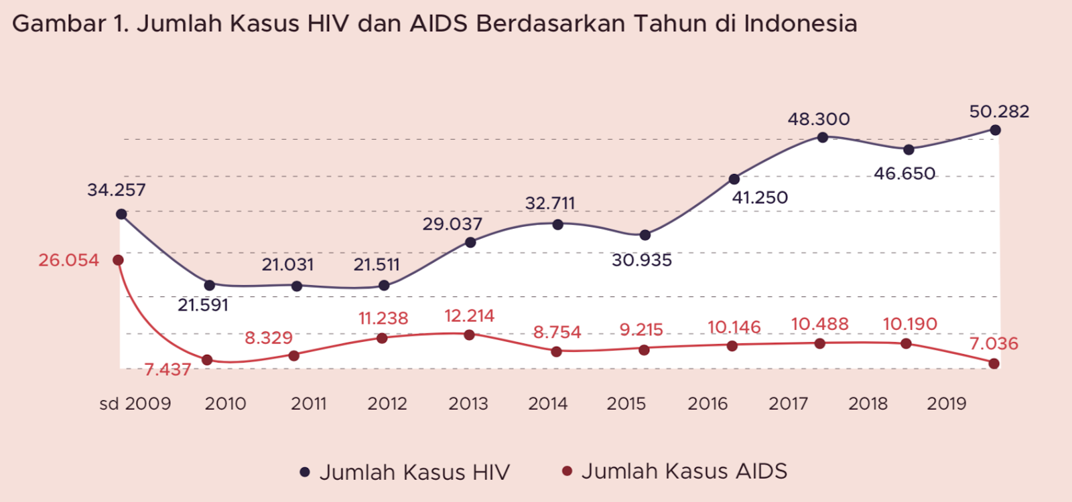
Background: HIV and AIDS as a Public Health Problem
HIV and AIDS remains a major global public health problem:
claimed nearly 33 million lives so far.
In Indonesia, the number HIV cases continue to rise, while the number of AIDS cases has flatlined.
Improved HIV case finding is urgently needed
Figure 1. Number of HIV and AIDS cases by year in Indonesia.
Key Populations ever been tested for HIV:
Female Sex Workers 14.7%
Transgender People 72%
Men who Sex with Men 59%
People who inject drugs 67.3%
Source: IBBS 2018-2019
only 49% PLHIV knew their HIV status
Source: MoH, 2020
number of HIV cases
number of AIDS cases
Source: Directorate General of Disease Prevention and Control 2019 Report in InfoDatin HIV 2020.

Slide 3
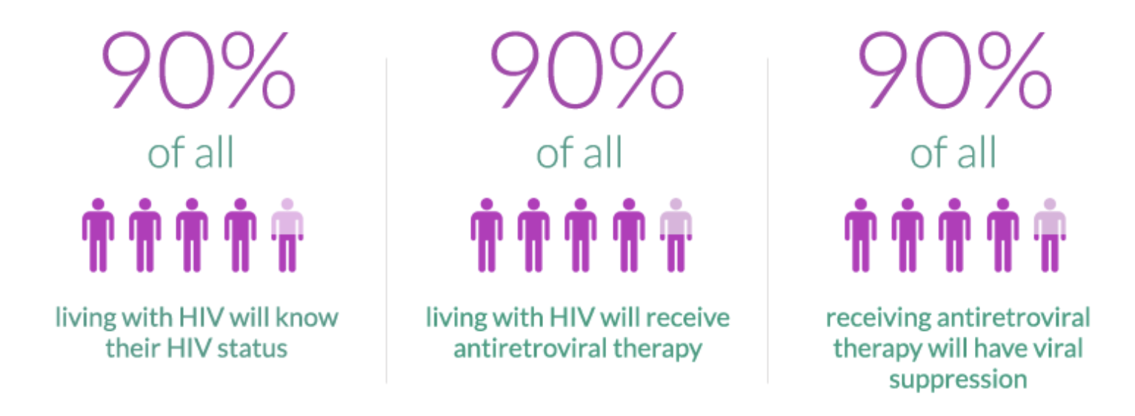
HIVST: a strategy to accelerate the rate of
HIV case finding
Ministry of Health (MoH) Fast Track 95-95-95 strategy
95%
95%
95%
Early Detection Strategy:
HIV self-testing (HIVST): an effective intervention to accelerate the rate of HIV case finding.
Monitoring
Implementation Research of HIV Community Based Screening by Implementing Partners
Collaboration between the Ministry of Health (MoH)
Republic of Indonesia and PATH through the Unitaid-funded HIV Self-Testing Africa Initiative Project Phase III (STAR III)
Community Distribution Point
Hotspot
Quality management
Workplace
Other locations
Evaluation

Slide 4
Research Questions:
Objectives
What distribution models, modalities, and modes were used to reach different targeted sub-populations?
How effective was CBS in detecting previously undetected HIV infections?
To what extent do persons with reactive CBS tests go on to receive confirmatory HIV tests at health facilities?
Sub-question: Does the degree of linkage between CBS and confirmatory HIV testing vary by distribution model or target sub-population?
What is the ART initiation rate among HIV-positive cases identified initially via CBS?
Sub-question: Does the ART initiation vary by distribution model or target sub-population?
What are the levels of acceptance of and consumer satisfaction with CBS?
Sub-question: Do levels acceptance and consumer satisfaction vary by distribution model or target sub-population?
To what extent are CBS clients willing to pay for CBS test kits in the future?
Sub-question: Does willingness to pay vary by distribution model or target sub-population?
The evaluation will focus on three (3) sets of issues:
1
Test kit distribution patterns and results
Linkage of HIV CBS with confirmatory testing at the health facility, and initiation of antiretroviral therapy (ART)
2
Acceptability of/consumer satisfaction with HIV CBS and willingness to pay for CBS
3

Slide 5
Methods
Evaluation of HIV CBS linkage to care services
Survey of consumer satisfaction & willingness to pay
HIV CBS Services
&
Export Data to SIHA 2.0
A longitudinal, observational design
Data collection using SIHA CBS from implementing partners
Documentation of (1) Test kit distribution and (2) community screening outcomes
Assessed client satisfaction with HIV CBS services and willingness to pay by online survey
Targeted sample was 10% of 80,000 test kits
Survey response rates were quite low, the final sample size was 1,799
Recording and Reporting
HIV CBS Data Services
Download Event Data (CSV Files)
Flow of Data in The Evaluation Study

Slide 6


Distribution of test kits
Number of test kits used: 36,616
By Gender
By Age
91.9%
3.8%
4.3%
Notes:
Test Kit Used 36,616

Slide 7
Distribution of test kits used by sub-population and assisted vs. unassisted
36,616
Notes:
Test Kit Used 36,616

Slide 8
Distribution of test kits used by distribution modality
%
* CDP: Community Distribution Point
* Other: Public Area and Private Residence

Slide 9
Percentage of first-time testers, overall and by population sub-group
83% of those undergoing CBS were first-time testers.
The results confirm CBS potential to reach sub-populations that had not been reached with more conventional HIV testing models.

Slide 10
Sensitivity and specificity of HIV CBS
HIV CBS Result | Confirmatory test result |  | Total
 | Negative | Positive
Non-reactive | 750 | 31 | 781
Reactive | 22 | 675 | 697
Total | 772 | 706 | 1478
Sensitivity = P (Screen reactive | confirmatory test positive) = 675/706 = 95.6%
Specificity = P (Screen non-reactive | confirmatory test negative) = 750/772 = 97.2%

Slide 11
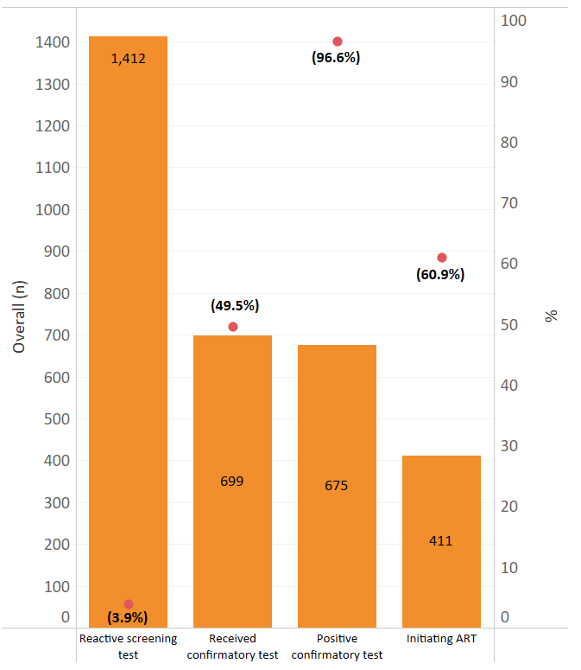
1,412
Cascades of HIV CBS to the ART initiation for overall clients
Overall (n)
699
675
411

Slide 12
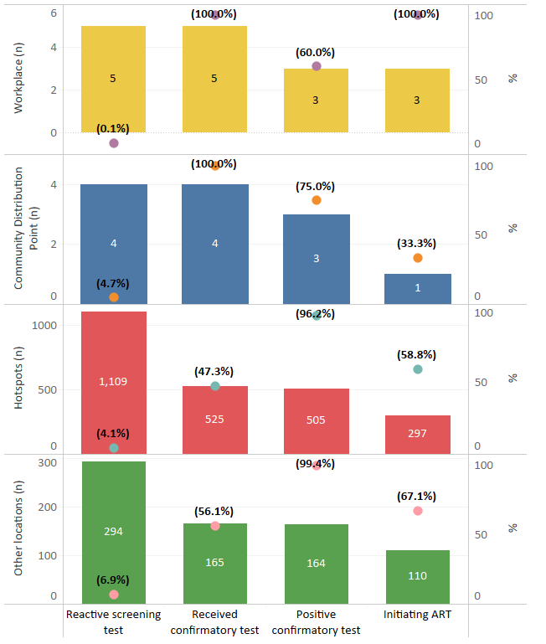
(100%)
(100%)
(60%)
workplace (n)
5
5
3
3
(0.1%)
Cascades of initiating ART: Test kit, reactive results, confirmatory tests, positive results, and initiating ART:
By distribution modality
(100%)
(75.0%)
CDP (n)
4
4
(33.3%)
3
(4.7%)
1
(96.2%)
(47.3%)
(58.8%)
Hotspot (n)
1109
(4.1%)
525
505
297
(99.4%)
Other Location (n)
(56.1%)
(67.1%)
294
165
164
(6.9%)
110

Slide 13
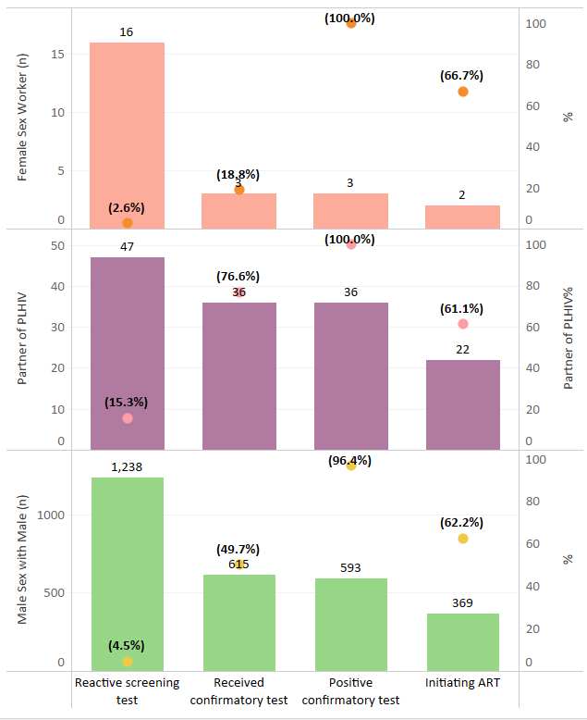
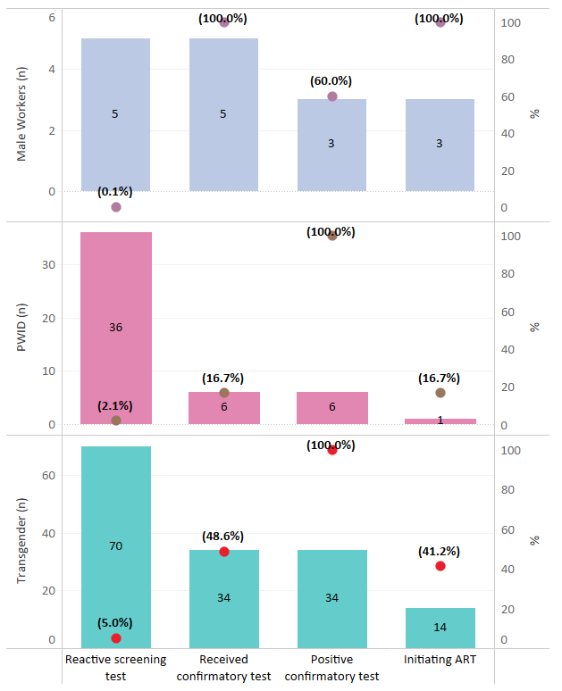
Cascades of initiating ART: Test kit, reactive results, confirmatory tests, positive results, and initiating ART by Sub-Population
(100%)
(100%)
(100%)
(60.0%)
(60.0%)
Female Sex
Worker (n)
5
5
16
Male Worker (n)
3
3
(18.8%)
(2.6%)
3
3
(0.1%)
2
(100%)
(100%)
(76.6%)
(61.1%)
Partners of PLHIV (n)
47
PWID (n)
36
36
36
(16.7%)
(16.7%)
(15.3%)
22
(2.1%)
6
6
1
(96.4%)
(100%)
(62.2%)
MSM (n)
1238
(49.7%)
Transgender (n)
70
(48.6%)
(41.2%)
615
593
6
6
(4.5%)
369
(5.0%)
14

Slide 14
HIV CBS satisfaction by age group and gender
(1,779 CBS clients responding to the online survey)
Age group
20-39 years old
Notes:
1,779 respondent

Slide 15
Willingness to pay for CBS in the future, overall and by age & gender
(1,779 CBS clients responding to the online survey )

Slide 16
Discussion and Conclusion
Test Kit Distribution
1
Only 48.4% of the 75,764 test kits that were released by the MoH for distribution to implementing partners were used during the evaluation period (80,000 kits were donated).
Most key population distribution occurring at “hotspots” and all private sector distribution occurring at workplaces.
2
3
Other distribution models and modalities will be used as national scale-up moves forward.

Slide 17
Discussion and Conclusion
Program Reach
1
Overall, 83% of those undergoing CBS during the reference period for the evaluation were first-time testers, with all population sub-groups for which data were available having first-time tester rates of 75% or above.
Our results confirm the CBS ability to reach sub-populations that had not been reached with more conventional HIV testing models in Indonesia.
2

Slide 18
Discussion and Conclusion
Case Finding
Overall, 3.9% of persons undergoing CBS during the reference period for the evaluation tested positive for HIV.
1
2
High positivity rate among partners of PLHIV
In Indonesia, a major challenge in reaching “the first 95” of the UNAIDS 95-95-95 targets is that about two-thirds of the estimated number of PLHIV are not key populations and are thus difficult to reach.
3
The low positivity rate among working men
  Companies and/or work sites that employ larger numbers of such men should be prioritized in the future expansion of CBS workplace efforts

Slide 19
Discussion and Conclusion
Consumer Satisfaction and Willingness to Pay
Consumer response to CBS was highly positive with an overall consumer satisfaction score of 4.5 on a five-point Likert scale.
1
The assessment was undertaken among respondents who received CBS under a limited number of distribution models and modalities.
2
Overall, only 26% of persons receiving CBS and responding to the online survey conducted as part of the evaluation reported a willingness to pay for CBS in the future, with another 21% being unsure – the majority of respondents (53%) reported being unwilling to pay for CBS in the future.
3
81% of respondents reported being unwilling to pay the cost of the test kits used in the initial CBS roll out phase
4

Slide 20






Acknowledgement
This research was supported by:
We extend a special thanks to all the implementing partners:

