Slide 1
Enhanced tuberculosis screening using computer-aided X-ray diagnosis and novel urine lipoarabinomannan assay among adults with HIV admitted to hospital (CASTLE study): a cluster randomised trial
Rachael Burke, Malawi-Liverpool-Wellcome
OALBB01 Late Breaker Track B

Slide 2
Conflict of Interest
I have no relevant financial relationships with ineligible companies to disclose.

Slide 3



Poor outcomes for PLHIV admitted to hospital
BUT
Community / national
Hospital
Tuberculosis in PLHIV in hospital
High HIV prevalence, low CD4 counts
Both ART experienced and naïve
High mortality (31% in meta-analysis)
ART roll out
Towards 95-95-95
Lives saved
Very high prevalence
Suboptimal diagnostics

Slide 4
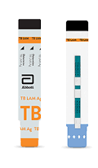
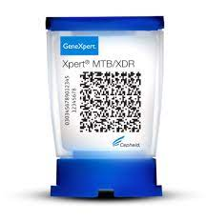
Diagnosing TB in PLHIV in hospital… is very difficult
Main existing ways to diagnose TB in PLHIV
Sputum NAATs (e.g. Xpert)
Urine LAM (AlereLAM)

Slide 5
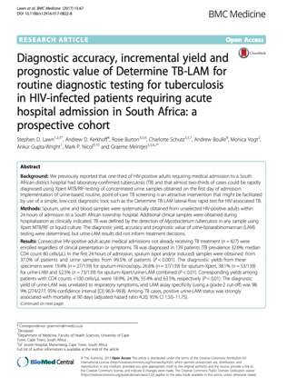
Diagnosing TB in PLHIV in hospital… is very difficult
Main existing ways to diagnose TB in PLHIV
In a study in Cape Town, extended microbiological testing for TB:
66 (47%) people would have had their TB diagnosis missed on 1 urine LAM + 1 sputum Xpert
Sputum NAATs (e.g. Xpert)
Urine LAM (AlereLAM)

Slide 6
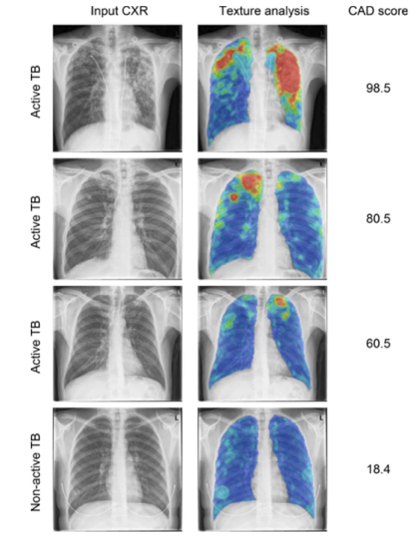
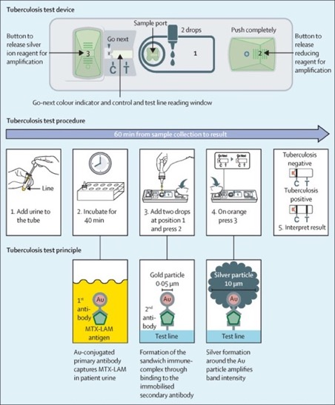
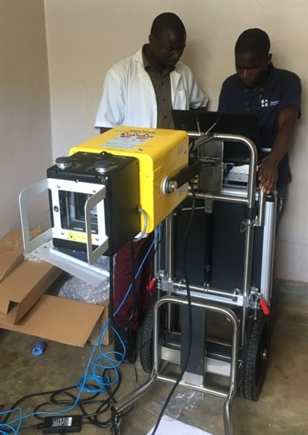
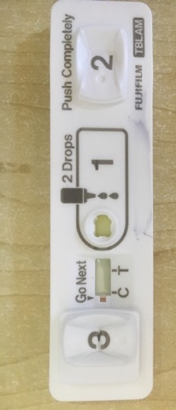
What might improve TB diagnosis?
Digital CxR with Computer Aided Diagnosis (dCXR-CAD)
High-sensitivity second-generation urine LAM (FujiLAM)

Slide 7
Research question
Among adults living with HIV admitted to hospital, can enhanced TB screening (dCXR-CAD + FujiLAM +alereLAM + usual care), compared to usual care alone, increase the proportion of people started on TB treatment?

Slide 8
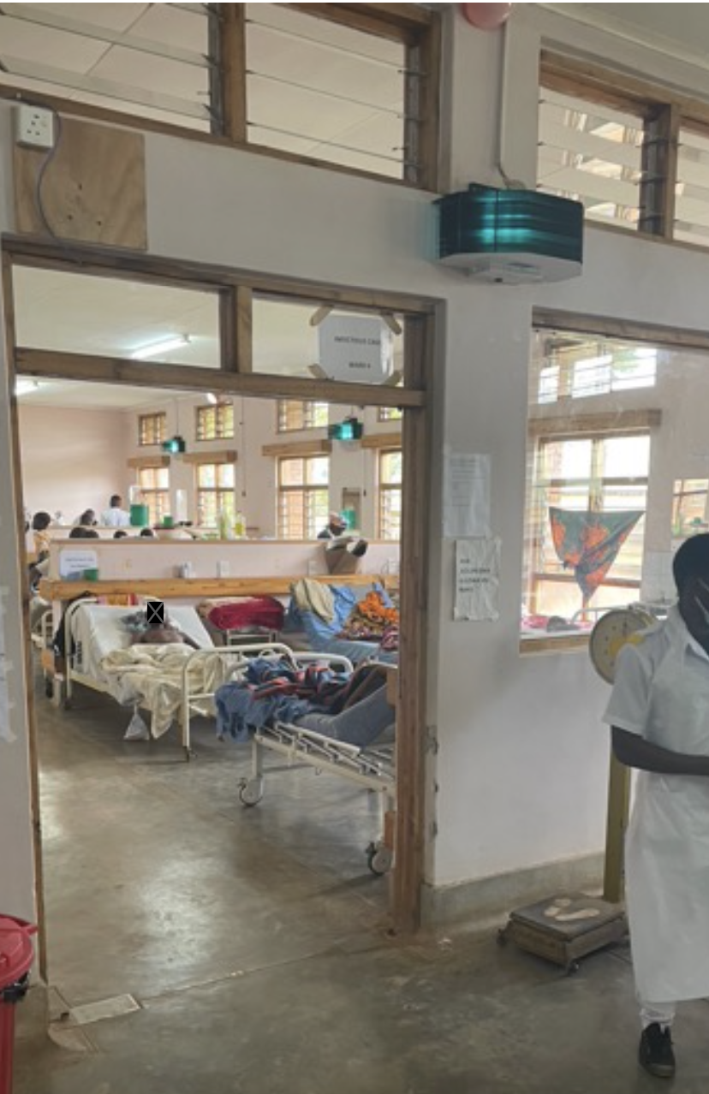
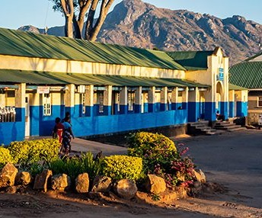
Study site and details
Single centre, Zomba Central Hospital in Malawi (Southern Africa)
Cluster randomized where clusters are day of admission.
Primary outcome: TB treatment initiation by discharge
Secondary outcomes: death by 56 days, same day TB treatment initiation, undiagnosed TB at discharge.

Slide 9
Participants
Inclusion
Age 18 years or older
HIV positive (any ART status)
Willing and able to consent
Exclusion criteria
Current or recent TB treatment
Admitted more than 18 hours at screening.

Slide 10
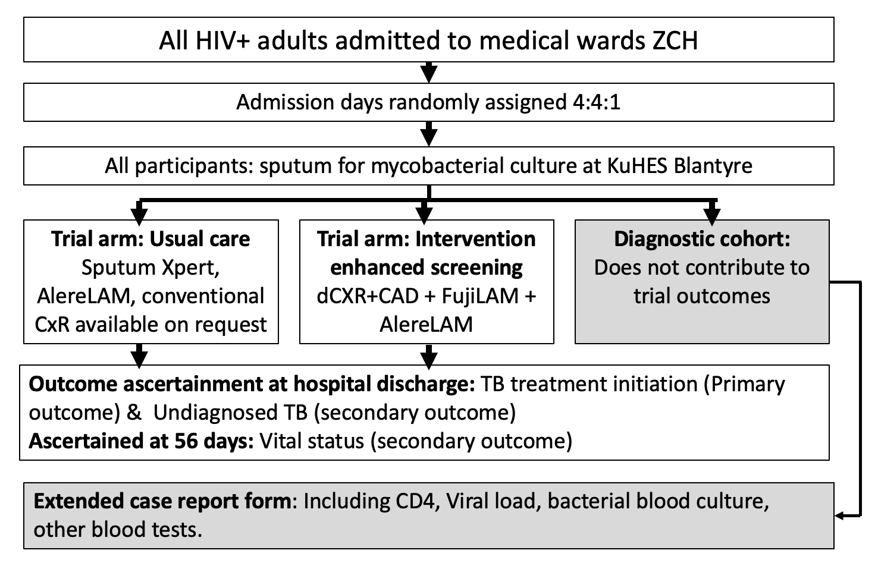
Interventions

Slide 11
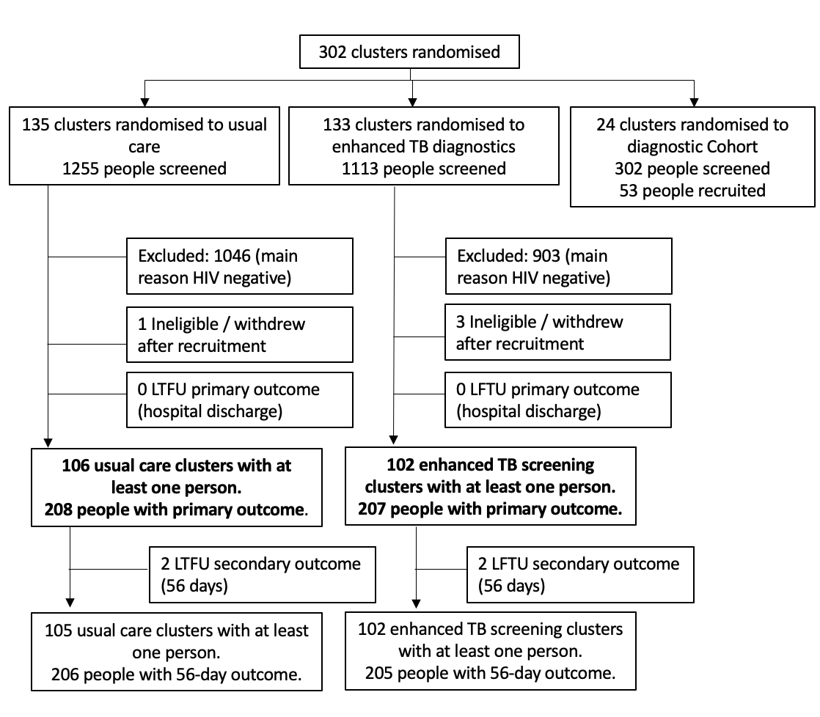
CASTLE: 2nd September 2020 – 15th Feb 2022
106 clusters usual care arm (208 people)
102 clusters in enhanced TB screening arm (207 people)

Slide 12
 |  | Usual Care | Enhanced TB screening
Number of individuals |  | 208 | 207
Age in years (median, IQR) |  | 42 (36 – 51) | 41 (32 – 51)
Sex
 | Men | 84 (40%) | 96 (46%)
 | Women | 124 (60%) | 111 (54%)
ART status
 | Not on ART (new HIV diagnosis) | 19 (9%) | 12 (6%)
 | Interrupted ART | 5 (2%) | 2 (1%)
 | On ART < 6 months | 20 (10%) | 30 (15%)
 | On ART >= 6 months | 164 (79%) | 163 (79%)
Any >=1 tuberculosis symptom (WHO 4SS) |  | 148 (71%) | 139 (67%)
Able to walk unaided |  | 103 (50%) | 102 (49%)
CD4 count
 | Median cell/mm³ (IQR) | 288 (146 - 438) | 220 (110 – 440)
 | < 100 cells/mm³ | 27 (13%) | 31 (15%)
 | >= 100 cells/mm³ | 131 (63%) | 118 (57%)
 | Not measured / not recorded | 50 (24%) | 58 (28%)
HIV viral load
 | Undetectable (<40 copies/mL) | 65 (31%) | 49 (24%)
 | 40 – 1000 copies/mL | 13 (6%) | 21 (10%)
 | High (>1000 copies/mL) | 19 (9%) | 27 (13%)
 | Not measured / not recorded | 111 (53%) | 110 (53%)

Slide 13
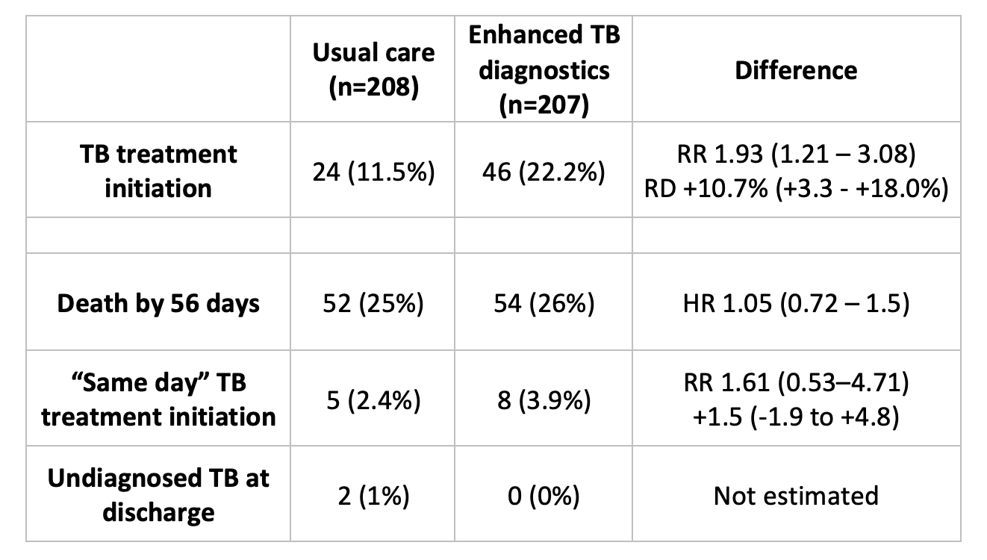
Primary outcome

Slide 14
Primary and secondary outcomes

Slide 15
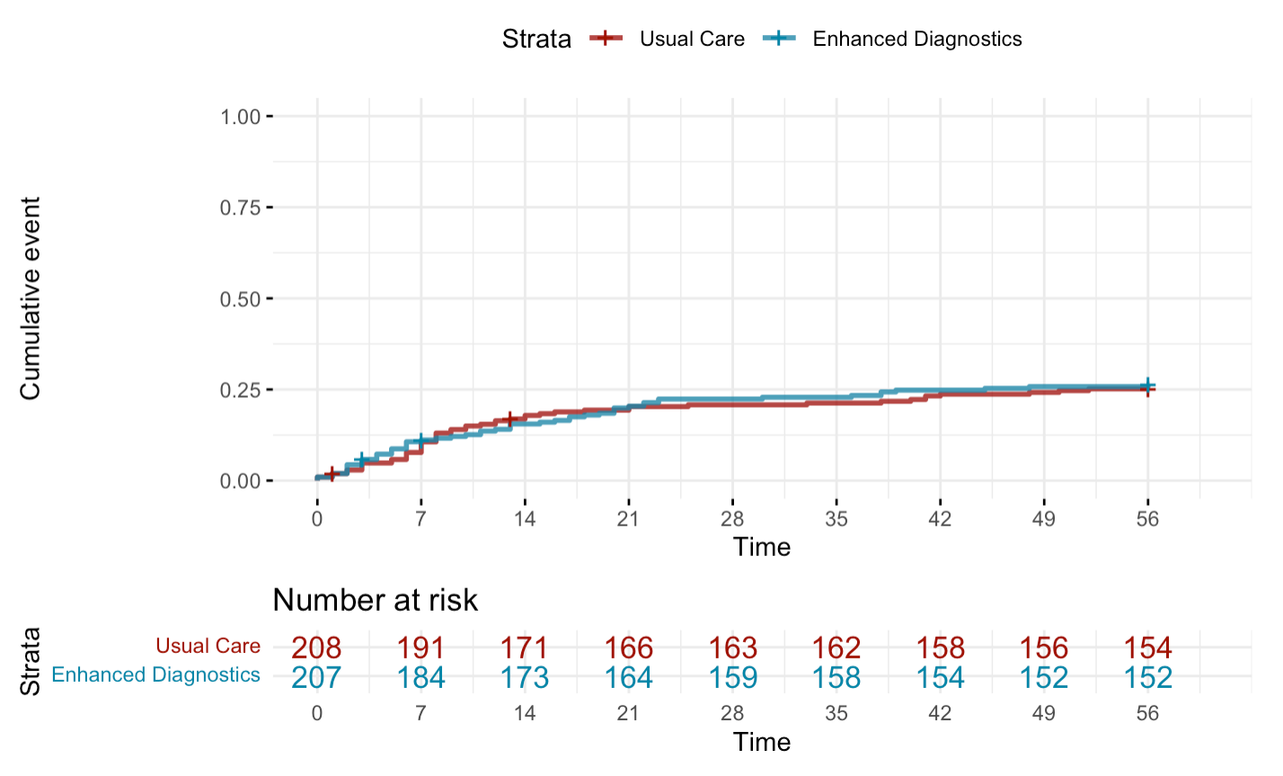
Survival curve

Slide 16
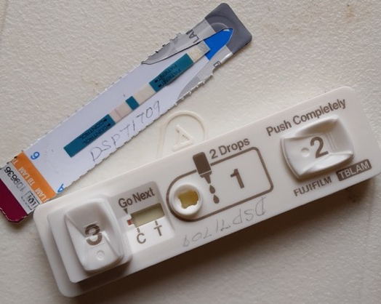
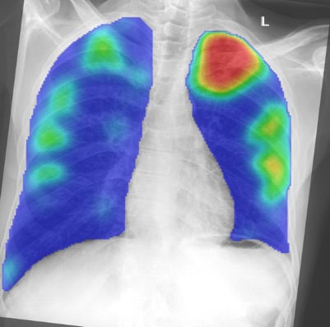
Summary of results
Enhanced TB diagnostics increased the proportion of people starting TB treatment (primary outcome)
But made no difference to 8-week all-cause mortality.

Slide 17
Conclusions
Enhanced TB screening is feasible, and led to more people being diagnosed with TB.
CAD scores on CxR are a useful adjunct for clinical decision making, but not a replacement for it.
More people being diagnosed with TB didn’t translate to survival benefit at 56 days.
PLHIV in hospital are a group at very high risk of death and should be prioritised for research in interventions.

Slide 18
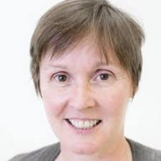

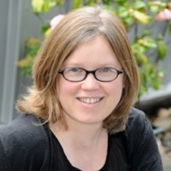


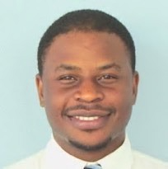
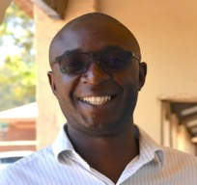
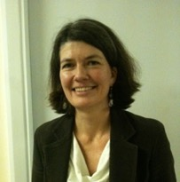
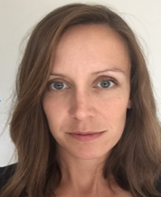
DSMC
Graeme Meintjes
Joe Jarvis
Euphemia Sibanda
Mavuto Mukaka
Trial staff
Timeo Mtenga
Ivy Missi
Gift Kameba
Madalitso Chiutsi
Elizabeth Philemon
Mercy Magombo
Raston Makandawire
Zomba hospital lab, radiography, HIV and clinical teams
Participants
With gratitude to all the participants and families
Thanks to
Liz Corbett
LSHTM & MLW
Peter MacPherson
LSTM & MLW
Ankur Gupta-Wright
UCL & LSHTM
Katherine Fielding
LSHTM
Marriott Nliwasa
KuHES
Saulos Nyriendra
ZCH
Liz Joekes
LSTM
Naomi Walker
LSTM

