Slide 1
AIDS 2022
Can we design, develop and manufacture antibodies that are effective, affordable, and easy to deliver?
Devin Sok, PhD
VP, Discovery and Innovation
31 July 2022

Slide 2
HIV Prevention Toolbox
A single product or approach will not stop the pandemic
[1] Long-term: a safe and efficacious vaccine
The availability of an HIV vaccine will be an essential component of a multi-pronged approach to a world without AIDS.
STI TREATMENT
MEDICAL MALE CIRCUMCISION
HIV TESTING AND COUNSELING
MICROBICIDES
TREATMENT/
PREVENTION OF DRUG/
ALCOHOL ABUSE
HIV
Prevention
Toolbox
Oral PrEP
[2] Short/medium-term: passive immunization
Broad and potent HIV neutralizing antibodies can be passively administered to provide long-acting prevention against HIV as we work towards an HIV vaccine. Antibodies have several advantages over other PrEP options: a) 3+ month protection, b) generally low adverse side-effects and well tolerated, c) discretion as an injection compared to oral tablets, d) not otherwise used in treatment.
CLEAN SYRINGES
Preventing vertical transmission
EDUCATION/
BEHAVIOR MODIFICATION
BLOOD SUPPLY SCREENING
TREATMENT AS PREVENTION
CONDOMS
We need a diversity of prevention options and programs to address the diverse needs of individuals at risk for HIV infection
2

Slide 3
Advancing HIV bnAbs for global access requires a multipronged approach
WHO PPC and access pathways
End user acceptability and feasibility research
Cost effectiveness studies
Sociobehavioral research w/ key populations
Demand forecast and generation
Integration into policy, financing & procurement platforms
Defining a pathway to global access
Approaches to reduce production costs in mammalian systems
Downstream process improvements
Alternative expression systems
Formulation, packaging and delivery devices
Discovery of highly potent bnAbs
Optimization of bnAbs for enhanced potency
Multivalent antibodies with synergistic activity
Multivalent antibodies with multiple specificities
Affordable and accessible bnAbs for prevention
Low-cost manufacturing and formulation
Highly potent bnAbs w/ extended
half-life
3

Slide 4
Discovery of highly potent HIV bnAbs
The field continues to isolate highly potent bnAbs that enable sterilizing immunity at low doses in NHP studies
Sok & Burton, Nature Immunology, 2018
4

Slide 5

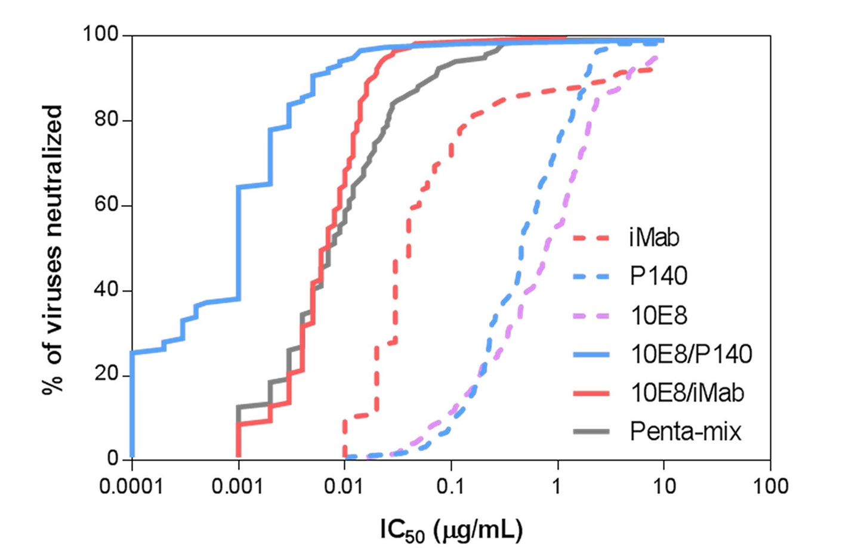
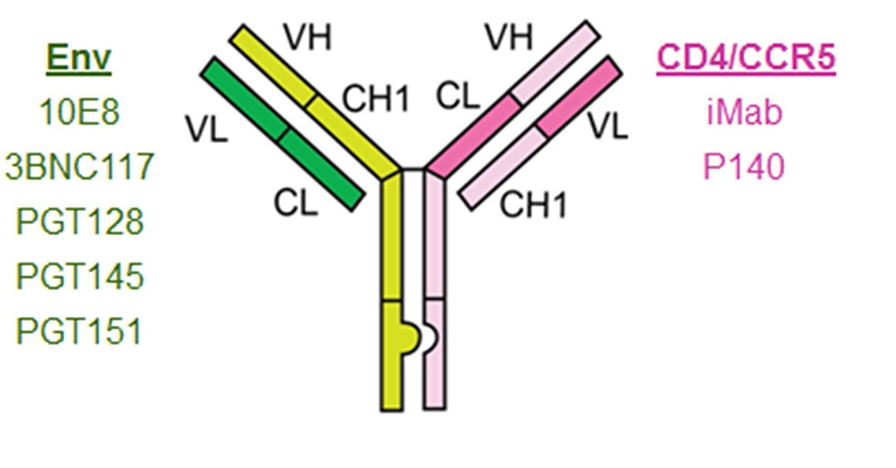

Bispecific HIV bnAb + anti-receptor antibody
Bispecific antibody designs can lead to large improvements in neutralization potency through synergistic binding
Bispecific synergistic neut activity
Bispecific design
June 2016
Volume 7
Issue 165
Engineered Bispecific Antibodies with Exquisite HIV-1-Neutralizing Activity
Yaoxing Huang, Jian Yu, Anastasia Lanzi, Xin Yao, Chasity D. Andrews, Lily Tsai, Mili R. Gajjar, Ming Sun, Michael S. Seaman, Neal N. Padte, and David D. Ho
5

Slide 6

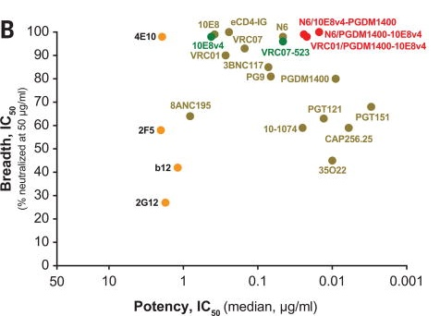
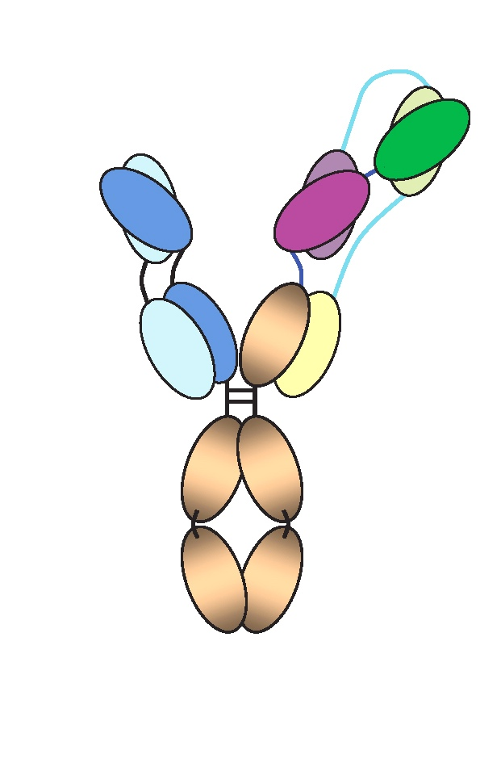
Trispecific HIV bnAb
Tri-specific antibody design combined three antibodies into a single construct, which can lower cost of production
Trispecific neutralization coverage
Trispecific design
October 2017
Volume 358
Issue 6359
10E8v4
Trispecific broadly neutralizing HIV antibodies mediate potent SHIV protection in macaques
Ling Xu, Amarendra Pegu, Ercole Rao, Nicole Doria-Rose, Jochen Beninga, Krisha McKee, Dana M Lord, Ronnie R Wei, Gejing Deng, Mark Louder, Stephen D Schmidt, Zachary Mankoff, Lan Wu, Mangaiarkarasi Asokan, Christian Beil, Christian Lange, Wulf Dirk Leuschner, Jochen Kruip, Rebecca Sendak, Young Do Kwon, Tongqing Zhou, Xuejun Chen, Robert T Bailer, Keyun Wang, Misook Choe, Lawrence J Tartaglia, Dan H Barouch, Sijy O'Dell, John-Paul Todd, Dennis R Burton, Mario Roederer, Mark Connors, Richard A Koup, Peter D Kwong, Zhi-Yong Yang, John R Mascola, Gary J Nabel
VRC01
PGDM1400
6

Slide 7
Monoclonal antibodies optimized for enhanced potency
IAVI, VRC, and partners have optimized HIV bnAbs for enhanced potency, leading to increases in neut coverage at low antibody concentrations
0.3 ug/ml cut off
Each circle represents a different virus, plotted values are neutralization IC80. Combination of three ebnAbs covers 94% of different clade C viruses that are circulating in South Africa compared to 5% for VRC01 (AMP trial)
Unpublished
Seaman Lab
7

Slide 8
Next-generation antibodies to treatment and prevention
Optimized bnAbs and their combination has broader and more potent activity than VRC01
ADARC
NIH
Sanofi
AMP study
NIH
10E8/P140
Trispecific
ePGDM1400
Rockefeller
CAP256-VRC26
NIH
NICD
CAPRISA
IAVI
Scripps
PGT121.414
CONFIDENTIAL
8

Slide 9
Advancing HIV bnAbs for global access requires a multipronged approach
WHO PPC and access pathways
End user acceptability and feasibility research
Cost effectiveness studies
Sociobehavioral research w/ key populations
Demand forecast and generation
Integration into policy, financing & procurement platforms
Defining a pathway to global access
Approaches to reduce production costs in mammalian systems
Downstream process improvements
Alternative expression systems
Formulation, packaging and delivery devices
Discovery of highly potent bnAbs
Optimization of bnAbs for enhanced potency
Multivalent antibodies with synergistic activity
Multivalent antibodies with multiple specificities
Affordable and accessible bnAbs for prevention
Low-cost manufacturing and formulation
Highly potent bnAbs w/ extended
half-life
9

Slide 10
Technology advancements to lower the costs of manufacturing
Reducing costs for production in mammalian systems; facilities with smaller footprints can reduce cost and increase flexibility
Single-use reactors
Perfusion cell culture and continuous processing
Process intensification and integrated manufacturing
Miniaturized, mobile, and/or benchtop bioreactors & modular manufacturing
Downstream process improvements
Purification by crystallization or chelation steps
Nontraditional (non-Pro A) chromatography resins and novel membranes
Process analytical technology
Alternative expression systems
Yeast, fungus, algae, or plants for high-yield, low-cost production
mRNA or DNA delivery approaches to decrease costs and simplify production
Packaging and delivery devices
Formulation approaches to minimize cold-chain requirements and achieve high-concentration for subcutaneous injections
Delivery devices that enable alternative delivery from conventional IV route

Slide 11
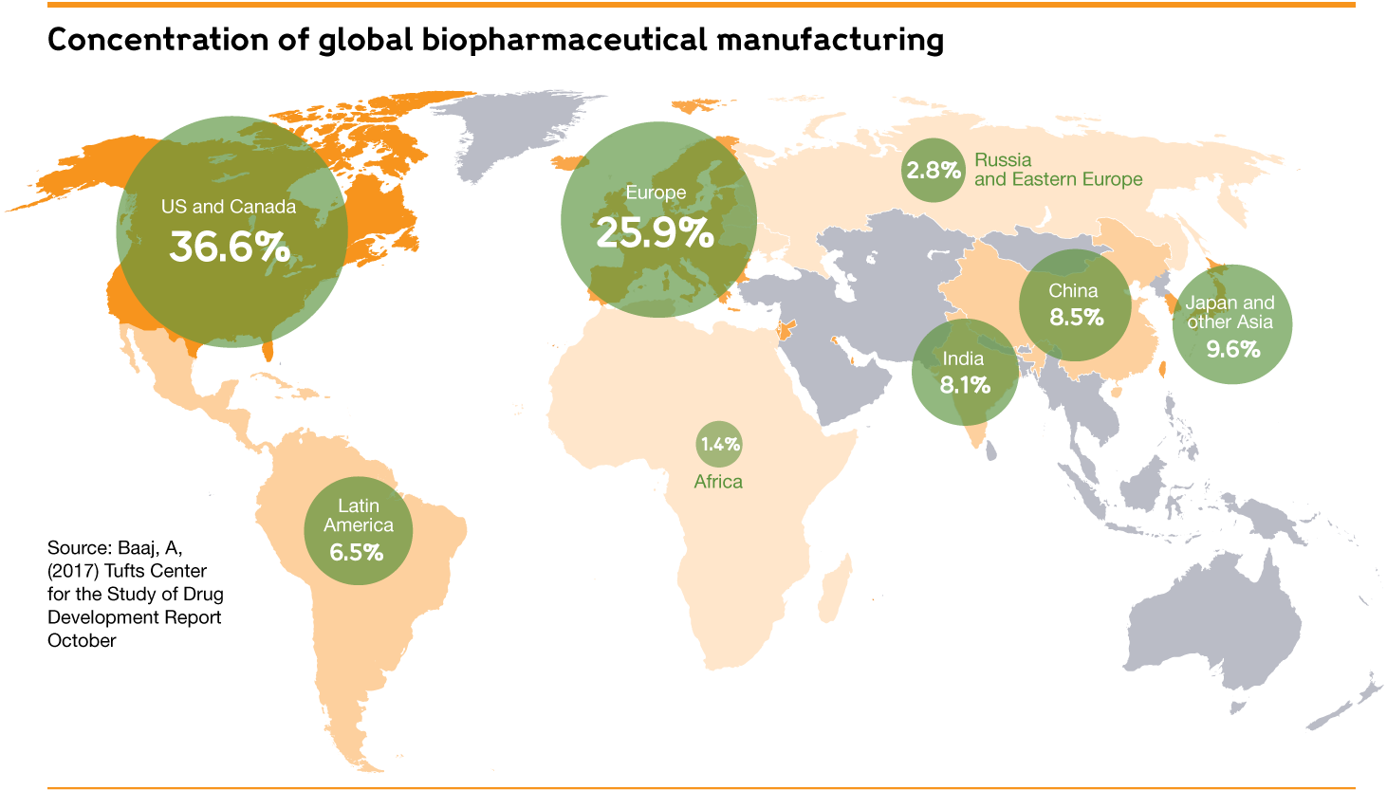
Biopharmaceutical Manufacturing Capabilities: growing presence in LMICs
Majority of biopharmaceutical manufacturing (> 60%) in North America and Europe; growing presence in Asia and Latin America, and initiatives to strengthen regional capacity in other areas like Africa
Supply to meet global demand – opportunity to leverage growing presence of facilities in some MICs to reduce supply risks
Could ensure sufficient manufacturing capacity for HIV bnAbs that align with WHO Target product profiles

Slide 12
Advancing HIV bnAbs for global access requires a multipronged approach
WHO PPC and access pathways
End user acceptability and feasibility research
Cost effectiveness studies
Sociobehavioral research w/ key populations
Demand forecast and generation
Integration into policy, financing & procurement platforms
Defining a pathway to global access
Approaches to reduce production costs in mammalian systems
Downstream process improvements
Alternative expression systems
Formulation, packaging and delivery devices
Discovery of highly potent bnAbs
Optimization of bnAbs for enhanced potency
Multivalent antibodies with synergistic activity
Multivalent antibodies with multiple specificities
Affordable and accessible bnAbs for prevention
Low-cost manufacturing and formulation
Highly potent bnAbs w/ extended
half-life
12

Slide 13
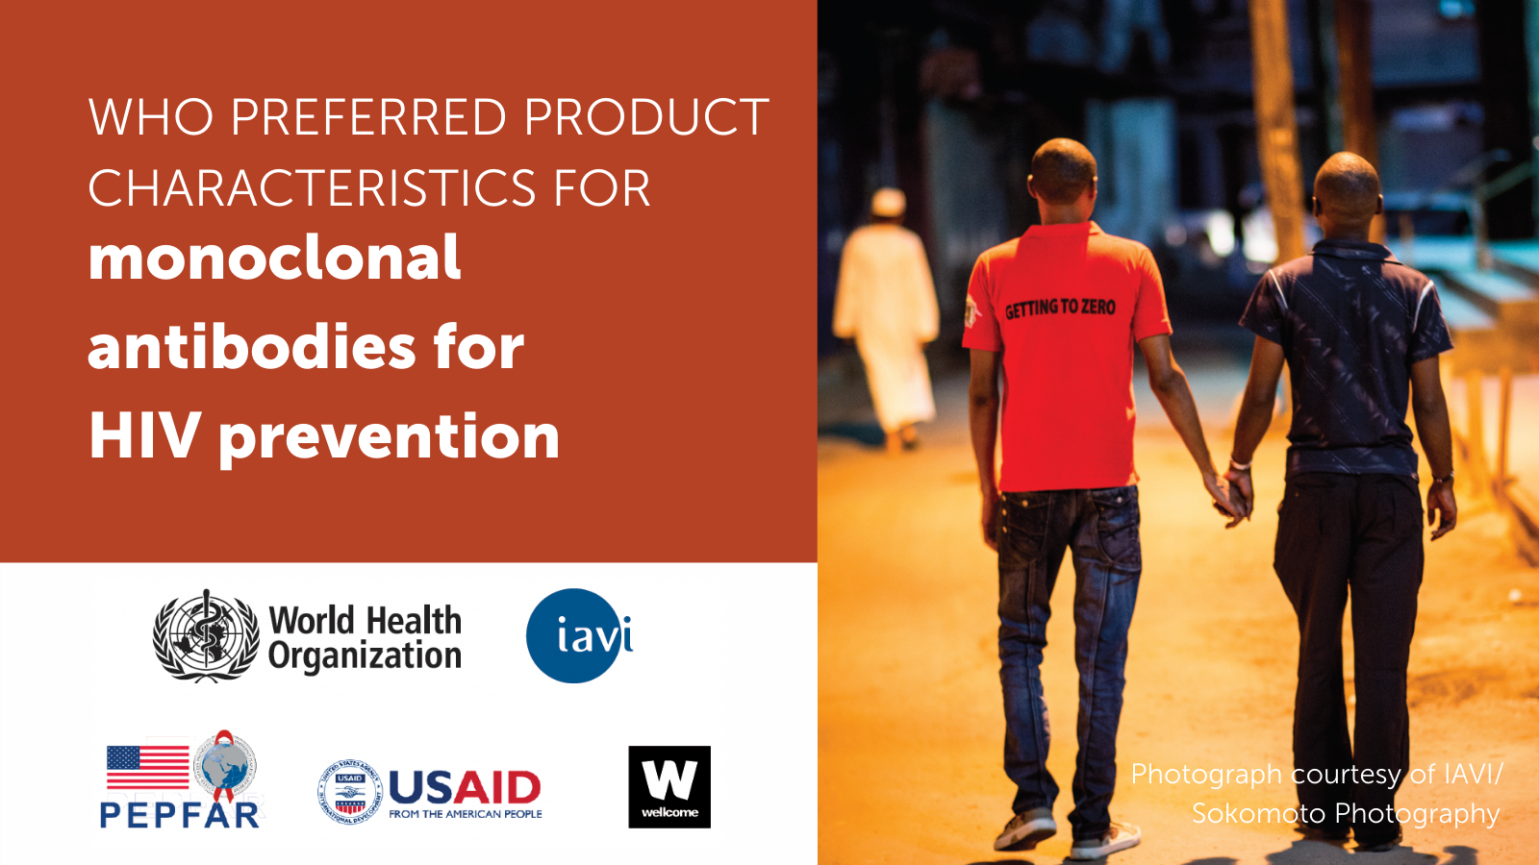

Slide 14
WHO PPCs for mAbs for HIV prophylaxis
Indication Prevention of HIV-1 infection in confirmed HIV-negative individuals; neonates and infants with HIV exposure.
Target population People at substantial risk of HIV infection and their sexual partners; inclusive of key and priority populations
Access & Affordability Product and health system delivery costs should be affordable and cost-effective in LMIC settings.
Efficacy Evidence of broad coverage of genetic diversity of HIV-1 across geographies, populations and modes of transmission.
Formulation Single vial product is preferred; For infants, 0.5 ml per dose is preferred. For children aged 5 years or younger, 1 ml per dose or less is preferred.
Dose regimen Administration every 3 months; Fixed, non-weight-based dosing is preferred; Single site, single injection is preferred .
Route of administration Subcutaneous or intramuscular injection is highly preferred for use in LMICs.

Slide 15
Advancing HIV bnAbs for global access requires a multipronged approach
WHO PPC and access pathways
End user acceptability and feasibility research
Cost effectiveness studies
Sociobehavioral research w/ key populations
Demand forecast and generation
Integration into policy, financing & procurement platforms
Defining a pathway to global access
Approaches to reduce production costs in mammalian systems
Downstream process improvements
Alternative expression systems
Formulation, packaging and delivery devices
Discovery of highly potent bnAbs
Optimization of bnAbs for enhanced potency
Multivalent antibodies with synergistic activity
Multivalent antibodies with multiple specificities
Affordable and accessible bnAbs for prevention
Low-cost manufacturing and formulation
Highly potent bnAbs w/ extended
half-life
15

Slide 16
Promising indication of ebnAbs in the prevention of vertical transmission
Promising safety and efficacy profile:
In neonatal macaques, administration of HIV monoclonal antibodies provided effective post-exposure prophylaxis in infants when administered within 30–48 hours of oral SHIV exposure (Shapiro et al, Nat Comm, 2020).
Single or multiple doses of VRC01 safe and well tolerated in Phase 1 study in newborn infants.
AMP trials provided proof of concept that an HIV monoclonal antibody could be effective at preventing HIV infections in strains specifically susceptible to the antibody; potent bnAb combinations will likely provide better coverage against circulating isolates.
Favorable potential dosing schedule
Quarterly or less (TBD) for ebnAbs in pipeline; high potency and long half-life of the antibodies could support a “vaccine-like” approach providing passive protection during breast-feeding.
Favorable profile to improve integration into existing health systems
Target volume of the combination of 1 mg/kg could enable 0.5 ML subcutaneous dose
Potential for more discrete administration and lower CoGS for pediatric vs adult indication
  Ongoing activities for advancing a PVT indication
  Current plan to initiate a Pediatric Program in sub-Saharan Africa once adult dosing has been selected from Phase 1 (early 2024)
  Work underway to define use case, potential demand & implementation strategies for infant indication to support goal of broad accessibility.
16

Slide 17
RECOMMENDED TALK!
Cost-effectiveness of broadly neutralizing antibodies for HIV prophylaxis for all infants born in high-burden settings
Presenter: Christopher Alba
Session title: Optimizing investments for health: Cash, cost and prices
Session date: Monday, 01 August 2022
Session time: 14:15 - 15:15
Session room: Channel/Room 6

