Slide 1
The future of HIV implementation science
Kenneth H Mayer, Fenway Health, United States
How does implementation science affect HIV policy and vice versa?

Slide 2
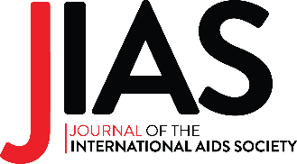
What works best?
Why it works?
How can it be applied in specific contexts?
Despite the availability of highly efficacious treatment and prevention interventions, impact has fallen short of targets because these interventions are often used with insufficient reach, consistency, sustainability and equity in diverse real-world settings.
Adapted from Geng et al. https://doi.org/10.1002/jia2.25898

Slide 3
Impactful implementation science: asking the right questions
What questions are being asked?
How are questions asked?
Whose perspectives?
Whose perspectives?
Incorporate a range of end-user voices into formulating scientific questions: scientists, policy makers, implementers, practitioners and communities
Interrogate systems: implementation gaps often result from friction between systems and people
Question not only failures of implementation but implementation of failure by design
Adapted from Geng et al. https://doi.org/10.1002/jia2.25898

Slide 4
Impactful implementation science: asking the right questions
What questions are being asked?
How are questions being asked?
Go beyond effectiveness studies to ask about the implementation strategies themselves
Study de-implementation of low-value or harmful beliefs and practices
Ask questions about context (geographical, organizational and sociological) to make findings about implementation strategies more relevant to diverse implementing settings
Use shared terminology and measurements about implementation whenever possible to facilitate progress
Seek generalizable insights
Draw from a broad range of methodologies for questions about implementation even if they are not branded as implementation research
Adapted from Geng et al. https://doi.org/10.1002/jia2.25898

Slide 5
To be impactful, future implementation science research must include end-user input and stakeholder engagement, be interpretable in specific implementing contexts, seek mechanistic insights and bounded generalizability, and draw from diverse disciplines.
Adapted from Geng et al. https://doi.org/10.1002/jia2.25898

