Slide 1
The power of modern techniques in HIV surveillance
Christophe Fraser
University of Oxford
PANGEA-HIV consortium
AIDS 2022, Montreal

Slide 2
Partnership: Activism, Science & Public Health

Slide 3
The U=U results built on many studies, each with some controversy
Rodger 2019
Rodger 2016
Bavington 2018
Cohen 2011
Eshleman 2011
Reynolds 2011
Hollingworth 2010
Redd 2011
Quinn 2000
Fideli 2001
Wawer 2005
Wawer 2009

Slide 4
Phylogenetics complements classical epidemiology
Classical epidemiology: the patient’s perspective
Phylogenetics: the virus’ perspective
Used wisely and with the trust of the community, molecular epidemiology can help
prevent infections and help link patients to care (Coltart et al Lancet HIV 2018).

Slide 5
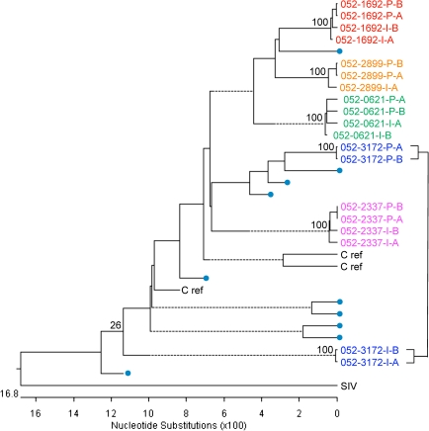
Phylogenetics firmly established U=U in the HPTN 052 trial
linked
linked
linked
linked
unlinked
3 out of 4 transmissions in couples in which the partner living with HIV started ART early turned out to originate from outside the couple.
Example tree
Partner 2 and Opposite Attract Studies to establish
U=U for GBMSM -- phylogenetic studies

Slide 6
Privacy is not the main issue
Privacy matters, but even more:
Beneficence (do good), confidentiality, consent
Leads to individual control and positive partnerships

Slide 7
Why do we need more science?
U=U is not something people in generalized epidemics can rely on
We need more viral load and drug resistance testing
There are still problems to solve:
Incidence is not declining as fast as expected
UTT trials have had intermediate success
Drug resistance will come up again

Slide 8
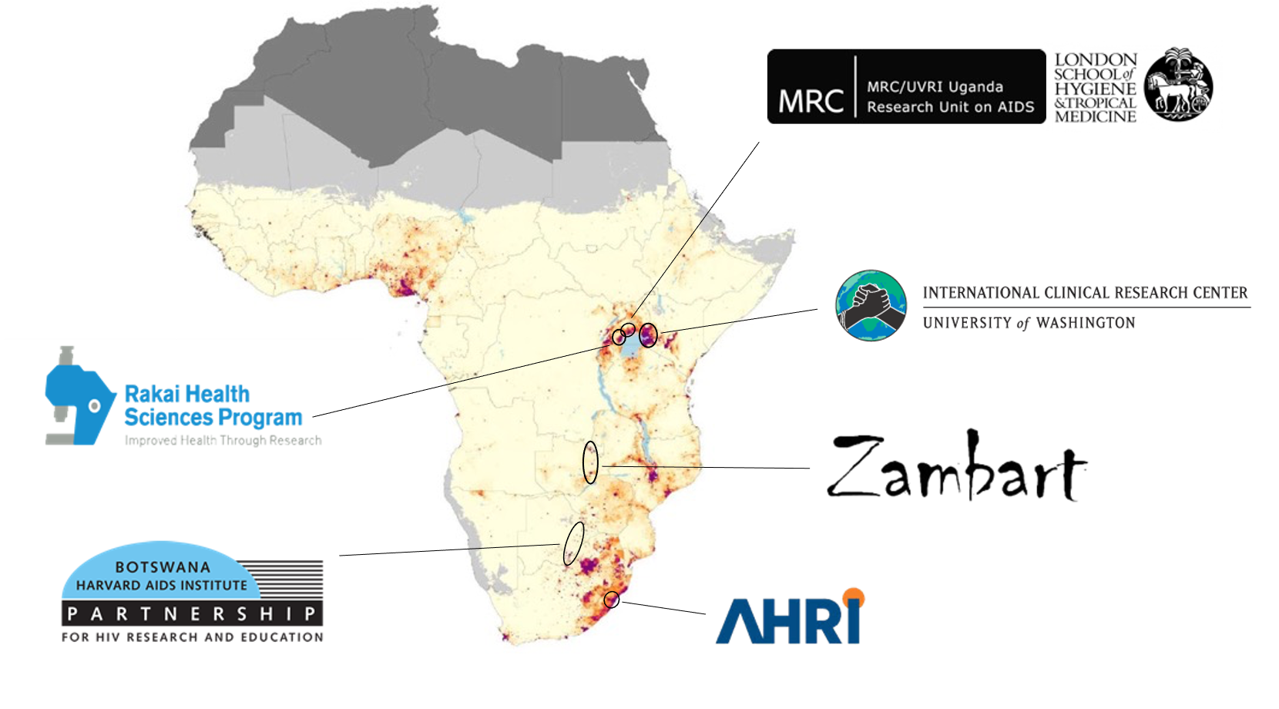
PANGEA uses phylogenetics to help guide HIV prevention policies in SSA
Map from Dwyer-Lindgren et al 2019

Slide 9
Molecular epidemiology generates sensitive data, but risks can be mitigated
Weighing risks and benefits before study design / public health use.
Well-designed informed consent forms.
Anonymisation / pseudonymisation of participant data.
Encryption and secure database storage.
Managed release of data into public databases.
Managed data sharing / training of people who get access.
Managing communication of findings.
Discontinuing an analysis if harm could result.

Slide 10
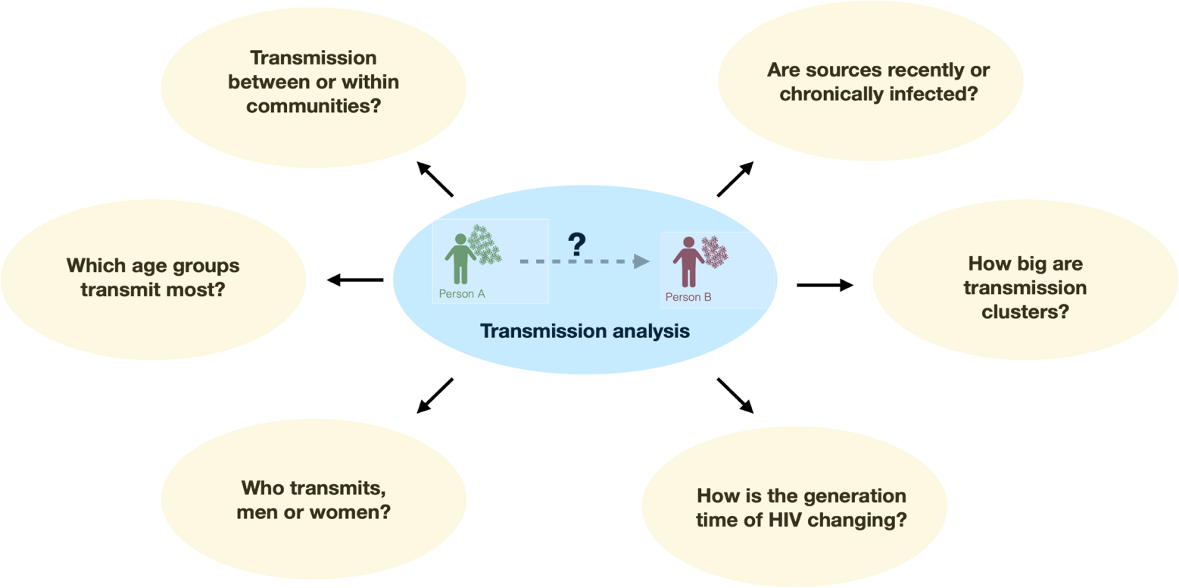
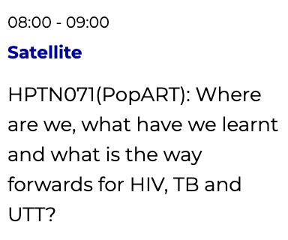
Main PopART Phylo results
87% within, 13% between
24:76
25-40 year-old men
small
Tuesday 02/08
Hall et al
medRxiv 2021
men 2x more, per capita
more skew

Slide 11
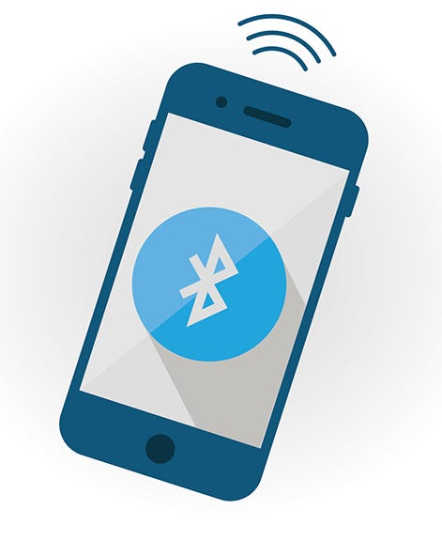
Other tools in precision public health
Lessons learnt from developing privacy-preserving app technology as used for COVID19 may have other applications for HIV.
Deliver U=U data.
Deliver private, confidential & differentiated clinical and public health information.

Slide 12
Summary
We need systems for beneficence, confidentiality, consent.
We need ongoing studies to reap benefits of U=U.
We need to work in partnerships.
We can accelerate the decline of HIV,
empowering individuals and communities.

Slide 13
Thanks to all study participants, all PANGEA researchers and the funder

