Slide 1
CVS’s Community-Led Monitoring System for Added Accountability
John Waters
Head of M&E and Research
Caribbean Vulnerable Communities Coalition (CVC)

Slide 2
CVS’s Community-based
The Caribbean Vulnerable Communities Coalition (CVC) was awarded a grant by ViiV to set up a community-based monitoring scorecard system to hold PEPFAR funded organizations accountable for the health services they provide to Key Populations (KP) in PEPFAR supported countries in Central America and the Caribbean.
The project involved facilitating stakeholder consensus on a standardized minimum set of data indicators to be included in a community-based monitoring scorecard, as well as establishing and operating a functioning community-led monitoring system for the effective monitoring of HIV care and treatment services for Key Populations.
We established indicators to define Key Population-led, and Key Population competent care service with health providers and PLWHIV in the DR, Panama and Guatemala.
Once established, we developed scorecards that enabled us to “rank” service providers in terms of the extent to which they are Key Population-led and competent.
The score cards then enable us to work with the lower scoring providers to make these providers more KP-led or competent, building their capacity to better meet the prevention and health demands of key Population groups.

Slide 3
Objectives
To monitor prevention and health challenges facing service providers and empower Key Populations to lead in resolving the challenges through engagement with relevant stakeholders.
To ensure Key Population groups are actively engaged in monitoring and offering solutions to health and HIV related advocacy issues affecting their health challenges.
To advocate for improvement in access to quality HIV Health services for key populations.

Slide 4
Activities
A1: Planning for the establishment of a Community Score Card monitoring system. Included conducting a literature review, assessing entitlement gaps, training Community Scorecard facilitators, and securing cooperation of all participating parties.
A 2: Country workshop to develop the Score Card with community groups including MSM, TW, and SW. Workshop in each country determined the existing barriers to the delivery of quality services to KPs.
Included group sessions with community groups to identify and prioritize issues (e.g. service access, utilization, and quality provision), and the clustering of similar issues to create the Score Card indicators.
Communities scored each issue identified and listed reasons for the score and generated suggestions for improvement. The Score cards were then consolidated across the different community groups providing us with country and regional score card criteria.
A 3: Country workshop to develop the Score Card with service providers.
The service providers essentially went through the same process as the Key Population groups, outlined above. They developed auto-evaluation cards.

Slide 5
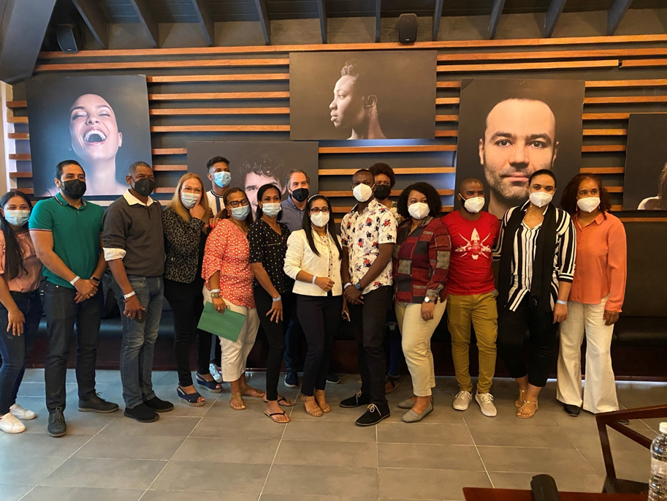

Slide 6
Activities
A 4: Conduct the Scorecard Interface Meeting and develop an action plan.
This involved PLHIV and state-based service providers, government staff and additional duty bearers coming together to share and discuss the Score Cards and to develop a joint action plan.
Based on the scores, participants collaboratively prioritized and identified actions to address.
A dashboard was developed to allow stakeholders to easily access, analyze, and report scorecard data.
Weak performing services providers where identified during this process and a plan developed to strengthen these service providers.
A 5: Implementation of strengthening plan for weak performing service providers.
Following the Scorecard Interface Meeting, those assigned with responsibility for actions within the action plan implement them over the following period – until the next scorecard score/review cycle six months later.
A 6: Reconvened Interface Meeting to re-evaluate the score card and progress against the action plan and rescored the scorecard to monitor progress and identify additional areas to work on.
This activity was completed at the end of the first year and then again at mid-way through and at the end of the second year of the project lifetime.
A 7: Training of KP CBOs in prevention and health policy advocacy.
This activity will equip KP CBOs with the necessary skills to use the score card data to advocate for KP prevention and health services.

Slide 7
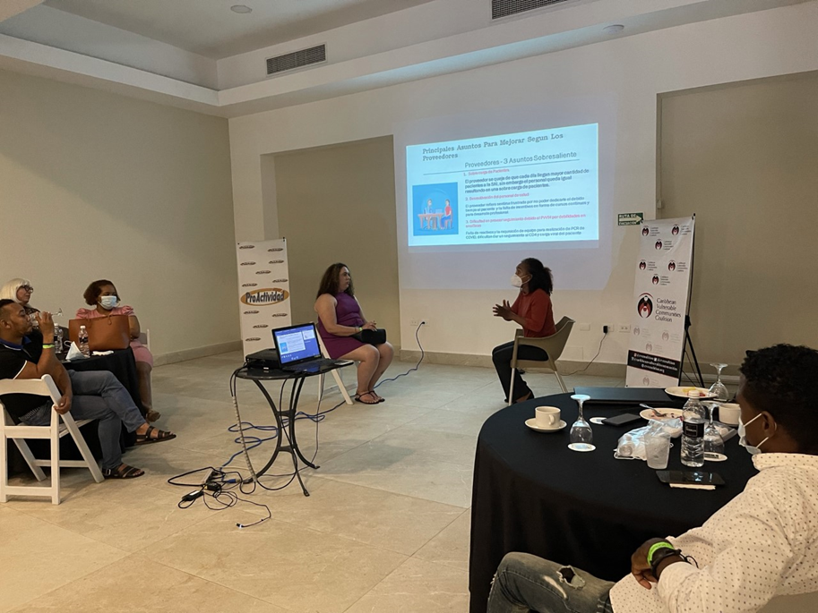

Slide 8
Results
CVC’s CLM model aimed to build collaborative capacity between the service users and partner organizations, such as government and service providers, through a rights-based framework capable of:
1. Empowering individuals and the institutions that support them in their communities to analyze their situation and take decisions about their lives, rather than being passive objects of choices made on their behalf;
2. Working with different levels of the government and Community Providers to see how best they can meet the needs of communities with respect to the provision of health services designed to meet the most critical health needs and rights of Key Populations.
Inherent in CVC’s approach is Key Population’s rights to access information; participate in decision-making processes; accountability; transparency; equity; and shared responsibility.
The score cards have helped KP give systematic and constructive feedback to service providers about their performance, while also helping governments learn directly from communities about which aspects of their services and programs are working well and which are not.
The information that the process generated enables decision makers to make informed decisions and policy choices and to implement service improvements that respond to citizens’ rights, needs and preferences.

Slide 9
What has worked well during the implementation of the project
One of the things that worked very well during this analysis process was the overwhelming agreement between patients and providers alike as to the major concerns, problems areas and remedial action plans needed to address these issues at each selected clinic.
Although, the intention was not originally to monitor care and treatment services for PLWHIV during COVID-19, because the implementation period coincided with the COVID-19 outbreak, many of the issues and problems flagged during the project ended up being very much COVID related.
Thus there was perhaps a greater degree of uniformity across the problem issues raised in each country and between countries, as well as between providers and users of the services. ‘
This might not have occurred to the same degree outside of COVID-19 situation.
COVID-19 seriously affected all aspects of HIV service uptake such as HIV VCT, provider-initiated HIV testing & counselling, ART, newly started ART, TB screening, and loss to ART follow-up.
“Loss to follow up” rates in many clinics reached peaks during COVID as people who were initiated on treatment, were not subsequently effectively retained in care, with the loss to follow-up intensified due to the COVID pandemic.

Slide 10
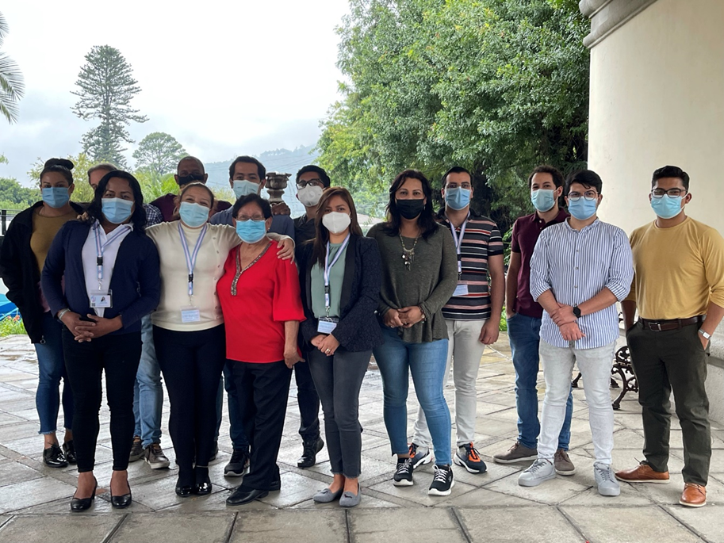

Slide 11
At the height of the pandemic, HIV services in all three countries were seriously curtailed.
Clinics were actually closed due to fears of COVID spreading, leaving PLWHIV scrambling to receive their medications and care services.
There were also important stock outs reported in all three countries, with patients and physicians reporting having to change patients’ regiments because certain ARVs were no longer available.
These stock outs were often worsened by many clinics giving out larger supplies (e.g. three months instead of one month’s supply),
During the lockdown period there was a substantial decline in the number of HIV tests conducted, as well as significant disruption to HIV services.
As COVID-19 prevention measures became more stringent, hospital visits were discouraged, people were advised to stay at home, and public gatherings were restricted in order to prevent the virus from spreading.

Slide 12
Furthermore, disruptions in key HIV commodities’ supply chains, logistics, and reporting systems hampered the ability to maintain HIV-related services.
In another area, HIV programs that received direct support had their budget curtailed as governments retreated to focus on their COVID-19 load.
This had a direct impact on the level at which HIV programs were implemented.
For example, in Panama prior to the COVID pandemic the government had pledged US$600,000 dollars for Social Contracting to NGOs for HIV prevention services. In the end they were only able to make US$100,000 available citing the COVID response as the reason for the drastically reduced budget.
In all three countries viral load equipment was “high jacked” to test for COVID and persons living with HIV reported major challenges in getting routine CD4 counts and viral load testing done.
Overall the COVID-19 pandemic exposed critical vulnerabilities contributing to disruptions in access to and utilization of HIV services in all three countries.

Slide 13
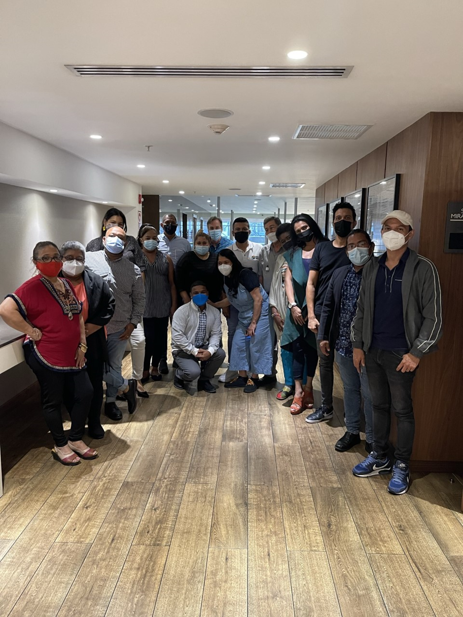

Slide 14
However, COVID has also brought a series of innovations, among them HIV self-testing, multi-month dispensing, community-based engagement in service implementation and monitoring, and visit appointment systems to facilitate spacing.
The scheduling of appointments was often seen as an improvement in the delivery of services and many PLWHIV felt there were valuable lessons learned worth continuing after the COVID situation subsided.
Multi-month dispensing was another feature that arose from COVID-19 that many PLWHIV believed should be continued into a post-COVID era.
This provided patients with several months of antiretroviral drugs at one time and reduced the need for monthly clinic visits to pick up medication refills.
This reduced the need for close interaction between patients and healthcare workers in clinical settings and improved access to patient-centred care by removing barriers related to monthly clinic visits, travel time, and cost.
Thus Multi-month drug dispensing can also help improve antiretroviral therapy (ART) adherence and help patients attain or maintain an undetectable viral load.

Slide 15
The COVID-19 pandemic and more specifically its impact on health systems required service delivery adaptations and innovations to maintain a continuity of health services, including in relation to HIV.
Some of the adaptations and innovations had been previously recommended, however uptake took place at a slow pace until COVID-19 risk mitigation measures disrupted HIV services.
The successful implementation of self-testing, multi-month dispensing, community-based engagement in service implementation and monitoring, and visit spacing have all helped health systems and healthcare providers to maintain a continuity of HIV services through a global public health crisis.

Slide 16
What worked less well?
Addressing continuing challenges in the quality of and access to services of PLWHIV is very much linked to addressing the accountability deficit that persists in the HIV response in our countries.
For example, the lack of accountability of the pharmacy services offered to PLWHIV at the Social Security Hospital in Panama, although easily addressed and flagged on multiple occasions with the hospital administration, is a good example of the accountability breakdown that often arises between providers and users of services.
As one user put it “The flagrant violation of patients’ rights to confidentiality at the Social Security hospital in Panama that make PLWHIV queue-up in a line dedicated to persons collecting their ARVs at the hospital’s general pharmacy is unbelievable in this day in age. It is almost as if the hospital administrators think -is it not enough that they receive their medications for free, they want us to serve them on a silver platter too”.

Slide 17
Community-led monitoring offers an opportunity to address both the continuing challenges and the accountability deficit in health services.
Community-led monitoring trains, supports and equips members of directly affected communities to themselves carry out routine, ongoing monitoring of the quality and accessibility of HIV treatment and prevention services.
By collecting quantitative and qualitative data through a wide variety of methods PLWHIV can reveal insights about the problems and solutions to health services - identifying problems at the facility, community, and national levels.
It allows for the full integration of evidence-based advocacy into a cycle that brings new information to the attention of decision makers and holds them accountable for acting on that information.
But it is the piece about ensuring accountability of decision makers and other duty bearers that can make CLM meet with resistance by the formal health sector.
Duty bearers in the region may not always understand the importance of CLM, nor appreciate the importance of feedback provided by PLWHIV who are generally low in the priority list of decision-makers and may belong to marginalized and criminalized groups.
In the Caribbean basin there is an important need to create a greater culture of accountability in healthcare.

Slide 18
We certainly met with different levels of resistance on a number of fronts in all three countries, despite our attempts to include and involve the relevant stakeholders and duty bearers throughout the process.
The duty bearers in each country frequently changed from one meeting to another requiring us to go over the same ground at each meeting to bring everyone up to speed.
The lack of continuity of the members of local authorities in attendance at each meeting also made the task of getting buy-in and permissions problematic.
For example, in the Dominican Republic we formally requested permission to apply the score cards and selected clinic sites on the 11th of November 2021. Despite numerous letters and communications with the authorities we did not hear back from them until the 17th February 2022 when they agreed to meet with us.
During that meeting we were asked to coordinate the selected clinic sites with UNAIDS who were also doing a community led monitoring exercise, and the idea was to ensure that efforts would not be duplicated at the same sites.
We quickly scheduled a meeting with UNAIDS to discuss the issue of the respective sites each entity would work with to avoid any possible duplication.
At this meeting USAID, CDC, and PEPFAR also participated. The respective agreed sites were communicated to the local authorities after the meeting, yet the local authorities took until the 27 April 2022 before they finally provided their written approval to allow us apply the score cards at the selected sites.

Slide 19
In Panama, we had a different issue to contend with.
We had the good fortune to have the physician who was the Director of the HIV program at the Social Security Hospital in Panama City present at the workshops and very invested in the process.
We presented the results of the CLM program to the local authorities on the 28th February 2022 and requested the Social Security Hospital as one of our pilot sites.
Despite numerous follow-up attempts, once again, the local authorities took ages to provide an answer. On the 17th June 2022, they finally responded saying that we would need to submit a petition for an exemption from research ethics review to the committee of bioethics.
We explained that this was not a research project, but none the less they made us submit a protocol of the process to be followed for collecting the data and receive the exoneration prior to commencing the process.
We subsequently received a decision from the ethical review board stating that they CLM activity would not be exempt and would need to submit a full protocol and a processing fee of US$1,500 to the review board for processing the application.

Slide 20
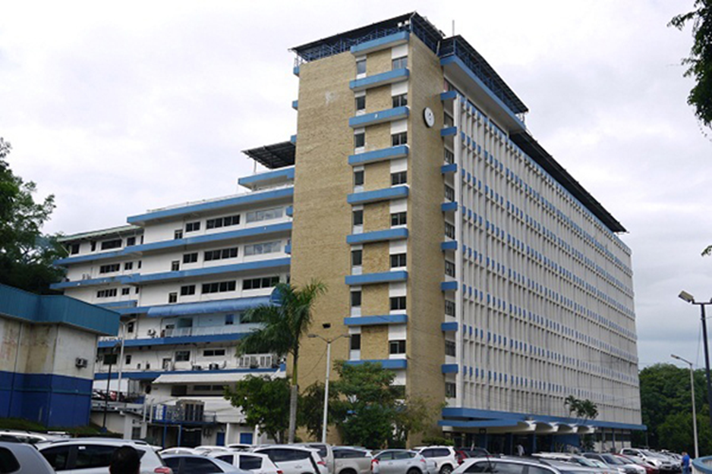

Slide 21
In Guatemala, we met with the local authorities on the 22 November 2021 when we presented the outputs of the workshops and requested applying the score cards at select sites.
We met again with them on the 28th April 2022 expecting to be granted permission to implement at the selected sites, however they informed us that they would provide us written feedback on the documents supplied to them in November.
On the 26th May 2022 we received a formal document listing a series of recommendations of changes to the score card and indicator sheets.
This document made some simple suggestions that we addressed and returned to them by the 10th June 2022.
We are still to hear back from them with respect to this document and regarding the implementation at the proposed sites.

Slide 22
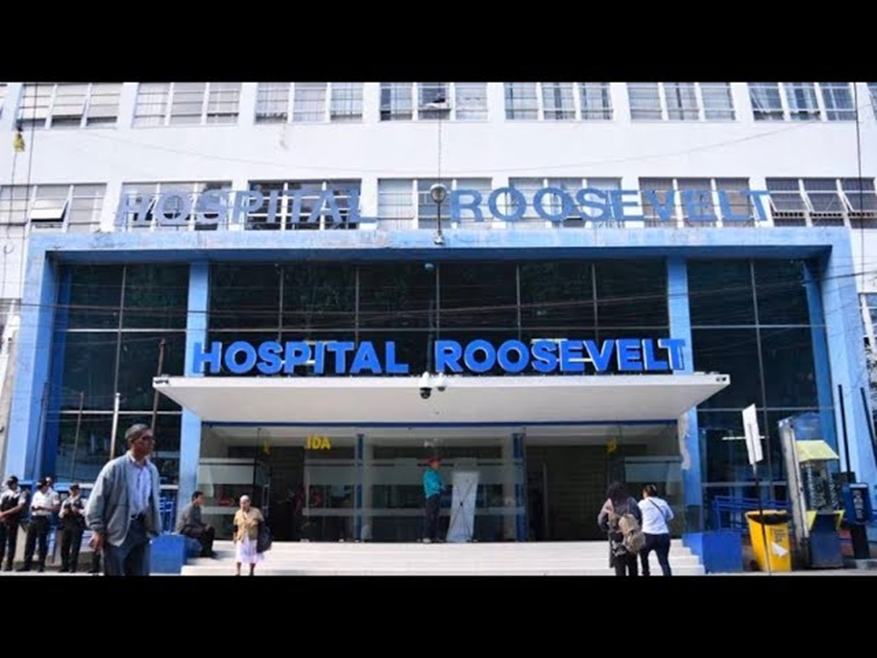

Slide 23
What are some of the key lessons we have learned?
A major lesson learned is that creating a culture of accountability in healthcare in the region takes time. We may not have succeeded with everything we set ourselves to achieve, but we have made a momentous start.
Our Community led monitoring project in the Caribbean Basin began at a similar time that a much larger and more influential organisation, UNAIDS, began a regional CLM initiative. Their project was also not without challenges and got bogged down in COVID and resistance to accountability.
Our project introduced numerous Civil Society Organisations, many of them working directly with People Living With HIV, to the importance of Community Led Monitoring, and left them with powerful tools and methodologies for carrying it out effectively and at low cost.
It also introduced healthcare providers and duty bearers to CLM.
Collaborating with community groups, civil society organizations, and patients/beneficiaries and service providers has been really exciting and empowering.
Together we have seen how we can help inform HIV programs and assist health institutions diagnose and pinpoint persistent problems, challenges, and barriers with service uptake at the site and facility level and improve service and client outcomes.
Most importantly we have shown that this collaboration can identify workable solutions that overcome these barriers and ensure beneficiaries have access to these services.

Slide 24
What are you particularly proud of during the implementation period?
One of the things that we are particularly proud about in this project is how we brought frontline service providers and users together to collectively gather quantitative and qualitative data and observations about components of HIV services, with a focus on getting input from recipients of the treatment services.
This was really a first for the three countries. Through the joint analysis of this data we have been able to monitor a wide range of issues, like the impact COVID-19 is having on PLWHIV, that are associated with effective and quality HIV service delivery.
In the Dominican Republic where we were able to complete a full cycle of the community score cards at three care and treatment sites (Centro de Salud Integral del COIN; Centro de Salud Fundación Activo 20-30, Clínica de la Familia de la Romana). We achieved almost six hundred persons completing the cards, ninety-three (93) healthcare professionals and five hundred (500) PLWHIV.

Slide 25
What are you particularly proud of during the implementation period?
Community monitoring is especially important for gathering crucial information and observations regarding HIV service delivery from and about key populations and other underserved groups.
One of the greatest testimonies to this project’s success is that we have achieved securing the commitment of healthcare personnel and PLWHIV at all the clinics to continue with this project beyond its lifetime.
We have all agreed to persist, even if we have to sit it out until we receive all the necessary permissions from the local authorities, to complete this CLM program that we are all so invested in.
This will give us the results of a full cycle in all three countries, and we are happy to share this with everyone when the due permissions come through and we can implement the score cards

