Slide 1
Ensuring individual- and community-informed consent for HIV surveillance
Peter Godfrey-Faussett, London School of Hygiene and Tropical Medicine
Ensuring an ethical future for HIV surveillance
I have no disclosures

Slide 2
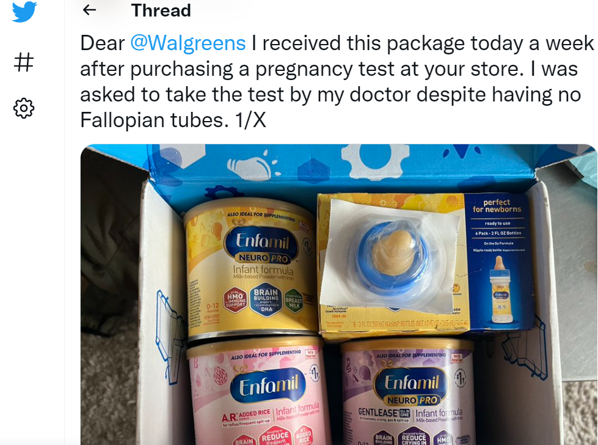

Slide 3
When is consent required in order to collect information on people (human subjects)?
Data collection approach
Deliverable
Shopping
Social Media
Journalism
Market research
Clinical research
Individually randomised trials
Cluster randomised trials
Audit and implementation science
Epidemiological surveys
Public health surveillance
Data; profiles; profit
Data; profiles; advertising; profit
News; information; profit
Business; profit
Clinical benefit; hypotheses
Clinical benefit; policy
Policy; population benefit
Health system improvement
Policy, prioritisation, etc.
Programme direction; Public health action

Slide 4

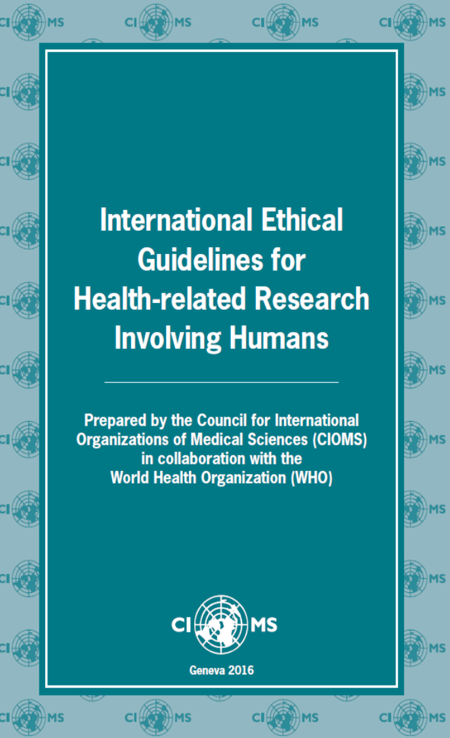
When is consent needed?
Journalism
Market research
Clinical research
Individually randomised trials
Cluster randomised trials
Audit and implementation science
Epidemiological surveys
Public health surveillance

Slide 5
While the primary purpose of medical research is to generate new knowledge, this goal can never take precedence over the rights and interests of individual research subjects.
will result in no more than a minor increase above minimal risk to the participant and risks are minimized, including through the use of effective mitigation procedures
Medical Research Ethics Committees or IRBs
Beneficence thus requires that we protect against risk of harm to subjects and also that we be concerned about the loss of the substantial benefits that might be gained from research.

Slide 6


Public health surveillance is NOT the same as public health research
Surveillance is governed by a different set of regulations.
Consent is not always mandated; Ethical framework much less discussed
Protection for the individual’s freedoms and privacy less prioritised (consider Ebola; Covid-19; food poisoning)

Slide 7
6. The global community has an obligation to support countries that lack adequate resources to undertake surveillance.
7. The values and concerns of communities should be taken into account in planning, implementing and using data from surveillance.
8. Those responsible for surveillance should identify, evaluate, minimize and disclose risks for harm before surveillance is conducted. Monitoring for harm should be continuous, and, when any is identified, appropriate action should be taken to mitigate it.
9. Surveillance of individuals or groups who are particularly susceptible to disease, harm or injustice is critical and demands careful scrutiny to avoid the imposition of unnecessary additional burdens.
10. Governments and others who hold surveillance data must ensure that identifiable data are appropriately secured.
11. Under certain circumstances, the collection of names or identifiable data is justified.
12. Individuals have an obligation to contribute to surveillance when reliable, valid, complete data sets are required and relevant protection is in place. Under these circumstances, informed consent is not ethically required.
13. Results of surveillance must be effectively communicated to relevant target audiences.
14. With appropriate safeguards and justification, those responsible for public health surveillance have an obligation to share data with other national and international public health agencies.
15. During a public health emergency, it is imperative that all parties involved in surveillance share data in a timely fashion.
16. With appropriate justification and safeguards, public health agencies may use or share surveillance data for research purposes.
17. Personally identifiable surveillance data should not be shared with agencies that are likely to use them to take action against individuals or for uses unrelated to public health.
1. Countries have an obligation to develop appropriate, feasible, sustainable public health surveillance systems. Surveillance systems should have a clear purpose and a plan for data collection, analysis, use and dissemination based on relevant public health priorities.
2. Countries have an obligation to develop appropriate, effective mechanisms to ensure ethical surveillance.
3. Surveillance data should be collected only for a legitimate public health purpose.
4. Countries have an obligation to ensure that the data collected are of sufficient quality, including being timely, reliable and valid, to achieve public health goals.
5. Planning for public health surveillance should be guided by transparent governmental priority-setting.

Slide 8
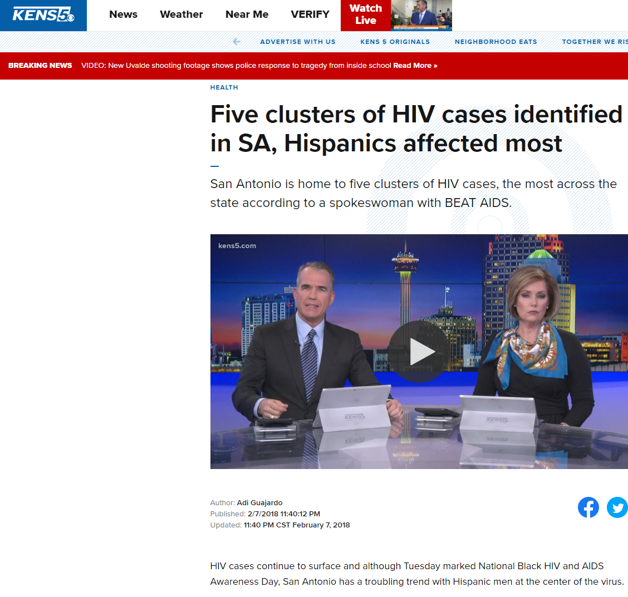
Potential Benefits and Plausible Harms
Conclusions and Public Health Interventions
Our investigation identified an actively growing transmission cluster of primarily young Hispanic MSM that was substantially larger than the molecular cluster; the underlying risk network (involving undiagnosed and HIV negative partners) is likely even larger,

Slide 9
Potential Benefits and Plausible Harms
Limits of consent – drug resistance testing is important for clinical decision making
Use of data – “anonymity”
Background epidemiology and burden – recognising “outbreaks” within more generalised settings
Prioritisation – we know the structural causes of many of the gaps in service provision that leave people behind.

Slide 10
Potential Benefits and Plausible Harms
Added value of this study
We reconstructed the HIV transmission network using all HIV sequences available from Los Angeles County. We identified transgender women within these networks and looked at how they were connected to other risk groups in the network. We found that transgender women were more connected to each other and to heterosexual men, and less connected to men who have sex with men, than expected.

Slide 11

Potential Benefits and Plausible Harms
HIV exceptionalism –
  “There are still two dozen U.S. states and territories that criminalize various types of alleged HIV exposure, non-disclosure, and transmission. People living with HIV are being prosecuted and criminalized anyway based on somebody's word against them, so this technology is being spread and funded in ways that are new and may create more vulnerability."
  “Does this new analysis, for example, provides anything we don't already know or couldn't get from sitting down with a group of transgender women in LA.”
  “Researchers get excited about fancy new technologies and consistently undervalue old-fashioned social science research, and not because the new technologies add anything of importance.”
Naina Khanna, executive director with Positive Women's Network interview with bodypro

Slide 12
Nature | Vol 607 | 21 July 2022 | 445

Slide 13
Where next?
This is a much wider conversation than HIV and phylogenetic surveillance.
The rapidity of progress in science and technology around phylogenetics, mobile phone tracking, bioinformatic power is a “good thing”.
Public engagement and dialogue with the most interested parties is urgently needed to ensure that governance and regulation catches up.
Recognise asymmetries of power.
Researchers, scientists and advocates of phylogenetic surveillance need to provide strong evidence of actual (rather than putative) benefits.
Plausible and potential risks need to be evaluated and appropriate mitigation put in place.
Public health surveillance and action must be evidence-informed and serve the good of society.
Human subject research must prioritise individual over societal benefits except where harms can be demonstrated to be minimal.

