Slide 1
The clinical syndrome and treatments
Monkeypox Outbreak and response in non-endemic countries
Dr Nicolò Girometti Consultant physician 56 Dean Street - Chelsea and Westminster Hospital NHS Foundation Trust London, United Kingdom

Slide 2
Conflict of interest disclosure
Dr Nicolò Girometti has received consultation fees from Viiv Healthcare

Slide 3
Numbers at Chelsea and Westminster Hospital - London (UK)
Up to 19th July 2022
620 confirmed MPX cases
42% of cases in London
29% of cases in UK
4% of cases globally ᶧ
99% gay men and other MSM
70% of white ethnicity, 38% UK-born *
31% people living with HIV *
>90% with an undetectable viral load
All with a last CD4 count > 350/mmc
Median age 39 years (IQR 33-43 years) *
94% reporting a new sex partner within 12 weeks prior MPX testing
43% travelled outside the UK in the 60 days prior MPX testing (none to areas where MPX is known to be endemic)
* Data extracted from the first 101 individuals testing positive to MPX ᶧ As of July 21th 2022 – source https://ourworldindata.org/monkeypox

Slide 4
Clinical presentations
INVASIVE PHASE
Mean incubation period 8.5 days (95%CI 6.6 -10.9 days) ᶧ
Usually mild illness with symptoms lasting a few days
(n = 101, tested positive between 14th May - 1st June 2022)
66% fever
64% asthenia
36% myalgia
32% headache
14% sore throat
17% did NOT report any prodromal symptoms
When prodromal symptoms were reported
64% had coincidental onset of skin lesions
In 36%, skin lesions occurred after prodromal symptoms (median time 2 days, IQR 2-4 days)
ᶧ Miura et al. Eurosurveillance, 2022

Slide 5
Clinical presentations
ERUPTIVE PHASE
Skin lesions can present at different stages of evolution simultaneously
33% showed lesions on >3 different anatomical sites, 31% on 1 site only
Wide array of skin and mucosal presentations
Direct inoculation associated with lesions distribution?
(n = 101, tested positive between 14th May - 1st June 2022)
99% presented with at least one characteristic skin lesion (macular, pustular/vesicular, crusted lesions + ulcerations)
93% ano-genital lesions (mirroring sexual practices)
56% penile lesions
47% perianal lesions
49% limbs
30% trunk
25% face/scalp/neck
20% hands/feet
6% had oral/pharyngeal mucosal involvement
62% inguinal lymphadenopathy, often bilateral

Slide 6
Complications and STI rates
COMPLICATIONS
17% presented with proctitis - severe rectal pain - constipation
25% required antibiotic treatment - cellulitis / abscess - bacterial superinfection
Reports of ulcerative pharyngeal lesions leading to difficulties in swallowing
Reports of conjunctival lesions - Corneal involvement is a criteria for antiviral treatment!
OTHER STIs
MPX can mimic other STIs in its presentation
53% were tested for HSV DNA on swab (6% positive)
23% were tested for Syphilis DNA on swab (none pos)
A sexual health screening was routinely offered 35% had a concomitant STI
22% had Neisseria gonorrhoeae
14% had Chlamydia trachomatis
6% had a new Syphilis infection

Slide 7
Some clinical differences with previous outbreaks

Slide 8
Some clinical differences with previous outbreaks

Slide 9
Some clinical differences with previous outbreaks
?
Is the current clinical presentation different compared to the historical MPX description in the Nigerian outbreak? Let’s consider differences in hosts, healthcare access, exposure sites …

Slide 10
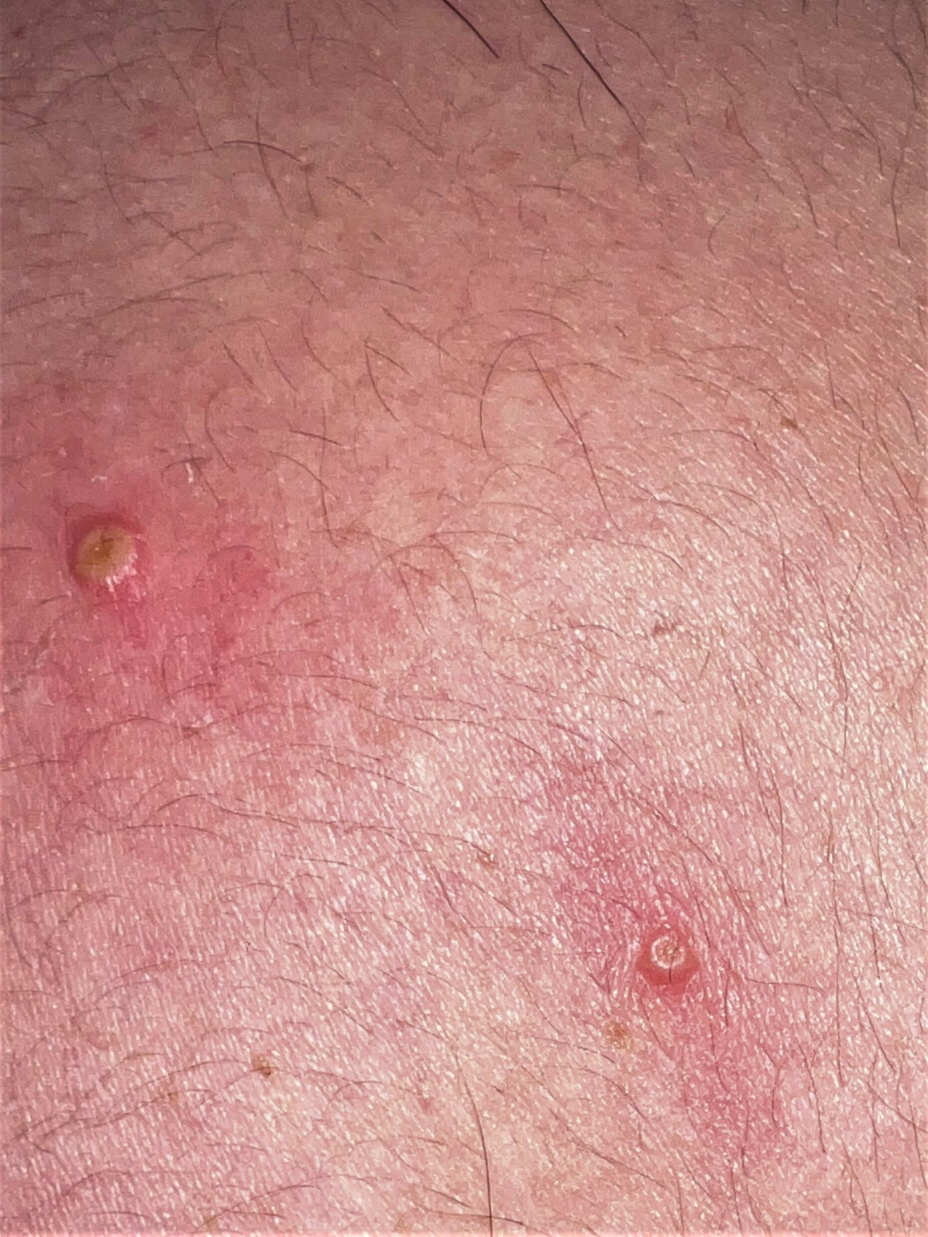
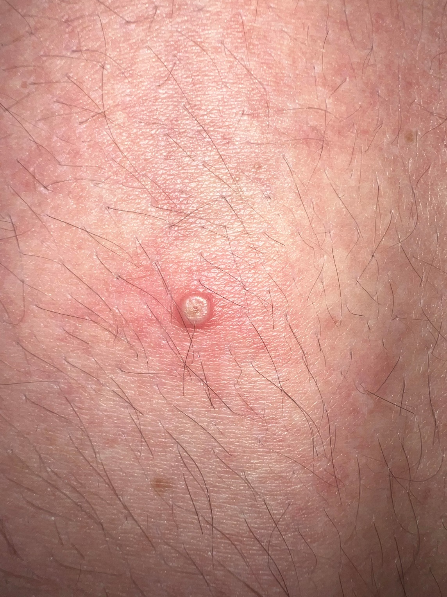
Clinical presentations
Thigh
Arm
Penile lesions
PHOTO #1,3 courtesy of the Lancet ID – Girometti et al. Lancet ID, 2022

Slide 11
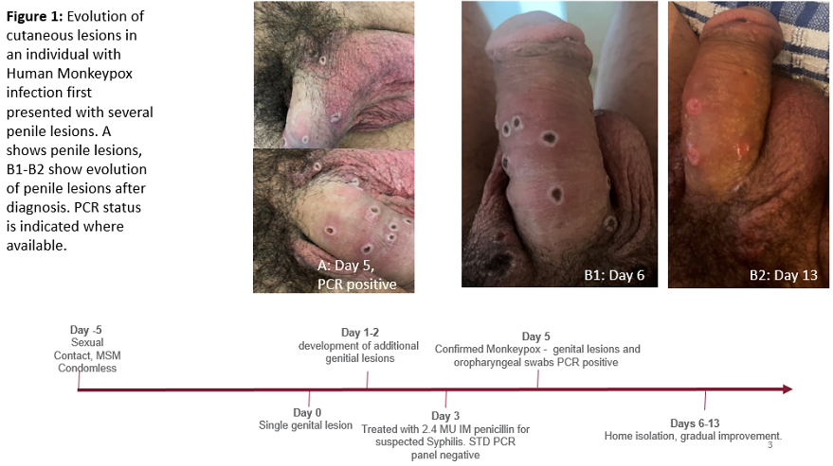
Clinical presentations
PHOTO courtesy of NEJM – Thornhill et al. NEJM, 2022

Slide 12
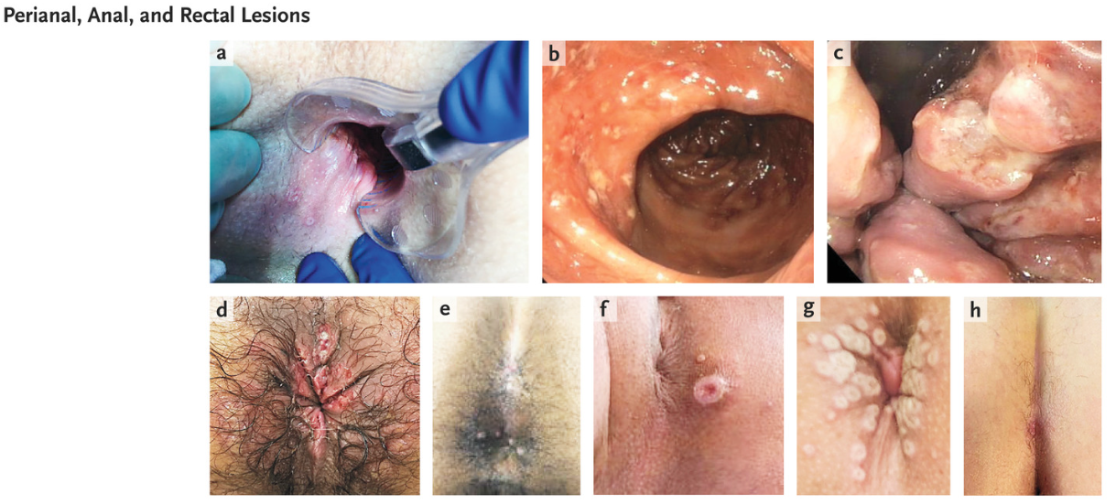
Clinical presentations
PHOTO courtesy of NEJM – Thornhill et al. NEJM, 2022

Slide 13
Clinical presentations
PHOTO courtesy of NEJM – Thornhill et al. NEJM, 2022

Slide 14
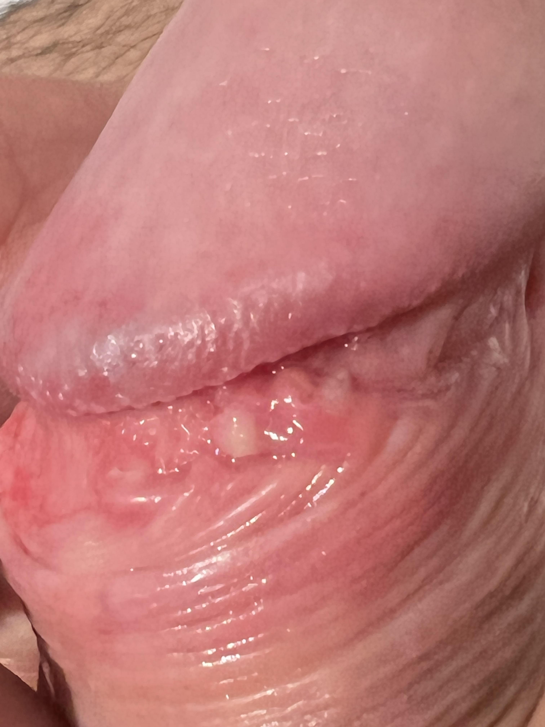
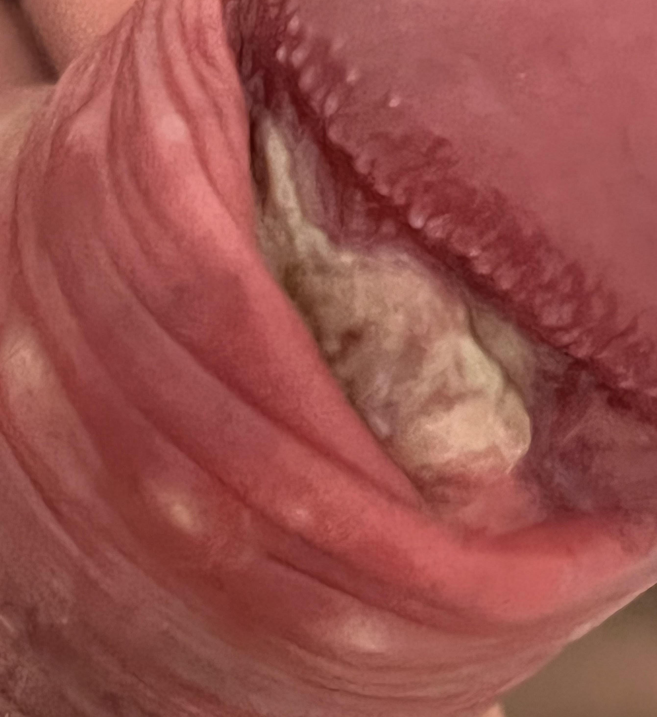
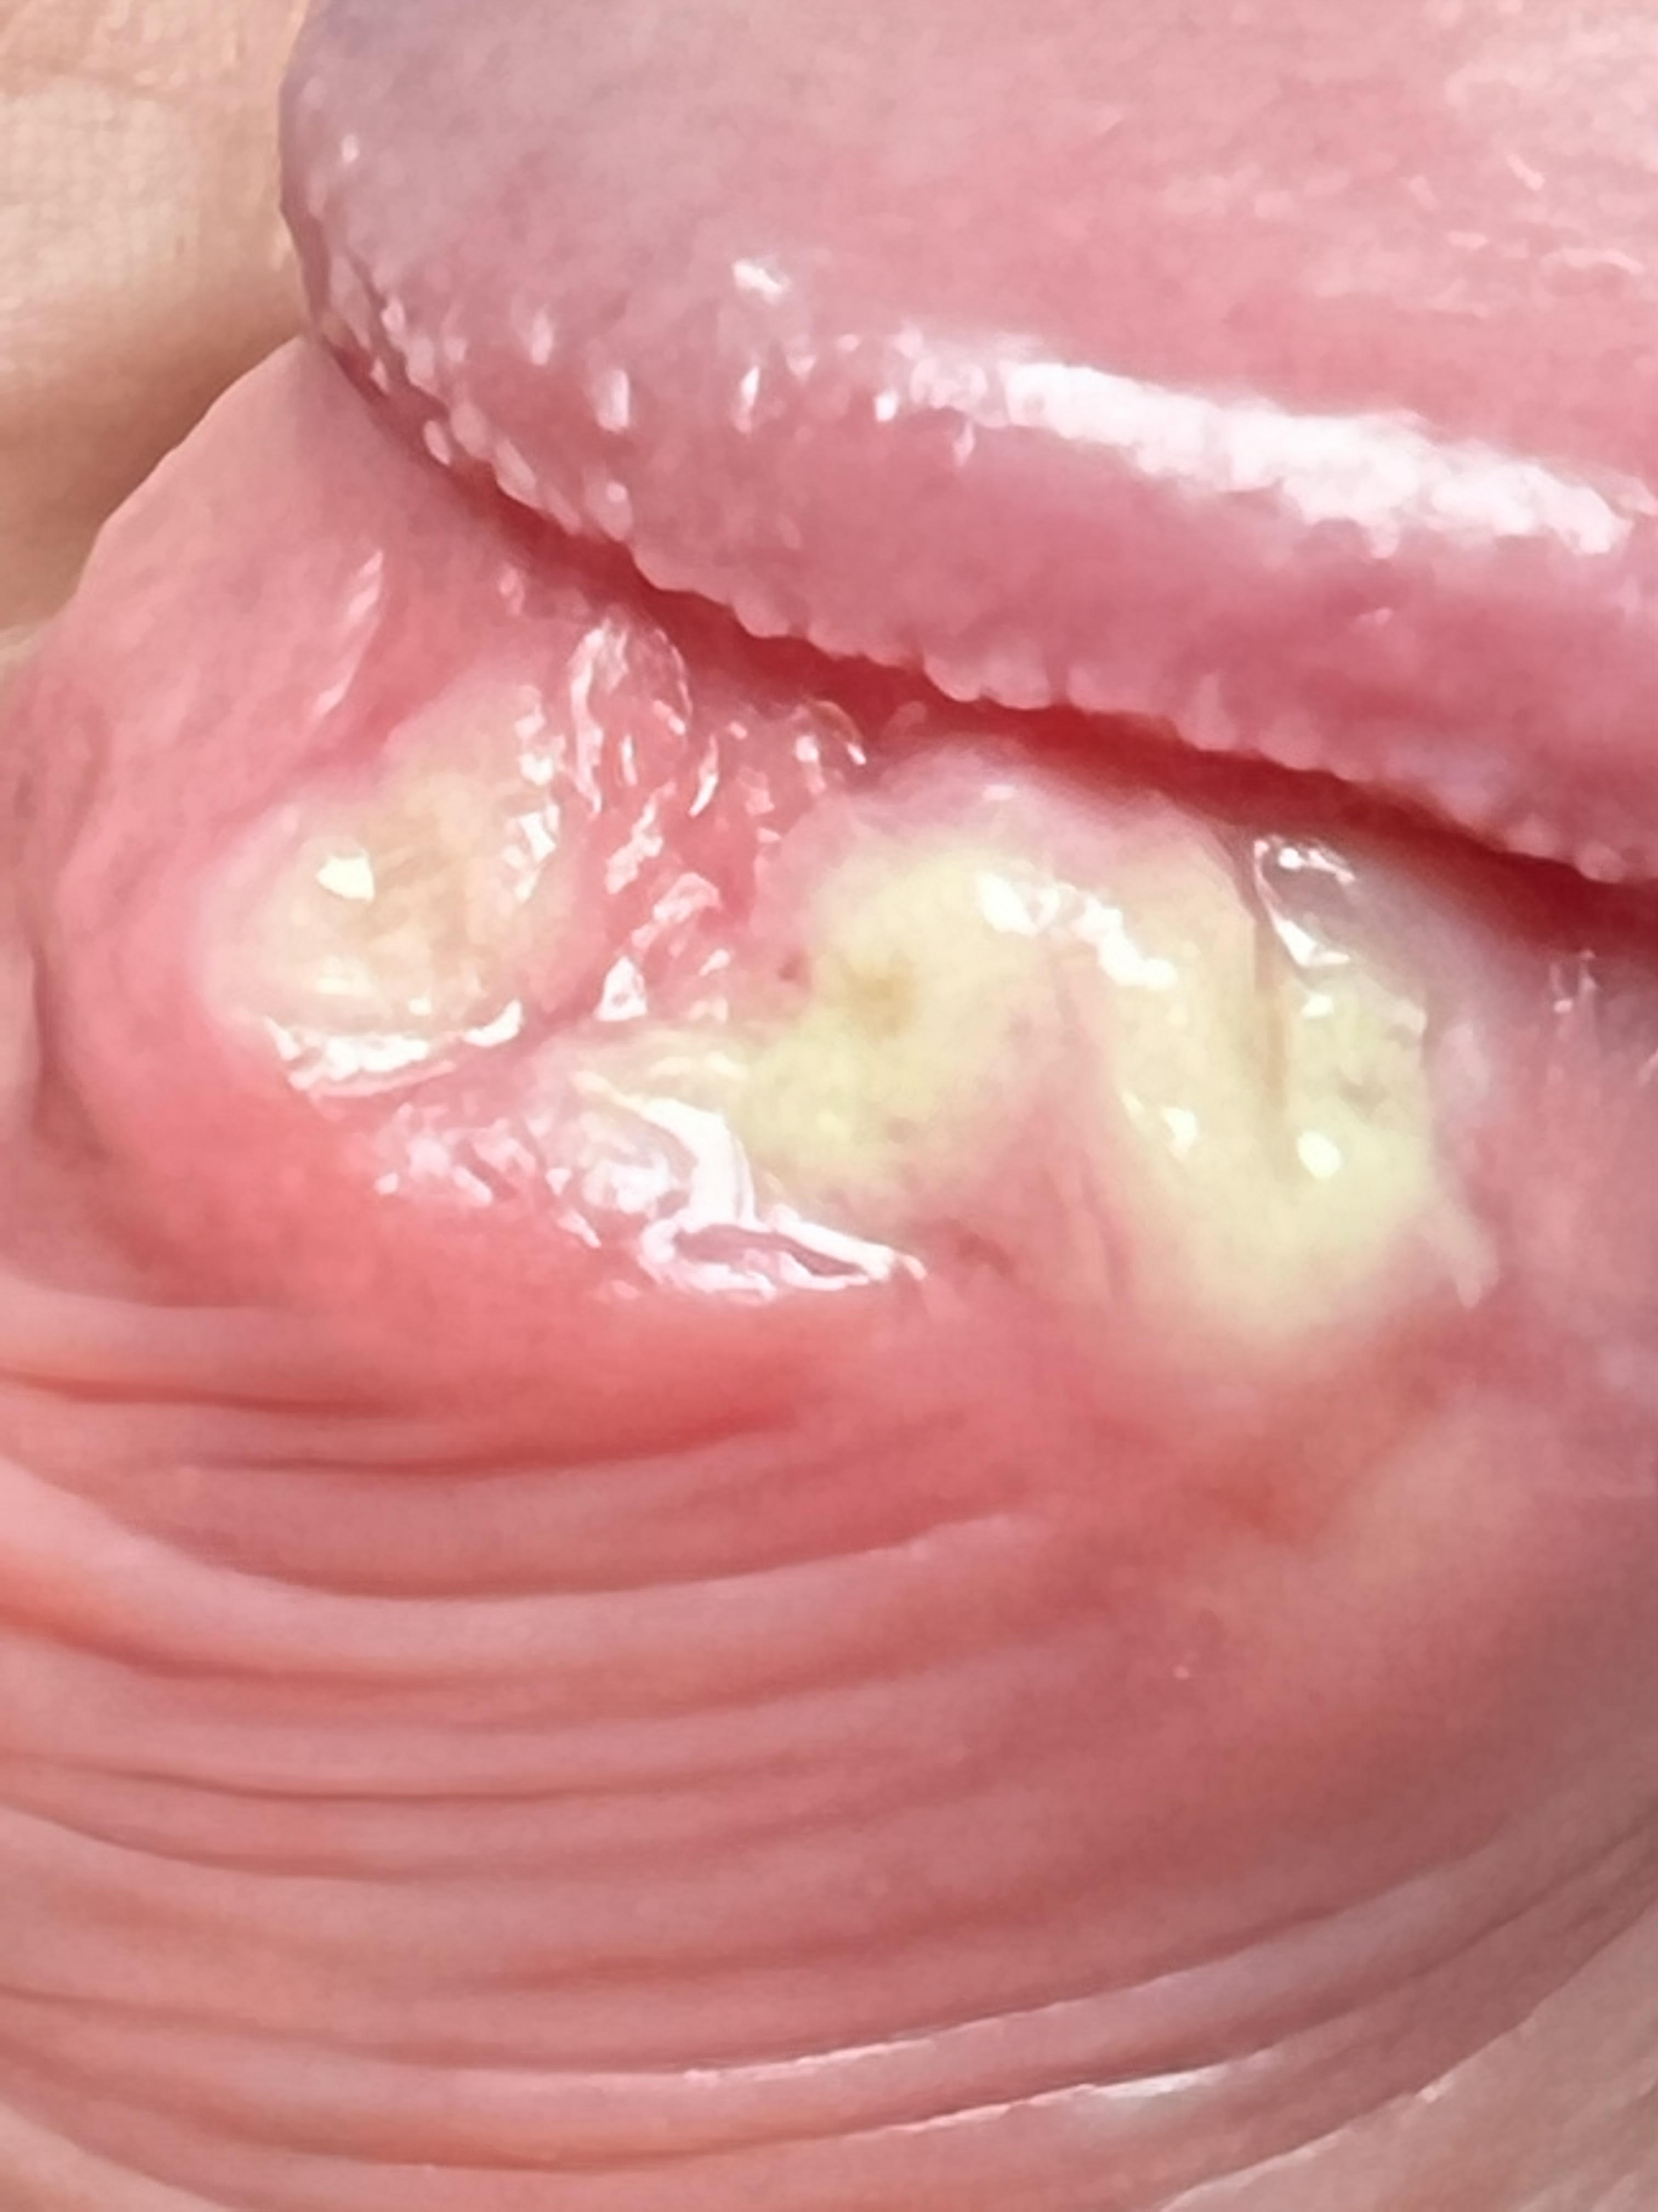
Progression of anogenital lesions
Perianal pustules evolving into large ulcerative lesion (8 days)
Penile lesions coalescing into large ulceration (8 days)
PHOTO courtesy of the Lancet ID – Girometti et al. Lancet ID, 2022

Slide 15
How do we treat monkeypox?
SYMPTOMATIC and SUPPORTIVE TREATMENT
Analgesia for prodromic phase (paracetamol, NSAIDs)
Hydration
.v TREATMENT of COMPLICATIONS
Analgesia for anal/rectal pain (paracetamol, codeine, morphine, lidocaine gels PRN)
Laxatives and hydration
Mesalazine enemas for proctitis
Antibiotics (penicillins / metronidazole)
Surgical incision and drainage for abscesses
Urethral catheterization for urethral pain

Slide 16
How do we treat monkeypox?
ANTIVIRALS
Mostly reserved to treat SEVERE cases (incl. individuals requiring hospitalization, children < 8 years, pregnant women)
No treatment approved specifically for monkeypox
Efficacy of antivirals mostly on studies in-vitro / on animals
TECOVIRIMAT (viral envelope protein VP37 inhibitor)
Effective in treating disease caused by orthopoxviruses on animal studies ¹ ²
May shorten the duration of illness and viral shedding
CIDOFOVIR / BRINCIDOFOVIR (viral DNA polymerase inhibitors)
effective against orthopoxviruses in in-vitro and animal studies ³
Brincidofovir has been approved by CDC for the treatment of human smallpox disease in adult and pediatric patients
Consider POST-EXPOSURE immunisation (best if within 4 days to prevent disease, 4-14 days to reduce symptoms)
1. Mucker et al. AAC, 2013 2. Grosenbach et al. NEJM, 2018 3. Rice et al. Viruses, 2011 4. Smee et al. AAC, 2008

Slide 17
Acknowledgements
The staff at 56 Dean Street, 10 Hammersmith Broadway, John Hunter Clinic
The microbiology team at Chelsea and Westminster Hospital
AND
Thank you to the kind patients who consented to have their pictures shared with us!
Thank you for your hard work!
CONTACTS: n.girometti@nhs.net 56deanstreet

