Slide 1
Setting the Scene: Phylogenetics
Diana M. Tordoff (she/her)
University of Washington, Department of Epidemiology
Big data and AI: An ethical and human rights-based HIV response?
Notes:
Thank you for inviting me to be part of this important discussion. I’m going to help set the scene for todayby first giving a brief overview of HIV Phylogenetics and some terminology

Slide 2
HIV Phylogenetics & Molecular Epidemiology
Molecular epidemiology:
General term used to describe the use of viral or bacterial DNA or RNA to understand the epidemiology of infectious diseases
different
same
G | C | T | A | G | T | G
G | C | T | A | G | C | C
Describe what strains, variants, or subtypes exist within a population
Identify antibiotic or antiviral resistance genes
Identity two or more sequences that are similar in terms of genetic distance (number of base-pairs that differ or percent similarity among all base-pairs), and potentially part of an HIV transmission network
G | C | T | A | G | A | A
Notes:
Phylogenetics and Molecular Epidemiology are two related terms that are sometimes used as synonyms, although they are not precisely interchangeable.
Molecular epidemiology is a more general term used to describe the use of viral or bacterial DNA or RNA to understand the epidemiology of infectious diseases.
[CLICK]
For examine, RNA from HIV can be translated into a series of base-pairs, as shown on the right. This information can be analyzed to:
Describe what strains, variants, or subtypes exist within a population
Identify antibiotic or antiviral resistance genes
[CLICK]
Identity two or more sequences that are similar in terms of genetic distance and potentially epidemiologically linked or part of an HIV transmission network

Slide 3
HIV Phylogenetics & Molecular Epidemiology
Phylogenetics:
The study of evolutionary relationships among biological entities (e.g. species, individuals, genes).
most recent common ancestor
Identify two or more sequences that are closely related
Estimate historic/geographic patterns of an epidemic
Identify the origin of outbreaks
Identify factors associated with high rates of transmission (e.g., which strains are transmitting more than others?)
Track transmission and evolution of drug resistance
Notes:
Phylogenetics, is the study of evolutionary relationships among biological entities
Phylogenetic analyses estimate a phylogenetic tree from HIV sequences, which is a like a family tree, [CLICK] where individual sequences are at the tips and a hypothetical most recent common ancestor of all the included sequences is at the root.
[CLICK]
Phylogenetic methods can also be used to identify two or more sequences that are closely related
Phylogenetic trees can be used to….
Estimate historic/geographic patterns of an epidemic
Identify the origin of outbreaks
Identify factors associated with high rates of transmission

Slide 4
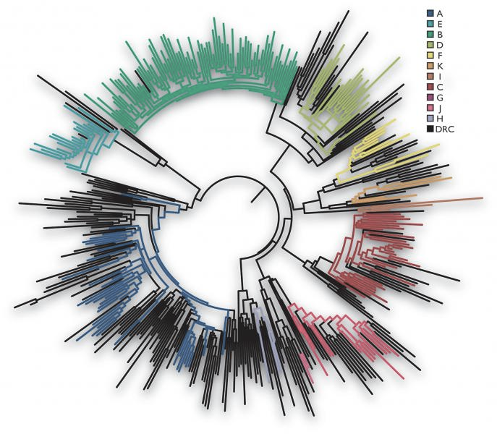
Example HIV Phylogenetic Trees
Population Level
Between Species
Within an Individual
Sainani, 2009. Biomed Comp Rev.
Sharp, 2005. Journal of Virology 79(7):3892
Yamaguchi, 1997. PNAS 94 (4) 1264-1269
Notes:
HIV Phylogenetic analysis can be done at the population level, where each sequence represents an individual person. They can also be done between species, for example to identify how HIV was introduced into human populations. Lastly, HIV phylogenetic analyses can be done at the individual level to examine within person evolution of HIV over time.
_________________
HIV Phylogenetic analysis can be done at the population level, where each sequence represents an individual. This tree illustrates the HIV subtype diversity within one country.
They can also be done between species – this phylogeny includes both HIV (in black) and SIV obtained from two different chimpanzees species (in red and blue), and illustrates how many times HIV-1 was potentially introduced into human populations.
Lastly, HIV phylogenetic analyses can be done at the individual level. This phylogeny includes sequences sampled from one person over a 7 year period and illustrates within person evolution of HIV.

Slide 5
How are HIV sequences used?
Research
Public Health Practice
(i.e., Molecular HIV Surveillance)
Notes:
HIV sequences can be used in research settings – in which case they are typically collected with informed consent.
[CLICK]
HIV sequences are also used in public health practice. For example, when someone is newly diagnosed with HIV, a clinician will take a blood sample so that their HIV virus is sequenced Their HIV sequence is then analyzed for potential drug resistance and this information is used to prescribe ART. These sequences are then shared with local public health agencies under the purview of public health surveillance without informed consent. This is also referred to as Molecular HIV Surveillance.
[CLICK]
Lastly, HIV sequences that were originally collected for public health purposes are sometimes used for Research.
Both molecular epidemiology and phylogenetic methods can be used in either context to provide important information for HIV treatment development, ART prescription recommendations, vaccine development, and monitoring for PrEP efficacy. Phylogenetic methods have also been used in partner studies, like HPTN 052, to prove than U=U. However, our symposium today will also consider the challenges and important ethical considerations in how HIV sequences are used in both research and public health practice.

Slide 6
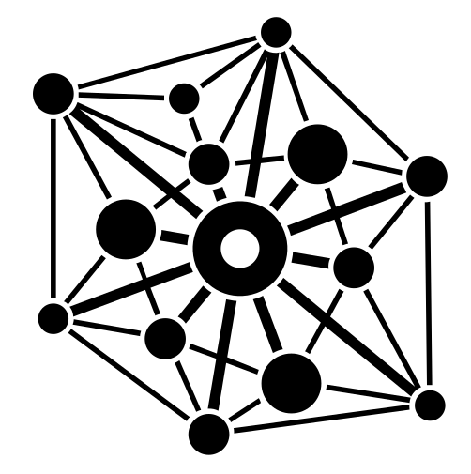
The Bigger Picture: Big Data Analytics
Public Health Surveillance Datasets
Biometric Data
HIV Sequences
Very large datasets of HIV pol genes are available due to routine genotype testing
Public repositories of HIV sequences, such as LANL
Large research partnerships, like the PANGEA HIV consortium
Electronic Health Records (EHR)
Payer Records
Sensor data (e.g., health tracking devices, wearable technologies, environmental sensors)
Other Genomic Sequence Data (e.g., GISAID for SARS-CoV-2 and Influenza)
Search Engines & Social Media
Notes:
To zoom out a bit, we are discussing the use of HIV sequences under the larger umbrella of Big Data because very large datasets of HIV pol genes are available because of routine genotype testing. But there are also large public repositories of HIV sequences, such as the Los Alamos database, as well as large research partnerships like the PANGEA Consortium.
Large datasets of genomic sequence are available for other pathogens as well, like SARS-CoV-2 and Influenza.
This is all part of a larger trend of Big Data Analytics in public health, including large public health surveillance datasets, biometric data, electronic health records, and more.

Slide 7
Thank You
Notes:
Thank you. I will now turn it back over to our moderators.

