Slide 1
HIV-associated TB: What's new and topical
Graeme Meintjes
University of Cape Town
Groote Schuur Hospital
31 July 2022
Notes:
Not comprehensive – highlights in the field in last 1-2 years

Slide 2
Scope
Global epidemiology
Systematic screening for TB in PLHIV
Treatment issues
ART and TB treatment
TB drug-induced liver injury
Treatment of drug-susceptible TB
Treatment of rifampicin-resistant TB
Disseminated HIV-associated TB
TB meningitis
TB preventive therapy

Slide 3
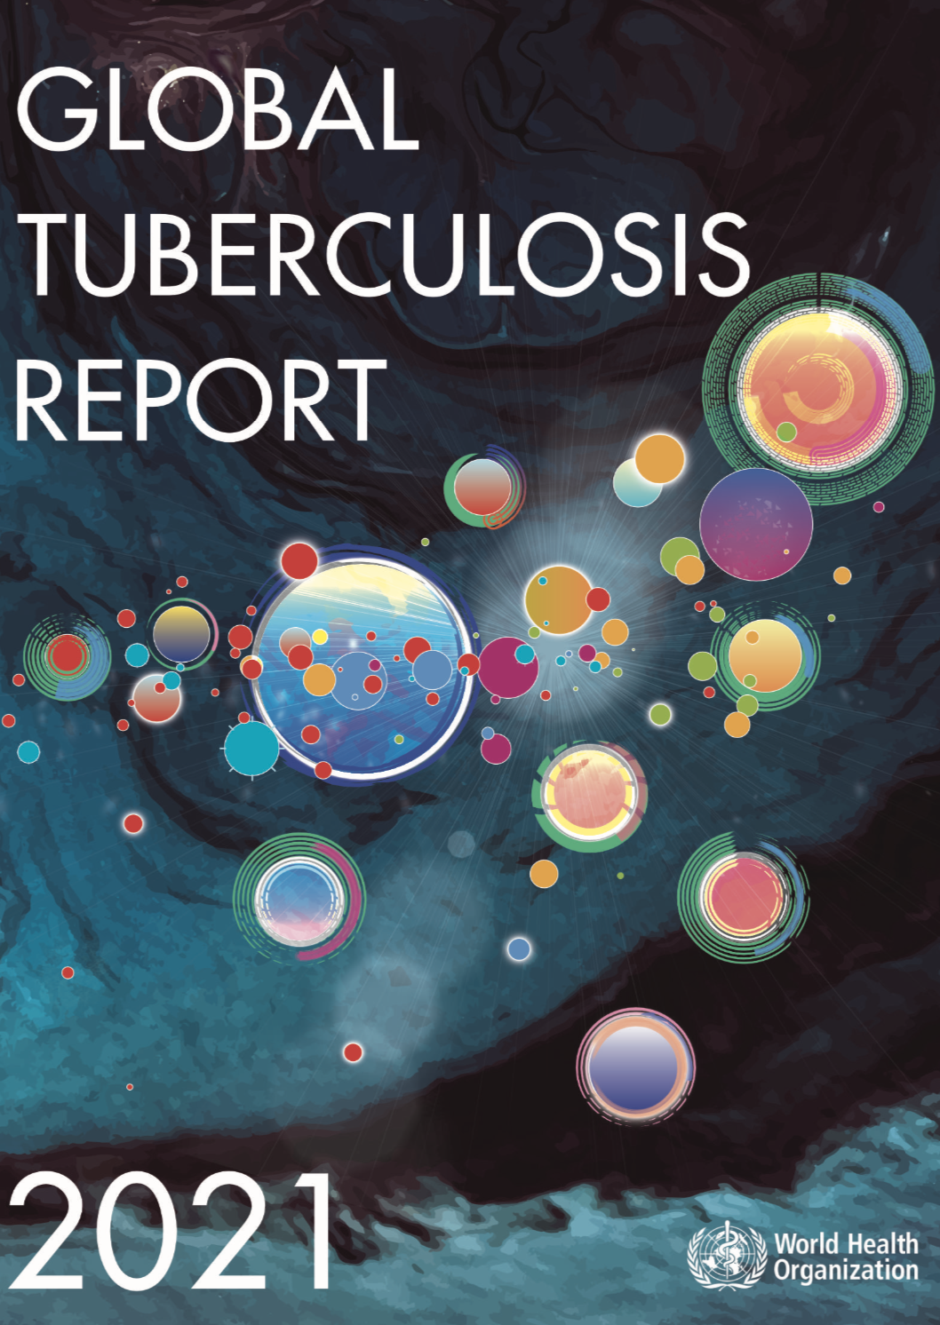
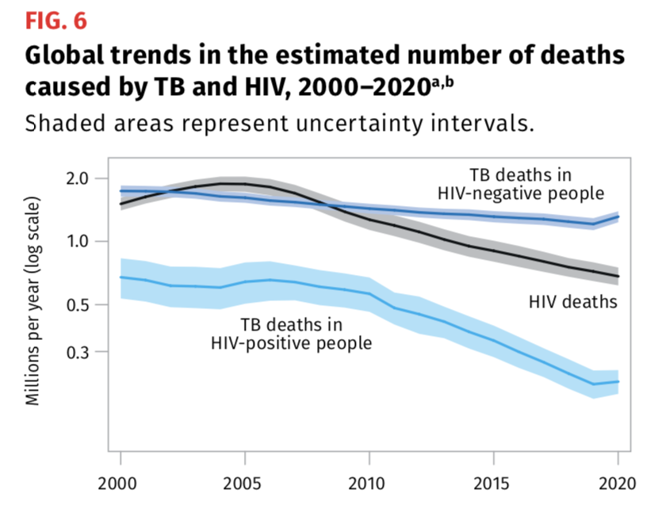
Global epidemiology of HIV-TB
In 2020:
787,000 cases of TB in PLHIV
Out of 9.9 million globally
214,000 TB deaths in PLHIV
60% reduction from 2000

Slide 4
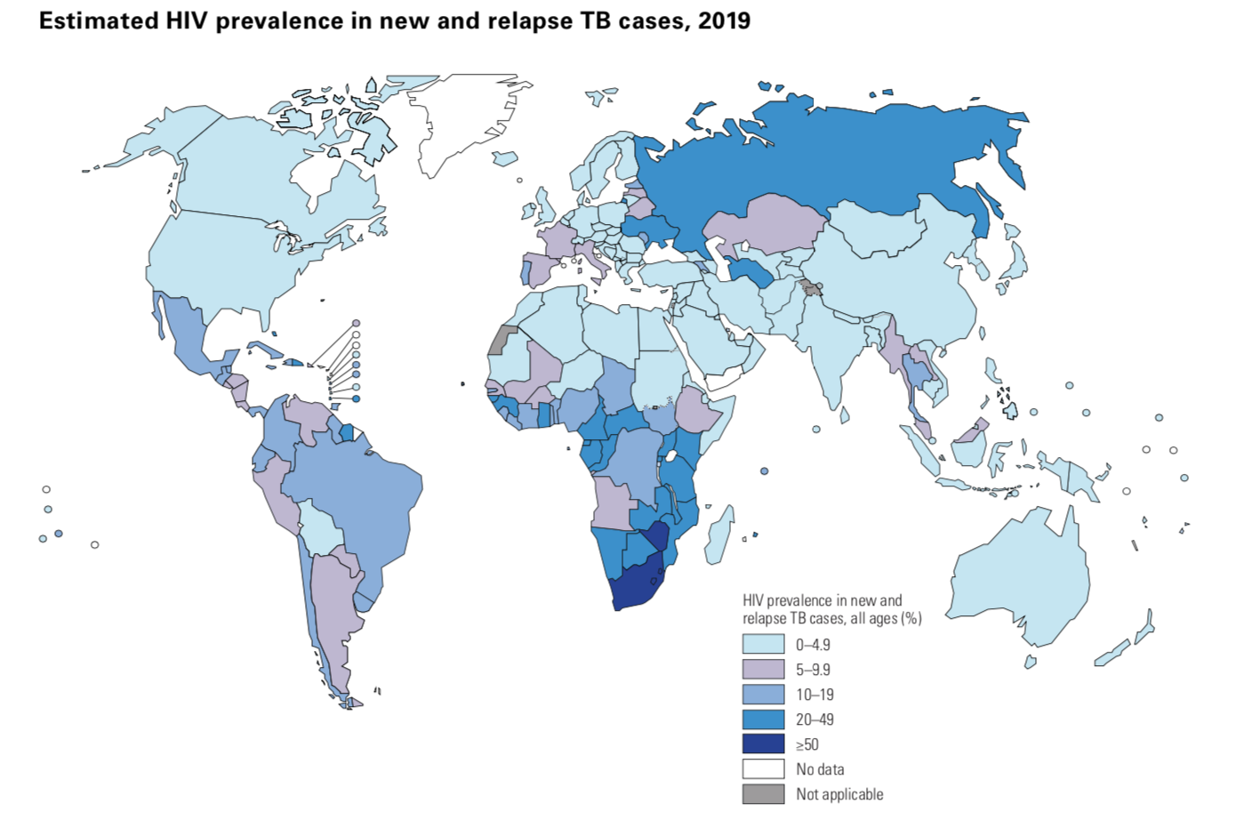
WHO Global TB Report, 2021

Slide 5
Diagnosis gap
Prior to COVID-19, WHO estimated that each year 1/3 of people who developed active TB disease were undiagnosed globally
TB case notifications declined 7.1 million (2019) to 5.8 million (2020)
WHO Global TB Report 2020
Trajman, Int J Tuberc Lung Dis 2022;26:710

Slide 6
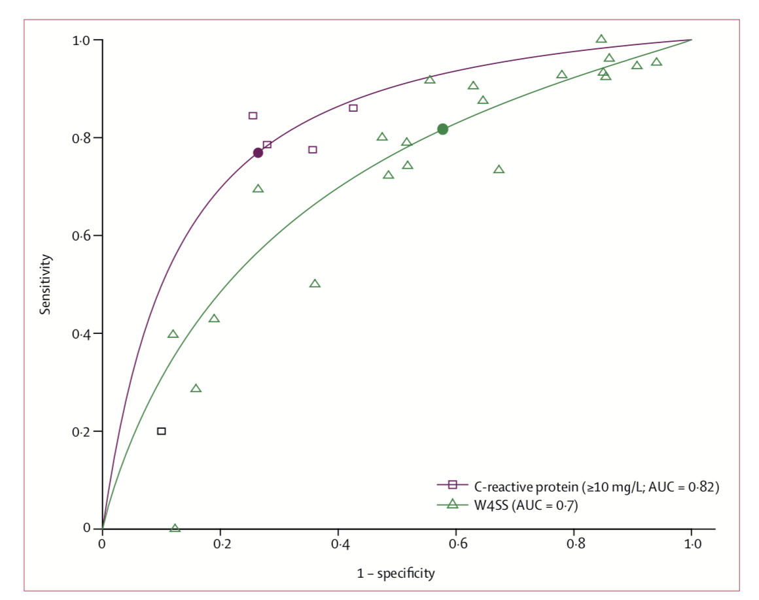
CRP for TB screening in outpatient PLHIV
Individual patient meta-analysis
n = 15,666 from 22 studies
WHO 4-symptom screen
Sensitivity = 82%
Specificity = 42%
C-reactive protein ≥ 10mg/L
Sensitivity = 77%
Specificity = 74%
Point-of-care CRP test available
WHO 4-symptom screen
C-reactive protein ≥ 10mg/L
Summary ROC curves
Dhana, Lancet Infect Dis 2022;22:507
Notes:
Summary ROC curves
CRP included in screening algorithms has potential to reduce for further diagnostics tests (Xpert)
More research in outpatients on ART required

Slide 7
Targeted Universal Testing for TB (TUTT)
Cluster randomized trial in South Africa involving 62 primary clinics
TUTT = clinic attendees with HIV, recent close contact with TB, or prior TB episode offered sputum test for TB, irrespective symptoms
SoC = symptom-directed TB testing
In primary analysis, no difference in TB diagnoses between arms
Pre-specified difference-in-differences analyses
Number of TB diagnoses in SoC clinics decreased over time
TUTT clinics had a 17% relative increase in TB diagnoses per month compared to the prior year (interaction IRR = 1.17, 95%CI = 1.14-1.19)
Martinson, preprint 2022. Available at SSRN: https://ssrn.com/abstract=4092970

Slide 8
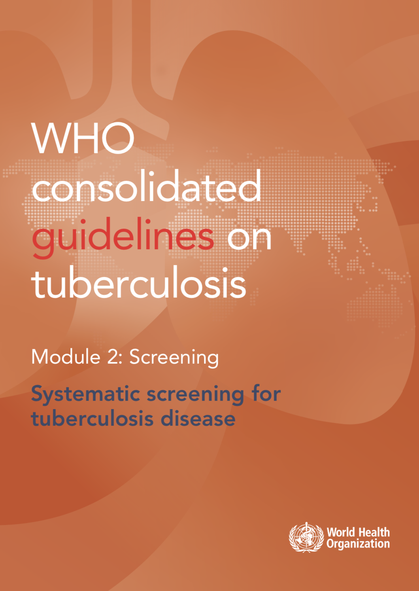
Main changes for adults and adolescents living with HIV
Screening with Chest X-ray improves sensitivity of
4-symptom screen for detecting TB, including in those on ART
CRP (cut-off > 5mg/L) may be used for TB screening in addition
to 4-symptom screen in settings with a high TB burden
Molecular WHO-recommended rapid diagnostics may be used
for TB screening in settings with a high TB burden
Particular recommendation for systematic testing of inpatients with HIV
in medical wards where TB prevalence is > 10%
Published in 2021

Slide 9
Co-treatment with TB medication and ART
Drug-drug interactions
Shared toxicities
Paradoxical TB-IRIS

Slide 10
Rifampicin induces enzymes/drug transporters
Repressor
Co-activator
Phase 1 metabolizing enzymes
eg. CYP3A4
Rifampicin
binding
Phase 2 metabolizing enzymes
eg. UGT1A1
PXR
RXR
Increased
transcription
Response element
Target gene
Efflux transporters
eg. P-glycoprotein
Rifampicin reduces plasma exposure to
TAF, NNRTIs, InSTIs, PIs, fostemsavir and maraviroc
Notes:
Hepatocyte and other cells
Rifabutin also induce but less potent

Slide 11
RADIANT-TB trial: Dolutegravir with rifampicin
50mg daily vs 50mg twice daily dolutegravir
with rifampicin-based TB treatment
Phase 2 non-comparative RCT
n=108 (re)initiating first line ART; CD4 > 100
Randomised 1:1 to dolutegravir or placebo
12 hours after TLD
No emergent ART resistance
83% in both arms had
VL < 50 at week 24
Griesel, AIDS 2022, Poster EPLBB01

Slide 12
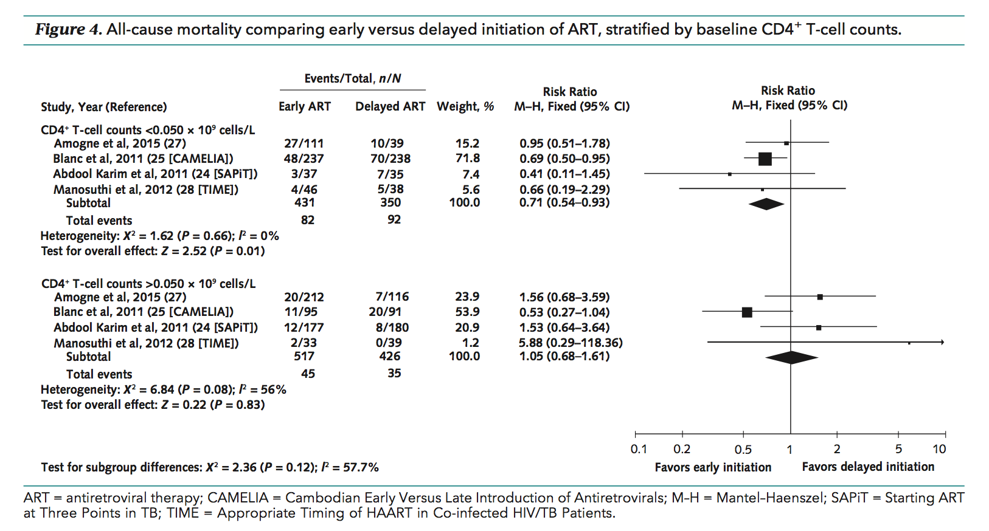
Early ART in TB reduces mortality if CD4 <50 Comparing starting ART ~2 weeks versus ~8 weeks on TB treatment
CD4 < 50
29% ↓ mortality
CD4 > 50
No difference
Uthman, Ann Intern Med 2015;163:32
Notes:
ART reduces death risk overall during TB Rx (two studies)

Slide 13
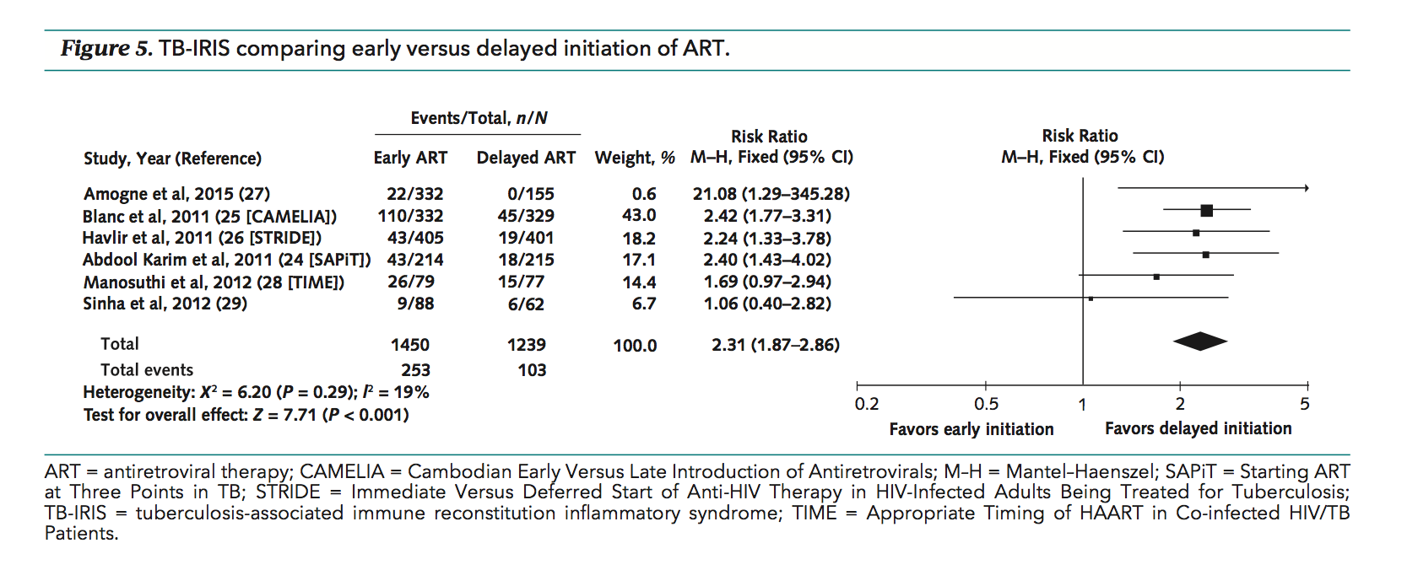
Early ART increases TB-IRIS risk Comparing starting ART ~2 weeks versus ~8 weeks on TB treatment
Uthman, Ann Intern Med 2015;163:32
Early ART (~2 weeks): 17%
Delayed ART (~8 weeks): 8%

Slide 14
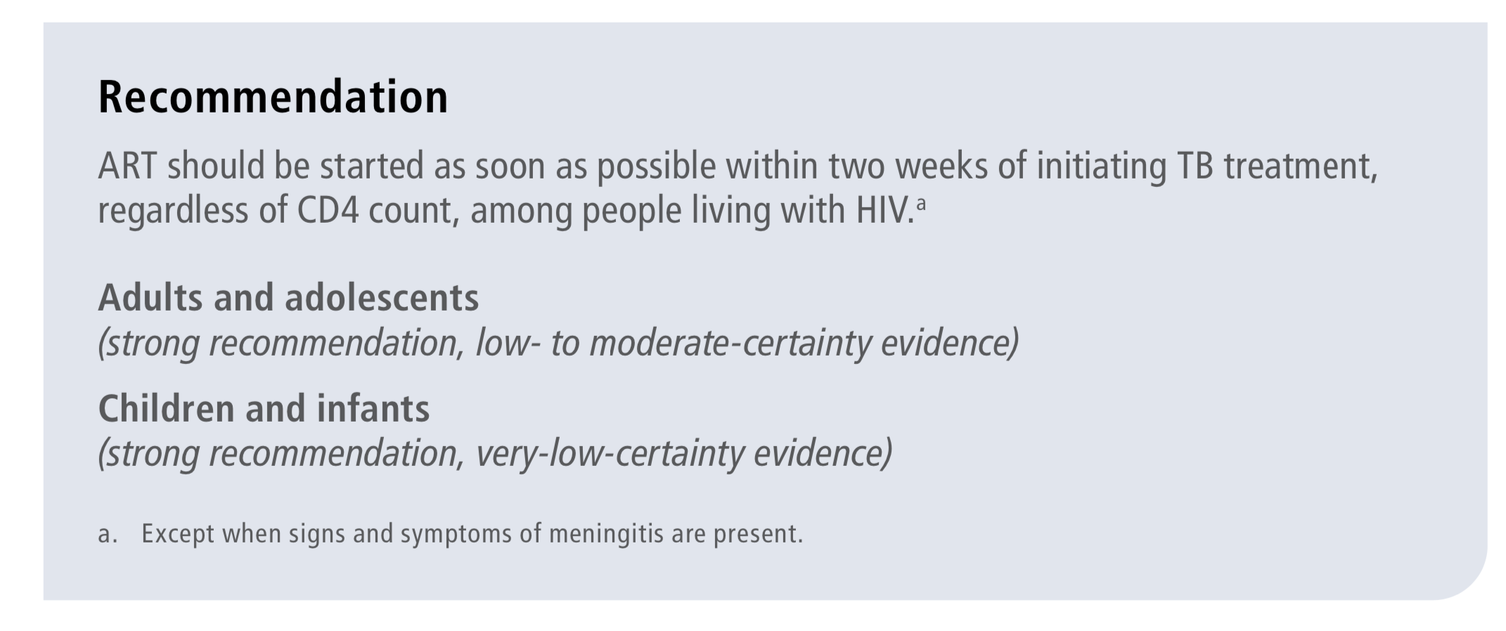
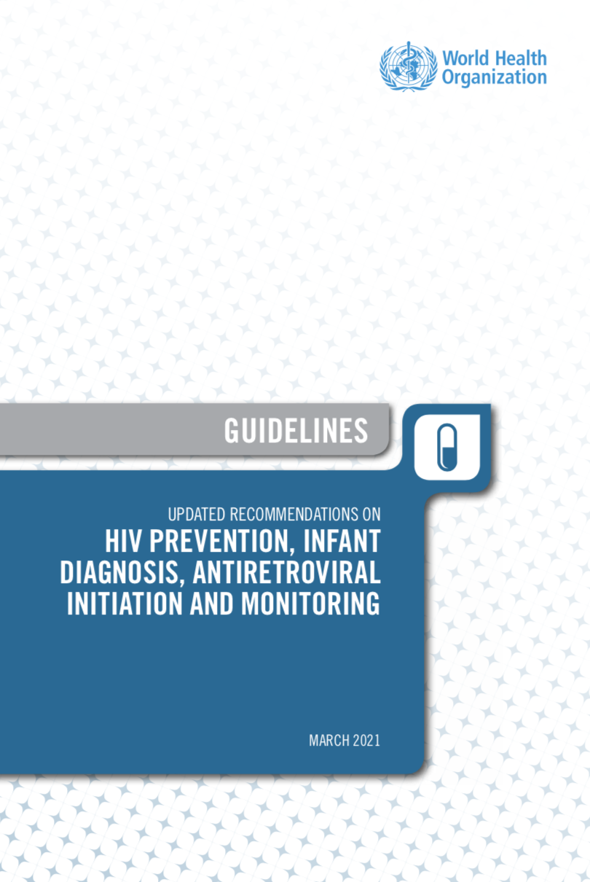
WHO guidance regarding ART timing
Published March 2021

Slide 15
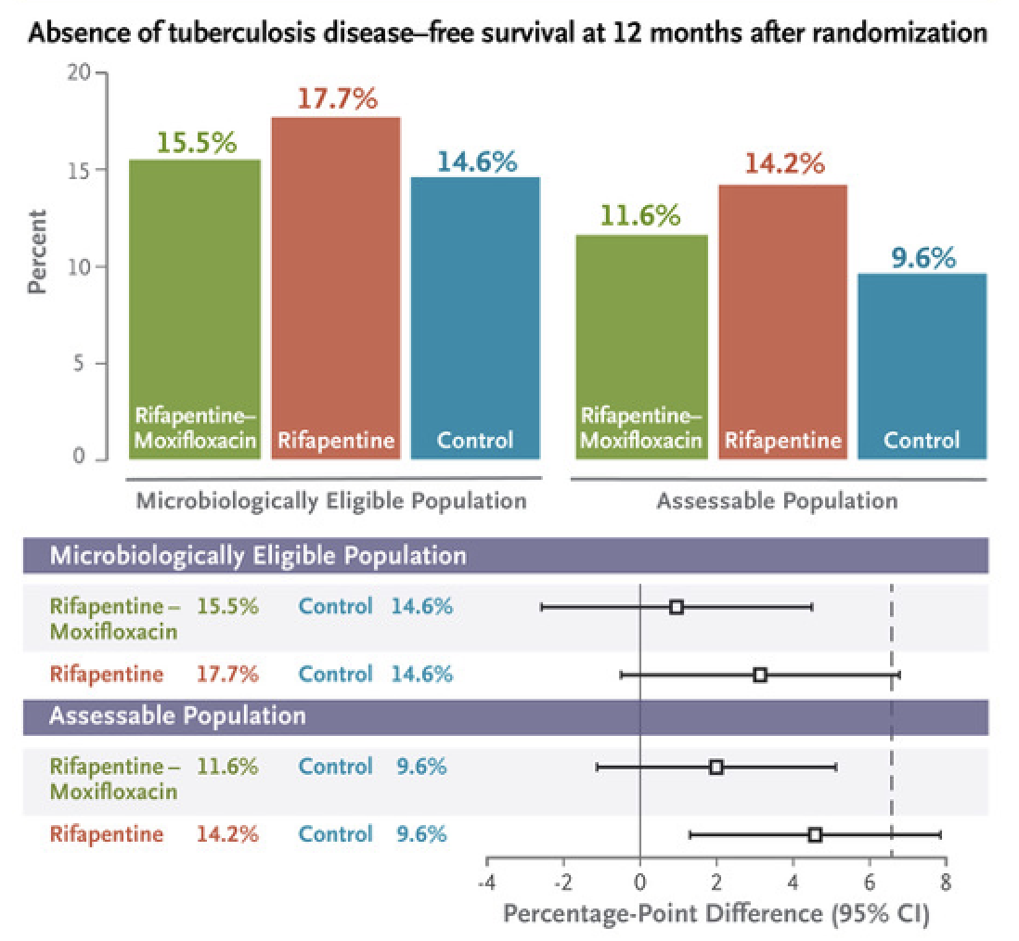
4-month regimens for drug-susceptible pulmonary TB
Dorman, N Engl J Med 2021;384:1705
3-arm open-label non-inferiority RCT:
RIFAPENTINE (P)-MOXIFLOXACIN ARM
2 months PHZM + 2 months PHM
RIFAPENTINE (P) ARM
2 months PHZE + 2 months PH
CONTROL
2 months RHZE + 4 months RH
2516 participants ≥ 12 years; 8% HIV-positive
Non-inferiority margin = 6.6%
RIFAPENTINE-MOXIFLOXACIN ARM NON-INFERIOR
Notes:
Similar in safety and premature discontinuations
Mention WHO Guideline

Slide 16
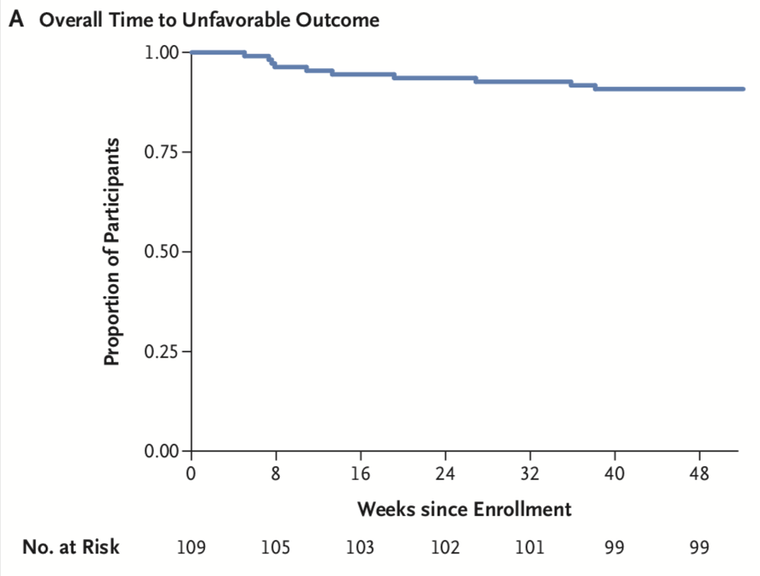
Nix-TB trial: Bedaquiline, Pretomanid, Linezolid 26 weeks treatment + 6 months follow-up
65% XDR-TB (others MDR)
51% HIV-positive
81% peripheral neuropathy
48% myelosuppression
Outcomes similar in
HIV positive & negative
11/109 patients (10%) had unfavorable outcomes
7 died; 1 LTFU; 1 withdrew; 2 relapses
Conradie, N Engl J Med 2020;382:893
Notes:
Nix-TB: 6-month regimen for complicated DR-TB
15% completed LZD 1200 daily with no interruption or dose reduction

Slide 17
ZeNix trial: Nix-TB regimen with variable LZD
181 participants (20% HIV-positive) randomized to one of 4 regimens
All 6 months BPaL with varying linezolid (LZD) dose and duration
Outcome evaluated 6 months after completing treatment
Need for LZD dose modification less with lower dose and shorter duration
Linezolid dose & duration (# assessable) | 1200mg 26 weeks (n=44) | 1200mg 9 weeks (n=45) | 600mg 26 weeks (n=44) | 600mg 9 weeks (n=44)
Favorable outcome | 41 (93%) | 40 (89%) | 40 (91%) | 37 (84%)
Conradie, IAS 2021, Abstract 2405

Slide 18
TB-PRACTECAL: 6 month all oral regimens
Open label RCT: Belarus, South Africa, Uzbekistan
23% HIV-positive
30% cavitation
28% fluoroquinolone resistant
 | BPaL (n=60) | BPaL + Clofazimine (n=64) | BPaL + Moxifloxacin (n=62) | WHO SoC 36-96 weeks (n=66)
Unfavorable outcomes | 23% | 19% | 11% | 49%
SAE or new grade 3 AE | 22% | 32% | 19% | 59%
BPaL = Bedaquiline, Pretomanid, Linezolid
Nyang’wa, CROI 2022, Abstract 71
Notes:
Mainly MDR
Stopped early by DSMC/B
42% early discontinuations in SOC arm

Slide 19
WHO Rapid Communication: May 2022
The 6-month BPaLM regimen, comprising bedaquiline, pretomanid, linezolid (600mg) and moxifloxacin, may be used programmatically in place of 9-month or longer (>18 months) regimens, in patients (aged ≥15 years) with MDR/RR-TB who have not had previous exposure to bedaquiline, pretomanid and linezolid (defined as >1 month exposure).
This regimen may be used without moxifloxacin (BPaL) in the case of documented resistance to fluoroquinolones (in patients with pre-XDR-TB). Drug susceptibility testing (DST) to fluoroquinolones is strongly encouraged, but DST should not delay treatment initiation.
Notes:
Key changes to the treatment of DR-TB
Number of ongoing trials
PLHIV too

Slide 20
Disseminated TB in hospitalised PLHIV
Meta-analysis: predicted probability of Mtb blood stream infection in inpatients with HIV-TB, WHO danger signs, and CD4=76 was 45%
Mortality 21.5% in large inpatient cohort in SA; death associated with:
Biomarkers of sepsis and organ dysfunction
Markers of Mtb dissemination in blood and urine
Innate immune activation profile in blood
Xpert Ultra performed on lysed blood showed “dose response” relationship with mortality
Barr, Lancet Infect Dis 2020;20:742
Schutz, PLoS Med 2019;16:e1002840
Boloko, Lancet Microbe 2022;3:e521

Slide 21
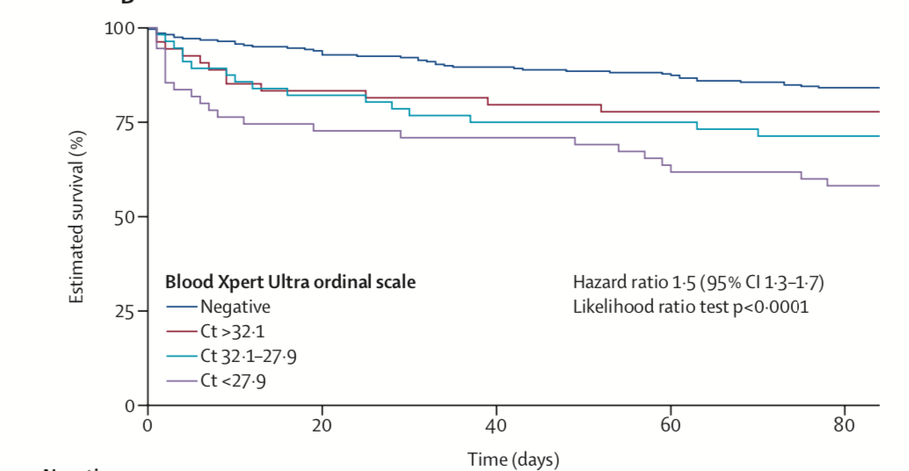
Xpert Ultra on lysed whole blood
Increasing Mtb
DNA abundance
in blood
Boloko, Lancet Microbe 2022;3:e521

Slide 22
NEW-STRAT TB: Randomized controlled trial
Hospitalised adults
Disseminated
HIV-TB
n =732
Standard
TB treatment
Prednisone 14 days
Placebo 14 days
Second
randomisation
Standard
TB treatment
PLUS
High dose Rif 35mg/kg
and Levofloxacin for 14 days
Prednisone 14 days
First
randomisation
Placebo 14 days
Co-PIs: Meintjes, Schutz
PRIMARY ENDPOINT:
All-cause mortality at 12 weeks
Recruitment started August 2021
183/732 recruited
Notes:
Factorial 2 x2
Std TB Rx therafter

Slide 23
TB meningitis
Estimated that 0.3-4.9% of all people with TB have TBM
Mortality higher in PLHIV and exceeds 60% in some studies
Standard TB treatment of 9-12 months duration advised
Dexamethasone improves survival; not specifically evaluated in PLHIV
ART initiation delay of 4-8 weeks advised due to risk of neurological IRIS
Huynh, Lancet Neurol 2022;21:450
Wilkinson, Nat Rev Neurol 2017;13:581

Slide 24
Current and planned TBM trials
Title/Number | Phase | Intervention(s) | Setting
NCT03787940 | 3 | High-dose INH (NAT2 stratified) | China
HARVEST | 3 | High-dose Rifampicin | Indonesia, SA, Uganda
TBM-KIDS | 2 | High-dose Rifampicin and Levofloxacin | India and Malawi
ALTER | 2 | High-dose Rifampicin and Linezolid | Uganda
SIMPLE | 2 | High-dose Rifampicin and Linezolid | Indonesia
LAST ACT | 3 | LTA4H-stratified Dexamethasone | Vietnam
ACT HIV | 3 | Dexamethasone in HIV-associated TBM | Vietnam and Indonesia
CTRI/2018/02/011722 | NA | Indomethacin | India
INTENSE-TBM | 3 | High-dose Rifampicin and Linezolid and Aspirin | Cote d’Ivoire, Madagascar, SA, Uganda
SURE | 3 | 6-month intensified TB treatment and Aspirin | India, Uganda, Vietnam, Zambia, Zimbabwe
LASER-TBM | 2 | High-dose Rifampicin and Linezolid and Aspirin | South Africa
TB Rx
Adjunct
TB Rx
+ Adjunct
Huynh, Lancet Neurol 2022; 21:450
Notes:
Paed and adult trials
Also TNF blockers trials planned
Many majority HIV+ adults – highlight ACT HIV

Slide 25
TB preventive therapy: main options
Isoniazid for 6 - 36 months (IPT)
Isoniazid + Rifapentine weekly for 3 months (3HP)
Isoniazid + Rifampicin daily for 3 months
Isoniazid + Rifapentine daily for 1 month (1HP)
Currently limited access to Rifapentine in LMIC settings

Slide 26
Annual TB preventive therapy ?
WHIP3TB trial compared 3 strategies:
Single-round 3HP
Annual 3HP
6 months INH
Completion rates: combined 3HP arms vs 6 months INH
90% vs 51% (RR=1.78, p<0.001)
TB incidence 0-24 months: annual vs single-round 3HP
1.21 vs 1.26/100 person-years (HR=0.96, p=0.85)
Annual 3HP did not reduce TB incidence over 2 years
3HP = INH + Rifapentine weekly for 3 months
Churchyard, Ann Intern Med 2021;174:1367

Slide 27
Key new developments
New evidence and guidelines for systematic screening for TB
Role for CRP, Chest X-ray, and molecular diagnostics
Alternative 4-month regimen for drug susceptible TB
Including rifapentine and moxifloxacin
Alternative 6-month regimens for drug resistant TB
BPaLM and BPaL regimens

Slide 28
Acknowledgements
UCT
Charlotte Schutz
Amy Ward
Muki Shey
Robert Wilkinson
Gary Maartens
Bianca Sossen
Linda Boloko
Phiona Namale
Mark Nicol
Katalin Wilkinson
Rulan Griesel
Ying Zhao
Ashar Dhana
Zaayid Omar
Avuyonke Balfour
Nomfundo Sibiya
University of Liverpool
David Barr
Gerry Davies
Kate Haigh
Andrew Hill
Bryony Simmons
Fundacão Oswaldo Cruz
Bruno Andrade
Kiyoshi Fukutani
University of Amsterdam
Saskia Janssen
MSF
Rosie Burton
UCSF
Andrew Kerkhoff

