Slide 1
Long Acting (LA) ART: Will all populations Benefit? Iskandar Azwa Infectious Diseases Unit, Department of Medicine Faculty of Medicine University of Malaya
Session: Long Acting treatment: Gamechanger or white elephant?

Slide 2
Conflicts of interest
I am no expert and I have no relevant financial relationships with ineligible companies to disclose.

Slide 3
Outline of my talk
Summary of Phase 3 LA ART studies
Opportunities & challenges of LA ART
Key populations and perceptions of LA ART
Clinical and implementation considerations
A focus on LMIC , advocacy and access issues

Slide 4
Long-lasting Treatment With Less Frequent Dosing Is a Priority for PLWH
Positive Perspectives Survey: 2016-2017, participants from 9 countries in North America, Europe, and Australia (N = 1111)
Average Importance
0
50
100
150
200
Weight, %
Long-lasting treatment, requiring less frequent dosing, is one of the most important unmet needs for PLWH, more than reduction of side effects and pill burden
Reduces long-term effects of HIV medicine on my body
24.7
20.7
18.4
13.8
10.2
5.4
4.7
2.0
Longer lasting so I can take treatment less often (eg, monthly injection administered by doctor/nurse)
Fewer side effects
I can take less HIV medicine and get the same effect
Does not cause a problem with medication I currently take for other illnesses
Fewer pills each day
No food restrictions or requirements
Smaller pill sizes
Young. IDWeek 2017. Abstr 1393. .
Notes:
PWH, people with HIV.

Slide 5
What does the data of Phase 3 LA ART show so far? Summary of the data in a nutshell
ATLAS & FLAIR have found monthly LA CAB + RPV injections to be noninferior to oral ART up to 96 weeks among individuals without baseline resistance associated mutations (RAMs, except K103N) or hepatitis B infection
ATLAS-2M: 2 monthly LA CAB +RPV is non inferior to 1 monthly LACAB + RPV up to 3 years of follow up. Small but real increased risk of virological failure occurred in 2% (n=11) of patients with emergent 2 class resistance with the 2 monthly regimen ( vs < 1% (n=1) on Q4W regimen) despite perfect adherence (no delayed injections).
Injections site reactions are common (80%), mild to moderate, rarely lead to discontinuation (1%) and and decrease over time
FLAIR extension study: Patients switching to LA IM CAB + RPV without an oral lead in had similar virological suppression rates and adverse event profiles to those who switched with an oral lead in
Overton. Lancet 2021. Overton. CROI 2022 Abstr 479. D’Amico. J Int AIDS Soc. 2020
Orkin. NEJM 2020..Swindells. NEJM. 2020. Smith. ID Week 2020
Notes:
Atlas 2 M – because of increased risk of virological failure with Q48W, more frequent VL testing to align with 8 weekly injections

Slide 6
Risk Factors of Virological Failure for LA CAB and RPV
Post hoc analysis of ATLAS, FLAIR, ATLAS-2M: 13/1039 (1.25%) with confirmed virological failure
Predictors of virological failure:
BMI > 30 kg/m² (OR 1.13)
Baseline proviral RPV resistance associated mutations (OR 40.36)
HIV subtype A1 or A6 (OR 5.92)
Low RPV levels at Week 8 (OR 5.0)
Need a combination of 2 or more baseline risk factors for increased risk of virological failure
Q8W dosing was not a significant factor
Orkin. NEJM 2020. Patel. CROI 2021. Cutrell AIDS. 2021. Overton CROI 2022 Abst 479

Slide 7
Long Acting Cabotegravir and Rilpivirine First complete long acting HIV regimen
REGULATORY APPROVALS
Canada - March 2020
Europe (EMA) – Dec 2020 – both monthly & 2 monthly
United States (FDA) – Jan 2021 (monthly), Feb 2022 (expanded label to 2 monthly)
Australia – May 2021 – only 2 monthly administration
US FDA March 2022 – 4 week oral lead-in now optional –
no difference in virological suppression rates between oral
lead in and direct to inject arm
Co-Pack = Carbenuva
Single Packs = Vocabria (CAB LA)
and Rekambys (RPV LA)

Slide 8
Why Long Acting regimens and where might they fit?
OPPORTUNITIES | CHALLENGES
Less frequent dosing & avoidance of “pill fatigue” | Cost and resource considerations, need for additional clinic visits every 1-2 months
Increases choice for patients & providers | Injectables cannot be self-administered, large injection volumes, injection site reactions (injection fatigue?)
Protection of health privacy, avoidance of HIV-related stigma/daily reminder of HIV | Knowledge gaps for vulnerable groups e.g. pregnancy,/breastfeeding, women, adolescents, resource poor settings
Addresses sub-optimal adherence | Missed doses, Long tail risks emergence of viral resistance
Convenience (work, travel) | Managing DDIs
Biological/strong medical need e.g. malabsorption, dysphagia, cognitive difficulty | Managing adverse events
Eliminates gut based DDIs & food effects | All treatment trials so far have included patients with optimal adherence
Possibility of co-formulation with other LA drugs
Swindells J Int Ass Providers of HIV Care 2021. Creswell Curr Opin HIV AIDS 2022

Slide 9
Factors associated with interest in LA CAB/RPV: PLWH vs HCP in EU
Interest in trying a long-acting HIV regimen was
highest among younger aged people living with
HIV <50 years (69.8%), those recently diagnosed
with HIV during 2017- 2019 (84.1%), those with
perceived stigma from their daily oral ART (83.3%)
and those stressed by their daily dosing schedule with
oral ART (78.0%).
Akinwunmi B, et al. Sex Transm Infect 2021
Notes:
https://www.aidsmap.com/news/oct-2020/two-thirds-people-living-hiv-would-try-injectable-treatment-according-european-survey
65.8% were interested in trying LA. The majority (80%--90%) of those with unmet needs felt LA would help, including those with strong medical needs (malabsorption and interfering gastrointestinal conditions), suboptimal adherence, confidentiality/privacy concerns and emotional burden of daily dosing.
Benefits included not having to carry pills when travelling (56.3%). Furthermore, 50.0% of people living with HIV perceived LA would minimize transmission risk and improve their sexual health.
The most disliked attribute was scheduling appointments (37.2%).
Interest in trying a long-acting HIV regimen was highest among PLWH < 50 years (69.8%), those recently diagnosed with HIV during 2017-- 2019 (84.1%), those with perceived stigma from their daily oral ART (83.3%) and those stressed by their daily dosing schedule with oral ART (78.0%).

Slide 10
FOR PREVENTION
FOR TREATMENT
LA PrEP is preferred by KP assuming episodic risk or who are unable to disclose or negotiate other HIV prevention products such as FSW, TGW and adolescents
FSW and TGW do not want products that can leave scars or are visible and would avoid buttocks (silicone fillings) as a site for injection
Preference for self injections and administration outside the health sector
Additional visits and costs and ambivalences around impact on daily life were important barriers for both prevention and treatment
Interest is high, varies bet 57-66% in developed countries (higher in LMIC)
Younger individuals, recently diagnosed who perceive more stigma or stress from taking oral treatment or who have difficulty scheduling and attending clinical visits express the greatest interest
Consistent factors that motivate switching ART to LA tx include pill fatigue, the need for strict adherence, unintended HIV disclosure and daily reminder of being HIV positive with pills
Preference for administration in a clinic at the same interval as clinic visits and for longer dosing intervals of 6-12 months
Notes:
Consistent factors that motivate switching ART to LA tx across most studies in different settings include pill fatigue, the need for strict adherence, unintended HIV disclosure and daily reminder of being HIV positive with pills

Slide 11
Clinical and Patient Considerations
No present or past evidence of viral resistance to, and no prior virologic failure, with agents of the NNRTI and INI class
Able to commit to scheduled dosing visits and understands the importance of adhering to the schedule
No hx treatment interruption
on NNRTI, unless re-suppressed
Understands the risk of failure
Daily oral ART*
Clinical considerations¹⁻²
Patient considerations¹⁻⁶
no contraindications or potential drug–drug interactions
Conception considered in women of childbearing age
BMI <30 if subtype A1/A6
No Hep B co-infection (vaccination)
Virologically suppressed adults (HIV-1 RNA <50 c/mL)
Difficulty taking oral ART or QOL vastly improved by LAI:
Fear of disclosure
Anxiety with staying adherent
Daily reminder of HIV
Inconvenience of taking daily pills
Fatigue with taking daily ARVs
Adapted from: 1. VOCABRIA GDS 03 Product Characteristics 2. REKAMBYS Hong Kong Product Characteristics 3. Derrick CB, et al. Open Forum Infect Dis. 2018;5:ofy247; 4. Williams J, et al. Nanomedicine 2013;8:1807-13; 5. de los Rios P, et al. AIDS Behav 2021;25:961-72; 6. de los Rios P, et al. Popul Med. 2020;2:23

Slide 12
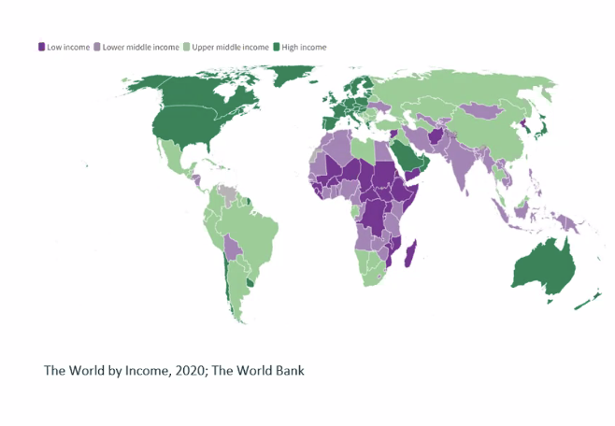
Implementation challenges In High Income Countries
Infrastructure/Health care system demands
Clinic readiness: scheduling of appointments & reminders, dedicated clinic space, additional HCP training, no shows
Time spent in clinic
Needs to be administered by a HCP in a health care setting
Comprehensive understanding of end user/HCP’s preferences and needs in different contexts
Available drug options
Drug storage & preparation
None currently available in Malaysia
Cost, cost effectiveness and coverage
Emergence of side effects
Islatravir: decreased in CD4 and lymphocyte (Dec 21)
Lenacapavir: glass vial housing releasing glass particles- recently lifted
Hoy J. APACC 2022 . Waters L Curr Opin HIV 2022

Slide 13
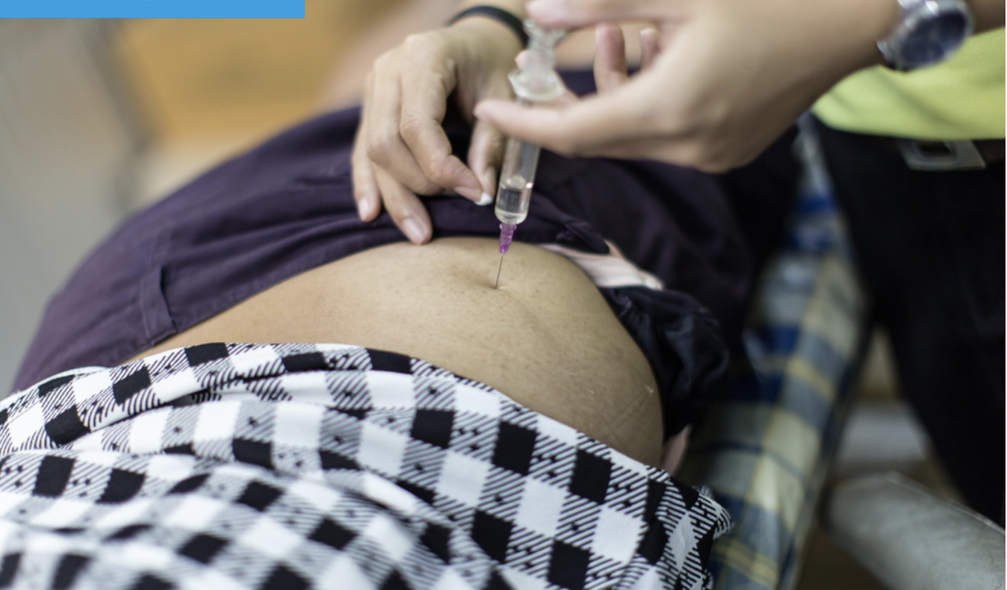
Suitability for LA injectable ART in LMIC
Those not suitable for LA CAB + RPV
Implementation considerations
Chronic Hepatitis B co- infection (absence of TDF or 3TC/FTC)
Pregnancy (insufficient data)
TB – Rifampicin (potent 3A4/UGT inducer) significantly reduces CAB/RPV exposure
Resistance to either drug in regimen/prior treatment failure
Unable to commit to regular 2 monthly clinic visits
Injection safety
Need to screen for Hep B sAg prior to switch
More data from subpopulations in LMIC esp TB & pregnancy
Requirement for baseline resistance testing
Cold chain requirements for LA RPV
Health care provider/system strengthening – health care provider acceptability, ability to deliver at scale
Conflict with differentiated service delivery models
Oral bridging for missed injections
May be more cost effective to target populations with poor adherence & VL > 1000 copies/mL
Creswell F. Implementation of LA ART in LMIC. Curr Opin HIV AIDS 2022
Phillips AN. The potential role of LA injectable CAB-RPV in the ttx of HIV in SSA: a modelling analysis. Lancet Glob Health 202;
Notes:
Viral load testing must be in line with trials– every IMI
Requirement for more frequent VL testing
RPV stored at 5- 8 degrees C, remove 15 mins pre-injection, cannot be refrigerated again
Conflict with differentiated service delivery models – allows patients to be seen every 6 months
Mechanism to access oral bridging to be in place prior to initiation of LA CAB/RPV in event of missed injections
Widespread NNRTI (RPV) resistance in Africa

Slide 14
CUSTOMIZE: Key implementation strategies for LA ART
Phase 3b implementation-effectiveness study of LA CAB + RPV
July 2019 to Oct 2020 from 26 providers and 109 patients from
8 clinics
Perceived Barriers to Implementation Among HCP Decreased from Baseline to M 12
Healthcare staff found CAB + RPV LA acceptable, appropriate, feasible,
and sustainable to implement across diverse US clinic types, with most
feeling that optimal implementation was achieved in 1 3 to months

Slide 15
The impact of transitioning to LA ART on building blocks of DSD for HIV treatment
WHO. Courtesy of Marco Vitoria
Notes:
The successes of the current models of DSD for HIV treatment that have scaled up in LMIC leading to more patient centred care and increased access should be leveraged upon
and should not lead to re-medicalization of care
For treatment, service delivery questions:
How to integrate LA ART into existing client preferred service models?
How to address additional training/certifications?
Cold chain requirements
Effective scheduling and follow up\
Track potential resistance

Slide 16
CONTRAINDICATIONS TO
CARBENUVA
FDA Prescribing Information

Slide 17
Research should focus not only on how best to transition LA products to these populations,
but also on early engagement → A parallel rather than sequential approach is needed when establishing
adult, adolescent, and paediatric clinical trials and seeking regulatory approval
Pregnant and lactating women should be included in adult clinical trials and pregnancy intentions should
not be a barrier to enrolment of women of child bearing potential → narrative on the inclusion of women in
clinical trials is fortunately shifting to a focus on fair inclusion and the concept of protecting women through
not from research
Lancet HIV 2019

Slide 18
YES

Slide 19
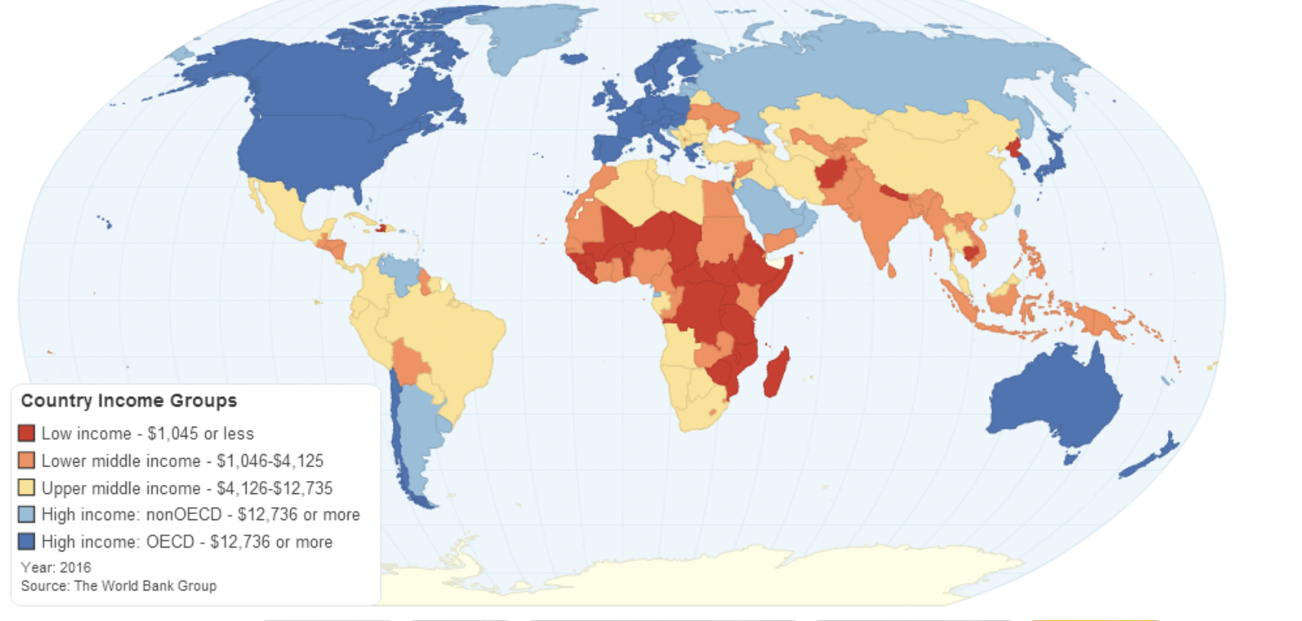
Will LA ART be practical in LMIC? The issue of cost & the need for implementation science research
Cost of Carbenuva is USD 50,000 (US) annually
Affordability is the most significant barrier to global implementation
Cost of injectables will need to be competitive against current SOC (USD 80 per year)
ViiV is actively seeking generic partners for LA injectables
Generic formulations of CAB-LA can be produced at around $15-23 for a one year course of injections
Development of LA products will take longer than oral products – longer BE study durations (average 3-4 years to market)
Critical for robust Implementation science research on preferences and concerns of end users, design of delivery systems to occur in parallel to product development to ensure market uptake when generics are available
Notes:
No current generic equivalent
Affordability is the most significant barrier to global implementation esp in SSA, Asia & Latin America
Need to also factor programmatic costs of delivering IM injections by highly trained staff

Slide 20
AVAC’s Pathway to Access and Impact & Immediate Priorities LA CAB as an example
“Products do not end pandemics; programs that deliver with equity and urgency do! “
“To paraphrase the old adage, you can build it, but if you can’t explain it, make it accessible and trusted, and create community support for it, they might not come.” Tweet AVAC July 19 2022
AVAC. Translating Scientific Advance into Public Health Impact: A Plan for Accelerating Access and Introduction of Injectable CAB for PrEP. June 2022
Notes:
In May 2022, ViiV Healthcare committed to grant VL for patents relating to LA Cabotegravir for PrEP to Medicines Patent Pool.
ViiV Healthcare and MPP are actively negotiating voluntary licensing terms to help widen access to LA CAB
https://i-base.info/htb/42974

Slide 21
Conclusion
LA ART is a game changing addition to the anti-HIV armamentarium
Younger individuals, recently diagnosed with HIV who perceive more stigma or stress from their daily oral ART express the greatest interest in trying a long acting HIV regimen.
Understudied populations, including pregnant women, adolescents and people with detectable viral loads due to poor adherence is lacking and very much needed
Robust implementation science studies on preferences and concerns of users and ways of integrating LA ART into client preferred models of care for treatment and prevention are needed to ensure effective implementation in LMIC
LA injectables for HIV treatment are unlikely to be SOC or first line in resource-limited settings if treatment costs remain unacceptably high and inequitable global access will continue to persist

Slide 22
Acknowledgements
Stephane Wen Wei Ku
Vicki Holohan
Marco Vittoria
Nittaya Phanuphak
Adeeba Kamarulzaman
ID Unit, University of Malaya

