Slide 1
Long-acting ARVs for special populations
Pedro Cahn

Slide 2
Conflict of interest disclosure
Advisory Boards: ViiV, Merck
Research grants: Merck, ViiV, Richmond, CanSino
Speaker: Janssen, ViiV
DSMB: Moderna
The potential effects of relevant financial relationships with ineligible companies have been mitigated. Any clinical recommendations are based on evidence and are free of commercial bias.

Slide 3
LA: Who would benefit?
Virologically suppressed persons with optimal adherence
Naive patients diagnosed in the context of acute opportunnistic infections not able to swallow pills
Hard to treat individuals due to concomitant diseases, lifestyle and/or socioeconomic conditions

Slide 4
Who are those special populations and what do they think?
Considering the wide range of populations that would benefit from LA, it goes beyond "key populations" (a term with focus on high risk behaviour)
Transgender persons, psychiatric conditions, people in nursing homes, people in jail, homeless, individuals unable to swallow pills…
Scarce data are available about their expectations…

Slide 5
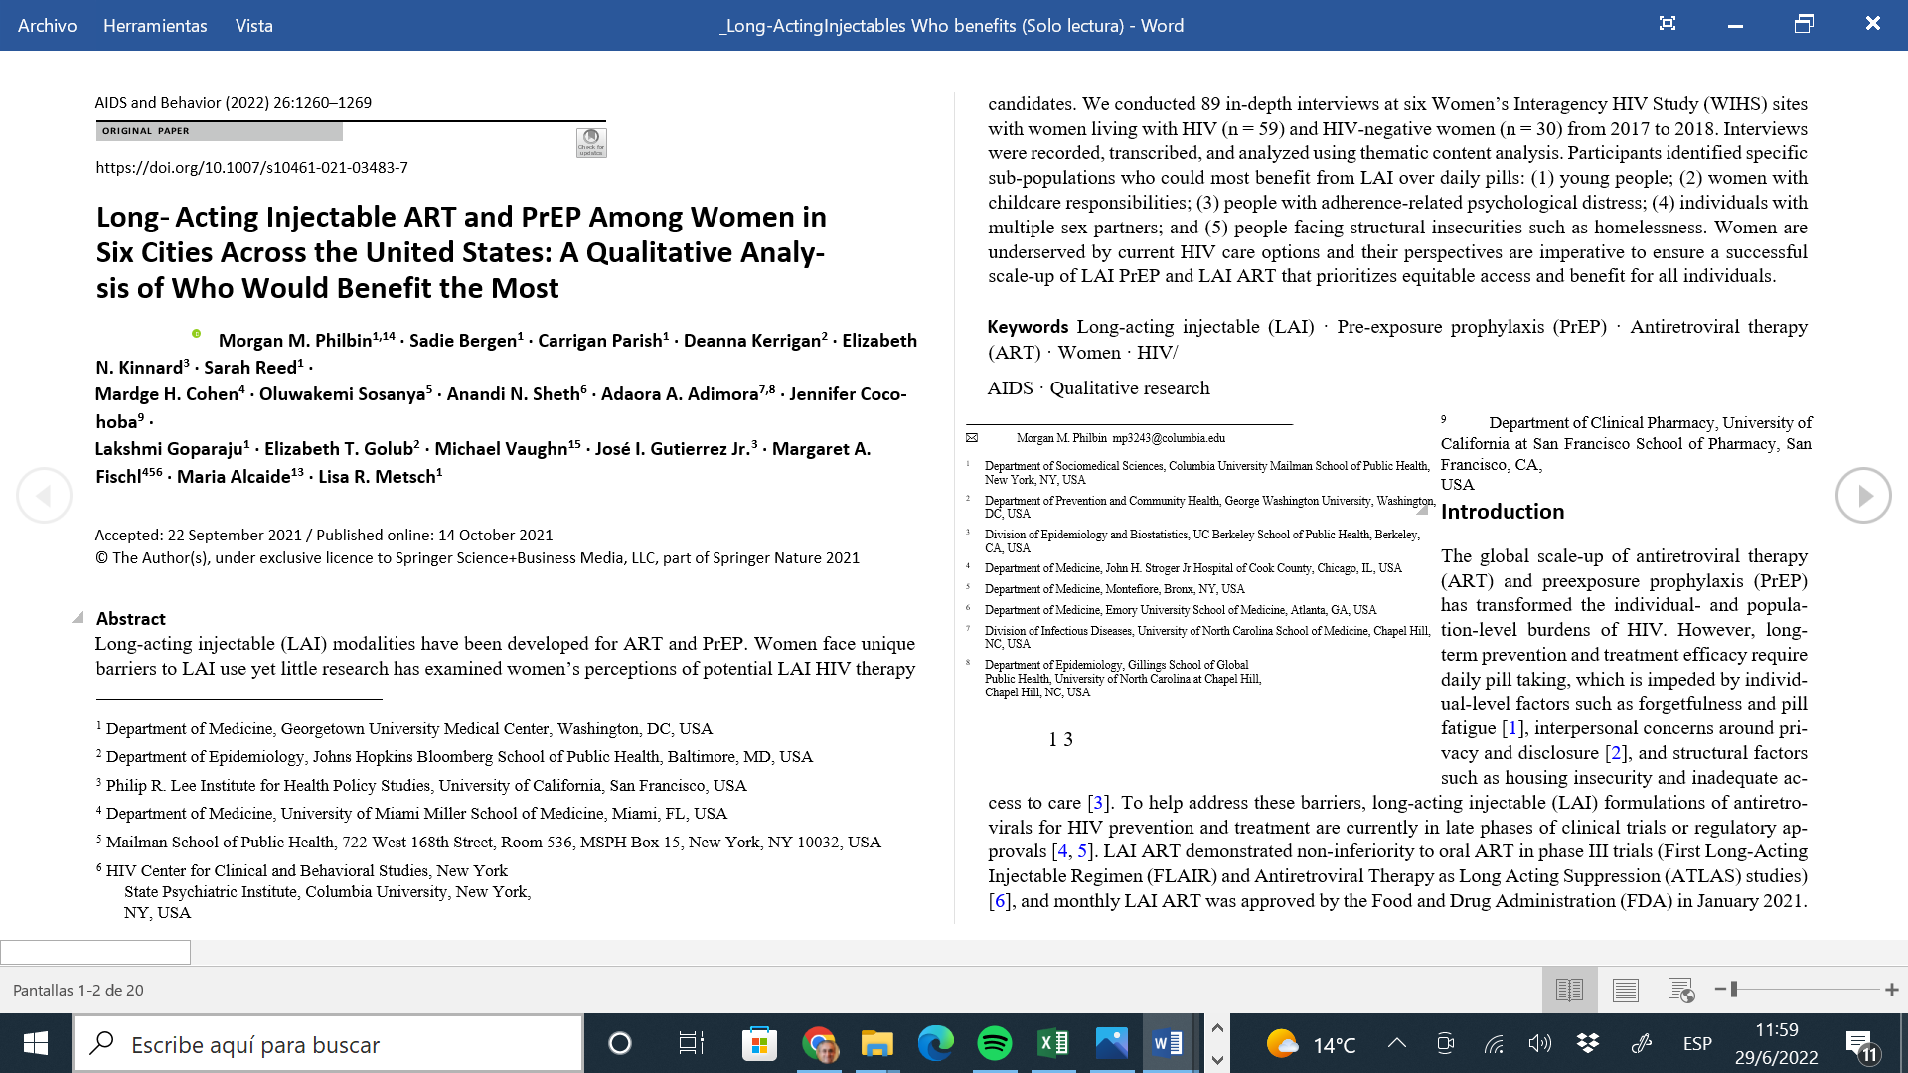
Participants identified specific sub-populations who could most benefit from LAI over daily pills: (1) young people; (2)
women with childcare responsibilities; (3) people with adherence-related psychological distress; (4) individuals with multiple sex partners; and (5) people facing structural insecurities such as homelessness. Women are underserved by current HIV care options and their perspectives are imperative to ensure a successful scale-up of LAI PrEP and LAI ART that prioritizes equitable access and benefit for all individuals

Slide 6
Preference for long acting injectable (LAI) antiretrovirals in Argentina
April-July 2021 Online survey to assess preference for long acting injectable (LAI) antiretrovirals over daily pills and willingness to use in Argentina.
1676 respondents: 804 PLWH+ 872 HIV-negative or unknown
Participants answered the survey based on subjective appraisals rather than experience of use
PLWH- 91.5% preferred injectable LA-ART
Gender/sexual orientation groups:
94.8% gay, bisexual and queer cisgender men
87.0% heterosexual cisgender women
85.1% Transgender and non-binary
84.6% heterosexual cisgender men
84.2% lesbian, bisexual and queer cisgender women
Positively associated with being younger and with higher educational level
HIV-negative - 68% preferred LA-PrEP
72.7% heterosexual cisgender men
70.5% lesbian, bisexual and queer cisgender women
68.4% heterosexual cisgender women
65.9% transgender and non-binary
65.6% gay, bisexual and queer men
Positively associated with having had a good experience using injectable medication before
Sciannameo et al 2022, AIDS 2022, e-poster EPB185

Slide 7
Transgender and non-binary had no greater preference for the use of LA-PrEP compared to the other groups. It is possible that the sample was too small (n=88) and it remains to investigate in future studies the factors that impact in their choice.
Concerning frequency of LA-ART, it was observed that those who choose one injectable every 6 months were more likely to be using drugs. Although it was not clear the reasons drug users preferred a longer spacing between injections, this result is in line with other studies that showed that some groups of PLWH (e.g.: youth, women using long-acting contraceptives) indicate a stronger willingness to switch to LAI-ART if the dosing frequency were three months or every six months.
While currently available LA-ART are monthly or bi-monthly dosing, developers should consider more frequency options for different groups of PLWH.

Slide 8
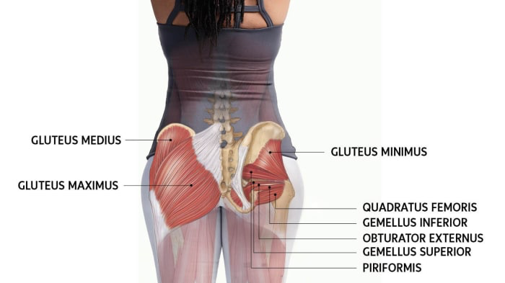
LA for TGW
Long-acting CAB is recommended for gluteal injection only. If using injectable PrEP or treatment , it is important to know whether a transgender woman has silicone prosthetic buttocks. If CAB is injected into the silicone, it will collect inside the silicone and not penetrate body tissues. For these patients, oral TFV-based PrEP or oral ART may be the best options.
In our cohort# (n:466)
52,3% had silicone injections
# # Transcitar cohort, Fundacion Huesped

Slide 9
Compassionate use of long-acting (LA) cabotegravir (CAB )and rilpivirine (RPV) for patients in need of parenteral ARV therapy (n:35)
Physicians could request CU under an expanded access program, supported by both manufacturers
Key criteria for granting requests included need for parenteral therapy, advanced disease, absence of key mutations associated with resistance to CAB or RPV, and established retention in care
All patients received a loading dose of CAB (600 mg) + RPV (900 mg) LA followed by Q4W maintenance dosing of CAB 400 mg + RPV 600 mg LA
D’Amico et al. AIDS 2020: Virtual. Poster PEB0263.

Slide 10
Demographics and Clinical Characteristics at Start of CU Program
Characteristic | N=35
Female, n (%) | 20 (57)*
Perinatally infected, n (%) | 11 (31)
Age, median (range), y | 36 (20-67)
BMI, median (range), kg/m² | 21 (16-38)
AIDS diagnosis, n (%) | 23 (66)
No. of regimens before CU, median (range) | 4 (1-10)
Detectable viremia, n (%) | 28 (80)
CD4+ cell count, median (range), cells/mm³ | 100 (3-918)
Initiation of injections without OLI, n (%) | 12 (34)
Primary reason for CU request, n
Psychological† | 15
Physical challenges‡ | 8
Malabsorption | 6
Dysphagia | 3
Limited cognitive skills | 3
*1 patient is a transgender male who was female at birth. †Includes issues with swallowing pills, pill fatigue, chronic poor oral adherence, and stigma. ‡Includes issues such as chronic diarrhea, incarcerated ventral hernia, severe mucositis, pancreatic insufficiency, intractable vomiting, and dumping syndrome.
D’Amico et al. AIDS 2020: Virtual. Poster PEB0263.

Slide 11
Efficacy
28/35 (80%) patients entered the CU program (10 without OLI) with detectable viremia (median [range] CD4+ cell count, 61.5 [3-691] cells/mm³), and at the time of this analysis, 16/28 (57%, 4/10 without OLI) achieved virologic suppression (<50 c/mL) with CAB + RPV LA
Median (range) duration of follow-up was 11 months (1-47)
Median (IQR) time to virologic suppression as reflected in the quarterly clinical updates was 6 months (1-31)
7/35 patients had virologic suppression at initiation of oral CAB + RPV
1/7 (patient no. 9) withdrew from the program and was suppressed on a different regimen
6/7 maintained suppression on CAB + RPV LA at their last physician visit
At the last follow-up, 22 (63%) patients were virologically suppressed on CAB + RPV LA (<50 c/mL)
2/13 (15%) patients (patient nos. 30 and 32) had not received injections until the last follow-up; hence, data are unavailable
3/13 (23%) patients (patient nos. 25, 26, and 29) started the program within the last 4 months; hence, adequate duration for full viral suppression was not yet achieved
5/13 (38%) patients withdrew from the program, 2 of whom (patient nos. 9 and 35) became suppressed (<50 c/mL) on other drugs after stopping CAB + RPV LA
D’Amico et al. AIDS 2020: Virtual. Poster PEB0263.

Slide 12
Conclusions
Among patients having severe adherence challenges with oral therapy for various psychological reasons or issues related to malabsorption or other GI pathology, most achieved or maintained virologic suppression on CAB + RPV LA Q4W
CAB + RPV LA was used successfully to treat a cohort of perinatally infected individuals (30% of this cohort), with 82% achieving or maintaining virologic suppression in this compassionate use setting
CAB + RPV LA Q4W was generally well tolerated in the majority of individuals
Of the few SAEs that were reported, 1 was considered possibly related to treatment
Overall, CAB + RPV LA CU access has been a valuable treatment option for individuals with co-morbidities or other issues preventing enteral administration of antiretroviral drugs
D’Amico et al. AIDS 2020: Virtual. Poster PEB0263.

Slide 13
Supporting Candidates for Long-Acting ART
Primary populations: those wanting or needing long-acting ART
Additional population: those needing injectable therapy because they are unable to take oral medications, studied under compassionate use²
Virologically suppressed patients desiring an ART switch
(current FDA approved indication)
Patients with suboptimal adherence to oral therapy
LATITUDE (ACTG A5359)¹
Strategies to Monitor and Circumvent Barriers to Long-Acting ART
Shot clinics in clinical programs
Pharmacies administer shots
Constant supply of oral CAB and RPV at home for “bridges”
Incentives
Mobile vans
1. NCT03635788. 2. D’Amico. IAS 2020. Abstr PEB0263
Slide credit: clinicaloptions.com
Notes:
ART, antiretroviral therapy; CAB, cabotegravir; RPV, rilpivirine.

Slide 14
LATITUDE (ACTG 5359)
This study is investigating if LA ART will be more successful for people who are non-adherent to their HIV medications than oral SOC regimens. The study lasts between 128-180 weeks
Inclusion: PLWH who are 18 years of age or older, prescribed ART for at least 6 months.
Screening HIV RNA is greater than 200 copies.
There is evidence of non-adherence defined as having poor virologic response within the last 18 months (defined as <1 log₁₀ decrease in HIV-1 RNA from the participant’s historical baseline value or HIV-1 RNA >200 copies/mL at two time points at least 4 weeks apart) in individuals who have been prescribed ART for at least 6 consecutive months.
Lost to clinical follow-up within the last 18 months with ART non-adherence for ≥6 consecutive months. Lost to clinical follow-up is defined as either no contact with provider or missed 2 or more appointments in a 6-month period. ART non-adherence is defined as a lapse in ART ≥7 days (consecutive or non-consecutive), in the 6-month period where they were lost to clinical follow-up per participant report.

Slide 15
Knowledge gaps

Slide 16
Panel 3: Key recommendations for the development of long-acting or extended release formulations for neonates, children, adolescents, and pregnant and breastfeeding women Pregnant and breastfeeding women Studies of investigational agents in non-pregnant women should allow those becoming pregnant during the trial to remain in the study and on their assigned study drug, with additional informed consent, unless there is clear justification for exclusion. Pregnant and breastfeeding women should be considered eligible for active enrolment in clinical trials unless clear justification for exclusion exists. Additional monitoring of maternal, pregnancy, and infant outcomes should be undertaken for all women who become pregnant during a clinical trial and all pregnant and breastfeeding women actively enrolled in trials with a standard protocol. Neonates (birth to 4 weeks) Neonatal washout studies are needed that describe the disappearance of drug present at birth after in-utero exposure, followed by dosing studies to describe safety and pharmacology in neonates and young infants to allow use of novel formulations for neonatal and young infant prophylaxis and early treatment. Children (4 weeks to 10 years) Protocols for trials of long-acting, extended release formulations in children should be developed alongside adult trials, and paediatric studies should be initiated as soon as early safety data from adult trials is released. Paediatric clinical trials should simultaneously enrol all paediatric age and weight cohorts rather than sequentially enrolling cohorts of decreasing age or size. Long-acting formulations for children should be harmonised across weight bands. Adolescents (10–19 years) Adolescents should be included in adult clinical trials of long-acting antiretroviral agents, or in separate trials proceeding nearby. Strategies to maximise recruitment and retention of adolescents in clinical trials should be employed. General recommendations Acceptability studies should be done early in the development of long-acting formulations to understand the attitudes of care providers, children of different ages and their parents, and pregnant and breastfeeding women. Coordinated action involving all key stakeholders is required from the early stages of development to maximise the chances of success.
Nachman et al; Lancet 2019

Slide 17
Conclusions
Long-acting agents are a game-changer option for treatment and PrEP
Most in need populations might benefit from these new options
Logistical challenges need to be addressed to make it happen
But it could widen the acccess gap if equity is not considered from scratch
A network of (peer?) navigators is needed to reach and support some of these left-behind populations
Research priorities include: populations with different vulnerabilities: PW, children and youngsters, transgender, people in jail, psychiatric patients, people in nursing homes and homeless individuals
Nobody should be left behind in this new treatment paradigm.

Slide 18
Thank you for your attention!
pedro.cahn@huesped.org.ar

