Slide 1
Challenges for long-acting ART in LMIC
.
Beatriz Grinsztejn, MD, PhD
Instituto Nacional de Infectologia Evandro Chagas - Fiocruz
Rio de Janeiro, Brazil
Notes:
I would like to thank you all for the presence and the CROI Committee for this opportunity.

Slide 2
Disclosure
GSK Advisory Board
Merck Advisory Board
Gilead Advisory Board
Janssen Advisory Board
Notes:
These are my disclosures.

Slide 3

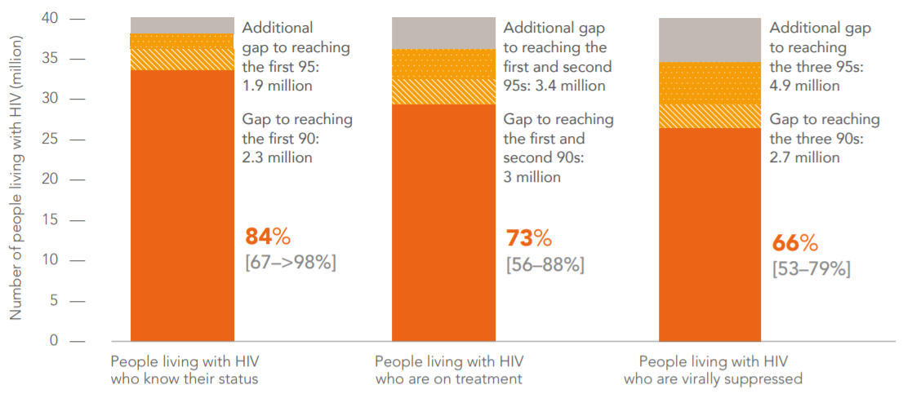
HIV testing and treatment cascade
Global, 2021
Lower rates of viral suppression among
Younger populations
Men compared to women
Key population members
85%
75%
68%
UNAIDS 2022
Notes:
In 2021, 85% of people living with HIV knew their HIV status. Among people who knew their status, 75% were accessing treatment and 68% were virally suppressed in 2021.
Although the focus and progress on the second of the three ‘‘95s’’ of the UNAIDS goals has been critical to reducing morbidity and mortality, these targets were missed at the global level.
The seemingly small gaps add up to leave one quarter (25%) of people living with HIV globally not on treatment, and roughly one third with unsuppressed viral loads.

Slide 4


Will Long-Acting Injectable ART really be a Game Changer?
Less Frequent dosing
Will Long-Acting Injectable ART really be a Game Changer?
Long-Acting formulations of ART
Notes:
With oral ART, HIV has become a manageable chronic illness. However, UNAIDS targets for virologic suppression have not yet been attained in many LMICs.
Long-acting drug formulations hold promise to improve treatment outcomes.
Novel long-acting antiretroviral agents and long-acting formulations of existing agents are rapidly evolving and the frontrunner regimen of 2-monthly intramuscular CAB/RPV is being rolled out in several high income countries.
Randomized controlled trials have shown that monthly long-acting injectable cabotegravir (CAB) and rilpivirine (RPV) is non-inferior to oral ART, and 2-monthly CAB/RPV is non-inferior to monthly injections. However, very few people from LMICs were included.
A modelling study predicts that in sub-Saharan Africa, injectable CAB/RPV is best targeted to those with poor adherence (HIV viral load >1000 copies/ml) in whom cost-effectiveness is greatest and risk of contributing to further resistance is no greater than continuation of oral ART.

Slide 5
Major studies with new Long-Acting ARVs (mid-2022)
Population | Phase II | Phase III | Implementation/Effectiveness | Implementation/Effectiveness
CAB-RPV for treatment
ART naive | LATTE (pk study, oral) LATTE-2 (Q4W & Q8W dosing) POLAR (Q8W dosing)
ART switch | A5357 (CAB Q4W + VRC01 Q12W dosing) | ATLAS (Q4W dosing) FLAIR (Q4W dosing) ATLAS 2M (Q8W dosing) SOLAR (Q8W dosing) | CUSTOMIZE (USA) – Q4W dosing CARISEL (EU) – Q8W dosing CARES (LMIC) IMPALA (LMIC) | CUSTOMIZE (USA) – Q4W dosing CARISEL (EU) – Q8W dosing CARES (LMIC) IMPALA (LMIC)
ART switch (adolescents) | MOCHA (Q4W dosing) | BREATHER PLUS (Q4W dosing) | LATA LMIC (Q8W dosing, adolescents aged 12-19 years) | LATA (Q8W dosing)
ART nonadherence |  | LATTITUDE (Q4W dosing)
CAB for prevention
PreP MSM/TG | ECLAIR | HPTN 083
PreP women | HPTN 077 | HTPN 084
Population | Phase II | Phase II | Phase III | Implementation/Effectiveness | Implementation/Effectiveness
ISL & LEN for treatment
ART naive | IMAGINE-DR (ISL/MK8507) | IMAGINE-DR (ISL/MK8507) | ILLUMINATE NAÏVE (ISL/DOR)
ART switch | IMAGINE-YOUTH (ISL/MK8507) | IMAGINE-YOUTH (ISL/MK8507) | ILLUMINATE SWITCH A&B (ISL/DOR) |  | CALLIBRATE (LEN + OBR)
ART salvage |  |  | ILLUMINATE HTE (ISL/DOR) |  | CAPELLA (LEN+ OBR)
ISL for prevention
PreP low risk HIV (pK study - oral) | MK8591-016 | MK8591-016
PreP low risk HIV (pK study- implant) | MK8591-043 | MK8591-043
PreP MSM/TG | MK8591-035 | MK8591-035 | IMPOWER 024 (ISL)
PreP women |  |  | IMPOWER 022 (ISL)
LEN for prevention
PreP adol girls & young women |  |  | PURPOSE 1(LEN )
PreP CG and TG men and women |  |  | PURPOSE 2 (LEN)
on full clinical hold (1)
on partial clinical hold (2)
on full clinical hold (3)
on full clinical hold (3)
(1) All participants have discontinued study treatment and switch to another ART (followed for at least 6 months)
(2) Participants already in the study will continue to receive drugs, but no new enrolment will be made. (3) Participants will no longer receive any drug, but CD4 and total lymphocyte cell counts will continue to be monitored
Notes:
In this slide we can see the major studies ongoing or close to start, and there are very few ART studies in LMIC.
The most extensively studied regimen is CAB/RPV administered intramuscularly every 1 or 2 months and the remaining of this presentation will focus on this combination.
Unfortunatelly, studies with islatravir, a quite promising long acting agente both for prevention and treatment were put on full clinical hold due to an unexpected toxicity.
Other promising agents, such as lenacapavir are under investigation and may prove particularly useful in heavily treatment-experienced adults.

Slide 6
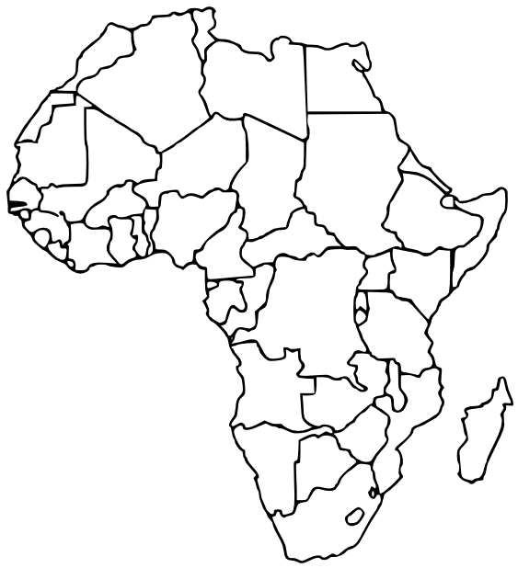









The Cares Study
PARTICIPANT ELIGIBILITY
512 participants will be enrolled and randomized 1:1 to either continue on their ART or switch to the CAB/RPV for 24 months.
Eligibility criteria:
Clinical Sites
Uganda
JCRC Kampala
JCRC Fort Portal
Infectious Diseases Institute
(IDI) Kampala
Kenya
Moi University College of Health Sciences, Eldoret
KEMRI, Kericho
Aga Khan University
South Africa
Ezintsha Research Centre, Johannesburg
Chatsworth Clinical Research Site, Durban
+
18
Female or Male
Age Group
On stable ART
(TDF+3TC/FTC) plus
DTG or EFV/NVP
Evidence of virological
suppression
(HIV RNA <50 copies/ml)
No prior history of
VL failure ( VL >200
copies/ml on ART)
Willing to adhere to the protocol
specific requirements; including
informed consent
Coordination Centre Uganda
JCRC Lubowa
Reference laboratory
JCRC Uganda
If female: Not pregnant
or breast feeding
If Male: Not intending
to directly or indirectly
cause pregnancy
Notes:
The CARES trial is a vital steppingstone for bringing injectable ART to treatment programs in sub-Saharan Africa, gather robust evidence to support its use in Africa as well as to build experience before large-scale implementation can happen.
A total of 512 participants will be enrolled (the large majority was already enrolled) at sites in Uganda, Kenya and Sounth Africa, under the coordination of Dr Cissy Kityo, from the JCRC in Kampala.

Slide 7
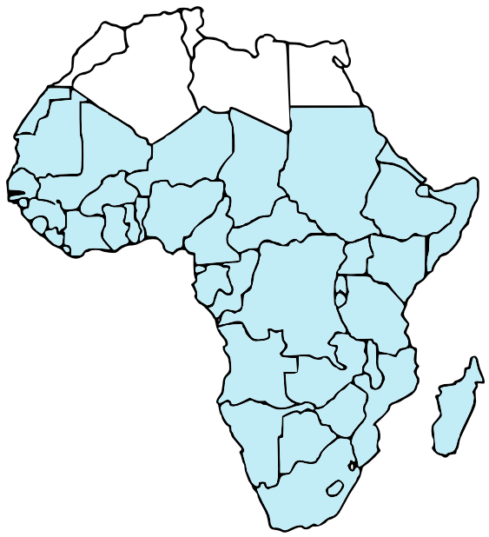
Studies in LMIC
IMPALA Study
LATA Study
(Long-Acting Treatment in Adolescents)
To investigate whether 2-monthly injectable CAB/RPV is non-inferior to the continuation of first-line DTG-based ART in individuals with a history or at risk of sub-optimal HIV control.
To investigate whether 2-monthly injectable CAB/RPV works as well as taking DTG-based ART every day in young people aged 12-19.
Brief Summary
Brief Summary
Target Population
Men who have sex with men, sex-worker, transgender, drug users, individuals 18-25 years old
Adolescents aged 12-19 years old
Target Population
Hasn’t Start yet
Not yet recruiting
Status
Status
Notes:
The Impala study will also be conducted at sites in Africa, and will enroll participants aged 18-25 Years, with a history or at risk of sub-optimal HIV control. The target population is Men who have sex with men, sex-worker, transgender, drug users, individuals 18-25 years old; the study will start enrolling soon.
The LATA Study targets individuals aged 12-19 years of age in Africa, and is not yet recruiting.

Slide 8
Advantages and challenges to effectively introducing of LA ART in LMICs
Drug-Level Advantages and Barriers
Patient-Level Advantages and Barriers
System-Level Advantages and Barriers
Notes:
We will now discuss advantages and barriers related to the drug itself, to the persons who are in need to use LA ART and to the health care system.
Historically, the introduction of evidence-based technologies into public health programs has been fraught with delays that result in missed opportunities for impact.
These delays have in part been due to the lack of preparatory evidence critical for introduction into programs at scale. Product registration timelines in LMIC usually longer, and sometimes never occur.

Slide 9
Drug-Level advantages and barriers
Advantages
Increases choice
Invisible/discreet/less stigmatizing
Facilitates adherence
DOT
Less frequent dosing
NRTI sparing regimen
Barriers
Oral lead-in
High volume gluteal injections
Injection site reactions
Drug-drug interactions (Rifampin)
Drug resistance (pharmacologic tail)
Not adequate for Hep B co-infected individuals
Cannot be withdrawn in the event of toxicity
Limited safety and efficacy data in LMICs (high prevalence of NNRTI resistance)
Requires oral lead in dose and IM injections (2 injections, large volume, not self administered)
Limited safety and efficacy data in LMICs (high prevalence of NNRTI resistance)
Notes:
Long-acting CAB and RPV is the first complete injectable ART regimen approved for the treatment of adults with HIV who have achieved virologic suppression on an oral regimen. Phase 3 clinical trial results support the efficacy and safety of long-acting CAB for HIV PrEP in both males and females.
Additional data regarding the risks and implications of virologic failure with resistance, during and after receipt of long-acting CAB and RPV, will need to be carefully evaluated in ongoing and post-marketing trials.
Long-acting CAB and RPV offers important advantages over oral therapy related to stigma and pill aversion but is not without implementation challenges that must be taken into consideration before initiating long-acting therapy.
Parenteral long-acting regimens increase choice and autonomy for PLHIV. Long-term adherence has been affected by stigma and fear of HIV status disclosure if pill bottles are seen. Injectables are discreet and may promote adherence in settings where disclosure has not occurred or is unsafe.
Long-acting regimens, such as CAB/RPV are nucleoside-sparing two drug regimens, which reduce tenofovir-associated toxicities, for example, renal or bone.
Important barriers are in place for implementation in LMIC, such as drug drug interactions with rifampin, limited safety and efficacy data in LMICs, where we have high prevalence of NNRTI resistance and insufficient data in pregnant women and children.

Slide 10
Individual-Level advantages and barriers
Advantages
Potential use targeting those who struggle most with adherence
Barriers
Frequent clinic visits (at least every two months)
Gluteal injection site issues (eg. obesity, buttock implants, tattoos)
Patient access (transportation, insurance)
Lack of efficacy/safety data in children <12 years
Lack of efficacy/safety data in pregnancy/breastfeeding
Lack of efficacy data in patients with prior virologic failure
Inability to treat HBV co-infection
Notes:
While in the clinical trials participant satisfaction with long-acting ART has been largely positive, provider enthusiasm has been more cautious.
Concerns include the need for patients to adhere to injection visits for treatment to be successful.

Slide 11
System-Level advantages and barriers
Advantages
Less treatment failures
Less hospitalizations
Lower health care costs
Barriers
Healthcare personnel education and training requirements
Increased clinic volume/need for private space for injections
Need for cold-chain storage capacity
Higher Drug cost
Staffing and space constraints
Pre-treatment genotyping not available
Injection tracking systems/monitor missing appoinments
Monitor reloading needs
Bridging with oral ART while unable to come for injections
Implications for DSD/task shifting
Need monthly visits (contrast with 3-6 monthly visits recommended for TLD)
Notes:
There are multiple factors that will complicate the implementation of long-acting regimens in LMICs, such as the lack of routine baseline resistance testing, infrequent viral load monitoring, the need to exclude hepatitis B and the need to switch to another regimen during TB treatment.
Data from both clinical trials and implementation studies in those settings are needed to inform policy around long-acting regimens.
Currently, most data to inform guidelines has arisen from clinical trial participants subject to extensive exclusion criteria prior to enrolment. Trial participants were largely recruited in countries with low TB and HBV prevalence and WITH well-resourced health systems WITH access to regular monitoring of viral load and safety bloods.
Generalizable efficacy and safety data from LMICs is required inclusive of adolescents, elderly, comorbidities like prior HBV and TB, and pregnant/breastfeeding women.
In addition, existing data must be viewed in the context of infrequent viral load monitoring and even less frequent or absent baseline resistance, CD4, renal and liver monitoring. In pregnancy, recent pharmacokinetic modelling suggests that there is no need for dose-adjustment of long-acting CAB but observational data on efficacy and safety is awaited as pregnant women have been excluded from clinical trials.

Slide 12
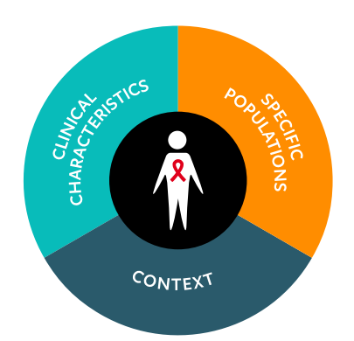

Differentiated service delivery - Elements to consider
Group models
Client perspective
Managed by health care workers
Managed by clients
Health care workers perspective
Individual models
Based at facilities
Not based at facilities
Notes:
LA ART brings challenges for the current differentiated service delivery building block, that will need to be adapted to accommodate the product and clients’ needs.
Being aspirational, with more advanced LA ART regimens, we hope that these challenges can be reduced and an optimized differentiated service delivery model can be developed, allowing for longer intervals to clinic visits, use of non traditional health models, such as Community based organizations, mobile vans, pharmacies can be incorporated.

Slide 13
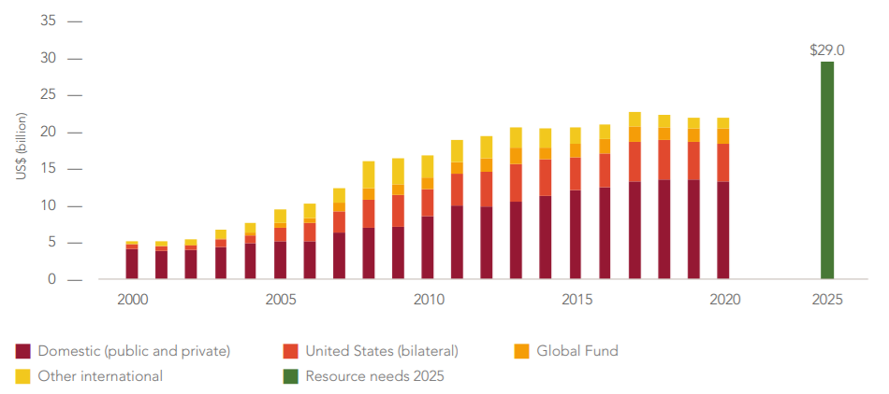
Resource availability for HIV in LMIC 2000–2020 and 2025 target
UNAIDS 2021 Epidemiological Estimates
Notes:
Under-investment in the HIV responses of LMICs was a major reason why global targets for 2020 were missed.
This has translated to more people living with HIV and more people at risk of HIV infection who are in need of services.
To get back on track to end AIDS, we must identify the inequalities that largely determine who has access to HIV services that meet their needs, who is experiencing HIV transmission and who is dying, and this includes the context where people living with HIV are. This also needs to be taken into account when evaluation the feasibility to incorporate new ART strategies and technologies.
We are at a critical inflection point in an AIDS pandemic that is far from over. If we do intend to end the HIV epidemic, we cannot overlook the real importance of inequalities.

Slide 14
Acknowledgments
Marco Vitoria
Valdilea G. Veloso
Emilia Jalil
Daniele Novaes
Marcelo Alves
Carlos Alberto Silva
Peter Denis Ghys
Carolina Coutinho
Sandra Wagner Cardoso
Cissy Kityo
Fionna Cresswell
Leticia Moraes
Mayara Secco
Notes:
I would like to thank the team I work with for their collaboration and support

Slide 15

Obrigada!
Beatriz Grinsztejn gbeatriz@ini.fiocruz.br
www.fiocruz.br
Notes:
Thank you very much for your attention.

