Slide 1
Impact and cost-effectiveness of a police education programme on HIV and overdose among people who inject drugs in Tijuana, Mexico
Javier Cepeda, Johns Hopkins Bloomberg School of Public Health
Health and human rights

Slide 2
Conflict of interest disclosure
I have no relevant financial relationships with ineligible companies to disclose.

Slide 3
Background
Discretionary police behaviors targeting people who use drugs often conflict with evidence-based public health practice and fundamental human rights
Syringe confiscation associated with increased odds of syringe sharing¹
Police often target harm reduction sites to harass or arrest people who inject drugs¹
Police arrest often serves as a gateway to the justice system, with associated harms
Higher HIV and HCV incidence associated with history of incarceration²
Elevated overdose mortality risk in immediate period post-release³
1. Baker et al., Epidem Rev. 2020; 2. Stone et al., Lancet ID, 2018, 3. Merrall et al., Addiction 2010

Slide 4
Police education program in Tijuana, Mexico
Major city along the U.S. – Mexico and nexus of drug trafficking
Strong associations between police exposures and injection-related risk behaviors
Arrest for sterile syringe possession associated with 2.87 higher odds of receptive syringe sharing¹
Arrest more likely to occur outside certified addiction treatment programs²
Novel police education program (Proyecto Escudo [Project Shield]) was conducted to align policing practices with evidence-based public health principles
1. Pollini et al., Addiction. 2008; 2. Werb et al., Addiction, 2016

Slide 5
Police education program in Tijuana, Mexico
1806 municipal police officers in Tijuana received training on
1) harm reduction, including the public health benefits of syringe service programs and methadone maintenance therapy
2) decriminalization reforms passed by the federal government in 2009 establishing threshold amounts for drug possession and mandated treatment for repeat offenders
3) occupational safety to enhance knowledge and capacity on averting accidental needlestick injuries and basic HIV and HCV epidemiology
Outcomes measured among:
Officers followed for 2 years
Parallel cohort of PWID before, during, and after the training (El Cuete, PI Strathdee)

Slide 6
Behaviors among police officers before and after police education
p<0.001
p<0.001

Slide 7
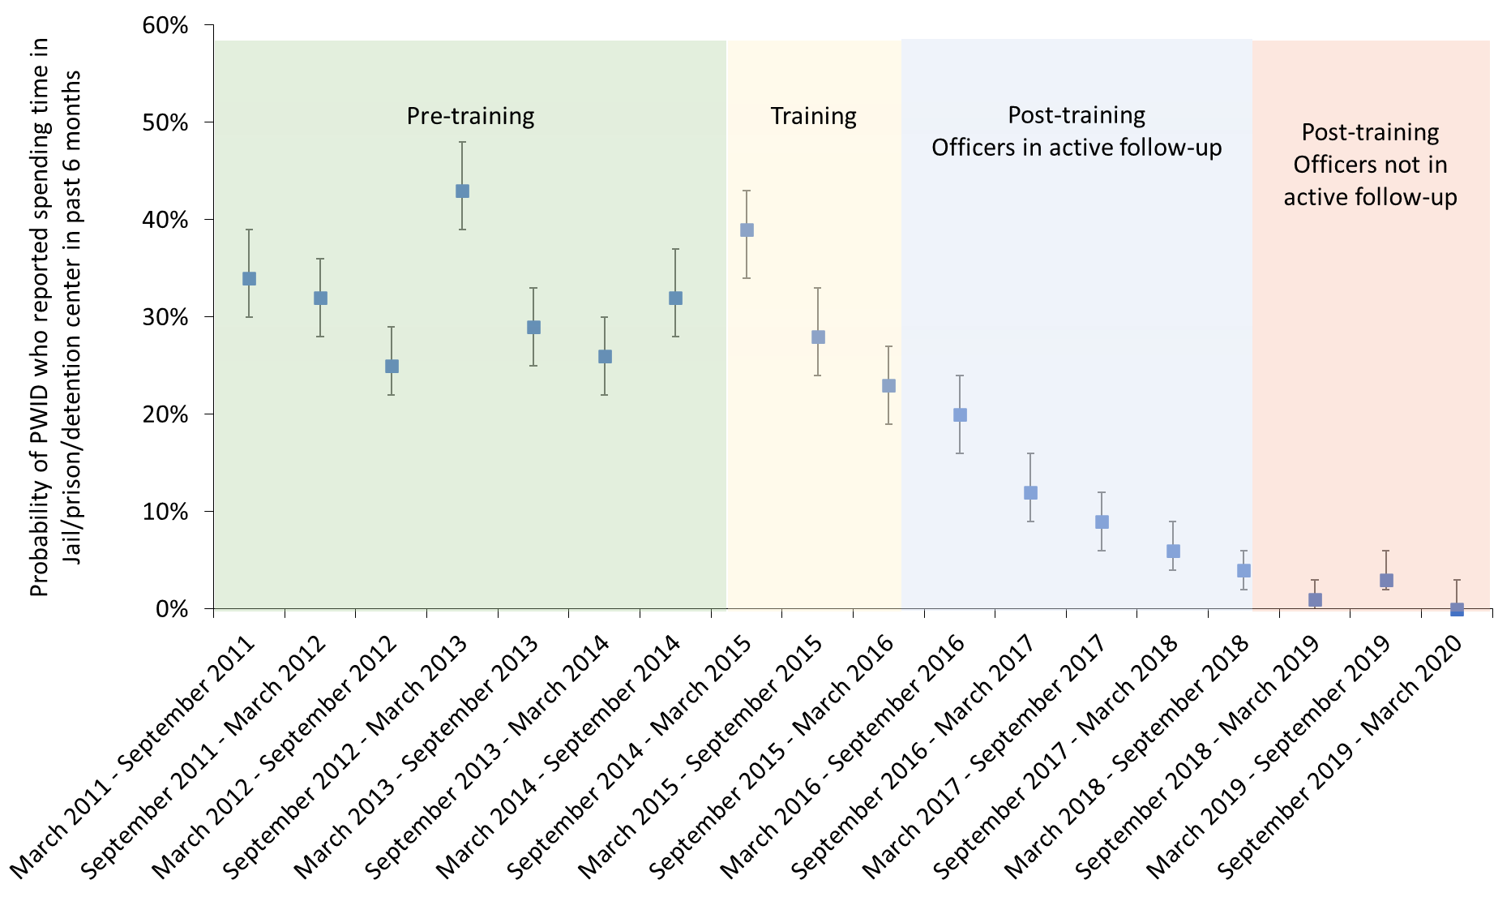
Trends in incarceration in parallel cohort of PWID
Individuals were 68% (95% CI: 0.26 – 0.40) less likely to have been incarcerated in post-training period compared to the pre-training period

Slide 8
Rationale and Objective of modelling
Unique opportunity to assess the impact and value for money of a structural, human-rights based HIV prevention intervention on reducing HIV incidence and fatal overdose associated with law enforcement and justice involvement
The objective was to evaluate the impact and cost-effectiveness of Escudo on preventing HIV transmission and fatal overdose among PWID in Tijuana, Mexico.

Slide 9
Modeling and economic evaluation of Escudo
Model: Adapted a published dynamic HIV transmission model among PWID calibrated to HIV prevalence, incidence, and incarceration in Tijuana, Mexico^{1,2}
Intervention and Comparator: Simulated observed declines in incarceration among PWID after Escudo (68% reduction) for 2 years [observed impact] and 10 years [sustained impact] compared to a counterfactual of no incarceration changes.
Costs: Costs of Escudo obtained via micro-costing methods ($129 per officer trained). Outcomes: HIV incidence, fatal overdose over 2 and 10 years
Cost-Effectiveness: Use 2 year intervention effect and 50 year time horizon. Track costs ($USD 2020) and health utilities (DALYs) among PWID and ex-PWID. Incremental cost-effectiveness ratio (ICER) compared to a willingness-to-pay threshold of per capita GDP in Mexico: $8,347 in 2020.
1. Borquez et al., Lancet Public Health. 2018; 2. Cepeda et al., JIAS, 2020

Slide 10
Impact and Cost-effectiveness
1.7% and 9% of new HIV infections and overdoses averted with 2-year intervention effect
3.1%-14% of new HIV infections and fatal overdoses averted with 10-year intervention effect
Mean incremental cost-effectiveness ratio: $6,828 per DALY averted < WTP threshold

Slide 11
Conclusions
Decline in incarceration coincided with implementation of police training intervention – though require more evidence for causality
Modeling suggests modest but important impact on preventing HIV (~2% new infections averted) and overdose (~10% fatal overdoses averted) over 2-year follow-up.
Police education could have additional benefits on HCV and other health harms
Training police on public health principles is cost-effective and should be implemented as an evidence-based human rights focused structural intervention

Slide 12
Acknowledgements
Collaborators
Natasha Martin (UCSD)
Leo Beletsky (UCSD)
Steffanie Strathdee (UCSD)
Daniela Abramovitz (UCSD)
Peter Vickerman (University of Bristol)
IAS-Lancet Commission on Health and Human Rights
(co-chairs Chris Beyrer, Adeeba Kamarulzaman)
Funders
National Institute on Drug Abuse
National Institute of Allergy and Infectious Diseases
Hopkins CFAR

